Slide 1



Encore Education Corporation
2022-2023 Property & Casualty Insurance Program
PRESENTER:
Jonathan Wheat
Principal, Charter School Practice
07.25.2022

Slide 2







Clients We Work With

Slide 3
Notable Changes
Notable Changes
Property | Lowered deductible from 10K All Other Peril, 100K water damage, 100k theft, and 100K vandalism to 5K across the board Lowered cost by 65% Reassessed Property value limits to get an additional 2M in building coverage Provided 2M in business interruption / extra expense coverage
Commercial Umbrella | Consolidated umbrella coverage from 3 excess policies to just one
Student Accident | Provided coverage
Auto Liability | Provided Hired and non-owned coverage
General Liability | Removed exclusions including assault and battery, athletic participants, playground equipment, special event, and medical expense
Cyber Liability Policy | Provided coverage
Alignment | Aligned the effective dates to 7/25 for all lines of business other than cyber liability
Terrorism and Active Assailant | Provided Coverage

Slide 4
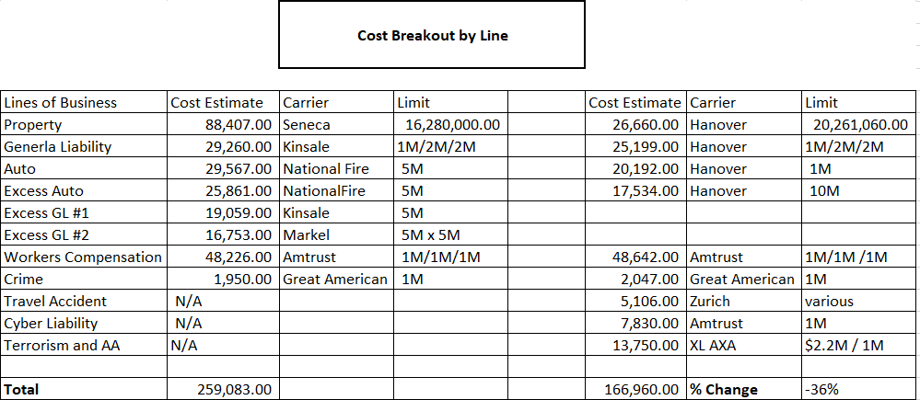
Cost Breakout by Line

Slide 5

Copyright © 2019 EPIC Insurance Brokers & Consultants (EPIC). All rights reserved. No part of this document may be reproduced, stored in a retrieval system
or transmitted in any form by any means, electronic, mechanical or otherwise without the prior written permission of EPIC.

