Slide 1
Year-End Data Presentation
CAASPP Projection
2023-2024

Slide 2
Assessments Administered
We use two nationally normed benchmarks assessments, iReady and NWEA, for two primary reasons:
We can use our best results for consideration at renewal along with the state required test – the California Assessment of Student Progress (CAASPP), also known as the Smarter Balanced Assessment System (SBAC);
Both tests help us predict how students will likely score on the spring state level test (SBAC/ CAAASP) and shows us progress at intervals during the year.

Slide 3
NWEA and iReady as Predictors of CAASPP Performance
California MAP Growth Linking Study Report
RIT cut scores on MAP have been aligned to CAASPP Level 3. Students scoring HiAvg on MAP are on target to score Level 3 on CAASPP.
Linking Study: Predicting Performance on CA SBAC Summative from MAP Growth Page 4

Slide 4
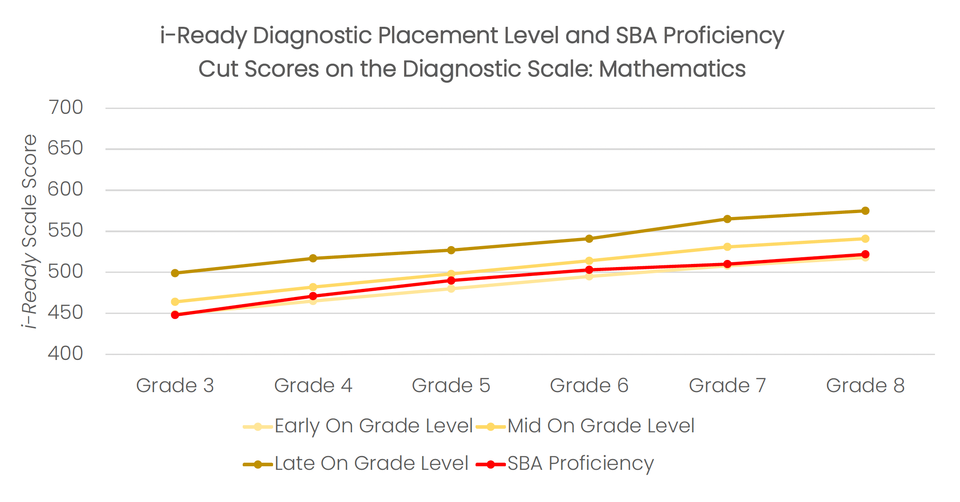
NWEA and iReady as Predictors of CAASPP Performance
California iReady Growth Linking Study Report
iReady cut scores in ELA and Math are Mid On Grade Level.
Students scoring Mid On Grade Level are on target to score Level 3 on CAASPP.

Slide 5
NWEA Projected to CAASPP Actual Spring 2022-2023 TEACH Public Schools
 | NWEA Percentage Projected Met/Exceeded Math | CAASPP Percentage Actual Met/Exceeded Math | NWEA Percentage Projected Met/Exceeded English | CAASPP Percentage Actual Met/Exceeded English
Grade 3 | 6.2% | 3.92% | 16% | 9.8%
Grade 4 | 3.8% | 9.26% | 20.4% | 23.08%
Grade 5 | 11.7% | 8.2% | 26.6% | 29.51%
Grade 6 | 1.7% | 4.31% | 7.8% | 8.62%
Grade 7 | 1.5% | 2.26% | 15.8% | 11.27%
Grade 8 | 3.3% | 3.41% | 19.5% | 19.66%
Grade 11 | 5.1% | 12.94% | 39.5% | 56.47%

Slide 6
NWEA and iReady Projected CAASPP Performance Winter 2023-2024 TEACH Public Schools
 | NWEA Percentage Met/Exceeded Math | iReady Percentage Met/Exceeded Math | NWEA Percentage Met/Exceeded English | iReady Percentage Met/Exceeded English
TPES | (Winter) 18.7% | (Diagnostic 3) 20% | (Winter) 15.8% | (Diagnostic 3) 9%
Academy | (Winter) 3.4% | (Diagnostic 3) 5% | (Winter) 10.9% | (Diagnostic 3) 1%
TECH | (Winter) 8.4% | N/A | (Winter) 34.8% | N/A

Slide 7
Additional Data
Chronic Absenteeism YTD
Teacher Turnover
Students on track to graduate
ADA YTD
TPES | 86.83%
Academy | 88.26%
TECH | 90.7%
TPES | 47.45%
Academy | 41.28%
TECH | 33.33%
TPES | 30%
Academy | 82%
TECH | 16%
TECH | 96%

