Slide 1



Health Insurance
Quote Review

Slide 2
Medical Plan
Recommended Medical Plan - Covered California for Small Business
Allows access to Blue Shield, Kaiser and other carrier options. Comparable plans to current offering a premium savings, multiple carrier/plan options and one invoice for medical plans.
Carrier Plan Options include Kaiser, Blue Shield HMO, Blue Shield PPO, Oscar EPO and Health Net PPO
Deductibles and out of pocket maximums incurred for the year would carry over on both Blue Shield plans and Kaiser plans for employees moving to the comparable plan with Covered California.

Slide 3
Ancillary Plans
Recommended Dental, Vision and Life Plans - Guardian
Dental Premium Savings of $362 per month over current Dental PPO and $118 savings over current for Dental HMO
Vision premium increases $56 per month, but Guardian is offering a choice of the following:
            Dental: Either a two-year rate guarantee or a one-month premium credit
      Vision: Either a three-year rate guarantee or a one month premium credit
Basic Term Life is $12 less than current premium
Convenience of single carrier employee enrollment and employer invoice

Slide 4
TPA Services and Enrollment
Annual administrative fees for Section 125 POP plan, COBRA and Zywave Human Resource package will be covered by Broker/General Agency.
Online enrollment and virtual employee benefit review can be conducted for most efficient enrollment process and employee plan education.
Employee benefit review can be recorded for future new-hires and those unable to attend the employee meeting.

Slide 9
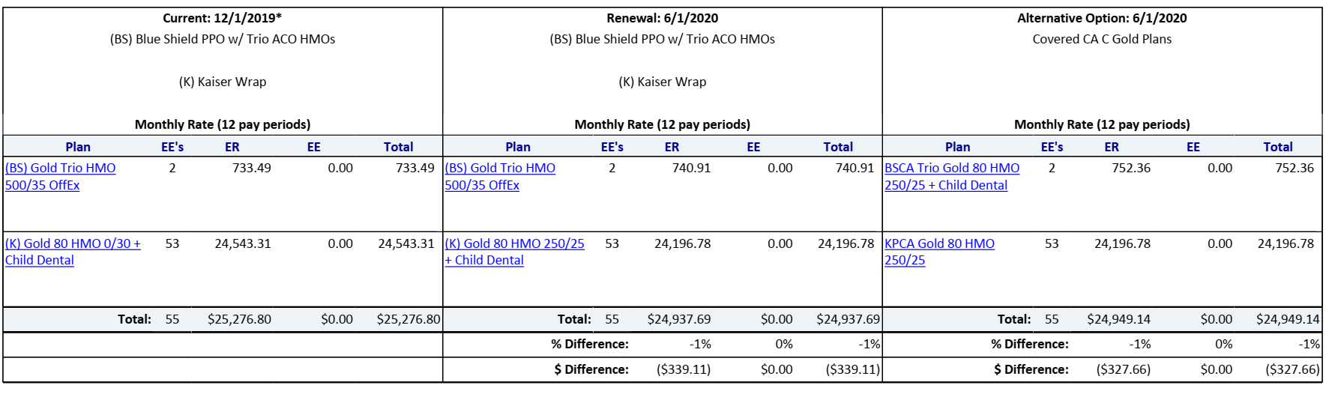
Medical Plans

Slide 10
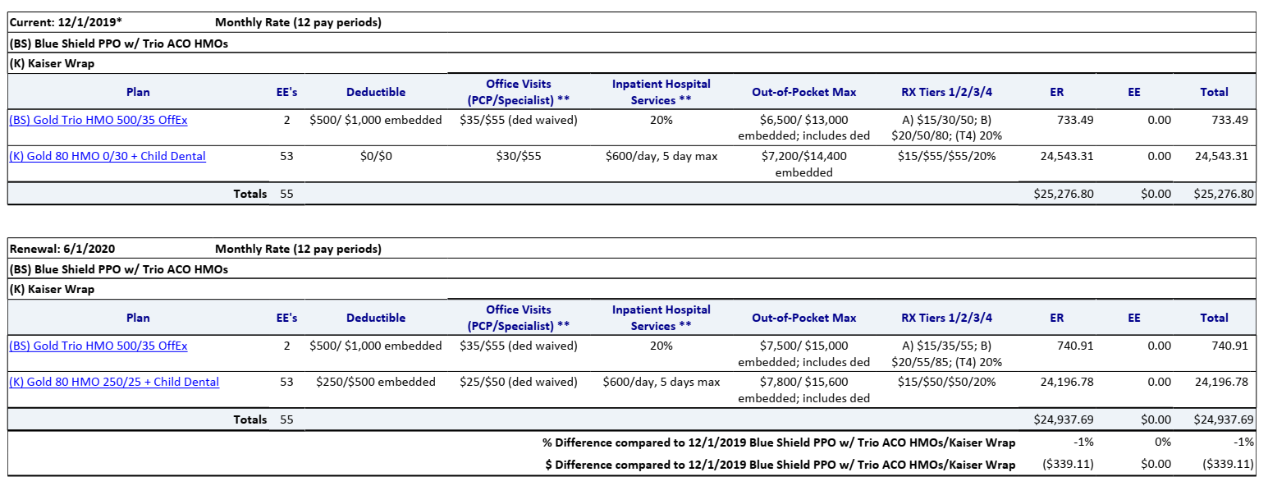
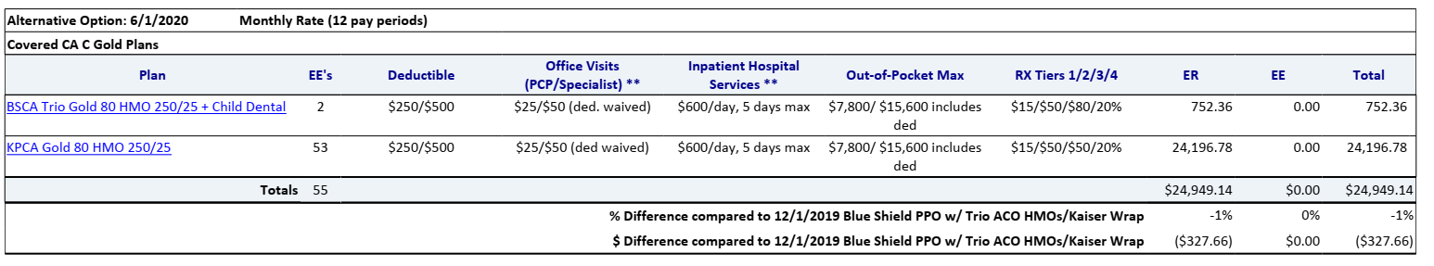
Medical Plans

Slide 11


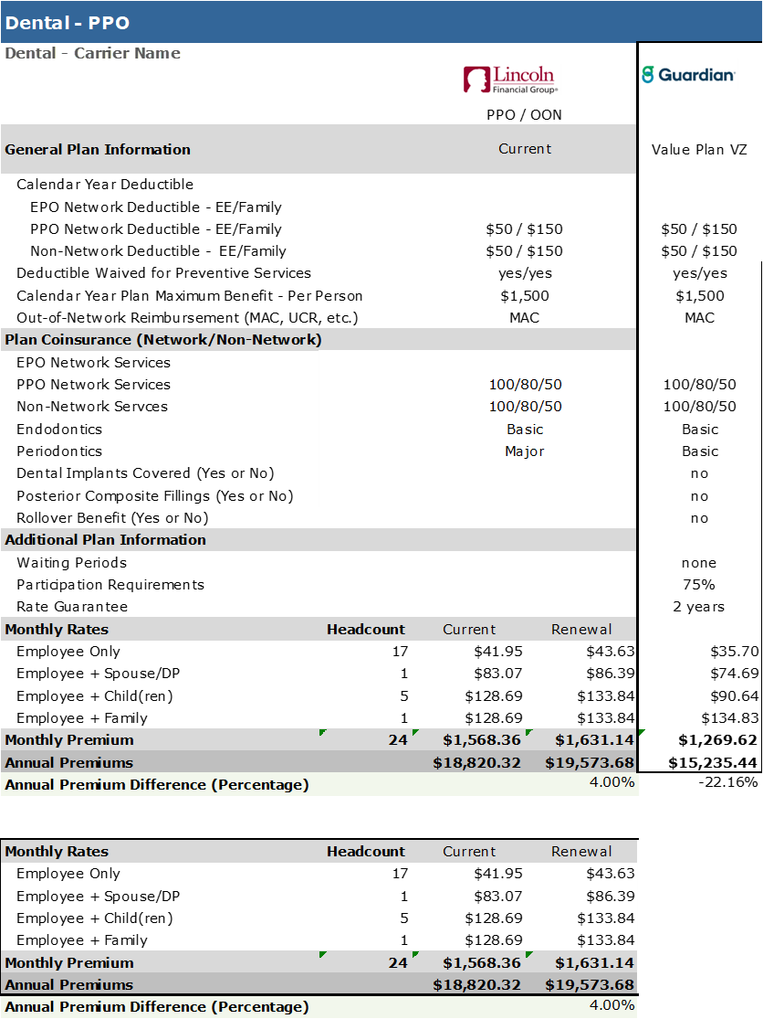
DPPO Dental Coverage
Dental

Slide 12

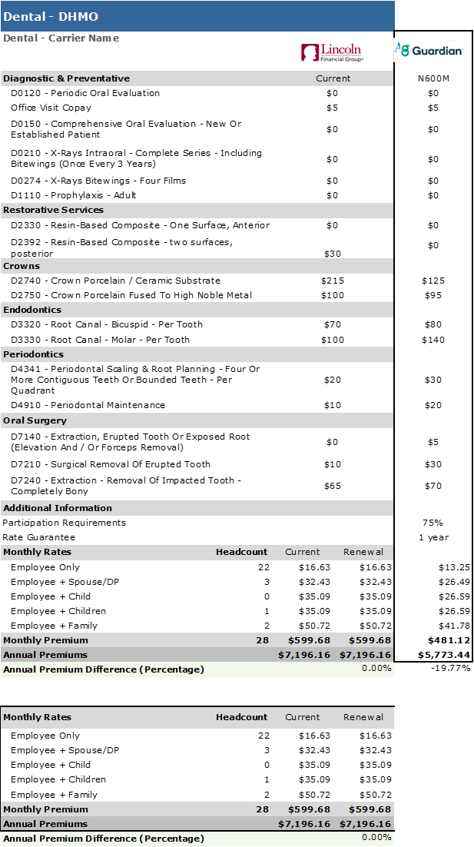
DHMO Dental Coverage
Dental

Slide 13

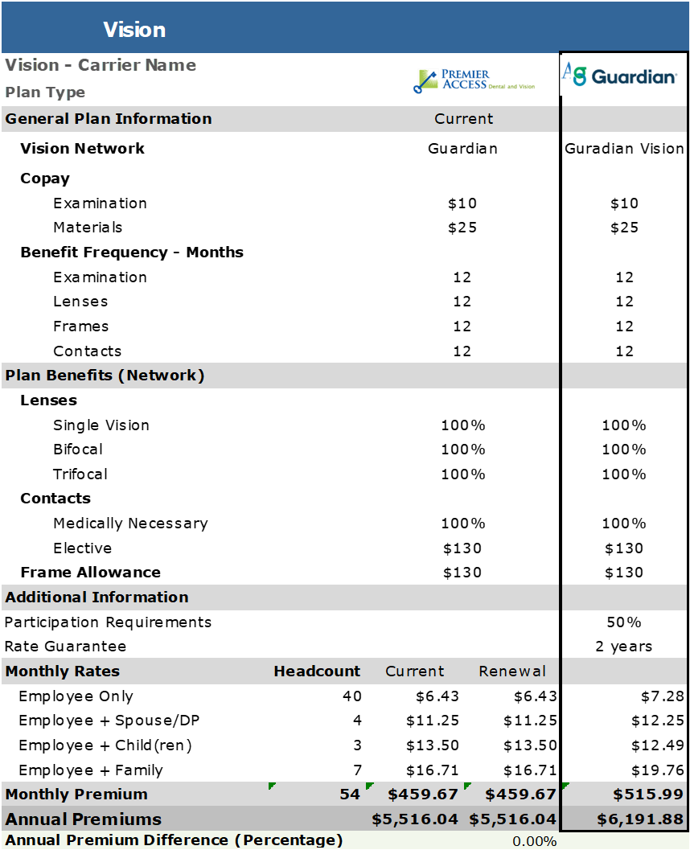
Vision Coverage
Vision

Slide 14


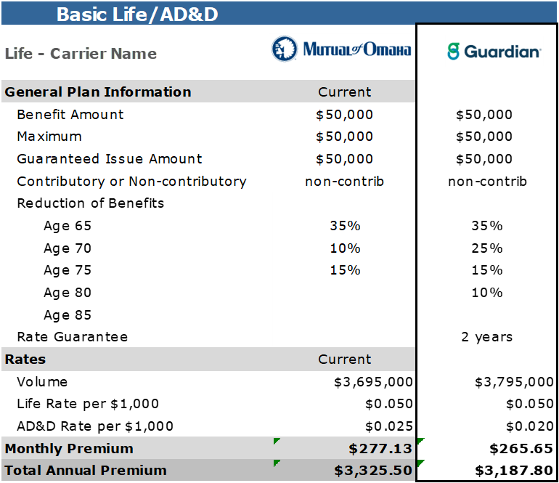
Life Coverage
Life

Slide 15

Post Implementation Services
Benefits questions
Insurance claims
Finding a provider
Insurance ID cards
Eligibility
Dependent benefits
Pre-authorization
Enrollment questions
Healthcare reform
Robert Stenzel
(818) 587-4265
Robert.Stenzel@equitable.com

