Slide 1



Slide 2


Slide 3

Comparative Data Analysis
Mastery View Predictive Assessment
2024-2025 School Year
April 9, 2024
Dr. LaWanda M. Clark,
Director of Curriculum and Instruction

Slide 4


Slide 5


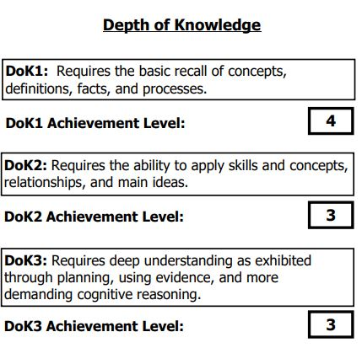
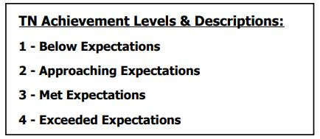
KEY TERMS-Review

Slide 6

Computation for Comparative Analysis
Average the Projected Percentage Proficiency & Total Scores for Test 1 Administration and Test 2 Administration (division of standards-selected for testing)
Subtract the average of Test 1 and Test 2 from the Projected Percentage Proficiency & Total Scores of Test 3 Administration (Composite of all standards)

Slide 7

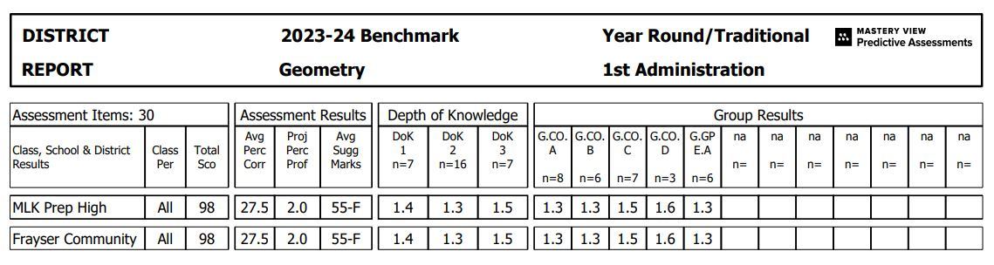
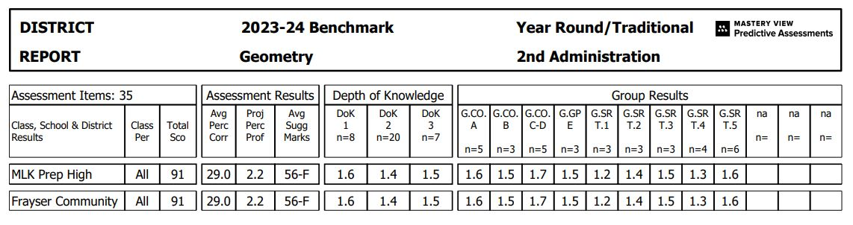
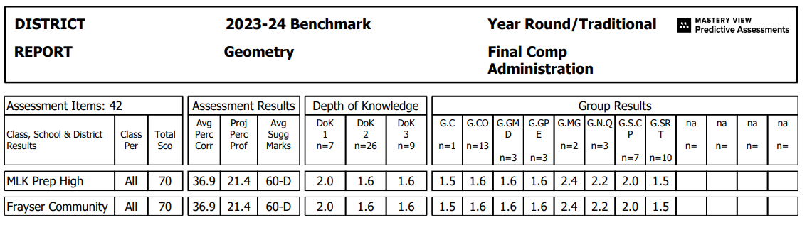
MLK: +19.3
Total Score: -24.5

Slide 8
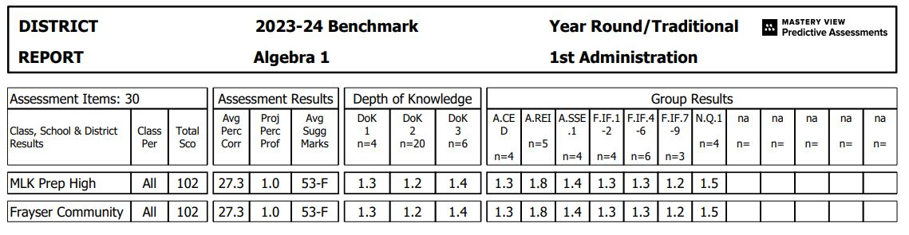
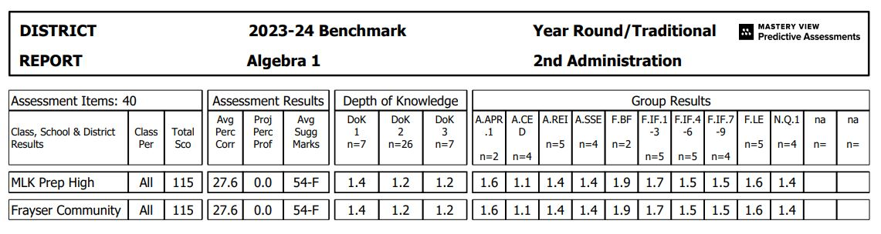
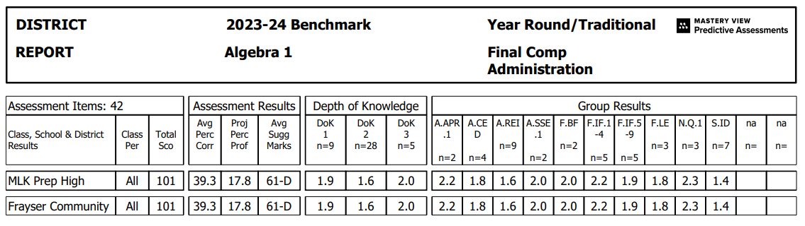
MLK: +17.3
Total Sco: –7.5

Slide 9
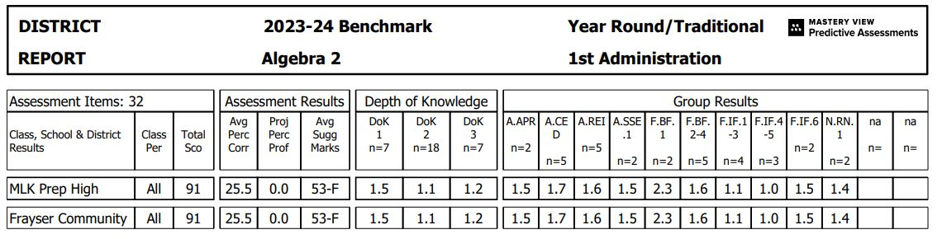
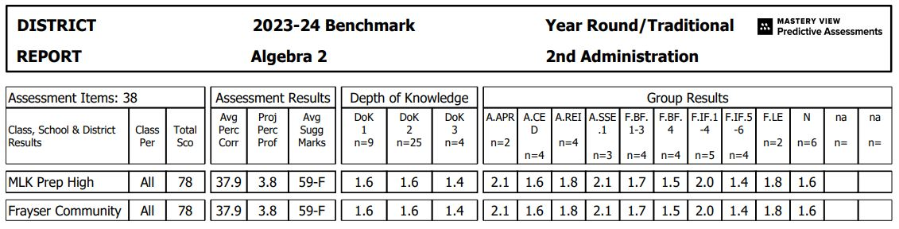
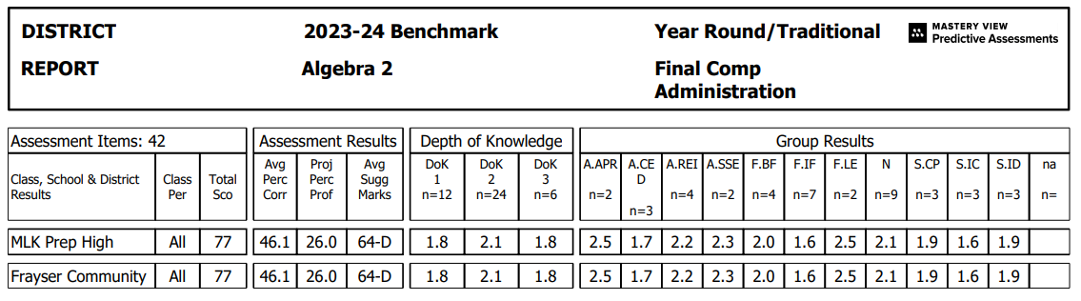
MLK: +24.1
Total Sco: –7.5

Slide 10
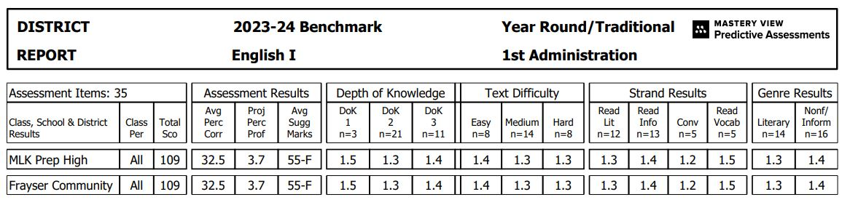
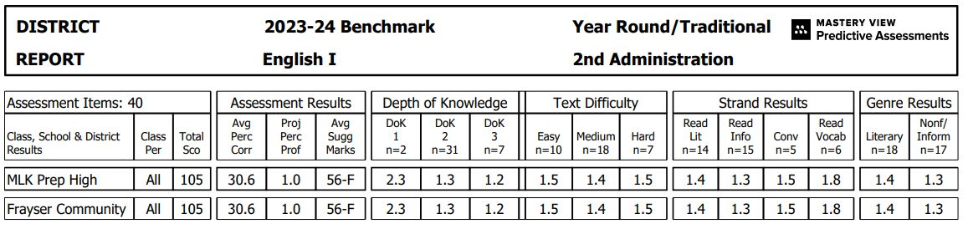
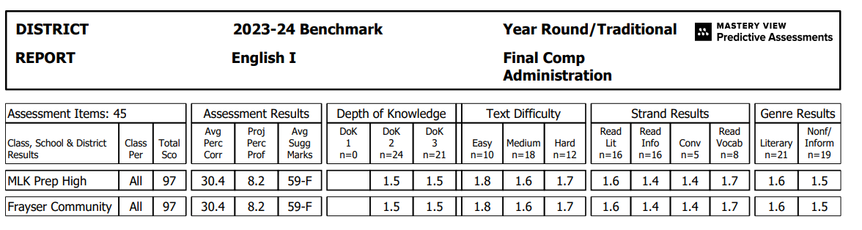
MLK: + 5.85
Total Sco: -10

Slide 11
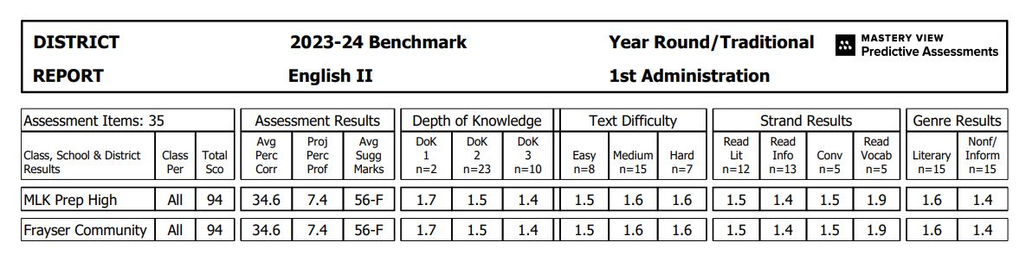
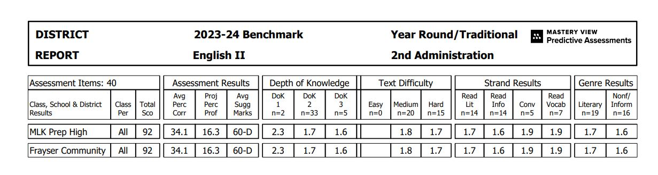
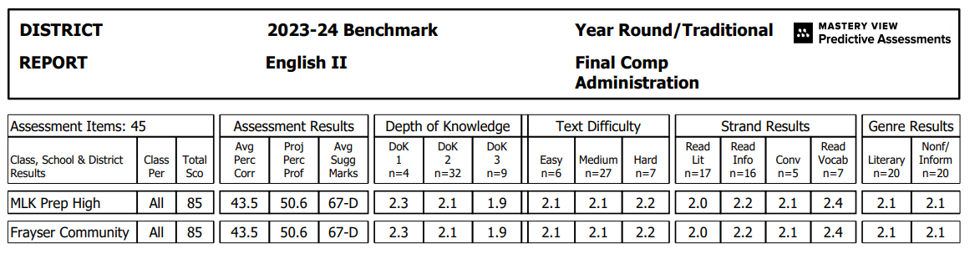
MLK: +38.75
Total Sco. -8

Slide 12
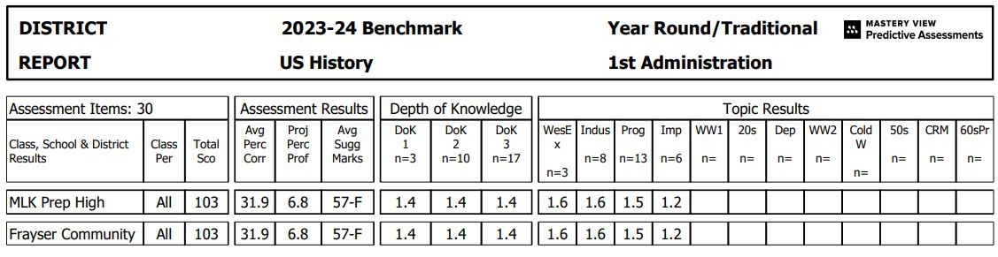
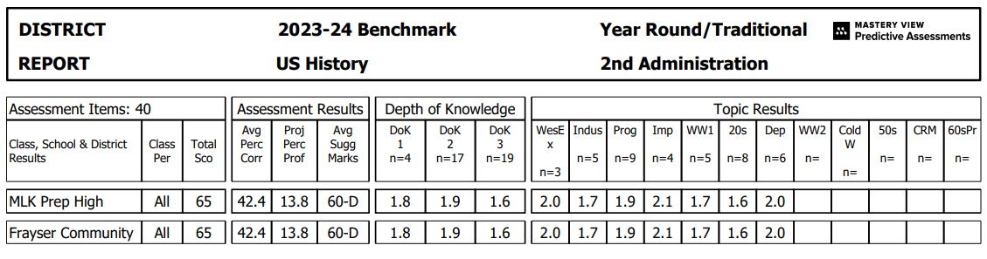
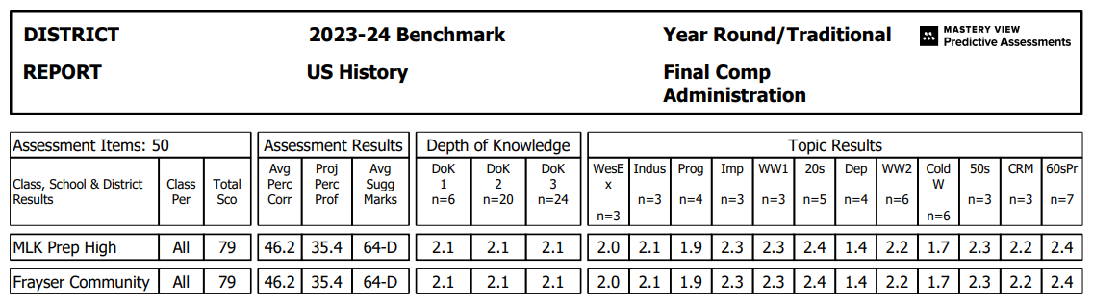
MLK: + 25.1
Total Sco. -5

Slide 13
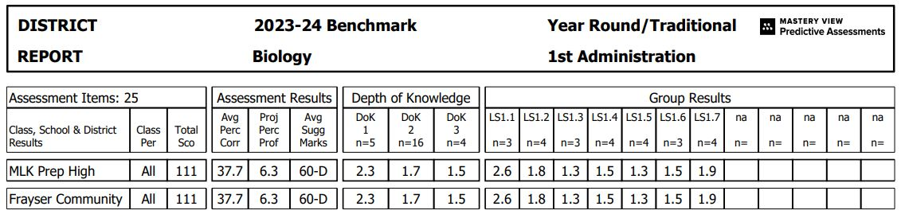
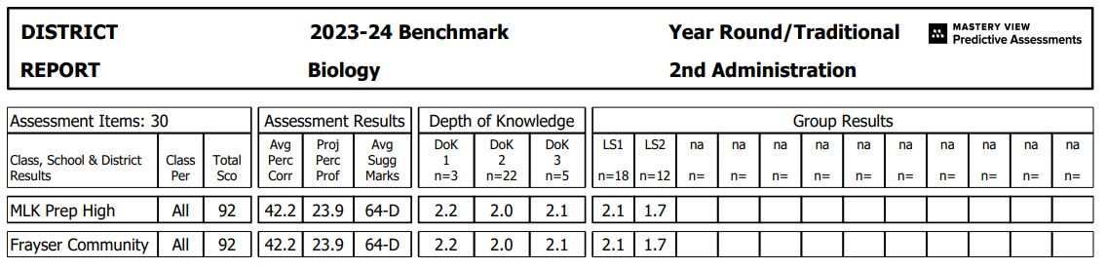
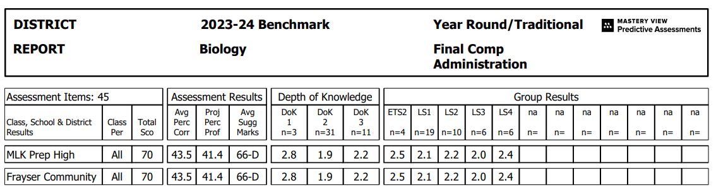
MLK: + 26.3
Total Sco: -31.5

Slide 14

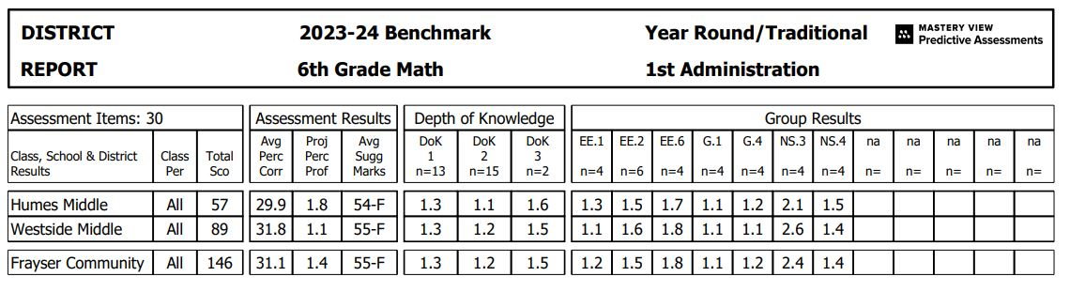
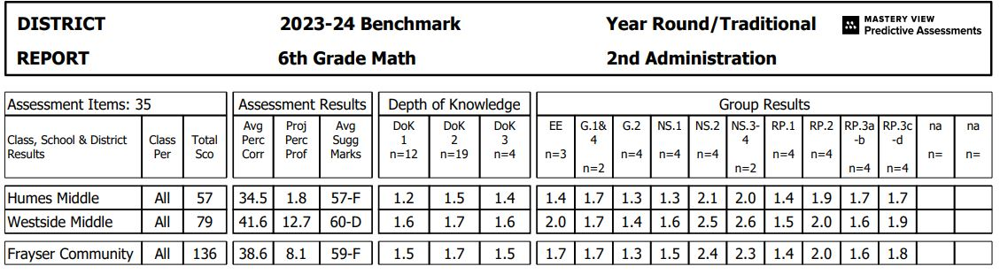

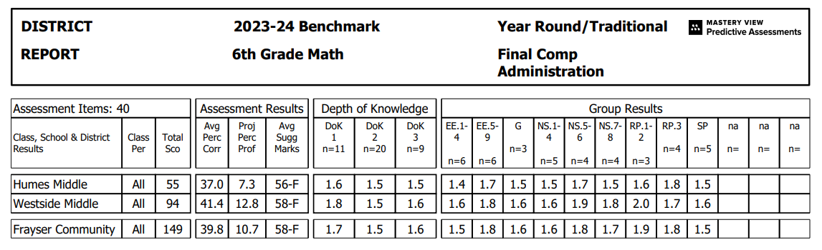
HMS +5.5
Total Sco: -2
WMS +5.9
Total Sco: +10

Slide 15
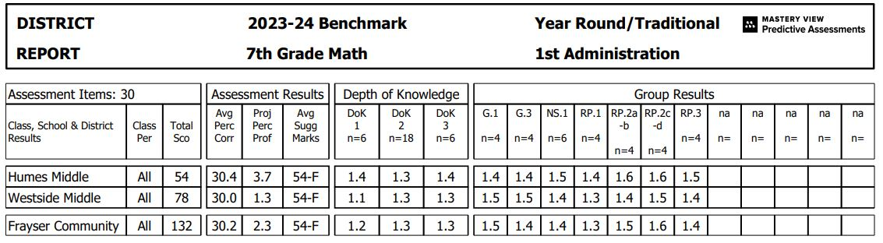
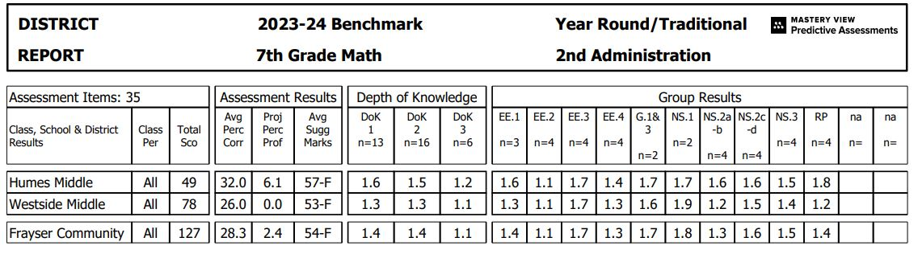
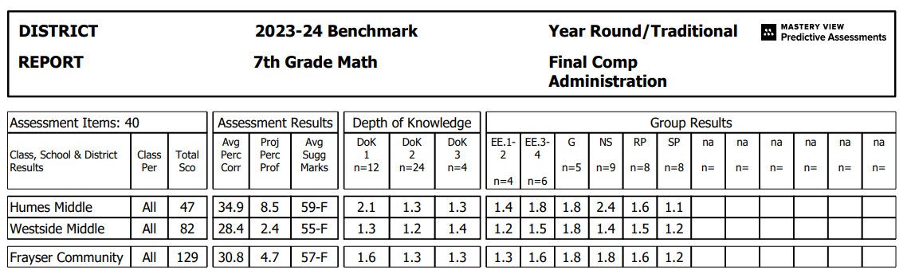
HMS +3.6
Total Sco: -4.5
WMS +1.75
Total Sco: +4

Slide 16
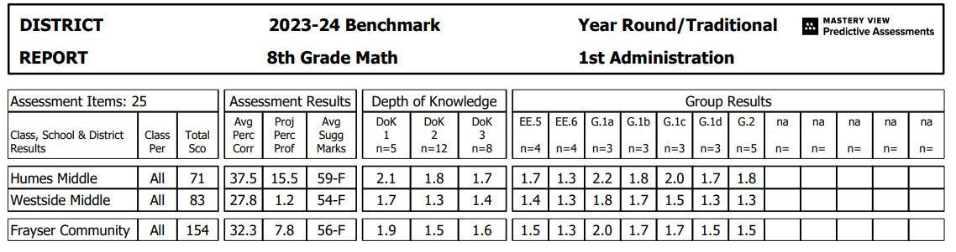
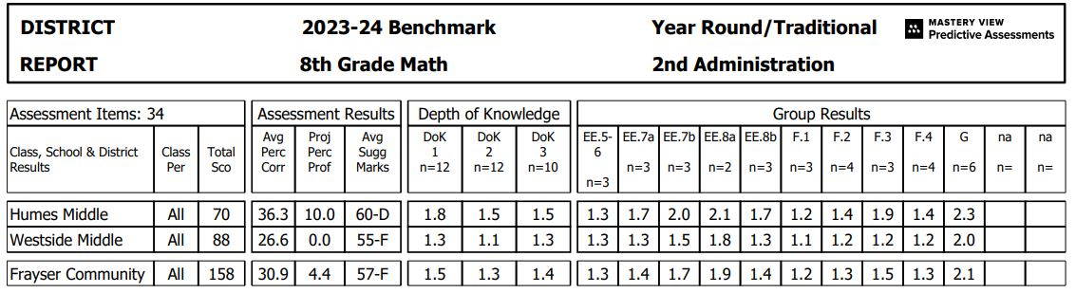
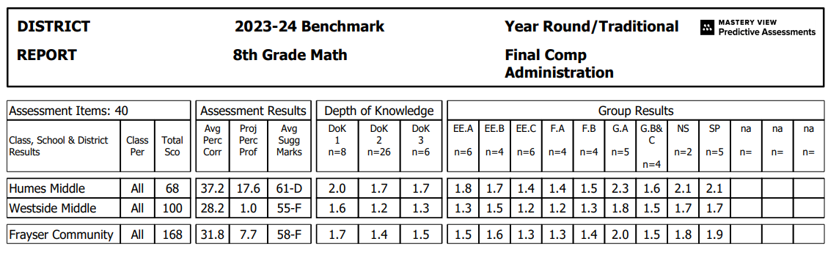
HMS +4.85
Total Sco: -2.5
WMS +0.4
Total Sco: +14.5

Slide 17
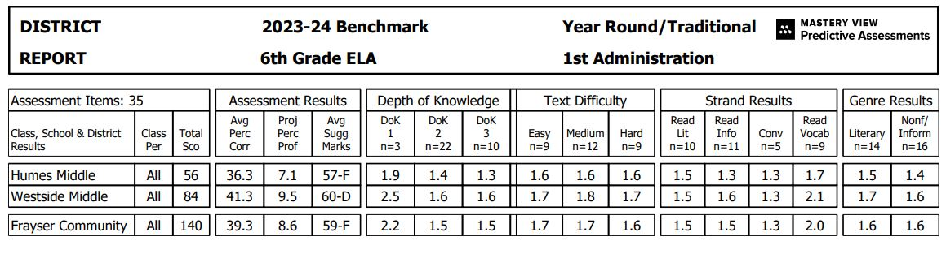
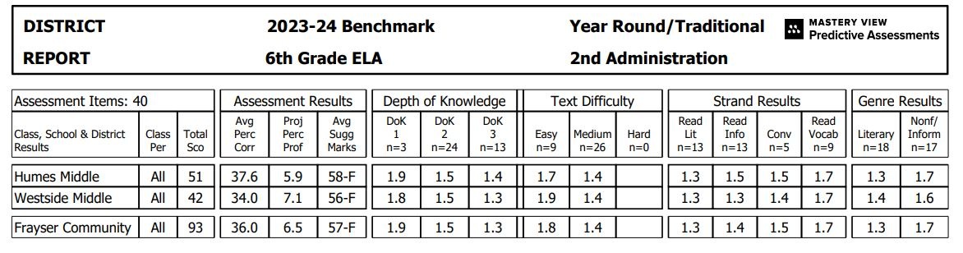
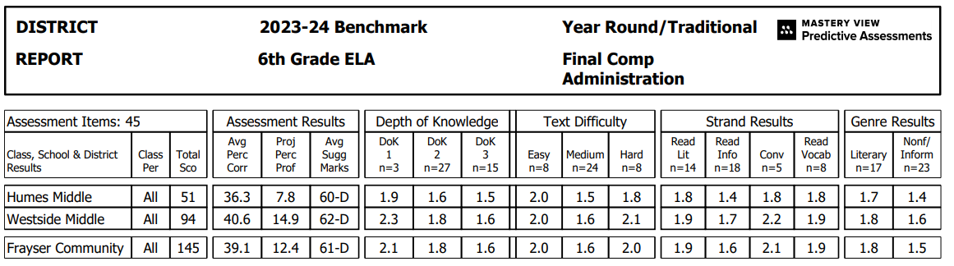
HMS +1.3
Total Sco: -2.5
WMS +6.6
Total Sco: +31

Slide 18
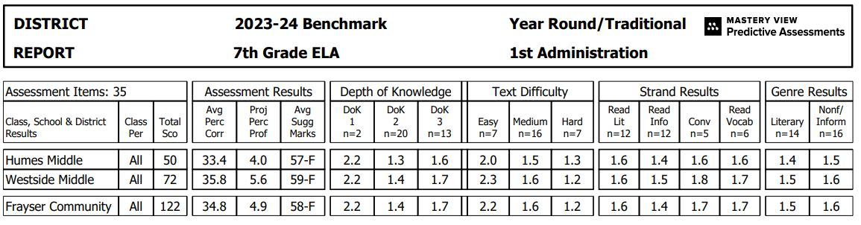
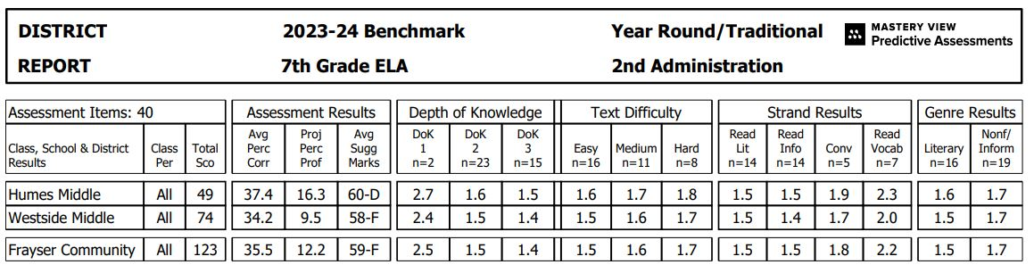
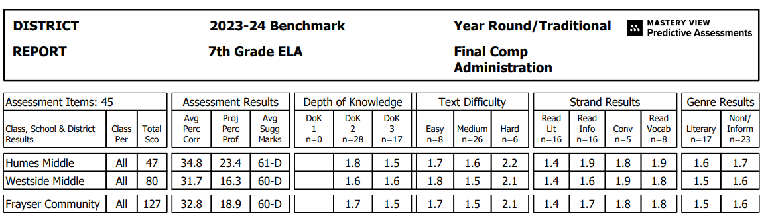
HMS +13.25
Total Sco: -2.5
WMS +8.75
Total Sco: +7

Slide 19
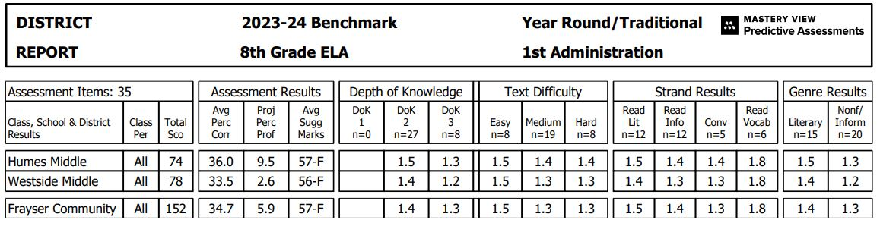
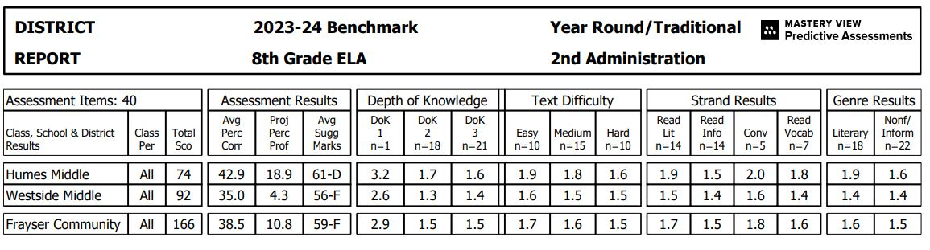

HMS +7.5
Total Sco :-5
WMS –0.45
Total Sco: +15

Slide 20
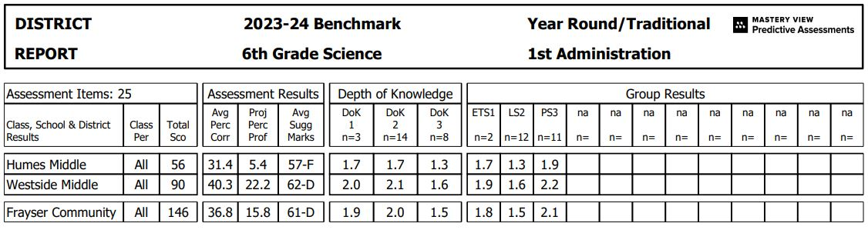
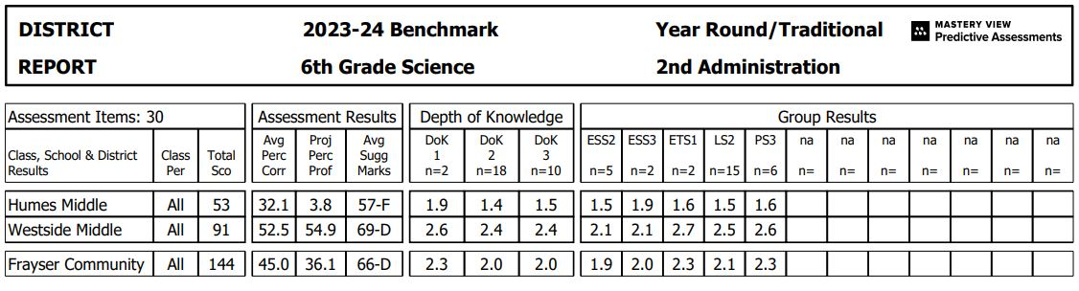
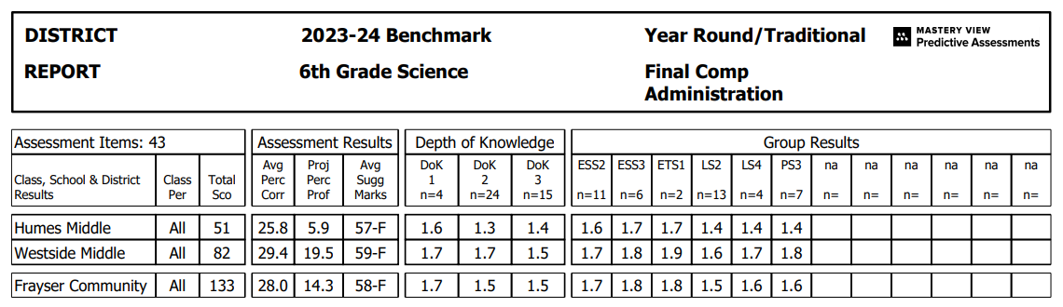
HMS +1.3
Total Sco: -3.5
WMS –19.05
Total Sco: -8.5

Slide 21
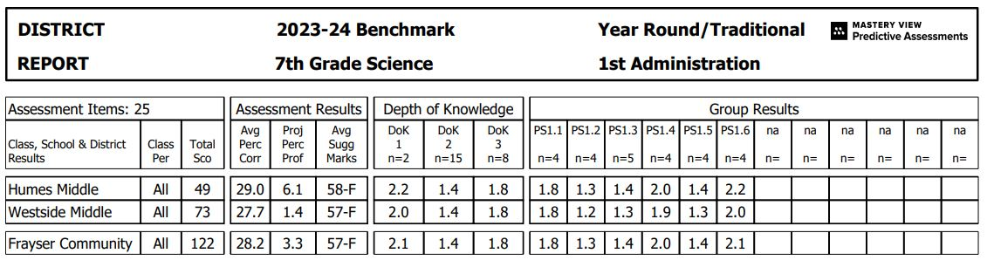
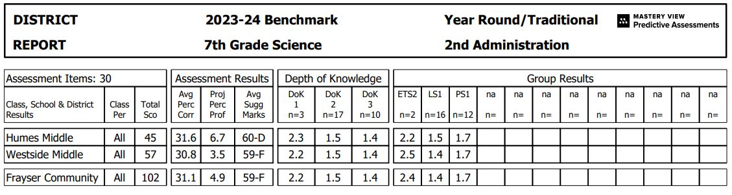
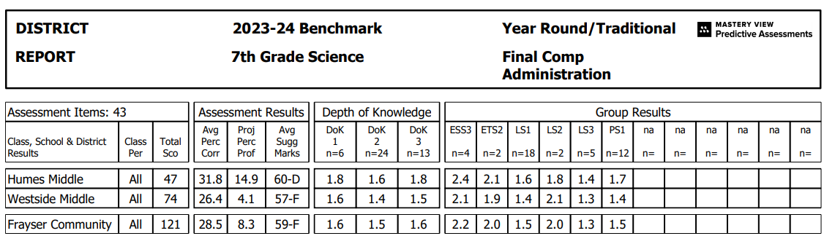
HMS +8.5
Total Sco: 0
WMS +1.65
Total Sco: +9

Slide 22
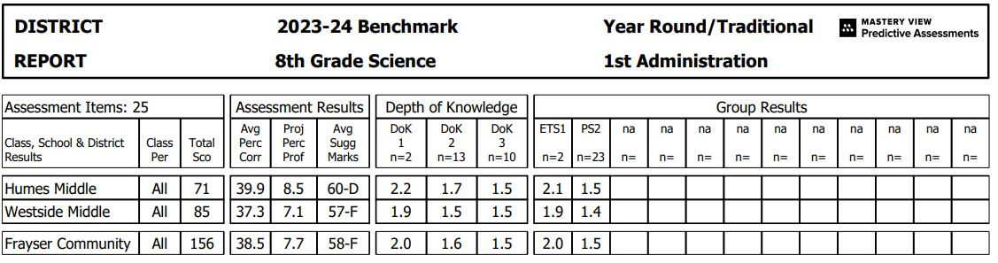
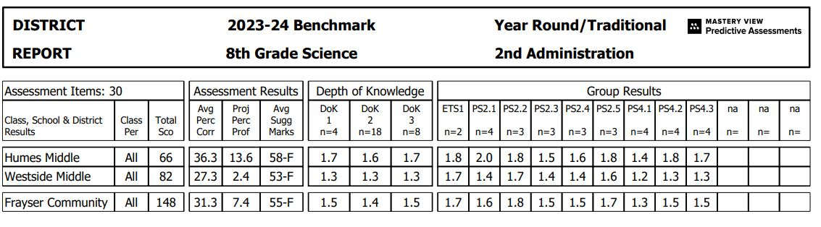
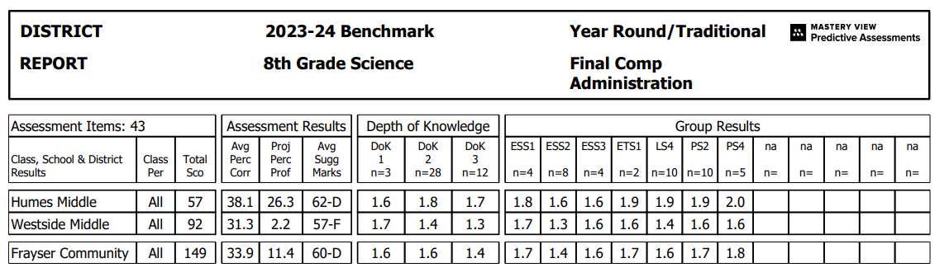
HMS +15.25
Total Sco: -11.5
WMS –2.55
Total Sco: 8.5

Slide 23
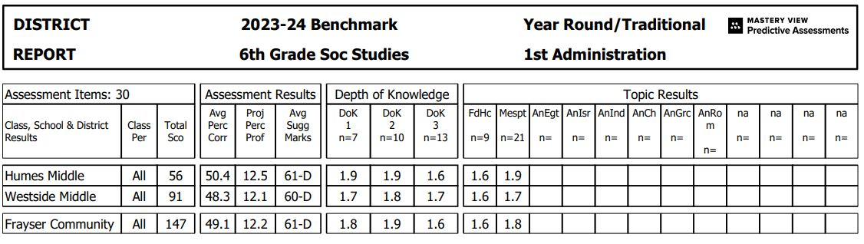


HMS –3.85
Total Sco: -.5
WMS +0.7
Total Sco: -2.5

Slide 24



HMS +6.8
Total Sco: -3.5
WMS +4.75
Total Sco: +4.5

Slide 25



HMS –9.15
Total Sco: -13
WMS +2.6
Total Sco: -5

