Slide 1
SY24-25 Budget
PREPARED MAY 15, 2024 BY
EdOps

Slide 2
Contents
Executive Summary
SY25 Budget
Revenue Overview
Expense Overview
Net Income and Gross Margin
Ending Cash and Days of Cash

Slide 3
Executive Summary
PROCESS & PRIORITIES
REVENUE & EXPENSE HIGHLIGHTS
KEY METRICS & NEXT STEPS
The key priorities for the SY24-25 budget are to
Maintain financial discipline to continue to support our high-performing programs
Reward our staff by increasing compensation
Navigate the closure of Zion City
Enrollment: Our enrollment target for next year is 500. This is a conservative estimate that we hope to improve upon.
Staffing: We have been able to retain the majority of our staff moving into FY25. We’re continuing to review our staffing model as we move into a post-ESSER funding phase.
Efficiently manage closure of Zion City to ensure that the transition minimally impacts students and staff
Prepare to utilize reserve funds as needed in FY25, this is allowable and can be built into our budget through the budget amendment process if needed
Continue student recruitment to bolster enrollment in FY25 and in out years

Slide 4
SY25 Budget
REVENUE
We have budgeted $10,385,620 in revenue based upon 500 students, . The largest components of revenue are $7.1m (68.0%) in State and Local Revenue and $3.3m (31.9%) in Federal Revenue.
REVENUE
 | State and Local Revenue | 7,067,360
 | Federal Revenue | 3,307,823
 | Earned Fees | 10,437
Total Revenue |  | 10,385,620
EXPENSES
 | Salaries | 4,761,010
 | Benefits and Taxes | 1,006,172
 | Purchased Professional & Technical Services | 1,556,213
 | Purchased Property Services | 411,279
 | Other Purchased Services | 1,613,541
 | Supplies | 792,500
 | Miscellaneous | 142,000
Total Expenses |  | 10,282,715
Net Income |  | 102,905
EXPENSES
We have budgeted $10,282,715 in expenses based on 76.85 staff, a 6.5 student to teacher ratio, and 142,000 in square feet for the facility. The largest components of expense are $4,761,010 (46.3%) in Salaries and $1,613,541 (15.7%) in Other Purchased Services.

Slide 5
Revenue | Overview
SY25 BUDGETED REVENUE %
REVENUE PER STUDENT
COMMENTS
We have budgeted $10,385,620 in revenue for SY24-25, which is $2.1m less than the amount forecasted for the year before. This is largely due to ESSER funding coming to an end in September.
The largest components of revenue are State and Local Revenue (68.0%) and Federal Revenue (31.9%).
Highlighted year-to-year changes:
$4m decrease (62.5% less per student) in Federal Revenue
$1.8m increase (11.5% more per student) in State and Local Revenue

Slide 6
Expenses | Overview
SY25 BUDGETED EXPENSE %
EXPENSE PER STUDENT
COMMENTS
We have budgeted $10,282,720 in expenses for SY24-25, which is $2m less than the amount forecasted for the year before. This is also due to reducing programs that were previously funded by ESSER funds.
The largest components of expenses are Salaries (46.3%) and Other Purchased Services (15.7%).
Highlighted year-to-year changes:
$849k decrease (30.1% less per student) in Salaries
$549k decrease (39.1% less per student) in Purchased Professional & Technical Services
$301k decrease (30.5% less per student) in Other Purchased Services
$261k decrease (34.6% less per student) in Benefits and Taxes
$110k decrease (27.6% less per student) in Supplies

Slide 7
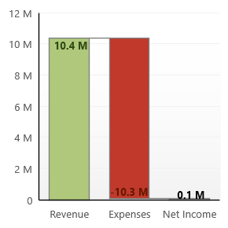
Net Income and Gross Margin
NET INCOME
GROSS MARGIN
COMMENTS
The forecasted net income is $102,905 on $10,385,620 in revenue. This yields .99% in gross margin.
Revenue | 10,385,620
Expenses | 10,282,715
Net Income | 102,905
Revenue | 10,385,620
Expenses | 10,282,715
Net Income | 102,905
Gross Margin | 0.99%
Gross Margin = Net Income / Revenue

Slide 8
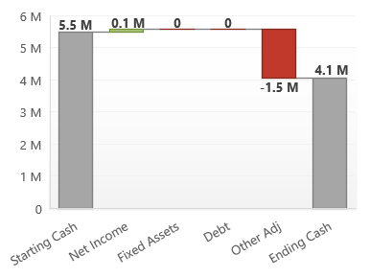
Ending Cash and Days of Cash
ENDING CASH WATERFALL
DAYS OF CASH
COMMENTS
We are predicting 144 days of cash at 6/30/25. This is based upon ending the year with 4,063,127 in cash.
This is a conservative estimate that is anticipating added expenses due to the closure of Zion City.
Starting Cash | 5,469,478
Net Income | 102,905
Fixed Assets | -
Debt | -
Other Adj | (1,509,256)
Net Annual Cash Increase | -1,406,351
Ending Cash | 4,063,127

Slide 9
QUESTIONS?
Please contact your
EdOps Finance Manager:
Dan Cembrola
dcembrola@ed-ops.com

