Slide 1


Financials through Jun 30, 2023
Monthly Financial Board Report
Prepared for: Compass Charter Schools
Prepared by School's CSMC SBM - Kristin Nowak

Slide 2

Financial Summary
Actual to Budget:
This report is as of Jun 30, 2023, compared against our board-approved budget on input date, based on input enrollment count students enrolled and input enrollment ADA ADA.
YTD Revenues Through Jun 30, 2023, are $34,120,820 or 7.2% over our current budget due to a significant increase in State Revenue (Income Accrual for SPED and UPK Grants) and STRS on Behalf Contribution
YTD Expenses Through Jun 30, 2023, are $34,046,892 or -7.5% over our current budget due to overspending in Personnel Expenses ($1,059,369) and Services ($383,152), being slightly offset by a decrease in Books and Supplies ($92,027).
Therefore, net income is $73,928 or -58.6% under our current budget.
Balance Sheet:
As of Jun 30, 2023, we had total cash of $11,535,387, short-term liabilities of $5,828,328, and long-term liabilities of $85,351. The ending fund balance is $9,623,553. NOTE: There is an increase in Due from Grantor Governments ($2,424,615, Prepaid Expenses ($155,690), and Accounts Payable ($145,451), being slightly offset by a decrease in deferred revenue ($365,668).
Report created on 9/1/2023 11:26:56 AM for Compass Charter Schools

Slide 3



Understanding the Financial Health of the Organization
The chart below explains some of the parameters that the school’s leadership can evaluate to understand their financial health, and potential areas of weakness.
Cash Ratio
Ability to meet short-term obligations with cash
 | Current: | Target:
 | 197.9 % | > 100.0 %
Formula: (Cash) / (Current Liabilities)
Defensive Interval
Months of continued operation without incoming funds
 | Current: | Target:
 | 5.2 | > 3 months
Formula: (Cash + Securities + AR)/(Average Expenses for Past 12 Months)
Current Ratio (Liquidity)
Ability to pay short-term obligations
 | Current: | Target:
 | 2.6 | > 1.0
Formula: (Current Assets) / (Current Liabilities)
Report created on 9/1/2023 11:26:55 AM for Compass Charter Schools

Slide 4

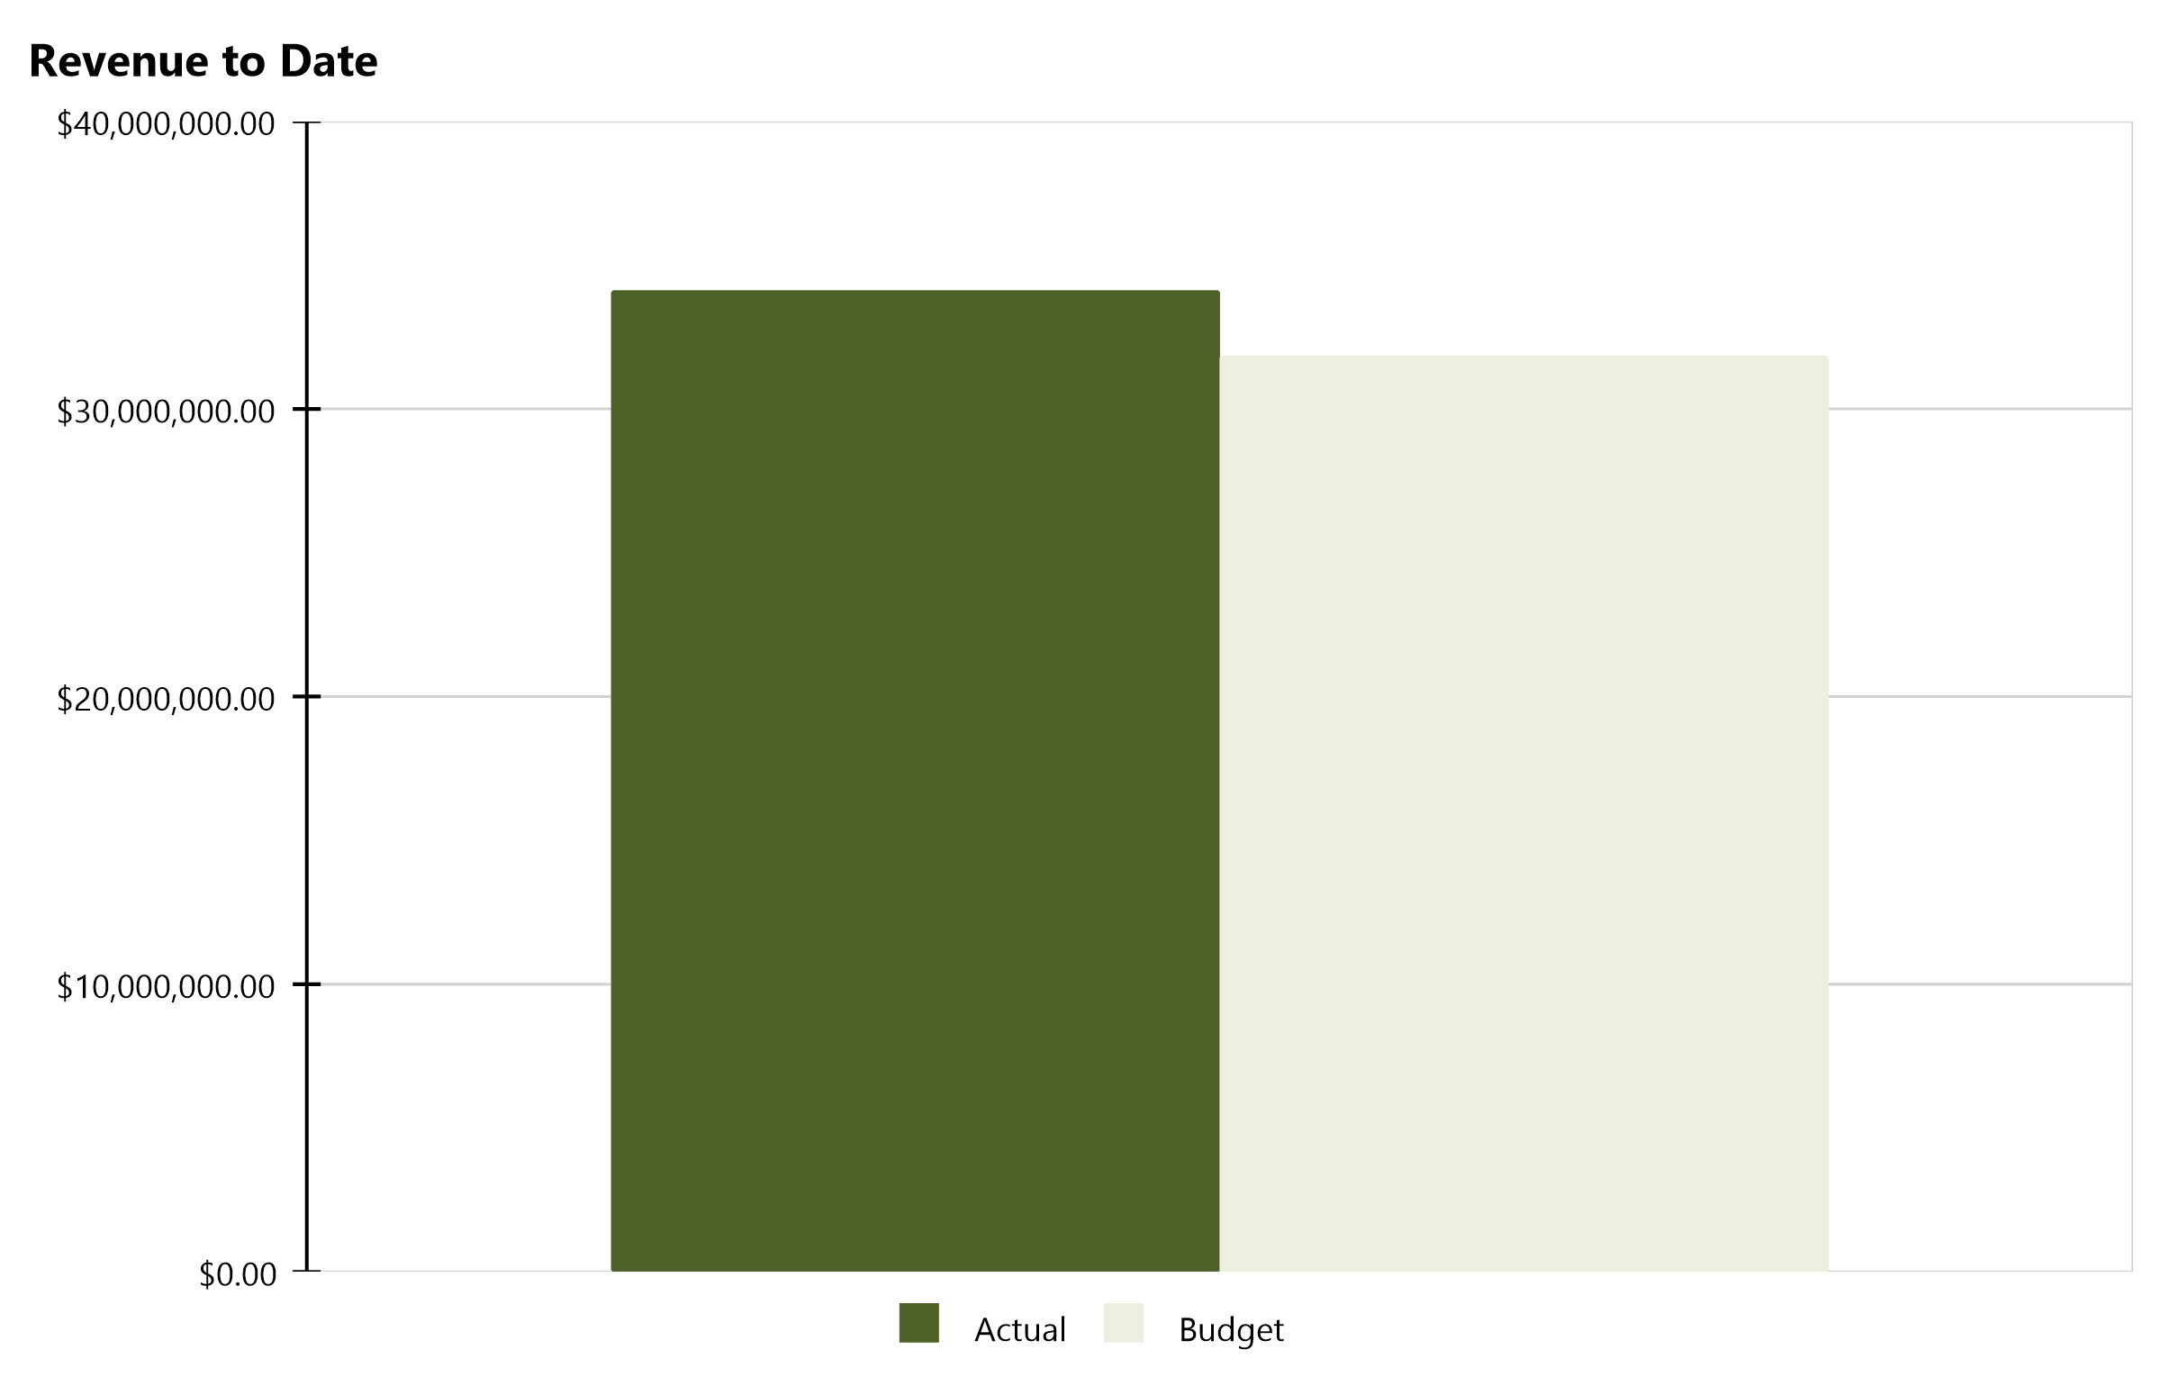
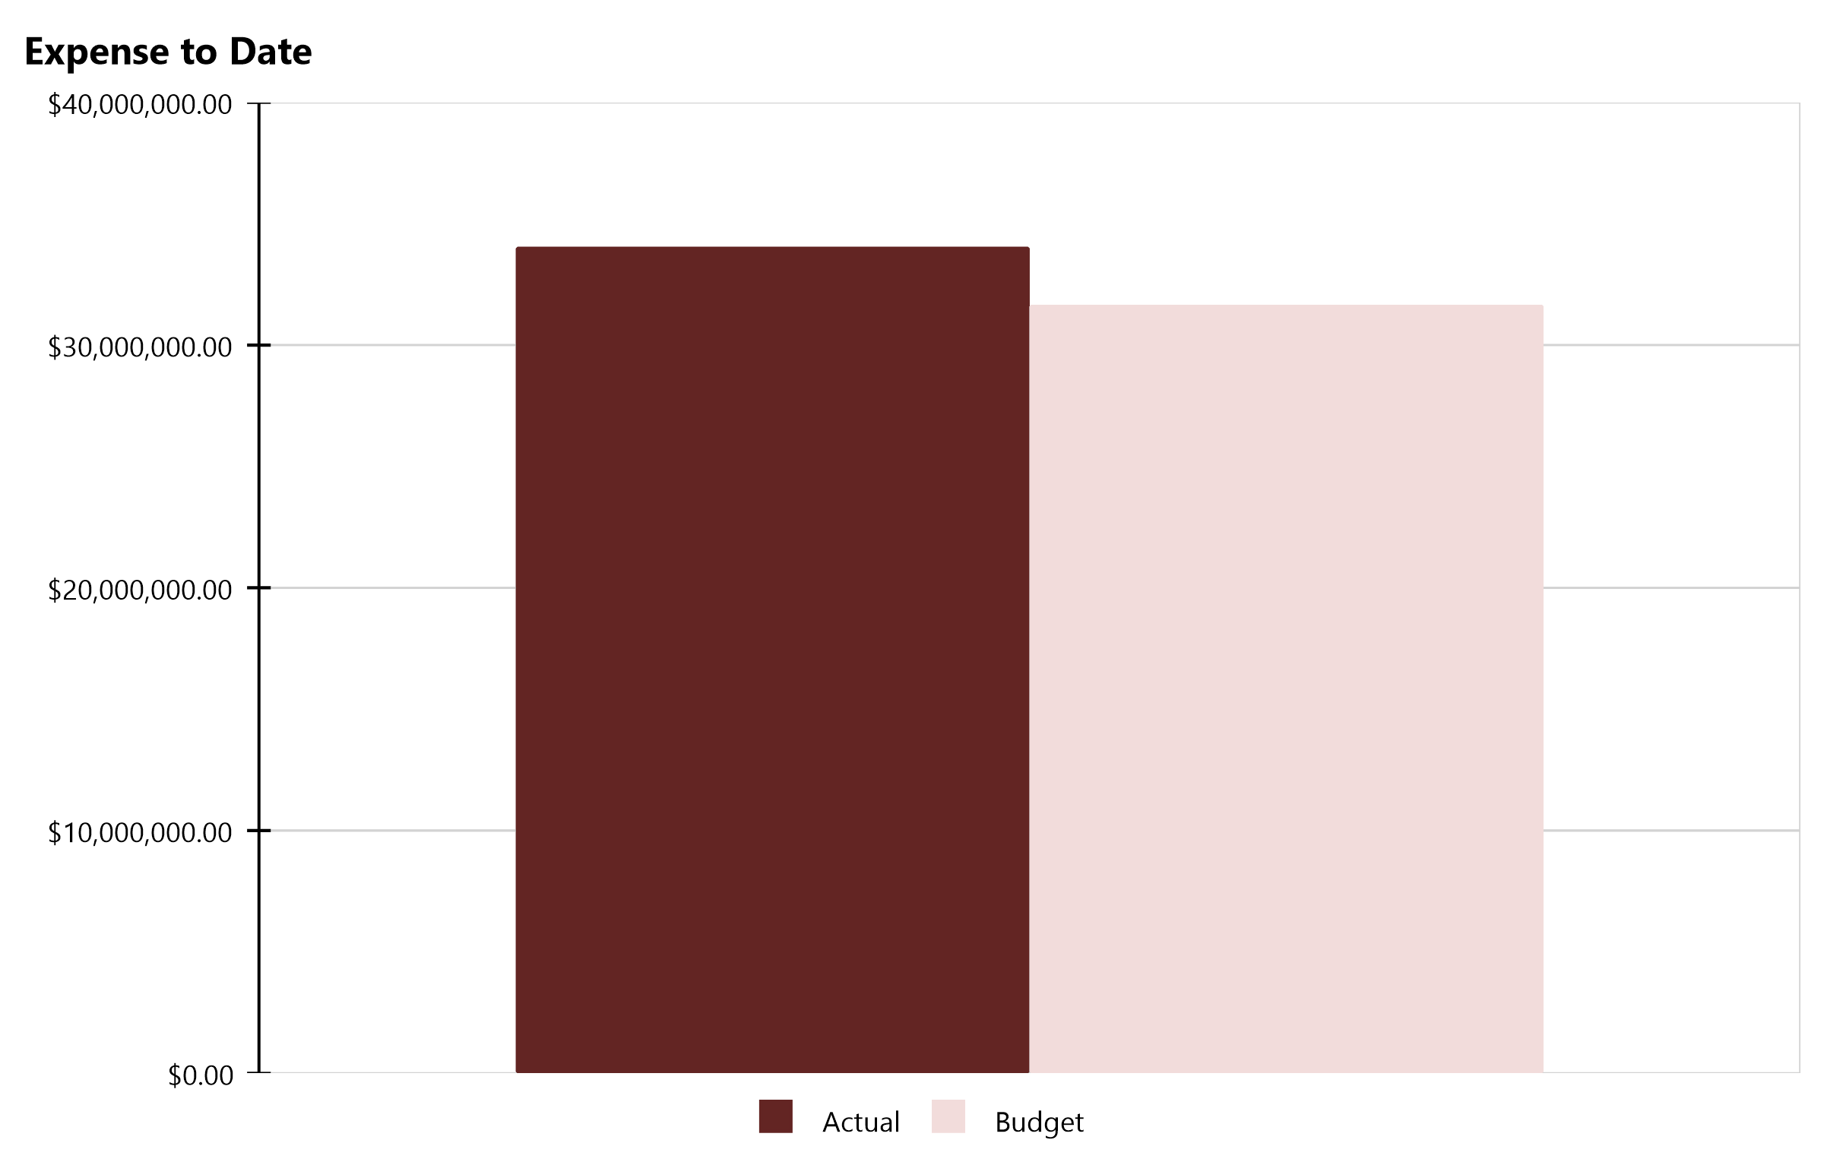
Compass Charter Schools Financial Snapshot
FY 2022-2023, July - June
Cash Balance
$11,535,387
Revenue Summary
Actual | $34,120,820
Budget | $31,842,005
Actual to Budget | 7.2 %
Expense Summary
Actual | $34,046,892
Budget | $31,663,399
Actual to Budget | 7.5 %
Report created on 9/1/2023 11:26:56 AM for Compass Charter Schools

Slide 5
Actual to Budget Summary
FY 2022-2023, July - June
Revenue
$34,120,820
Expenses
$34,046,892
Surplus / (Deficit)
$73,928
 | July - Last Closed |  |  | 2022-2023
Account Description | Actual | Budget | Variance $ | Total Budget | Actual to Total Budget % | Remaining Budget
LCFF Revenue | $25,491,579 | $25,474,652 | $16,927 | $25,474,652 | 100.1 % | ($16,927)
Federal Revenue | $1,917,425 | $1,966,618 | ($49,193) | $1,966,618 | 97.5 % | $49,193
State Revenue | $5,487,135 | $4,287,664 | $1,199,471 | $4,287,664 | 128.0 % | ($1,199,471)
Local Revenue | $1,224,681 | $113,070 | $1,111,611 | $113,070 | 1,083.1 % | ($1,111,611)
Total Revenue | $34,120,820 | $31,842,005 | $2,278,816 | $31,842,005 | 107.2 % | ($2,278,816)
Certificated Salaries | $12,714,053 | $12,787,392 | $73,339 | $12,787,392 | 99.4 % | $73,339
Classified Salaries | $3,338,922 | $3,303,250 | ($35,672) | $3,303,250 | 101.1 % | ($35,672)
Benefits | $6,262,959 | $5,165,923 | ($1,097,035) | $5,165,923 | 121.2 % | ($1,097,035)
Total Personnel Expenses | $22,315,933 | $21,256,565 | ($1,059,369) | $21,256,565 | 105.0 % | ($1,059,369)
Books and Supplies | $4,408,847 | $4,500,874 | $92,027 | $4,500,874 | 98.0 % | $92,027
Services | $6,289,112 | $5,905,960 | ($383,152) | $5,905,960 | 106.5 % | ($383,152)
Other Outgo | $1,033,000 | - | ($1,033,000) | - | 103,300,000.0 % | ($1,033,000)
Total Operational Expenses | $11,730,959 | $10,406,834 | ($1,324,125) | $10,406,834 | 112.7 % | ($1,324,125)
Total Expenses | $34,046,892 | $31,663,399 | ($2,383,494) | $31,663,399 | 107.5 % | ($2,383,494)
Net Income | $73,928 | $178,606 | ($104,678) | $178,606 | 41.4 % | $104,678
This report displays all actual and budgeted revenue and expenditures by object code series and by month. This report can be useful in ensuring you receive your revenue in a timely manner and that you stay within the board approved expenditure levels.
Report created on 9/1/2023 11:26:56 AM for Compass Charter Schools

Slide 6
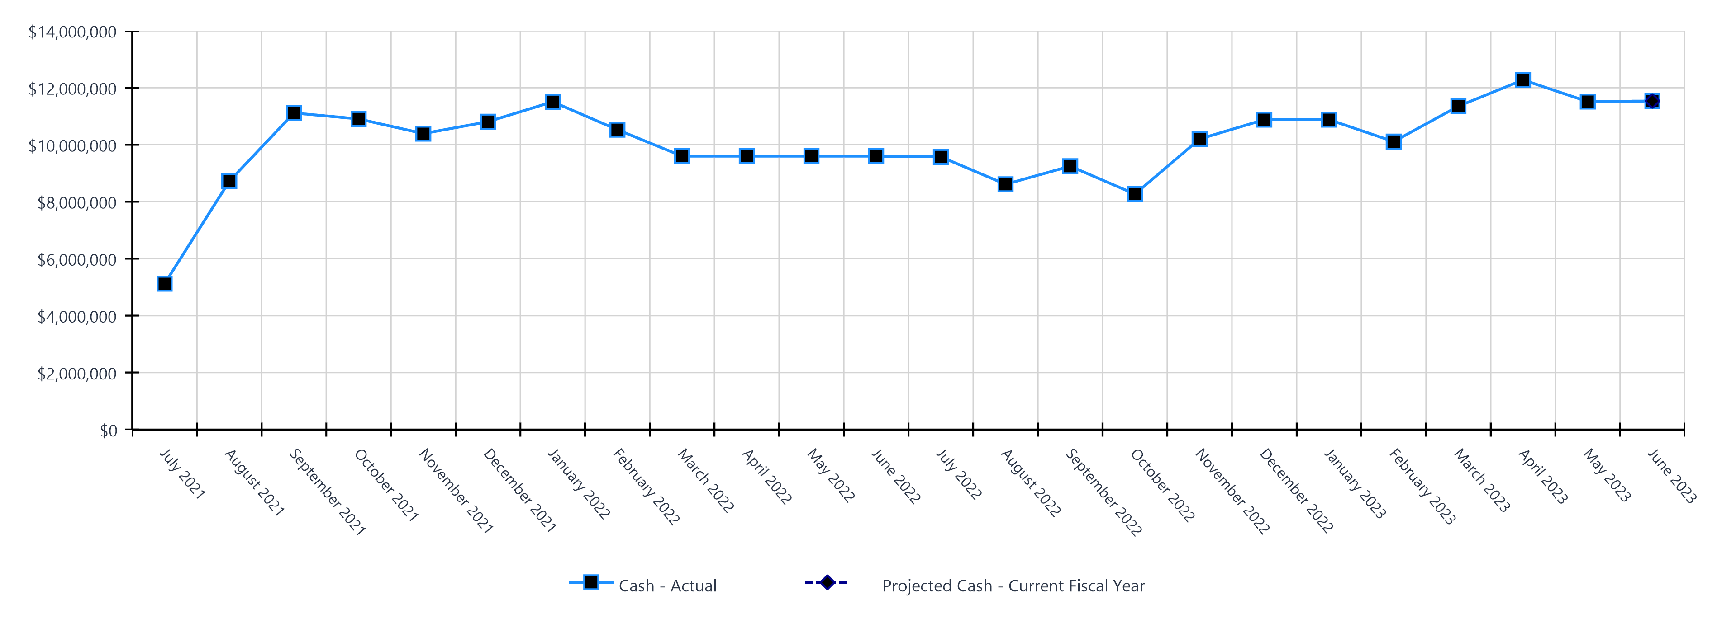
Monthly Cash Balance Over Time
Current fiscal year and prior year
 | Cash Amount | Actual or Projected
July 2021 | $5,121,620.34 | Actual
August 2021 | $8,718,061.60 | Actual
September 2021 | $11,113,904.09 | Actual
October 2021 | $10,905,645.35 | Actual
November 2021 | $10,390,528.49 | Actual
December 2021 | $10,808,568.05 | Actual
January 2022 | $11,507,548.45 | Actual
February 2022 | $10,527,180.02 | Actual
March 2022 | $9,600,208.18 | Actual
April 2022 | $9,600,208.18 | Actual
May 2022 | $9,600,208.18 | Actual
June 2022 | $9,600,208.18 | Actual
 | Cash Amount | Actual or Projected
July 2022 | $9,574,236.91 | Actual
August 2022 | $8,611,838.91 | Actual
September 2022 | $9,246,236.00 | Actual
October 2022 | $8,268,561.64 | Actual
November 2022 | $10,201,001.92 | Actual
December 2022 | $10,880,194.48 | Actual
January 2023 | $10,880,095.75 | Actual
February 2023 | $10,109,841.05 | Actual
March 2023 | $11,352,089.26 | Actual
April 2023 | $12,274,544.19 | Actual
May 2023 | $11,513,514.86 | Actual
June 2023 | $11,535,386.73 | Actual
Report created on 9/1/2023 11:26:56 AM for Compass Charter Schools

Slide 7
Balance Sheet Summary FY 2022-2023 - June
The balance sheet displays all of the school’s assets and the school’s obligations (‘liabilities’) at a particular point in time. It is a useful way to ensure the school has enough money to pay off its debts.
Liquidity Ratio
2.6
Assets
Current Assets
Accounts Receivable | $2,564,017
Cash and Cash Equivalents | $11,535,387
Employee Advances | $29
Prepaid Expenses | $544,154
Short Term Investments | $794,268
Total Current Assets | $15,437,854
Fixed Assets
Fixed Assets | $89,158
Total Fixed Assets | $89,158
Other Assets
Other Assets | $10,220
Total Other Assets | $10,220
Total Assets | $15,537,232
Liabilities and Net Assets
Current Liabilities
Accounts Payable | $542,531
Accrued Liabilities | $987,482
Other Short Term Liability | $4,298,315
Total Current Liabilities | $5,828,328
Long Term Liabilities
Other Liabilities | $85,351
Total Long Term Liabilities | $85,351
Total Liabilities | $5,913,679
Net Increase/(Decrease in Net Assets)
Net Increase/(Decrease) in Net Assets | $73,928
Total Net Increase/(Decrease) in Net Assets | $73,928
Ending Net Assets
Ending Net Assets | $9,549,625
Total Net Assets | $9,549,625
Total Liabilities and Net Assets | $15,537,232
Report created on 9/1/2023 11:26:57 AM for Compass Charter Schools

Slide 8
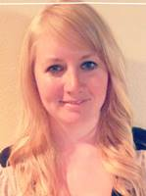
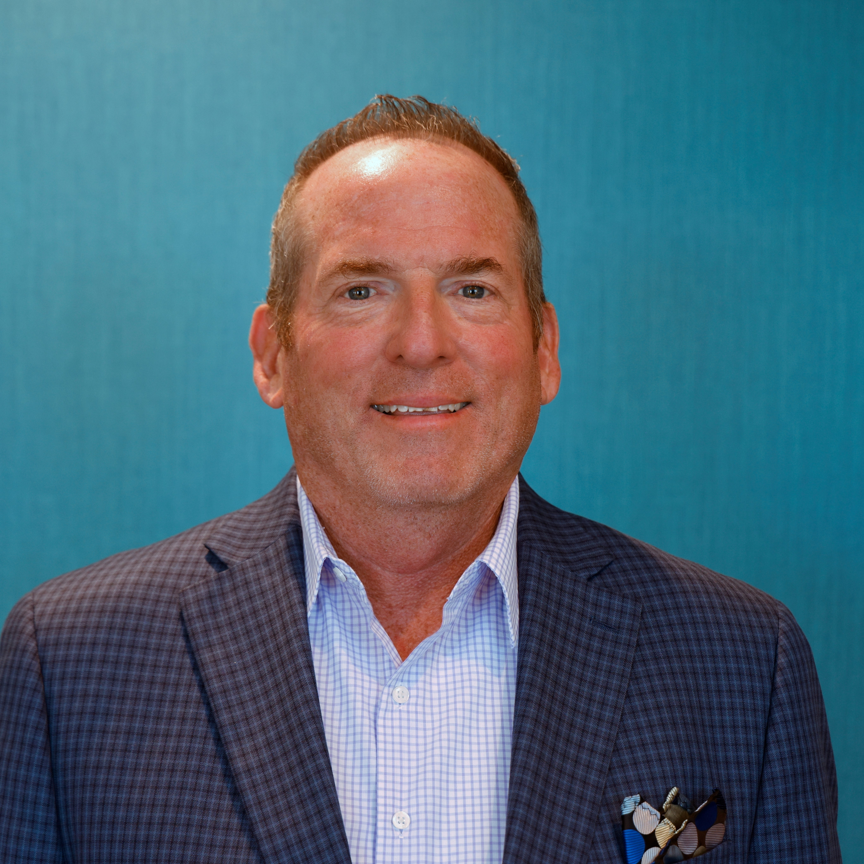


CSMC Charter School Support Team
 | Executive VP of Client Services Tom Nichols tnichols@csmci.com
 | School Business Manager Kristin Nowak knowak@csmci.com
 | Account Manager Mai Luong mluong@csmci.com
 | Associate AM Kimber Nelson knelson@csmci.com
Report created on 9/1/2023 11:26:57 AM for Compass Charter Schools

Slide 9
Looking Ahead
9/2/2023 | Special education final expenditure reports for prior year, reports and timing vary by SELPA
9/13/2023 | Fall Office Hours
9/15/2023 | Unaudited Actuals Report (state deadline, local deadline often earlier)
 | Corrections to Prior Year annual or P-2 attendance data
9/27/2023 | Webinar #3
9/30/2023 | CTEIG application possible deadline
 | Educator Effectiveness annual expenditure report
 | UPK Planning and Implementation report
9/30/2023 | Board Meeting
10/1/2023 | Special education current year Level 3 placement requests; timing varies by SELPA
10/14/2023 | CARES, ESSER, ESSER II, ESSER III expenditure report
10/15/2023 | Special education one time funding reports; timing varies by SELPA
10/25/2023 | Webinar #4
10/31/2023 | If PENSEC filed, 20 Day Attendance Report
 | ASES attendance and expenditure reports
 | Federal Cash Management Data Collection (CMDC)
11/29/2023 | Webinar #5
Report created on 9/1/2023 11:26:57 AM for Compass Charter Schools

Slide 10

HELPING THE EDUCATION MOVEMENT SUCCEED ONE SCHOOL AT A TIME
info@csmci.com
Office: 888.994.CSMC
43460 Ridge Park Dr., Ste. 100
Temecula, Ca 92590
POWERED BY:
Report created on 9/1/2023 11:26:56 AM for Compass Charter Schools
www.csmci.com
Charter Vision

