Slide 1


Financials through Aug 31, 2023
Monthly Financial Board Report
Prepared for: Compass Charter Schools
Prepared by School's CSMC SBM - Kristin Nowak

Slide 2

Financial Summary
Actual to Budget:
This report is as of Aug 31, 2023, compared against our board-approved budget on input date, based on input enrollment count students enrolled and input enrollment ADA ADA.
YTD Revenues Through Aug 31, 2023, are $1,720,571 or -33.7% under our current budget due to receiving less than the budgeted amount for Local Revenue by ($226K) and the late timing of receiving LCFF revenue (August 2023 payment for SD ($253K) was received within the month. LCFF revenue for LA ($486K) and YOLO (300K) was received first week of September)
YTD Expenses Through Aug 31, 2023, are $4,109,892 or 15.9% under our current budget due to underspending in Books/Supplies by ($974K). This was slightly offset by overspending in Personnel Services ($170K) and Services ($27K).
Therefore, net income is ($2,389,321) or 4.3% under our current budget.
Balance Sheet:
As of Aug 31, 2023, we had total cash of $9,959,138, short-term liabilities of $5,135,010, and long-term liabilities of $64,531. The ending fund balance is $7,234,232. There was a decrease in cash by ($550K) and an increase in short-term liabilities ($651K), being slightly offset by a decrease in long-term liabilities ($16K).
Report created on 9/19/2023 9:46:05 AM for Compass Charter Schools

Slide 3



Understanding the Financial Health of the Organization
The chart below explains some of the parameters that the school’s leadership can evaluate to understand their financial health, and potential areas of weakness.
Cash Ratio
Ability to meet short-term obligations with cash
 | Current: | Target:
 | 193.9 % | > 100.0 %
Formula: (Cash) / (Current Liabilities)
Defensive Interval
Months of continued operation without incoming funds
 | Current: | Target:
 | 4.2 | > 3 months
Formula: (Cash + Securities + AR)/(Average Expenses for Past 12 Months)
Current Ratio (Liquidity)
Ability to pay short-term obligations
 | Current: | Target:
 | 2.4 | > 1.0
Formula: (Current Assets) / (Current Liabilities)
Report created on 9/19/2023 9:46:04 AM for Compass Charter Schools

Slide 4

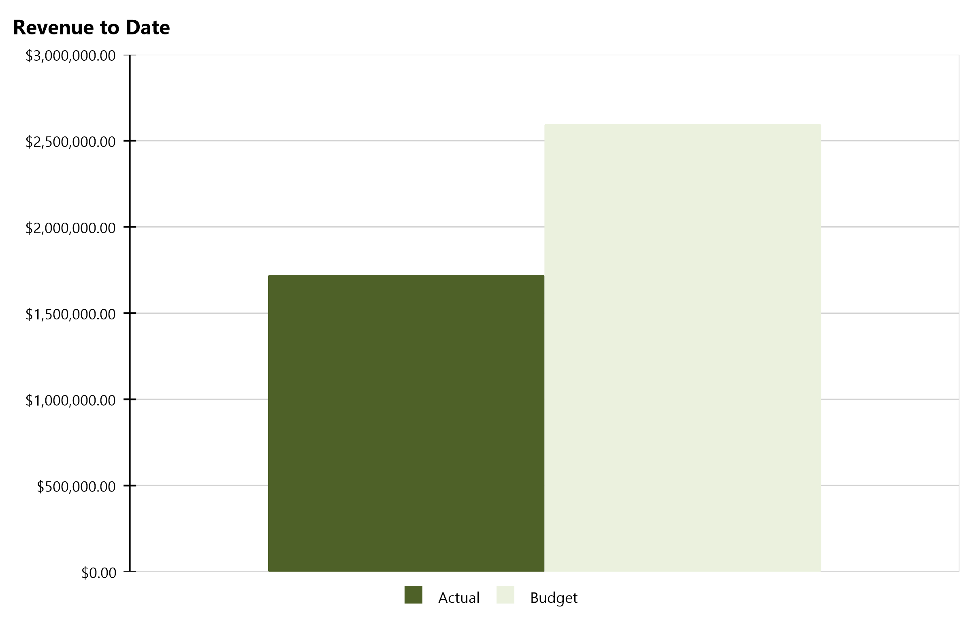
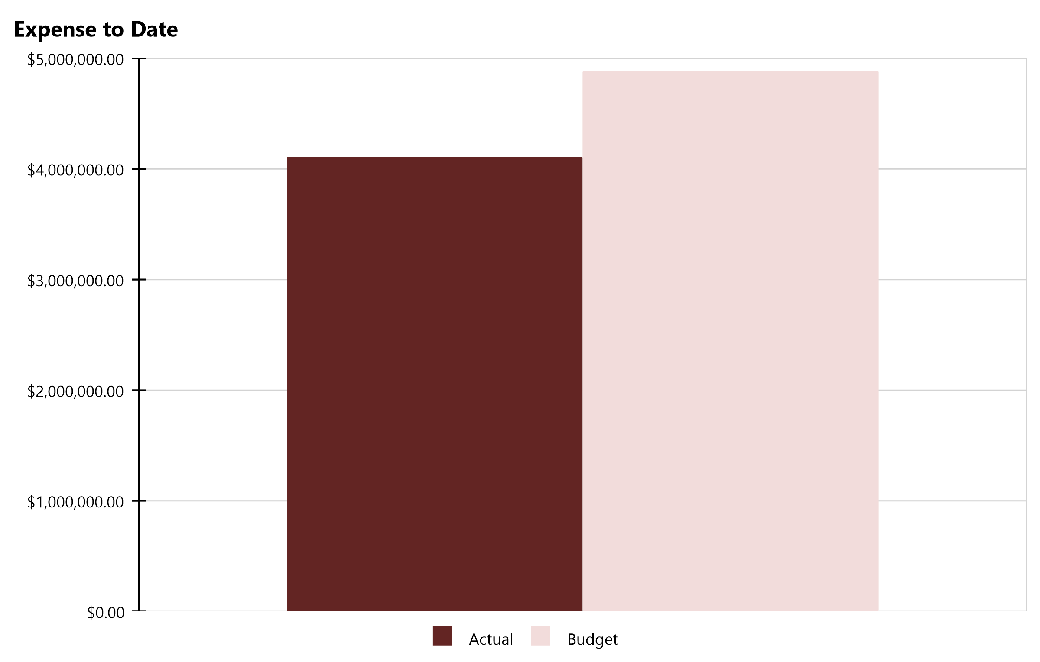
Compass Charter Schools Financial Snapshot
FY 2023-2024, July - August
Cash Balance
$9,959,138
Revenue Summary
Actual | $1,720,571
Budget | $2,595,909
Actual to Budget | -33.7 %
Expense Summary
Actual | $4,109,892
Budget | $4,886,096
Actual to Budget | -15.9 %
Report created on 9/19/2023 9:46:05 AM for Compass Charter Schools

Slide 5
Actual to Budget Summary
FY 2023-2024, July - August
Revenue
$1,720,571
Expenses
$4,109,892
Surplus / (Deficit)
($2,389,321)
 | July - Last Closed |  |  | 2023-2024
Account Description | Actual | Budget | Variance $ | Total Budget | Actual to Total Budget % | Remaining Budget
LCFF Revenue | $1,402,824 | $2,349,147 | ($946,323) | $27,853,061 | 5.0 % | $26,450,237
Federal Revenue | $57,250 | - | $57,250 | $2,559,176 | 2.2 % | $2,501,925
State Revenue | $246,461 | $6,537 | $239,924 | $2,155,576 | 11.4 % | $1,909,115
Local Revenue | $14,036 | $240,225 | ($226,189) | $2,447,450 | 0.6 % | $2,433,414
Total Revenue | $1,720,571 | $2,595,909 | ($875,337) | $35,015,263 | 4.9 % | $33,294,692
Certificated Salaries | $1,425,581 | $1,231,212 | ($194,369) | $13,558,595 | 10.5 % | $12,133,013
Classified Salaries | $537,960 | $548,622 | $10,662 | $3,304,952 | 16.3 % | $2,766,992
Benefits | $888,190 | $901,598 | $13,408 | $5,431,313 | 16.4 % | $4,543,123
Total Personnel Expenses | $2,851,731 | $2,681,432 | ($170,299) | $22,294,859 | 12.8 % | $19,443,128
Books and Supplies | $395,920 | $1,370,205 | $974,285 | $5,619,650 | 7.0 % | $5,223,730
Services | $862,241 | $834,458 | ($27,783) | $5,906,474 | 14.6 % | $5,044,232
Total Operational Expenses | $1,258,161 | $2,204,664 | $946,502 | $11,526,124 | 10.9 % | $10,267,963
Total Expenses | $4,109,892 | $4,886,096 | $776,204 | $33,820,983 | 12.2 % | $29,711,091
Net Income | ($2,389,321) | ($2,290,187) | ($99,134) | $1,194,280 | -200.1 % | $3,583,601
This report displays all actual and budgeted revenue and expenditures by object code series and by month. This report can be useful in ensuring you receive your revenue in a timely manner and that you stay within the board approved expenditure levels.
Report created on 9/19/2023 9:46:05 AM for Compass Charter Schools

Slide 6
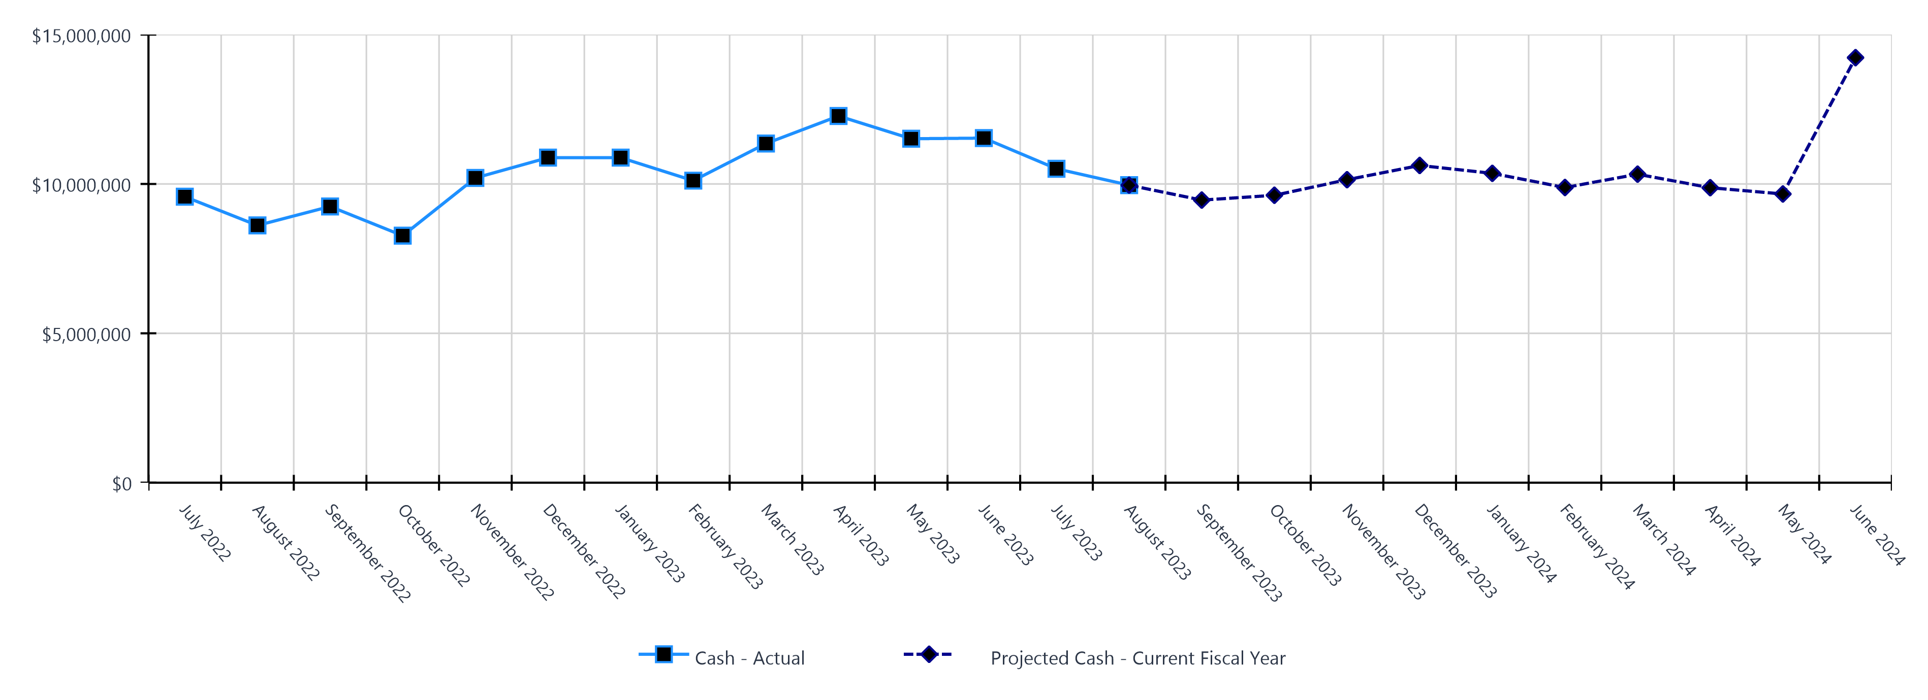
Monthly Cash Balance Over Time
Current fiscal year and prior year
 | Cash Amount | Actual or Projected
July 2022 | $9,574,236.91 | Actual
August 2022 | $8,611,838.91 | Actual
September 2022 | $9,246,236.00 | Actual
October 2022 | $8,268,561.64 | Actual
November 2022 | $10,201,001.92 | Actual
December 2022 | $10,880,194.48 | Actual
January 2023 | $10,880,095.75 | Actual
February 2023 | $10,109,841.05 | Actual
March 2023 | $11,352,089.26 | Actual
April 2023 | $12,274,544.19 | Actual
May 2023 | $11,513,514.86 | Actual
June 2023 | $11,535,386.73 | Actual
 | Cash Amount | Actual or Projected
July 2023 | $10,508,844.93 | Actual
August 2023 | $9,959,137.57 | Actual
September 2023 | $9,459,701.00 | Projected
October 2023 | $9,620,237.00 | Projected
November 2023 | $10,141,785.00 | Projected
December 2023 | $10,619,537.00 | Projected
January 2024 | $10,354,972.00 | Projected
February 2024 | $9,880,852.16 | Projected
March 2024 | $10,325,710.19 | Projected
April 2024 | $9,874,641.55 | Projected
May 2024 | $9,664,276.32 | Projected
June 2024 | $14,228,228.75 | Projected
Report created on 9/19/2023 9:46:05 AM for Compass Charter Schools

Slide 7
Balance Sheet Summary FY 2023-2024 - August
The balance sheet displays all of the school’s assets and the school’s obligations (‘liabilities’) at a particular point in time. It is a useful way to ensure the school has enough money to pay off its debts.
Liquidity Ratio
2.4
Assets
Current Assets
Accounts Receivable | $1,044,255
Cash and Cash Equivalents | $9,959,138
Employee Advances | $266
Prepaid Expenses | $547,844
Short Term Investments | $797,525
Total Current Assets | $12,349,028
Fixed Assets
Fixed Assets | $79,525
Total Fixed Assets | $79,525
Other Assets
Other Assets | $5,220
Total Other Assets | $5,220
Total Assets | $12,433,772
Liabilities and Net Assets
Current Liabilities
Accounts Payable | $209,551
Accrued Liabilities | $1,081,800
Other Short Term Liability | $3,843,659
Total Current Liabilities | $5,135,010
Long Term Liabilities
Other Liabilities | $64,531
Total Long Term Liabilities | $64,531
Total Liabilities | $5,199,541
Net Increase/(Decrease in Net Assets)
Net Increase/(Decrease) in Net Assets | ($2,389,321)
Total Net Increase/(Decrease) in Net Assets | ($2,389,321)
Ending Net Assets
Ending Net Assets | $9,623,553
Total Net Assets | $9,623,553
Total Liabilities and Net Assets | $12,433,772
Report created on 9/19/2023 9:46:05 AM for Compass Charter Schools

Slide 8
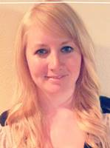
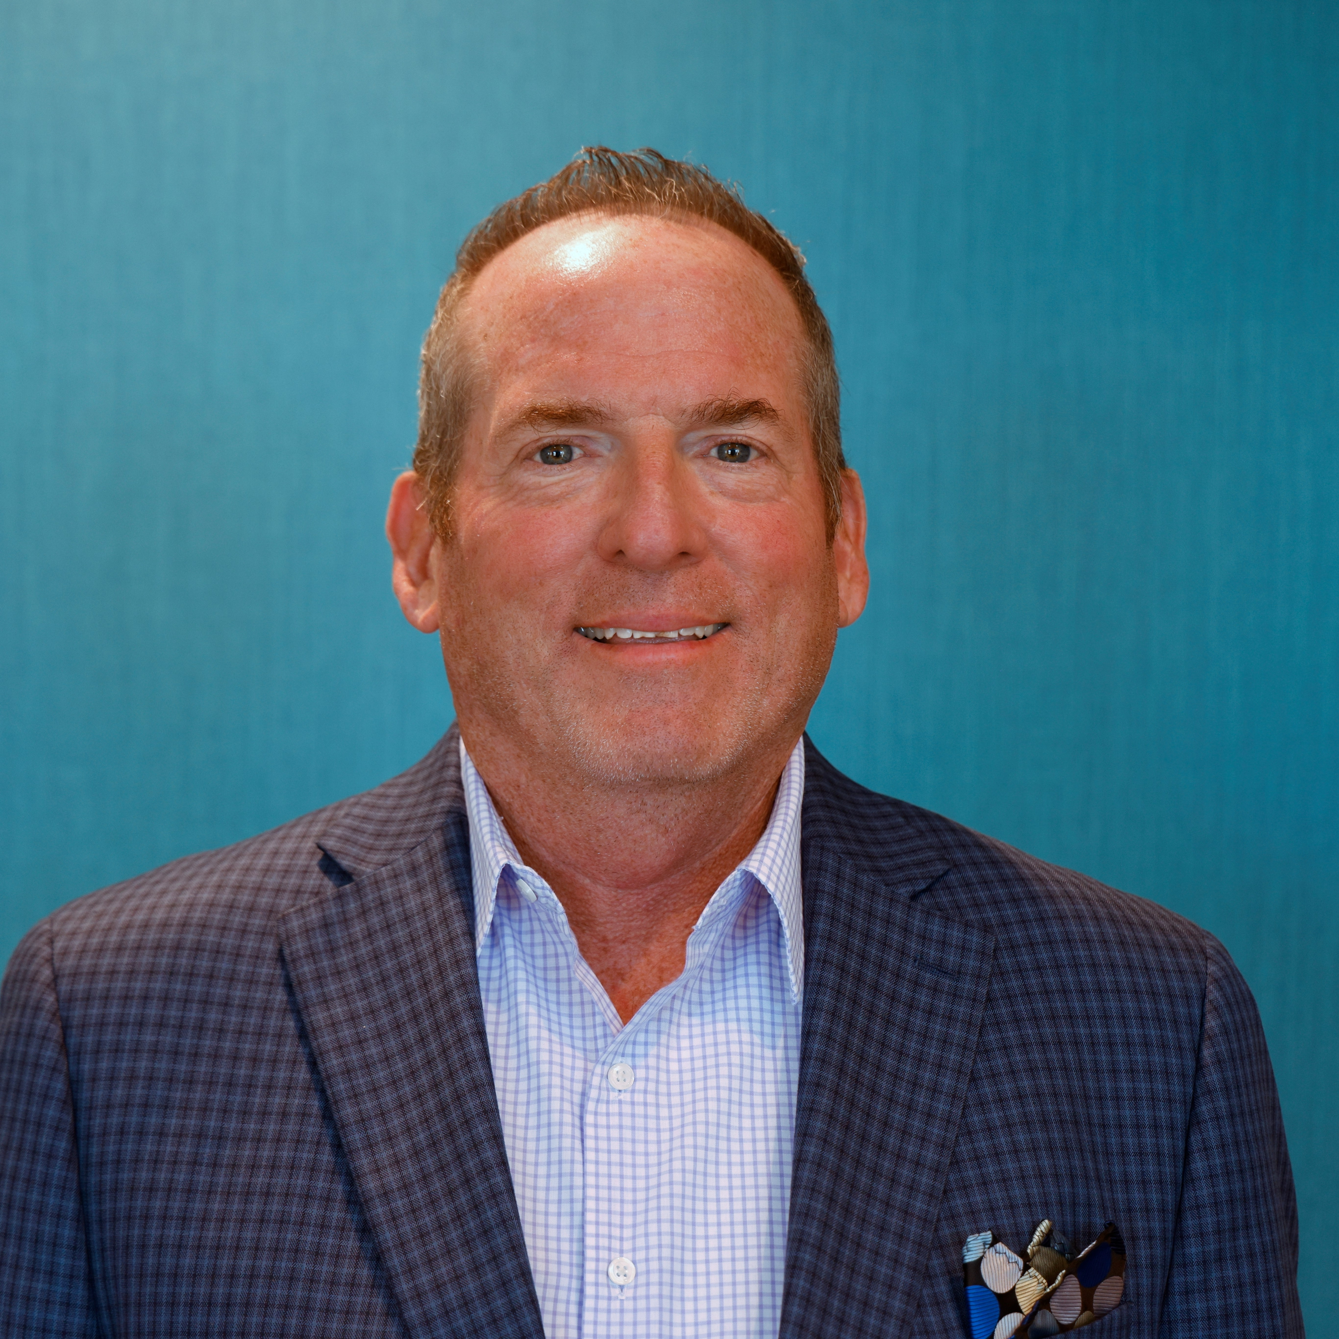


CSMC Charter School Support Team
 | Executive VP of Client Services Tom Nichols tnichols@csmci.com
 | School Business Manager Kristin Nowak knowak@csmci.com
 | Account Manager Mai Luong mluong@csmci.com
 | Associate AM Kimber Nelson knelson@csmci.com
Report created on 9/19/2023 9:46:06 AM for Compass Charter Schools

Slide 9
Looking Ahead
9/27/2023 | Webinar #3
9/29/2023 | CTEIG application deadline
9/30/2023 | Educator Effectiveness annual expenditure report
 | UPK Planning and Implementation report
9/30/2023 | Board Meeting
10/1/2023 | Special education current year Level 3 placement requests; timing varies by SELPA
10/14/2023 | CARES, ESSER, ESSER II, ESSER III expenditure report
10/15/2023 | Special education one time funding reports; timing varies by SELPA
10/25/2023 | Webinar #4
10/31/2023 | If PENSEC filed, 20 Day Attendance Report
 | ASES attendance and expenditure reports
 | Federal Cash Management Data Collection (CMDC)
11/29/2023 | Webinar #5
12/5/2023 | Workshop Topic: LCAP & Accountability Planning
12/7/2023 | Workshop Topic: LCAP & Accountability Planning
12/13/2023 | Winter Office Hours
12/15/2023 | Annual Financial Audit Report deadline
 | First Interim Financial Report
Report created on 9/19/2023 9:46:06 AM for Compass Charter Schools

Slide 10

HELPING THE EDUCATION MOVEMENT SUCCEED ONE SCHOOL AT A TIME
info@csmci.com
Office: 888.994.CSMC
43460 Ridge Park Dr., Ste. 100
Temecula, Ca 92590
POWERED BY:
Report created on 9/19/2023 9:46:05 AM for Compass Charter Schools
www.csmci.com
Charter Vision

