Slide 1
Compass Charter Schools
FY23
Unaudited Actuals

Slide 2
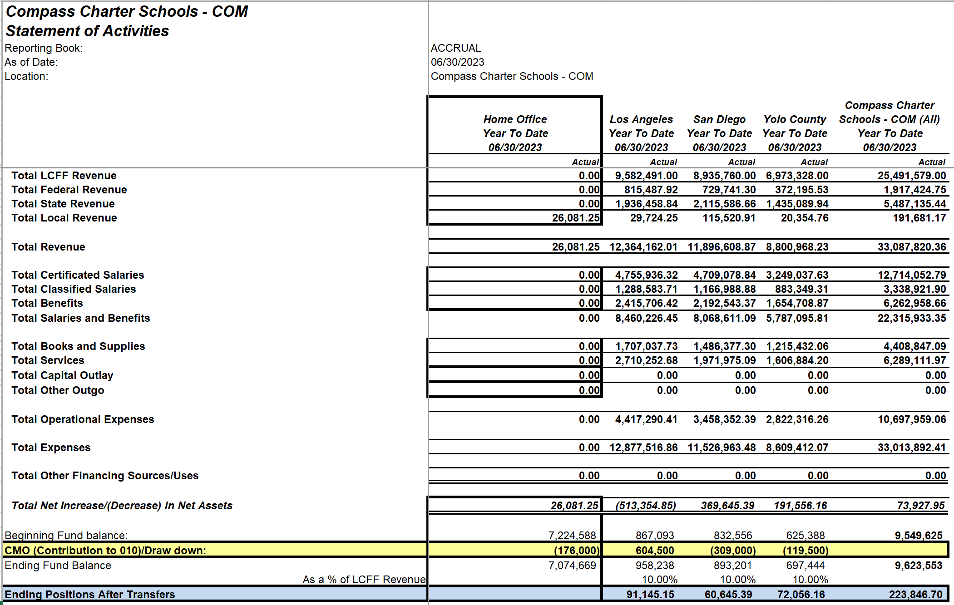
FY23 Unaudited Actuals Summary
FY23

Slide 3
Fund Balance Transfers
FY23

Slide 4
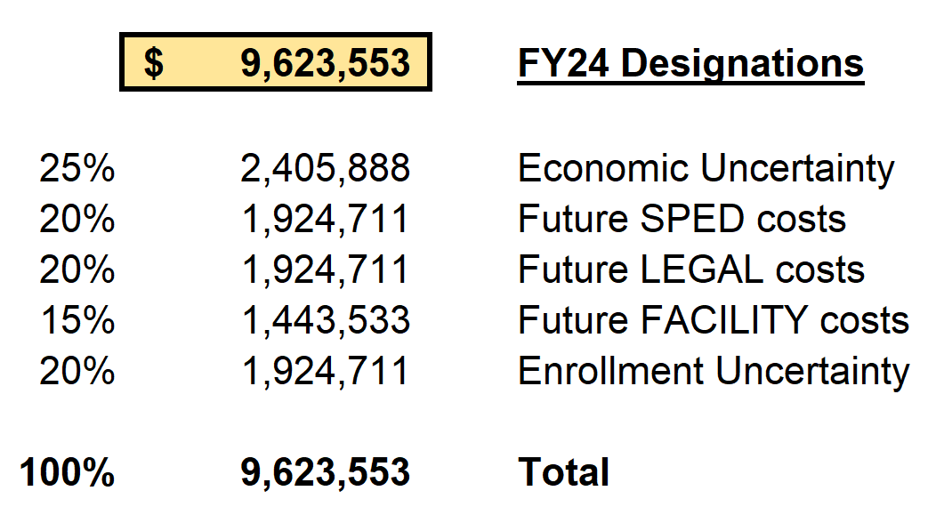
Reserve Designations
FY24

Slide 5
Funding Determination %s
FY23

Slide 6
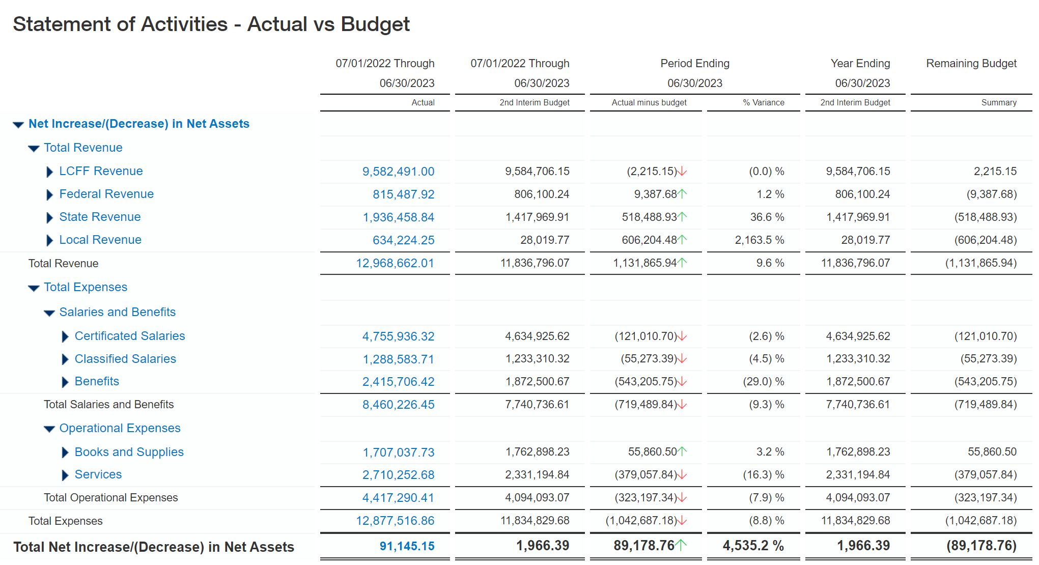
UAR: CCS LA
FY23
Proportional share of spending impacted actual results- Overspend in:
Payroll approximately $200k (stipends)
5800 Consulting: $63k
5805 Legal: $115k
5810 SPED: $241k
5815 Advertising: $14k
5900 Comms $24k

Slide 7
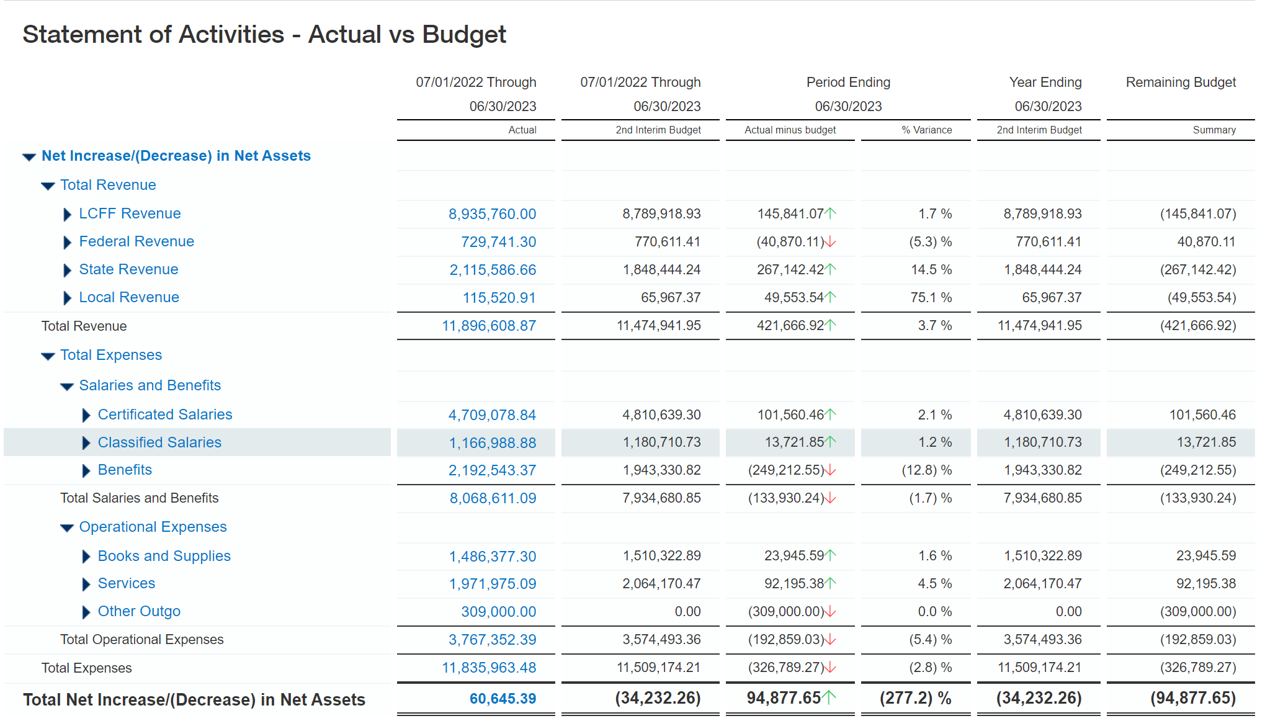
UAR: CCS SD
FY23
SD major variances due to higher SPED revenues $368k

Slide 8
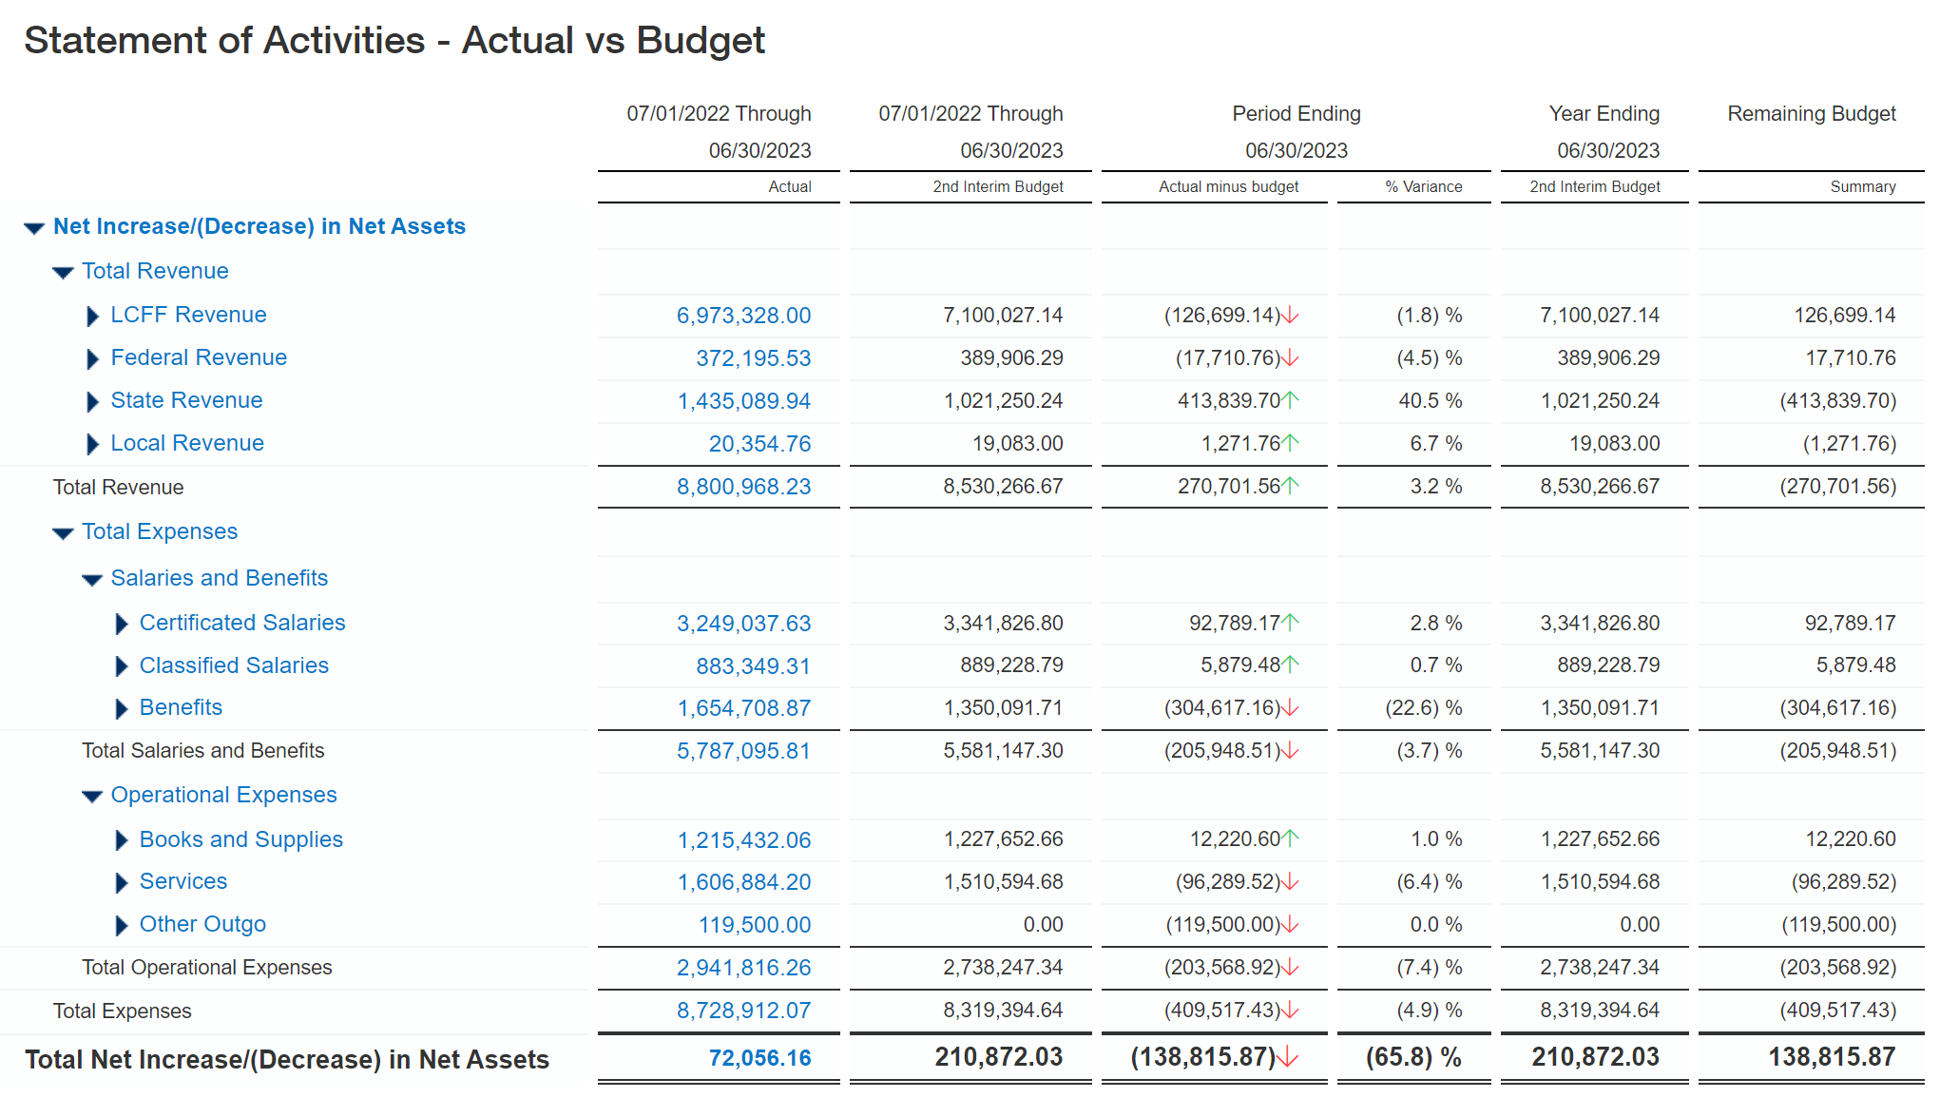
UAR: CCS Yolo
FY23
Results as expected before transfer $191k vs $211k

