Slide 1
Compass Charter Schools
FY24
INITIAL

Slide 2
Average Daily Attendance Driving Revenue
Enrollment increase of 116, ADA increase of 85.07
FY24 Initial
FY24 Initial
CCS Yolo: ADA variance from 2nd Interim: 15.61 increase
CCS SD: ADA variance from 2nd Interim: 28.18 increase
CCS LA: ADA variance from 2nd Interim: 41.29 increase
FY 23 2nd Interim:

Slide 3
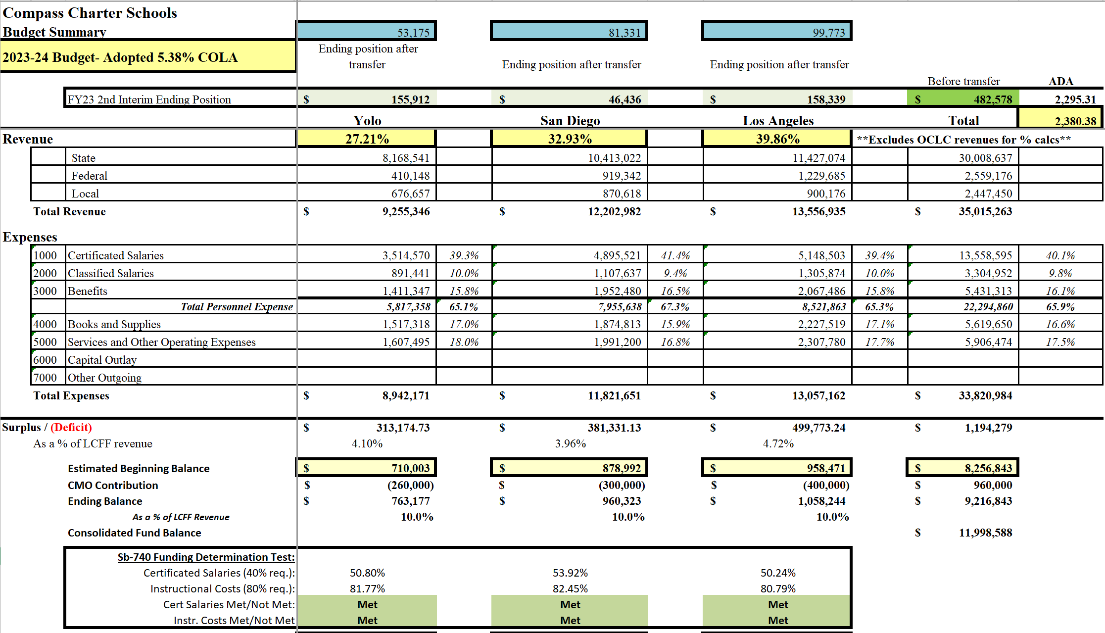
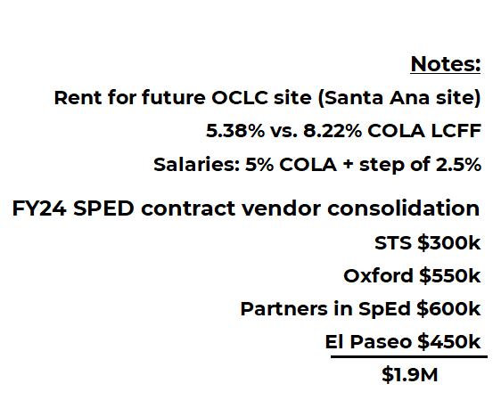
FY24 Initial Budget Summary
Variance from FY23 2nd Interim= $178,604- $1,194,279 = $1,015,675 increase
FY24

Slide 4
Initial Budget Summary- Funding Determinations
FY24

Slide 5
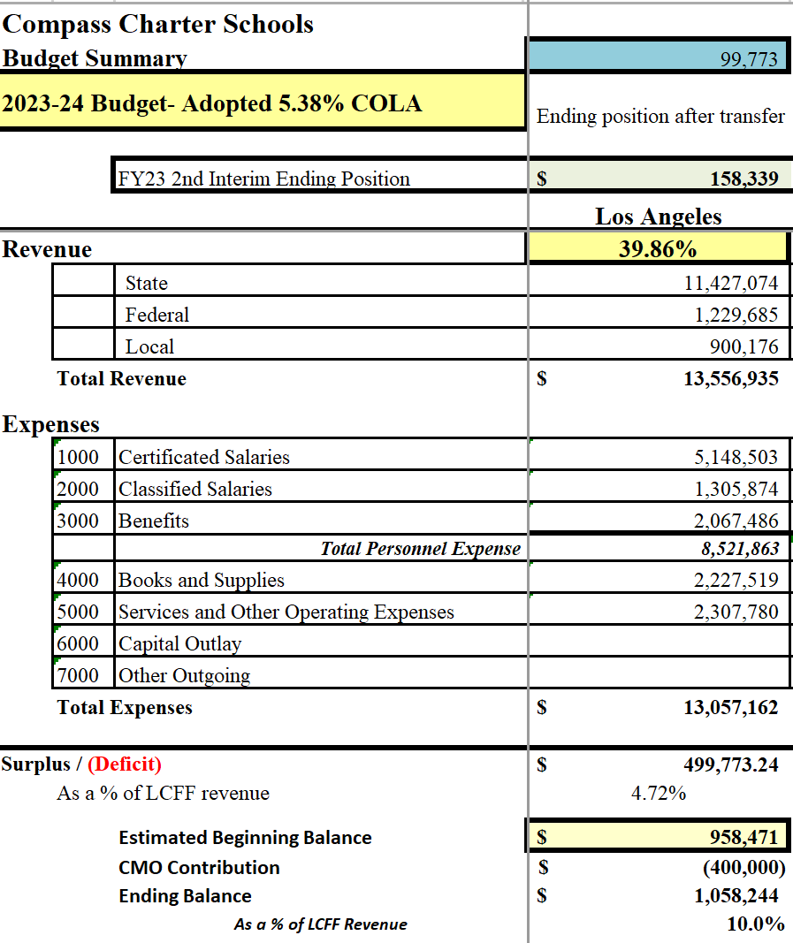
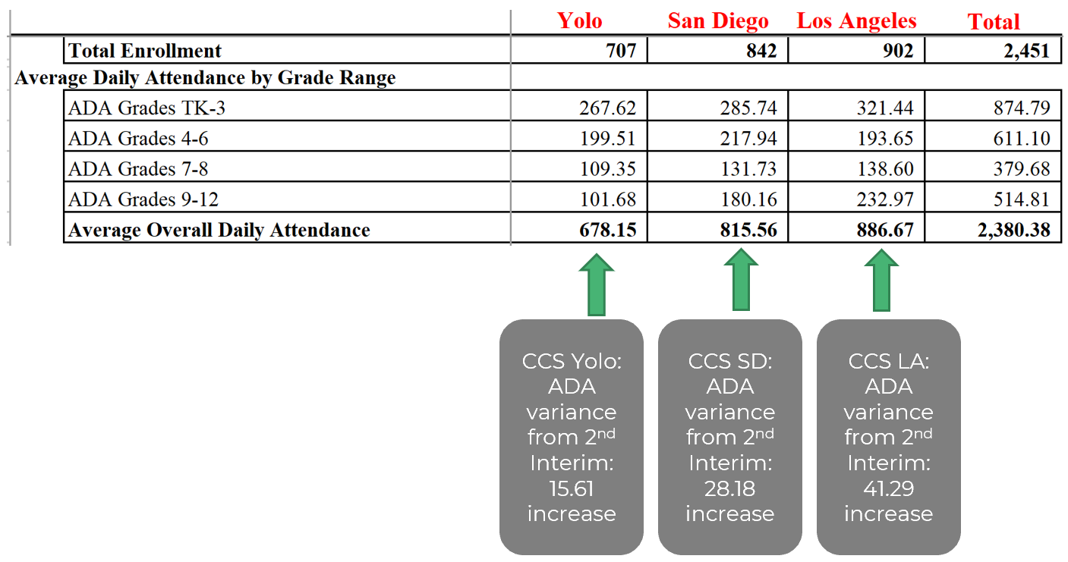
Initial Budget: Los Angeles
CCS LA: ADA variance from 2nd Interim: 41.29 increase
FY24

Slide 6
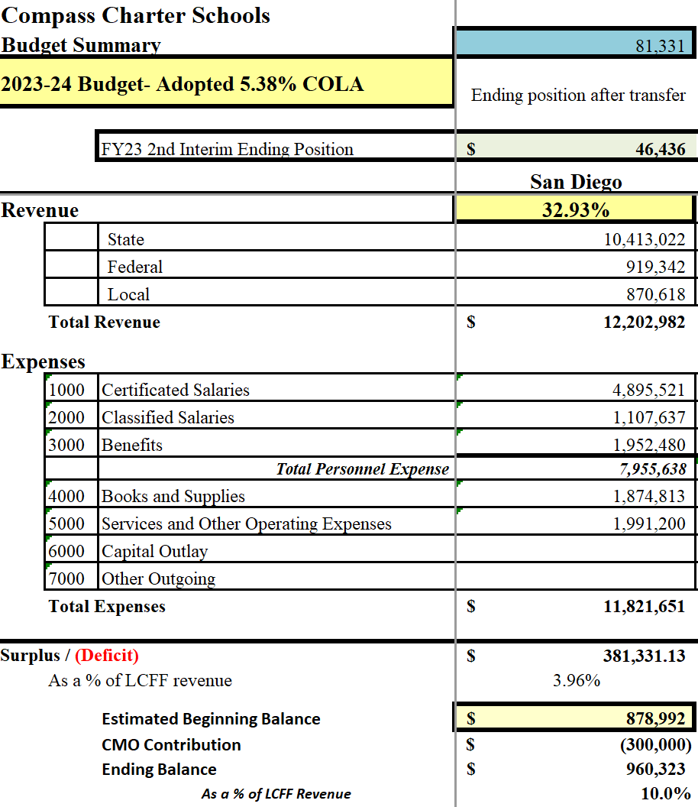
Initial Budget: San Diego
CCS SD: ADA variance from 2nd Interim: 28.28 increase
FY24

Slide 7
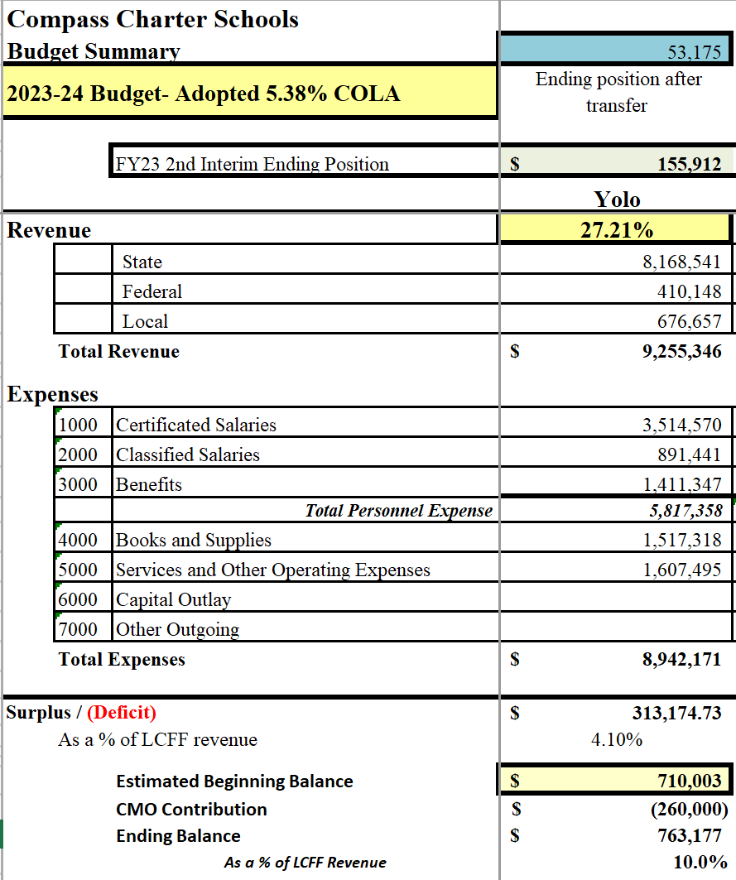
Initial Budget: Yolo
CCS Yolo: ADA variance from 2nd Interim: 15.61 increase
FY24

Slide 8
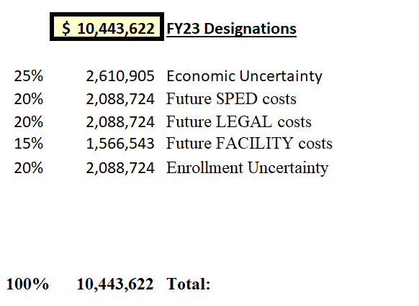
Reserve Designations
FY23
FY24 designations:
To be updated during UARs

