Slide 1
Compass Charter Schools
Operations Division
June 2023

Slide 2
Agenda
Mission and Vision
Values
Community Providers Department
Finance Department
Information Technology Department
Operations Department
Q & A

Slide 3
Our Mission and Vision
MISSION STATEMENT
Our mission is to inspire and develop innovative, creative, self-directed learners, one scholar at a time.
VISION STATEMENT
Our vision is to create a collaborative virtual learning community, inspiring scholars to appreciate the ways in which arts and sciences nurture a curiosity for life-long learning, and prepare scholars to take responsibility for their future success.

Slide 4
Our Values

Slide 5
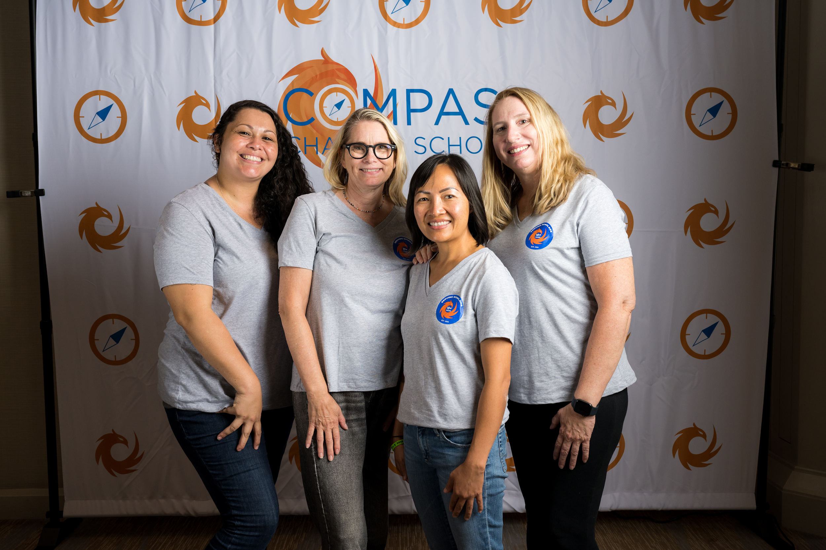
Community Providers Department

Slide 7
Service Provider Highlights
Live Online Math
Live Online Math offers real-time online math sessions and tutoring for pre-algebra through Geometry. Several CCS scholars have started out with difficulties in Math but by the end of the course not enjoyed the course but improved their STAR score! For our English Language Learners a Spanish speaking instructor is available.
Art & Soul Creative & Performing Arts
Art & Soul is a very popular provider of various arts. This past school year 32 of our scholars participated in many forms of art including music and vocal Lessons, dance classes, and cartooning classes.
Bumblebunch Sewing Studio
“We don't just teach kids to sew. We provide them opportunities to flex their creative muscles, give them confidence in their choices, show them the benefits of patience, how to focus on their projects, and take pride in their accomplishments. These are the lessons I hope they will carry with them forever.”
Adventures for Young Explorers
Many of our scholars enjoy Ms Jen’s online classes which include Math (up to Algebra), World History/Geography, Grammar/Composition, and Virtual Adventures. In 2021, Ms. Jen was a finalist for the MoMath Rosenthal Prize for Innovation and Inspiration in Math Teaching.

Slide 8
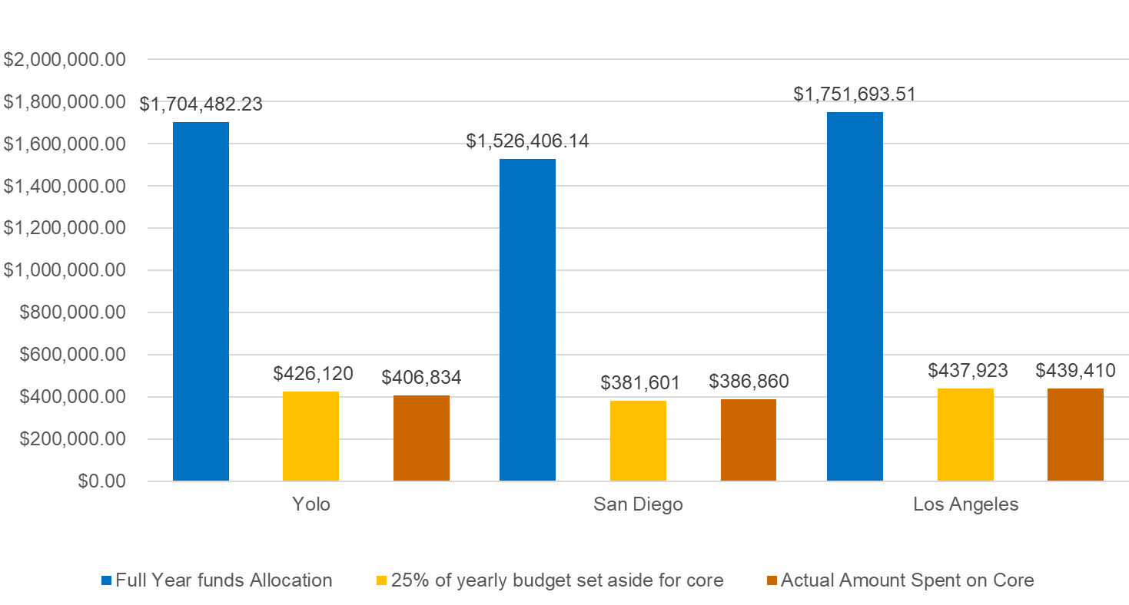

Slide 9
Top 5 Options Providers

Slide 10
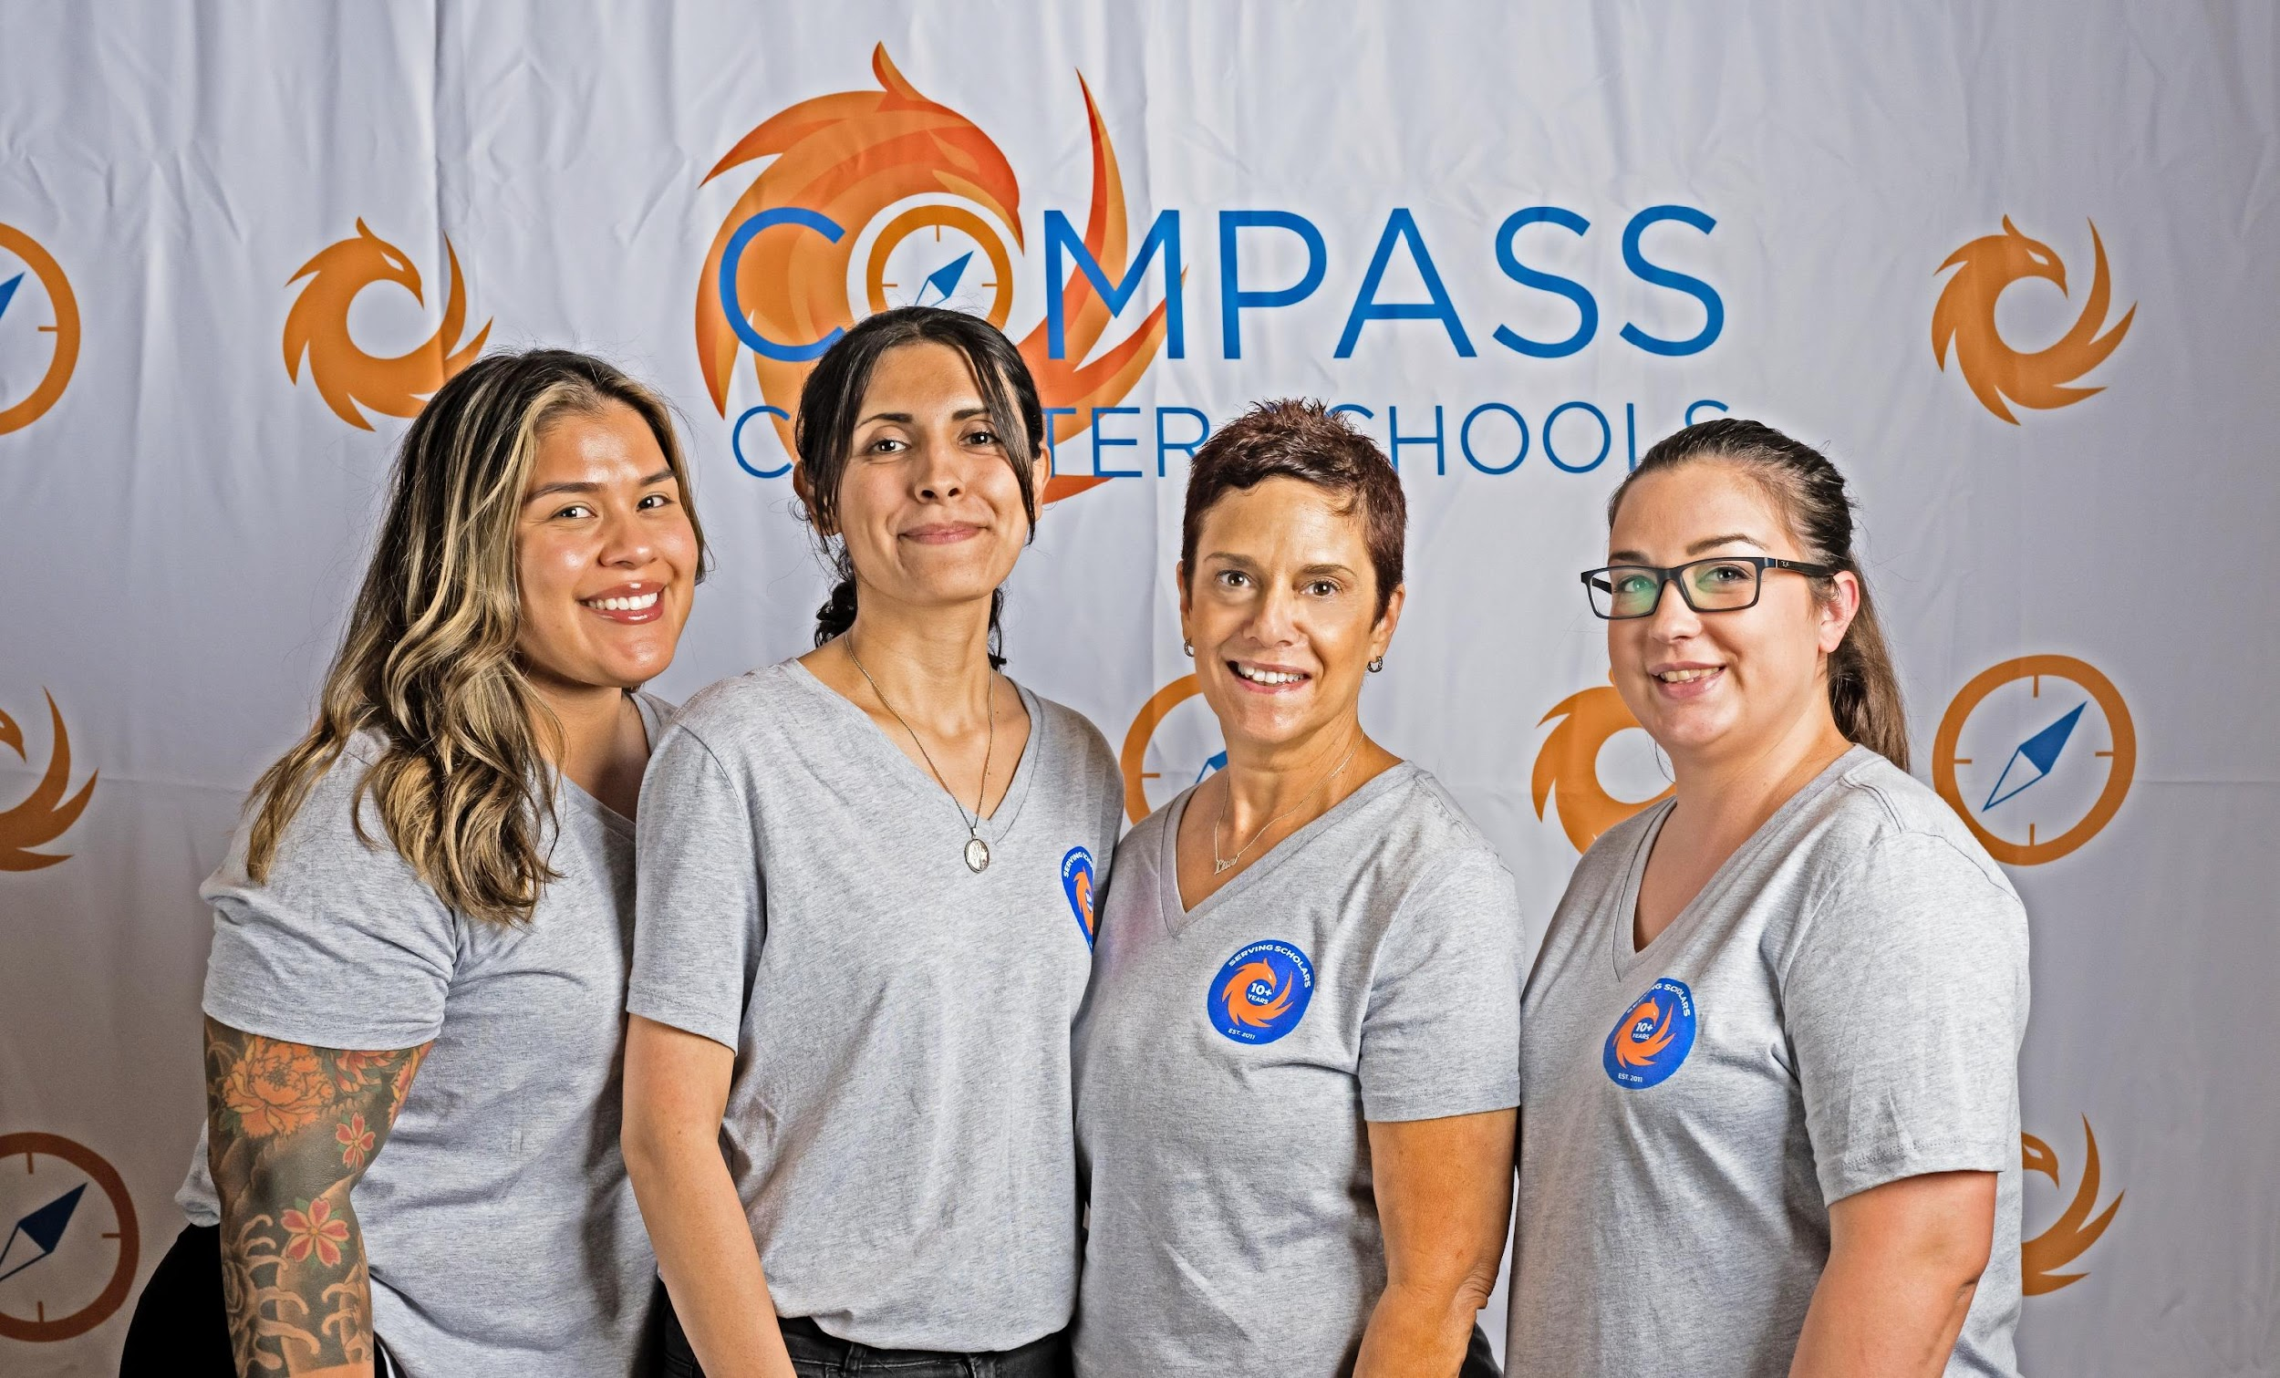
Finance Department

Slide 11
Curriculum Locker
*Total Additional Items Cataloged in the locker from the month of April and May is 197.

Slide 12
LCAP Expenditures by Charter As of 06.15.23

Slide 13
Restricted Funds as of 06.15.23
Apportionments

Slide 14
Restricted Funds as of 06.12.23
Expenditures

Slide 15
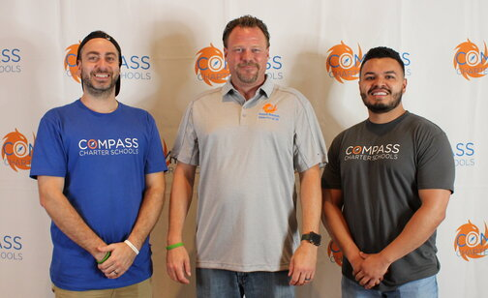
Information Technology Department

Slide 16
New Data Studio Dashboards for 23-24

Slide 17
ClassLink Software Users
Notes:
Month of May 2023
Renaissance - K12 assessment
School Pathways – SIS
BrainPOP - online educational solution
Lexia - learning platform for meaningful engagement
StarFall- personalized education

Slide 18
ZoHo Helpdesk

Slide 19
Information Technology ZoHo Helpdesk Top Issues

Slide 20
Information Technology TPX Cyber Security Training September All Staff (211)
% of Staff Phished using 24 templates
% of Staff completed cyber security training

Slide 21
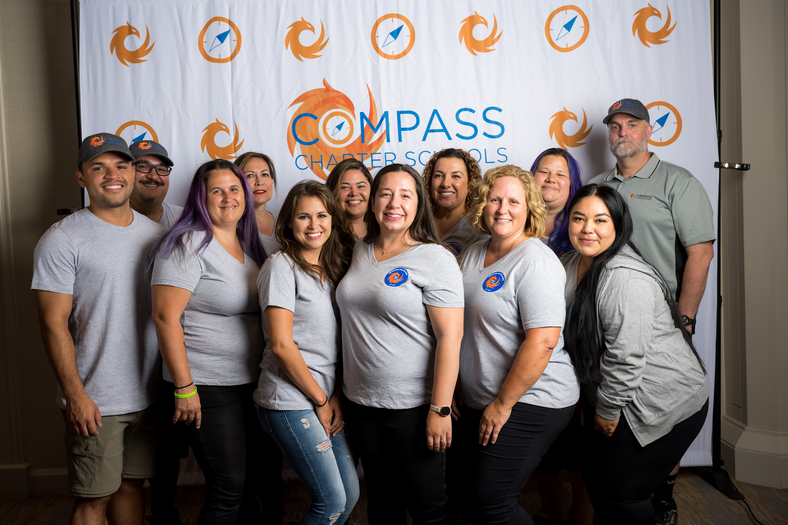
Operations Department

Slide 22
Approved MA vs Enrollment Cap

Slide 23
ADA Percentage by School Year

Slide 24
Projected Enrollment for 23-24 School Year

Slide 25
McKinney-Vento Scholars
Total McKinney-Vento Scholars = 217

Slide 26
McKinney-Vento Residency Status

Slide 27
Total Withdrawals 22-23 School Year

Slide 28
2022-2023 Top Withdrawal Reason

Slide 29
Operations Helpdesk Purpose
Why?
Over the years, the Operations Department received numerous requests for internal support for different areas across the organization. Many times, staff struggled to remember who was responsible for which process. We wanted to streamline how we received these support requests that will in turn allow us to analyze the data and identify trends. The Operations Helpdesk was created by our Compliance Coordinator, Vanessa Plascencia, using Jot Form. It was released to the entire Compass staff on August 3, 2022. Vanessa also trained each member of the Operations Department and provided a training guide to help navigate the helpdesk.
Who?
The Operations Helpdesk was monitored by all coordinators under the Operations Department including the Director of Operations. As staff selected a type of problem/ issue, the helpdesk would automatically route the inquiry to the appropriate Operations Department staff member. The staff under the Operations Department includes the Compliance Coordinator, Attendance Coordinator, Registrar, Outreach Coordinator, Scholar Community Advocate (aka CARES).

Slide 30
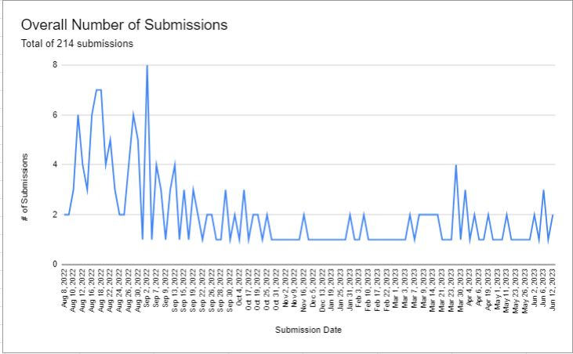
Notes:
This graph shows the number of tickets submitted each day between August 2022 and June 2023. This helps identify peak times of support. It is clear that the beginning of the school year is a peak support time.

Slide 31
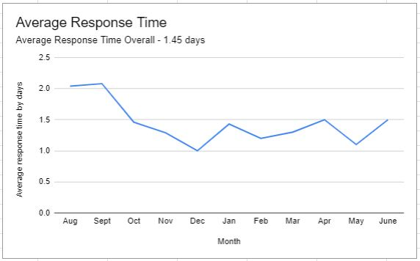
Notes:
Our average response time varied per ticket. In most cases, we were able to complete a ticket within 1 business day. Other tickets may have required more support from our SIS vendor representative or technical assistance. When calculating this data, we based it on when the ticket has been completed and omitted weekends/ holidays.

Slide 32
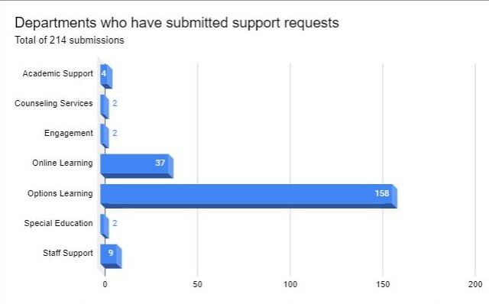
Top Submitter (by department): Options Learning
Notes:
This graph shows the number of departments that completed a support request or ticket in the Operations Helpdesk. The top users were Options and Online Learning.

Slide 33
Questions?
Contact:
Lisa Fishman | Chief Operations Officer
(818) 732-4692
lfishman@compasscharters.org

