Slide 1


Financials through May 31, 2023
Monthly Financial Board Report
Prepared for: Compass Charter Schools
Prepared by School's CSMC SBM - Kristin Nowak

Slide 2

Financial Summary
Actual to Budget:
This report is as of May 31, 2023, compared against our board-approved budget.
YTD Revenues Through May 31, 2023, are $26,435,665 or 2% ($521,386) over our current budget due to the timing of ESSER funds ($298,939), State SPED and Lottery ($448,037), these were partially offset by lower than anticipated LCFF funds ($294,599) .
YTD Expenses Through May 31, 2023, are $29,281,585 or 2.1% ($628,317) under our current budget due to lower than anticipated spending in Personnel Expenses ($438,282), as well as Books and Supplies ($374,354), these were partially offset by an increase in Services ($184,319).
Therefore, net income is ($2,845,920) or -28.8% over our current budget.
Balance Sheet:
As of May 31, 2023, we had total cash of $11,513,515, short-term liabilities of $6,121,101, and long-term liabilities of $90,122. The ending fund balance is $6,703,705. Reconciled cash decreased $761,029 in the month of May due to decreases in Accounts Payable ($1,021,403) and Accrued Liabilities ($85,181). These were partially offset by Revenue exceeding expenses ($79,139).
Report created on 6/13/2023 9:04:12 PM for Compass Charter Schools

Slide 3



Understanding the Financial Health of the Organization
The chart below explains some of the parameters that the school’s leadership can evaluate to understand their financial health, and potential areas of weakness.
Cash Ratio
Ability to meet short-term obligations with cash
 | Current: | Target:
 | 188.1 % | > 100.0 %
Formula: (Cash) / (Current Liabilities)
Defensive Interval
Months of continued operation without incoming funds
 | Current: | Target:
 | 4.7 | > 3 months
Formula: (Cash + Securities + AR)/(Average Expenses for Past 12 Months)
Current Ratio (Liquidity)
Ability to pay short-term obligations
 | Current: | Target:
 | 2.1 | > 1.0
Formula: (Current Assets) / (Current Liabilities)
Report created on 6/13/2023 9:04:10 PM for Compass Charter Schools

Slide 4

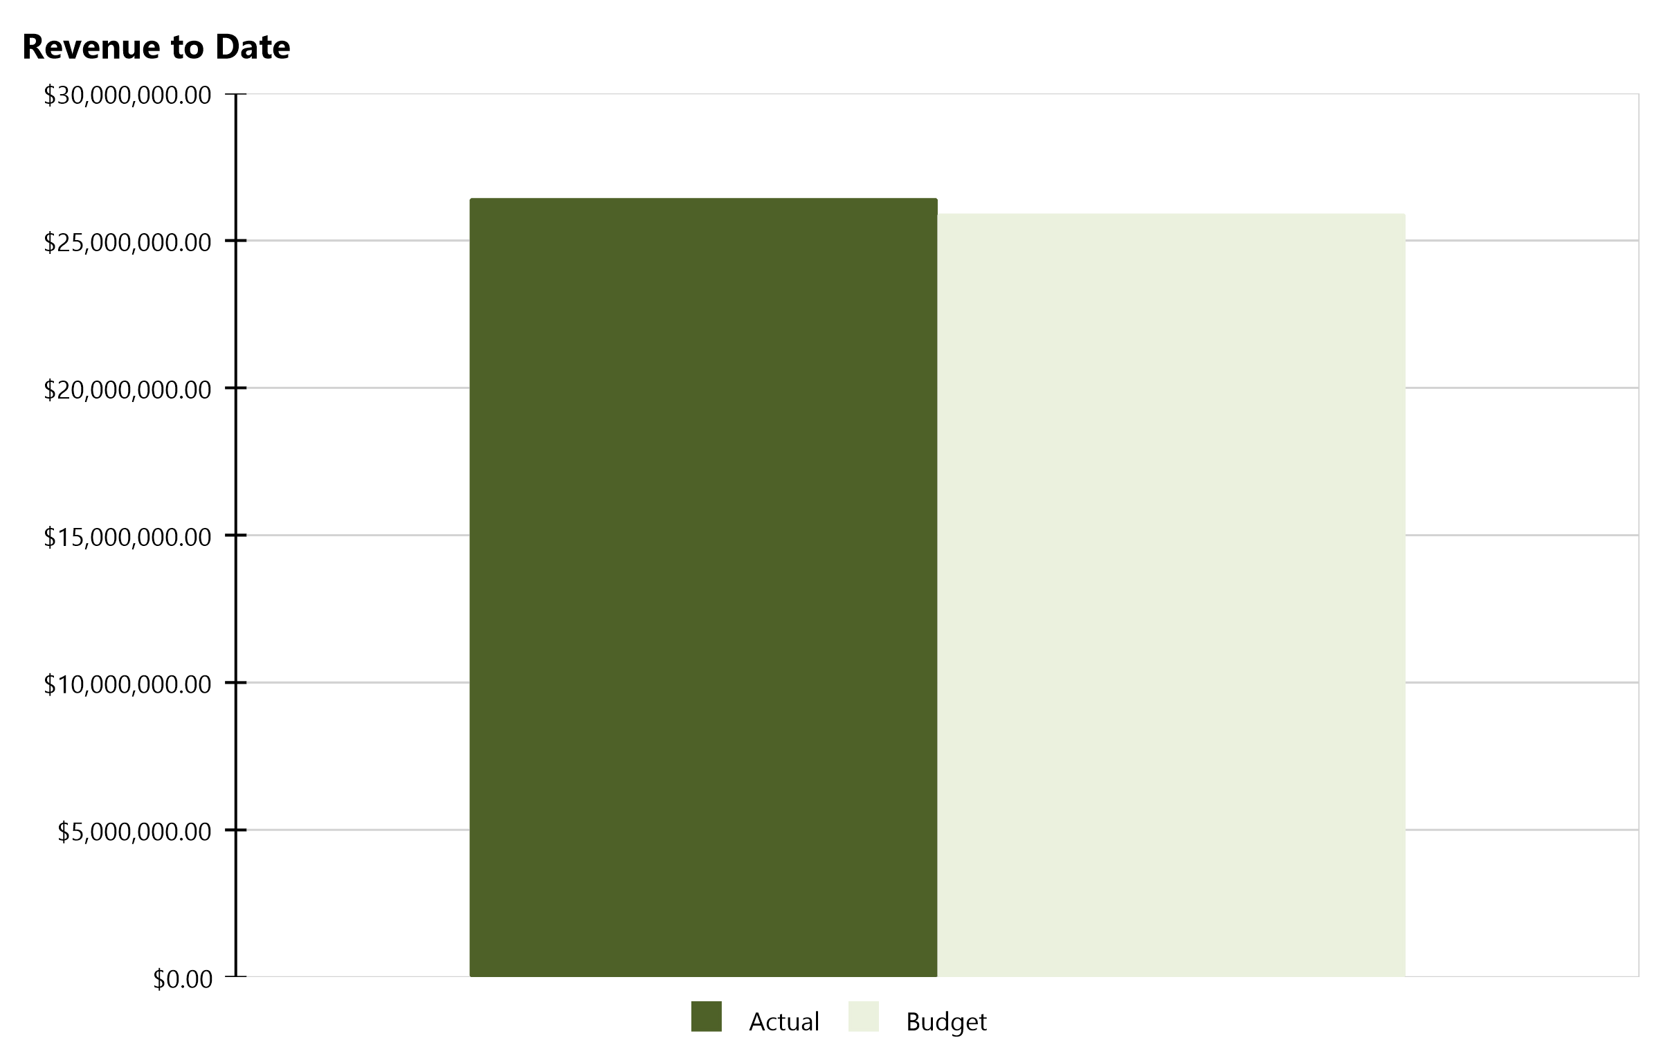
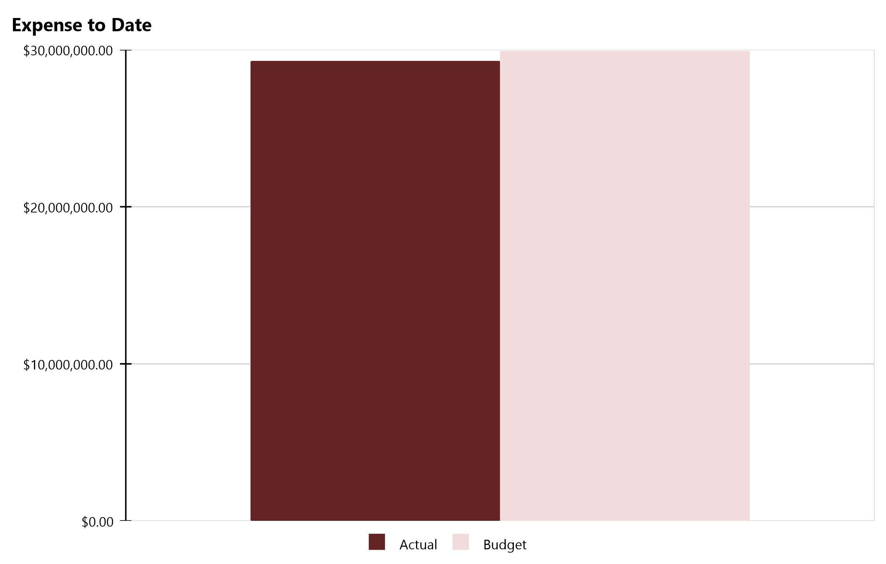
Compass Charter Schools Financial Snapshot
FY 2022-2023, July - May
Cash Balance
$11,513,515
Revenue Summary
Actual | $26,435,665
Budget | $25,914,279
Actual to Budget | 2.0 %
Expense Summary
Actual | $29,281,585
Budget | $29,909,902
Actual to Budget | -2.1 %
Report created on 6/13/2023 9:04:12 PM for Compass Charter Schools

Slide 5
Actual to Budget Summary
FY 2022-2023, July - May
Revenue
$26,435,665
Expenses
$29,281,585
Surplus / (Deficit)
($2,845,920)
 | July - Last Closed |  |  | 2022-2023
Account Description | Actual | Budget | Variance $ | Total Budget | Actual to Total Budget % | Remaining Budget
LCFF Revenue | $21,977,472 | $22,272,071 | ($294,599) | $25,474,652 | 86.3 % | $3,497,180
Federal Revenue | $1,311,742 | $1,052,315 | $259,427 | $1,966,618 | 66.7 % | $654,876
State Revenue | $3,005,517 | $2,479,848 | $525,669 | $4,287,664 | 70.1 % | $1,282,147
Local Revenue | $140,934 | $110,045 | $30,890 | $113,070 | 124.6 % | ($27,864)
Total Revenue | $26,435,665 | $25,914,279 | $521,386 | $31,842,005 | 83.0 % | $5,406,340
Certificated Salaries | $11,570,854 | $12,241,937 | $671,083 | $12,787,392 | 90.5 % | $1,216,538
Classified Salaries | $3,072,587 | $3,037,904 | ($34,683) | $3,303,250 | 93.0 % | $230,663
Benefits | $4,945,177 | $4,747,059 | ($198,118) | $5,165,923 | 95.7 % | $220,746
Total Personnel Expenses | $19,588,618 | $20,026,900 | $438,282 | $21,256,565 | 92.2 % | $1,667,947
Books and Supplies | $4,117,358 | $4,491,712 | $374,354 | $4,500,874 | 91.5 % | $383,516
Services | $5,575,609 | $5,391,290 | ($184,319) | $5,905,960 | 94.4 % | $330,351
Total Operational Expenses | $9,692,967 | $9,883,002 | $190,035 | $10,406,834 | 93.1 % | $713,867
Total Expenses | $29,281,585 | $29,909,902 | $628,317 | $31,663,399 | 92.5 % | $2,381,813
Net Income | ($2,845,920) | ($3,995,624) | $1,149,704 | $178,606 | -1,593.4 % | $3,024,526
This report displays all actual and budgeted revenue and expenditures by object code series and by month. This report can be useful in ensuring you receive your revenue in a timely manner and that you stay within the board approved expenditure levels.
Report created on 6/13/2023 9:04:12 PM for Compass Charter Schools

Slide 6
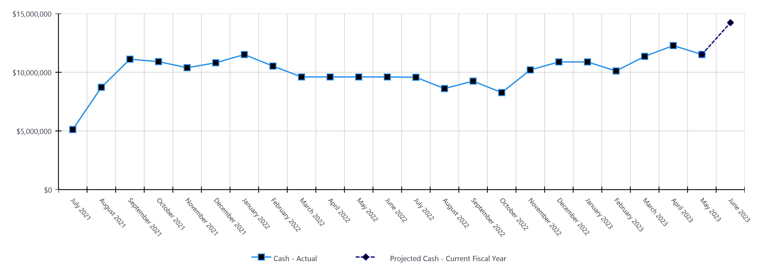
Monthly Cash Balance Over Time
Current fiscal year and prior year
 | Cash Amount | Actual or Projected
July 2021 | $5,121,620.34 | Actual
August 2021 | $8,718,061.60 | Actual
September 2021 | $11,113,904.09 | Actual
October 2021 | $10,905,645.35 | Actual
November 2021 | $10,390,528.49 | Actual
December 2021 | $10,808,568.05 | Actual
January 2022 | $11,507,548.45 | Actual
February 2022 | $10,527,180.02 | Actual
March 2022 | $9,600,208.18 | Actual
April 2022 | $9,600,208.18 | Actual
May 2022 | $9,600,208.18 | Actual
June 2022 | $9,600,208.18 | Actual
 | Cash Amount | Actual or Projected
July 2022 | $9,574,236.91 | Actual
August 2022 | $8,611,838.91 | Actual
September 2022 | $9,246,236.00 | Actual
October 2022 | $8,268,561.64 | Actual
November 2022 | $10,201,001.92 | Actual
December 2022 | $10,880,194.48 | Actual
January 2023 | $10,880,095.75 | Actual
February 2023 | $10,109,841.05 | Actual
March 2023 | $11,352,089.26 | Actual
April 2023 | $12,274,544.19 | Actual
May 2023 | $11,513,514.86 | Actual
June 2023 | $14,228,228.75 | Projected
Report created on 6/13/2023 9:04:12 PM for Compass Charter Schools

Slide 7
Balance Sheet Summary FY 2022-2023 - May
The balance sheet displays all of the school’s assets and the school’s obligations (‘liabilities’) at a particular point in time. It is a useful way to ensure the school has enough money to pay off its debts.
Liquidity Ratio
2.1
Assets
Current Assets
Accounts Receivable | $139,473
Cash and Cash Equivalents | $11,513,515
Employee Advances | $455
Prepaid Expenses | $388,464
Short Term Investments | $768,842
Total Current Assets | $12,810,749
Fixed Assets
Fixed Assets | $93,960
Total Fixed Assets | $93,960
Other Assets
Other Assets | $10,220
Total Other Assets | $10,220
Total Assets | $12,914,928
Liabilities and Net Assets
Current Liabilities
Accounts Payable | $397,080
Accrued Liabilities | $1,129,404
Other Short Term Liability | $4,594,618
Total Current Liabilities | $6,121,101
Long Term Liabilities
Other Liabilities | $90,122
Total Long Term Liabilities | $90,122
Total Liabilities | $6,211,224
Net Increase/(Decrease in Net Assets)
Net Increase/(Decrease) in Net Assets | ($2,845,920)
Total Net Increase/(Decrease) in Net Assets | ($2,845,920)
Ending Net Assets
Ending Net Assets | $9,549,625
Total Net Assets | $9,549,625
Total Liabilities and Net Assets | $12,914,928
Report created on 6/13/2023 9:04:12 PM for Compass Charter Schools

Slide 8

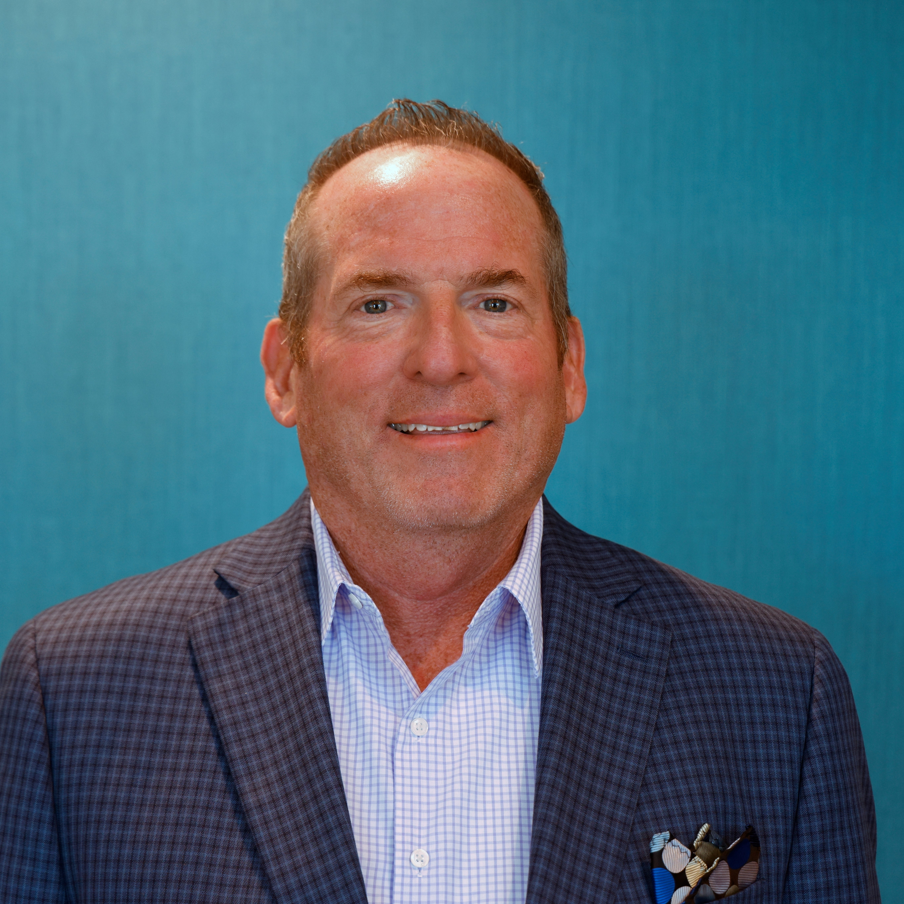


CSMC Charter School Support Team
 | Executive VP of Client Services Tom Nichols tnichols@csmci.com
 | School Business Manager Kristin Nowak knowak@csmci.com
 | Account Manager Mai Luong mluong@csmci.com
 | Associate AM Kimber Nelson knelson@csmci.com
Report created on 6/13/2023 9:04:12 PM for Compass Charter Schools

Slide 9
Looking Ahead
6/24/2023 | Board Meeting
6/30/2023 | Winter Consolidated Application / CARS report forms close
7/9/2023 | Date to be determined: CSMC Workshop: Charter Renewal
7/11/2023 | Date to be determined: CSMC Workshop: Charter Renewal
7/17/2023 | SB740 Facility Other Costs due
7/22/2023 | Finalize 2022-2023 Student Exit Codes and Completion Statuses in SIS
 | 2022–23 P-Annual Attendance Data
7/28/2023 | CALPADS EOY Submission Closes
7/29/2023 | CALPADS EOY Amendment Window Opens
8/25/2023 | CALPADS EOY Amendment Window Closes
Report created on 6/13/2023 9:04:13 PM for Compass Charter Schools

Slide 10

HELPING THE EDUCATION MOVEMENT SUCCEED ONE SCHOOL AT A TIME
info@csmci.com
Office: 888.994.CSMC
43460 Ridge Park Dr., Ste. 100
Temecula, Ca 92590
POWERED BY:
Report created on 6/13/2023 9:04:12 PM for Compass Charter Schools
www.csmci.com
Charter Vision

