Slide 1


Financials through Apr 30, 2023
Monthly Financial Board Report
Prepared for: Compass Charter Schools
Prepared by School's CSMC SBM - Kristin Nowak

Slide 2

Financial Summary
Actual to Budget:
This report is as of Apr 30, 2023, compared against our board-approved budget.
YTD Revenues Through Apr 30, 2023, are $23,537,349 or .6% over our current budget due to the timing of Federal Revenue such as ELO and ESSER ($248k), as well as State Lottery ($122k), State Sped ($253k). These were offset by less than anticipated LCFF Revenues ($444k)
YTD Expenses Through Apr 30, 2023, are $26,462,408 or 2.3% under our current budget due to lower than anticipated spending in Benefits ($295k), Curriculum ($189k), Software ($93k), and Supplies ($59k). These were offset by a slightly higher spending in Services ($49k)
Therefore, net income is ($2,925,059) or -20.5% over our current budget.
Balance Sheet:
As of Apr 30, 2023, we had total cash of $12,274,544, short-term liabilities of $6,932,564, and long-term liabilities of $94,867. The ending fund balance is $6,624,565. Reconciled cash increased $922,454 in the month of April due to increases in Accounts Receivable ($305,902), Accounts Payable ($1,166,624) and Short-Term Liabilities ($1,099,606), partially offset by decreases in Accrued Liabilities ($1,088,081) and Net Assets ($537,167)
Report created on 5/15/2023 10:51:41 AM for Compass Charter Schools

Slide 3



Understanding the Financial Health of the Organization
The chart below explains some of the parameters that the school’s leadership can evaluate to understand their financial health, and potential areas of weakness.
Cash Ratio
Ability to meet short-term obligations with cash
 | Current: | Target:
 | 177.1 % | > 100.0 %
Formula: (Cash) / (Current Liabilities)
Defensive Interval
Months of continued operation without incoming funds
 | Current: | Target:
 | 5.0 | > 3 months
Formula: (Cash + Securities + AR)/(Average Expenses for Past 12 Months)
Current Ratio (Liquidity)
Ability to pay short-term obligations
 | Current: | Target:
 | 2.0 | > 1.0
Formula: (Current Assets) / (Current Liabilities)
Report created on 5/15/2023 10:51:40 AM for Compass Charter Schools

Slide 4

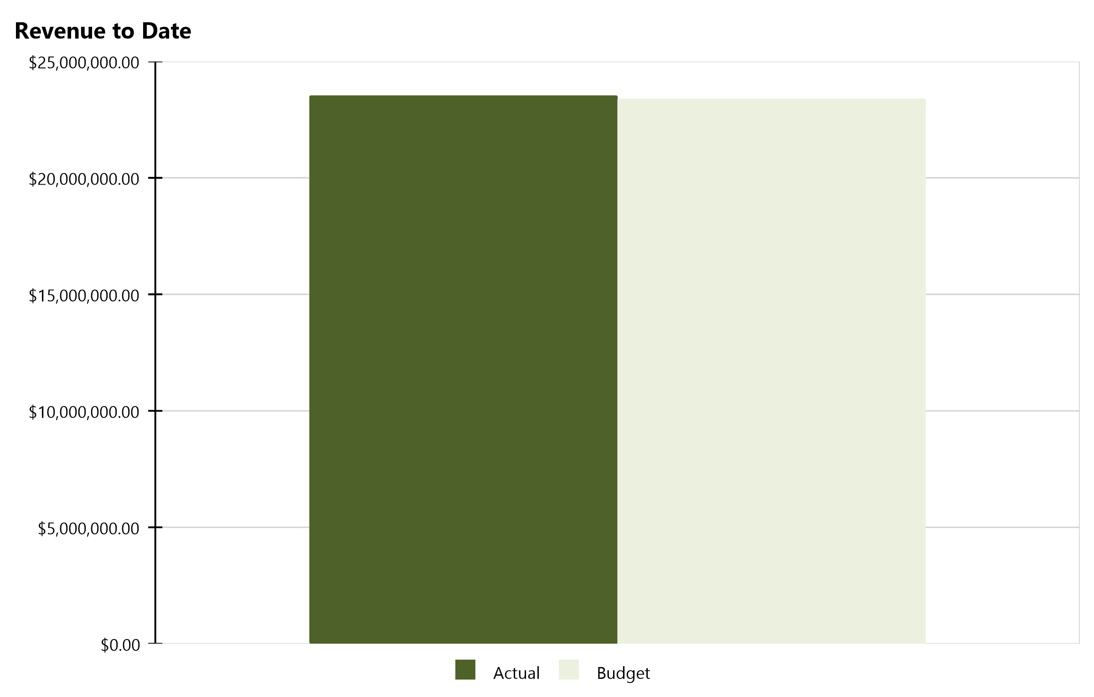
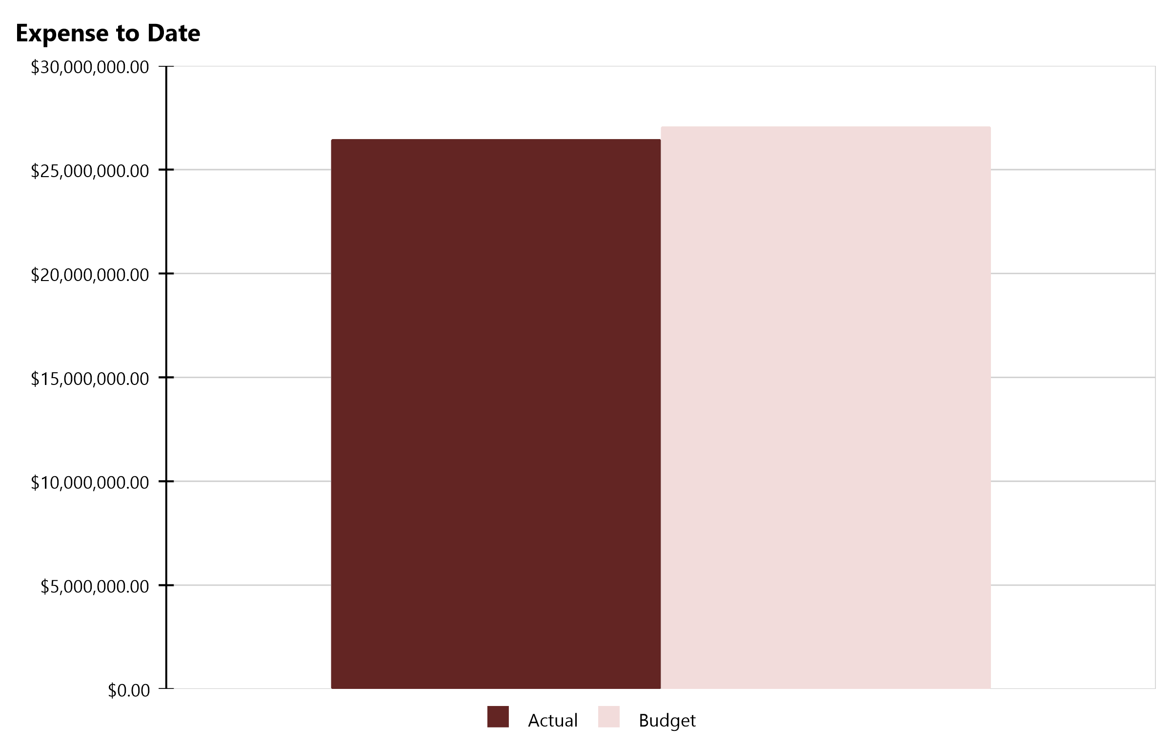
Compass Charter Schools Financial Snapshot
FY 2022-2023, July - April
Cash Balance
$12,274,544
Revenue Summary
Actual | $23,537,349
Budget | $23,395,524
Actual to Budget | 0.6 %
Expense Summary
Actual | $26,462,408
Budget | $27,072,798
Actual to Budget | -2.3 %
Report created on 5/15/2023 10:51:41 AM for Compass Charter Schools

Slide 5
Actual to Budget Summary
FY 2022-2023, July - April
Revenue
$23,537,349
Expenses
$26,462,408
Surplus / (Deficit)
($2,925,059)
 | July - Last Closed |  |  | 2022-2023
Account Description | Actual | Budget | Variance $ | Total Budget | Actual to Total Budget % | Remaining Budget
LCFF Revenue | $19,584,127 | $20,028,459 | ($444,332) | $25,474,652 | 76.9 % | $5,890,525
Federal Revenue | $1,135,499 | $1,013,576 | $121,923 | $1,966,618 | 57.7 % | $831,119
State Revenue | $2,681,268 | $2,246,470 | $434,798 | $4,287,664 | 62.5 % | $1,606,397
Local Revenue | $136,455 | $107,019 | $29,436 | $113,070 | 120.7 % | ($23,385)
Total Revenue | $23,537,349 | $23,395,524 | $141,825 | $31,842,005 | 73.9 % | $8,304,656
Certificated Salaries | $10,427,722 | $10,937,991 | $510,269 | $12,787,392 | 81.5 % | $2,359,669
Classified Salaries | $2,797,864 | $2,772,559 | ($25,306) | $3,303,250 | 84.7 % | $505,385
Benefits | $4,518,344 | $4,328,195 | ($190,150) | $5,165,923 | 87.5 % | $647,579
Total Personnel Expenses | $17,743,931 | $18,038,745 | $294,814 | $21,256,565 | 83.5 % | $3,512,634
Books and Supplies | $3,799,985 | $4,164,305 | $364,320 | $4,500,874 | 84.4 % | $700,889
Services | $4,918,492 | $4,869,748 | ($48,744) | $5,905,960 | 83.3 % | $987,468
Total Operational Expenses | $8,718,477 | $9,034,053 | $315,576 | $10,406,834 | 83.8 % | $1,688,357
Total Expenses | $26,462,408 | $27,072,798 | $610,390 | $31,663,399 | 83.6 % | $5,200,990
Net Income | ($2,925,059) | ($3,677,274) | $752,215 | $178,606 | -1,637.7 % | $3,103,665
This report displays all actual and budgeted revenue and expenditures by object code series and by month. This report can be useful in ensuring you receive your revenue in a timely manner and that you stay within the board approved expenditure levels.
Report created on 5/15/2023 10:51:42 AM for Compass Charter Schools

Slide 6
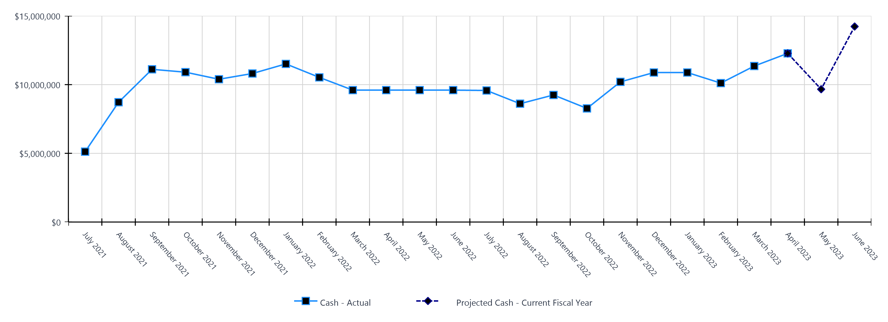
Monthly Cash Balance Over Time
Current fiscal year and prior year
 | Cash Amount | Actual or Projected
July 2021 | $5,121,620.34 | Actual
August 2021 | $8,718,061.60 | Actual
September 2021 | $11,113,904.09 | Actual
October 2021 | $10,905,645.35 | Actual
November 2021 | $10,390,528.49 | Actual
December 2021 | $10,808,568.05 | Actual
January 2022 | $11,507,548.45 | Actual
February 2022 | $10,527,180.02 | Actual
March 2022 | $9,600,208.18 | Actual
April 2022 | $9,600,208.18 | Actual
May 2022 | $9,600,208.18 | Actual
June 2022 | $9,600,208.18 | Actual
 | Cash Amount | Actual or Projected
July 2022 | $9,574,236.91 | Actual
August 2022 | $8,611,838.91 | Actual
September 2022 | $9,246,236.00 | Actual
October 2022 | $8,268,561.64 | Actual
November 2022 | $10,201,001.92 | Actual
December 2022 | $10,880,194.48 | Actual
January 2023 | $10,880,095.75 | Actual
February 2023 | $10,109,841.05 | Actual
March 2023 | $11,352,089.26 | Actual
April 2023 | $12,274,544.19 | Actual
May 2023 | $9,664,276.32 | Projected
June 2023 | $14,228,228.75 | Projected
Report created on 5/15/2023 10:51:42 AM for Compass Charter Schools

Slide 7
Balance Sheet Summary FY 2022-2023 - April
The balance sheet displays all of the school’s assets and the school’s obligations (‘liabilities’) at a particular point in time. It is a useful way to ensure the school has enough money to pay off its debts.
Liquidity Ratio
2.0
Assets
Current Assets
Accounts Receivable | $139,571
Cash and Cash Equivalents | $12,274,544
Employee Advances | ($73)
Prepaid Expenses | $360,157
Short Term Investments | $768,842
Total Current Assets | $13,543,040
Fixed Assets
Fixed Assets | $98,736
Total Fixed Assets | $98,736
Other Assets
Other Assets | $10,220
Total Other Assets | $10,220
Total Assets | $13,651,996
Liabilities and Net Assets
Current Liabilities
Accounts Payable | $1,418,484
Accrued Liabilities | $1,214,585
Other Short Term Liability | $4,299,495
Total Current Liabilities | $6,932,564
Long Term Liabilities
Other Liabilities | $94,867
Total Long Term Liabilities | $94,867
Total Liabilities | $7,027,430
Net Increase/(Decrease in Net Assets)
Net Increase/(Decrease) in Net Assets | ($2,925,059)
Total Net Increase/(Decrease) in Net Assets | ($2,925,059)
Ending Net Assets
Ending Net Assets | $9,549,625
Total Net Assets | $9,549,625
Total Liabilities and Net Assets | $13,651,996
Report created on 5/15/2023 10:51:42 AM for Compass Charter Schools

Slide 8

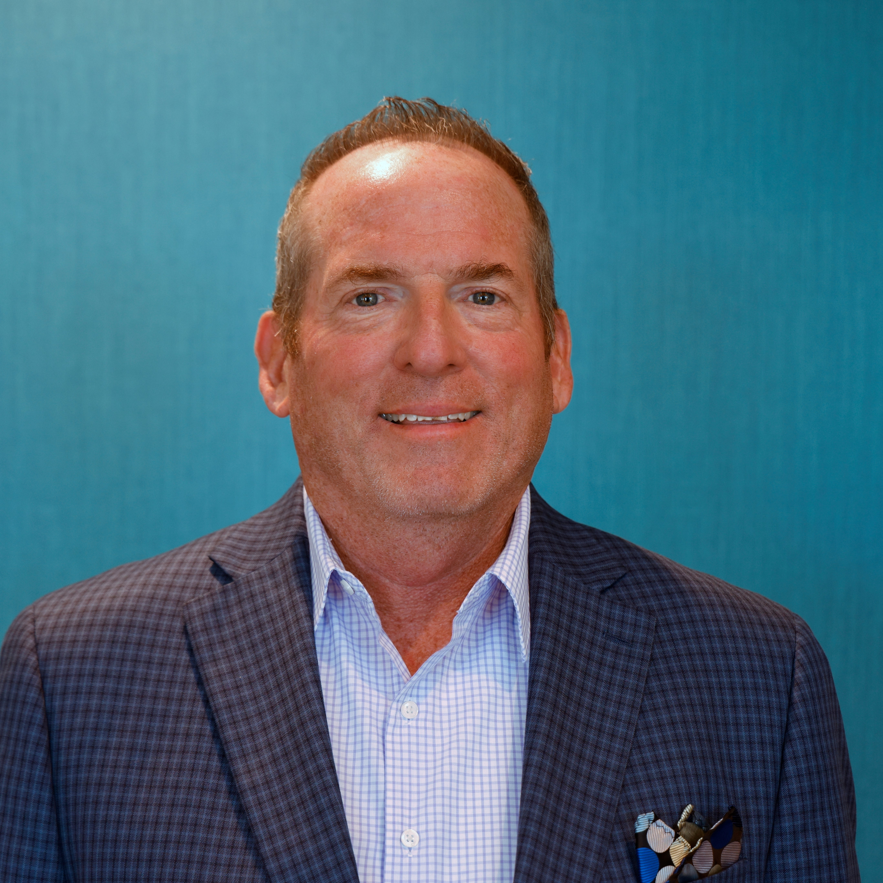


CSMC Charter School Support Team
 | Executive VP of Client Services Tom Nichols tnichols@csmci.com
 | School Business Manager Kristin Nowak knowak@csmci.com
 | Account Manager Mai Luong mluong@csmci.com
 | Associate AM Kimber Nelson knelson@csmci.com
Report created on 5/15/2023 10:51:42 AM for Compass Charter Schools

Slide 9
Looking Ahead
5/20/2023 | Annual report for federal pandemic relief funds
 | Charter school information survey due to CDE
5/20/2023 | Board Meeting
5/31/2023 | CSMC Webinar
 | Winter Consolidated Application / CARS report possibly due
 | Submit 2023-2024 Calendar to Student Data Services
6/1/2023 | June Board Meeting: Approval of LCAP and Budget, due 6/30
6/2/2023 | SB740 application due
6/7/2023 | CSMC Regional Office Hours
6/24/2023 | Board Meeting
7/9/2023 | Date to be determined: CSMC Workshop: Charter Renewal
7/11/2023 | Date to be determined: CSMC Workshop: Charter Renewal
7/22/2023 | Finalize 2022-2023 Student Exit Codes and Completion Statuses in SIS
 | 2022–23 P-Annual Attendance Data
7/28/2023 | CALPADS EOY Submission Closes
7/29/2023 | CALPADS EOY Amendment Window Opens
Report created on 5/15/2023 10:51:43 AM for Compass Charter Schools

Slide 10

HELPING THE EDUCATION MOVEMENT SUCCEED ONE SCHOOL AT A TIME
info@csmci.com
Office: 888.994.CSMC
43460 Ridge Park Dr., Ste. 100
Temecula, Ca 92590
POWERED BY:
Report created on 5/15/2023 10:51:41 AM for Compass Charter Schools
www.csmci.com
Charter Vision

