Slide 1


Financials through Mar 31, 2023
Monthly Financial Board Report
Prepared for: Compass Charter Schools
Prepared by School's CSMC SBM - Kristin Nowak

Slide 2

Financial Summary
Actual to Budget:
This report is as of Mar 31, 2023, compared against our board-approved budget.
YTD Revenues Through Mar 31, 2023, are $21,122,670 or 1.8% over our current budget primarily due to the timing of received Title ($100k), State Lottery ($111k), ESSER III ($200k), and State SPED ($169k). This was offset by lower than anticipated In-Lieu of Property Taxes ($208k).
YTD Expenses Through Mar 31, 2023, are $23,510,561 or 1.9% under our current budget due to lower than anticipated spending in Certificated Salaries ($340k), Software Licensing ($74k) and Travel and Conferences ($34k)
Therefore, net income is ($2,387,891) or -25.5% over our current budget.
Balance Sheet:
As of Mar 31, 2023, we had total cash of $11,352,089, short-term liabilities of $5,754,414, and long-term liabilities of $99,606. The ending fund balance is $7,161,733. Reconciled cash increased $1,242,248 in the month of March due to Revenue exceeding expenses by $1,295,575.
Report created on 5/10/2023 9:25:10 AM for Compass Charter Schools

Slide 3



Understanding the Financial Health of the Organization
The chart below explains some of the parameters that the school’s leadership can evaluate to understand their financial health, and potential areas of weakness.
Cash Ratio
Ability to meet short-term obligations with cash
 | Current: | Target:
 | 197.3 % | > 100.0 %
Formula: (Cash) / (Current Liabilities)
Defensive Interval
Months of continued operation without incoming funds
 | Current: | Target:
 | 5.3 | > 3 months
Formula: (Cash + Securities + AR)/(Average Expenses for Past 12 Months)
Current Ratio (Liquidity)
Ability to pay short-term obligations
 | Current: | Target:
 | 2.2 | > 1.0
Formula: (Current Assets) / (Current Liabilities)
Report created on 5/10/2023 9:25:09 AM for Compass Charter Schools

Slide 4

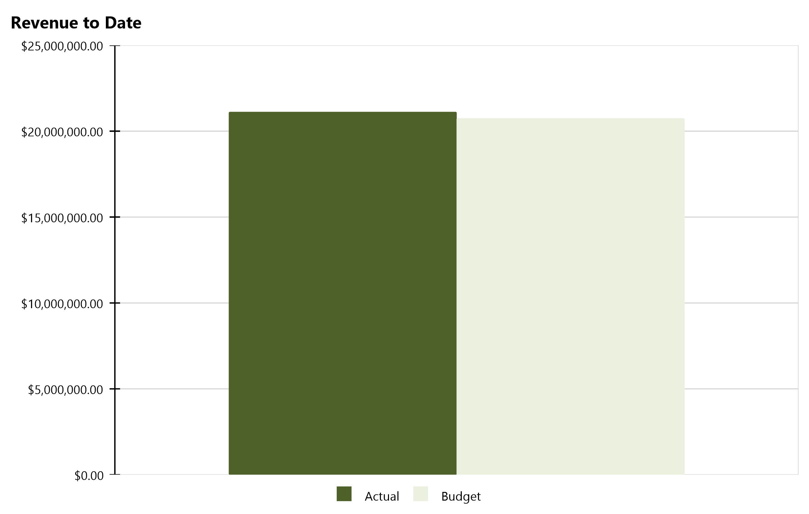
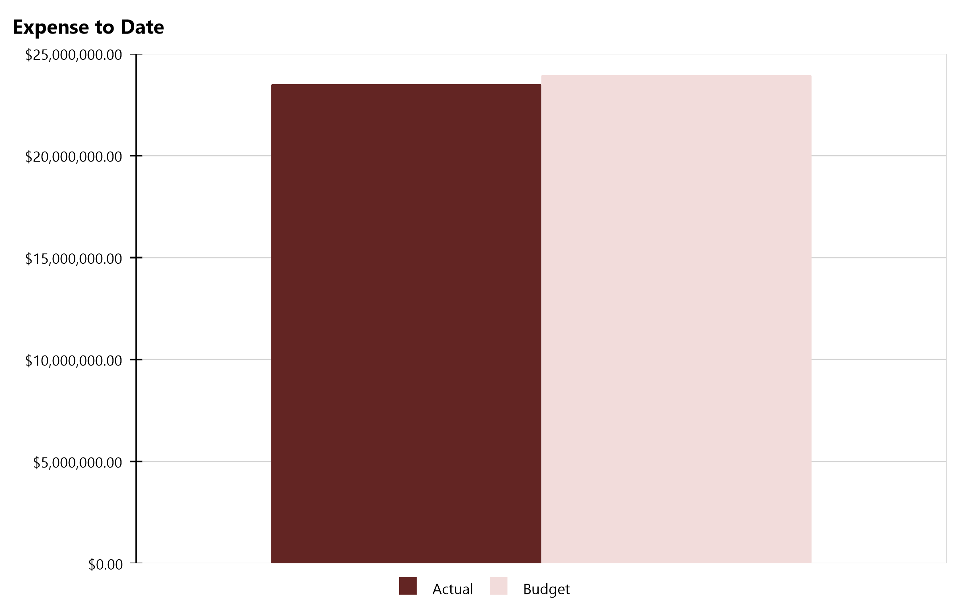
Compass Charter Schools Financial Snapshot
FY 2022-2023, July - March
Cash Balance
$11,352,089
Revenue Summary
Actual | $21,122,670
Budget | $20,751,286
Actual to Budget | 1.8 %
Expense Summary
Actual | $23,510,561
Budget | $23,955,521
Actual to Budget | -1.9 %
Report created on 5/10/2023 9:25:10 AM for Compass Charter Schools

Slide 5
Actual to Budget Summary
FY 2022-2023, July - March
Revenue
$21,122,670
Expenses
$23,510,561
Surplus / (Deficit)
($2,387,891)
 | July - Last Closed |  |  | 2022-2023
Account Description | Actual | Budget | Variance $ | Total Budget | Actual to Total Budget % | Remaining Budget
LCFF Revenue | $17,568,924 | $17,784,847 | ($215,923) | $25,474,652 | 69.0 % | $7,905,728
Federal Revenue | $1,068,742 | $849,353 | $219,388 | $1,966,618 | 54.3 % | $897,876
State Revenue | $2,353,392 | $2,013,092 | $340,301 | $4,287,664 | 54.9 % | $1,934,272
Local Revenue | $131,612 | $103,994 | $27,618 | $113,070 | 116.4 % | ($18,542)
Total Revenue | $21,122,670 | $20,751,286 | $371,384 | $31,842,005 | 66.3 % | $10,719,335
Certificated Salaries | $9,293,489 | $9,634,045 | $340,557 | $12,787,392 | 72.7 % | $3,493,903
Classified Salaries | $2,532,095 | $2,507,213 | ($24,882) | $3,303,250 | 76.7 % | $771,155
Benefits | $3,913,859 | $3,909,331 | ($4,528) | $5,165,923 | 75.8 % | $1,252,065
Total Personnel Expenses | $15,739,442 | $16,050,589 | $311,147 | $21,256,565 | 74.0 % | $5,517,122
Books and Supplies | $3,519,415 | $3,576,378 | $56,964 | $4,500,874 | 78.2 % | $981,459
Services | $4,251,704 | $4,328,554 | $76,850 | $5,905,960 | 72.0 % | $1,654,256
Total Operational Expenses | $7,771,119 | $7,904,932 | $133,813 | $10,406,834 | 74.7 % | $2,635,715
Total Expenses | $23,510,561 | $23,955,521 | $444,960 | $31,663,399 | 74.3 % | $8,152,837
Net Income | ($2,387,891) | ($3,204,235) | $816,344 | $178,606 | -1,337.0 % | $2,566,498
This report displays all actual and budgeted revenue and expenditures by object code series and by month. This report can be useful in ensuring you receive your revenue in a timely manner and that you stay within the board approved expenditure levels.
Report created on 5/10/2023 9:25:11 AM for Compass Charter Schools

Slide 6
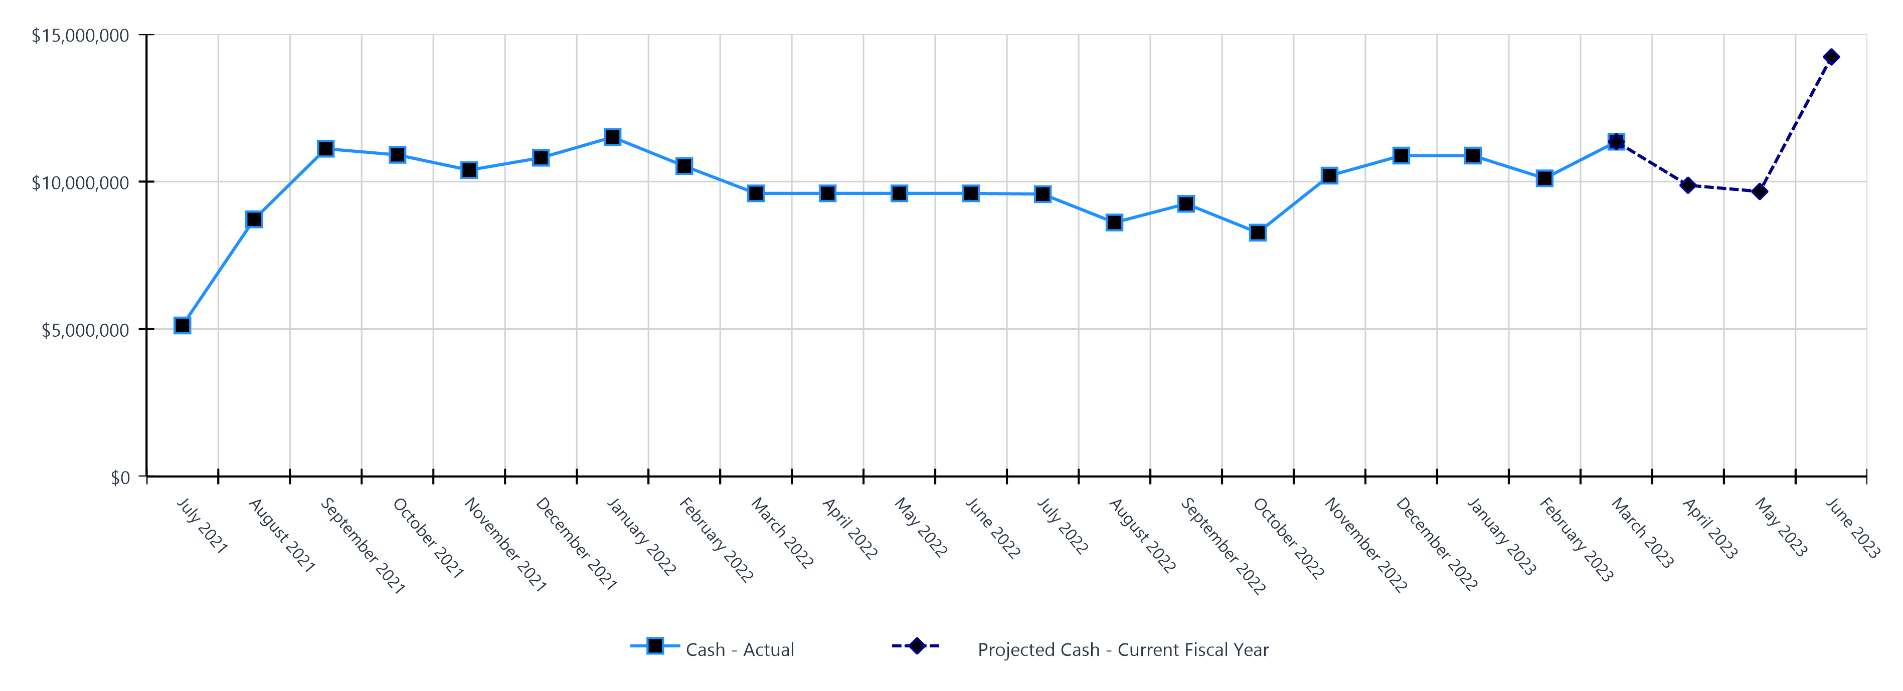
Monthly Cash Balance Over Time
Current fiscal year and prior year
 | Cash Amount | Actual or Projected
July 2021 | $5,121,620.34 | Actual
August 2021 | $8,718,061.60 | Actual
September 2021 | $11,113,904.09 | Actual
October 2021 | $10,905,645.35 | Actual
November 2021 | $10,390,528.49 | Actual
December 2021 | $10,808,568.05 | Actual
January 2022 | $11,507,548.45 | Actual
February 2022 | $10,527,180.02 | Actual
March 2022 | $9,600,208.18 | Actual
April 2022 | $9,600,208.18 | Actual
May 2022 | $9,600,208.18 | Actual
June 2022 | $9,600,208.18 | Actual
 | Cash Amount | Actual or Projected
July 2022 | $9,574,236.91 | Actual
August 2022 | $8,611,838.91 | Actual
September 2022 | $9,246,236.00 | Actual
October 2022 | $8,268,561.64 | Actual
November 2022 | $10,201,001.92 | Actual
December 2022 | $10,880,194.48 | Actual
January 2023 | $10,880,095.75 | Actual
February 2023 | $10,109,841.05 | Actual
March 2023 | $11,352,089.26 | Actual
April 2023 | $9,874,641.55 | Projected
May 2023 | $9,664,276.32 | Projected
June 2023 | $14,228,228.75 | Projected
Report created on 5/10/2023 9:25:11 AM for Compass Charter Schools

Slide 7
Balance Sheet Summary FY 2022-2023 - March
The balance sheet displays all of the school’s assets and the school’s obligations (‘liabilities’) at a particular point in time. It is a useful way to ensure the school has enough money to pay off its debts.
Liquidity Ratio
2.2
Assets
Current Assets
Accounts Receivable | $445,473
Cash and Cash Equivalents | $11,352,089
Employee Advances | $976
Prepaid Expenses | $334,647
Short Term Investments | $768,842
Total Current Assets | $12,902,027
Fixed Assets
Fixed Assets | $103,507
Total Fixed Assets | $103,507
Other Assets
Other Assets | $10,220
Total Other Assets | $10,220
Total Assets | $13,015,754
Liabilities and Net Assets
Current Liabilities
Accounts Payable | $251,859
Accrued Liabilities | $2,302,666
Other Short Term Liability | $3,199,889
Total Current Liabilities | $5,754,414
Long Term Liabilities
Other Liabilities | $99,606
Total Long Term Liabilities | $99,606
Total Liabilities | $5,854,020
Net Increase/(Decrease in Net Assets)
Net Increase/(Decrease) in Net Assets | ($2,387,891)
Total Net Increase/(Decrease) in Net Assets | ($2,387,891)
Ending Net Assets
Ending Net Assets | $9,549,625
Total Net Assets | $9,549,625
Total Liabilities and Net Assets | $13,015,754
Report created on 5/10/2023 9:25:11 AM for Compass Charter Schools

Slide 8

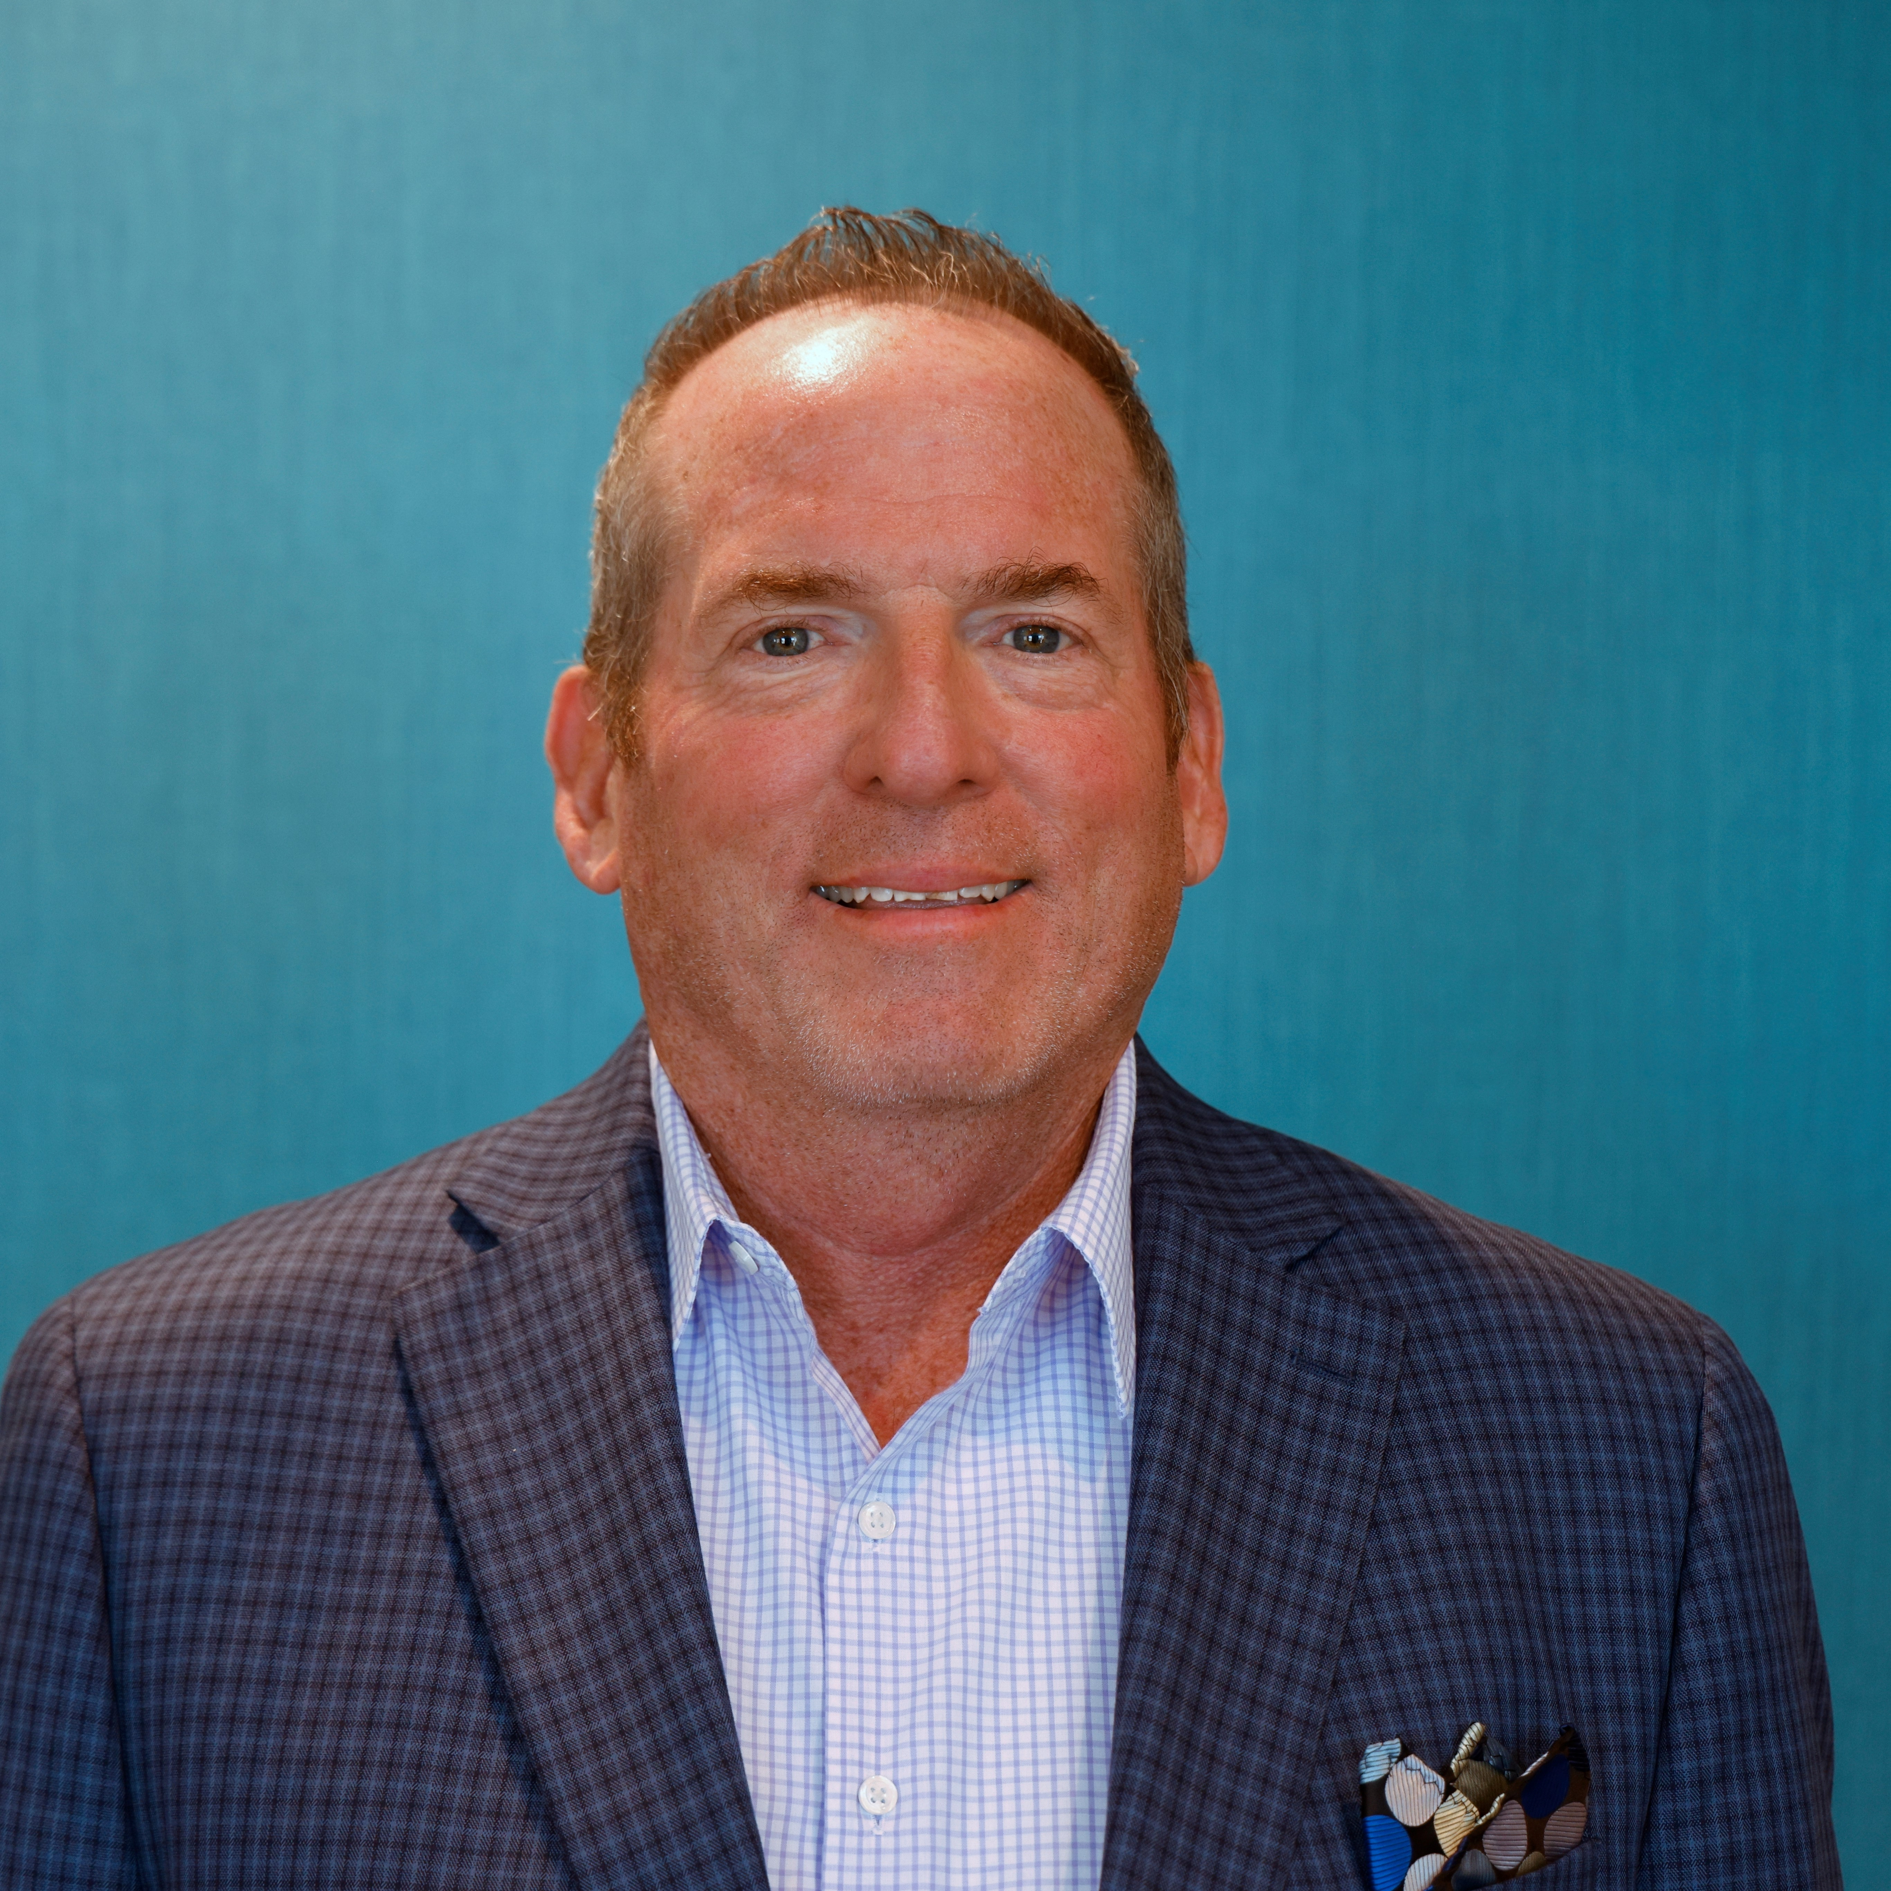


CSMC Charter School Support Team
 | Executive VP of Client Services Tom Nichols tnichols@csmci.com
 | School Business Manager Kristin Nowak knowak@csmci.com
 | Account Manager Mai Luong mluong@csmci.com
 | Associate AM Kimber Nelson knelson@csmci.com
Report created on 5/10/2023 9:25:11 AM for Compass Charter Schools

Slide 9
Looking Ahead
5/15/2023 | Form 990 Return of Exempt Organization
5/20/2023 | Annual report for federal pandemic relief funds
 | Charter school information survey due to CDE
5/20/2023 | Board Meeting
5/31/2023 | CSMC Webinar
 | Winter Consolidated Application / CARS report possibly due
 | Submit 2023-2024 Calendar to Student Data Services
6/1/2023 | June Board Meeting: Approval of LCAP and Budget, due 6/30
6/2/2023 | SB740 application due
6/7/2023 | CSMC Regional Office Hours
6/24/2023 | Board Meeting
7/9/2023 | Date to be determined: CSMC Workshop: Charter Renewal
7/11/2023 | Date to be determined: CSMC Workshop: Charter Renewal
7/22/2023 | Finalize 2022-2023 Student Exit Codes and Completion Statuses in SIS
 | 2022–23 P-Annual Attendance Data
7/28/2023 | CALPADS EOY Submission Closes
7/29/2023 | CALPADS EOY Amendment Window Opens
Report created on 5/10/2023 9:25:12 AM for Compass Charter Schools

Slide 10

HELPING THE EDUCATION MOVEMENT SUCCEED ONE SCHOOL AT A TIME
info@csmci.com
Office: 888.994.CSMC
43460 Ridge Park Dr., Ste. 100
Temecula, Ca 92590
POWERED BY:
Report created on 5/10/2023 9:25:10 AM for Compass Charter Schools
www.csmci.com
Charter Vision

