Slide 1
Compass Charter Schools
Operations Division
March 2023

Slide 2
Agenda
Mission and Vision
Values
Community Providers Department
Finance Department
Information Technology Department
Operations Department
Q & A

Slide 3
Our Mission and Vision
MISSION STATEMENT
Our mission is to inspire and develop innovative, creative, self-directed learners, one scholar at a time.
VISION STATEMENT
Our vision is to create a collaborative virtual learning community, inspiring scholars to appreciate the ways in which arts and sciences nurture a curiosity for life-long learning, and prepare scholars to take responsibility for their future success.

Slide 4
Our Values

Slide 5
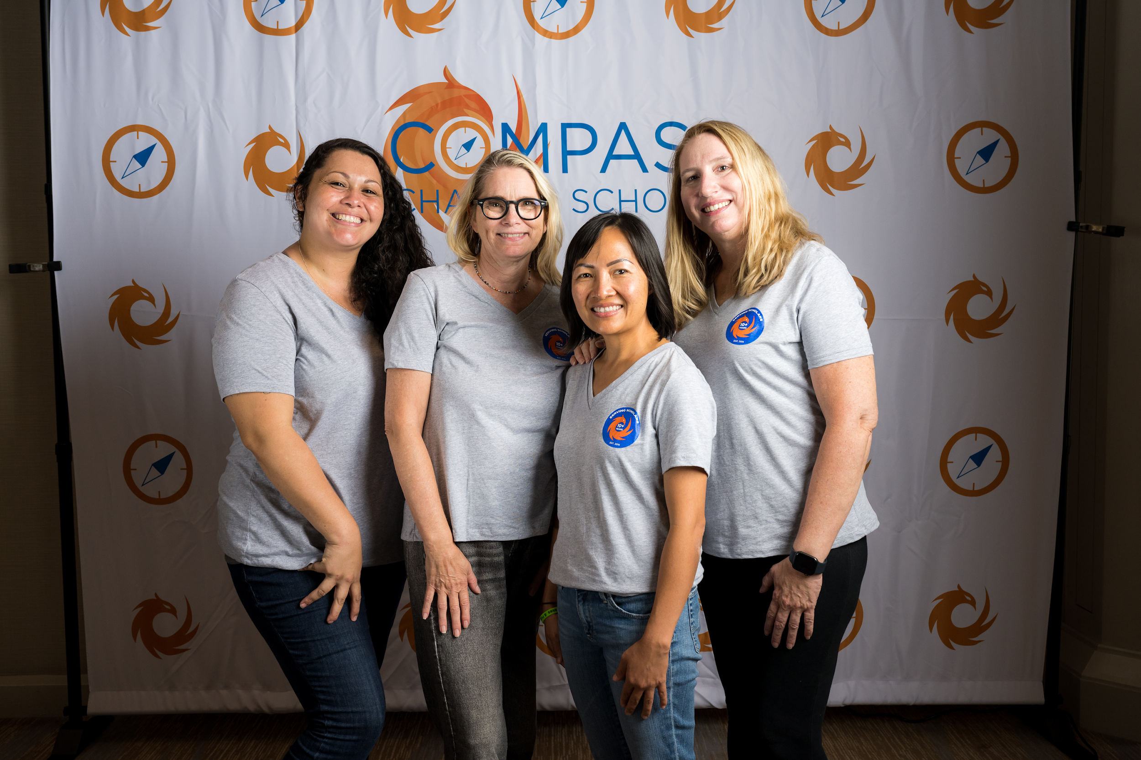
Community Providers Department

Slide 6
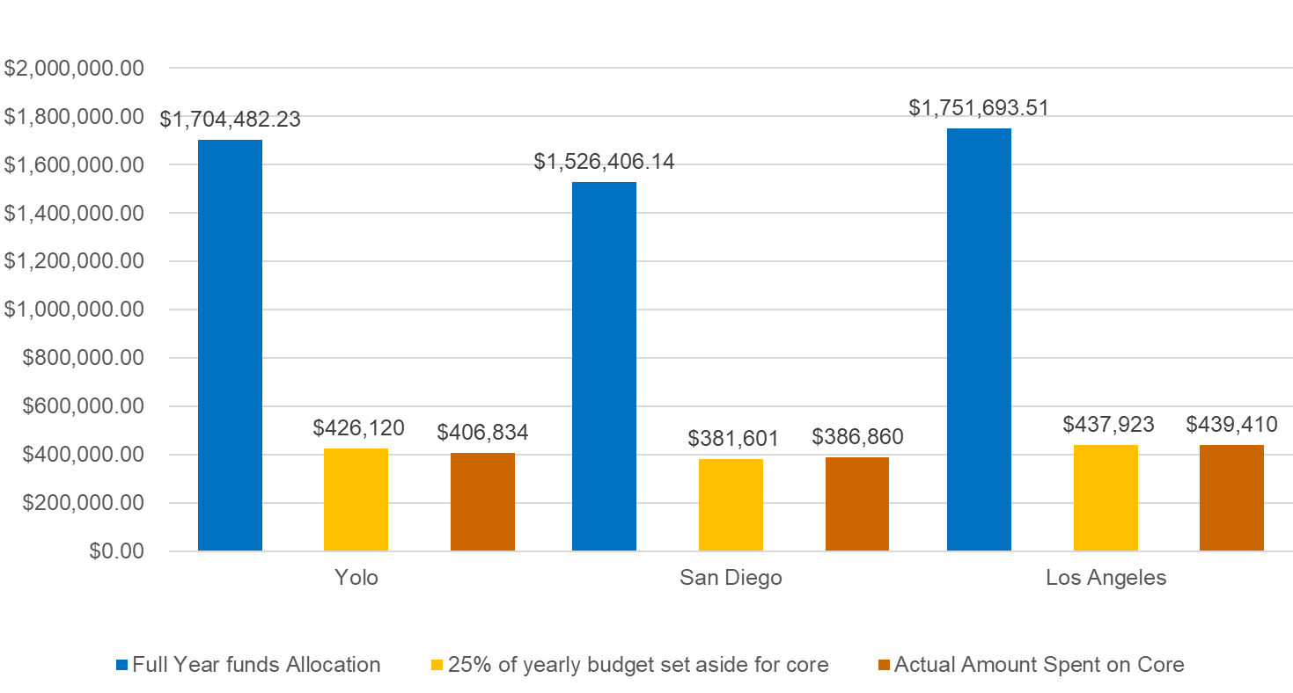

Slide 7
Top 5 Options Providers

Slide 8
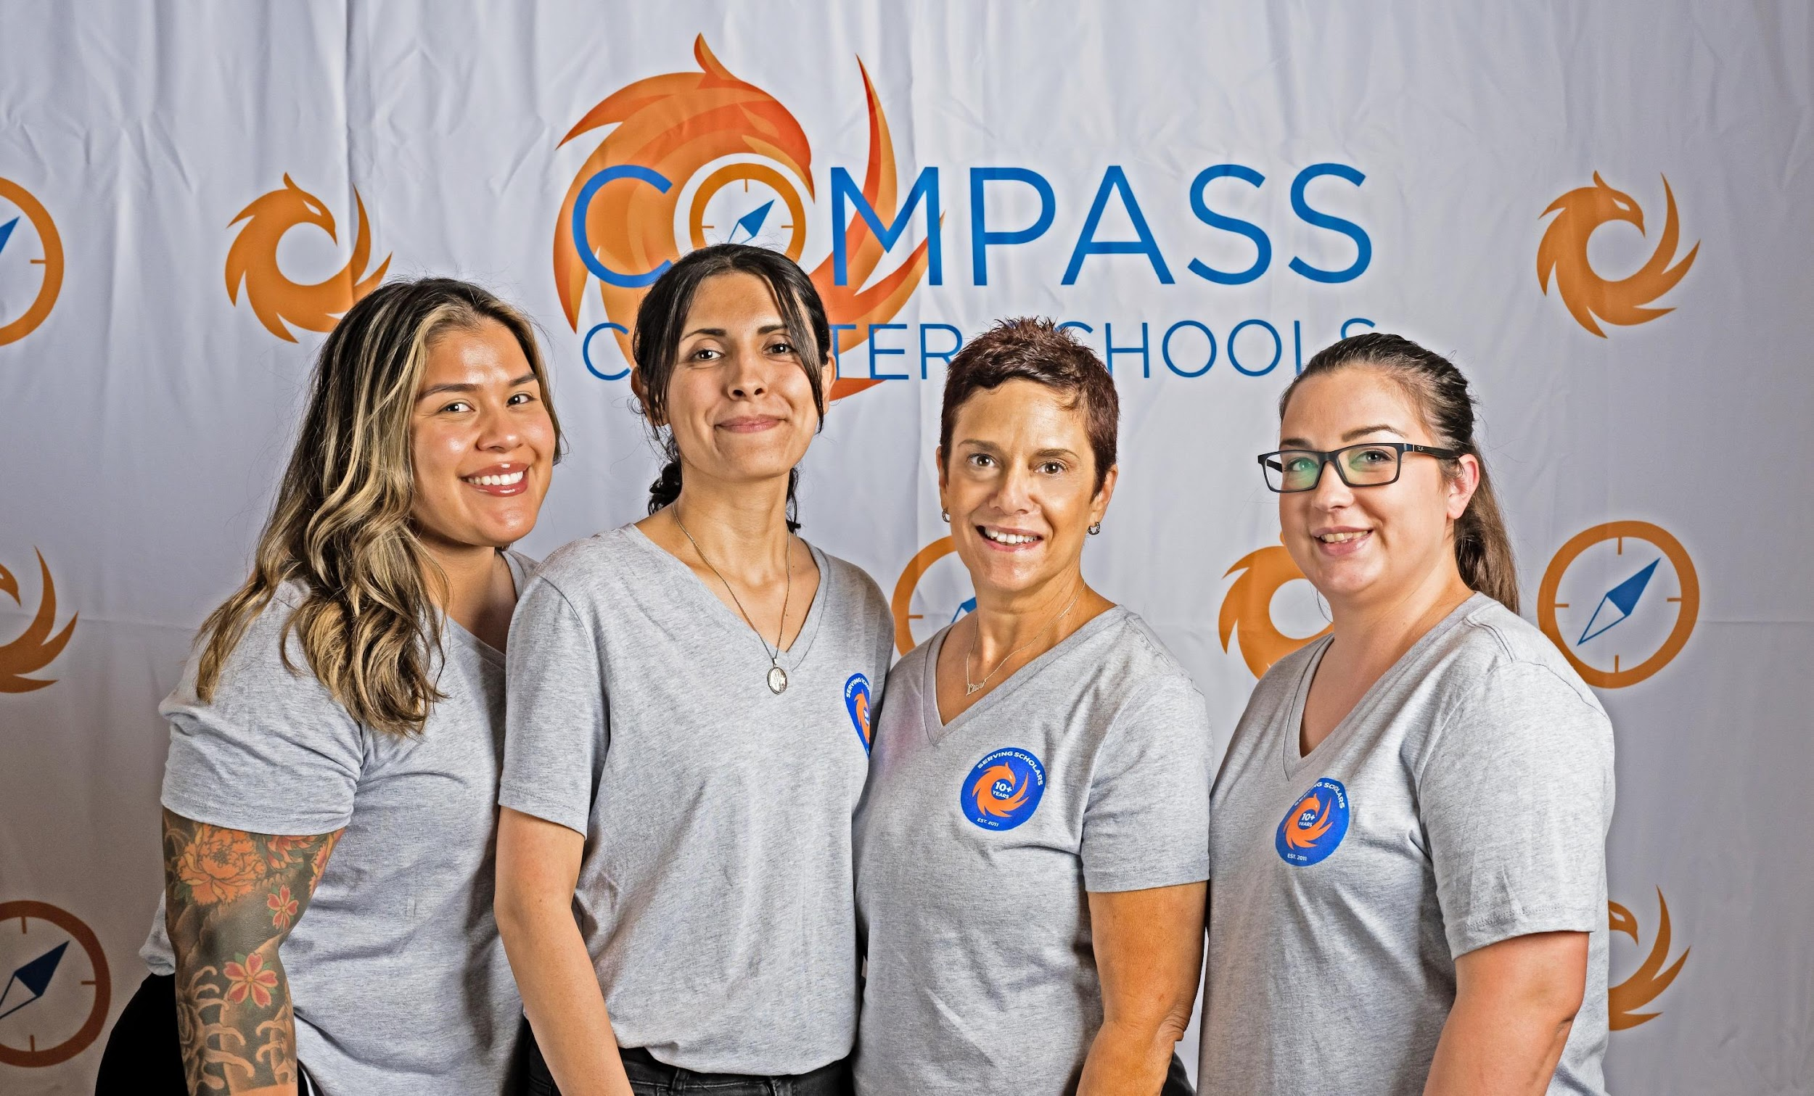
Finance Department

Slide 9
Finance Department
LCAP Expenditures by Charter As of 03.15.23

Slide 10
Restricted Funds
Apportionments as of 03.15.23

Slide 11
Restricted Funds Expenditures as of 03.15.23

Slide 12
Curriculum Locker
*Total Items added to the locker from the months of February through March is 275 materials.

Slide 13
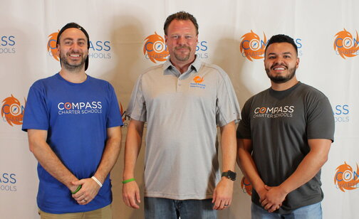
Information Technology Department

Slide 14
ClassLink Software Users
Notes:
Renaissance - K12 assessment
School Pathways – SIS
BrainPOP - online educational solution
SeeSaw - learning platform for meaningful engagement
Paper.co - personalized online tutoring

Slide 15
IT ZoHo Helpdesk

Slide 16
ZoHo Helpdesk Top Issues

Slide 17
TPX Cyber Security Training All Staff (220)

Slide 18
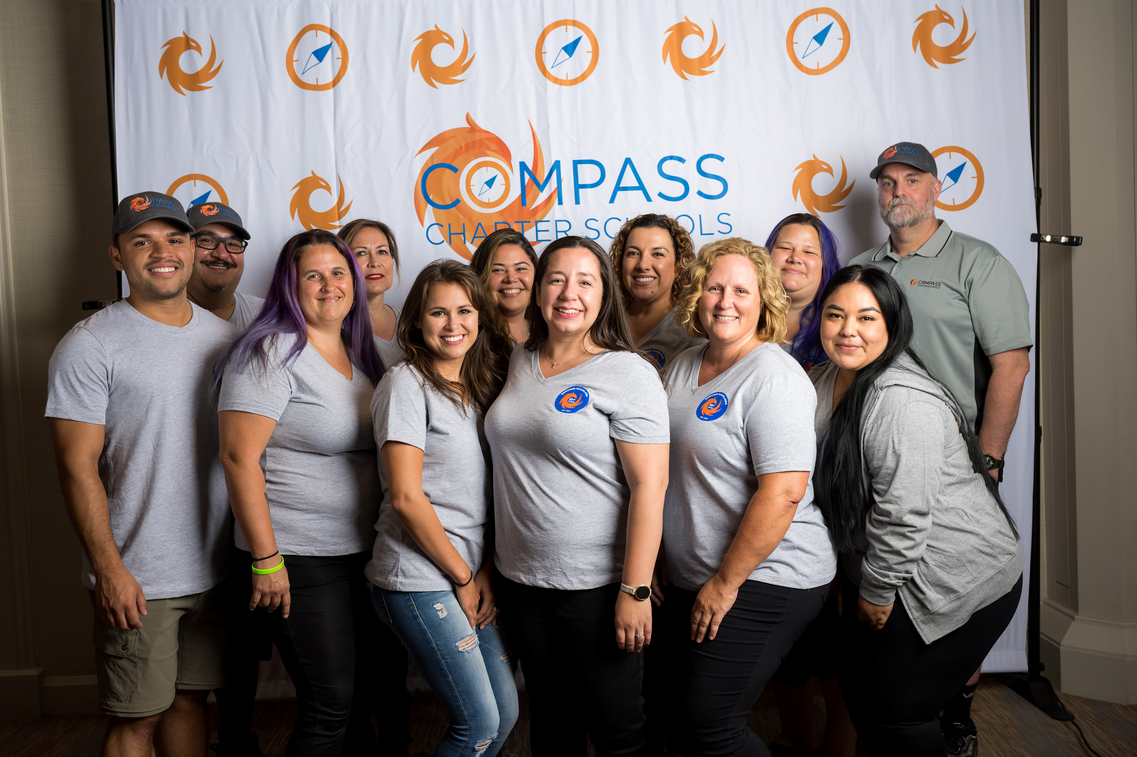
Operations Department

Slide 19
Fall 2022-2023 Scholar Enrollment

Slide 20
McKinney-Vento Scholars
Total McKinney-Vento Scholars = 208
(9 less than January 2023)

Slide 21
McKinney-Vento Residency Status

Slide 22
Total Withdrawals by Full School Year

Slide 23
Top Withdrawal Reason January to March 2023
Notes:
P-1 estimated future apportionment (estimated at 97%):
LA - 857.36
SD - 800.20
Yolo - 656.29

Slide 24
Questions?
Contact:
Lisa Fishman | Chief Operations Officer
(818) 732-4692
lfishman@compasscharters.org

