Slide 1
Financials through Jan 31, 2023
Monthly Financial Board Report
Prepared for: Compass Charter Schools
Prepared by School's CSMC SBM - Kristin Nowak

Slide 2
Financial Summary
Actual to Budget:
This report is as of Jan 31, 2023, compared against our board-approved budget
YTD Revenues Through Jan 31, 2023, are $14,836,942
YTD Expenses Through Jan 31, 2023, are $17,682,850
Therefore, net income is ($2,845,908)
Balance Sheet:
As of Jan 31, 2023, we had total cash of $10,880,096, short-term liabilities of $5,821,031, and long-term liabilities of $109,051. The ending fund balance is $6,703,717.
Report created on 3/20/2023 1:59:43 PM for Compass Charter Schools

Slide 3
Understanding the Financial Health of the Organization
The chart below explains some of the parameters that the school’s leadership can evaluate to understand their financial health, and potential areas of weakness.
Cash Ratio
Ability to meet short-term obligations with cash
 | Current: | Target:
 | 169.8 % | > 100.0 %
Formula: (Cash) / (Current Liabilities)
Defensive Interval
Months of continued operation without incoming funds
 | Current: | Target:
 | 4.9 | > 3 months
Formula: (Cash + Securities + AR)/(Average Expenses for Past 12 Months)
Current Ratio (Liquidity)
Ability to pay short-term obligations
 | Current: | Target:
 | 2.0 | > 1.0
Formula: (Current Assets) / (Current Liabilities)
Report created on 3/20/2023 1:59:42 PM for Compass Charter Schools

Slide 4
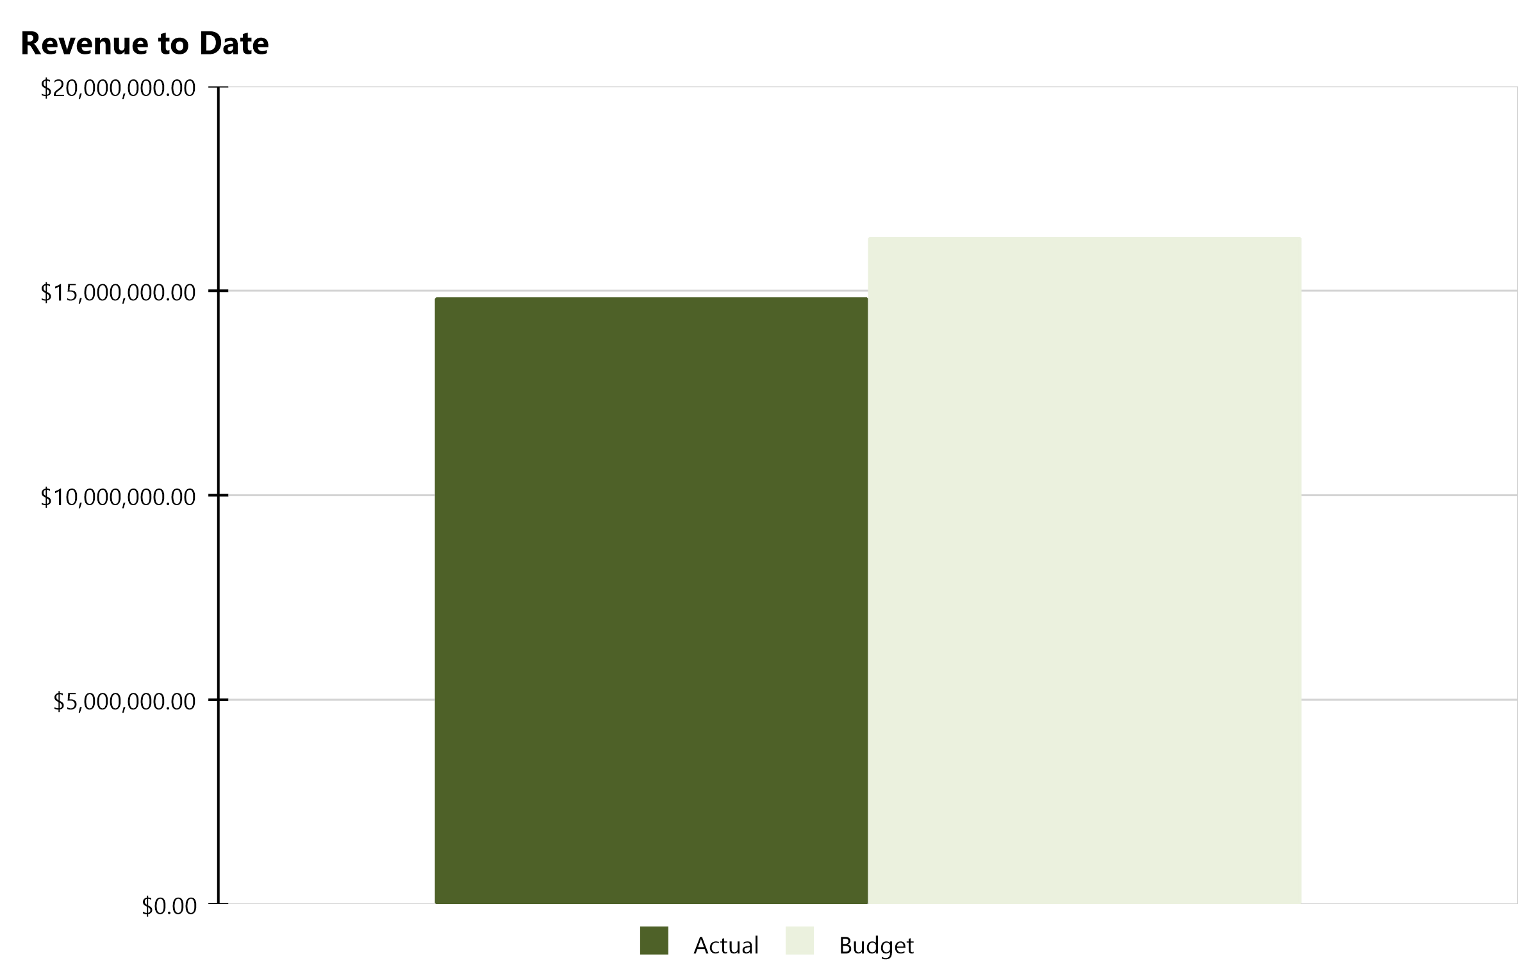
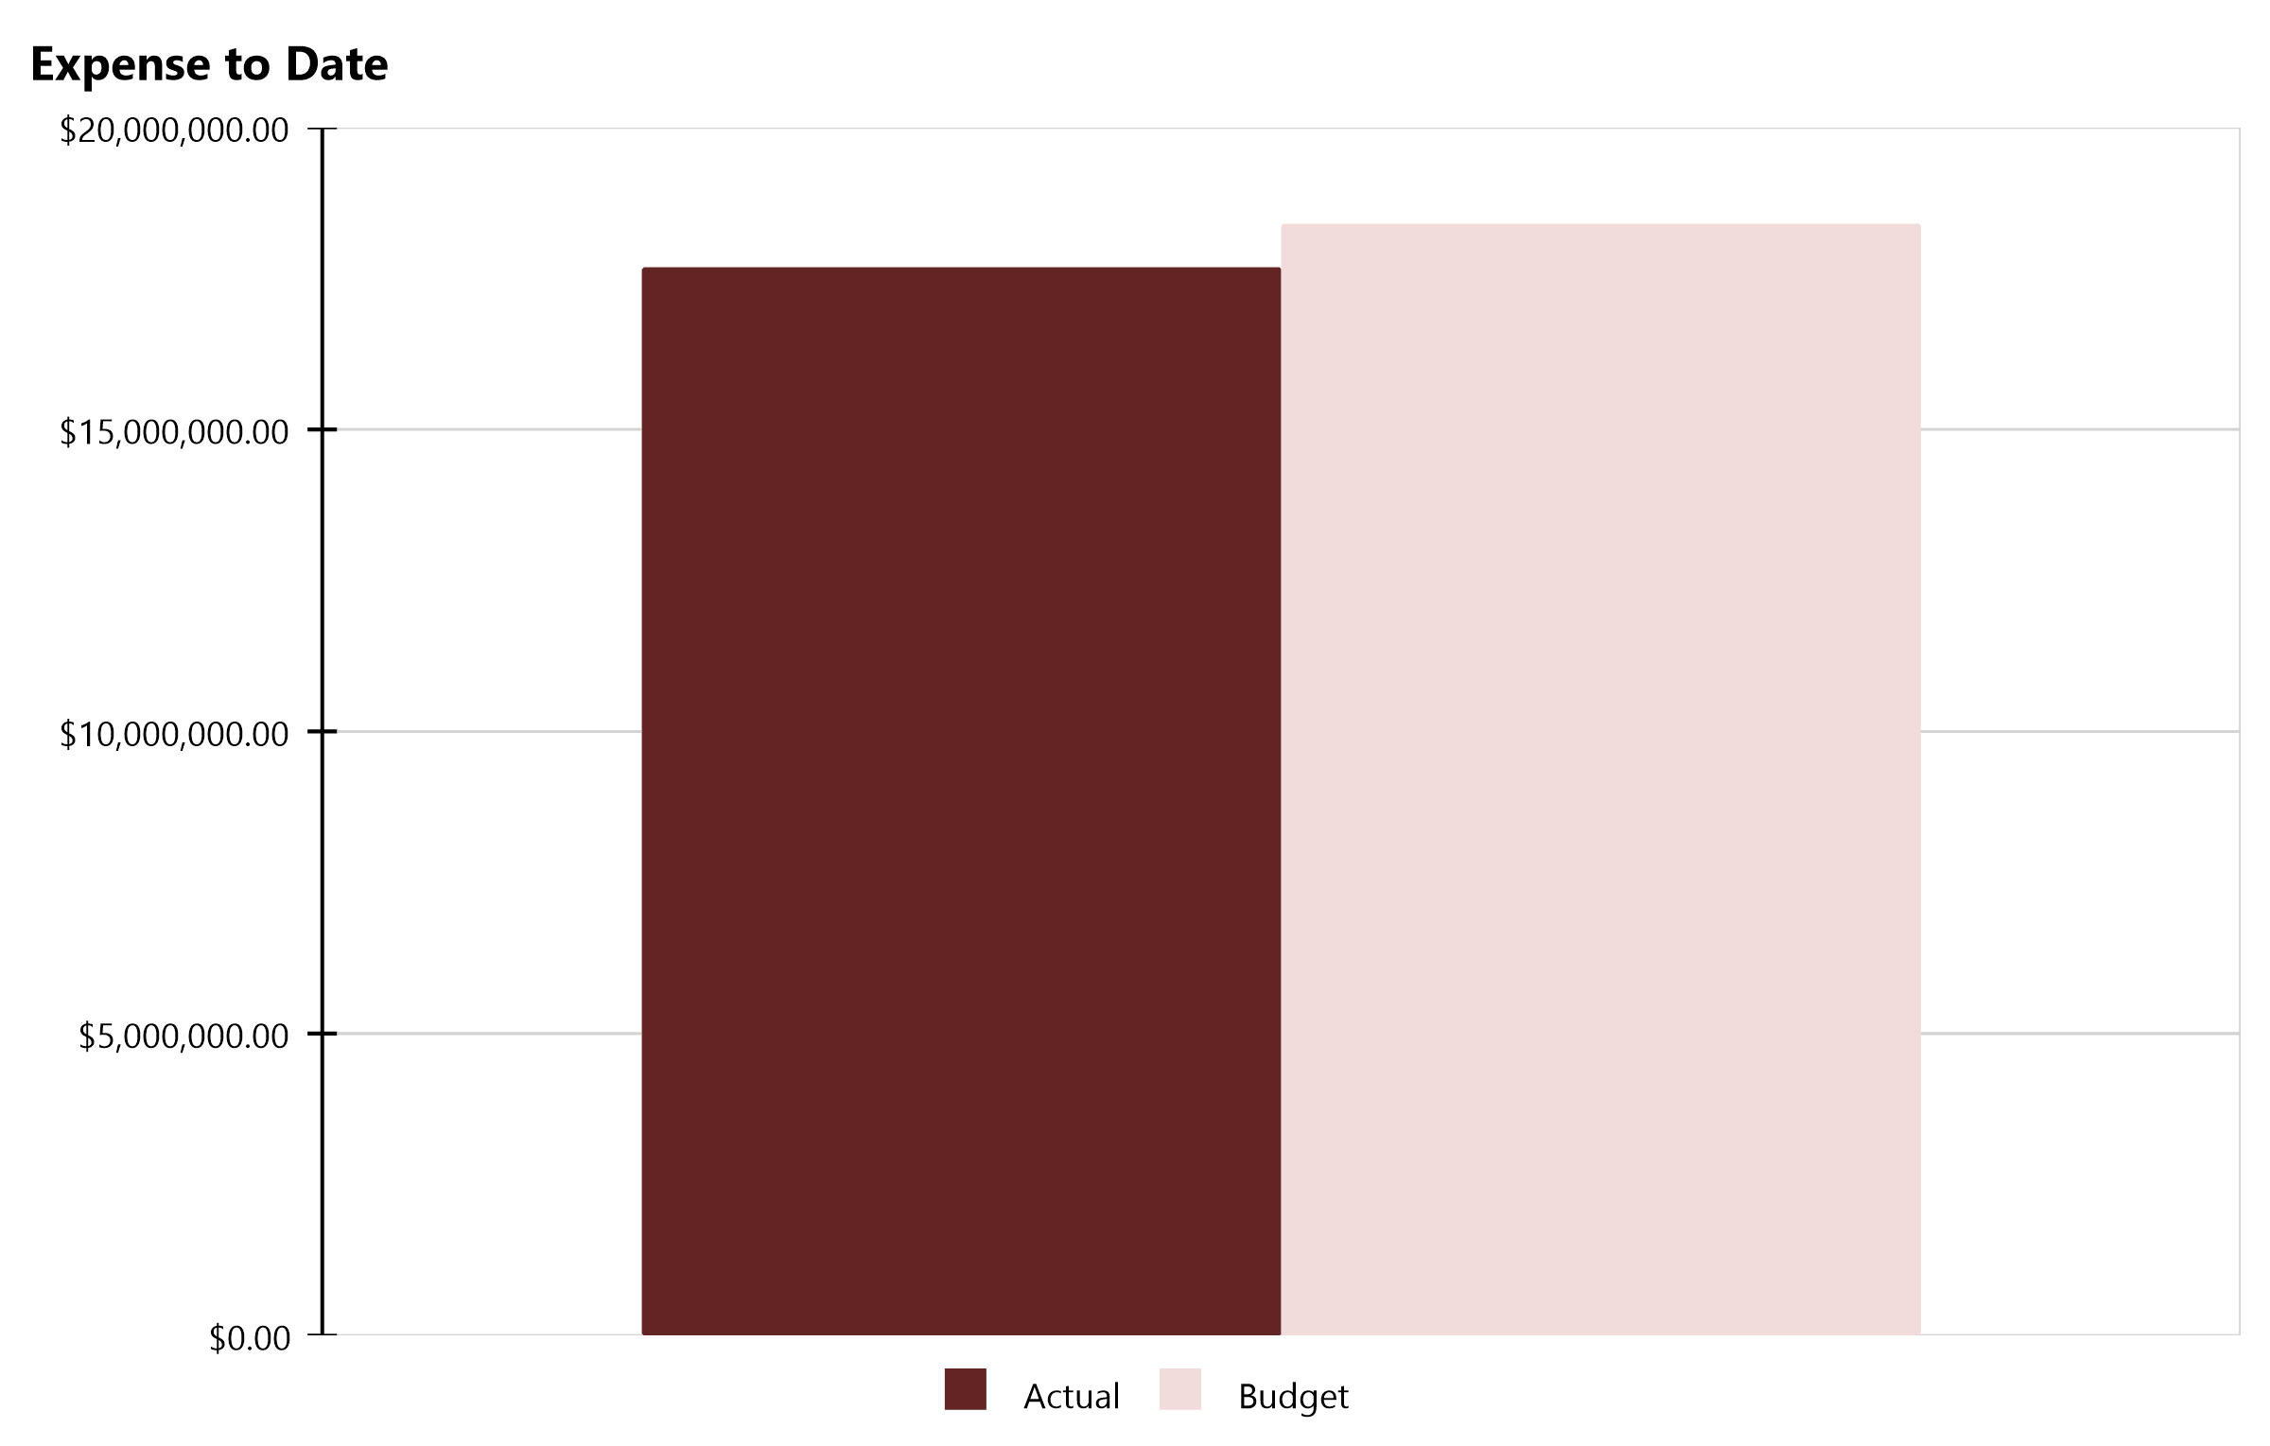
Compass Charter Schools Financial Snapshot
FY 2022-2023, July - January
Cash Balance
$10,880,096
Revenue Summary
Actual | $14,836,942
Budget | $16,312,326
Actual to Budget | -9.0 %
Expense Summary
Actual | $17,682,850
Budget | $18,403,156
Actual to Budget | -3.9 %
Report created on 3/20/2023 1:59:43 PM for Compass Charter Schools

Slide 5
Actual to Budget Summary
FY 2022-2023, July - January
Revenue
$14,836,942
Expenses
$17,682,850
Surplus / (Deficit)
($2,845,908)
 | July - January |  |  | 2022-2023
Account Description | Actual | Budget | Variance $ | Total Budget | Actual to Total Budget % | Remaining Budget
LCFF Revenue | $12,292,745 | $12,990,757 | ($698,012) | $25,797,152 | 47.7 % | $13,504,407
Federal Revenue | $768,819 | $725,050 | $43,769 | $2,417,591 | 31.8 % | $1,648,772
State Revenue | $1,675,435 | $2,526,358 | ($850,922) | $3,899,495 | 43.0 % | $2,224,059
Local Revenue | $99,943 | $70,162 | $29,781 | $83,914 | 119.1 % | ($16,029)
Total Revenue | $14,836,942 | $16,312,326 | ($1,475,384) | $32,198,153 | 46.1 % | $17,361,210
Certificated Salaries | $7,028,778 | $7,305,627 | $276,849 | $12,937,248 | 54.3 % | $5,908,470
Classified Salaries | $1,992,531 | $2,133,799 | $141,268 | $3,943,413 | 50.5 % | $1,950,882
Benefits | $3,076,589 | $2,972,283 | ($104,306) | $5,372,146 | 57.3 % | $2,295,557
Total Personnel Expenses | $12,097,898 | $12,411,709 | $313,811 | $22,252,806 | 54.4 % | $10,154,908
Books and Supplies | $2,371,559 | $2,874,916 | $503,358 | $4,609,818 | 51.4 % | $2,238,259
Services | $3,213,393 | $3,116,531 | ($96,862) | $4,852,166 | 66.2 % | $1,638,773
Total Operational Expenses | $5,584,952 | $5,991,447 | $406,496 | $9,461,984 | 59.0 % | $3,877,032
Total Expenses | $17,682,850 | $18,403,156 | $720,306 | $31,714,790 | 55.8 % | $14,031,940
Net Income | ($2,845,908) | ($2,090,831) | ($755,077) | $483,362 | -588.8 % | $3,329,270
This report displays all actual and budgeted revenue and expenditures by object code series and by month. This report can be useful in ensuring you receive your revenue in a timely manner and that you stay within the board approved expenditure levels.
Report created on 3/20/2023 1:59:43 PM for Compass Charter Schools

Slide 6
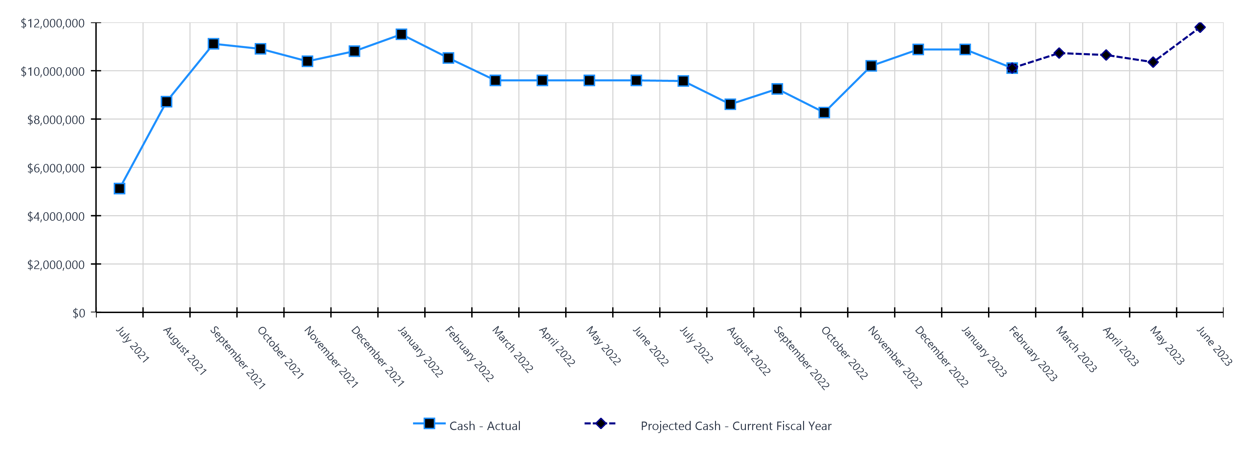
Monthly Cash Balance Over Time
Current fiscal year and prior year
 | Cash Amount | Actual or Projected
July 2021 | $5,121,620.34 | Actual
August 2021 | $8,718,061.60 | Actual
September 2021 | $11,113,904.09 | Actual
October 2021 | $10,905,645.35 | Actual
November 2021 | $10,390,528.49 | Actual
December 2021 | $10,808,568.05 | Actual
January 2022 | $11,507,548.45 | Actual
February 2022 | $10,527,180.02 | Actual
March 2022 | $9,600,208.18 | Actual
April 2022 | $9,600,208.18 | Actual
May 2022 | $9,600,208.18 | Actual
June 2022 | $9,600,208.18 | Actual
 | Cash Amount | Actual or Projected
July 2022 | $9,574,236.91 | Actual
August 2022 | $8,611,838.91 | Actual
September 2022 | $9,246,236.00 | Actual
October 2022 | $8,268,561.64 | Actual
November 2022 | $10,201,001.92 | Actual
December 2022 | $10,880,194.48 | Actual
January 2023 | $10,880,095.75 | Actual
February 2023 | $10,109,841.05 | Actual
March 2023 | $10,730,579.00 | Projected
April 2023 | $10,650,234.00 | Projected
May 2023 | $10,355,047.00 | Projected
June 2023 | $11,799,912.00 | Projected
Report created on 3/20/2023 1:59:43 PM for Compass Charter Schools

Slide 7
Balance Sheet Summary FY 2022-2023 - January
The balance sheet displays all of the school’s assets and the school’s obligations (‘liabilities’) at a particular point in time. It is a useful way to ensure the school has enough money to pay off its debts.
Liquidity Ratio
2.1
Assets
Current Assets
Accounts Receivable | $608,791
Cash and Cash Equivalents | $10,880,096
Employee Advances | $275
Prepaid Expenses | $252,562
Short Term Investments | $768,842
Total Current Assets | $12,510,565
Fixed Assets
Fixed Assets | $113,014
Total Fixed Assets | $113,014
Other Assets
Other Assets | $10,220
Total Other Assets | $10,220
Total Assets | $12,633,799
Liabilities and Net Assets
Current Liabilities
Accounts Payable | $284,343
Accrued Liabilities | $2,610,866
Other Short Term Liability | $2,925,822
Total Current Liabilities | $5,821,031
Long Term Liabilities
Other Liabilities | $109,051
Total Long Term Liabilities | $109,051
Total Liabilities | $5,785,842
Net Increase/(Decrease in Net Assets)
Net Increase/(Decrease) in Net Assets | ($2,845,908)
Total Net Increase/(Decrease) in Net Assets | ($2,845,908)
Ending Net Assets
Ending Net Assets | $9,549,625
Total Net Assets | $9,549,625
Total Liabilities and Net Assets | $12,633,799
Report created on 3/20/2023 1:59:43 PM for Compass Charter Schools

Slide 8
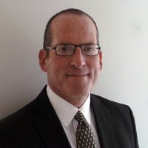
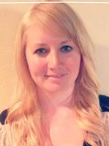
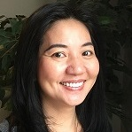
CSMC Charter School Support Team
 | Executive VP of Client Services Tom Nichols tnichols@csmci.com
 | Regional AM Director Mai Luong mluong@csmci.com
 | School Business Manager Kristin Nowak knowak@csmci.com
 | Account Manager Mai Luong mluong@csmci.com
 | Associate AM Kimber Nelson knelson@csmci.com
Report created on 3/20/2023 1:59:43 PM for Compass Charter Schools

Slide 9
Looking Ahead
3/24/2023 | Varies: Special education MOE pre-test; timing and steps vary by SELPA
3/25/2023 | Board Meeting
3/28/2023 | ESSER and GEER Annual Report due
3/29/2023 | CSMC Webinar
3/31/2023 | Winter Consolidated Application / CARS report possibly due
4/1/2023 | Audit firm selection
 | Form 700
4/15/2023 | CARES, ESSER, ESSER II, ESSER III, ELOG, ARP expenditure report
4/18/2023 | Varies: Special education MOE pre-test; timing and steps vary by SELPA
4/19/2023 | CSMC Regional Office Hours
4/22/2023 | Varies: Special education federal and level 3 reports; timing and steps vary by SELPA
4/30/2023 | Federal Cash Management Data Collection (CMDC)
 | ASES attendance and expenditure reports
5/1/2023 | May Board Meeting: Recommended public hearing for preliminary budget and LCAP
 | 2022–23 P-2 Attendance Data
5/2/2023 | Varies: Special education low incidence reimbursement; timing and steps vary by SELPA
5/3/2023 | CSMC Webinar
5/8/2023 | CALPADS EOY Submission Opens
5/9/2023 | CSMC Workshop: Charter Renewal
Report created on 3/20/2023 1:59:43 PM for Compass Charter Schools

Slide 10
Looking Ahead
5/11/2023 | CSMC Workshop: Charter Renewal
5/15/2023 | Form 990 Return of Exempt Organization
5/20/2023 | Annual report for federal pandemic relief funds
 | Charter school information survey due to CDE
5/20/2023 | Board Meeting
5/31/2023 | CSMC Webinar
 | Submit 2023-2024 Calendar to Student Data Services
6/1/2023 | June Board Meeting: Approval of LCAP and Budget, due 6/30
6/2/2023 | SB740 application due
6/7/2023 | CSMC Regional Office Hours
Report created on 3/20/2023 1:59:43 PM for Compass Charter Schools

Slide 11
HELPING THE EDUCATION MOVEMENT SUCCEED ONE SCHOOL AT A TIME
info@csmci.com Office: 888.994.CSMC 43460 Ridge Park Dr., Ste. 100 Temecula, Ca 92590
POWERED BY:
Report created on 3/20/2023 1:59:42 PM for Compass Charter Schools
www.csmci.com
Charter Vision

