Slide 1
Compass Charter Schools
FY23
2nd Interim

Slide 2
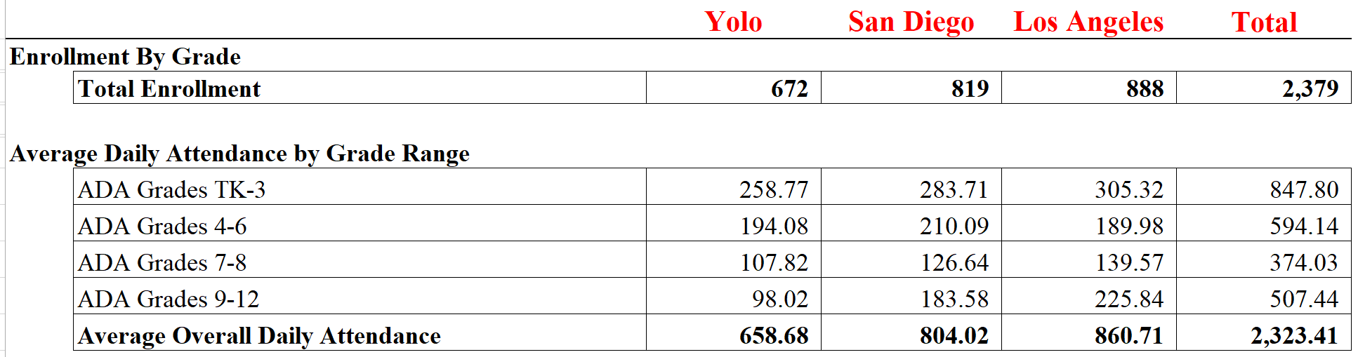
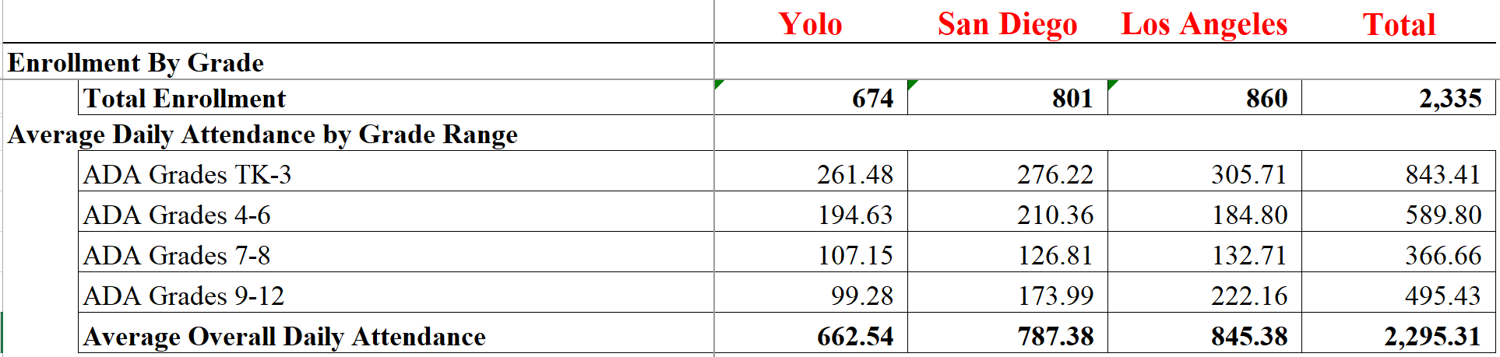
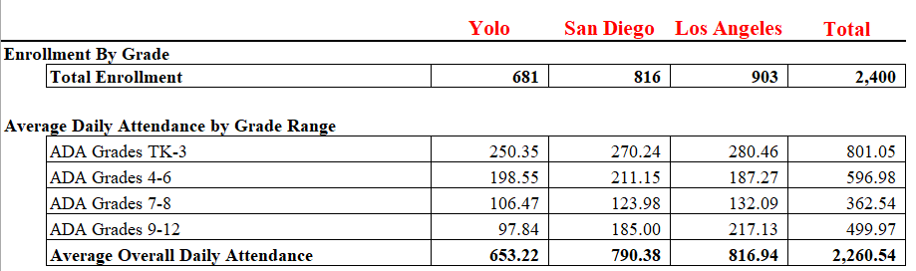
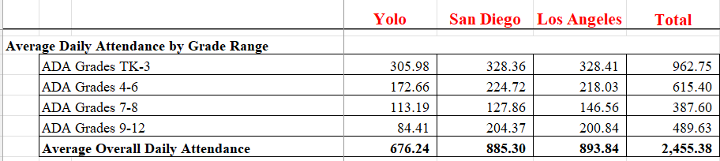
Average Daily Attendance Driving Revenue
Enrollment reduction of 44, ADA decrease of 28.1
2nd Interim
2nd Interim
FY 23 1st Interim
FY23 Sept revise ADA
CCS Yolo: ADA variance from 1st Interim: 3.86 increase
CCS SD: ADA variance from 1st Interim: 16.64 decrease
CCS LA: ADA variance from 1st Interim: 15.33 decrease
FY23 Initial

Slide 3
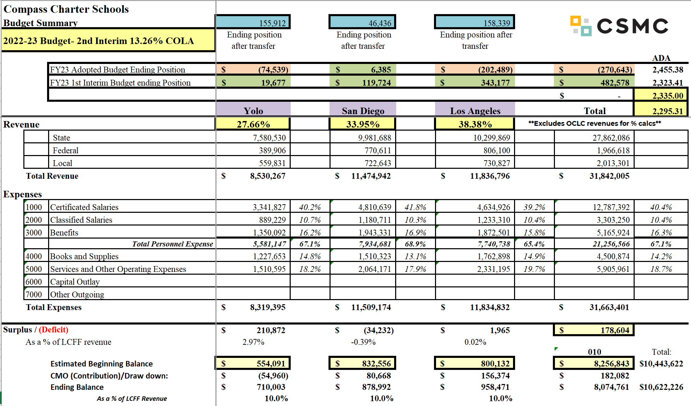
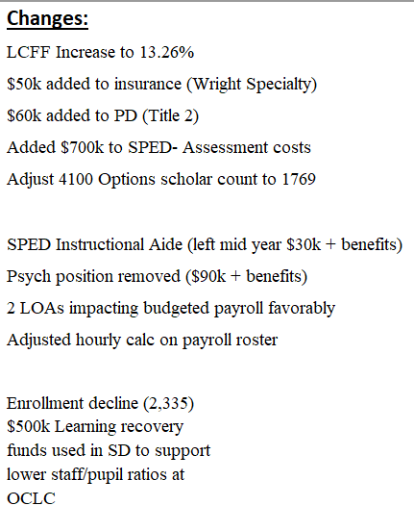
2nd Interim Budget Summary
Variance from FY23 1st Interim= $482,578- $178,604= $303,974
FY23

Slide 4
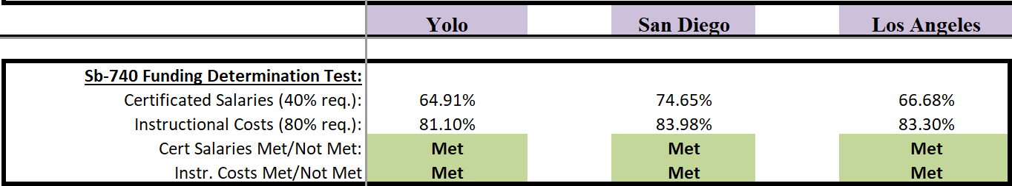
2nd Interim Budget Summary- Funding Determinations
FY23

Slide 5
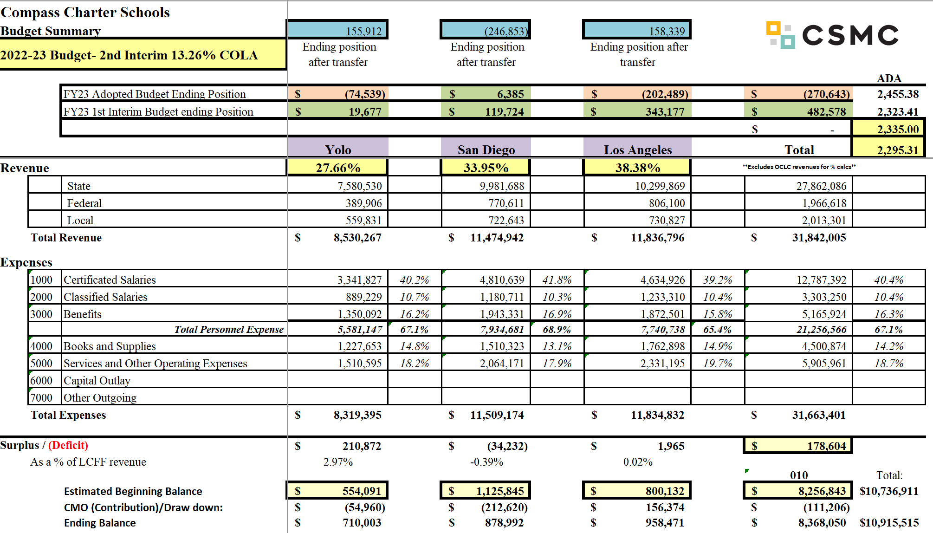
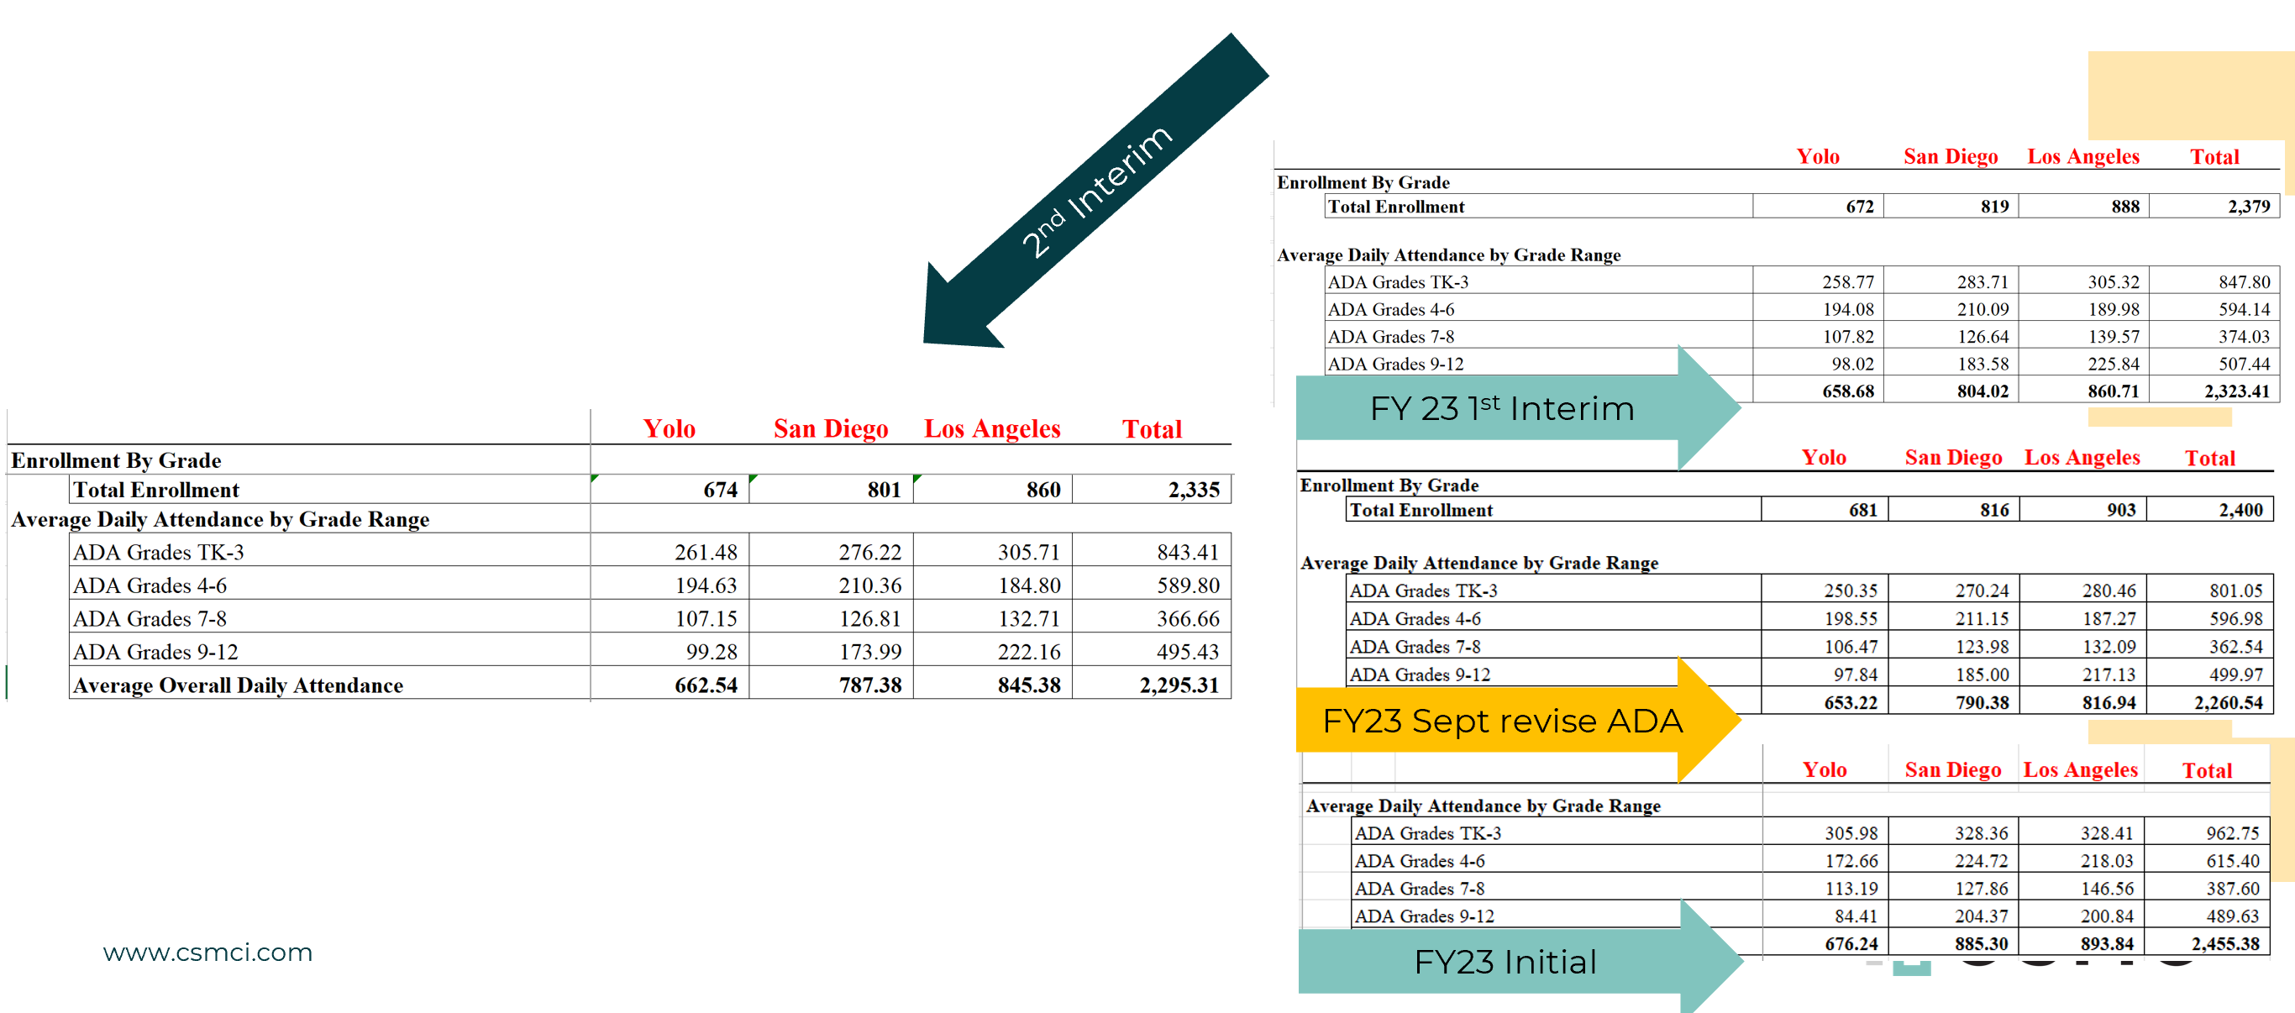
2nd Interim Budget: Los Angeles
CCS LA: ADA variance from 1st Interim: 15.33 decrease
FY23

Slide 6
2nd Interim Budget: San Diego
CCS SD: ADA variance from 1st Interim: 16.64 decrease
FY23

Slide 7
2nd Interim Budget: Yolo
CCS Yolo: ADA variance from 1st Interim: 3.86 increase
FY23

Slide 8
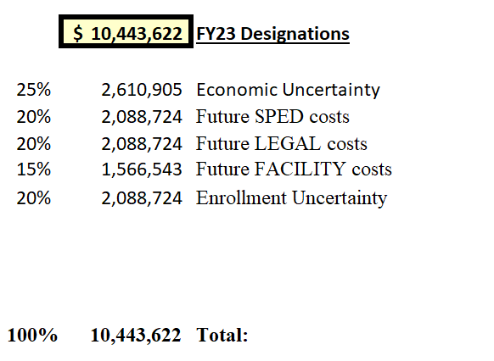
Reserve Designations
FY23

