Slide 1
Compass Charter Schools
Academic Services Division Board Report
Supplemental Data Charts
March 25, 2023

Slide 2
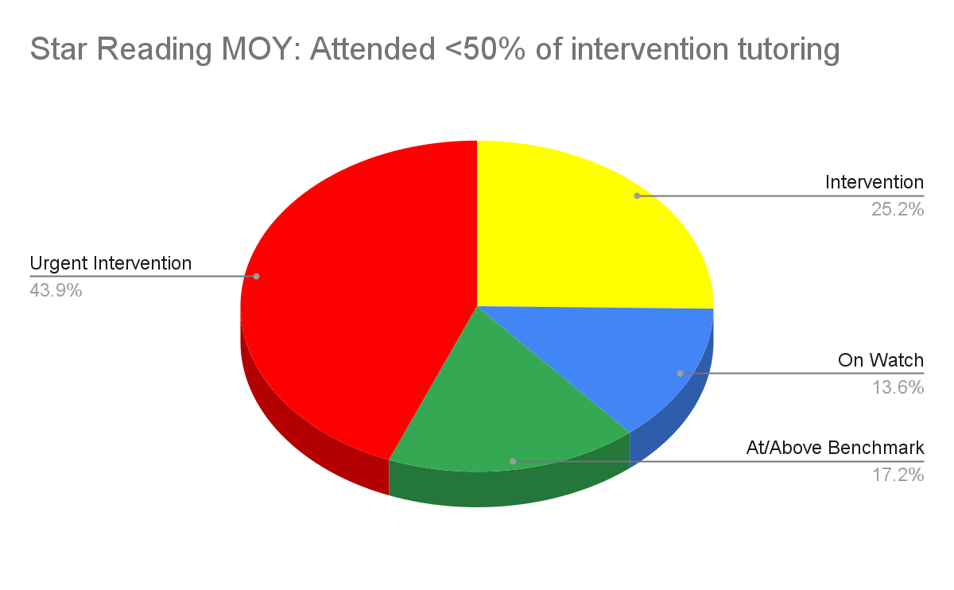
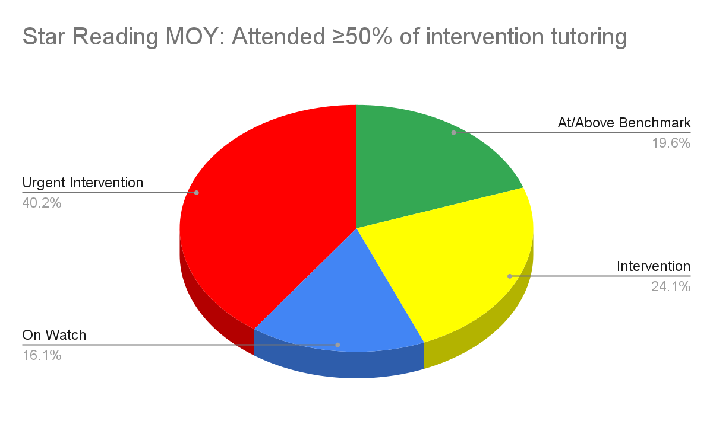
Academic Support
Intervention Tutoring Attendance and MOY Reading Scores
Notes:
Star Reading and Attendance
Scholars that attended ≥50% of their intervention live sessions with tutors, outperformed those that attended <50% of sessions:
35.7% of scholars that attended >50% of their intervention live sessions with tutors were On-Watch or At/Above
30.8% of scholars that attended <50% of their intervention live sessions with tutors were On-Watch or At/Above
25% of scholars who never attended were On-Watch or At/Above.

Slide 3
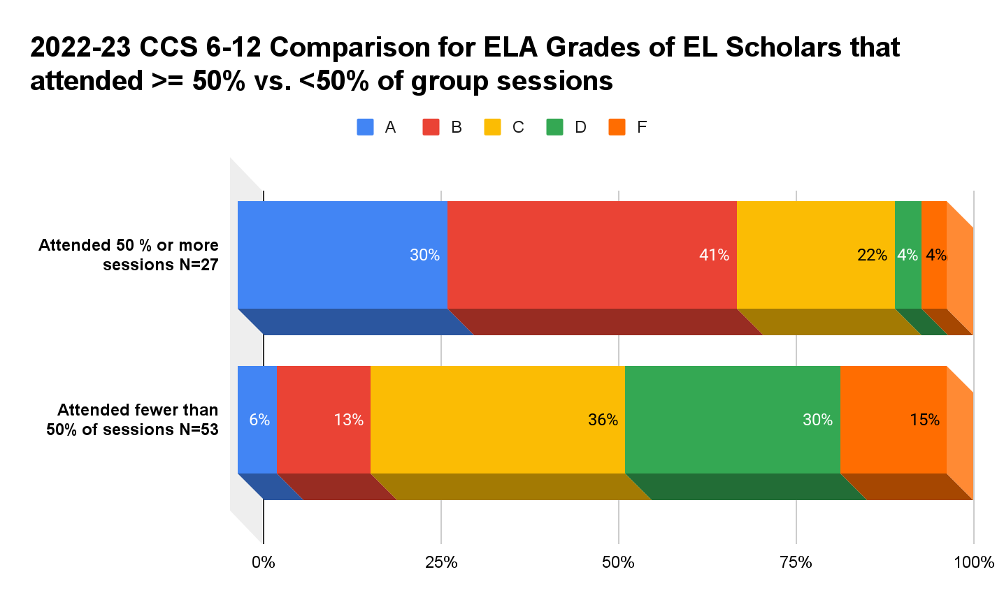
Academic Support
English Learners: Attendance and Semester 1 ELA Grades
Notes:
Out of 80 6-12th grade EL scholars, it was noted that semester 1 ELA grades for scholars that attended 50% or more of their EL live sync sessions, were considerably higher that those for scholars that attended less than 50%.
>50%: A- 30%, B- 41%, C- 22%, D- 4%, F- 4%(C or higher: 93%)
<50%: A- 6%, B- 13%, C- 36%, D- 30%, F- 15% (C or higher: 55%)

Slide 4
Academic Support
English Learners: TK-5 grade Lexia Progress in Grade Level Material (GLM)
Notes:
At MOY, 20% of K-5 EL scholars moved into In or Above Grade Level Material (GLM) in Lexia EL scholars moved into In or Above Grade Level Material (GLM) in Lexia

Slide 5
Academic Support
English Learners: 6-12 grade Lexia Progress in Word Study, Grammar and Reading Comprehension Skills
Notes:
For 612: At MOY, 20% of EL scholars had moved into In or Above Grade Level Material (GLM) in Lexia
Word Study- 25% of EL scholars had moved into Intermediate or Advanced in Lexia
Grammar- 16% % of EL scholars had moved into Intermediate or Advanced in Lexia
Comprehension- 23% of EL scholars had moved into Intermediate or Advanced in Lexia

Slide 6
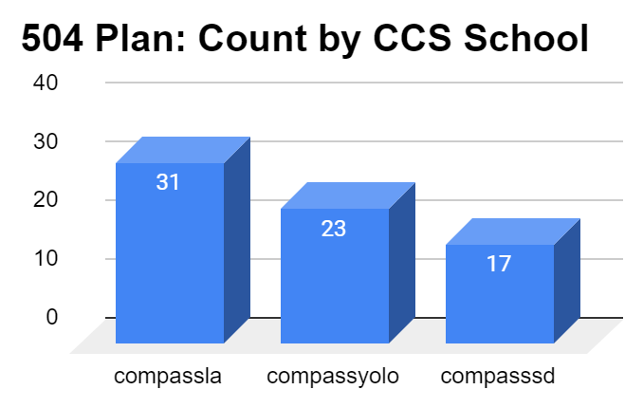
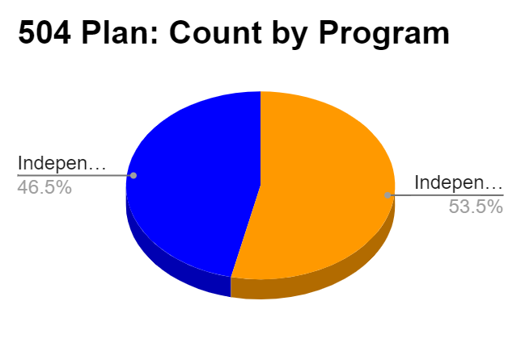
Academic Support
504 Counts by Charter and Program

Slide 7
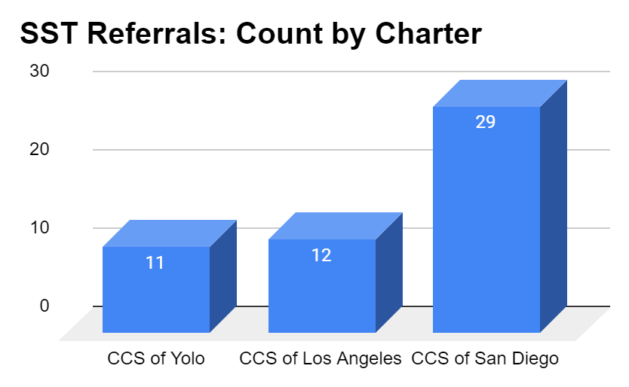
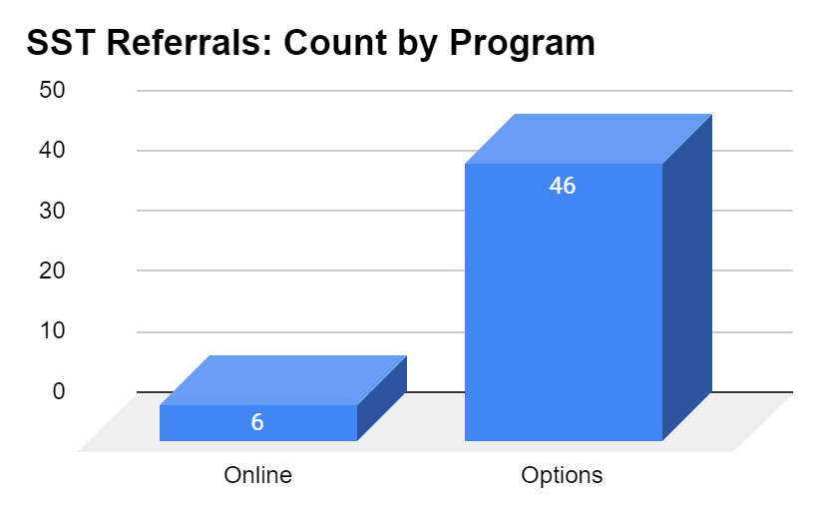
Academic Support
SST Counts by Charter and Program

Slide 8
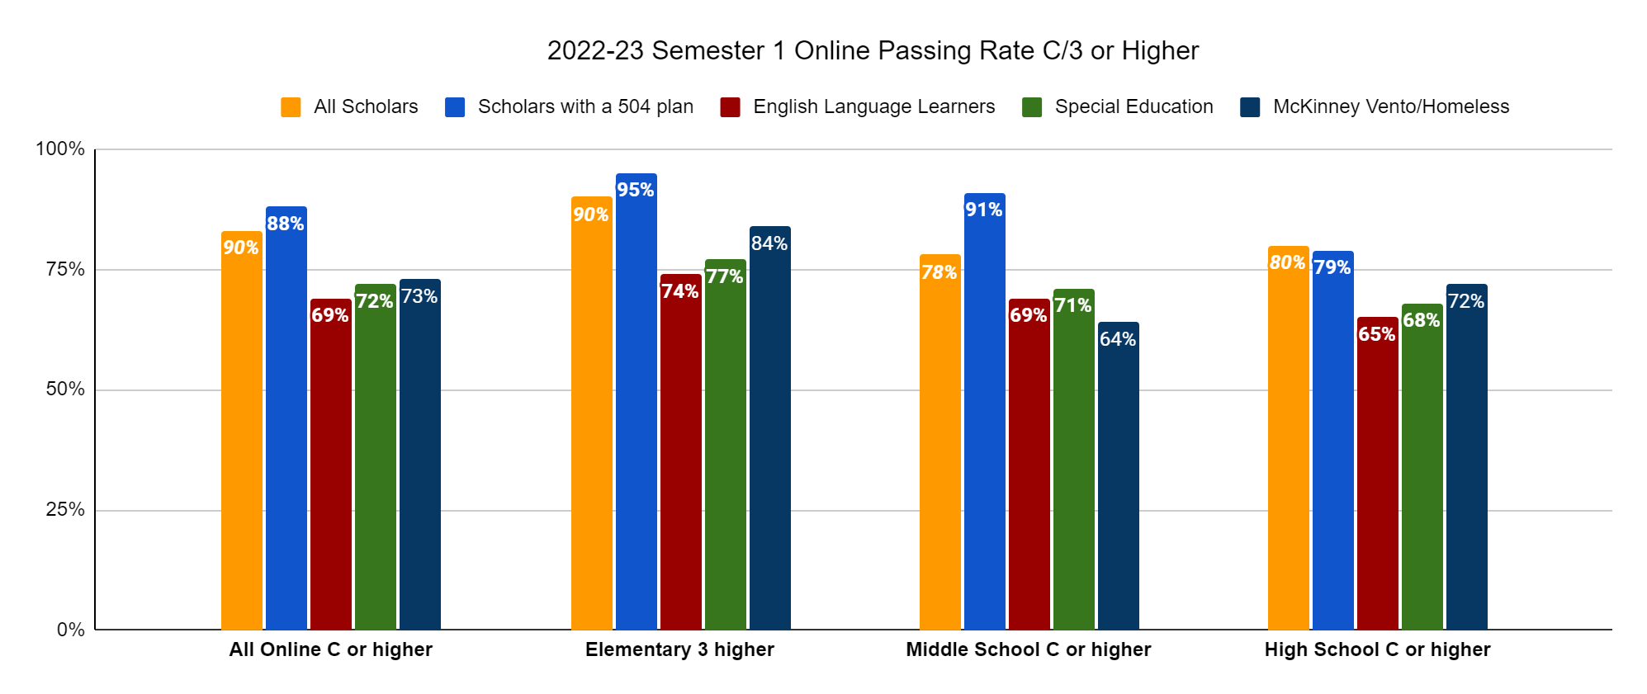
Online Learning
2022-23 Semester 1 Online Passing Rate C/3 or Higher

Slide 9
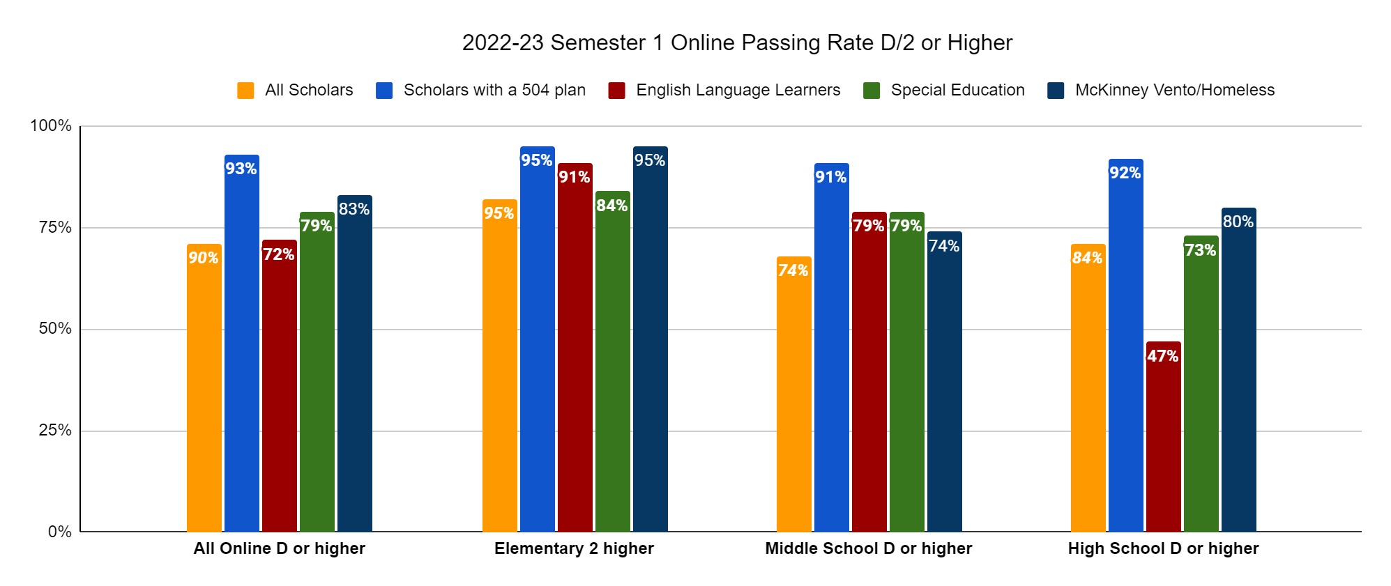
Online Learning
2022-23 Semester 1 Online Passing Rate D/2 or Higher

Slide 10
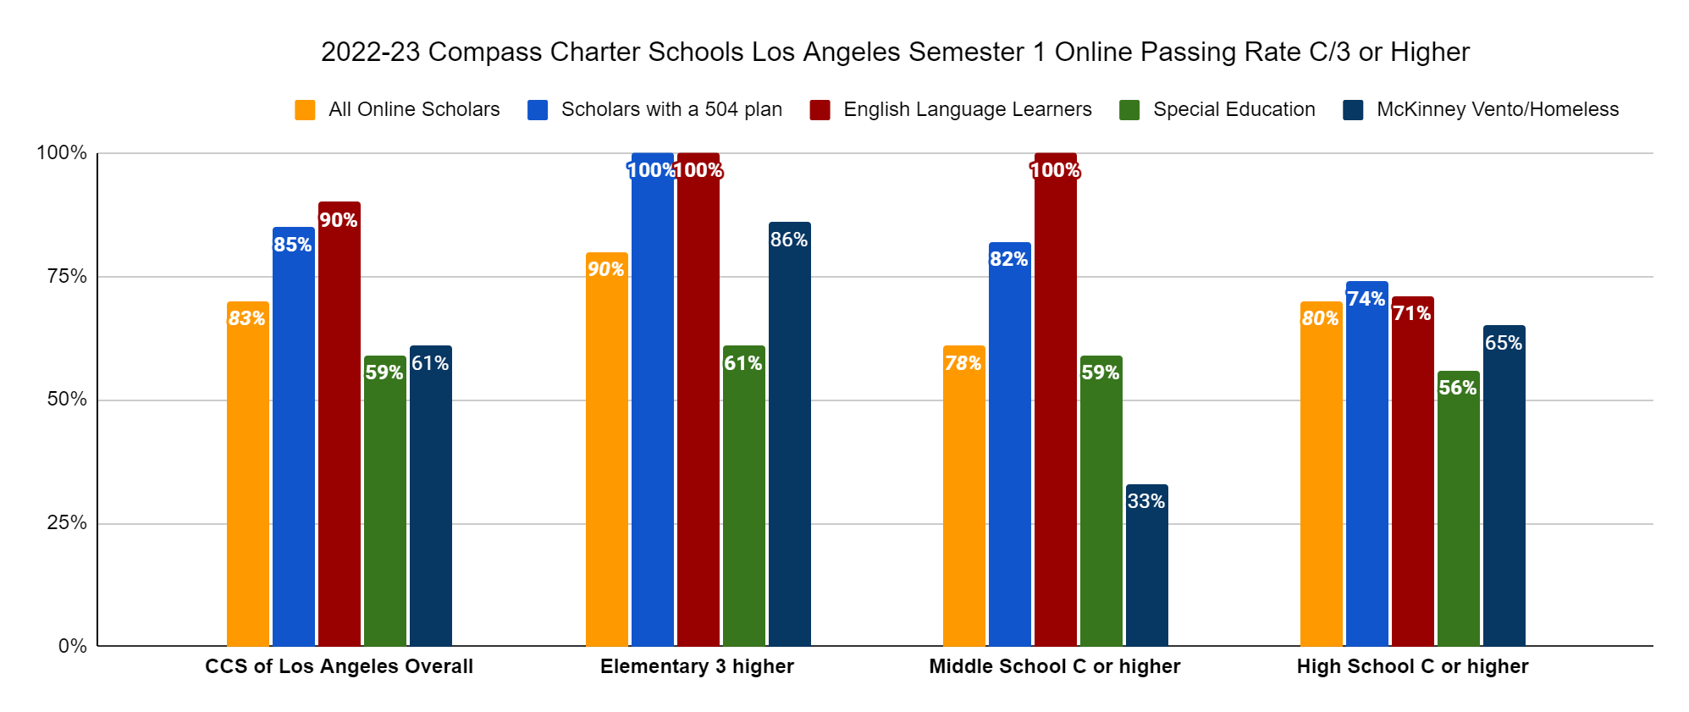
Online Learning
2022-23 Compass Charter Schools of Los Angeles Semester 1 Passing Rate C/3 or Higher

Slide 11
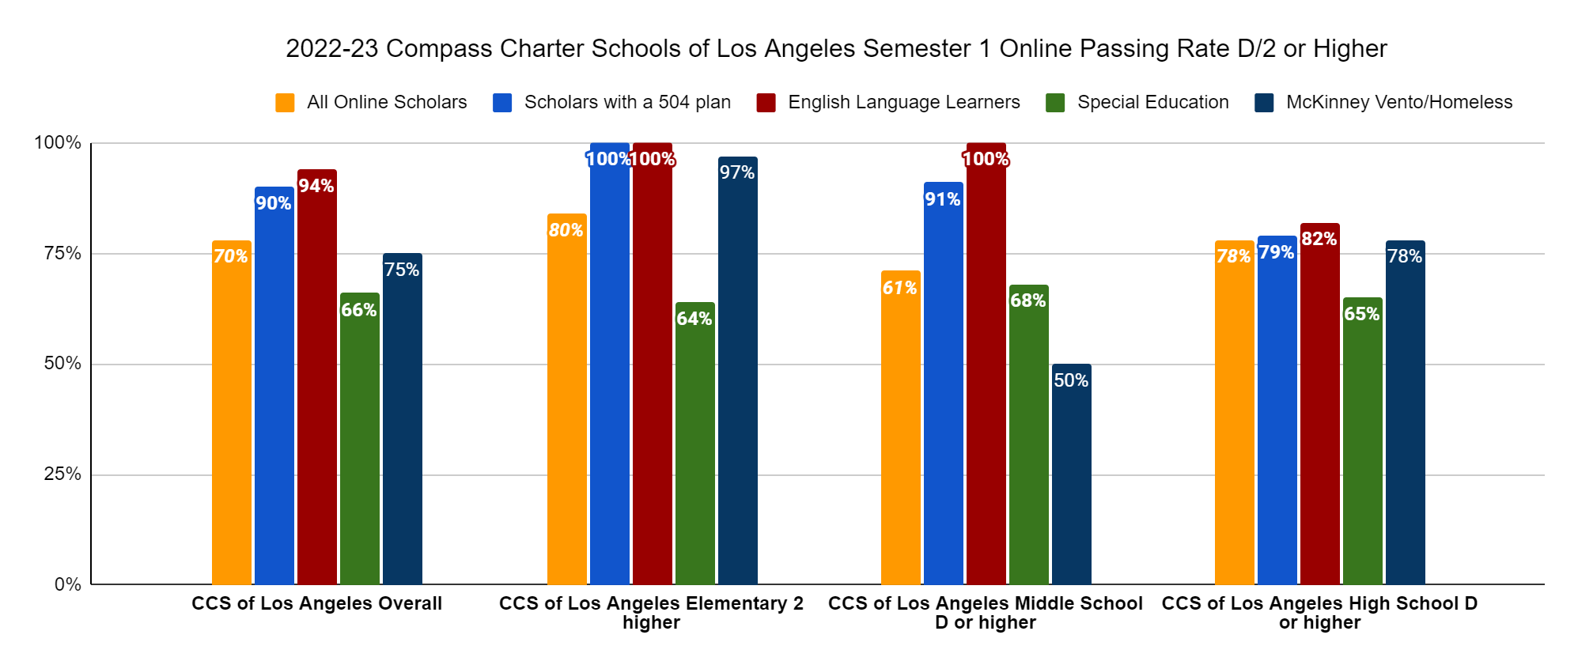
Online Learning
2022-23 Compass Charter Schools of Los Angeles Semester 1 Online Passing Rate D/2 or Higher

Slide 12
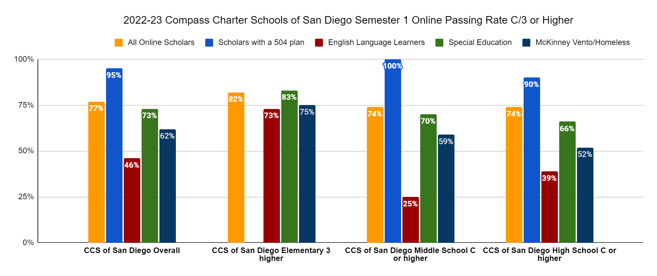
Online Learning
2022-23 Compass Charter Schools of San Diego Semester 1 Online Passing Rate C/3 or Higher

Slide 13
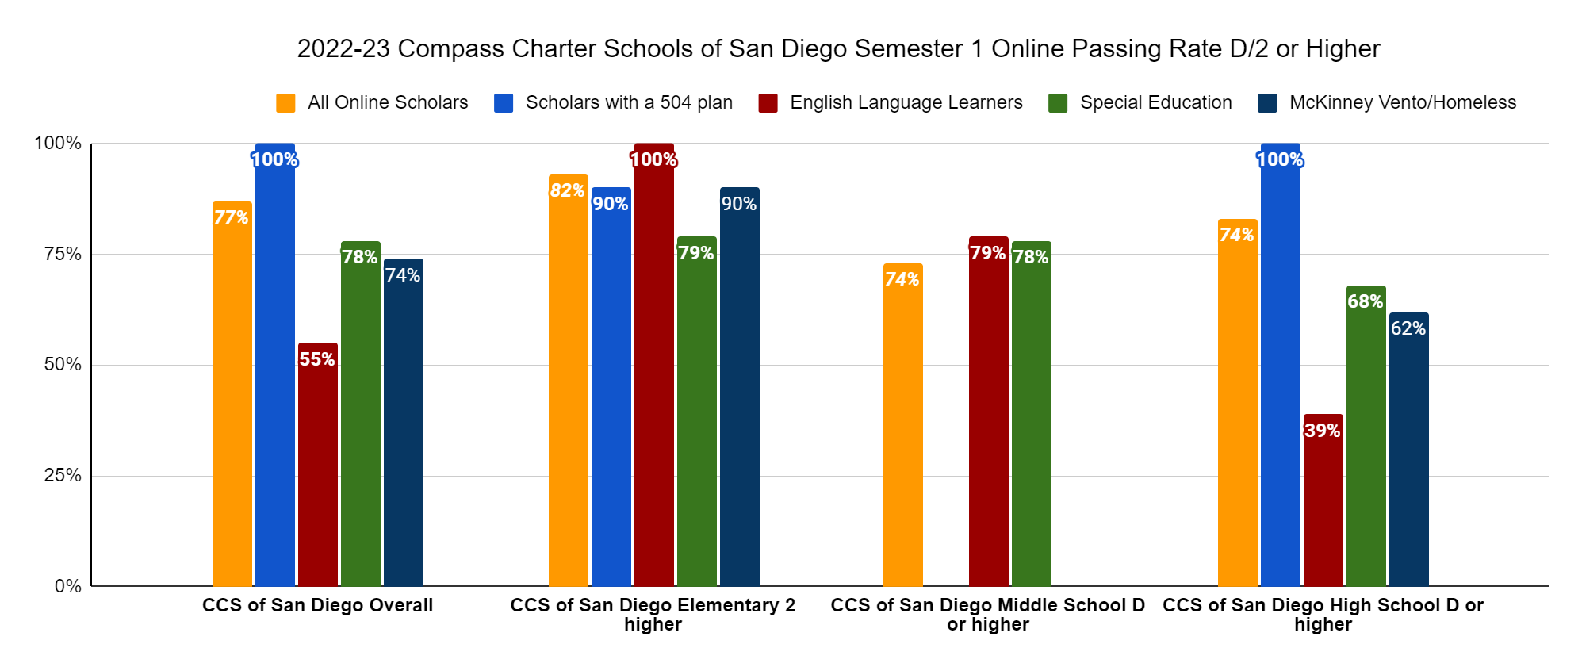
Online Learning
2022-23 Compass Charters Schools of San Diego Semester 1 Online Passing Rate D/2 or Higher

Slide 14
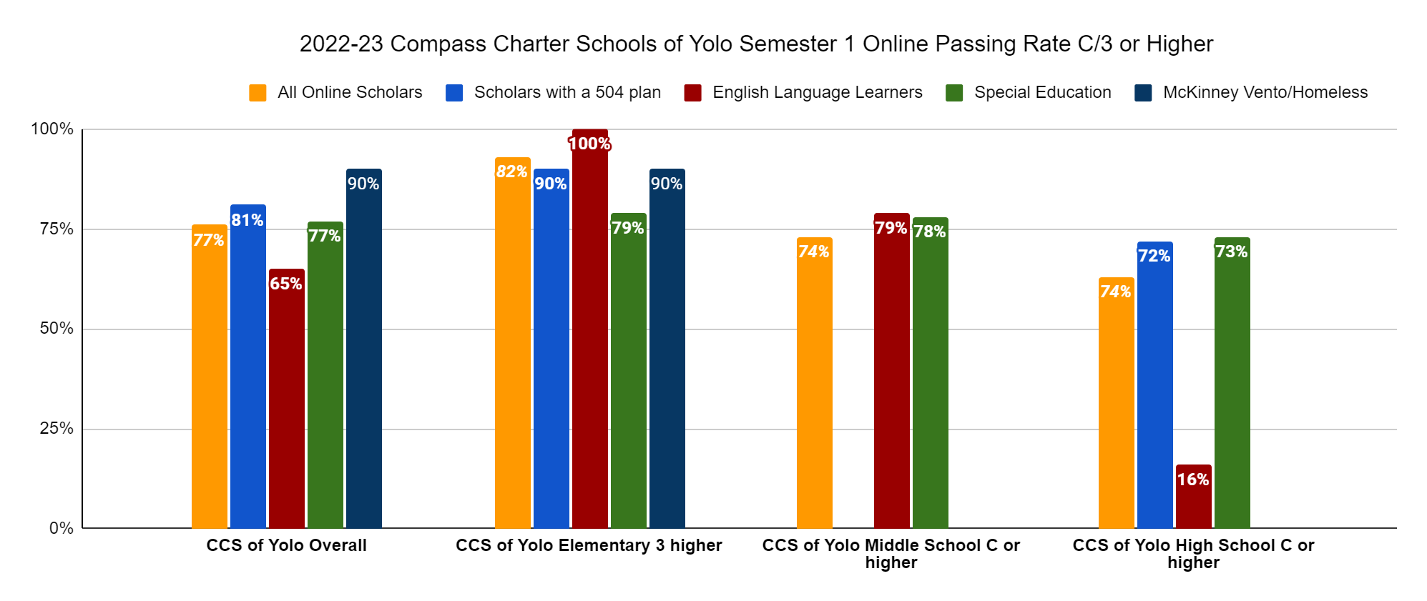
Online Learning
2022-23 Compass Charters Schools of Yolo Semester 1 Online Passing Rate C/3 or Higher

Slide 15
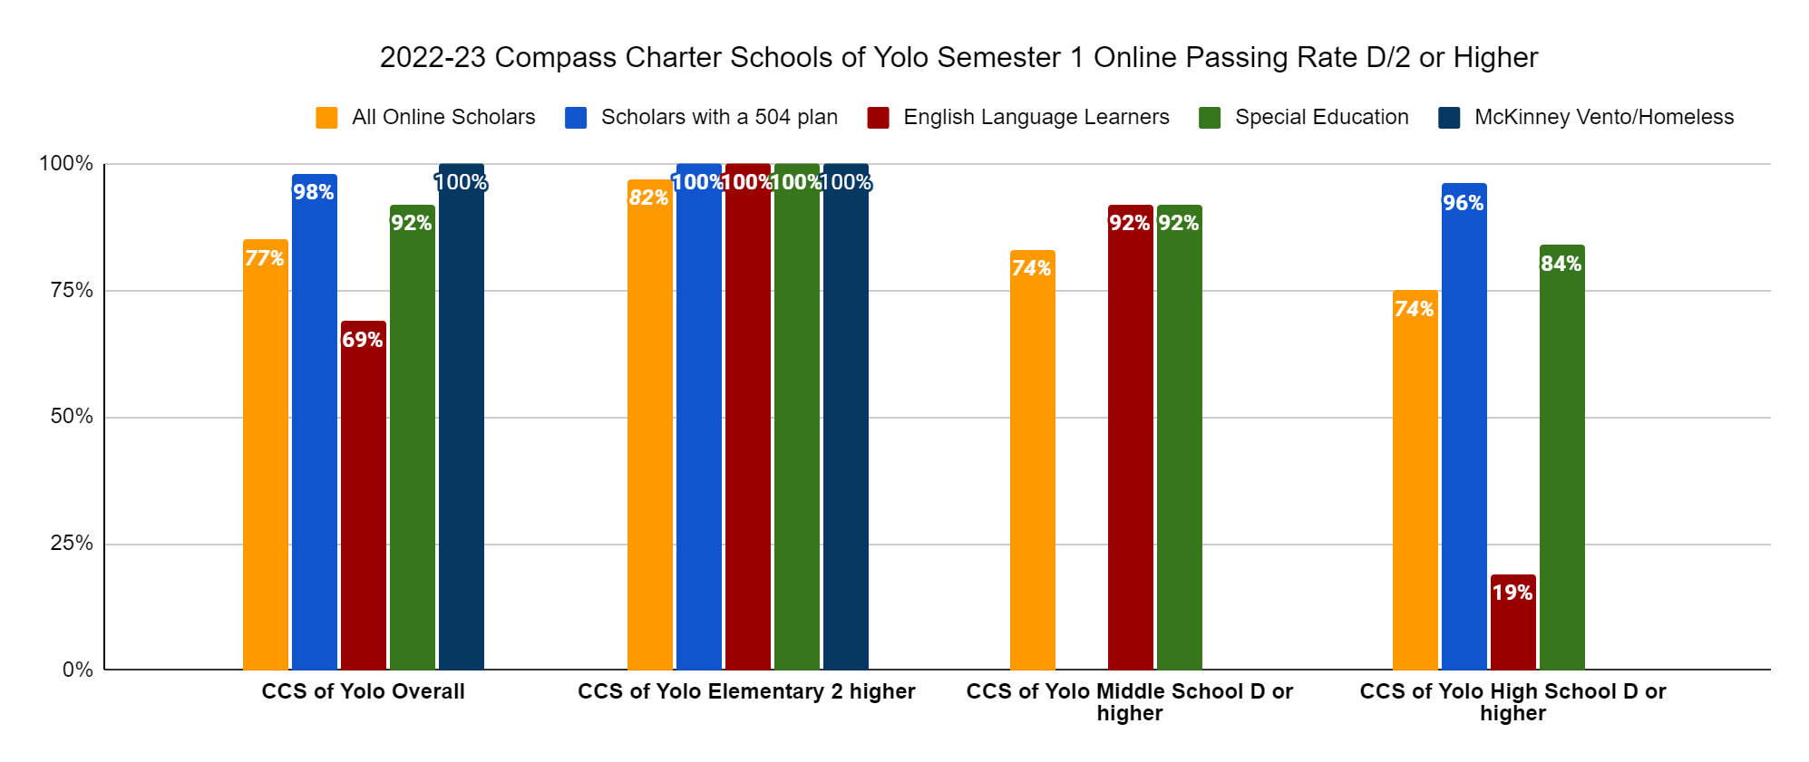
Online Learning
2022-23 Compass Charter Schools of Yolo Semester 1 Online Passing Rate D/2 or Higher

Slide 16
Online Learning
Online Learning Connection Meeting Attendance for Semester 1
Notes:
In the Online Learning Program, attendance is monitored through time spent in Accelerate Education courses, daily work submission in the Online Learning courses, Activity Logs, Attendance in synchronous sessions, and connection meetings (to discuss overcoming barr.
With additional data to determine scholar attendance and performance provided by the Student Information System (SIS), continuing to communicate connection meeting attendance with Online learning coaches and scholars has helped to increase this participation.
During the Online Learning data discussions each month, action plans created to support scholars also include strategies to ensure connection meeting attendance so learning coaches, scholars, and the teachers can collaborate to support scholar learning needs.

Slide 17
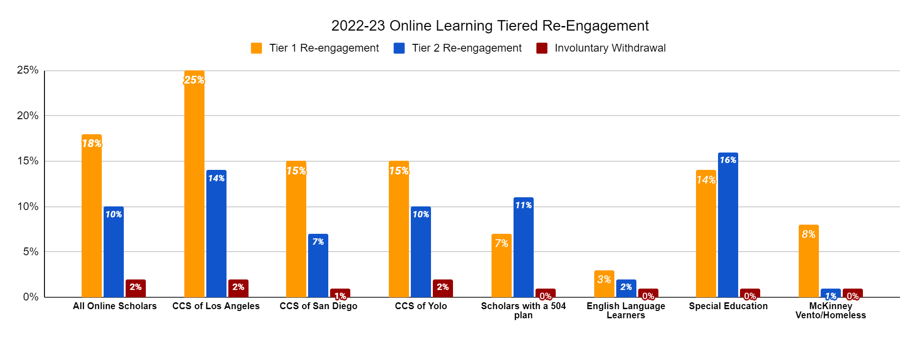
Online Learning
2022-23 Online Learning Fall Tiered Re-engagement
Notes:
In order to focus on restorative practices, during the tier 2 re-engagement process, learning coaches and scholars meet with a team that includes the program director and/or coordinator, supervising teacher, and support staff, as applicable, to address barriers to learning and create an action plan to help support scholars in building consistent processes and learning routines to work towards enabling their success in an independent study learning environment.

Slide 18
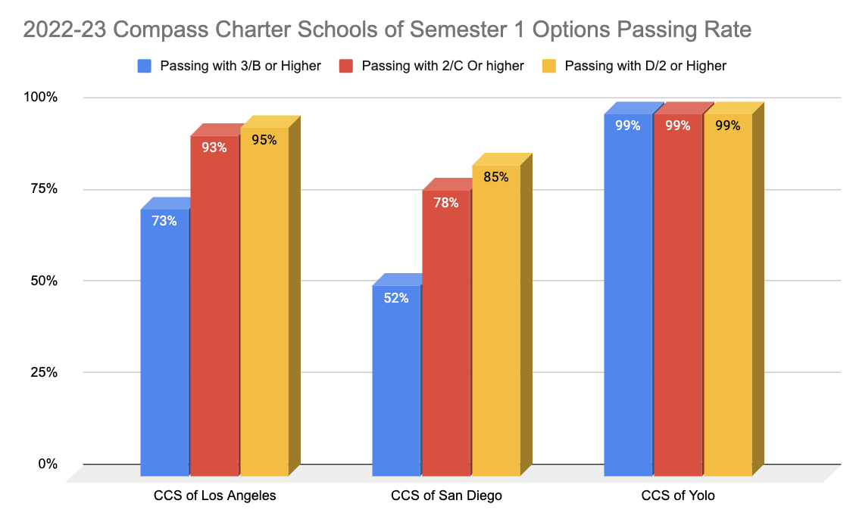
Options Learning
Grading Breakdown
Notes:
This graph is a breakdown of the of scholars who have earned a c or better, a b or better and a D or better. This data shows that our scholars are excelling academically with many high school aged scholars on track to graduate. This data shows all scholars on both the traditional grading scale as well as the mastery based grading scale.

Slide 19
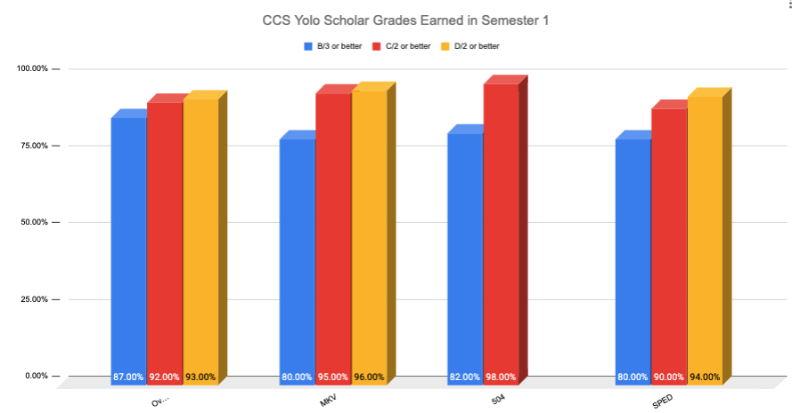
Options Learning
Grading Breakdown
Notes:
This graph is a breakdown of the of scholars who have earned a c or better, a b or better and a D or better. This data shows that our scholars are excelling academically with many high school aged scholars on track to graduate. This data shows all scholars on both the traditional grading scale as well as the mastery based grading scale.

Slide 20
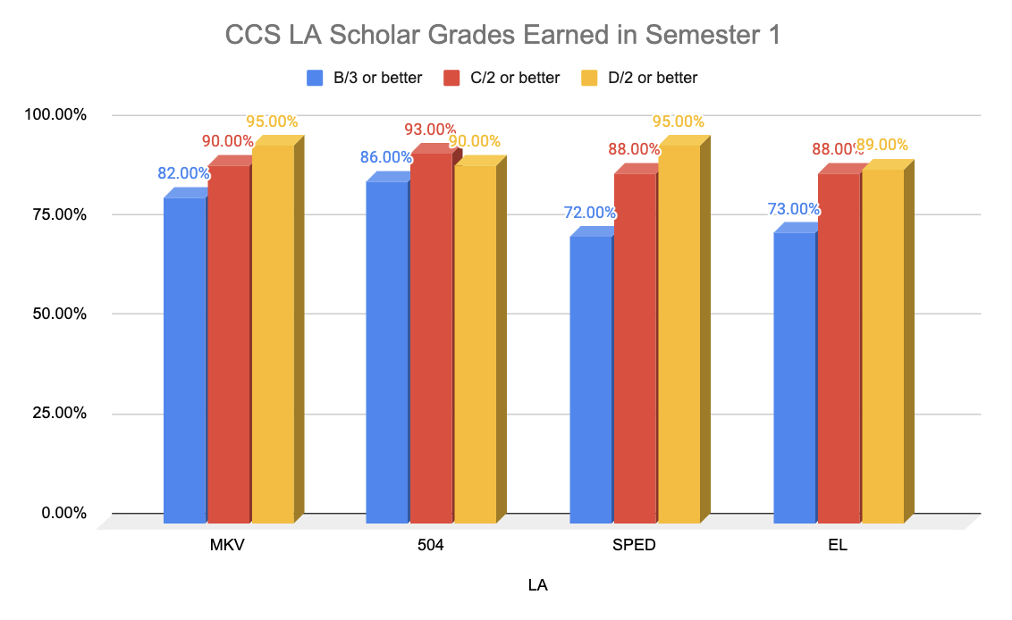
Options Learning
Grading Breakdown
Notes:
This graph is a breakdown of the of scholars who have earned a c or better, a b or better and a D or better. This data shows that our scholars are excelling academically with many high school aged scholars on track to graduate. This data shows all scholars on both the traditional grading scale as well as the mastery based grading scale.

Slide 21
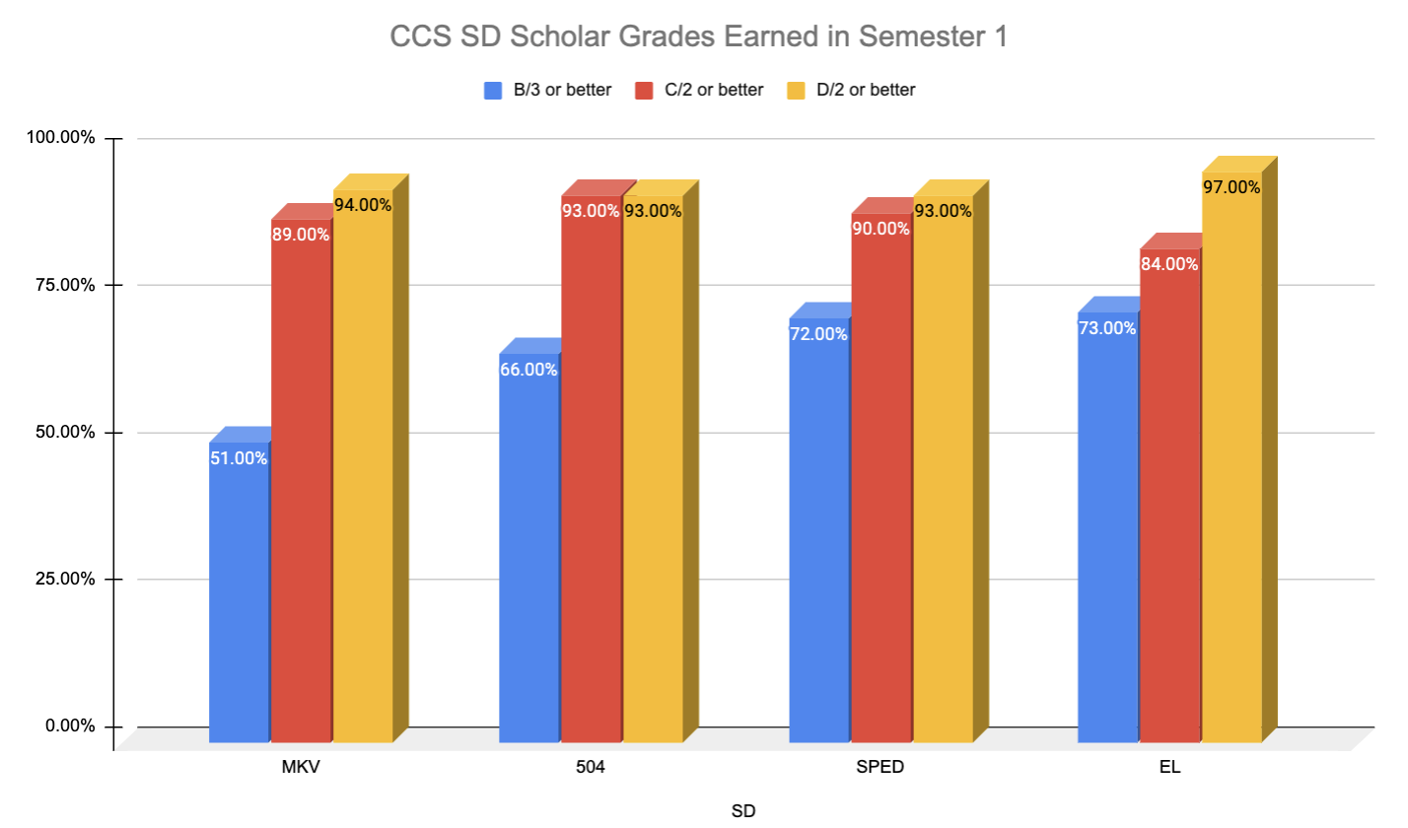
Options Learning
Grading Breakdown
Notes:
This graph is a breakdown of the of scholars who have earned a c or better, a b or better and a D or better. This data shows that our scholars are excelling academically with many high school aged scholars on track to graduate. This data shows all scholars on both the traditional grading scale as well as the mastery based grading scale.

Slide 22
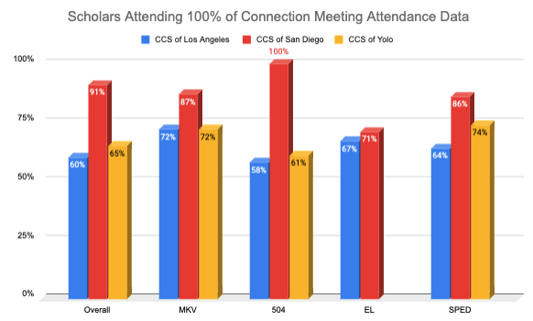
Options Learning
Connection Meeting Attendance
Notes:
This graph is a breakdown of the of scholars who have earned a c or better, a b or better and a D or better. This data shows that our scholars are excelling academically with many high school aged scholars on track to graduate. This data shows all scholars on both the traditional grading scale as well as the mastery based grading scale.

Slide 23
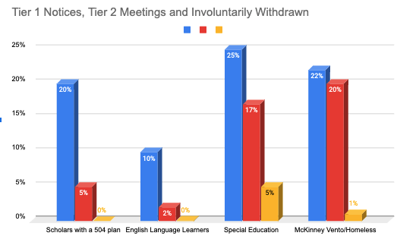
Options Learning
Notes:
The blue bar in this chart shows the % of scholars who received at least 1 tier notice during the first semester of the school year for the specific subgroup. This number is in comparison to the overall number of students in that scope that went from tier 1 to tier 2.. The red bar indicates that 22% of the overall number of scholars in that scope went to tier 2 and the yellow show the number that went to tier 3.

Slide 24
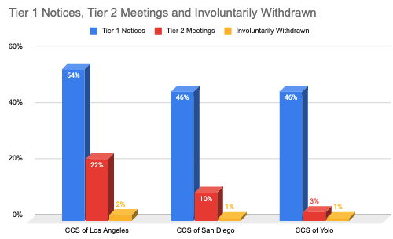
Options Learning
Notes:
The blue bar in this chart shows the % of scholars who received at least 1 tier notice during the first semester of the school year. This number is in comparison to the overall number of students in that scope. The red bar indicates that 22% of the overall number of scholars in that scope went to tier 2 and the yellow show the number that went to tier 3.

Slide 25
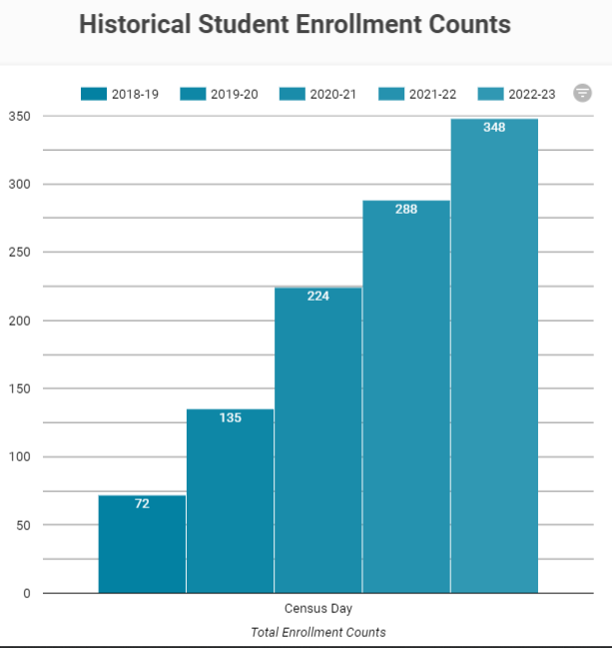
Special Education
Enrollment
Enrollment for special education scholars at Compass Charter Schools over the past 5 years.
The percentage of scholars enrolled at Compass at the October Census Day has increased from 6% in 2018-19 to 15% in 2022-23.
graph from PARSECGO 3/15/2023

Slide 26
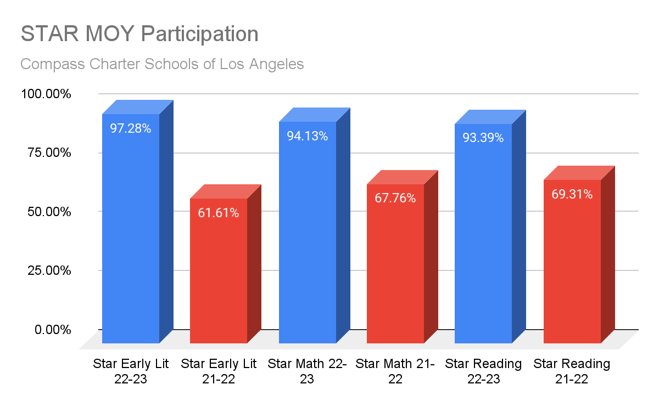
Staff Support
CCS of Los Angeles MOY STAR Participation Comparison 2021-2022 and 2022 - 2023

Slide 27
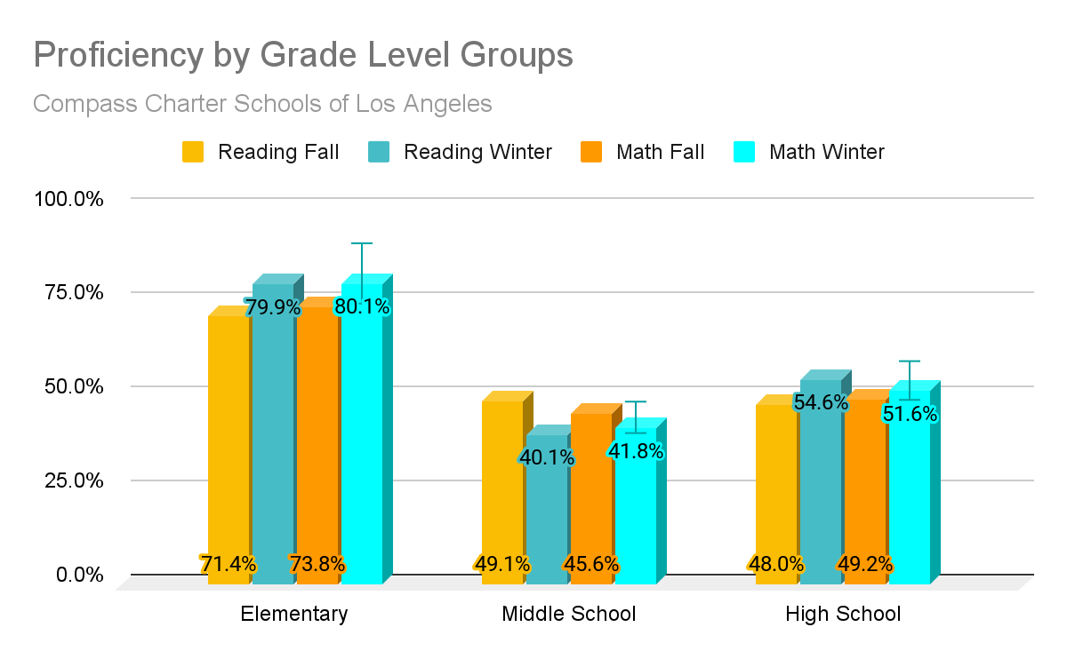
Staff Support
CCS of Los Angeles STAR Data:
BOY to MOY Growth

Slide 28
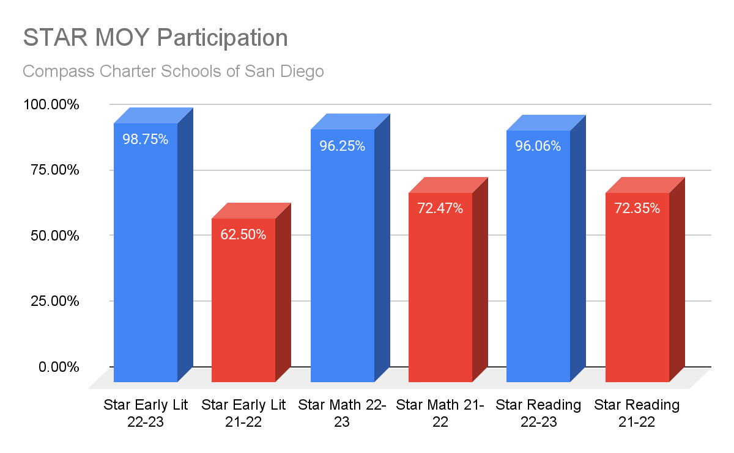
Staff Support
CCS of San Diego MOY STAR Participation Comparison 2021-2022 and 2022 - 2023

Slide 29
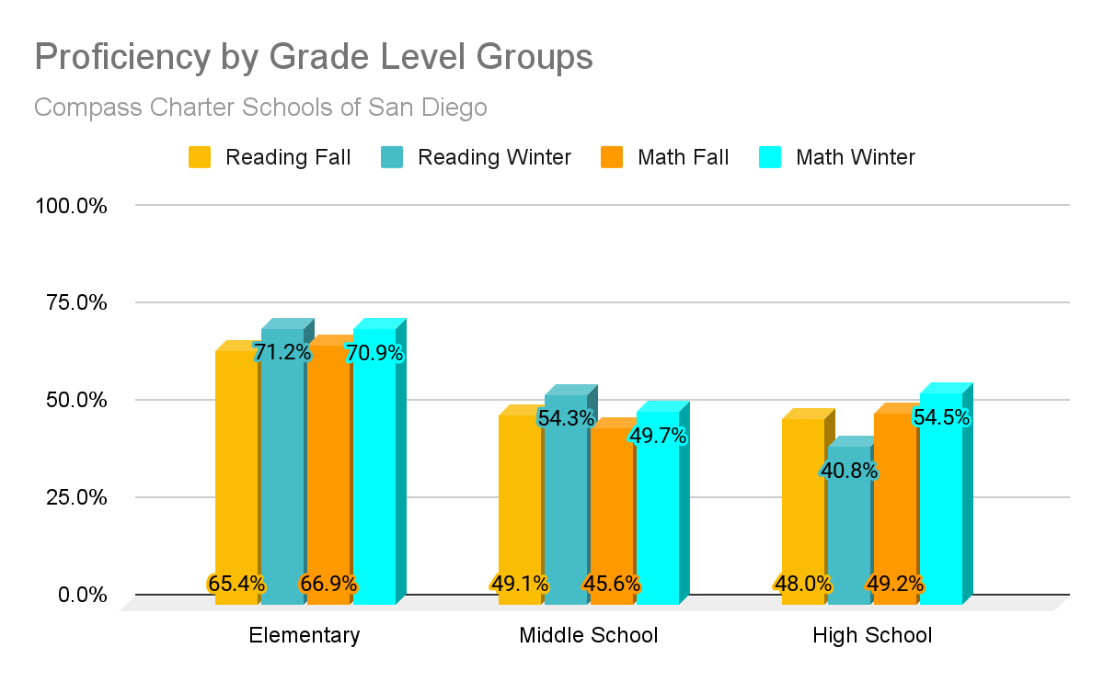
Staff Support
CCS of San Diego STAR Data:
BOY to MOY Growth

Slide 30
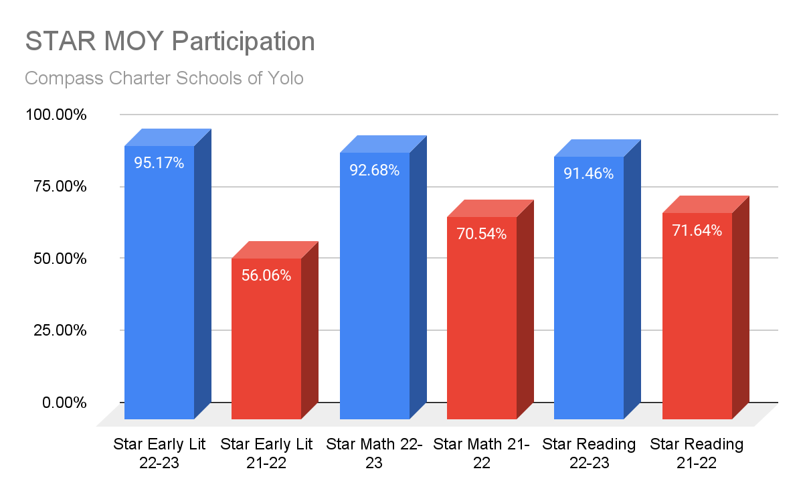
Staff Support
CCS of Yolo MOY STAR Participation Comparison
2021-2022 and 2022 - 2023

Slide 31
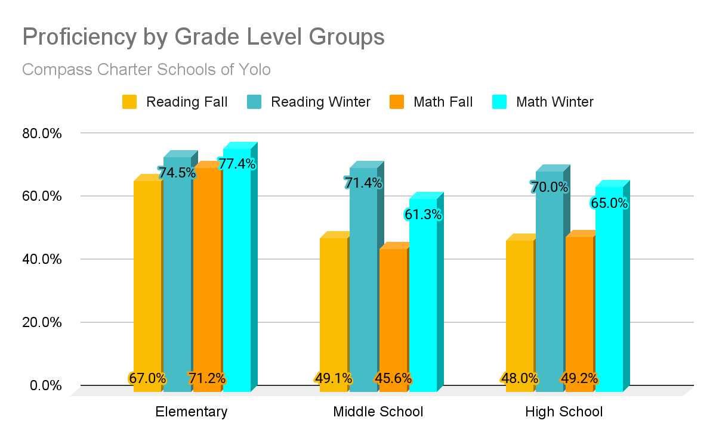
Staff Support
CCS of Yolo STAR Data: BOY to MOY Growth

Slide 32
Questions?
Contact:
Aviva Ebner, Ph.D. | Assistant Superintendent &
Chief Academic Officer
805-358-4381
aebner@compasscharters.org

