Slide 1


Financials through Dec 31, 2022
Monthly Financial Board Report
Prepared for: Compass Charter Schools
Prepared by School's CSMC SBM - Kristin Nowak

Slide 2

Financial Summary
Actual to Budget:
This report is as of Dec 31, 2022, compared against our board-approved budget.
YTD Revenues Through Dec 31, 2022, are $13,339,082.
YTD Expenses Through Dec 31, 2022, are $14,901,625.
Therefore, net income is ($1,562,543).
Balance Sheet:
As of Dec 31, 2022, we had total cash of $11,649,036, short-term liabilities of $4,560,345, and long-term liabilities of $0. The ending fund balance is $7,987,081.
Report created on 1/15/2023 4:16:36 PM for Compass Charter Schools

Slide 3



Understanding the Financial Health of the Organization
The chart below explains some of the parameters that the school’s leadership can evaluate to understand their financial health, and potential areas of weakness.
Cash Ratio
Ability to meet short-term obligations with cash
 | Current: | Target:
 | 255.4 % | > 100.0 %
Formula: (Cash) / (Current Liabilities)
Defensive Interval
Months of continued operation without incoming funds
 | Current: | Target:
 | 4.4 | > 3 months
Formula: (Cash + Securities + AR)/(Average Expenses for Past 12 Months)
Current Ratio (Liquidity)
Ability to pay short-term obligations
 | Current: | Target:
 | 2.7 | > 1.0
Formula: (Current Assets) / (Current Liabilities)
Report created on 1/15/2023 4:16:30 PM for Compass Charter Schools

Slide 4

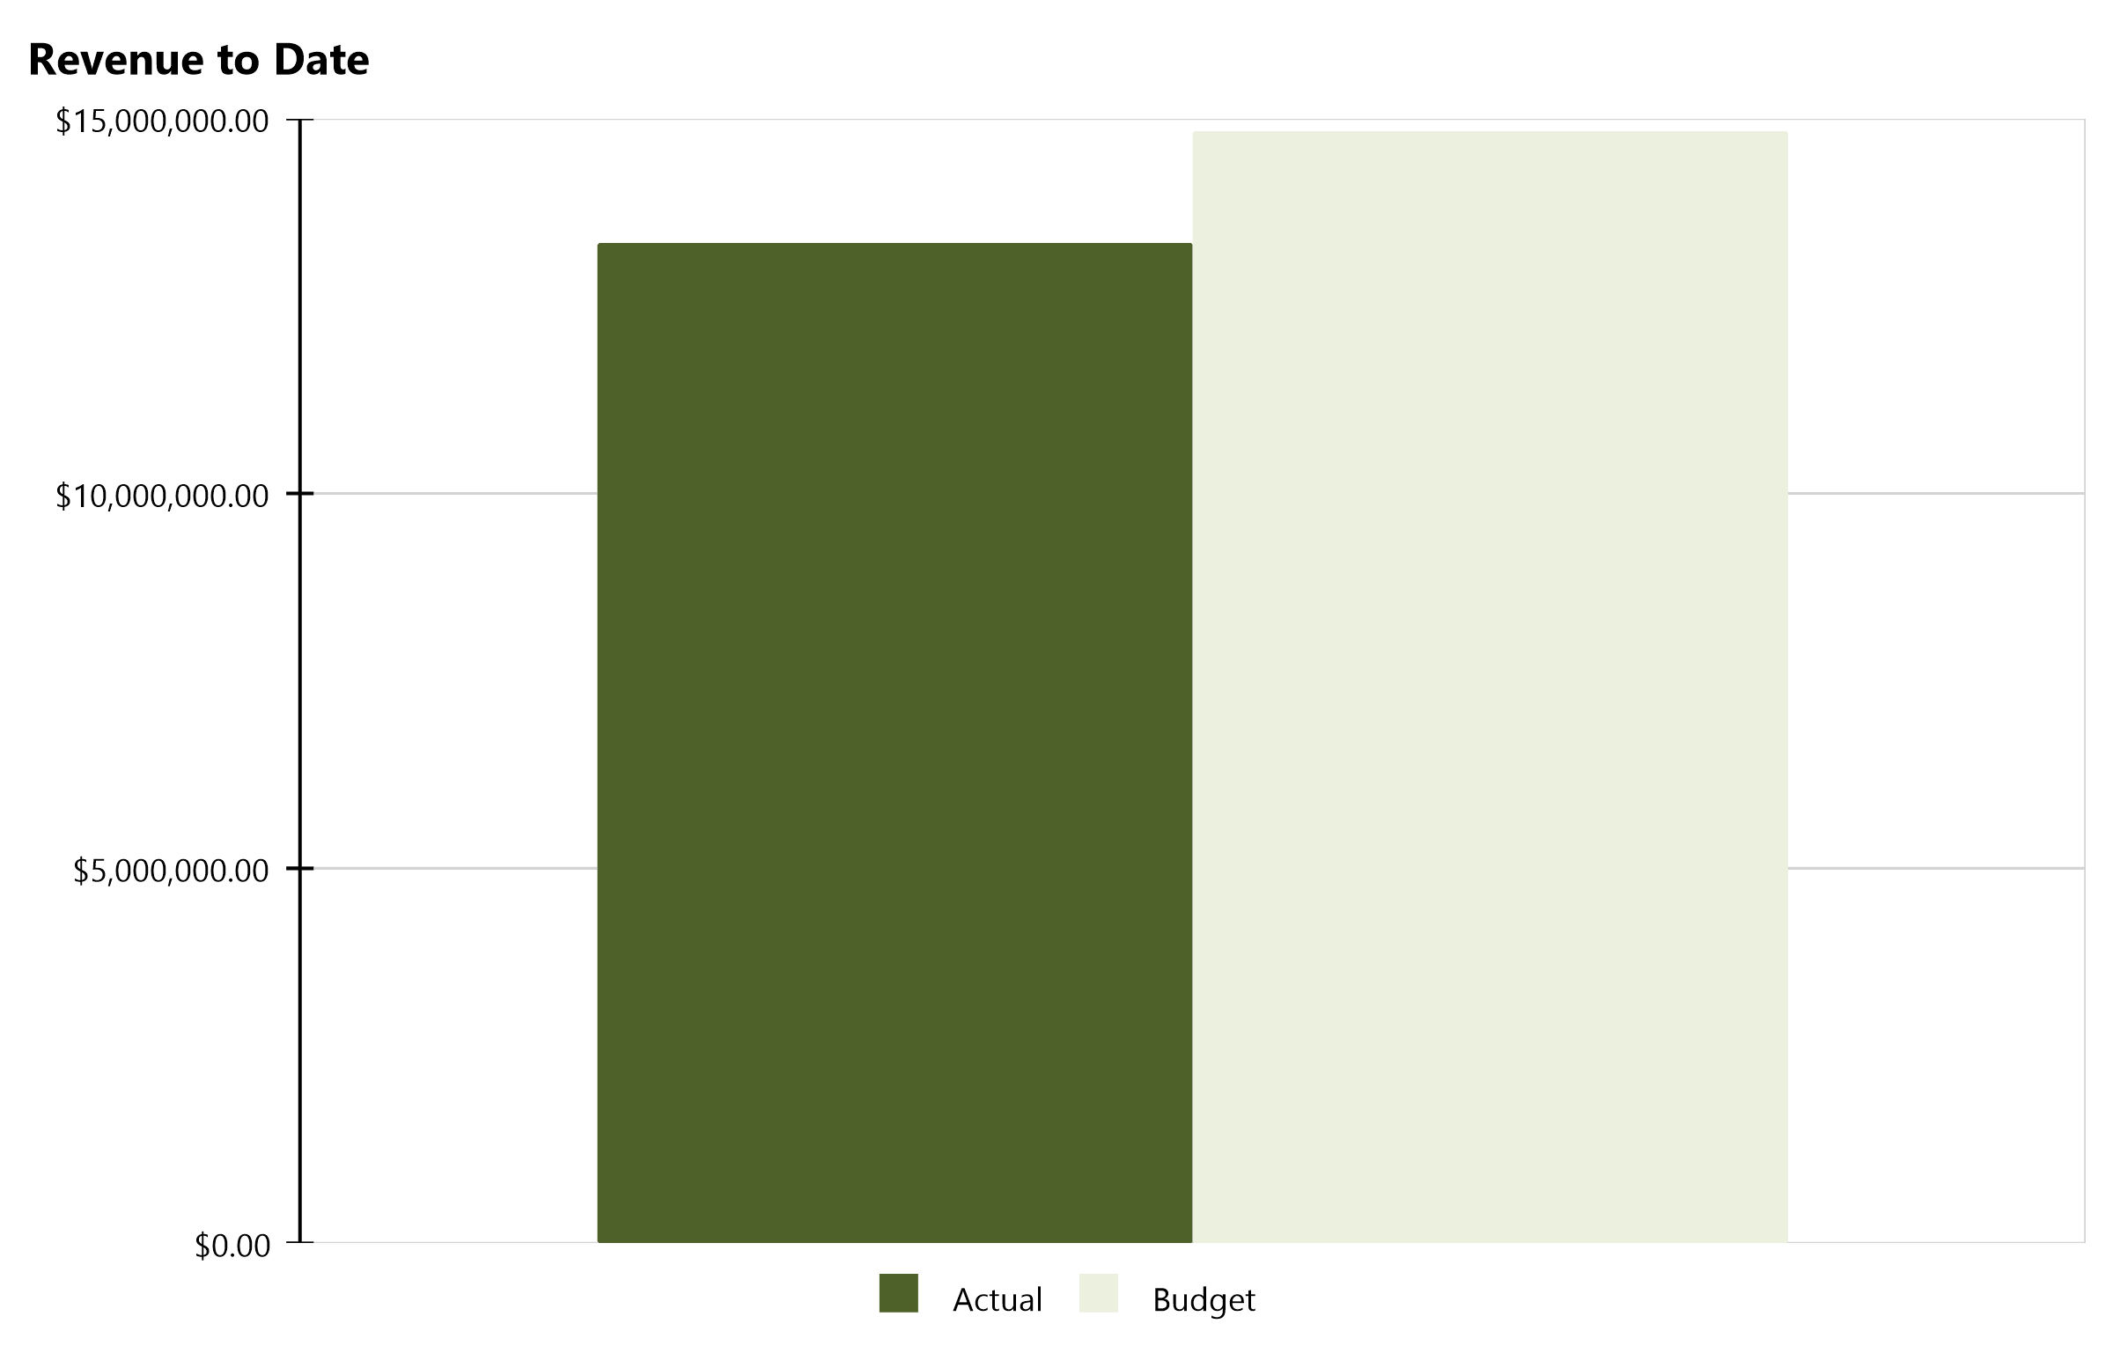
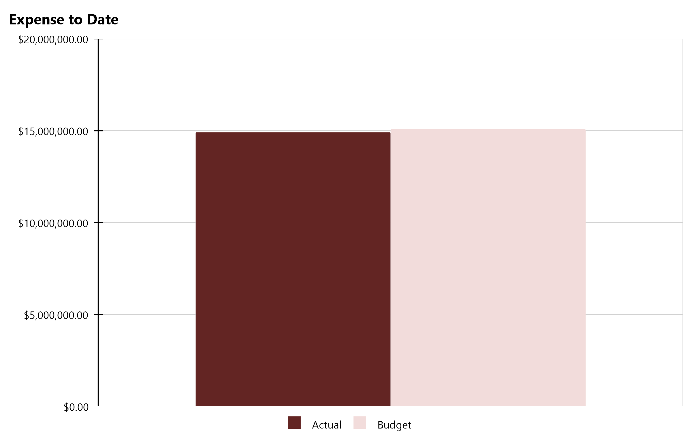
Compass Charter Schools Financial Snapshot
FY 2022-2023, July - December
Cash Balance
$11,649,036
Revenue Summary
Actual | $13,339,082
Budget | $14,830,764
Actual to Budget | -10.1 %
Expense Summary
Actual | $14,901,625
Budget | $15,081,663
Actual to Budget | -1.2 %
Report created on 1/15/2023 4:16:36 PM for Compass Charter Schools

Slide 5
Actual to Budget Summary
FY 2022-2023, July - December
Revenue
$13,339,082
Expenses
$14,901,625
Surplus / (Deficit)
($1,562,543)
 | July - Last Closed |  |  | 2022-2023
Account Description | Actual | Budget | Variance $ | Total Budget | Actual to Total Budget % | Remaining Budget
LCFF | $10,133,203 | $11,694,407 | ($1,561,204) | $25,500,258 | 39.7 % | $15,367,055
Federal Revenue | $574,617 | $1,612,473 | ($1,037,856) | $2,369,008 | 24.3 % | $1,794,391
Other State Revenue | $1,625,358 | $554,969 | $1,070,389 | $1,173,818 | 138.5 % | ($451,540)
Local Revenue | $1,005,904 | $968,915 | $36,989 | $2,110,755 | 47.7 % | $1,104,851
Total Revenue | $13,339,082 | $14,830,764 | ($1,491,682) | $31,153,839 | 42.8 % | $17,814,757
Certificated Salaries | $5,889,810 | $5,909,198 | $19,389 | $12,433,234 | 47.4 % | $6,543,425
Classified Salaries | $1,718,005 | $1,740,828 | $22,823 | $3,495,638 | 49.1 % | $1,777,633
Employee Benefits | $2,500,014 | $2,600,525 | $100,512 | $5,221,939 | 47.9 % | $2,721,925
Total Personnel Expenses | $10,107,828 | $10,250,551 | $142,723 | $21,150,811 | 47.8 % | $11,042,983
Books and Supplies | $2,065,336 | $2,419,532 | $354,195 | $5,229,464 | 39.5 % | $3,164,128
Services & Other Operating Expenses | $2,728,461 | $2,411,580 | ($316,881) | $5,044,207 | 54.1 % | $2,315,746
Other Outgo | - | - | - | - | 0.0 % | $0
Total Operational Expenses | $4,793,797 | $4,831,112 | $37,315 | $10,273,671 | 46.7 % | $5,479,874
Total Expenses | $14,901,625 | $15,081,663 | $180,038 | $31,424,482 | 47.4 % | $16,522,857
Net Income | ($1,562,543) | ($250,899) | ($1,311,644) | ($270,643) | 577.3 % | $1,291,900
This report displays all actual and budgeted revenue and expenditures by object code series and by month. This report can be useful in ensuring you receive your revenue in a timely manner and that you stay within the board approved expenditure levels.
Report created on 1/15/2023 4:16:37 PM for Compass Charter Schools

Slide 6
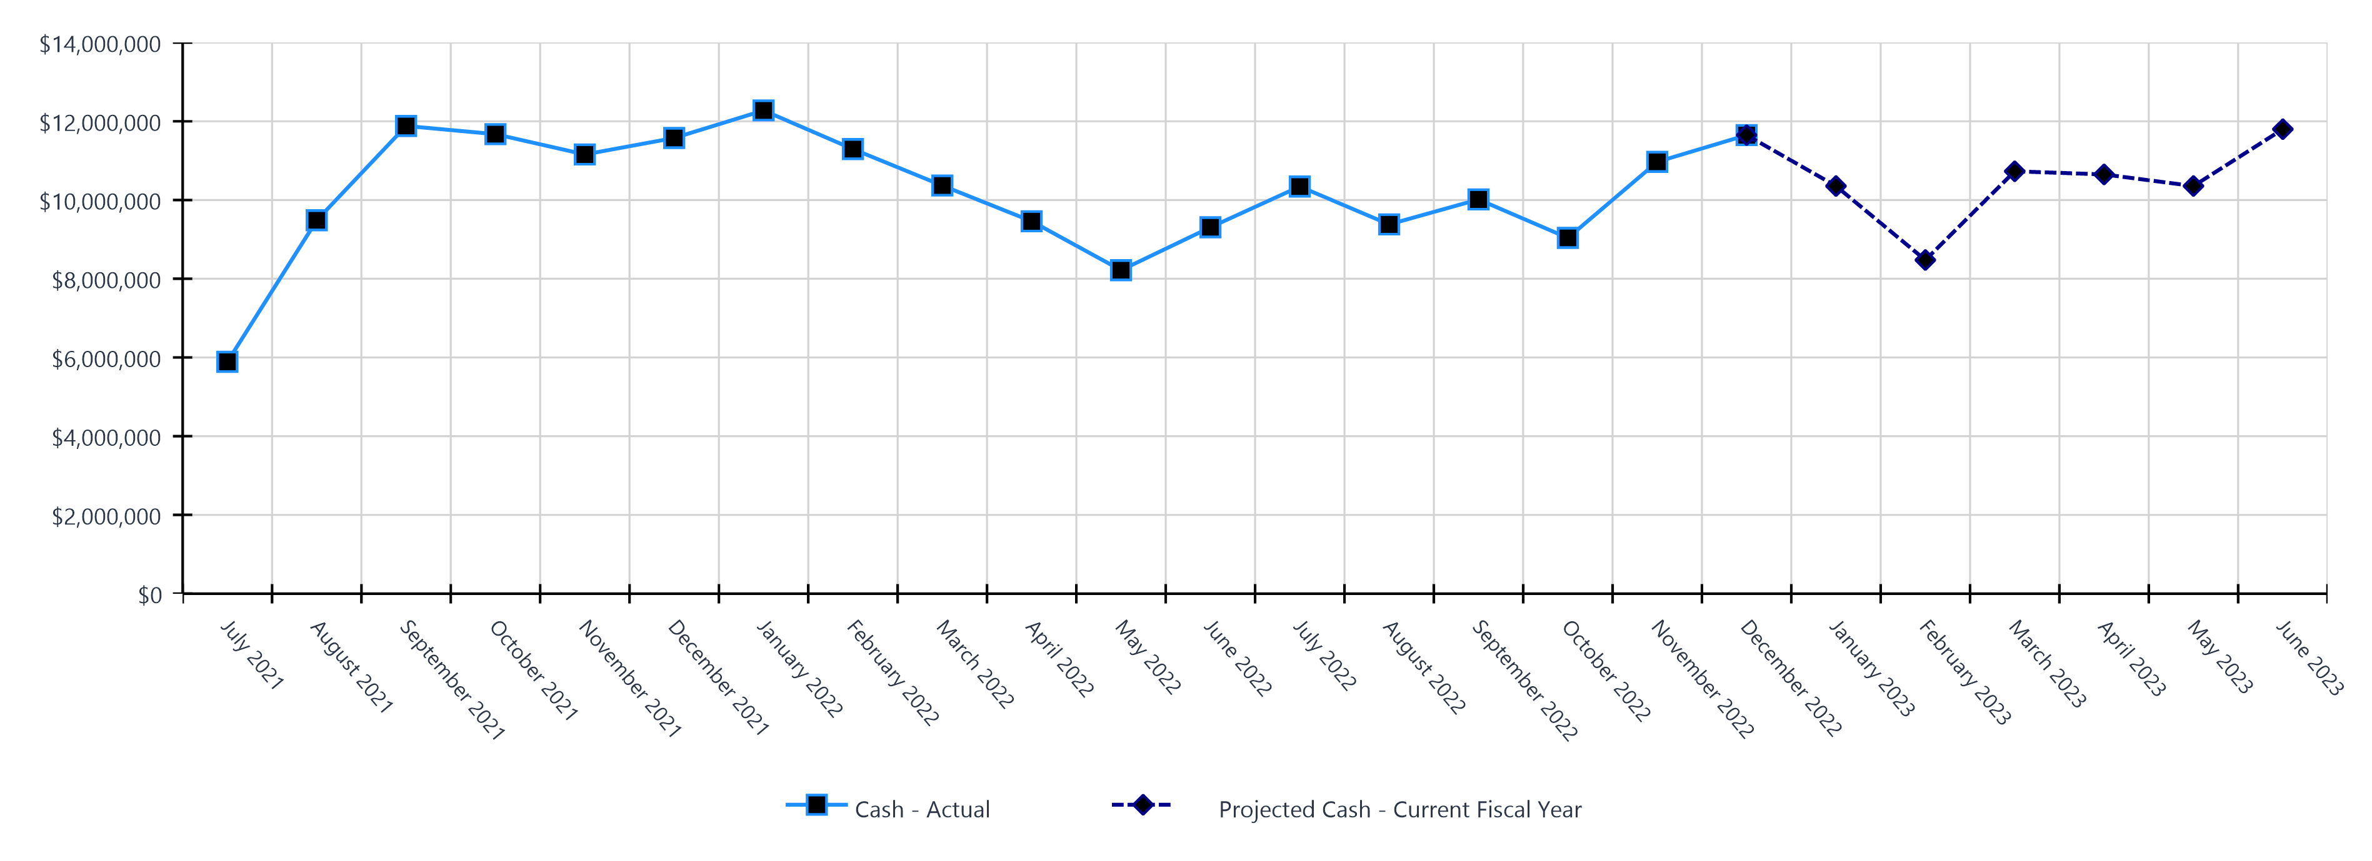
Monthly Cash Balance Over Time
Current fiscal year and prior year
 | Cash Amount | Actual or Projected
July 2021 | $5,888,993.16 | Actual
August 2021 | $9,485,434.42 | Actual
September 2021 | $11,881,276.91 | Actual
October 2021 | $11,673,018.17 | Actual
November 2021 | $11,157,901.31 | Actual
December 2021 | $11,575,940.87 | Actual
January 2022 | $12,274,921.27 | Actual
February 2022 | $11,294,552.84 | Actual
March 2022 | $10,367,581.00 | Actual
April 2022 | $9,459,720.14 | Actual
May 2022 | $8,217,541.31 | Actual
June 2022 | $9,307,312.07 | Actual
 | Cash Amount | Actual or Projected
July 2022 | $10,343,078.82 | Actual
August 2022 | $9,380,680.82 | Actual
September 2022 | $10,015,077.91 | Actual
October 2022 | $9,037,403.55 | Actual
November 2022 | $10,969,843.83 | Actual
December 2022 | $11,649,036.39 | Actual
January 2023 | $10,354,972.00 | Projected
February 2023 | $8,475,201.00 | Projected
March 2023 | $10,730,579.00 | Projected
April 2023 | $10,650,234.00 | Projected
May 2023 | $10,355,047.00 | Projected
June 2023 | $11,799,912.00 | Projected
Report created on 1/15/2023 4:16:37 PM for Compass Charter Schools

Slide 7
Balance Sheet Summary FY 2022-2023 - December
The balance sheet displays all of the school’s assets and the school’s obligations (‘liabilities’) at a particular point in time. It is a useful way to ensure the school has enough money to pay off its debts.
Liquidity Ratio
2.7
Assets
Current Assets
Cash | $11,649,036
Accounts Receivables | $582,417
Prepaid Expenses | $305,393
Other Current Assets | $360
Total Current Assets | $12,537,207
Other Assets
Security Deposits | $10,220
Total Other Assets | $10,220
Total Assets | $12,547,426
Liabilities and Net Assets
Current Liabilities
Accounts Payable | $2,188,619
Accrued Salaries, Payroll Taxes, Postemployment Benefits | $919,792
Deposits held on behalf of other employees | $212,072
Deferred Revenue | $1,239,862
Total Current Liabilities | $4,560,345
Long Term Liabilities
Total Long Term Liabilities | $0
Total Liabilities | $4,560,345
Net Assets
Unrestricted Net Assets | $9,549,625
Profit/Loss YTD | ($1,562,543)
Total Net Assets | $7,987,081
Total Liabilities and Net Assets | $12,547,426
Report created on 1/15/2023 4:16:37 PM for Compass Charter Schools

Slide 8
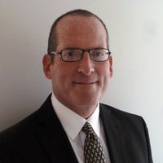



CSMC Charter School Support Team
 | Executive VP of Client Services Tom Nichols tnichols@csmci.com
 | Regional AM Director Mai Luong mluong@csmci.com
 | School Business Manager Kristin Nowak knowak@csmci.com
 | Account Manager Mai Luong mluong@csmci.com
 | Associate AM Kimber Nelson knelson@csmci.com
Report created on 1/15/2023 4:16:37 PM for Compass Charter Schools

Slide 9
Looking Ahead
1/16/2023 | Mid-January - Several special education reports due; timing and steps vary by SELPA
1/25/2023 | CSMC Webinar
1/28/2023 | Board Meeting
1/31/2023 | Federal Cash Management Data Collection (CMDC)
 | ASES attendance and expenditure reports
2/1/2023 | School Accountability Report Card (SARC) due in CDE portal
 | CSMC Regional Office Hours
2/7/2023 | CSMC Workshop: State and Federal programs compliance
2/9/2023 | CSMC Workshop: State and Federal programs compliance
2/13/2023 | Mid-Month: ASES applications for next year due
2/15/2023 | Property tax exemption requests due
2/16/2023 | CSMC Virtual Office Hours, open to all CSMC clients
2/22/2023 | CSMC Webinar
3/8/2023 | CSMC Regional Office Hours
3/11/2023 | Winter Consolidated Application / CARS report possibly due
3/15/2023 | Second Interim Financial Report state deadline, authorizers may require earlier
3/18/2023 | Varies: Special education MOE pre-test; timing and steps vary by SELPA
3/25/2023 | Board Meeting
3/29/2023 | CSMC Webinar
Report created on 1/15/2023 4:16:37 PM for Compass Charter Schools

Slide 10
Looking Ahead
4/1/2023 | Audit firm selection
 | Form 700
4/15/2023 | CARES, ESSER, ESSER II, ESSER III, ELOG, ARP expenditure report
Report created on 1/15/2023 4:16:37 PM for Compass Charter Schools

Slide 11

HELPING THE EDUCATION MOVEMENT SUCCEED ONE SCHOOL AT A TIME
info@csmci.com
Office: 888.994.CSMC
43460 Ridge Park Dr., Ste. 100
Temecula, Ca 92590
POWERED BY:
Report created on 1/15/2023 4:16:36 PM for Compass Charter Schools
www.csmci.com
Charter Vision

