Slide 1
Compass Charter Schools
22-23 Finance Update
September 2022

Slide 2
Agenda
Mission and Vision
Values
Enrollment Update
Fiscal Impacts
Funding Determination
Q & A

Slide 3
Our Mission and Vision
MISSION STATEMENT
Our mission is to inspire and develop innovative, creative, self-directed learners, one scholar at a time.
VISION STATEMENT
Our vision is to create a collaborative virtual learning community, inspiring scholars to appreciate the ways in which arts and sciences nurture a curiosity for life-long learning, and prepare scholars to take responsibility for their future success.

Slide 4
Our Values

Slide 5
2022 - 23 Local Control Funding Rates
Base Grant Funding, EC Section 42238.02(d)
Grade Span | LCFF Base Grant
TK-3 | $9,132
4-6 | $9,270
7-8 | $9,544
9-12 | $11,061
Grade Span | Grade Span Adjustment
TK-3 | $950
9-12 | $28

Slide 6
FY 23 Projected Revenue
Los Angeles | San Diego | YOLO | Home Office | Total
$11,682,988 | $11,066,527 | $8,345,205 | $0 | $31,094,720
FY 23 Projected Expenses
Los Angeles | San Diego | YOLO | Home Office | Total
$11,621,250 | $10,988,556 | $8,298,150 | $0 | $30,907,956
FY 23 Projected Surplus/Deficit
Los Angeles | San Diego | YOLO | Home Office | Total
$61,738 | $77,971 | $61,738 | $0 | $186,701
Based on enrollment of 2,400 scholars

Slide 7
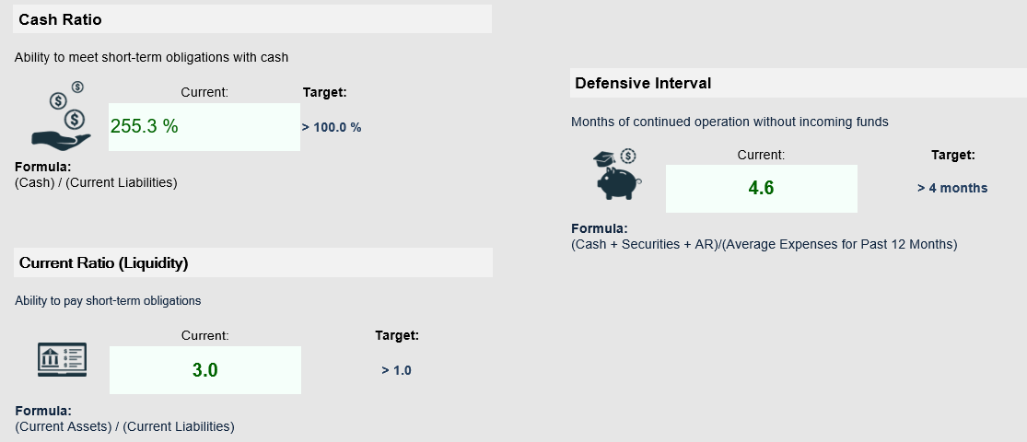
CCS Financial Heath
The chart below explains some of the parameters that the school’s leadership can evaluate to understand their financial health, and potential areas of weakness.

Slide 8
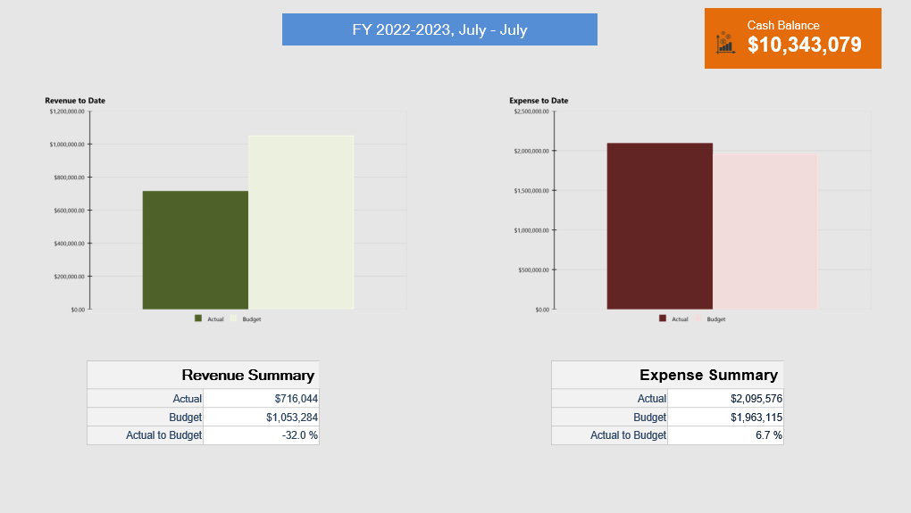
CCS Financial Snapshot

Slide 9
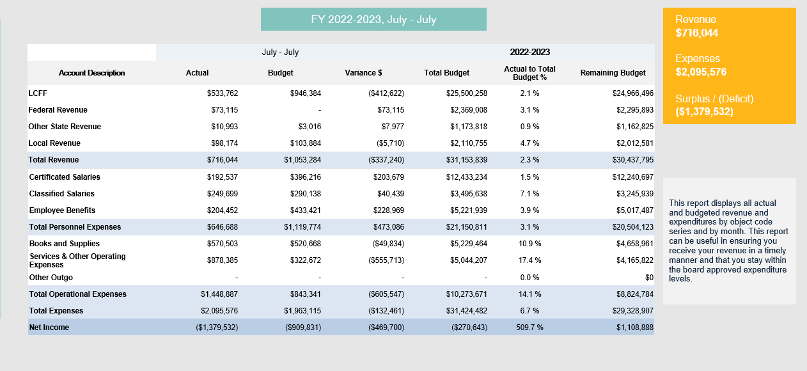
Actual to Budget Summary
As of July 30, 2022
Notes:
This report is as of Jul 31, 2022, compared against our board-approved budget on input date, based on input enrollment count students enrolled and input enrollment ADA ADA.
YTD Revenues Through Jul 31, 2022, are $716,044 or -32% under our current budget due to timing of revenue receipts.
YTD Expenses Through Jul 31, 2022, are $2,095,576 or -6.7% over our current budget
Therefore, net income is ($1,379,532)
Balance Sheet:
As of Jul 31, 2022, we had total cash of $10,343,079, short-term liabilities of $4,050,613, and long-term liabilities of $0. The ending fund balance is $8,170,093.

Slide 10
Percent spent on Certificated Employee Salaries & Benefits to Total Public Revenues (5 CCR 11963.3[c][1]) Target 40%

Slide 11
80/40 Funding Determination
Percent spent on Instruction & Instruction-Related Services to Total Revenues (5 CCR 11963.3[c][2]) Target 80%
Target Met

Slide 12
Questions?
Contact:
Lisa Fishman | Chief Operations Officer
(818) 732-4692
lfishman@compasscharters.org

