Slide 1
Head of School Evaluation
MCCPS Board of Trustees Training
March 28, 2023
Notes:
This template can be used as a starter file for presenting training materials in a group setting.
Sections
Sections can help to organize your slides or facilitate collaboration between multiple authors. On the Home tab under Slides, click Section, and then click Add Section.
Notes
Use the Notes pane for delivery notes or to provide additional details for the audience. You can see these notes in Presenter View during your presentation.
Keep in mind the font size (important for accessibility, visibility, videotaping, and online production)
Coordinated colors
Pay particular attention to the graphs, charts, and text boxes.
Consider that attendees will print in black and white or grayscale. Run a test print to make sure your colors work when printed in pure black and white and grayscale.
Graphics, tables, and graphs
Keep it simple: If possible, use consistent, non-distracting styles and colors.
Label all graphs and tables.

Slide 2
Overview
Remaining timeline and steps in the process
Summative Report
Performance Standards and Indicators
HOS Goals
Evidence that will be used
Notes:
Give a brief overview of the presentation. Describe the major focus of the presentation and why it is important.
Introduce each of the major topics.
To provide a road map for the audience, you can repeat this Overview slide throughout the presentation, highlighting the particular topic you will discuss next.

Slide 3
Timeline
March-April
HOS Evaluation Training
Val-Ed, Board on Track, and HOS Faculty Satisfaction Survey launched by Personnel committee
Board members thoroughly read and understand HOS Evaluation documents
HOS completes self-evaluations within surveys
HOS launches Parent Satisfaction survey
April-May
HOS presents End of Cycle Progress Report
Personnel Committee presents summary results of surveys
Board members collect and synthesize evidence toward assessment
May-June
Board members complete individual End-of-cycle Summative Evaluation Report
Board Chair and Vice-chair compile individual ratings and drafts summation
Board reviews draft, discusses revisions, and adopts report at public meeting
Report is placed in personnel file and used to inform HOS goals for following year
Notes:
This is another option for an overview using transitions to advance through several slides.

Slide 4
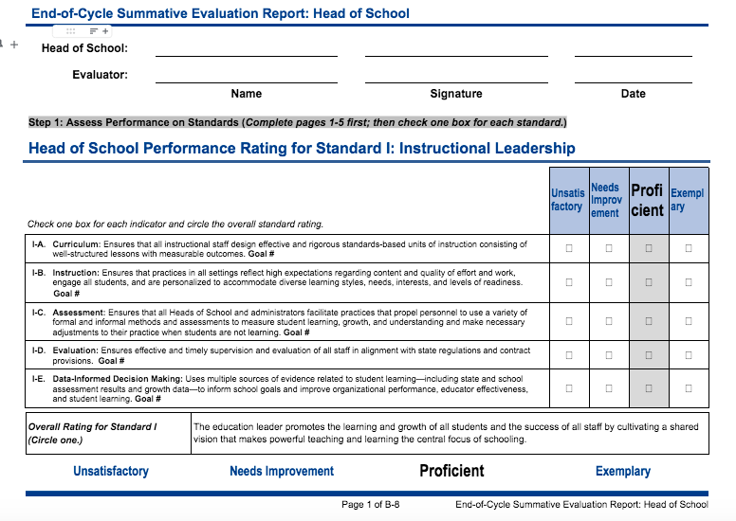
Performance Standards & Indicators Each Board member will begin by assessing the HOS on 4 Standards of Effective Head of School Leadership. Each of the four Standards has between 4-6 Indicators. *These will be labeled and tied to one of the 3 goals for reference.
Notes:
This is another option for an overview slide.

Slide 5
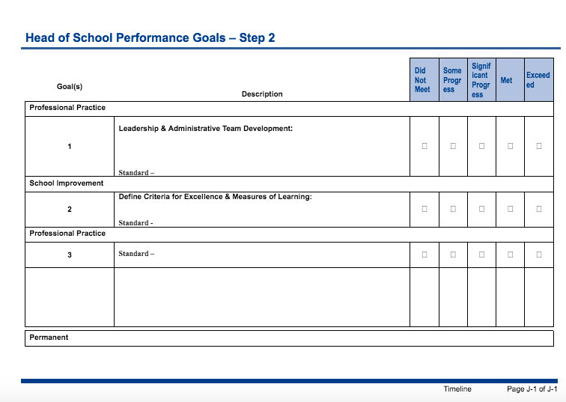
Head of School Goals
Each Board member will then assess the HOS progress toward the 3 current goals. *These will be filled in will Peter’s goals and matching standards will be noted.

Slide 6
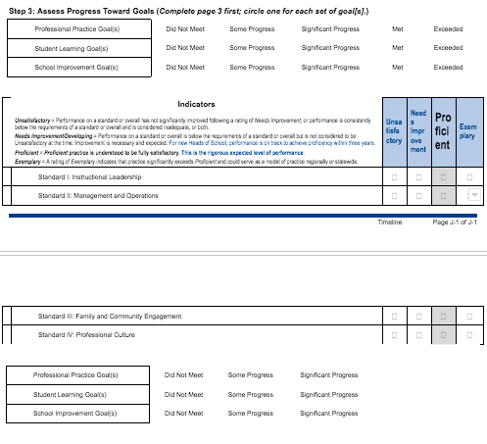
Progress toward Goals
Each Board member will then assess the HOS overall progress toward the 3 current goals and indicators.

Slide 7
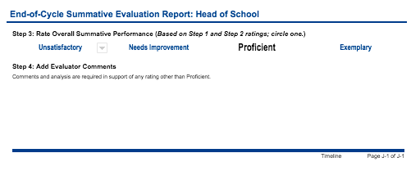
Overall Assessment
Each Board member provides an overall Summative assessment and comments.

Slide 8
Evidence to use
Mid-cycle Progress Report and comments
Results from Val-Ed, Board on Track, & Faculty Satisfaction survey created by Personnel
End-of-cycle Progress Report presentation by HOS
Other relevant evidence gathered by Board members including attendance at Board meetings, HOS reports, school events, school communications, etc.

Slide 9
Questions?
Thank you for your time and careful consideration in this most important job.

Slide 10
Questions? Thank you for your thoughtful work and service to mccps.

