Slide 1
Head of School Evaluation
MCCPS Board of Trustees Training
November 30, 2021
Notes:
This template can be used as a starter file for presenting training materials in a group setting.
Sections
Sections can help to organize your slides or facilitate collaboration between multiple authors. On the Home tab under Slides, click Section, and then click Add Section.
Notes
Use the Notes pane for delivery notes or to provide additional details for the audience. You can see these notes in Presenter View during your presentation.
Keep in mind the font size (important for accessibility, visibility, videotaping, and online production)
Coordinated colors
Pay particular attention to the graphs, charts, and text boxes.
Consider that attendees will print in black and white or grayscale. Run a test print to make sure your colors work when printed in pure black and white and grayscale.
Graphics, tables, and graphs
Keep it simple: If possible, use consistent, non-distracting styles and colors.
Label all graphs and tables.

Slide 2
Overview
Importance of role and responsibility
Timeline and steps in the process
Evidence that will be used
Mid-cycle Progress Report
End of Cycle Summative Report Rubric
Performance Standards and Indicators
Notes:
Give a brief overview of the presentation. Describe the major focus of the presentation and why it is important.
Introduce each of the major topics.
To provide a road map for the audience, you can repeat this Overview slide throughout the presentation, highlighting the particular topic you will discuss next.

Slide 3
Timeline
November
HOS Evaluation Training
Board members thoroughly read and understand HOS Evaluation Policy and Procedures and review HOS Evaluation documents
Ongoing
HOS presents monthly reports and progress toward goals at Board meetings
BoT members read newsletters, email communications, social media posts and attend committee meetings, exhibitions, concerts, plays, sporting events, etc. when scheduled.
January
HOS presents Mid-Cycle Progress
Board members complete Mid-cycle Progress Report
February-April
Board members continue to collect and synthesize evidence
Val-Ed and Board on Track surveys completed by BoT members & stakeholders
Teacher and Community Satisfaction surveys completed
March
Board Training on HOS Evaluation-Part 2
May
Board members complete individual End-of-cycle Summative Evaluation Report
Board Chair and Vice-chair compile individual ratings and drafts summation
Board reviews draft, discusses revisions, and adopts report at public meeting
Report is placed in personnel file and used to inform HOS goals for following year
Presentation by June 1st
Notes:
This is another option for an overview using transitions to advance through several slides.

Slide 4
Evidence
Monthly HOS Reports
Mid-cycle Progress Report and comments
Val-Ed, Board on Track, and Community Satisfaction survey results
End-of-cycle Progress Report presentation by HOS (which will include summary results from the HOS Parent and Teacher Satisfaction Surveys)
Other relevant evidence gathered by Board member which should include frequent attendance at school functions, Committee work experiences, etc.

Slide 5
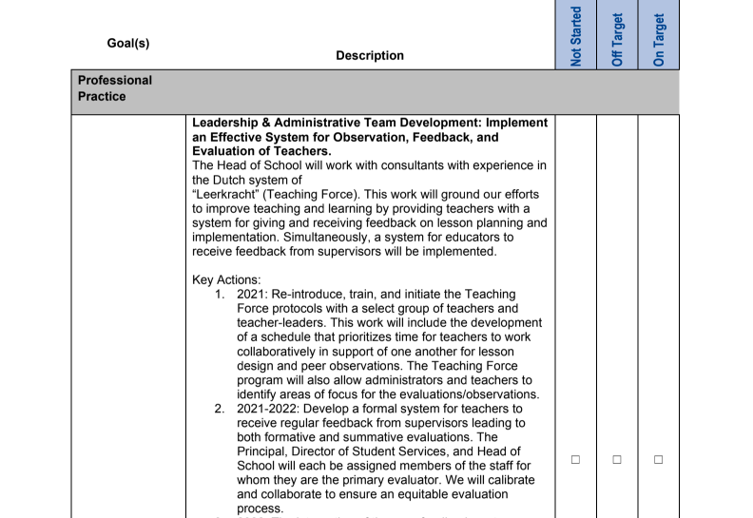
The HOS will present his progress toward his three goals at the January Board meeting.
Board members will individually complete a Mid-cycle Review Progress Report and rate HOS goals as: not started, off target or on target.
Head of School Mid-cycle Review

Slide 6
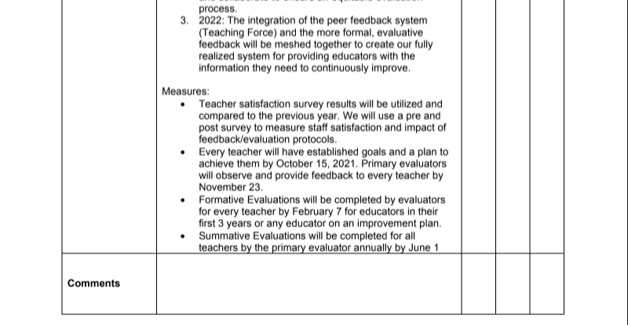

Slide 7
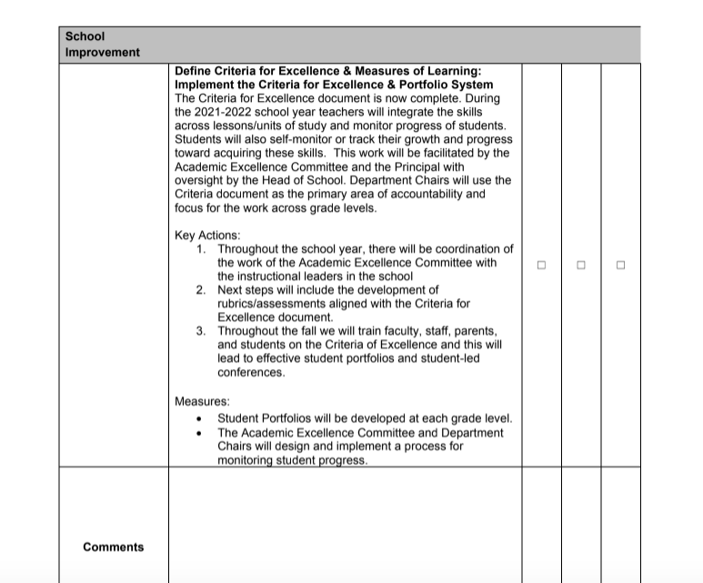

Slide 8
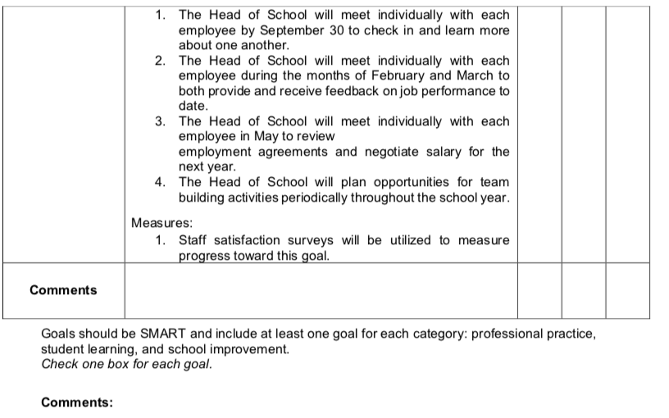

Slide 9
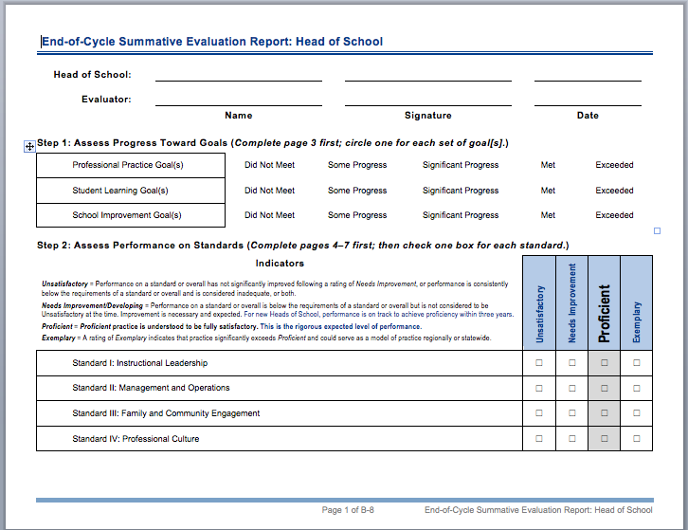
Summative Report
In June, after surveys are completed and all evidence has been gathered, each Board member individually fills out this End of Cycle “report card” on the HOS. Pages 3-6 are completed first followed by page 1-2.

Slide 10
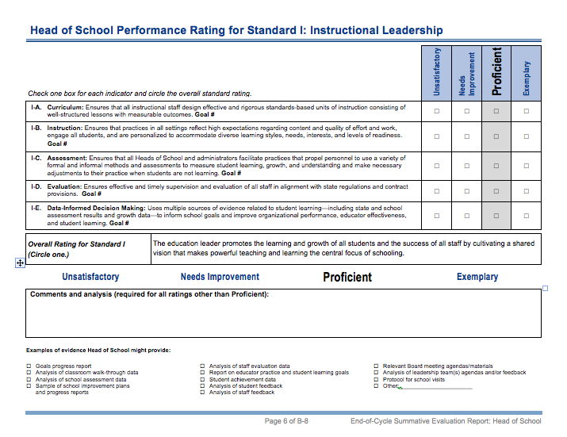
Performance Standards & Indicators Each Board member will assess the HOS on 4 Standards of Effective Head of School Leadership. Each of the four Standards has between 4-6 Indicators, most of which correlate to a HOS goal. Goal #s will be written on document. Those that do not directly tie to a goal will either be greyed out or have other evidence provided. Individual Evaluation forms will be collated by Chair and Vice-chair.
Notes:
This is another option for an overview slide.

Slide 11
Questions? Thank you for your thoughtful work and service to MCCPS.

