Slide 1
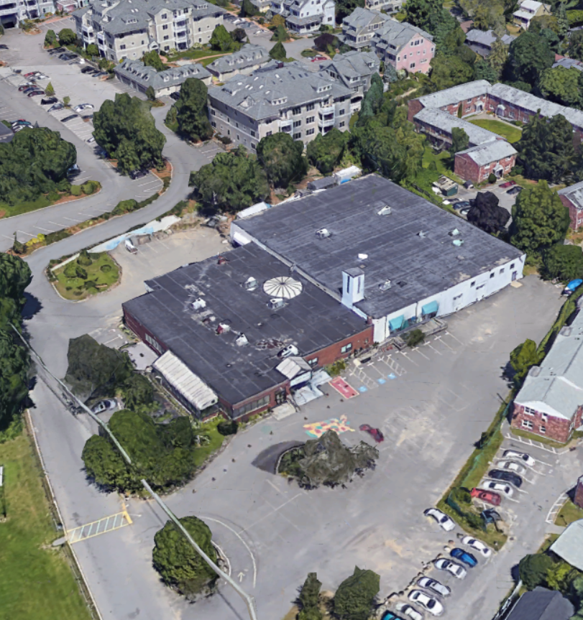
MARBLEHEAD COMMUNITY CHARTER PUBLIC SCHOOL
FACILITY MASTER PLAN
Draft Outline 5/18/2021

Slide 2
CONTENTS
MASTER PLAN REPORT
Introduction (1 page)
Vision Statement & Guiding Principles (1)
Assumptions (1)
Existing Conditions (+/- 10)
Community Engagement Findings (+/- 3)
Space Program (+/- 3)
Scenarios (+/- 10)
Financial Analysis (+/- 2)
Timeline (1+)
Recommendations & Next Steps (1)
APPENDIX
Detailed Program Spreadsheets
Detailed Cost Estimate Calculations
Precedents & Benchmarks
Community Engagement Notes / Backup
Technical Reports as needed

Slide 3
INTRODUCTION
Goal of This Report:
State what this report does and does not include and why.
Describe what needs to be further developed.
Process Overview:
Facilities Task Force established January 2021, composed of Head of School, Director of Student Services, Board members, parents, and community members.
Task Force meets monthly and works in between its sessions to develop options.
School History:
Founded in 1995.
First charter school in the Commonwealth.
Facilities History:
Building was constructed in 1968 and originally used as an Elks Club.
MCCPS has occupied the structure since its founding in 1995.
MCCPS purchased the building in 2014 for $4.25 million.

Slide 4
VISION STATEMENT & GUIDING PRINCIPLES
Facilities Task Force Vision Statement:
The MCCPS Facilities Task Force will contribute to the cost-effective transformation of the existing school facility in order to provide a school building that is welcoming and visually appealing; that supports the MCCPS pedagogy of highly-engaging, project-based learning personalized for all students; that celebrates student, family and community contributions; and that is environmentally and economically sustainable.
Facilities Task Force Mission Statement:
The MCCPS Facilities Task Force will develop and price three design concepts for the renovation of the existing school facility, to share with the Board of Trustees for their review, feedback and ultimate selection. This work will take place during the spring, summer and fall of 2021, with target implementation beginning in fall of 2021 or spring of 2022.

Slide 5
VISION STATEMENT & GUIDING PRINCIPLES
Guiding Principles:
Front entry should be more welcoming.
All classrooms should get natural daylight and fresh air.
Add a Black Box Theater and science lab.
Provide multiple multi-purpose small group rooms.
Address security concerns.
Resolve any outstanding code issues.
Address deferred maintenance issues (new roof, new bathroom plumbing, other)
Overarching statement about the vision for the future facility

Slide 6
ASSUMPTIONS
Scope Assumptions
MCCPS to remain at 17 Lime Street (Board directive).
Work within existing exterior shell.
Incorporate warehouse space.
Enrollment to remain 230 students.
Grades to remain 4-8.
Building must remain operational during any renovations.
Program Assumptions
Non-regulation size gymnasium is acceptable; MCCPS will continue to rent elsewhere for games.
MCCPS does not seek exact alignment with state (MSBA) standards for K-12 facilities.
Cost Assumptions
Fundraising for this project will be a challenge so explored should be as cost-effective as possible.
Costs will be phased along with construction phasing.
Funding Assumptions
Funds will come from a combination of capital campaign, construction loan, and grants.
Black Box Theater will bring in monthly revenue. Maker space may bring in intermittent revenue.

Slide 7
EXISTING CONDITIONS
Planning Metrics:
Site area: 61,420* gsf
Building gross area: 33,316* gsf
Total net square footage: 28,146 nsf
Academic: 8,009 nsf
Special Education: 868 nsf
Art & Music: 1,119 nsf
Library & Technology: 623 nsf
Health & PE: 3,496 nsf
Kitchen & Dining: 4,239 nsf
Staff Spaces: 1,405 nsf
Custodial & Maintenance: 240 nsf
Other (Warehouse): 8,147 nsf
Net SF per student: 87 nsf
Comparison to state (MSBA) standards:
Site area**: n/a
Building gross area: 59,768 gsf
Total net square footage: 39,845 nsf
Academic: 11,540 nsf
Special Education: 3,020 nsf
Art & Music: 3,125 nsf
Library & Technology: 4,724 nsf
Health & PE: 8,750 nsf
Kitchen & Dining: 5,325 nsf
Staff Spaces: 2,511 nsf
Custodial & Maintenance: 1,850 nsf
Other: 0 nsf
Net SF per student***: 173 nsf
* Per Marblehead GIS website.
** The state does not opine on site locations or sizes for K-12 schools.
*** Calculations made using an enrollment of 230 students.

Slide 8
EXISTING CONDITIONS
Existing First Floor Plan
Existing Mezzanine Plan:
colored by use category (e.g. classrooms, administrative, etc.) and labeled
colored by use category (e.g. classrooms, administrative, etc.) and labeled

Slide 9
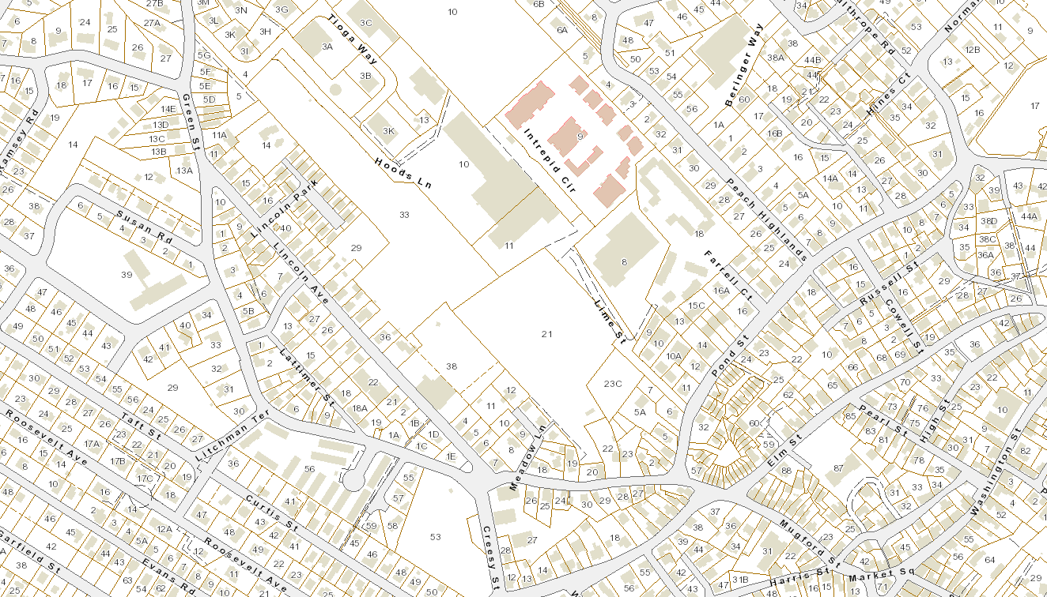
EXISTING CONDITIONS
Site Plan: Neighborhood Context
Redd’s Pond
(park name
here)

Slide 10
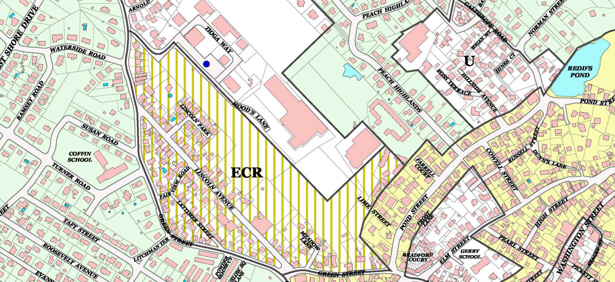
EXISTING CONDITIONS
Site Plan: Zoning & Land Use
MCCPS is zoned “Unrestricted / Non-residential Uses.”
0’ front setback
6’ side setback
8’ rear setback
35’ maximum height

Slide 11
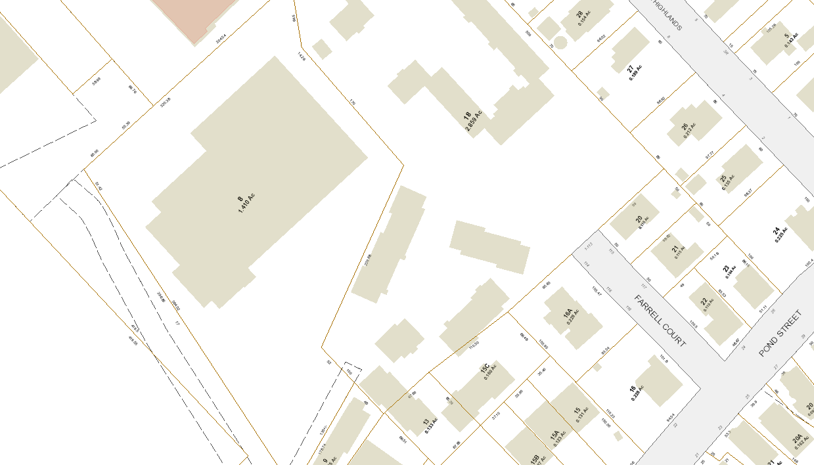
EXISTING CONDITIONS
Site Plan: Outdoor Space & Site Conditions

Slide 12
EXISTING CONDITIONS
Site Plan: Parking & Traffic
Current parking spaces available to MCCPS: XX
Current rented spaces: XX
Current parking space rental income: $XXX/yr

Slide 13
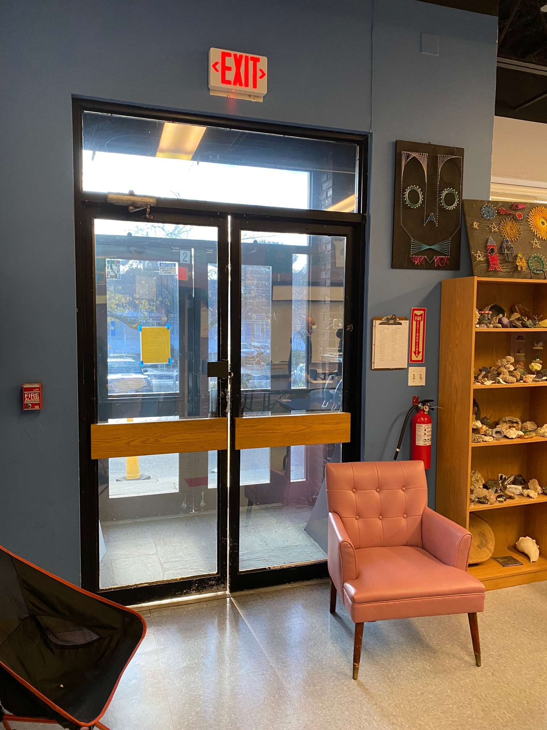
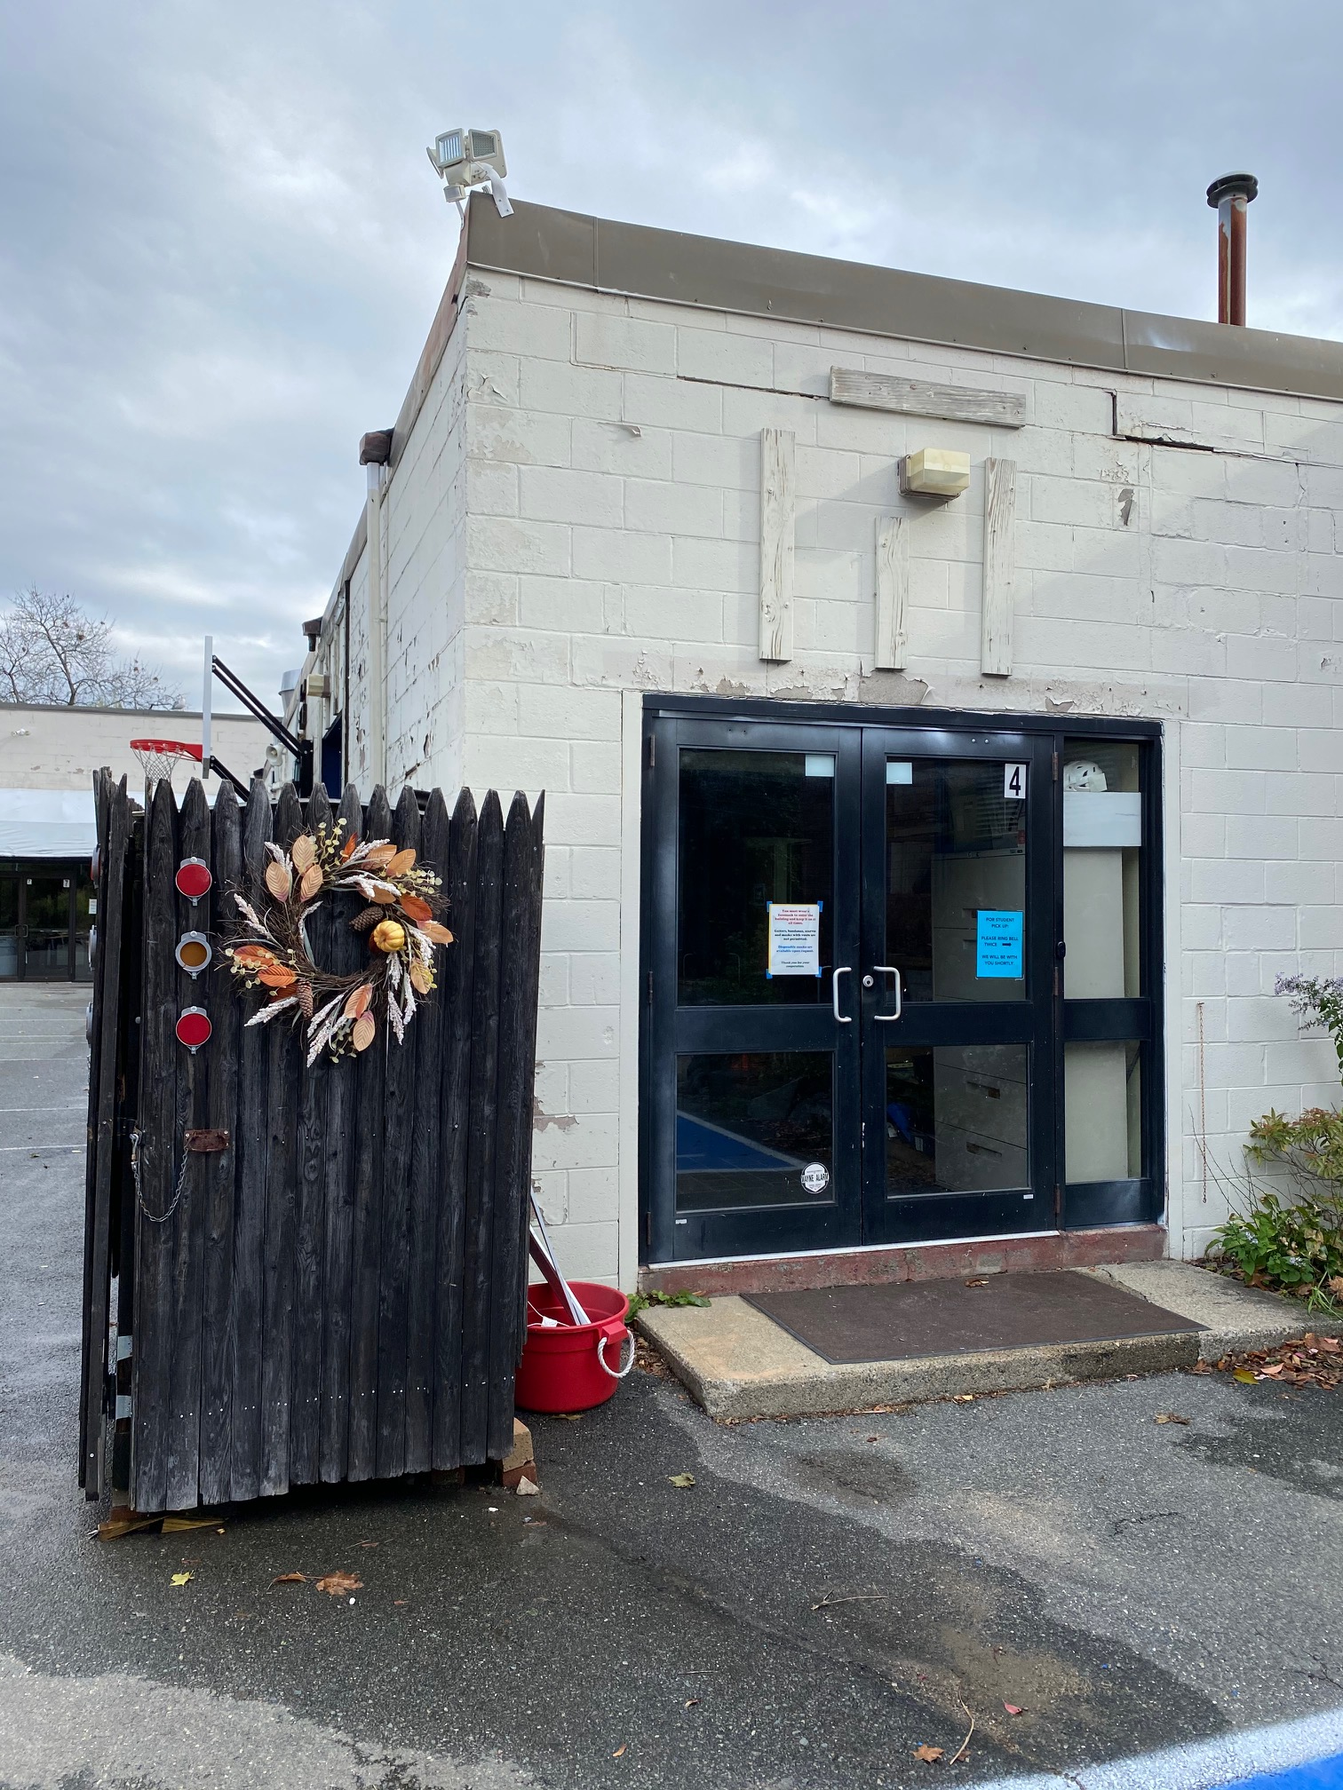
EXISTING CONDITIONS
Conditions Assessment: Building Exterior
Roof is failing and needs to be replaced as soon as possible.
Greenhouse foundation is cracked; this space should be fixed or demolished.
Many exterior doors are a security concern and are not necessary.
Service entry overlaps with exterior play space used by students.

Slide 14
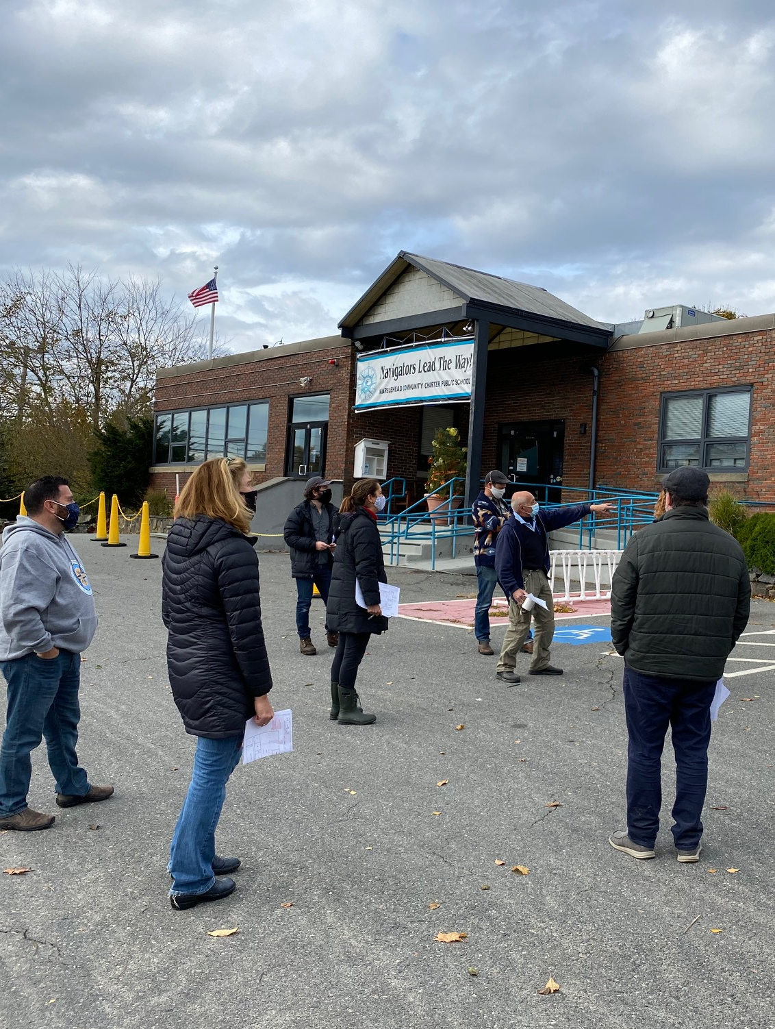
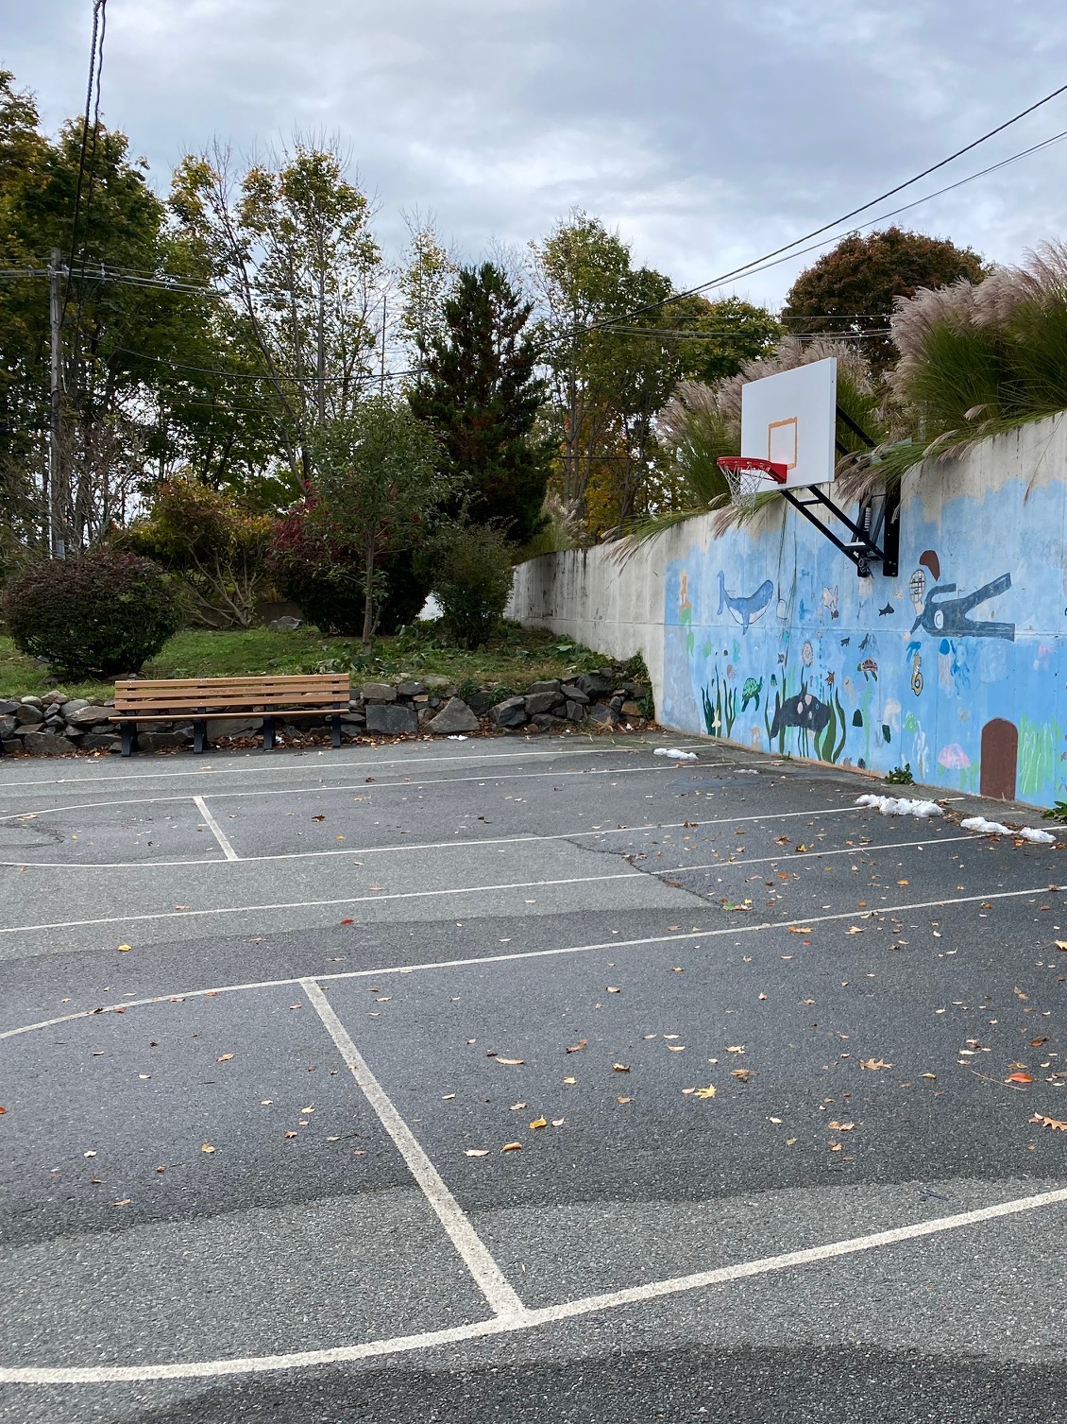
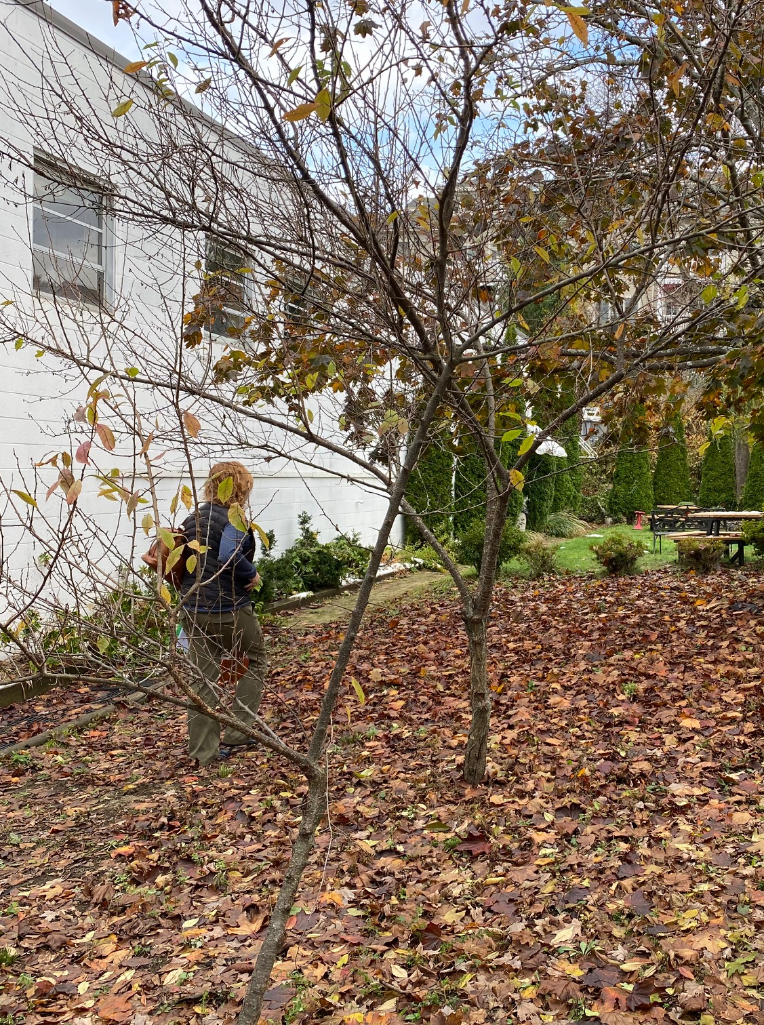
EXISTING CONDITIONS
Conditions Assessment: Building Exterior
Current entry lacks curb appeal.
Entry façade has multiple stair/ramp combinations that could be consolidated.
Exterior play space open to adjacent street is a security concern.
Outdoor classroom is oriented north and receives limited direct sun.

Slide 15
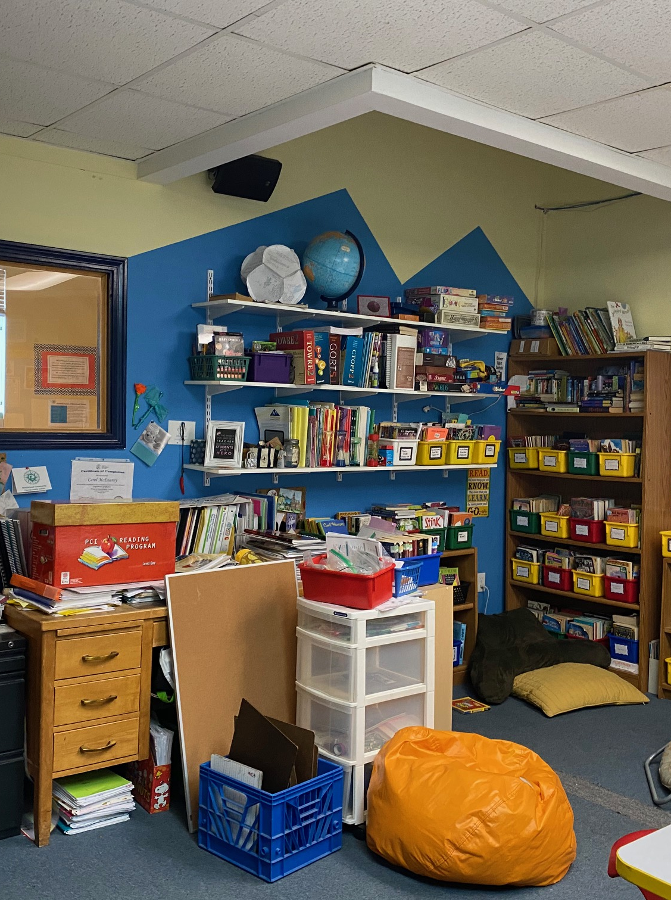
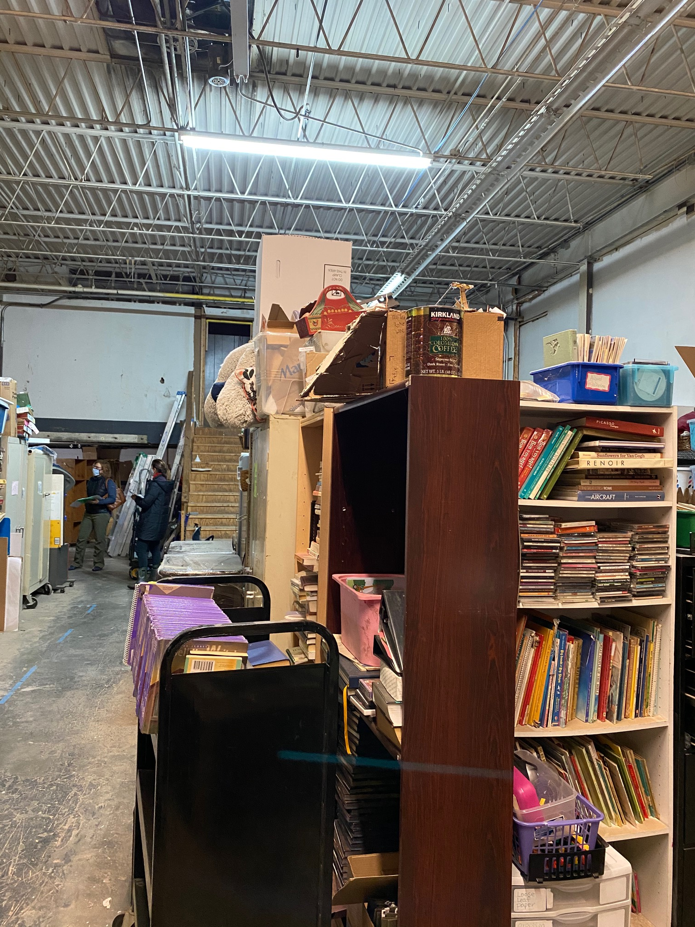
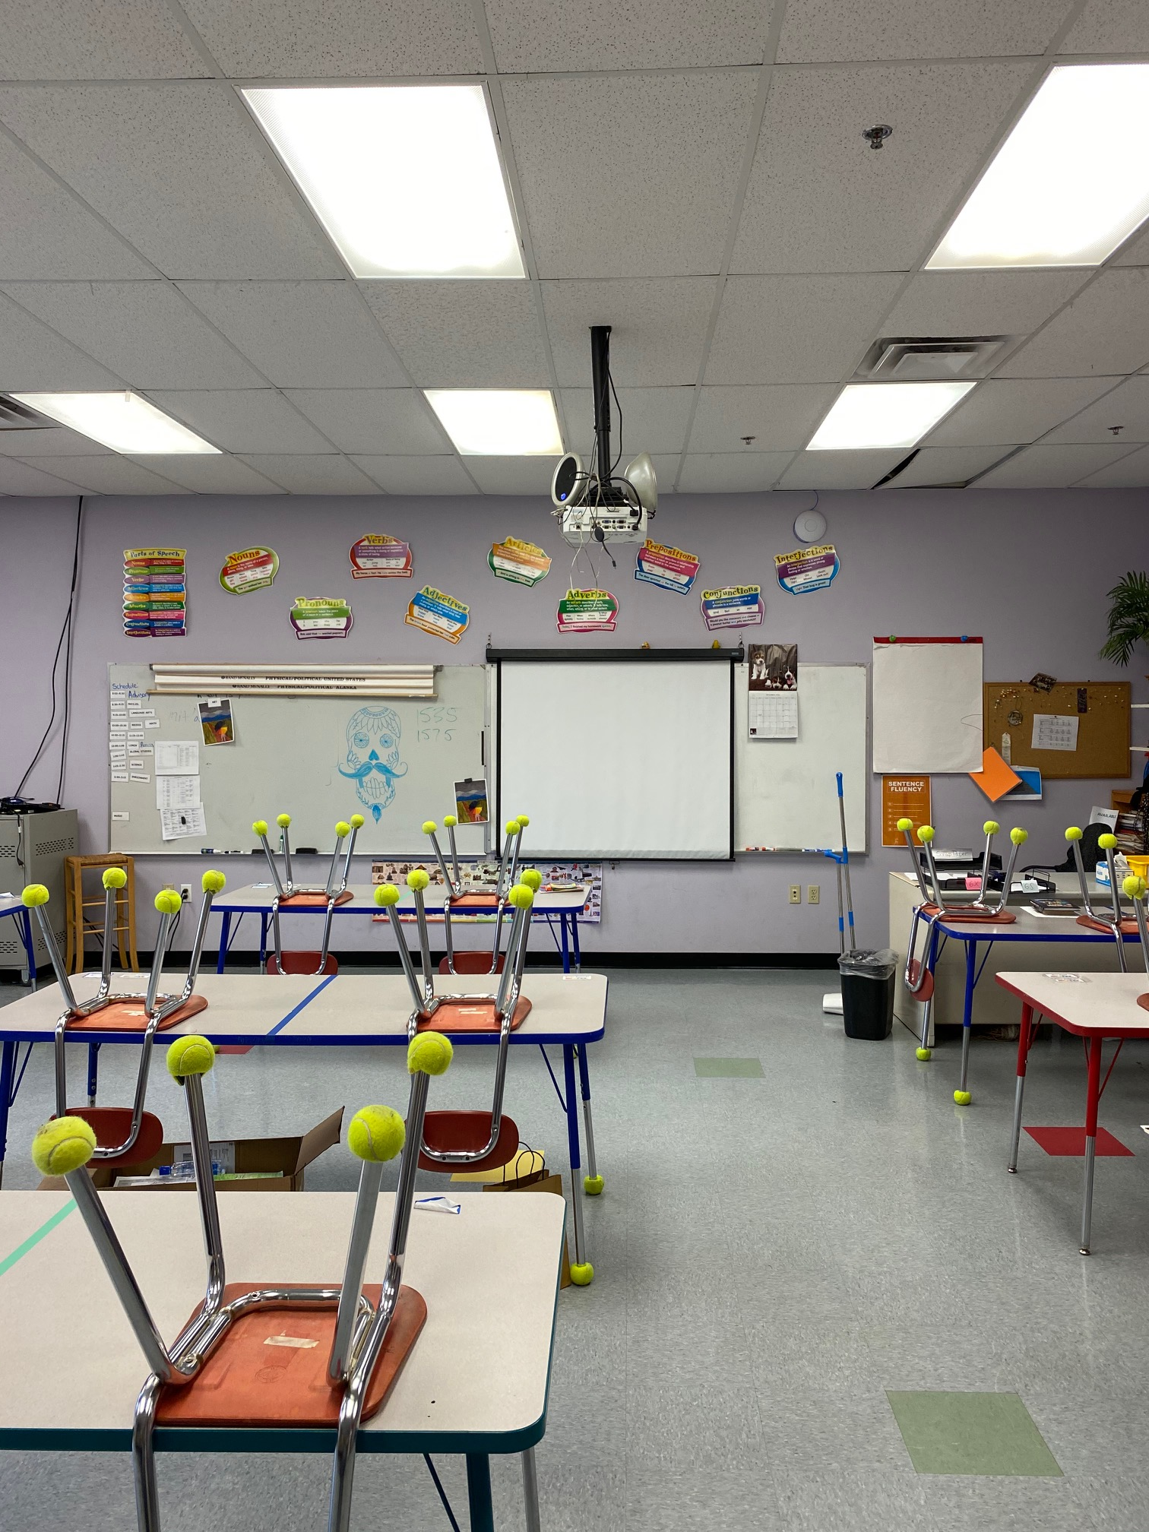
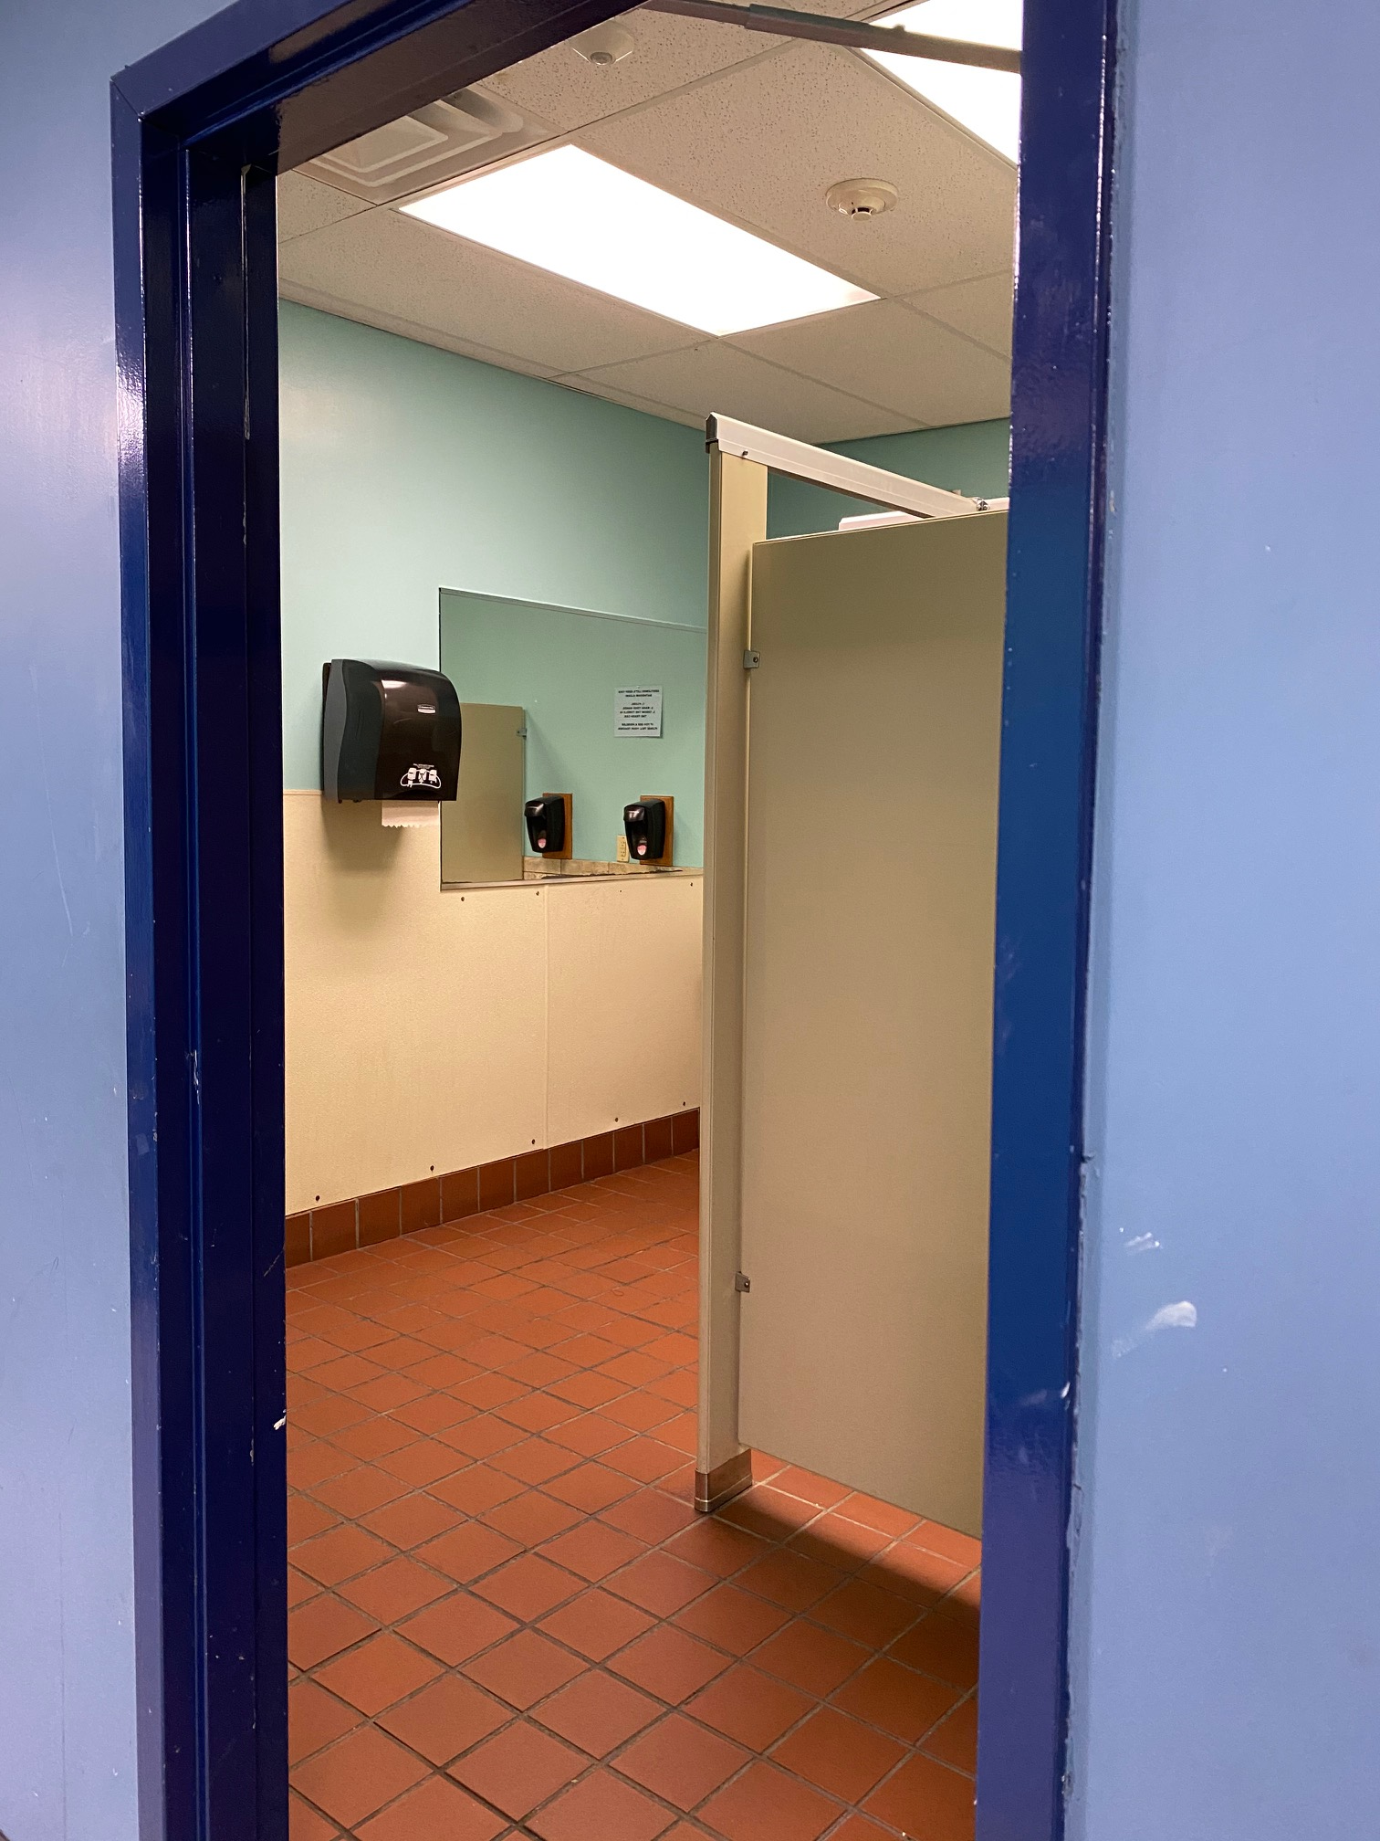
EXISTING CONDITIONS
Conditions Assessment: Building Interior
Warehouse is used for storage, not occupiable space.
Grade 4 and Grade 5 classrooms have no windows.
Northern bathroom plumbing routinely fails and needs to be replaced.
Insufficient storage space for teaching materials results in crowded classrooms.

Slide 16
EXISTING CONDITIONS
Conditions Assessment: Utilities & Energy Usage
Information coming from Jeff Barry.

Slide 17
EXISTING CONDITIONS
Conditions Assessment: Deferred Maintenance
Roof was last replaced in XXXX.
Other?

Slide 18
EXISTING CONDITIONS
Conditions Assessment: Code Review
Text here.

Slide 19
COMMUNITY ENGAGEMENT FINDINGS
Summary of Methods
Director of Student Services issued a survey to faculty and students using (email? Other?).
20 faculty members responded.
XX students responded.
Results were tabulated and are shown on the following page.
Insert photos of sessions here, if available.

Slide 20
COMMUNITY ENGAGEMENT FINDINGS
Faculty Wishlist (20 Replies)
Student Wishlist (XX Replies)
Information Coming from Andrea
“Can we find a student quote?” – student (grade X?)
“I’d love to see if we could redesign our current space at the same time as expanding.” – teacher

Slide 21
SPACE PROGRAM
+/- 3 pages: 1 page of summary plus detail
Explain methodology for developing the program (e.g. based on statewide benchmarks for similar schools and MCCPS projected enrollment, etc.)
Space summary worksheet – summary of total area by category on first page followed by detail with room counts on following pages
Compare needs vs existing, identify delta
Quantify available space in the warehouse and compare to additional space needs
Identify any remaining unused capacity
Discuss how to handle program that won’t fit into existing building?

Slide 22
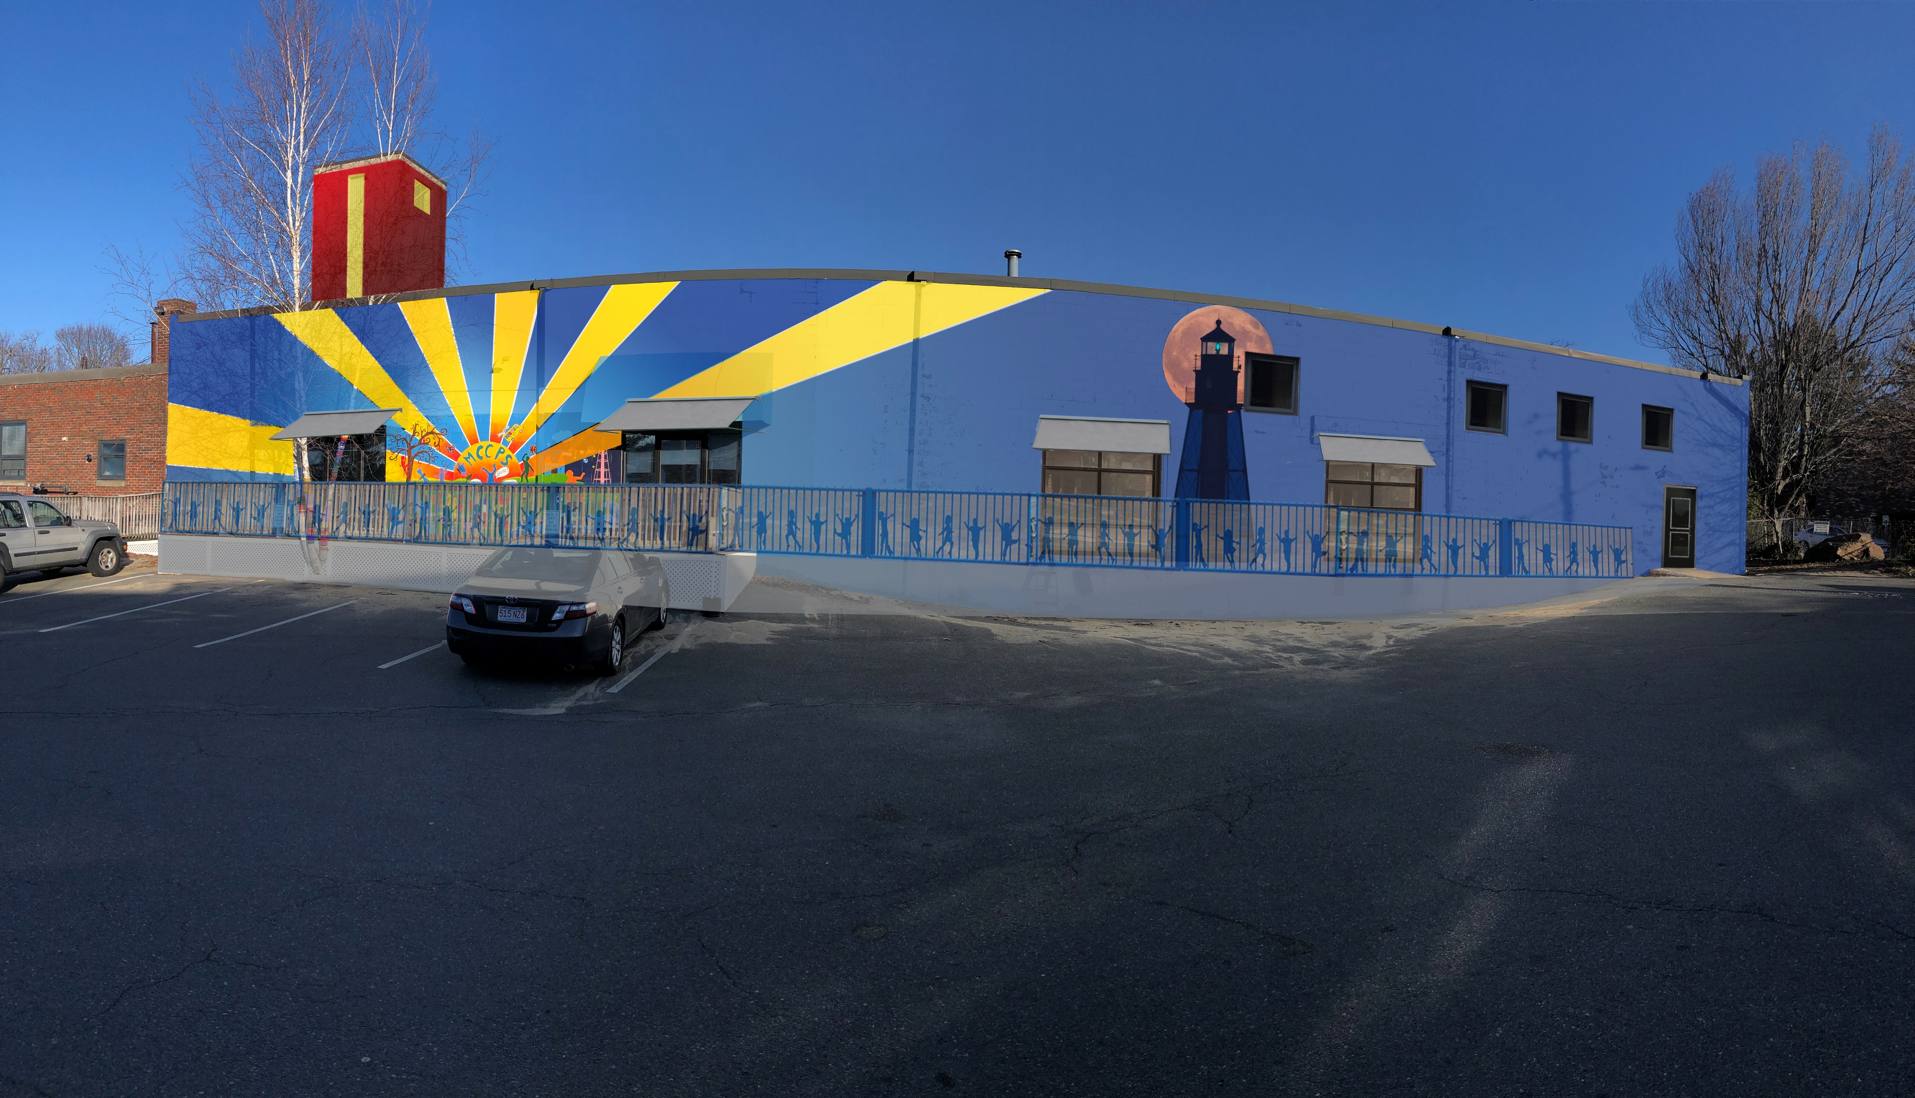
SCENARIOS - OVERVIEW
Option 1
Option 2
Option 3
Exterior Refresh
+ Increase Curb Appeal
+ Fix Deferred Maintenance
+ Address Security Concerns
- No Interior Improvements
Capital Cost:
Operating Cost:
Revenue: none
Capture Warehouse Space
+ pro
+ pro
- con
- con
Capital Cost:
Operating Cost:
Revenue:
Rework Existing Spaces
+ pro
+ pro
- con
- con
Capital Cost:
Operating Cost:
Revenue:

Slide 23
SCENARIO DETAIL
+/- 3 pages on each option
1st page
Describe the scope of work
Total SF of renovations by space category
Program results – does the option satisfy all of the space requirements?
Deferred maintenance results – does the option address all of the existing issues?
2nd page: Floor plan colored by use category and labeled
3rd page: Additional visuals / views as needed to illustrate the option

Slide 24
FINANCIAL ANALYSIS
+/- 2 pages
Cost estimate details and methodology
Project cash flow
Project funding considerations
Revenue estimates
Operating cost impact

Slide 25
TIMELINE
1 page (depending on how much the options differ)
Project approvals
Funding milestones
RFP’s
Contracting
Design
Construction
Occupancy
Community / occupant outreach events
Align with academic calendar

Slide 26
RECOMMENDATIONS & NEXT STEPS
1 page
Recommendation of preferred option from the Facilities Task Force
Board approval of selected option
Next steps for funding
Identify any follow-up studies required
Identify any outstanding decisions to be made
RFP’s and contracting

