Slide 1
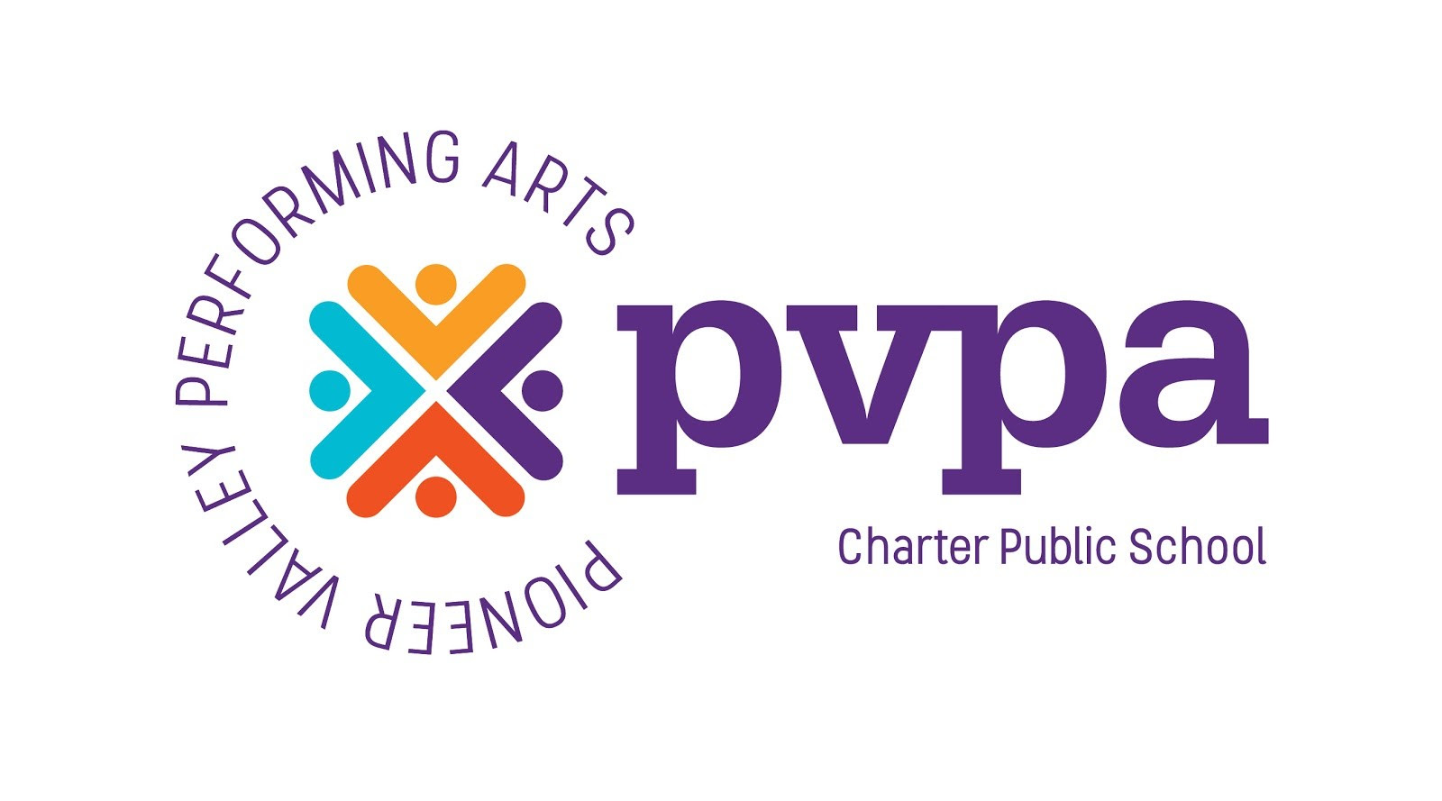
PVPA Arts: A Way Forward
Building a future for arts education at PVPA, in the evolving K-12 public school landscape.
By: Frank Newton
PVPA Director of Arts

Slide 2
Who the heck is Frank Newton(He, Him, His)?
“The Man”
Age: 46
Family: Married with 2 kids (teens…help me!)
Hobbies: Cinephile, Foodie, Cooking, Building Hot Wheels tracks, travel (though I don’t get to do it very often)
Fears: Haunted houses, Liver and Onions (the dish), Biting off more than I can chew.
Joys: My Family’s smiles, watching/helping someone learn something, creating
“The Artist”
Education: BM Jazz Studies (saxophone performance) JMU, Armed Forces School of Music graduate, MM Jazz Composition and Arranging UMass Amherst, PhD School of Hard Knocks.
Skills: Professional Saxophonist/Woodwind doublers, Professional Composer and Arranger, 26 years as a music educator and arts producer.
PVPA: (Hired 8/23/2010), Music Instructor and Department head, Department Leader, Sound engineer, BSU advisor, Open mic coordinator, Graduation MD, Director of Arts.

Slide 3
What does Frank believe?
In 13 years and 6 month as a dedicated member of the PVPA community, this is what I believe:
The arts provide a way for all constituencies of the PVPA community to learn about themselves as evolving humans, contextualize and understand the world around them, and express emotion and ideas that allow individuals to claim and validate their place in the world.
The arts are a service to humanity that holds a mirror up to our collective human experience, and those who practice and study the arts have a responsibility to give that service to the world with fidelity and authenticity, in order to serve the growth and betterment of all.
To give a hungry person a fish to eat is good…to teach them to fish is better.

Slide 4
Look where you’ve been, to know where you are going…
The educational landscape in Massachusetts has changed dramatically since the opening of PVPA. The 1993 Education Reform Act, paved the way for charter schools in Massachusetts. PVPA entered into the fledgling charter school system in 1996 with this statement:
“The Pioneer Valley Performing Arts High School is the realization of the dream of scores of individuals who believe the balance of creative and critical thinking is essential to develop an optimal educational environment. Equal emphasis on excellence in academics and performance art is a vehicle that will produce confident adults, with a clear direction for their individual creativity, and an ability to successfully meet all challenges as lifelong learners.” (1996 Original Charter School Application for PVPA, Executive Summary)
PVPA would go on to develop the practices, policies and traditions that allowed for our growth in that educational climate.

Slide 5
1996-2008 PVPA at a glance
Logistics
Traditions
Housed in a multi-building campus in Hadley,MA
Friends of PVPA 501c3 formed (pre-opening)
Original PVPA Board of Trustees formed
First 4 years PVPA student body grows adding one new class of students each year. 1999-2000 school year PVPA has 9th-12th grade students. Total student body approximately 250.
Academic faculty member with strong proclivities toward the performing arts.
Most employed arts teacher hired part time.
More fluid accountability standards with much less oversight from state and federal agencies.
Most school resources were donated, personal relationships were leveraged to create vendor/venue agreements
Community day
Field day
Diversity committee
Paideia
Arts internships/Community service as graduation requirements
Catalyst Contemporary Dance Company, 5 Alone, Headgear, Theater production including musicals, Visual arts incorporating technical theater design and creation.
Small high school community, with great flexibility to take advantage of institutional opportunities with little oversight or regulatory accountability.
Arts Concentrations developed

Slide 6
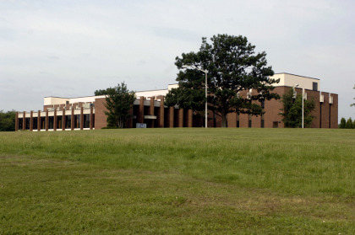
1996-2008 Summary
The educational and logistical environment allowed PVPA more flexibility because of our small size and a far less stringent regulatory/accountability standards for early charter schools. In turn, the practices and traditions that were created during that time, were designed to work for the students, faculty, administrators, and logistical functioning of PVPA within that environment. In the final few years (2005-2006 to 2007-2008) PVPA would purchase a new home building in South Hadley, Ma. We would add 7th and 8th grade students to our student body and embark on a new future in a new home, with new DNA, with the hope of creating a transformative learning environment for middle and high school students.

Slide 7
2008-2020 PVPA at a glance
Far more stringent regulatory requirements from 2002 “No Child Left Behind Act”, DESE revamping accountability expectations for charter schools (2014)
PVPA widens its region of sending towns, ultimately changing its student body demographics.
PVPA moves from a part time model for arts teachers to a full time model.
Founders depart PVPA
7 heads of schools/executive directors in 12 years.
Opening of the PVPA mainstage theater (Jan.2016)
Various bell schedules, Changes to school day
Teacher union formed
Much more extensive production calendar
Charter renewal put under condition, mission statement change.
WOFA African Drum and Dance Company created
Funkadelic Dance Company Created
We Came to Play Music Tour created
Spotlight theater festival created
Restorative practice and Standards based grading more solidified
Enormous technological growth
Greater investment in academic programing to keep up with regulatory/accountability expectation.
Arts department formalized, arts curriculum development initiated.
Affinity groups join the litany of school clubs and activities.

Slide 8
2008-2020 Summary
If 1996-2008 was the birth and elementary school years for PVPA, then 2008-2020 was definitely our middle school and teenage years. We existed in a world that was unbelievable volatile from an administrative, and logistical view. Instituting 7th and 8th grade students into the everyday working of PVPA was a feat just by itself. It was clear to all of us who were here, that the upheaval and evolution of PVPA was coming into conflict with many of the initiatives designed and created in the early days of the school. Administrators, faculty and students created task forces, had formal and informal meetings, and made significant changes to school wide logistics and events such as community time, community/unity days, restorative practice techniques, production processes, paideia and grading. These conversation took place when a much more institutional knowledge was maintained in the faculty and administration. Through these twelve years, changes to old models were instituted to keep them solvent. But, the reality of evolution is that it will inevitably show the weaknesses of that which needs to be left behind. Wonderful things were created during these twelve year, but what would be coming on the horizon, would move things faster than anyone was prepared for.

Slide 9
2020-present PVPA at a glance
March 13, 2020 PVPA closed its doors to in person schooling, Due to the Covid-19 pandemic.
During remote school, the school day goes through a drastic change.
Director of Arts position is created.
CDC becomes a major factor in creating school practices to create safety.
DESE adopts CDC practice, changing K-12 educational expectation.
Covid pandemic brings into question public education in its original format.
PVPA changes entire logistical functioning to meet post covid needs.
New school day established as part of the second collective bargaining agreement.
Production apparatus stops for a time, and rebuilds from the ground up.
Creation of the the bi annual “One Night Gallery” for the visual arts department.
A new production apparatus is created to meet the needs of our current educational environment
Cultural changes to community time, community day/unity day, lunch, student supervision.
Building upgrades and infrastructure investment increase.
New graduation venue and apparatus.

Slide 10
2020-Present Summary
The Covid-19 pandemic moved our evolution into fast forward. We did amazing things to invest in our technological capacity to meet the needs of our students. Administration and staff went to great lengths to provide an educational and artistic experience regardless of our proximity to one another. When we returned to in-person schooling (2021-2022 school year) with a new administration, we scrambled to keep the door open, where students understanding and social development was different. Teacher experience and expectation was different and we wanted to do everything to retain quality instructors. Finally, we continued to evaluate our processes, policies and activities so that we are administering them through the lens of equity, and social justice practices. In short, 2020 shook K-12 public education to it core, and placed us in an environment to build our institution in such a way that it insulates our ability to offer transformative arts focused education regardless of the status of our world environment. I believe the covid pandemic moved us down a road that was ultimately inevitable. Now we have to face change in order to survive.

Slide 11
PVPA “Real Talk” for the future.
When an institution considers its future, it must always reconcile the joys of the past and nostalgia, with the uncertainty of the present. PVPA is at a point in our development that we have to take a hard objective look at our practice, policies and procedures, and make sure they are functional, valid, and serving our students today. When they are not, we must have the courage to change or discard them, for something that serves the children we teach. By giving you a glimpse of where we came from, I hope it will make the reality of where we are, something that we all can accept and face together as a community.

Slide 12
The Reality for PVPA.
The history of PVPA is one of evolution and visionary destiny. We are looking at where we have come from to figure out a path into the future that is sustainable, remains current in the educational and artistic world, and give students the education experience that makes them fall in love with learning and becoming their truest selves.
PVPA realities for the foreseeable future;
Events/activities/curriculum must be available to all students.
Events/activities/curriculum must work seamlessly in our regular school day.
Events/activities/curriculum design must provide a general equality of experience for academic faculty and arts faculty.
Events/activities/curriculum must not overburden faculty planning time with its student offerings design.
Events/activities/curriculum offerings must have accountability for their artistic and academic rigor.
Events/activities/curriculum must be sustainable regardless of administrative personnel available.
Events/activities/curriculum must be able to run within our school building with our entire student body, faculty and staff.
Events/activities/curriculum must involve all full time teaching faculty executing the process.
PVPA initiatives that need change to meet our reality;
Standards based Grading
Community time and methods for club/affinity group cultivation
Paideia
Production calendar layout and production capacity
Production expectation brought inline with design capacity.
Permanent block schedule that serves students and faculty

Slide 13
What we’ve done…what we’re doing.
Done
Revamped production calendar to account for all constituencies of PVPA.
Changed production apparatus to make design element more attainable and accessible.
Standardized a 2 year arts curriculum for Theater, Dance, Music, and Visual Arts
Position Costuming and Film to create a new 5th arts department in Technical Theater
Revamp Senior Thesis process creating more accessibility for all seniors
Revamped arts concentration for better tracking and sustainable advisory from department leaders.
Created the theater manager position
Created apparatus for parent volunteers to be more deeply involved in production development.
Created a new director’s handbook and arts department leader handbook solidifying roles in arts production apparatus
Doing
Revamping grading model to lower grading burden on faculty and create more transparent communication with students and faculty.
Reenvisioning Paideia “the activity” into Paideia “the philosophy” and aligning PVPA’s academic and artistic practice with the concept of true Arts Integration, as envisioned in the founding charter.
Reevaluating the production calendar for equity across constituencies, and production development based on stipend allotment
Developing bell schedule and after school protocols/expectations to increase student club/affinity group participation.

Slide 14
Final Thoughts/Conclusion
Miles Davis was an outstanding jazz trumpet player from the middle 20th century. He was a flawed man, and honestly not the best role model as far as morality is concerned. But, I keep a poster of him directly behind my home office desk because he is a constant reminder for me, to never be so in love with the things I create that I can’t change them. Miles was great because he embraced change and searched out people to help him change. PVPA has reached a point in our evolution that we must change. We must change to remain relevant in the arts and academic education. We must change to respond to the needs of our students. We must change to survive. If you are watching/listening to this presentation and you were involved with or graduated from PVPA in its first 12-15 years, I empathize with your feelings of nostalgia and what you feel is lost to a “better time”. But, before you judge what we have done, and continue to do to shepard PVPA into the 21st century, please come and spend some time with us. See the love that emanates from our faculty and staff. See the students of today navigate their world through PVPA toward their own individual destinies. I believe that any sense of loss, will be replaced by hope. Though the means have changed, the mission remains the same.

