Slide 1
Sponsor Evaluation

Slide 2
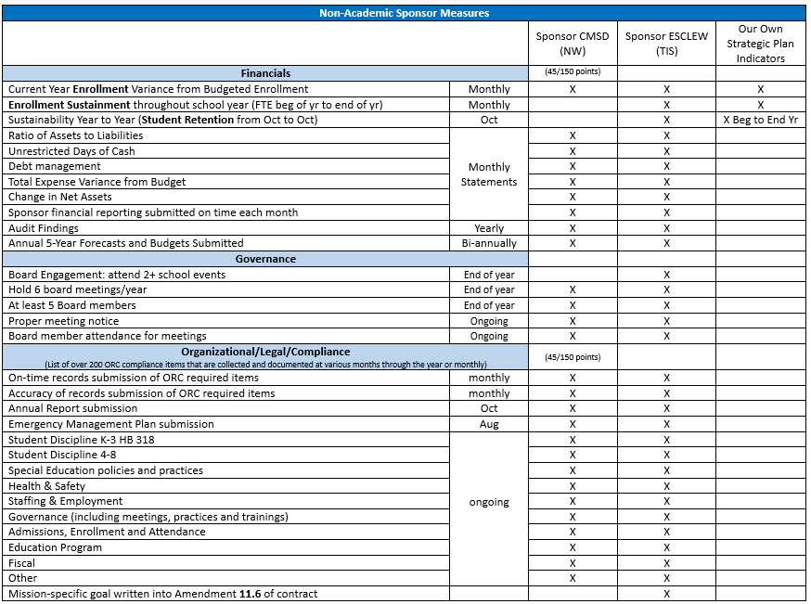
Over 200 items annually

Slide 3
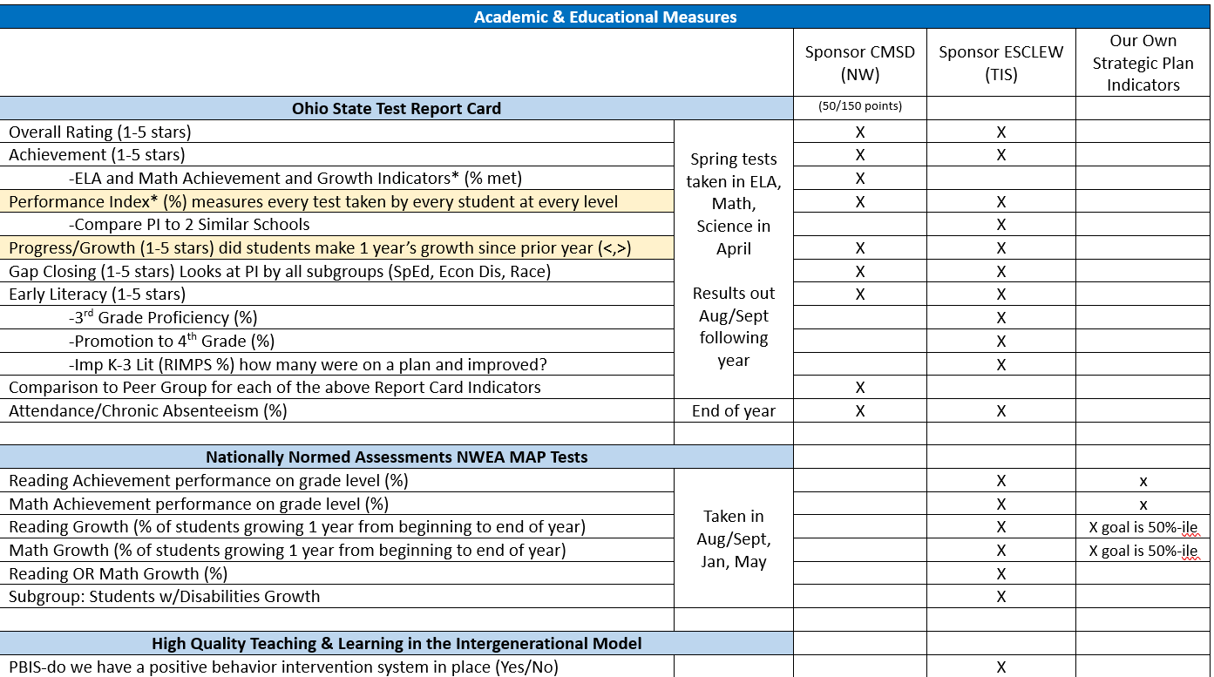

Slide 5
Spring OST Comparisons

Slide 6
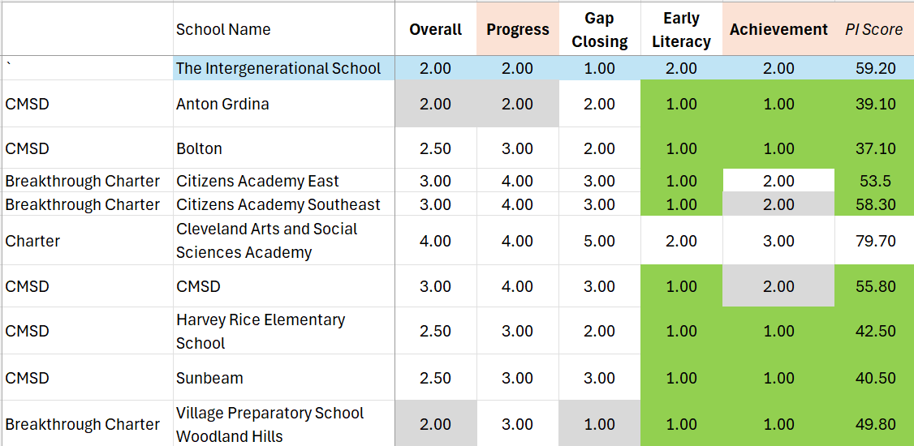

Slide 9
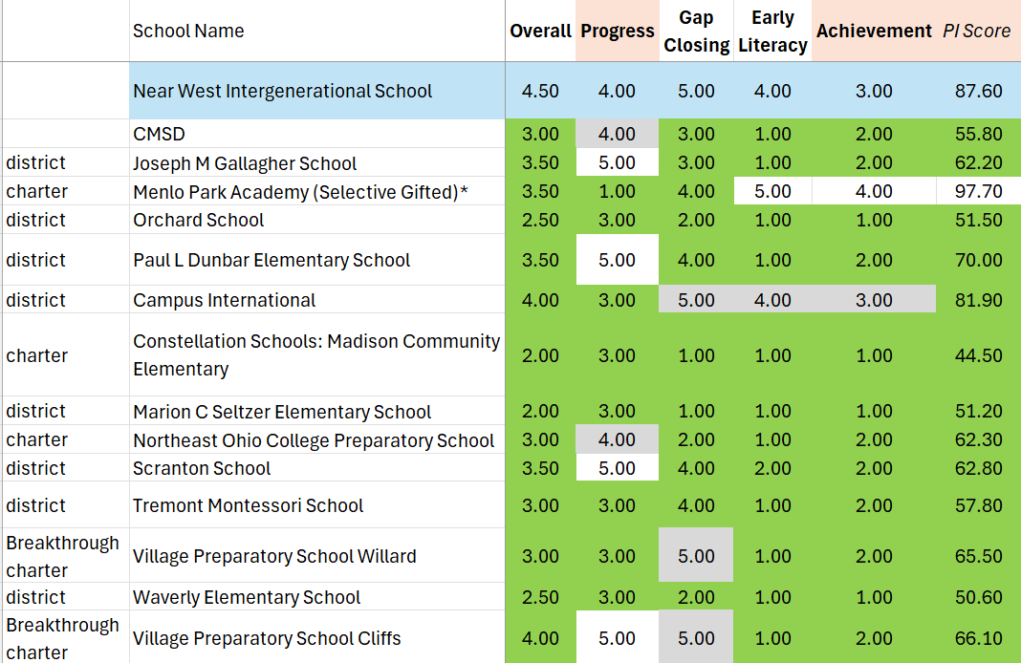

Slide 11
