Slide 1
Racial and Ethnic Diversity in the Intergenerational Schools
2023-2024

Slide 2
TIS-East Neighborhood Demographics
1%
2%
Source: census.gov
Notes:
Presentations are visual. Don’t overwhelm your audience with text.

Slide 3
Near West Neighborhood Demographics
14%
33%
5%
54%
Source: census.gov

Slide 4
Lakeshore Neighborhood Demographics
30%
Source: census.gov
2%

Slide 5
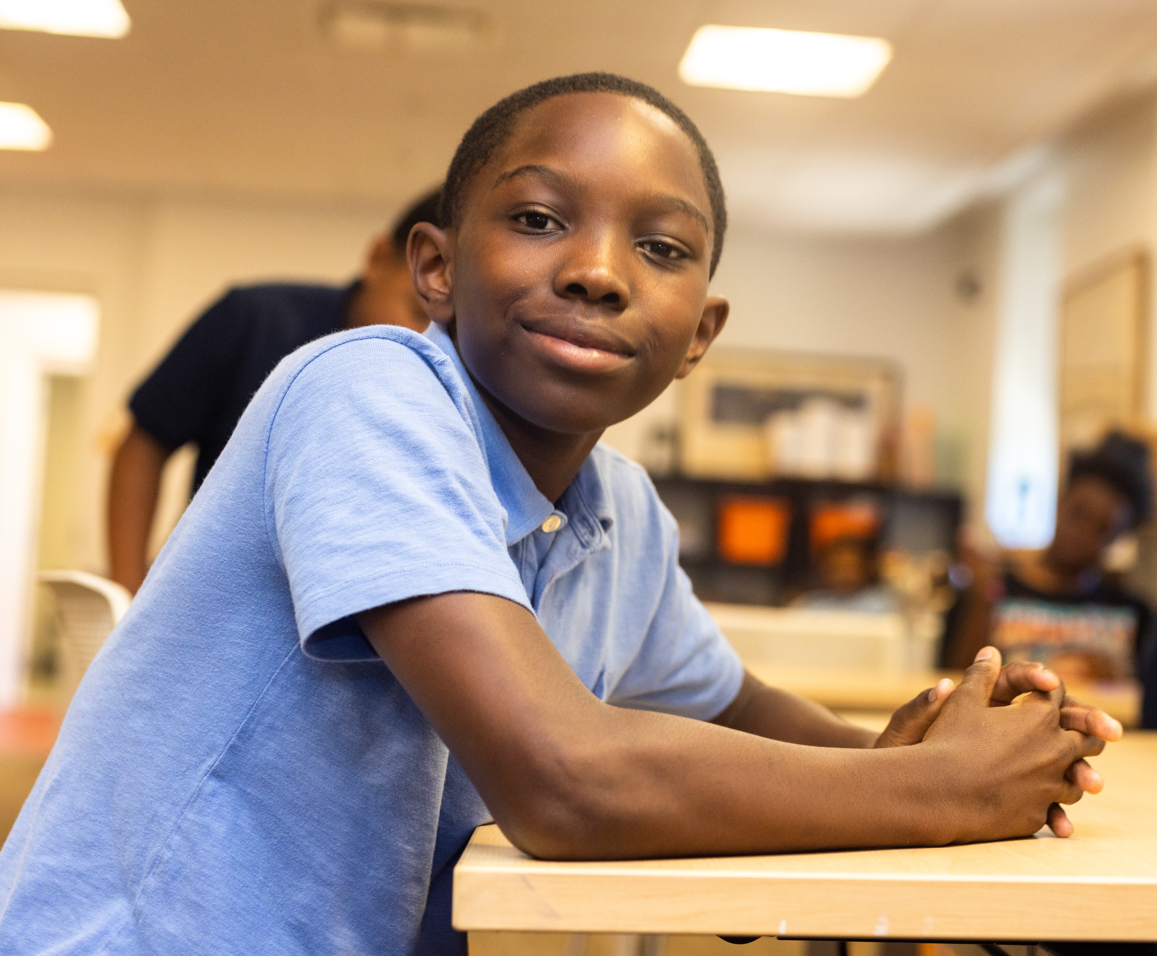
The Intergenerational School

Slide 6
The Intergenerational School
107

Slide 7
The Intergenerational School
1

Slide 8
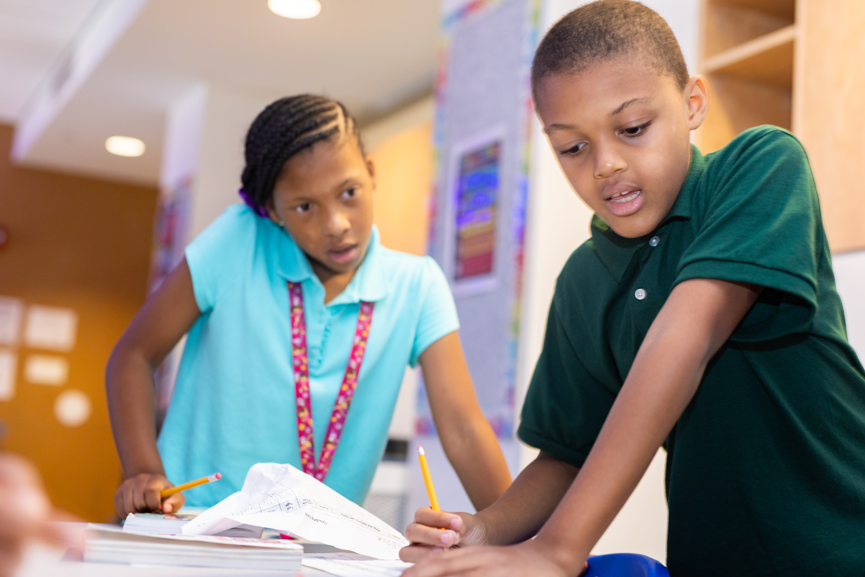
TIS-East City of Residence

Slide 9
Near West Intergenerational School

Slide 10
Near West Intergenerational School
122
93

Slide 11
Near West Intergenerational School
5

Slide 12
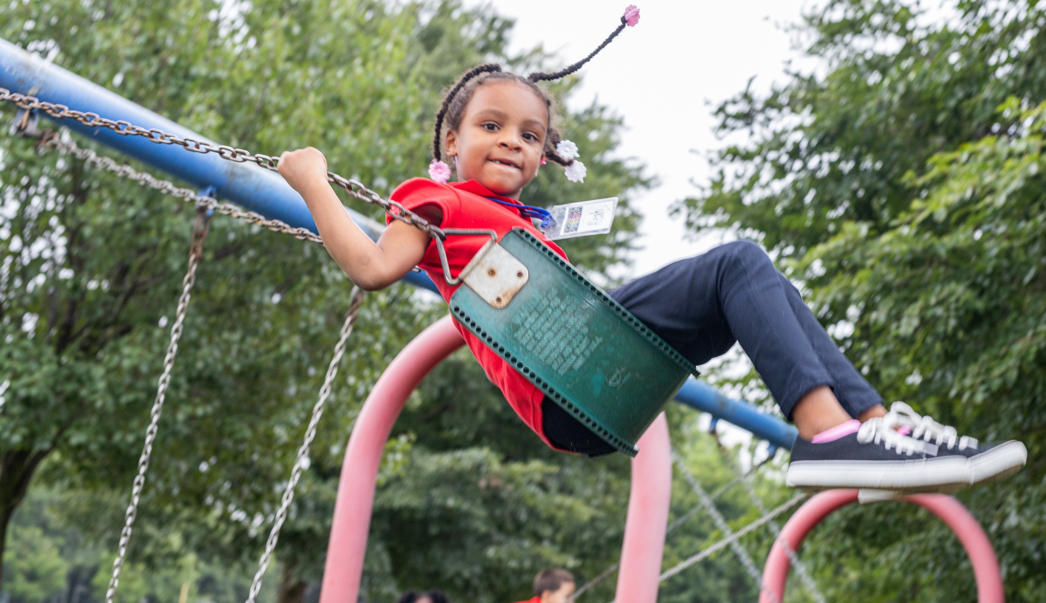
Near West-City of Residence

Slide 13
Lakeshore Intergenerational School

Slide 14
Lakeshore Intergenerational School
1

Slide 15
Lakeshore Intergenerational School

Slide 16
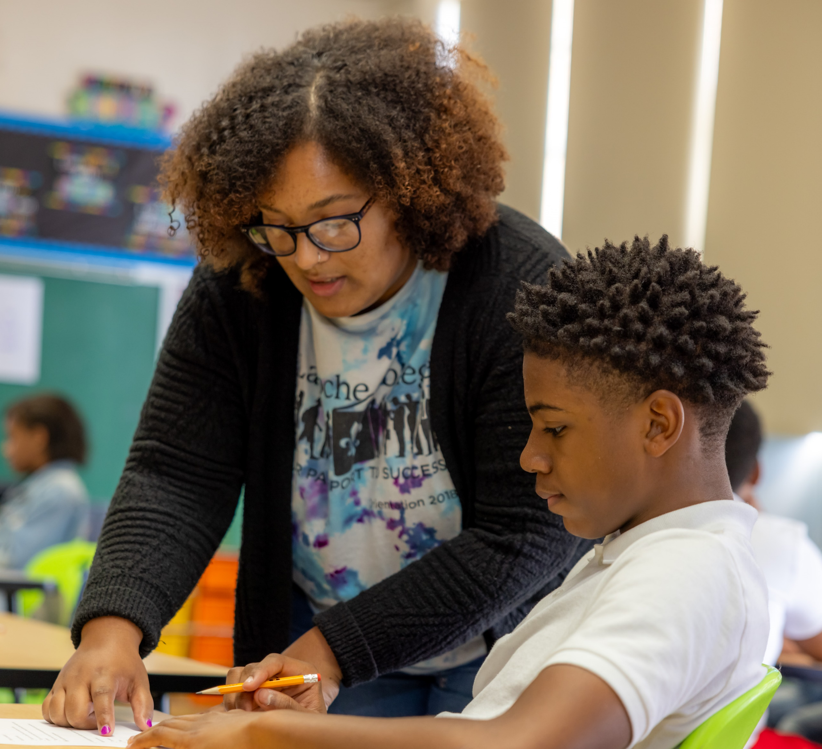
Lakeshore-City of Residence

Slide 17
Review of Family Income by City
The following slide was created using data from Power School, the Model’s student information system. This review was done to analyze:
Student’s city of residence
Percentage of economic disadvantaged students (ED) by city by school.
This review illustrates where our student population resides in relation to our schools as well as the percentage of economically disadvantaged students enrolled in the Model.

Slide 18
TIS-East Percentage of Economically Disadvantaged
Source: niche.com

Slide 19
Near West Percentage of Economically Disadvantaged
Source: niche.com

Slide 20
Lakeshore Percentage of Economically Disadvantaged
Source: niche.com

Slide 21
Efforts to Increase Diversity to Reflect the Surrounding Neighborhood
TIS-East | Near West | Lakeshore
Strengthen the partnership between the school and B&GC and East End Neighborhood by regularly communicating with their leaders to help support the students that attend both programs. | Near West has welcomed back Learning Partners of all ages to work with the students. They have also started their monthly IG visits to local nursing homes & adult care facilities. | Lakeshore Intergenerational will continue to partner with neighborhood resources, including, but not limited to; Art for Resistance Through Change, The Nottingham Public Library, The Collinwood Recreation Center, and John Carroll University to provide enrichment and extracurricular programs that support academic achievement, culturally responsive teaching, and social and emotional learning.
Continue to celebrate the diversity in our school by reading books, giving presentations, inviting in speakers, going on field trips, and holding our Celebration of Learning. | Continue to provide books, stories, visitors, and experiences that reflect our student population. CLP has come to the school to set up books full of Hispanic authors for Hispanic Heritage Month and to present on Hispanic culture. Families were also able to sign up for a library card. CPL will be back for Black History Month | Continue to provide our students with multi-cultural as well as intergenerational experiences.
Intentionally seeking and retaining talent within our community and on-boarding educators of color to fill open positions. | Near West would like to hire staff that is reflective of our very diverse student population when the opportunity arises, | Continue to assess and evaluate the diversity in the staff of Lakeshore and strive to hire staff that reflect the student body.

