Slide 1
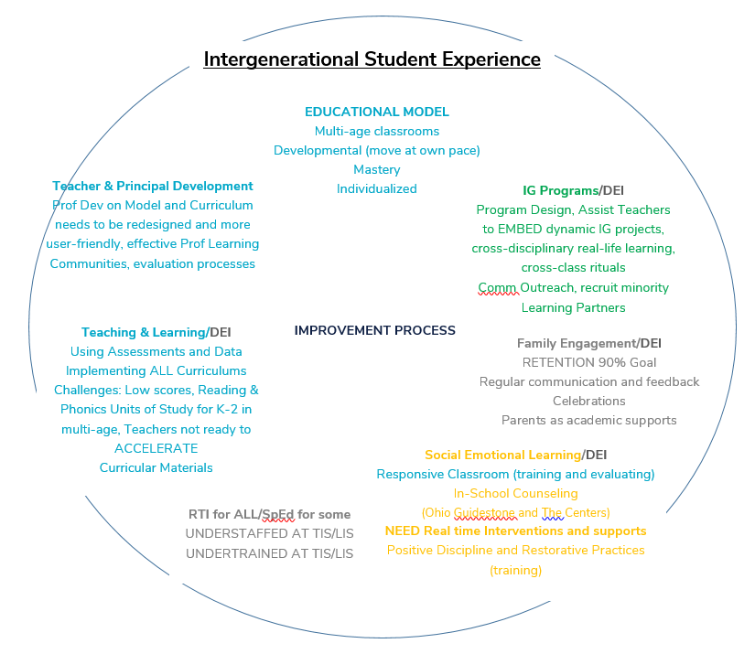
HR & Staffing
Finding the right people
Reducing # of Sub Licenses
Development/ Marketing/Outreach Sharing dynamic programs through
-Marketing
-Social Media
-Website
-Podcasting
Notes:
Presentations are visual. Don’t overwhelm your audience with text.

Slide 2
Corresponding Strategic Goals:
Recruiting and Hiring:
Changes to Compensation Plan to allow for more $$ at hire (suspend 1 to 2 year Apprentice period)
Invest additional resources in outside recruiting help
Simplify application process and tailor to the IG model of teaching at the onset
Increase capacity and elevate Intergenerational Programming and align with BOTH our Teacher Professional Development and our Development & Marketing efforts
Redesign Professional Development for All
Accessible, asynchronous, bite-sized, individualized resources paired with
Ongoing coaching/training in real-time within the classrooms
Develop our Principals to develop our teachers towards our educational model and vision, and ensure that all development and evaluation is based on progress towards that vision
Scaffold current curriculums to be more user-friendly for our teachers
Implement a multi-layered DEI program
Student-led assessments and programming
Revive DEI Board Task Force
Staff recruiting from HBCU’s
Feasibility of providing transportation
Carry out this year’s plan of hiring in-house School Counselors for school-based activities alongside therapeutic services of outside providers
Notes:
Presentations are visual. Don’t overwhelm your audience with text.

Slide 3
Investment Sources
 | TIS | NW | LIS | Model
High Quality Funding Rev | 328,781 | 316,557 | 321,225 | 966,563 | non-recurring
High Quality Expenses | 270,433 | 301,433 | 270,433 | 842,300
Remaining High Quality | 58,348 | 15,124 | 50,792 | 124,263 | Remaining
Charge to ESSER | 159,800 | 159,800 | 159,800 | 479,400 | Last year for funding
Charge to General Operating | 45,533 | 45,533 | 45,533 | 136,600
Total Investment | 475,767 | 506,767 | 475,767 | 1,458,300
*budgeted $783,180 on these items in ‘23
$644,120 more in ‘24
Notes:
Presentations are visual. Don’t overwhelm your audience with text.

