Slide 1
School Update

Slide 2
Core Values

Slide 3
MISSION
Through rigorous academics, character development, and strong supports for every learner, Libertas Academy Charter School prepares all sixth through twelfth grade students to succeed within the college of their choice and to be positive, engaged members of their communities.

Slide 4
Highlights

Slide 5
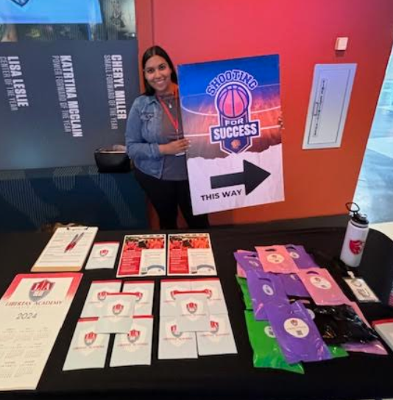
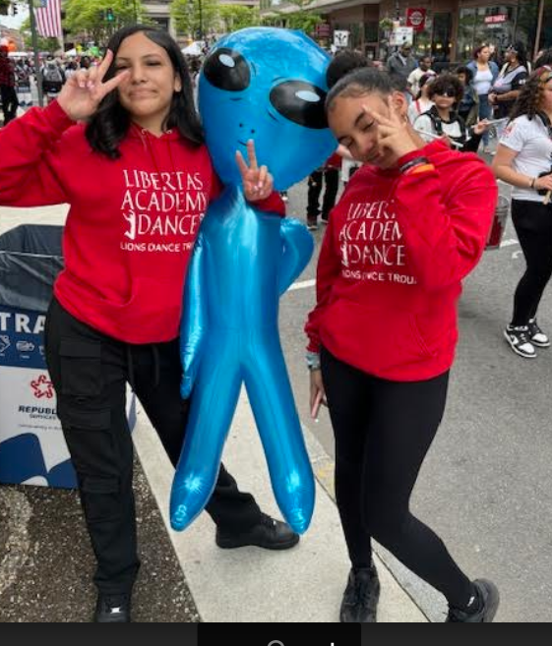
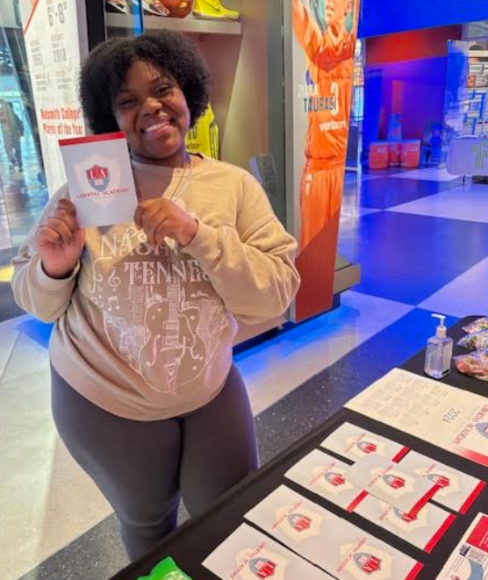
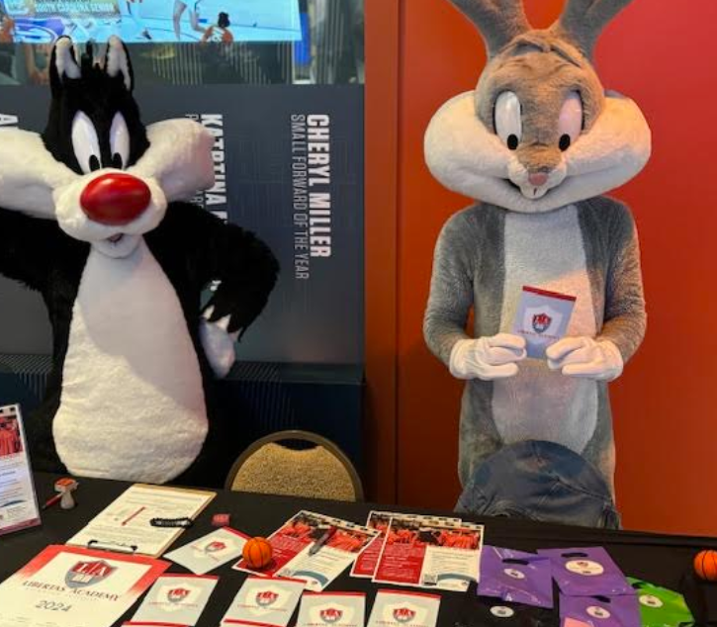
HIGHLIGHTS- Recruitment
Highlights for Recruitment
Applications are coming in Hot! This weekend I got 10 applications one of them was a 10th grader.
2. We were at the largest breakfast this weekend Drumline and dance team did a great job.
3.Joined Follow my steps mentoring program at the basketball hall of fame for a basketball tournament.

Slide 6
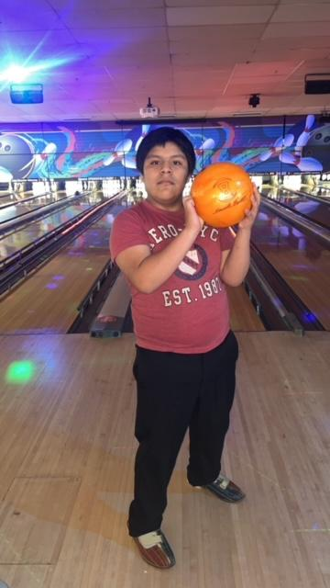
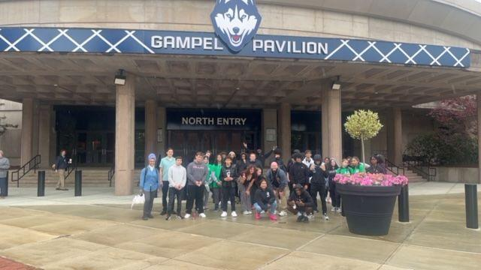
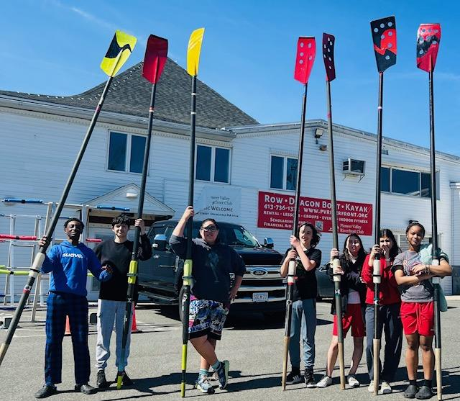
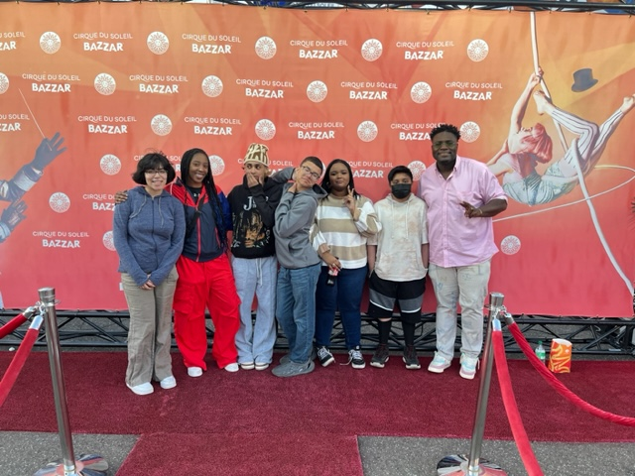
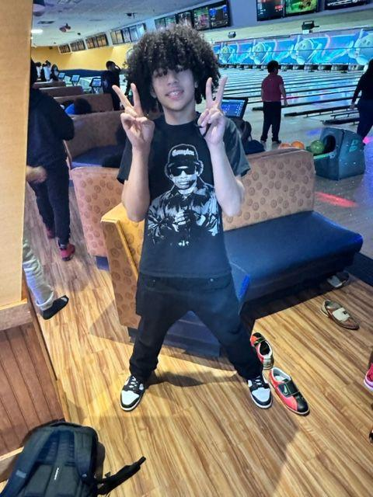
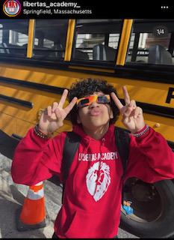
Student Life- highlights
Launched Events/Programs
-Royal Ambassadors
-Teacher Appreciation Week
-Spring Fling
-UConn Field Trip
-SGA Fundraising initiatives
-9th Grade Field Trip
-10th Grade Field Trip
-Royal Ambassadors- Tour Support
-NHS
-Cirque Du Soleil Trip
-Gardening Club
-Spoken Word Club
-Book Club
Upcoming
Junior Week: Interskate, Revolution Bowling, Junior Awards Ceremony, Prom, Six Flags
Top 10% Dinner

Slide 7
HIGHLIGHTS - ELL
ACCESS Celebration May 28th 7:30 - 9!
Inviting 41 students (and families!) who met target, reclassified, or grew more than 1 full point.
Breakfast buffet
Certificates for everyone
Medals w/ names engraved for Special Awards
I am REALLY proud of our kids and my team!

Slide 8
COLLEGE OFFICE HIGHLIGHTS
11th Grade Schedule, 5/16 - 5/31
Arrival & Morning Entry
Advisory & CCR 304, 305, 306 (Tancredi advisory move to 302)
ESSAY GROUPS 306, 506, 505 (German 1 move to 403)
SAT ELA (Santos) 505 | SAT ELA (Collins + Cowley) 302 | Conferences (College Team + Filion) 304
 | Conferences (College Team + Filion) 402 | SAT ELA (Collins + Cowley) 303
Lunch
Physics Robles 306 | Math Holladay 304 | Health Hawker 305
Health Hawker 302 | Physics Robles 508 | Math Holladay 305 (move AP sem to royal ambassador)
Math Holladay 305 | Health Hawker 402 | Physics Robles 506
We have officially launched the new junior schedule!
This new format is to ensure students are able to focus on what is needed for their junior portfolios:
Resume
Letter of Recommendation
College/Career List
Personal Statement
FSA ID (for FAFSA)
Junior Portfolio Tracker

Slide 9
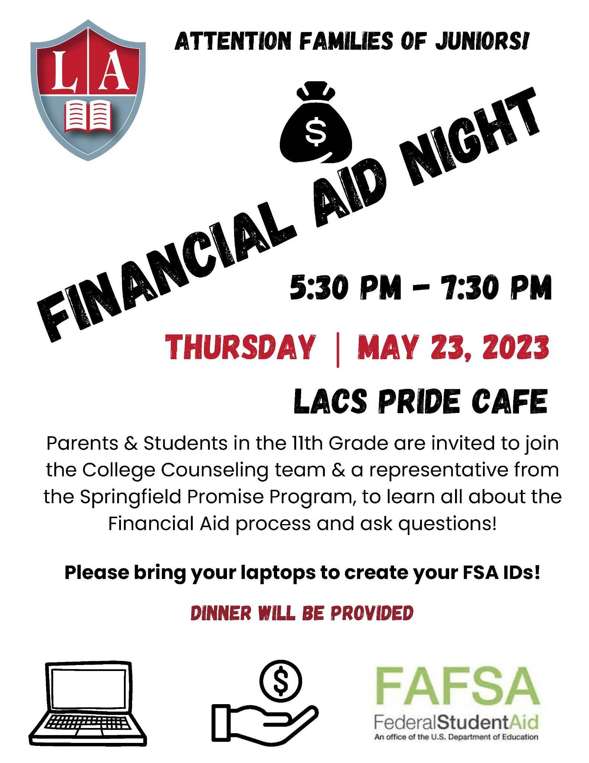
COLLEGE OFFICE HIGHLIGHTS
The FSA ID (for FAFSA)
Students & families will get guidance on how to create the FSA ID at Financial Aid Night on Thursday, May 23rd from 5:30-7:30pm & get information about FinAid resources.
This is step one of the FAFSA process. All students need their own individual ID separate from their parents.
We are encouraging ALL parents to come in, regardless of it they plan on actually providing financial support. Without the FAFSA, students cannot receive federal funding (grants, need-based scholarships, loans) & it will make it difficult for schools to offer institutional aid.
We are partnering with the Springfield Promise Program. They will be present to assist with answering Financial Aid specific questions. They will available to provide additional support throughout the year, and in the fall and points of contact for parents.
We will host a FAFSA completion night in the fall.

Slide 10
Summer Program - Updates
The following students have applied to summer programs:
Grade 9 | Massenberg STEM institute | UMass Amherst | 10 students applied
Nashley Colon | Samuel Marin | Jenisha Sarki | Jade Rivera | Jaydriel Diaz | Destani Ayala | Davian Feliciano |
Jaslene Gonzalez | Ariannah De Jesus | Luis Campos
In lieu of interviews, students had to submit a 2-minute video after their nomination forms were submitted. All students submitted videos and selections should be announced soon.
Grade 10
Jadalize Brown Vazquez: Tufts Medical Program | Accepted
Sherlline Mercado - Yale Young Global Scholars - Waitlisted
Eli Challenger - STCC Airbrushing program | Under Review
UMass Programs (all still under review)
Adrian Cedano: The Graphic Novel
Vanessa Martin: The Graphic Novel
Destiny Barfield: Entrepreneurship - Becoming a Game-changer
Cardion Collins - Entrepreneurship - Becoming a Game-changer
Jose Mulero: Summer Engineering Institute
Tavoy Bryan: Summer Engineering Institute

Slide 11
Summer Pre-College Program - Updates
The following students have applied to summer programs:
Grade 11
Adeychalis Andin0 | Bentley - Wall Street 101 | Application submitted
Sa’ad Maigari | Bentley - Analytics Academy | Application submitted
Ismael Maranon | Boston University Calculus 3 | Application submitted
Luis Umpierre Atilano - Carleton College - Accepted
Cliff Salgado Bermudez - Global Glimpse (D.R.) & Germany Trips
Ruth Monserrate - Global Glimpse (D.R.) & Brown (still pending)
Ana Ramirez Hernandez - Incomplete/Need support
Additional opportunities have become available as well, for ex. Make-It-Springfield - a visual art/fashion design summer program. More updates to come.
Many students opting to work - Six Flags, MassHire, Retail, Food Service, etc.
All Final Summer Plans will be updated in tracker by 5/31

Slide 12
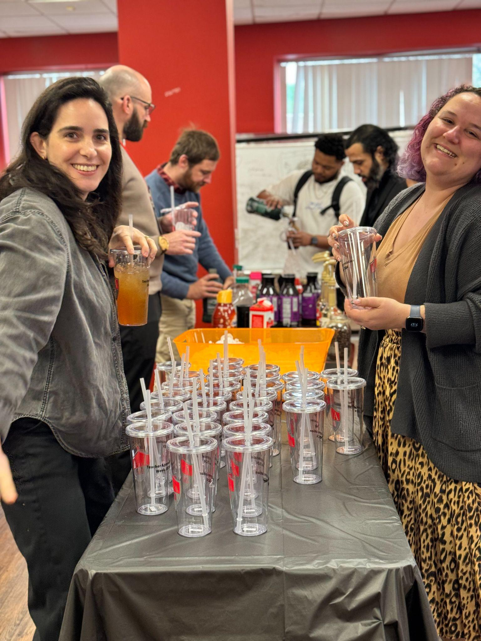
HIGHLIGHTS- TALENT
New Office Manager Naomi Colon!
Teacher appreciation week! The committee planned a variety of ways to celebrate the love language of all teachers
TAP Kickoff! Strong communication and support plan for incoming teachers

Slide 13
262 Liberty St. Update

Slide 14
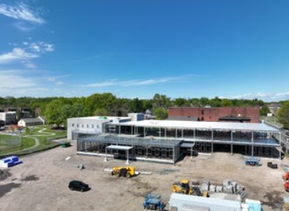
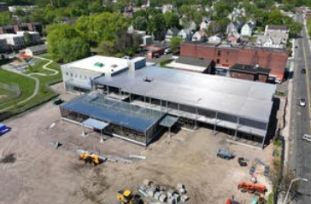
Construction Update
Steel structure complete
First floor exterior studs installed
Kitchen layout revisions complete
Exterior sheathing - begins this week
Roofing on one story - begins this week
Concrete deck on second floor - complete 5/29
Underground MEP (mechanical, electrical and plumbing) - installed by end of this week
Elevator masonry is 50% complete - done by end of this week
Additional projects in progress:
Interior framing
HVAC in gym
Exterior underground utilities
Current aerial photos of site (5/19/2024)

Slide 15
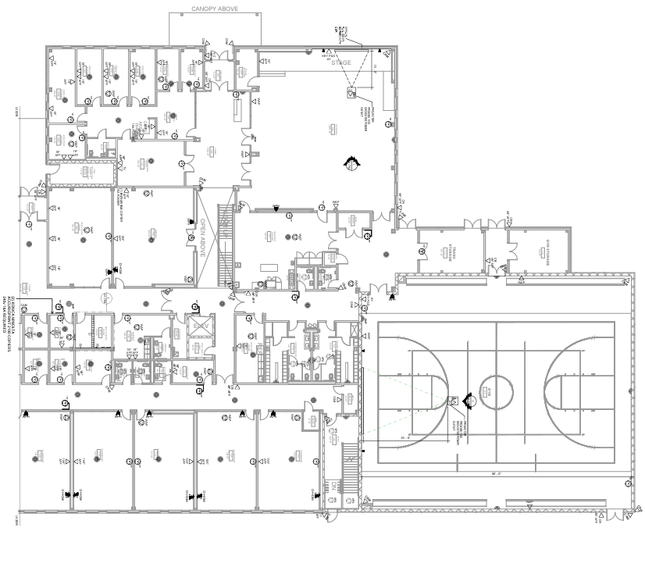
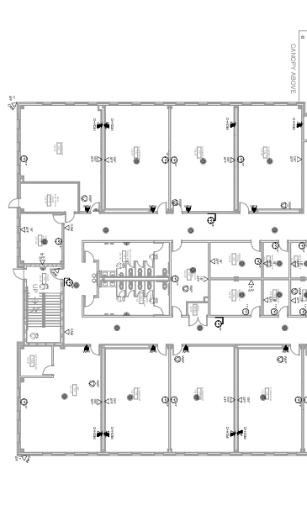
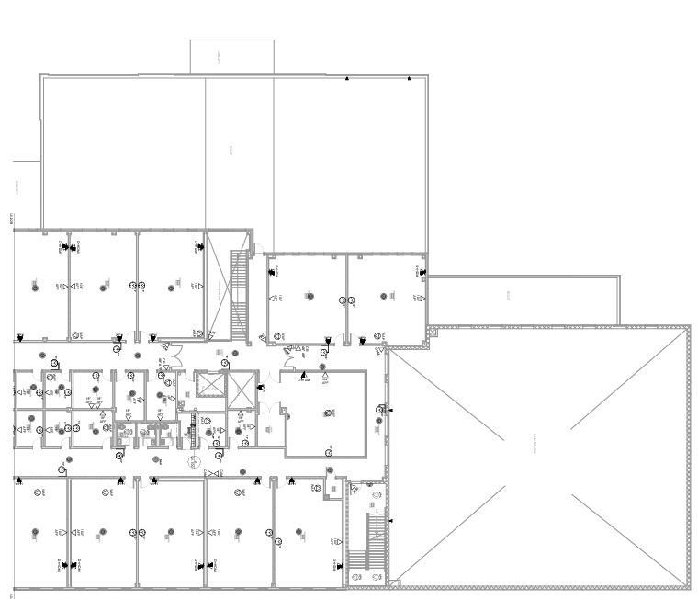
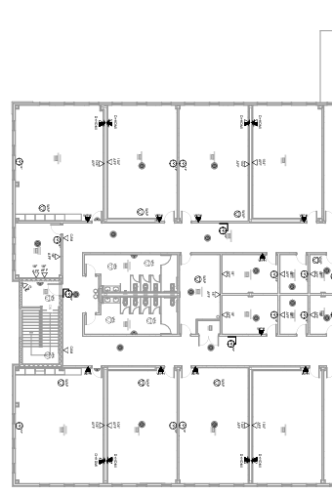
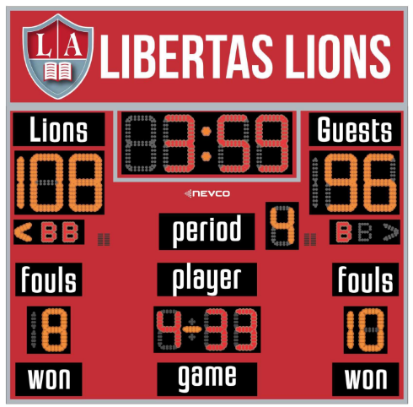
Technology Planning Update
Three Liberty Street tech quotes signed 5/16
Gym/Cafeteria AV
E-Rate
Low voltage, cabling, equipment
Coming up: Gymnasium scoreboards
Floor 1
Floor 2

Slide 16
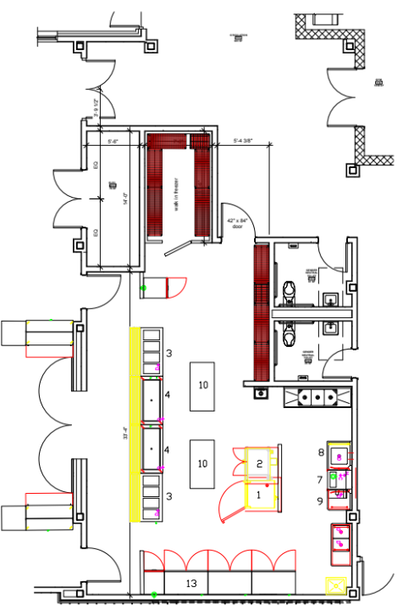
Kitchen Equipment Update

Slide 17
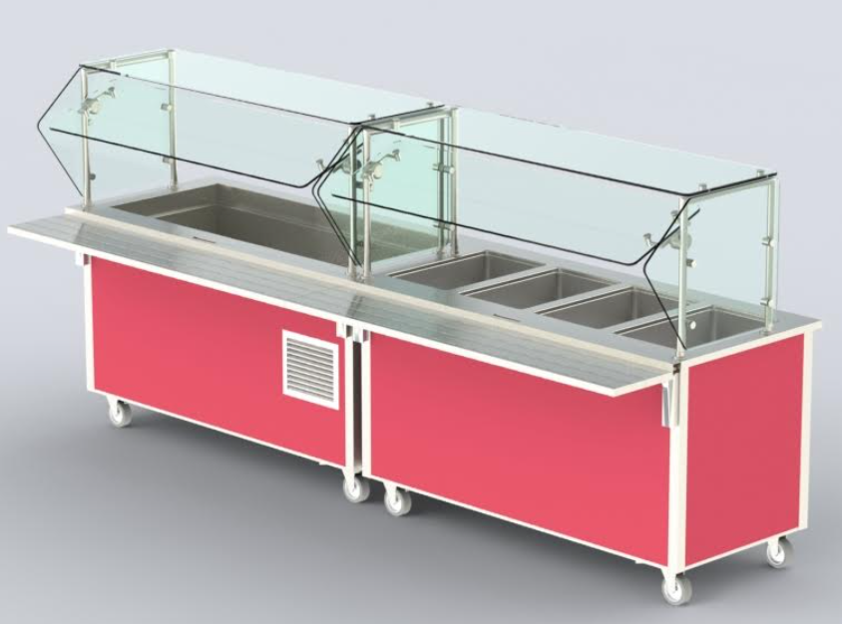
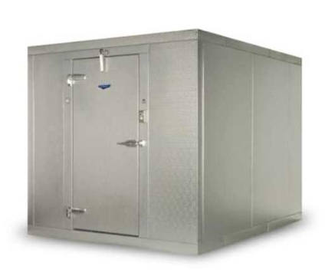
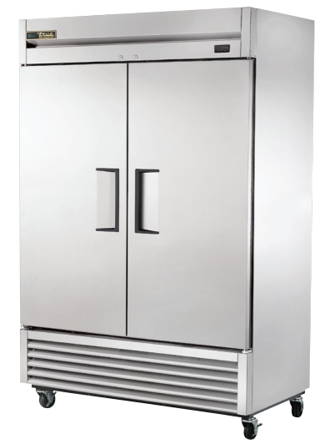
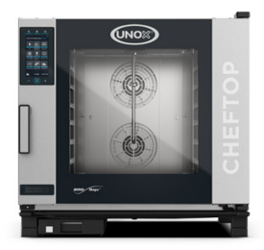
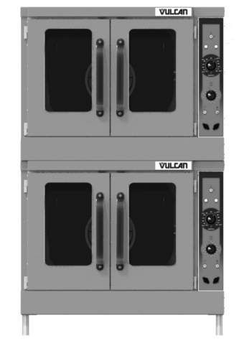
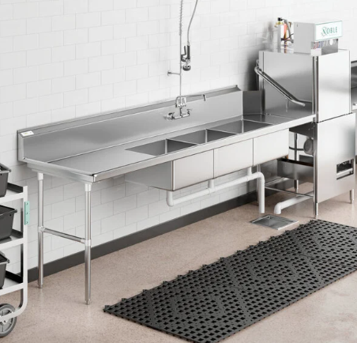
Kitchen Equipment Update
Entry and Exit Doors to Cafeteria
Two Hot Food and Two Cold Food Serving Counters
Walk-In Freezer
Three Reach-In Refrigerators
Two Combination Ovens
Two-Door Convection Oven
Commercial Dish Machine and Prep Line

Slide 18
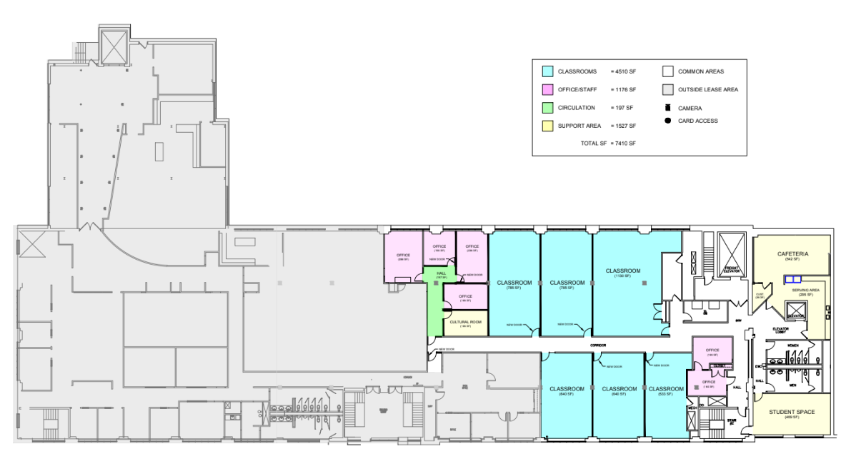
Satellite Campus Review
1 Federal St, Bldg 111-4
6 classrooms
5 offices plus main office area
Private staircase for LACS student arrival/dismissal
Accessible elevator
1 DCD room
1 additional student space
ADA compliant student- and staff-bathroom locations
Nutrition location
Swipe card access to all LACS doors on floor for security

Slide 19
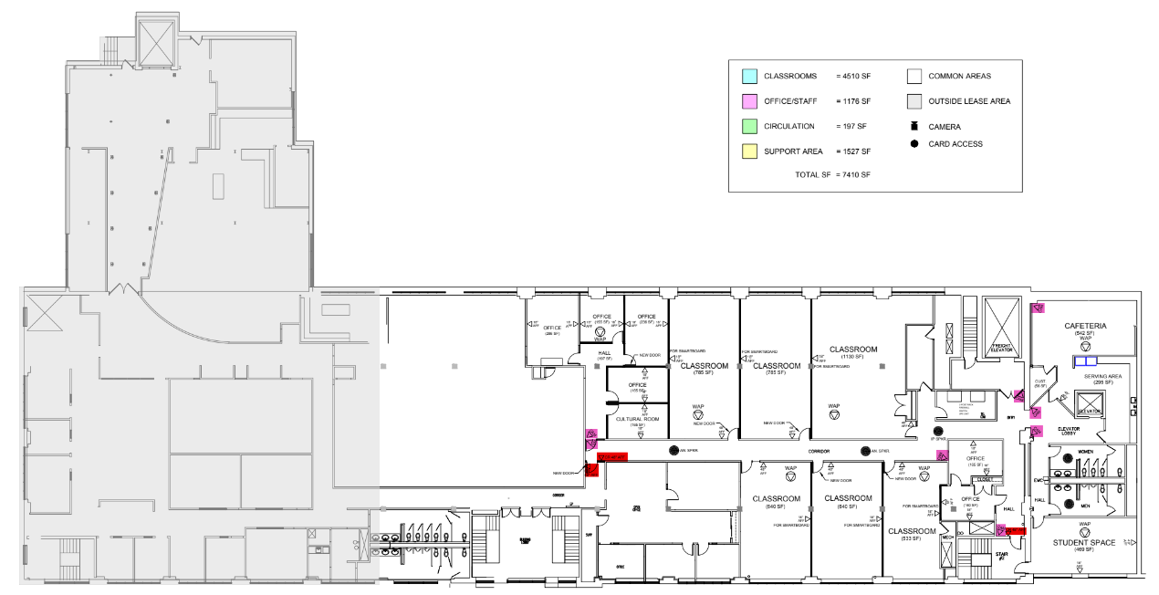
Satellite Campus Update
Furniture quote signed 4/19
Tech markups confirmed, equipment quote signed 5/16
Construction schedule provided, CO projected to be granted on 7/18

Slide 20
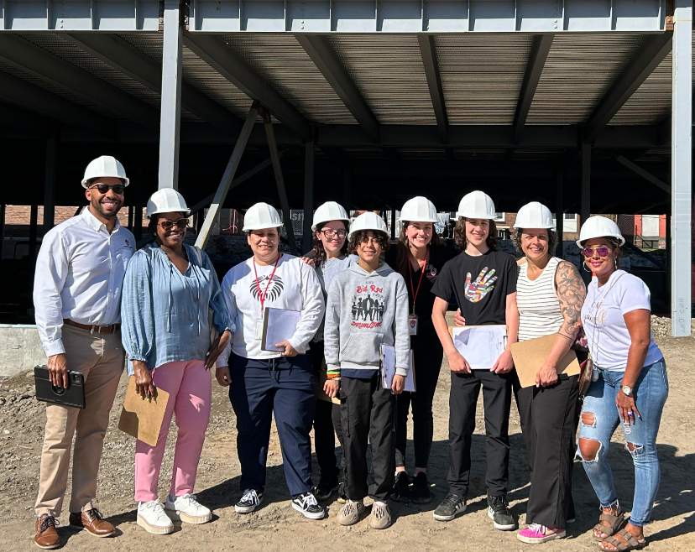
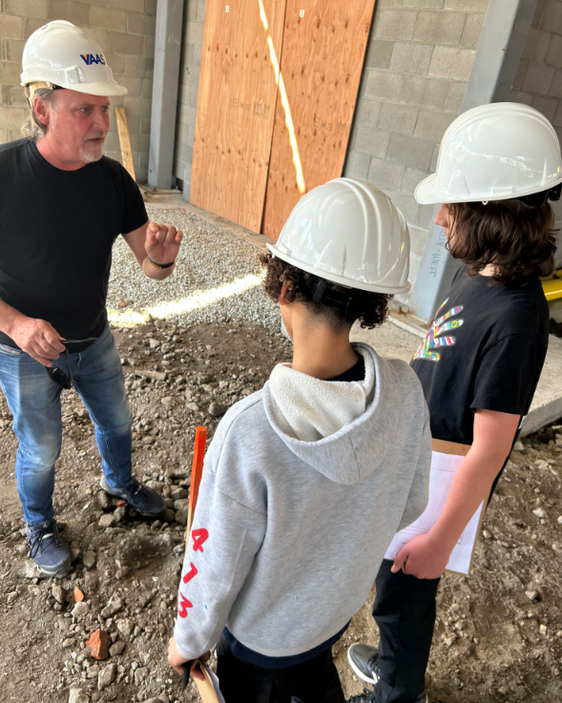
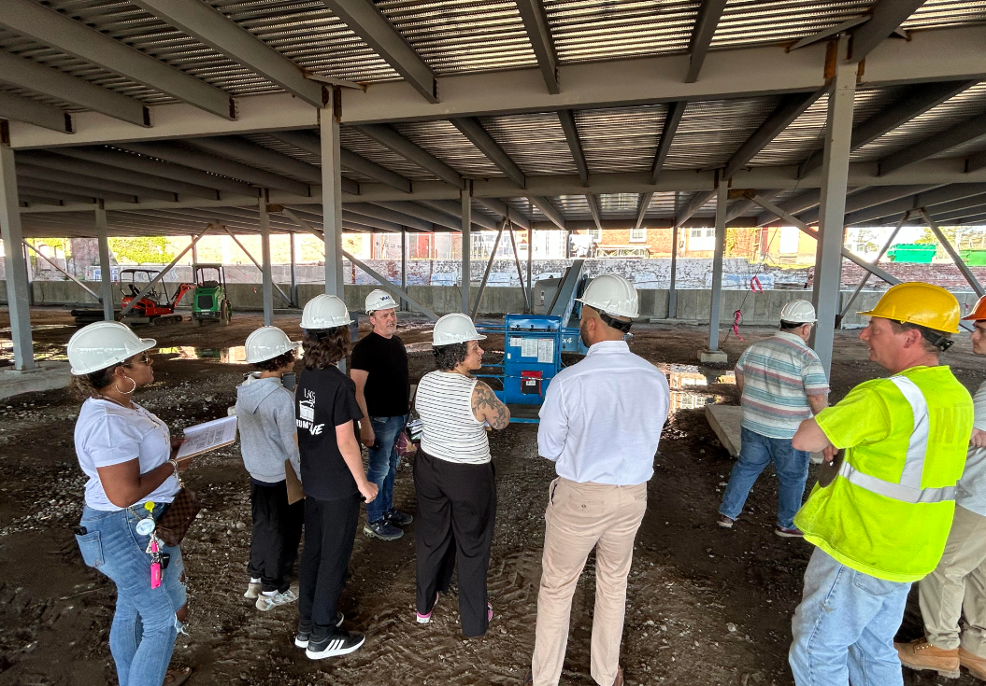
Legacy Ambassador Committee
Legacy Ambassador Committee members tour the Liberty Street construction site with Modesto, Emma, and Vaas Builders (5/7/2024).

Slide 21
Key School Data

Slide 22
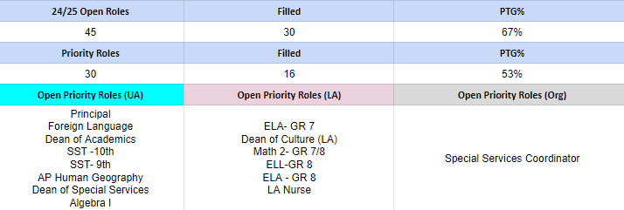
GOALS & DATA- TALENT
Fill 100% of Priority roles by July 1, 2024 (somewhat on track)
SUB-GOALS
Fill 70% of priority roles by 5/1 (not met)
FIll 90% of priority roles by 6/1 (off track)

Slide 23
STRATEGIES- TALENT
$1,500 Sign On Bonus for AP roles
Libertas tagged as “Featured Employer” on Indeed - ensuring LACS roles have increased visibility on the platform
Partnership with TFA - lead to (3) new hires for the 24-25 SY
Partnership with School Works- supporting a pipeline of candidates for Principal/PIR role
Internal references- 6 new hires have been referred by internal staff
He is Me- Black Male Teacher Summit on 6/1-opportunity to network and expand the LACS brand in Boston

Slide 24
GOALS & DATA- Recruitment
Recruitment - Lottery and ITR
Families who were pulled, who accepted, and ITR ino.

Slide 25
GOALS & DATA- Recruitment
Recruitment - Lottery registration information.

Slide 26
LA Headline Goals

Slide 27
UA Headline Goals

Slide 28
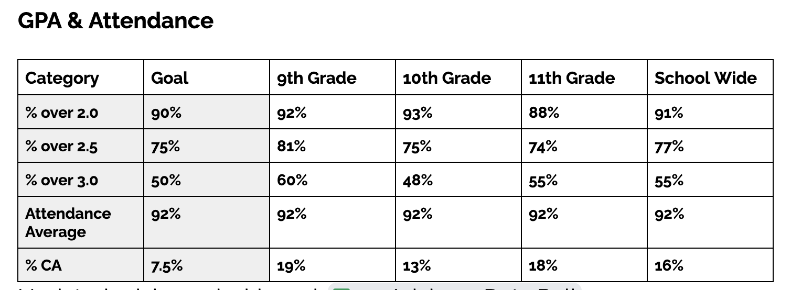
23-24 GAP & Attendance

Slide 29
Upcoming LACS Events

Slide 30
Upcoming LACS Events
Event | Date | Time
ACCESS Celebration | May 28th | 7:30 - 9 AM
Top 10% Dinner | May 30th | 5 to 6 PM
8th Grade Promotion | June 13th | 4-5:30 PM

Slide 31
FYIs & Approvals
Approvals:
FYIs:
Tech Park Lease
Construction Update
MassDevelopment & Budget

Slide 32
MISSION
Through rigorous academics, character development, and strong supports for every learner, Libertas Academy Charter School prepares all sixth through twelfth grade students to succeed within the college of their choice and to be positive, engaged members of their communities.

Slide 33
LACS Strategic Plan 2023-2027
1 | We will prepare our students for a successful post-secondary transition that focuses on college access as a pivotal step toward career success.
2 | We will dramatically increase student achievement performance.
3 | We will recruit, develop, and retain highly effective teachers.
Notes:
448 is our target.

Slide 34
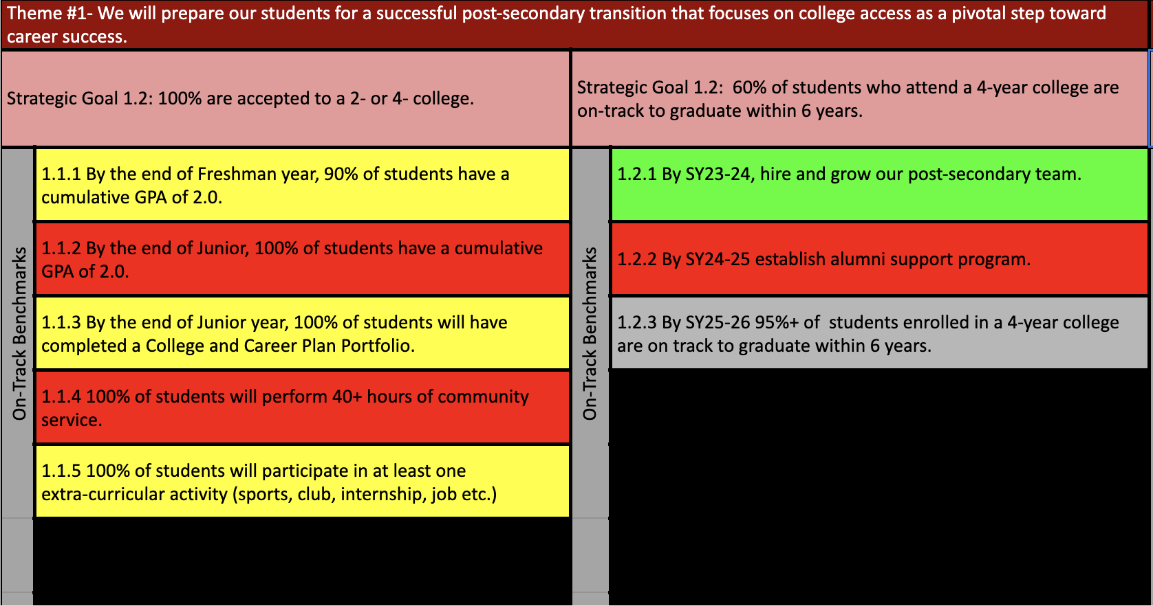
Notes:
AP data: 88%

Slide 37
Upcoming LACS Events
Look at school calendar: https://docs.google.com/spreadsheets/d/1GdGJGI4IYizFUWEpR7mSQp9Rwj9N2mT3PPbaaUGFe9Y/edit#gid=1594803582
LA tinyurl.com/FY24LACalendar
UA: tinyurl.com/FY24UACalendar
Look at recruitment events! (Student and Staff)

Slide 38
Upcoming LACS Events
Event | Date | Time
Club Showcase | 12/20 | 5 PM
 | 3/8 | 7 PM

