Slide 1
School Update

Slide 2
Core Values

Slide 3
MISSION
Through rigorous academics, character development, and strong supports for every learner, Libertas Academy Charter School prepares all sixth through twelfth grade students to succeed within the college of their choice and to be positive, engaged members of their communities.

Slide 4
Highlights

Slide 5
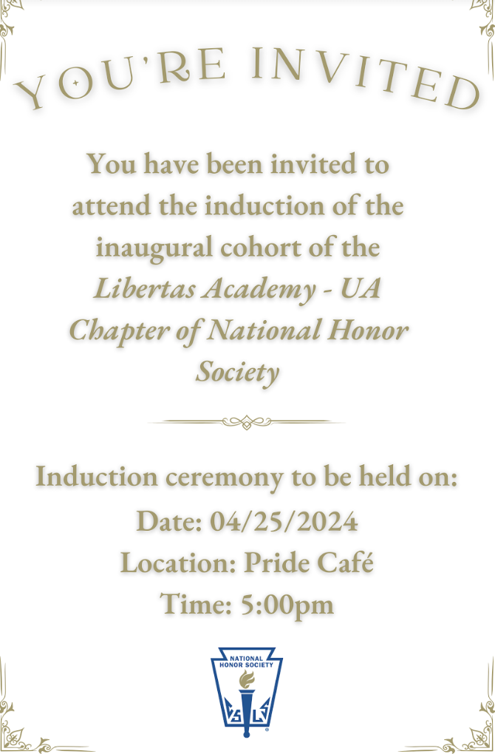
Notes:
Progress updates:
Close to hiring a project manager who will oversee the move.
Did a walkthrough of the site w/ Mike Ronan.
Met with our furniture partner to kick off the process.

Slide 6
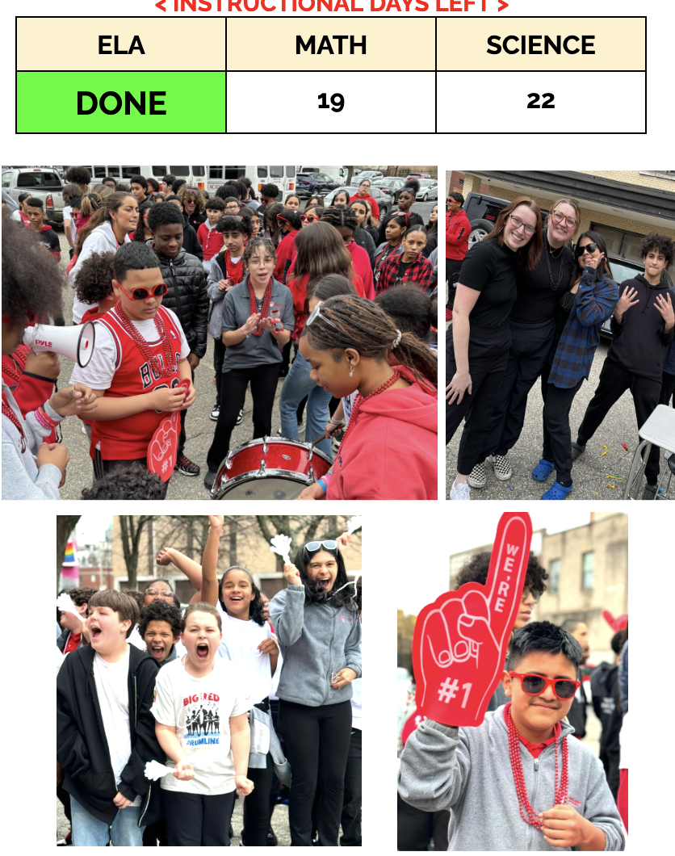
HIGHLIGHTS-

Slide 7
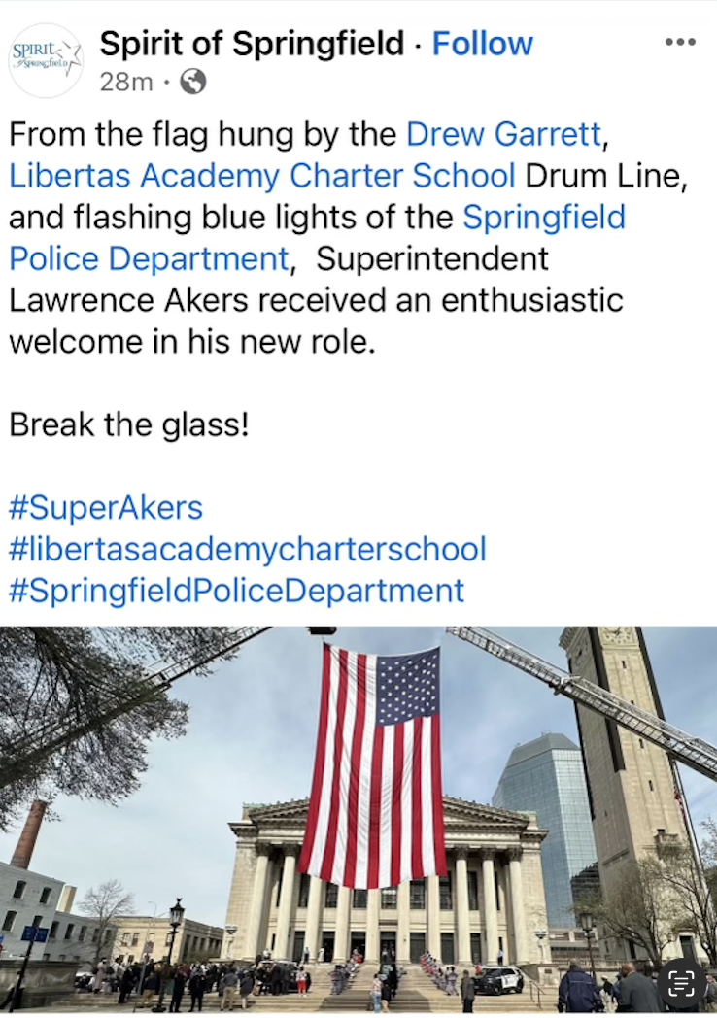
HIGHLIGHTS

Slide 8
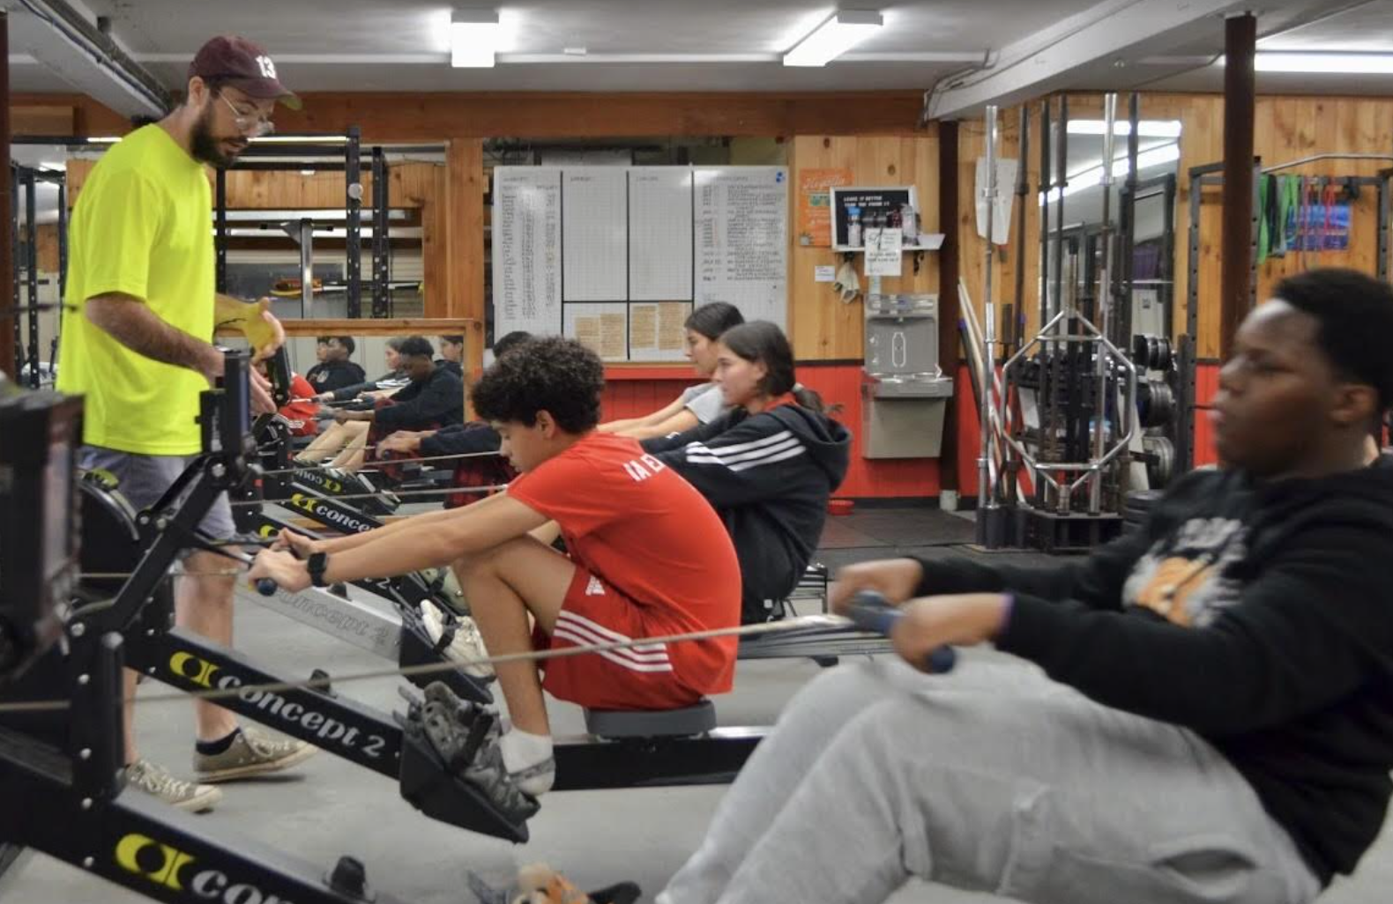
HIGHLIGHTS

Slide 9
262 Liberty St. Update

Slide 10
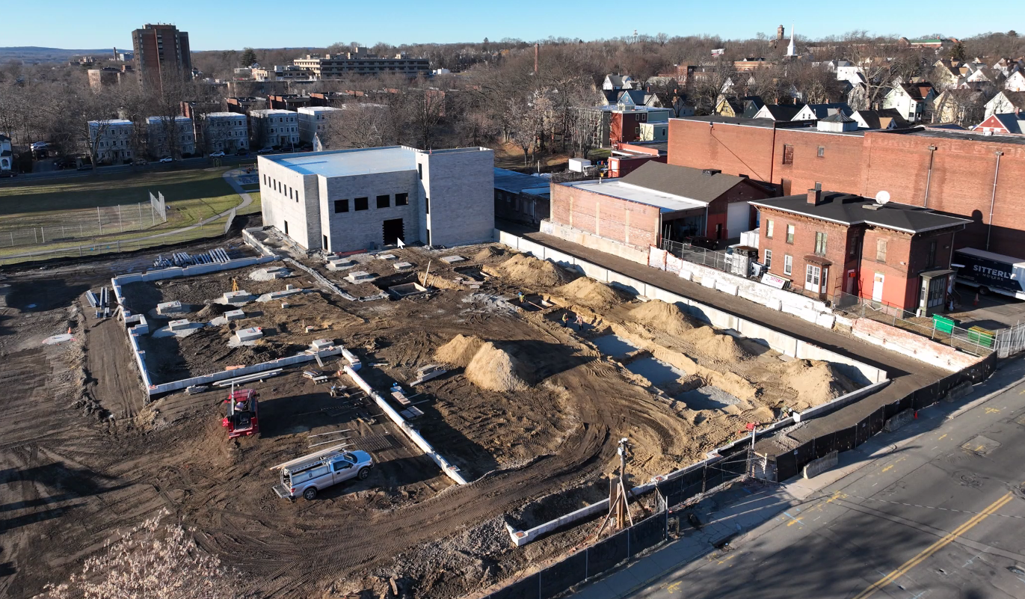
The Liberty St. Project Today
Construction Update
Floor 1 steel frame completed, currently working on Floor 2
Status of switchgear / impact on delayed opening
Contingency planning for Fall 2024 semester
Tech Park
Communication to Libertas community (leaders, staff, Legacy Ambassador Committee, families)
Aerial photo as of 2/26/24

Slide 11
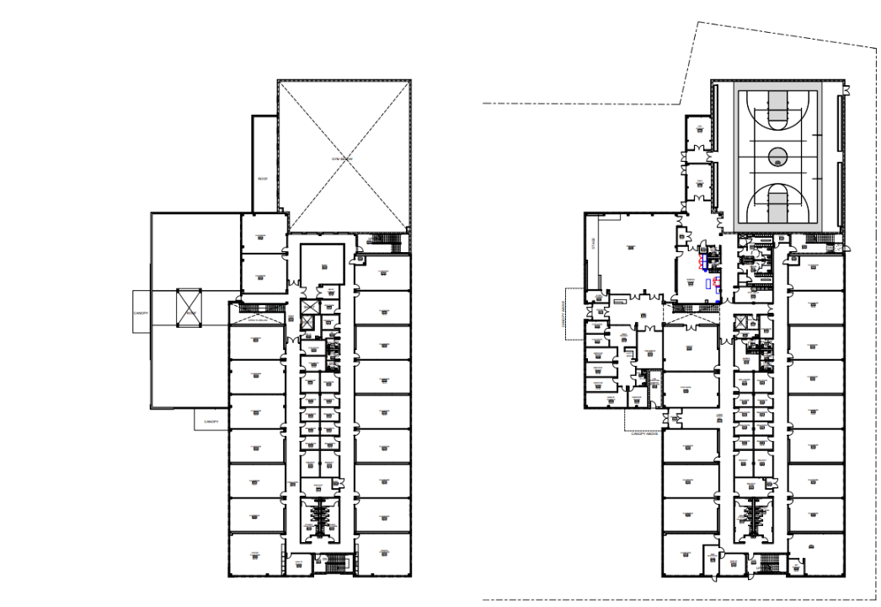
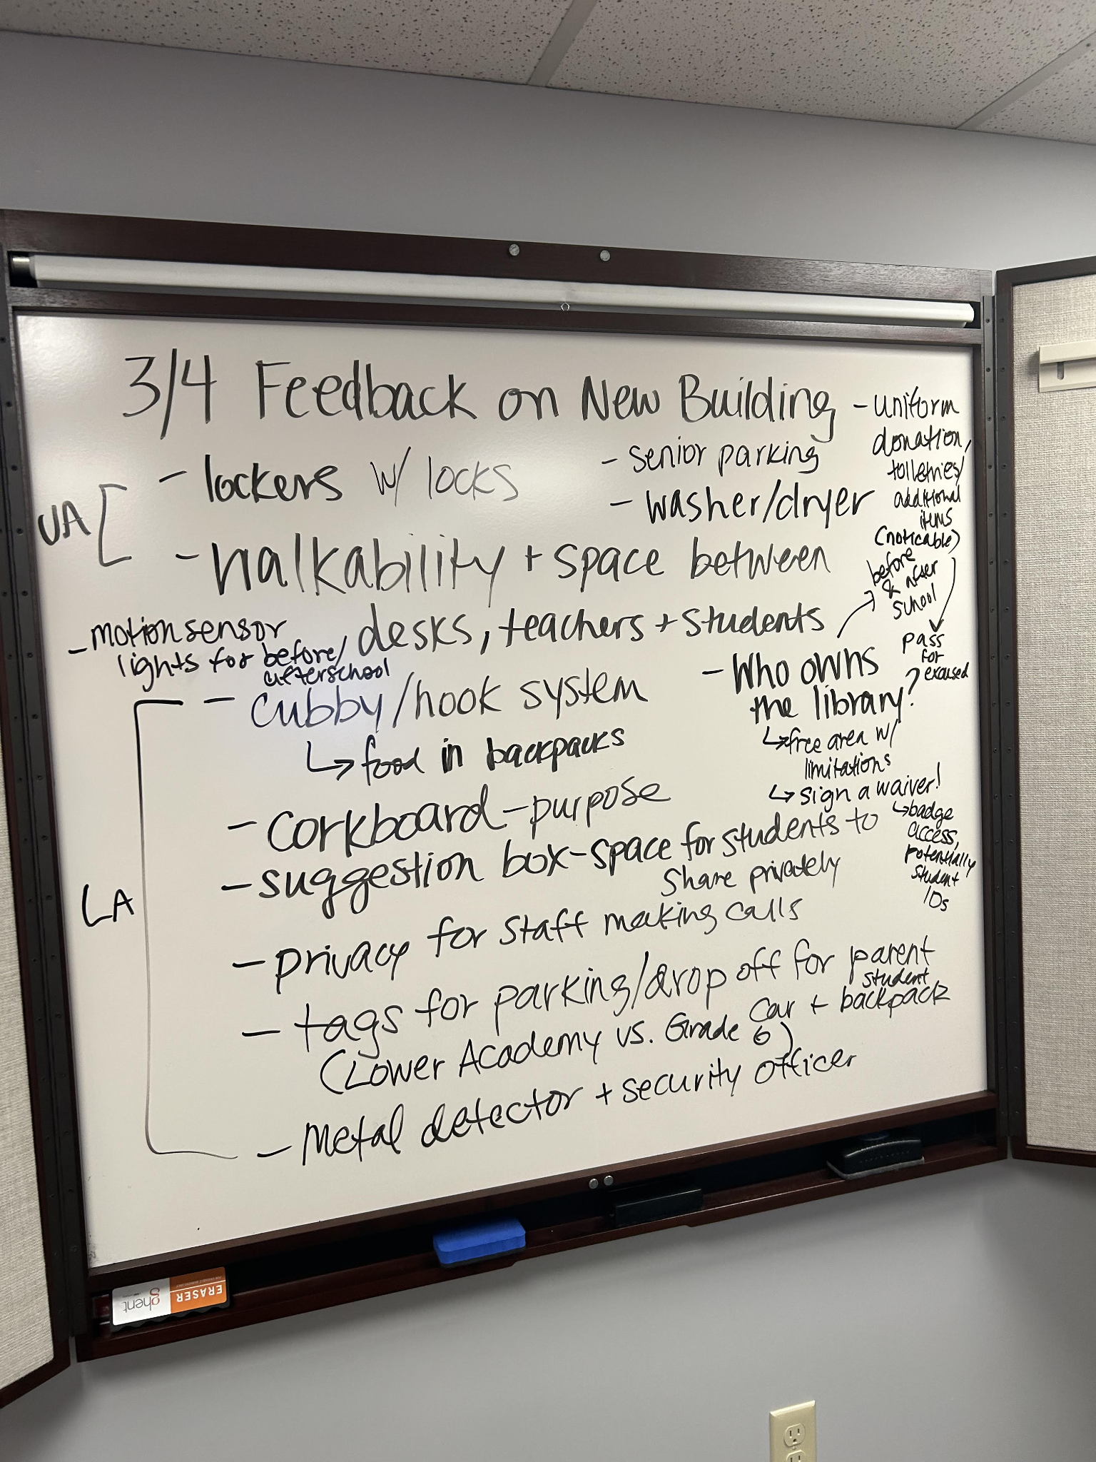
The Liberty St. Project Today - cont’d
Partnerships & Vendors
Furniture & Building Planning
Legacy Ambassador Committee
Nutrition
Movers
Commercial Cleaners
Technology
Design plan finalized for all spaces
Clarity from leaders on uses for all spaces
Full inventory of current items
Furniture quote update
Committee launched on Monday, 3/4
1 UA parent
1 LA parent
2 UA students
2 LA students
1 UA staff
2 LA staff
Second meeting on Thursday, 4/4

Slide 12
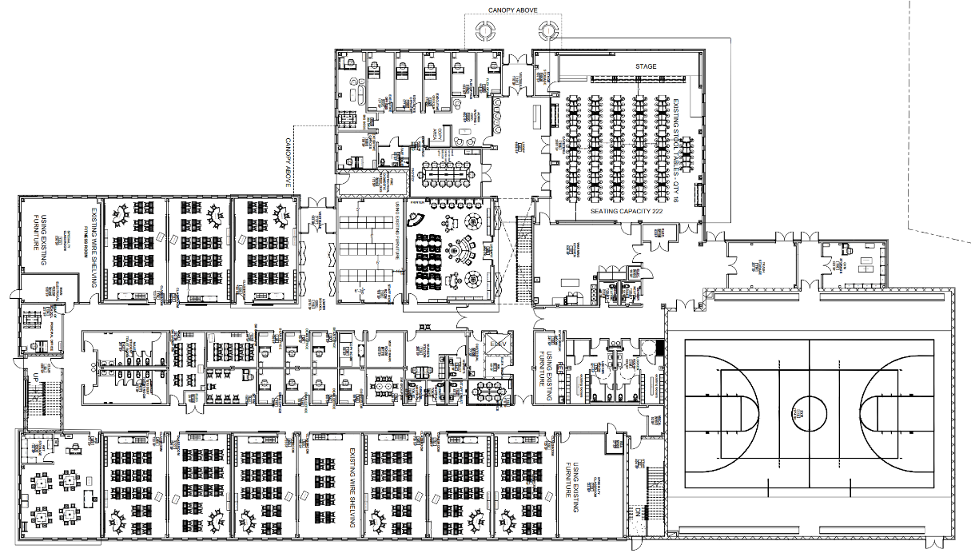
Floor 1 - Admin and Lower Academy
Notes:
These will also be printed/posted around room.

Slide 13
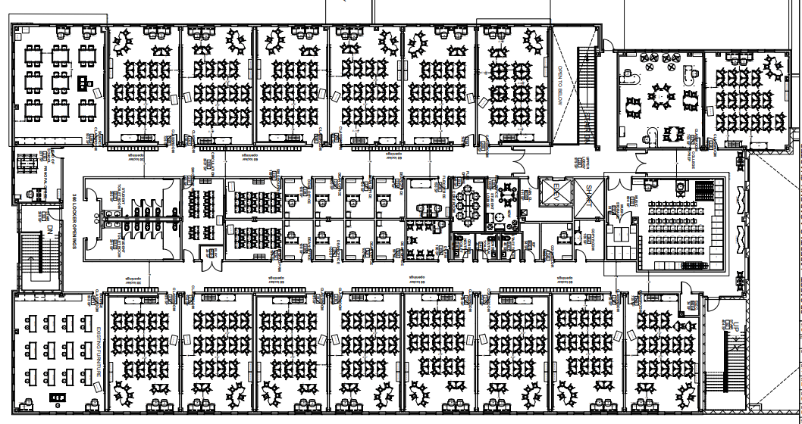
Floor 2 - Upper Academy
Notes:
These will also be printed/posted around room.

Slide 14
Key School Data

Slide 15
GOALS & DATA- TALENT
Fill 100% of Priority roles by July 1, 2024 (on track)
SUB-GOALS
Fill 70% of priority roles by 5/1 (somewhat on track)
FIll 90% of priority roles by 6/1 (somewhat on track)
24/25 Open Roles | Filled | PTG%
37 | 10 | 27%
Priority Roles | Filled | PTG%
24 | 5 | 21%
Open Priority Roles (UA) | Open Priority Roles (LA) | Open Priority Roles (Org)
Principal AP Language HS Science-12th SST -10th AP Govt & Politics AP Research Foreign Language Dean of Academics SST -10th SST- 9th AP Human Geography Biology | ELA- GR 7 Dean of Culture (LA) Math 2- GR 8 Math 2- GR 7 ELL-GR 8 ELA - GR 8 | Special Services Coordinator

Slide 16
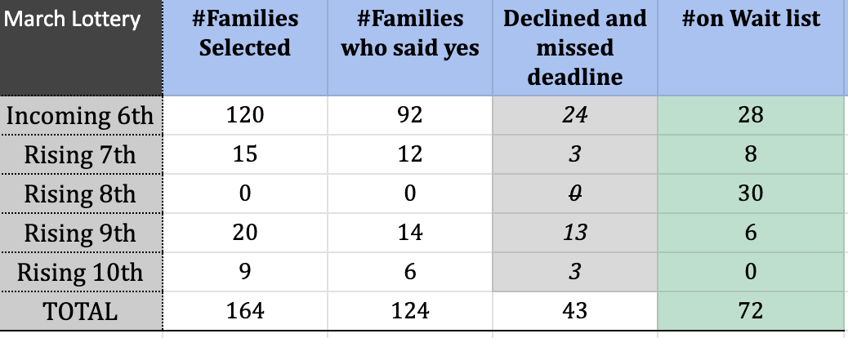
GOALS & DATA- Recruitment

Slide 17
LA Headline Goals

Slide 18
UA Headline Goals

Slide 19
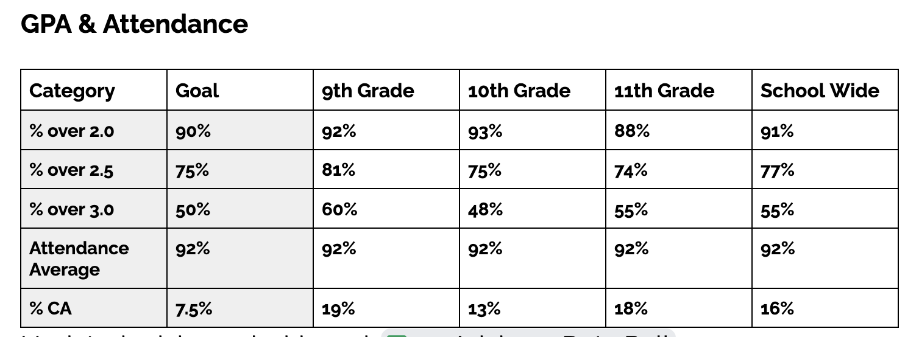
23-24 GAP & Attendance

Slide 20
Upcoming LACS Events

Slide 21
FYIs & Approvals
Approvals:
FYIs:
Tech Park Lease
Construction Update
MassDevelopment & Budget

Slide 22
MISSION
Through rigorous academics, character development, and strong supports for every learner, Libertas Academy Charter School prepares all sixth through twelfth grade students to succeed within the college of their choice and to be positive, engaged members of their communities.

Slide 23
LACS Strategic Plan 2023-2027
1 | We will prepare our students for a successful post-secondary transition that focuses on college access as a pivotal step toward career success.
2 | We will dramatically increase student achievement performance.
3 | We will recruit, develop, and retain highly effective teachers.
Notes:
448 is our target.

Slide 24
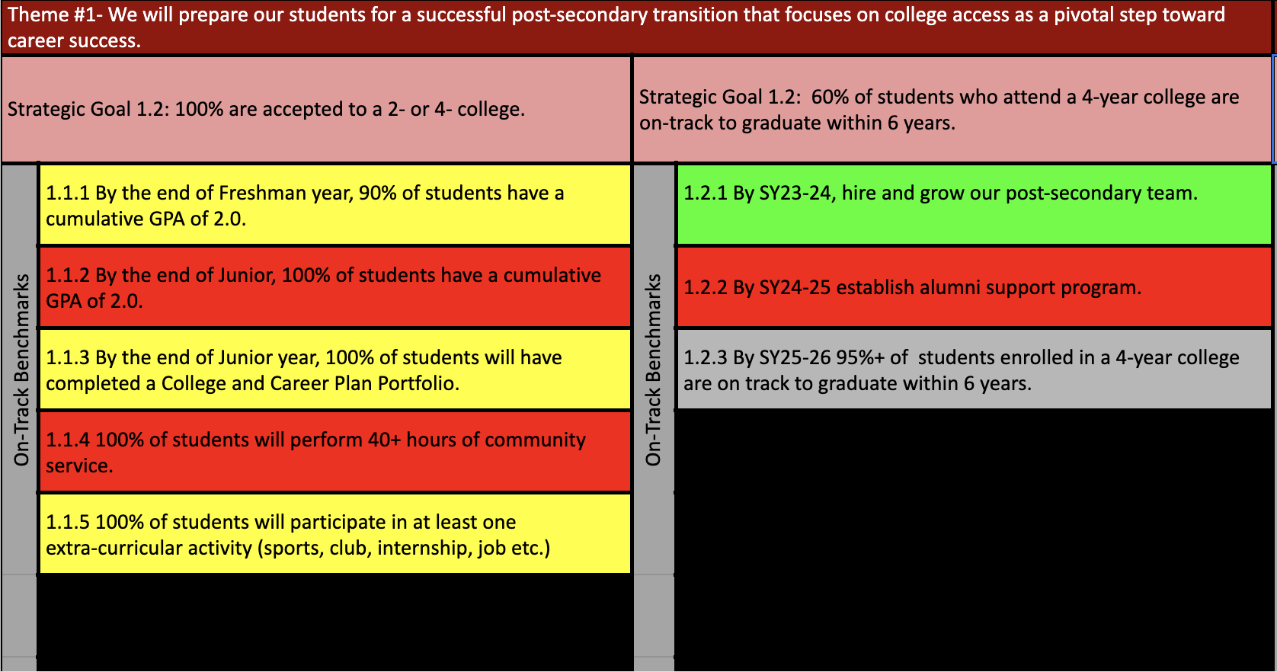
Notes:
AP data: 88%

Slide 27
Upcoming LACS Events
Look at school calendar: https://docs.google.com/spreadsheets/d/1GdGJGI4IYizFUWEpR7mSQp9Rwj9N2mT3PPbaaUGFe9Y/edit#gid=1594803582
LA tinyurl.com/FY24LACalendar
UA: tinyurl.com/FY24UACalendar
Look at recruitment events! (Student and Staff)

Slide 28
Upcoming LACS Events
Event | Date | Time
Club Showcase | 12/20 | 5 PM
 | 3/8 | 7 PM

