Slide 1
School Update

Slide 2
Core Values

Slide 3
MISSION
Through rigorous academics, character development, and strong supports for every learner, Libertas Academy Charter School prepares all sixth through twelfth grade students to succeed within the college of their choice and to be positive, engaged members of their communities.

Slide 4
Highlights

Slide 5
Notes:
Progress updates:
Close to hiring a project manager who will oversee the move.
Did a walkthrough of the site w/ Mike Ronan.
Met with our furniture partner to kick off the process.

Slide 6
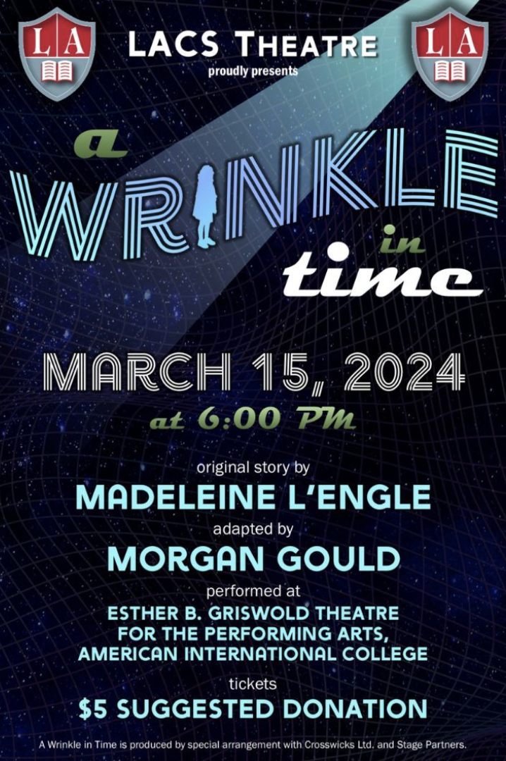
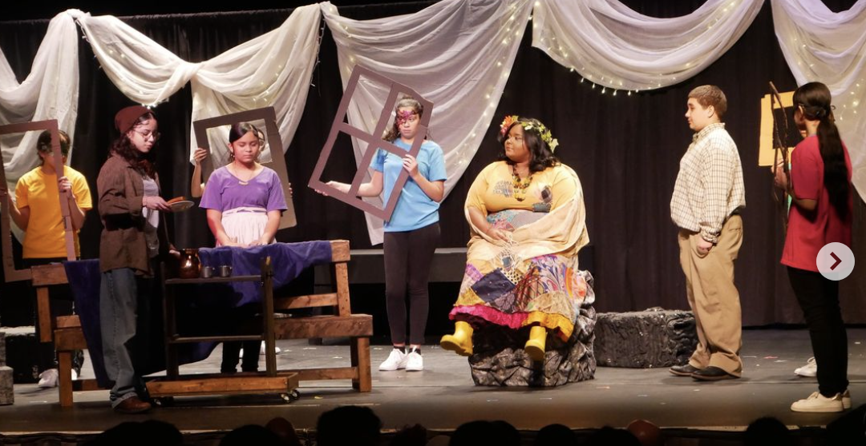
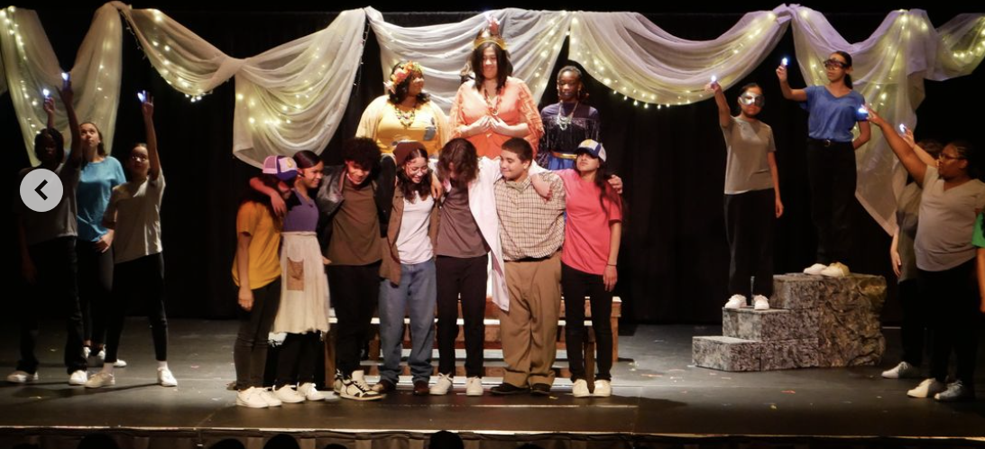
HIGHLIGHTS-

Slide 7
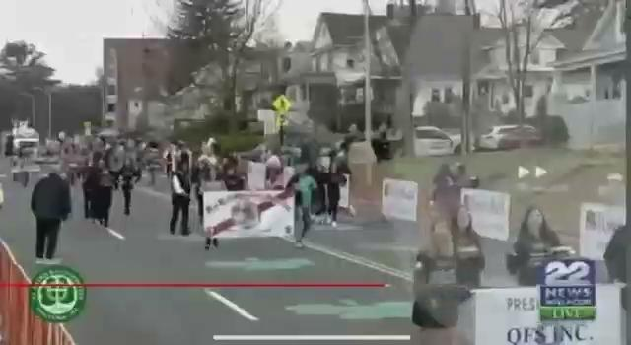
HIGHLIGHTS

Slide 8
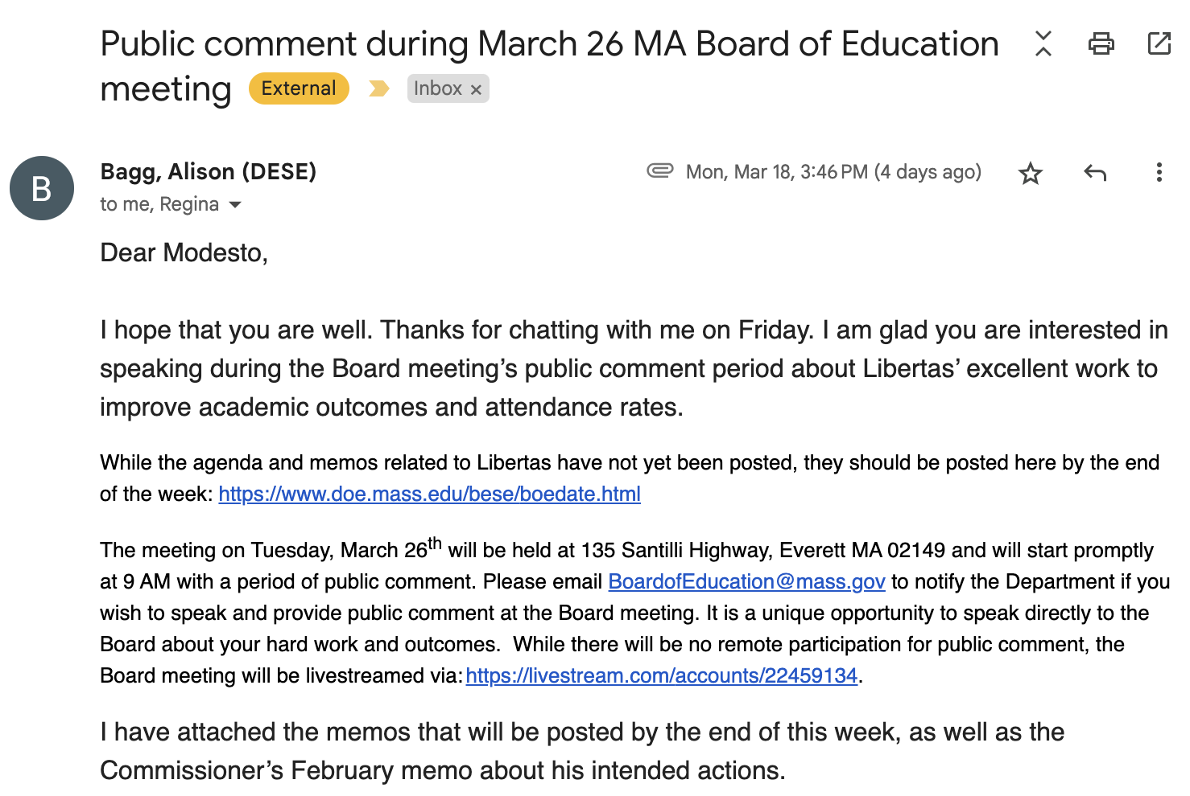
HIGHLIGHTS

Slide 9
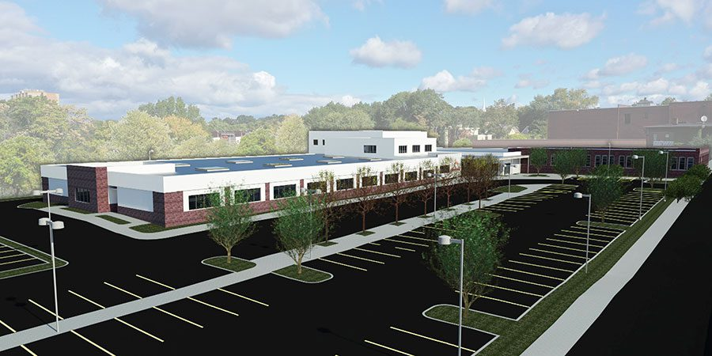
262 Liberty St. Update

Slide 10
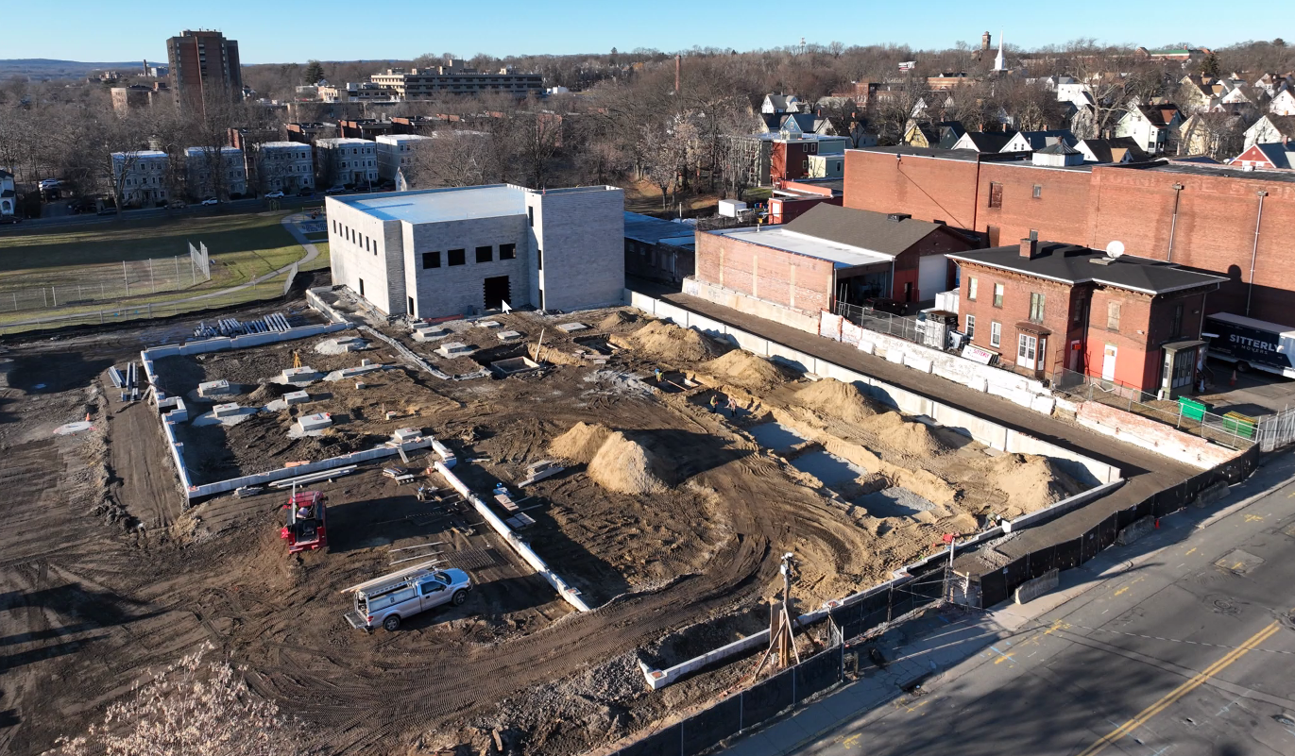
The Liberty St. Project Today
Construction Update
Floor 1 steel frame completed, currently working on Floor 2
Status of switchgear / impact on delayed opening
Contingency planning for Fall 2024 semester
Tech Park
Communication to Libertas community (leaders, staff, Legacy Ambassador Committee, families)
Aerial photo as of 2/26/24

Slide 11
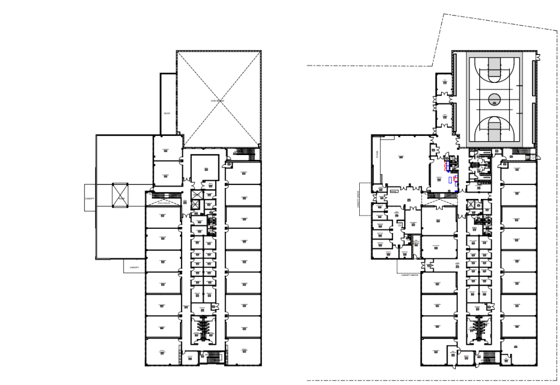
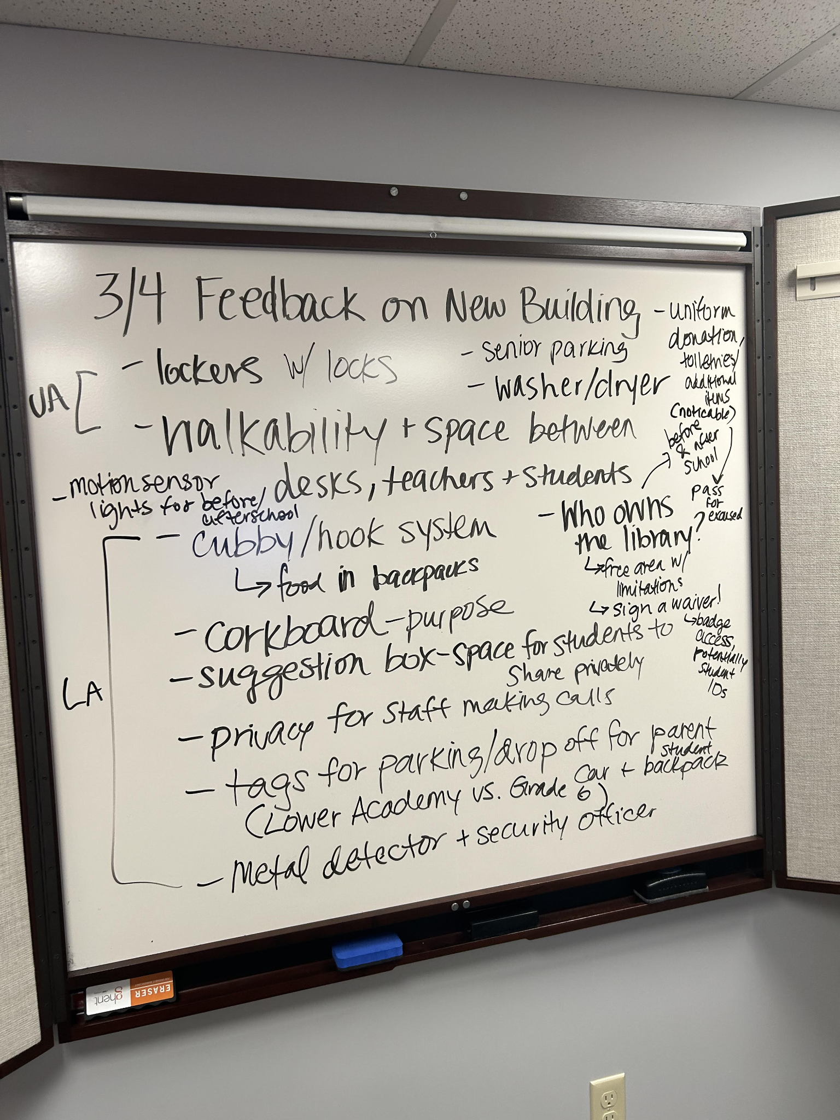
The Liberty St. Project Today - cont’d
Partnerships & Vendors
Furniture & Building Planning
Legacy Ambassador Committee
Nutrition
Movers
Commercial Cleaners
Technology
Design plan finalized for all spaces
Clarity from leaders on uses for all spaces
Full inventory of current items
Furniture quote update
Committee launched on Monday, 3/4
1 UA parent
1 LA parent
2 UA students
2 LA students
1 UA staff
2 LA staff
Second meeting on Thursday, 4/4

Slide 12
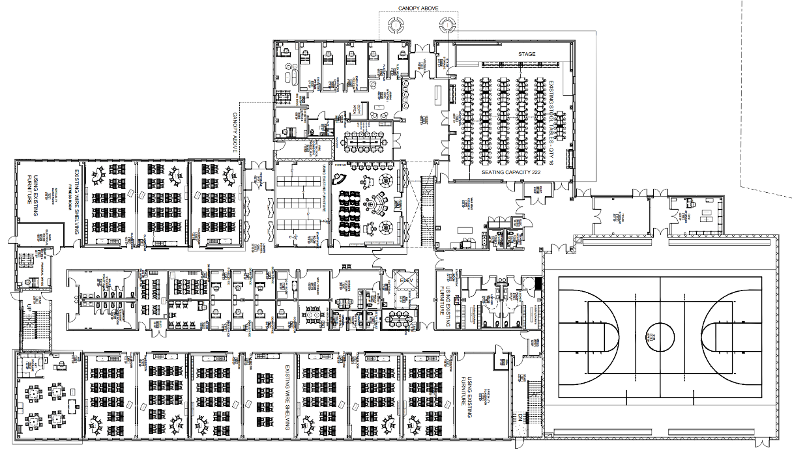
Floor 1 - Admin and Lower Academy
Notes:
These will also be printed/posted around room.

Slide 13
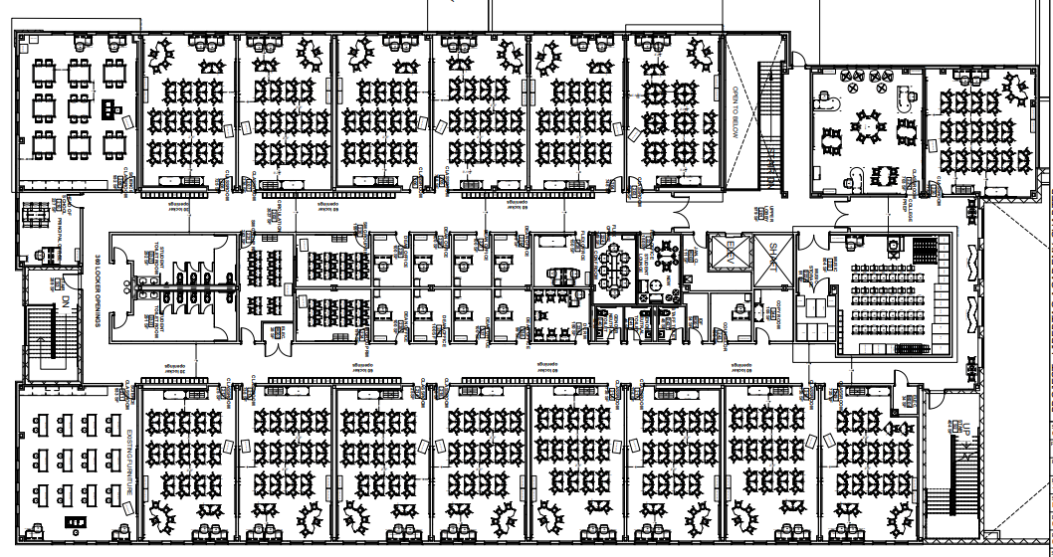
Floor 2 - Upper Academy
Notes:
These will also be printed/posted around room.

Slide 14
Key School Data

Slide 15
OPEN ROLES 24-25 SY!

Slide 16
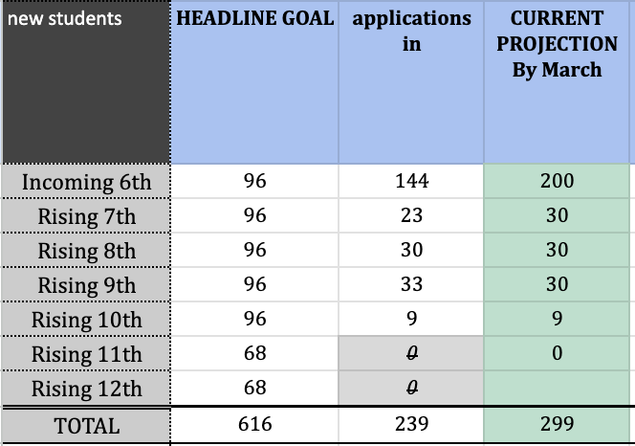
GOALS & DATA- Recruitment

Slide 17
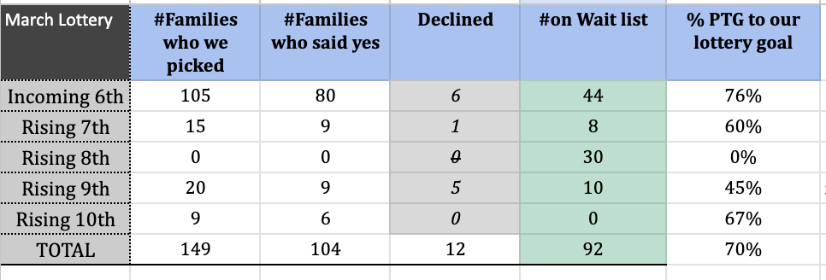
GOALS & DATA- Recruitment

Slide 18
HIGHLIGHTS- Recruitment

Slide 19
LA Headline Goals

Slide 20
UA Headline Goals

Slide 21
Upcoming LACS Events

Slide 22
FYIs & Approvals
Approvals:
FYIs:
SY24-25 School Calendar

Slide 23
MISSION
Through rigorous academics, character development, and strong supports for every learner, Libertas Academy Charter School prepares all sixth through twelfth grade students to succeed within the college of their choice and to be positive, engaged members of their communities.

Slide 24
LACS Strategic Plan 2023-2027
1 | We will prepare our students for a successful post-secondary transition that focuses on college access as a pivotal step toward career success.
2 | We will dramatically increase student achievement performance.
3 | We will recruit, develop, and retain highly effective teachers.
Notes:
448 is our target.

Slide 25
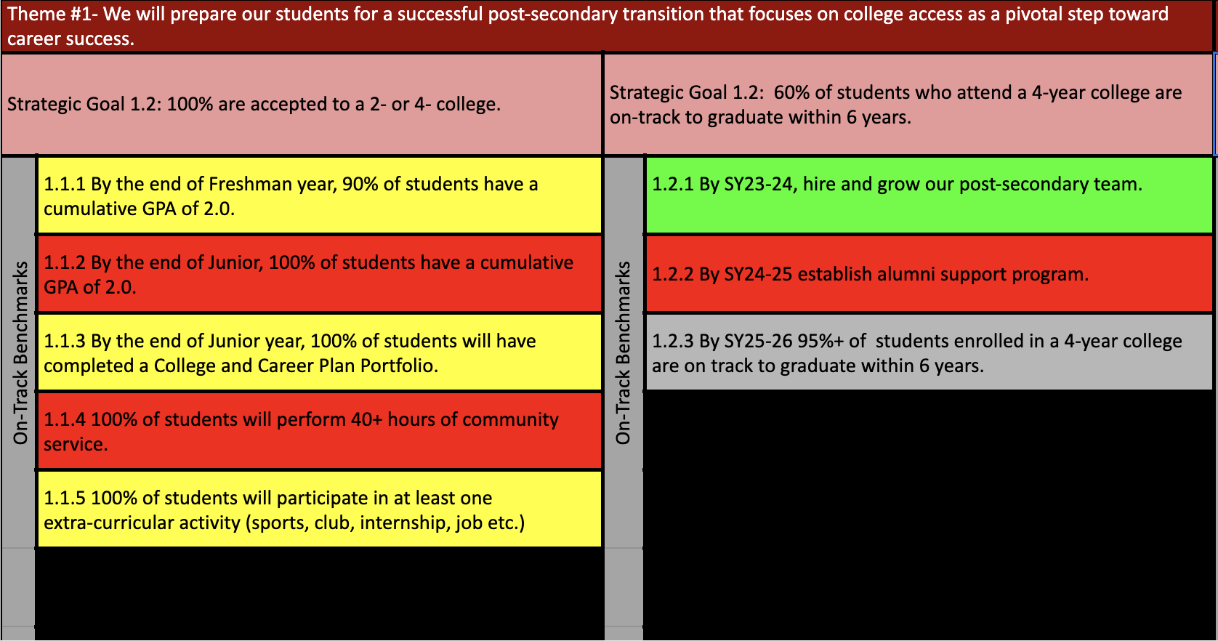
Notes:
AP data: 88%

Slide 28
Upcoming LACS Events
Look at school calendar: https://docs.google.com/spreadsheets/d/1GdGJGI4IYizFUWEpR7mSQp9Rwj9N2mT3PPbaaUGFe9Y/edit#gid=1594803582
LA tinyurl.com/FY24LACalendar
UA: tinyurl.com/FY24UACalendar
Look at recruitment events! (Student and Staff)

Slide 29
Upcoming LACS Events
Event | Date | Time
Club Showcase | 12/20 | 5 PM
 | 3/8 | 7 PM

