Slide 1
Director’s Meeting
October 24 , 2022

Slide 3
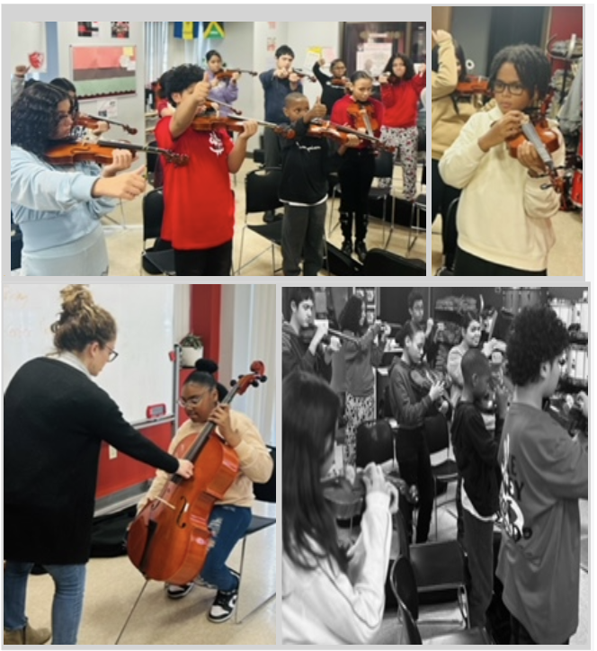
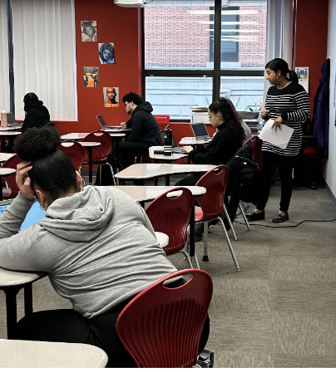

Slide 4
INCLUSIVE COMMUNITY
EXCELLENCE IN ALL EFFORTS
OUR PEOPLE MATTER
PURSUE YOUR BEST SELF
OUR VALUES
SPRINKLE
JOY
LEAVE A LEGACY

Slide 5
Q2 LA Data
Notes:
Now we are going to look at our Q1 Academic Data. The questions we are thinking about are the same.
I will stay on these slides a little bit longer.

Slide 6
6G ELA IA2 - High Level Data
MCAS GOALS 6G = 30% M+E; <25% NM
Progress Towards 6G ELA MCAS Goals
M+E Goal - 30% | NM Goal - <25%
IA#1 M+E - 12% → off track | IA#1 NM - 41% → off track
IA#2 M+E - 22% → off track | IA#2 NM - 28% → off track
ELA6 IA#2 Data
Notes:
While

Slide 7
IA#1 Action Plan Reflection:
What worked well? Keep doing?
The percentage of students meeting or exceeding expectations (>70) increased by 8% to a total of 12% of students, compared to 2023. Secondly, the grade average improved by 3% to a 46%.
What didn’t work? Needs to be different?
The most concerning gaps in the data are the OER average for this year (down 9% from 2022 at 27% average) and the percentage of students not meeting expectations (down 9% from 2022 at 41% of students). There is work to be done in teaching reading-based essays, starting at thesis-writing. There is also work to be done in moving more students into the partially meeting category, and from there into the meeting/exceeding category.
A - F: How well do you feel you drove data between IAs?
I think we did well driving OER data. Students have gotten better at writing theses and evidence
Notes:
LEAD ELA OWNS

Slide 8
Gradewide Headline
We will meet our M+E and NM goals by IA#3 if we keep implementing our current rate of growth! Specifically, we will target writing and inferential reading.
Notes:
LEAD ELA OWNS

Slide 9
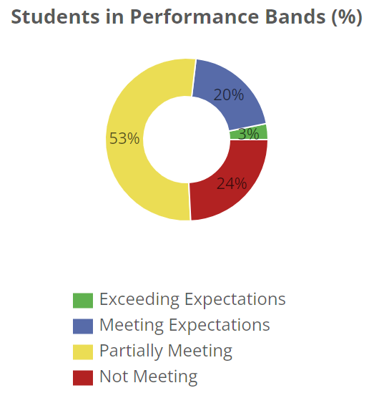
7G ELA IA2 - High Level Data
MCAS GOALS <7G> = 40% M+E; Less than 20% NM
Progress Towards 7G ELA MCAS Goals
M+E: OFF TRACK (23%) Down 19% from IA 1 | NM: OFF TRACK (24%) Down 3% from IA 1
7G AVERAGE SCORE: 53% (down 6% from IA 1)
UCONN AVG SCORE: 59%
(down 17% from IA 1)
MIDD AVG SCORE: 54%
(up 5% from IA 1)
BROWN AVG SCORE: 46%
(down 5% from IA 1)
GRADE WIDE %
>70% = 23% (down 19%)
>50% = 60% (down 3%)
<30% = 14% (no change)
Notes:
LEAD ELA OWNS

Slide 10
Headline
Disclaimer: I’m cautious about overreacting to this data given ANET IAs do not mirror MCAS. Our last ELA IA (October) was truly an accurate assessment of progress towards MCAS goals - and celebrating felt right (42% M/E). However, this data does tell a story.
(1 of 2) My biggest thought taking this test is that there were a LOT of close answers on this test’s MC. The result? Majority of kids were 1-3 questions away from passing. We MUST improve critical thinking through rigorous MC practice to move cusp (53% of the grade). There’s a lot of potential here but the bar must be raised.
(2 of 2) We continue to be off track towards the NM goal but made some progress. We continue to have changes to make here if we are to reach goal.
We are dissatisfied
Notes:
LEAD ELA OWNS

Slide 11
IA #1 Action Plan Reflection:
WORKED WELL
More MC practice + discourse weekly
ELA 2 with differentiation
NEEDS TO CHANGE
Independent reading and stamina (less scaffolding)
More discourse around Part A and B questions
More discourse on 2 close answers - how to delineate from true vs BEST
More MC revision
More neutral coaching for incorrect AND correct answers to build self-assurance
Walk me through your process… How did you answer this question… How did you determine which close answer was the BEST?
A-F: HOW WELL DID I DRIVE DATA BETWEEN IA 1 & 2?
Score: B
Weaknesses: not enough writing feedback and revision; over scaffolding IR; too much coaching of priority students
Notes:
LEAD ELA OWNS

Slide 12
8G ELA IA2 - High Level Data
MCAS GOALS 8G = 55% M + E; <10%NM
Progress Towards < >G ELA MCAS Goals
M + E: 14% | NM: 27%
Notes:
LEAD ELA OWNS

Slide 13
Gradewide Headline
We need to be ready for CHALLENGE if we want to see GROWTH .
Notes:
We need to back our confidence with credential

Slide 14
IA#1 Action Plan Reflection:
What worked well? Keep doing?
Whatever was done with writing earlier in the year needs to be built off of because it is showing up in stronger writing. However, writing needs to be more consistency and skills need to be more nuanced for meeting/exceeding students. Keep driving PQ - sweat MC reasoning…
What didn’t work? Needs to be different?
Consistency in MC practice. We need to be doing work with “close”answer choices as well as part A/B… Especially thinking about students scoring 0 based on wrong selection for pt A for MCAS. We haven’t nailed CI or summary of reading.
A - F: How well do you feel you drove data between IAs?
I think I was feeling more like I was at a B but then when I saw the data I felt more like a C. I felt confident from the uptick of PQ and consistency once mastery felt met… but now I feel like I would have been/will be more meticulous with MC reasoning and CI understanding.
Notes:
LEAD ELA OWNS

Slide 15
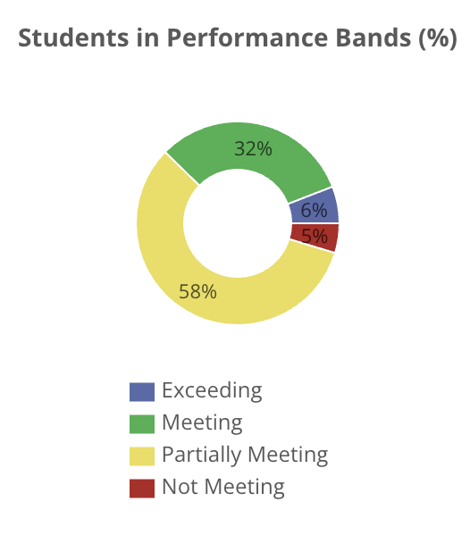
6G Math High Level Data
MCAS GOALS
Progress Towards MCAS Goals
M + E: 35% | NM: <25%
AVERAGES
Overall: 53%
UMASS: 61%
HARVARD: 48%
WILLIAMS: 50%
CUTS
> 60: 38%
> 21: 58%
< 20: 5%
Notes:
Math 1 Teacher Owns

Slide 16
Math 1 Teacher’s Headline
We made it by the skin of our teeth for M+E. Is this foreshadowing MCAS?
Notes:
My thoughts: so what? Now what? What do I think?
Link to purpose of data day and achievement meetings
Preview schedule for the day

Slide 17
IA#1 Math 1 Action Plan Reflection:
What worked well? Keep doing?
What didn’t work? Needs to be different?
We met goal for M+E.
Open-ended responses didn’t answer the question. Students struggle with explaining how they got the answer.
Notes:
Math 1 Teacher Owns

Slide 18
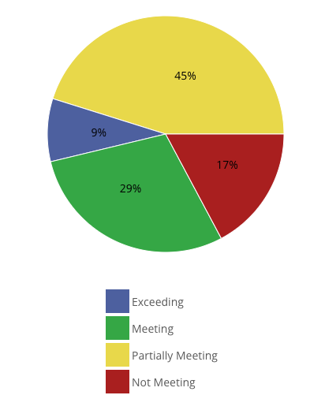
7G Math High Level Data
MCAS GOALS
Progress Towards MCAS Goals
M + E: 38% | NM:17%
AVERAGES:
Overall : 49%
UCONN: 61%
BROWN: 44%
MIDD : 44%
CUTS
> 60% = 38%
> 21% = 45%
< 20% = 17%
Notes:
Math 1 Teacher Owns

Slide 19
GROWTH
71% of students showed growth from IA #1 to IA #2
8% of students scored the same score on both IAs
Notes:
Math SST Teacher Owns
Link to purpose of data day and achievement meetings
Preview schedule for the day

Slide 20
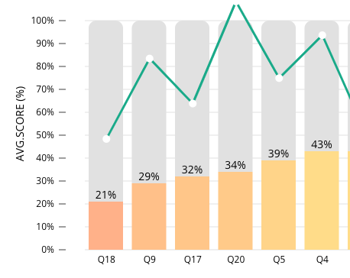
Math 1
AREAS OF GROWTH …
Word Problems/Fractions
Students scored the lowest when it came to questions with fractions and dividing decimals.
With the added bonus of signs. Students are not hyper vigilant of the positive and negative signs.
Critical Thinking/Logical
Students are not logically thinking about the problem which in turn they are choosing 2nd best answer.
Notes:
Math 1 Teacher Owns
Link to purpose of data day and achievement meetings
Preview schedule for the day

Slide 21
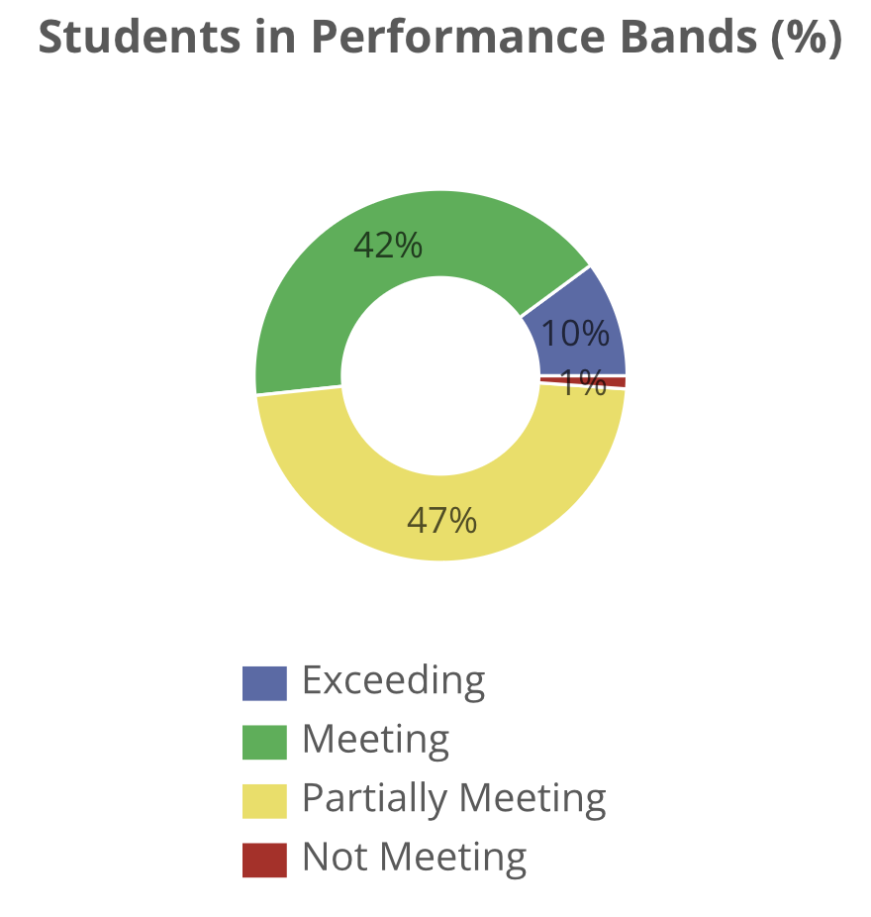
8G Math High Level Data
MCAS GOALS
Progress Towards MCAS Goals
M + E: 52% | NM: 1%
AVERAGE BY HOMEROOM:
Princeton → 59%
Morehouse → 60%
Spelman → 66%
CUTS
> 60 → 52%
> 20 & < 59 → 47%
< 20 → 1%
Notes:
Math 1 Teacher Owns

Slide 22
Math 1 Teacher’s Headline
The students showed up and showed out for IA2! Grade 8 exceeded MCAS goal by 12% and are currently staying on track with meeting NM goal with the previous 2 EET’s and IA2.
How do we capture and continue with the amazing momentum our students are showing as we lean into quarter 3?
Notes:
My thoughts: so what? Now what? What do I think?
Link to purpose of data day and achievement meetings
Preview schedule for the day

Slide 23
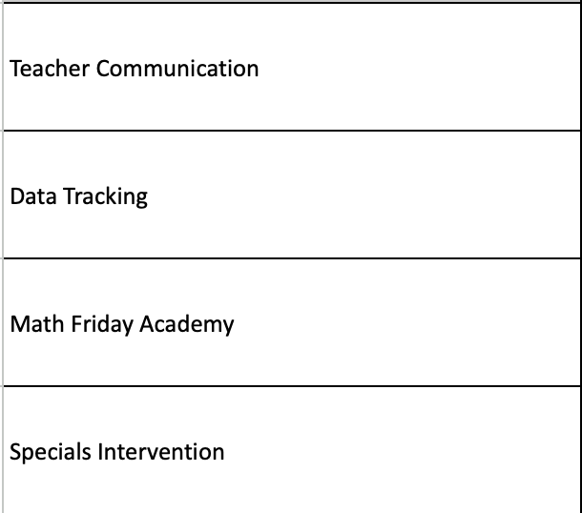
IA#1 Math 1 Action Plan Reflection:
What worked well? Keep doing?
What didn’t work? Needs to be different?
Communication was more focused around alignment of instruction in math 2 across all three classes
Norming specific material instruction (i.e. transformations, two-way tables) was very helpful and students showed consistency on scores across each homeroom on normed material
Data tracking was consistent for priority students
Represented which students were on track for mastery of material in IA2
Will launch end of February/beginning of March
8th grade did not utilize specials intervention
Notes:
Math 1 Teacher Owns

Slide 24
Q2 UA Data
Notes:
Now we are going to look at our Q1 Academic Data. The questions we are thinking about are the same.
I will stay on these slides a little bit longer.

Slide 25
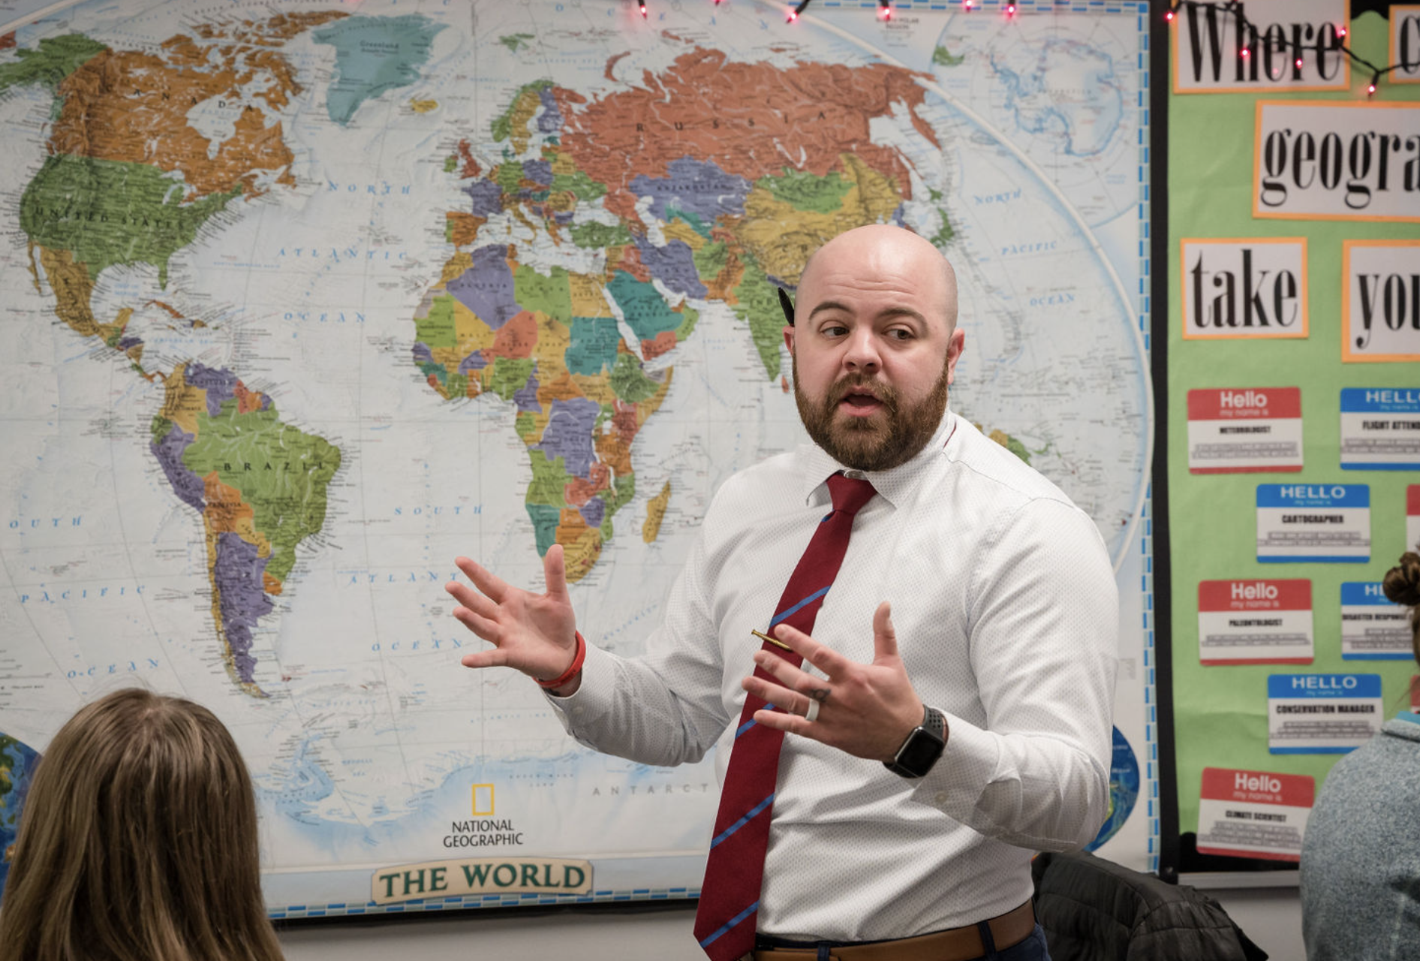
History

Slide 26
AP Human Geography
GOAL = 25% PASS AP EXAM WITH 3+
 | Multiple Choice | FRQ | TOTAL
% Proficient | 7% | 0% | 0%
% Cusp + Proficient | 39% | 4% | 9%
% Off Track | 61% | 96% | 91%
Top 3 Performers:
Davian
Jendel
Nashely
Notes:
5% last year, 0% this year

Slide 27
AP World History
GOAL = 30% PASS AP EXAM WITH 3+
 | Multiple Choice | DBQ | TOTAL
% Proficient | 15% | 15% | 12%
% Cusp + Proficient | 32% | 21% | 26%
% Off Track | 68% | 79% | 74%
Top 3 Performers:
Adrian
Sherlline
Gray
Notes:
5% proficient last year, 12% proficient this year. 12% cusp and higher last year, 26% cusp and higher this year
5% proficient on DBQ last year, 15% this year

Slide 28
AP US History
GOAL = 45% PASS AP EXAM WITH 3+
 | Multiple Choice | DBQ | TOTAL
% Proficient | 22% | 9% | 9%
% Cusp + Proficient | 55% | 18% | 36%
% Off Track | 45% | 82% | 64%
Top 3 Performers:
Ismael
Gaby
Luis U / Jeyrianis
Notes:
Compared to group I taught in 2018-2019 school year - results very similar, 42% passed the APUSH exam (18 kids)

Slide 29
History Dept Headlines
AP World is our bright spot. With skill-based lessons in intervention and intentional targeting of gaps during regular instruction, we made solid gains over the quarter that put us in a better position than last year.
While the data for APUSH indicates we are far from goal, the broader context of the data makes me cautiously optimistic. We must get laser focused on the data now so we can solidify key FRQ skills and close content gaps.
APHG is the farthest off track. We are re-evaluating our approach in this course.

Slide 30
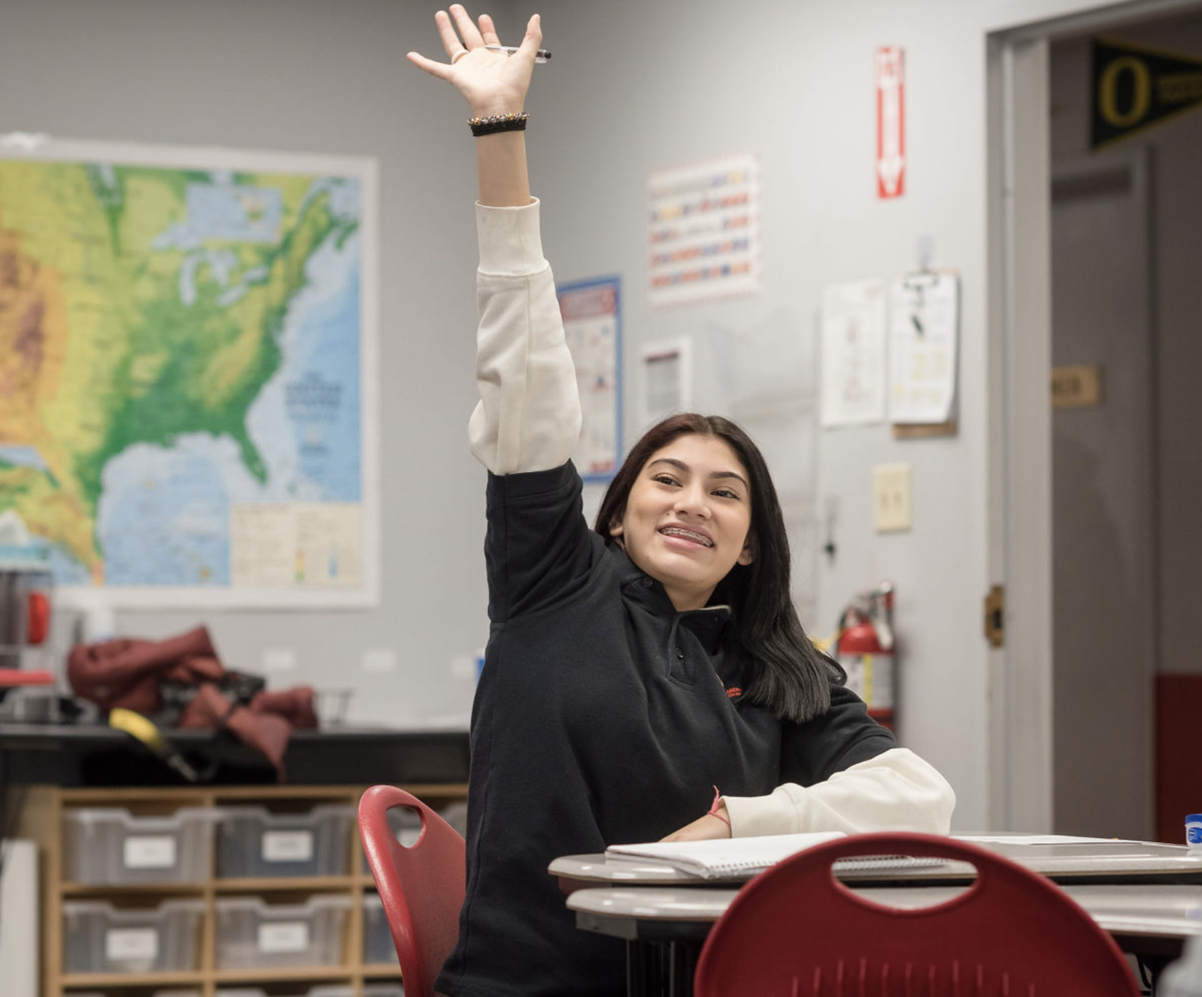
Literature

Slide 31
Literature I
GOAL = 40% ARE MEETING/PARTIALLY MEETING ON MCAS EXAM
 | Multiple Choice | FRQ/OER | TOTAL
% Proficient | 16% | 18% | 9%
% Cusp | 11% | 23% | 34%
% Off Track | 73% | 59% | 56%
Top 3 Performers:
Samuel Marin
Monica-Jimenez
Jaydriel Diaz
Notes:
3% increase in proficient

Slide 32
Literature II
GOAL = 45% ARE MEETING/PARTIALLY MEETING ON MCAS EXAM
 | Multiple Choice | OER | TOTAL
% Proficient | 27% | 33% | 25%
% Cusp | 14% | 20% | 22%
% Off Track | 59% | 47% | 53%
Top 3 Performers:
Sherlline Mercado
Adrian Cedano
Grey Alicea
Notes:
1% decrease in proficiency
19% increase in FRQ proficiency, 19% decrease in multiple choice proficiency

Slide 33
AP English Language and Composition
GOAL = 25% ARE MEETING/PARTIALLY MEETING ON MCAS EXAM
 | Multiple Choice | FRQ/OER | TOTAL
% Proficient | 0% | 23% | 18%
% Cusp + Proficient | 5% | 32% | 27%
% Off Track | 95% | 68% | 73%
Top 3 Performers:
Ismael
Ruth / Ana / Gaby
Notes:
Teacher reads

Slide 34
Literature Dept Headlines
The MCAS for 10th graders is 6 weeks away, and we are far from our goal. This has real and immediate implications for kids’ futures, so we have to drastically ramp up our demand of and support for kids.
In AP Lang, we have a similar story with the data, but more time to right the ship. We are dramatically changing the curriculum to truly prepare kids for the AP exam.

Slide 35
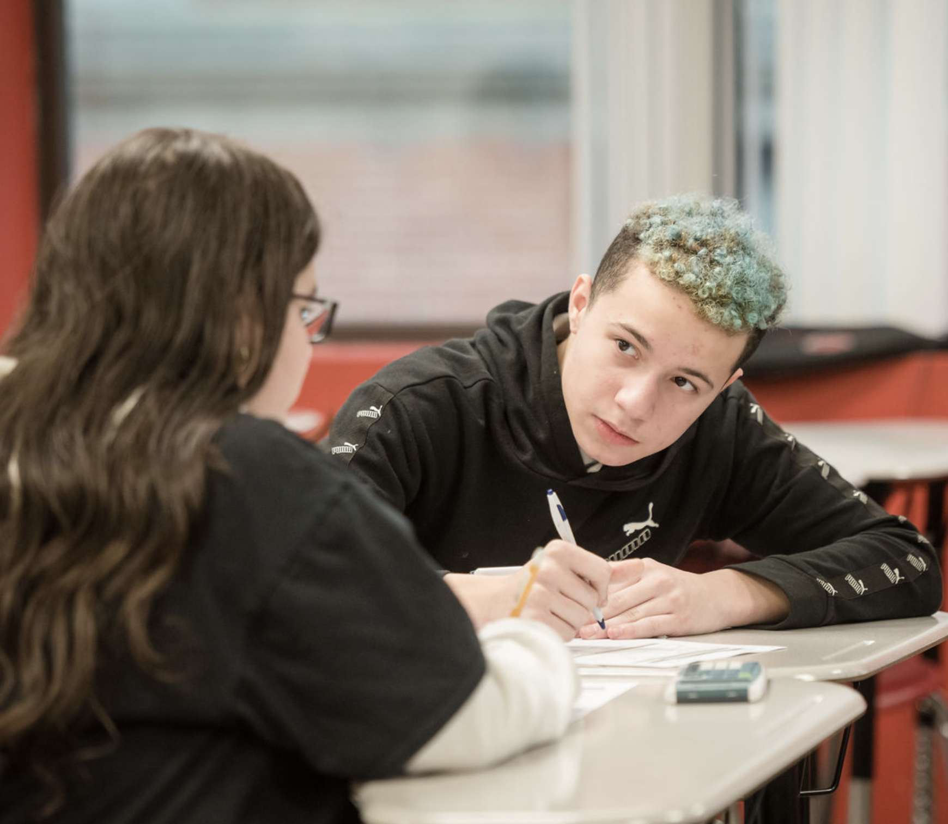
Seminar

Slide 36
Seminar I
GOAL = XX% ARE MEETING/PARTIALLY MEETING ON MCAS EXAM
 | FRQ/OER | TOTAL
% Proficient | 42% | 42%
% Cusp | 23% | 23%
% Off Track | 35% | 35%
Top 3 Performers:
18 Students tied for top score!
Notes:
Teacher reads

Slide 37
AP Seminar
GOAL = 30% ARE MEETING/PARTIALLY MEETING ON AP EXAM
 | FRQ/OER | TOTAL
% Proficient | 38% | 38%
% Cusp + Proficient | 64% | 64%
% Off Track | 36% | 36%
Top 3 Performers:
Javed (K)
Sa’Ad
Gray / Adeychalis / Shanece / Keyon
Notes:
Teacher reads

Slide 38
Seminar Dept Headlines
While the team papers and presentations in AP Seminar led to some significant struggles for scholars, the EOC exam data indicates many scholars are mastering the key skills and concepts! This makes me feel optimistic about AP results as long as we can stay the course.
In addition, the data from Seminar I indicates many scholars are on track to be ready for AP Seminar in 2 years.

Slide 39
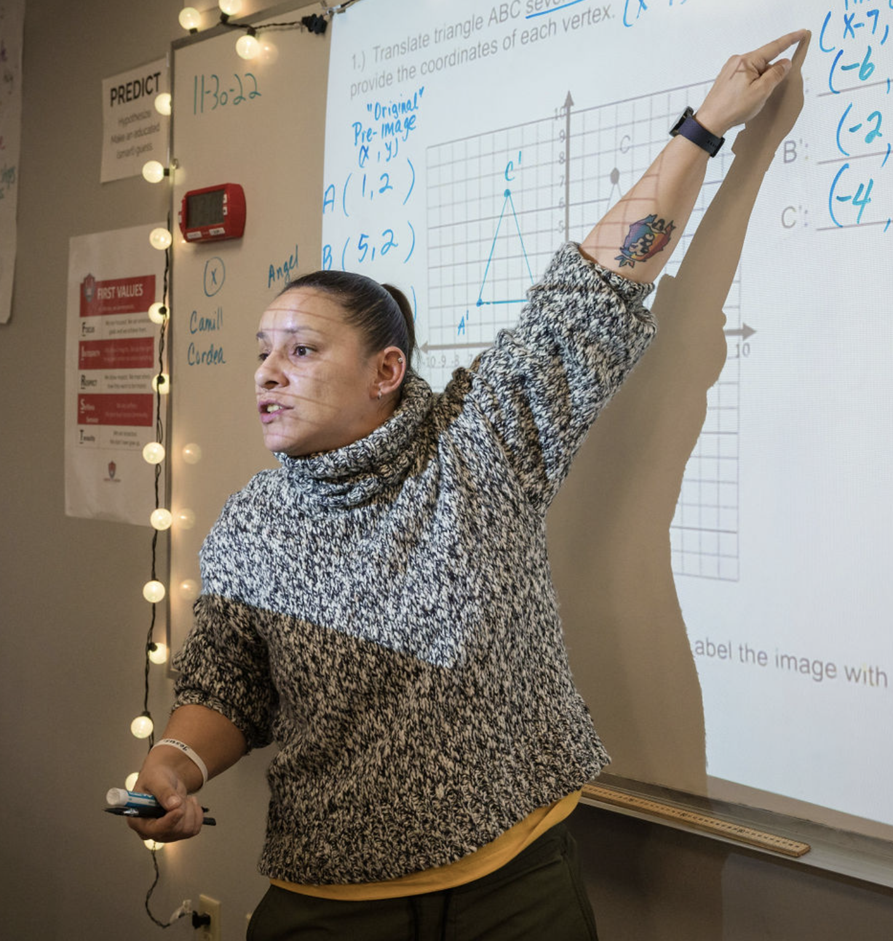
Math

Slide 40
Algebra I
GOAL = 35% ARE MEETING/PARTIALLY MEETING ON MCAS EXAM
 | Multiple Choice | FRQ/OER | TOTAL
% Proficient | 59% | 12% | 44%
% Cusp | 19% | 23% | 12%
% Off Track | 22% | 65% | 44%
Top 3 Performers:
Monica (100)
Davian
Sam

Slide 41
Geometry/Algebra 2
GOAL = 35% ARE MEETING/PARTIALLY MEETING ON MCAS EXAM
 | Multiple Choice | FRQ/OER | TOTAL
% Proficient | 36% | 41% | 26%
% Cusp | 11% | 21% | 27%
% Off Track | 53% | 38% | 47%
Top 3 Performers:
Gray (100)
Isiah T. (100)
Adrian

Slide 42
Precalculus
GOAL = 63% of Students are prepared for AP Calculus
 | Multiple Choice | FRQ/OER | TOTAL
% Proficient | 75% | 50% | 72%
% Cusp | 7% | 18% | 18%
% Off Track | 18% | 32% | 10%
Top 3 Performers:
Ruth
Jesus
Adeychalis
Notes:
Teacher reads

Slide 43
AP Statistics
GOAL = 50% ARE MEETING on AP EXAM
 | Multiple Choice | FRQ/OER | TOTAL
% Proficient | 67% | 67% | 67%
% Cusp | 33% | 33% | 33%
% Off Track | 0% | 0% | 0%
Top 3 Performers:
Ismael
Adeychalis
Mattie/Gaby
Notes:
Teacher reads

Slide 44
Math Dept Headlines
We continue to make progress in math courses ESPECIALLY in the free response section! Students have strengthened their explanations (and willingness to explain their work)
We have adjusted our cut scores in Geometry to be much more conservative aligned to MCAS goals so feeling optimistic -> our focus will be moving kids from partially meeting to meeting
We must continue to include spiraled review in all course work so that students continue to maintain previously mastered standards while moving forward

Slide 45
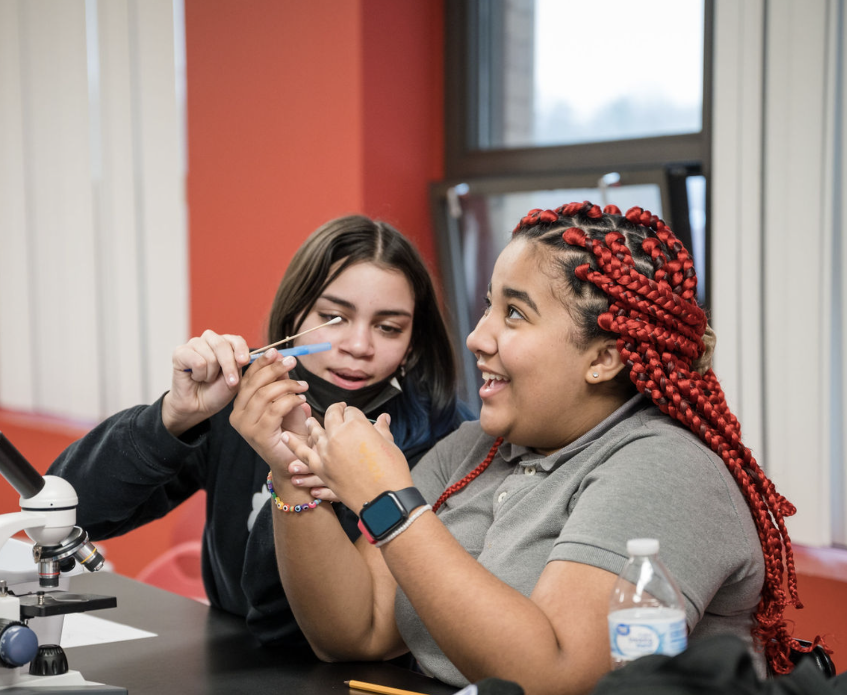
Science

Slide 46
Biology
GOAL = 35% ARE MEETING/EXCEEDING ON MCAS EXAM
90% ARE PASSING (PM OR HIGHER)
 | Multiple Choice | FRQ/OER | TOTAL
% Meeting / Exceeding | 29% | 33% | 31%
% Passing | 82% | 63% | 75%
% Off Track | 18% | 37% | 25%
Top 3 Performers:
Chris C.
Sam M.
Monica J.
Notes:
Teacher reads

Slide 47
Science Dept Headlines
We are close to being on track for Biology meeting/exceeding - but are far off track for the passing goal
In order to move closer to our goal, we must increase the rigor & demand for all students while continuing to ensure that we have supports in place to reach our middle and struggling students
We must continue to include spiraled review in all course work so that students continue to maintain previously mastered standards while moving forward

Slide 48
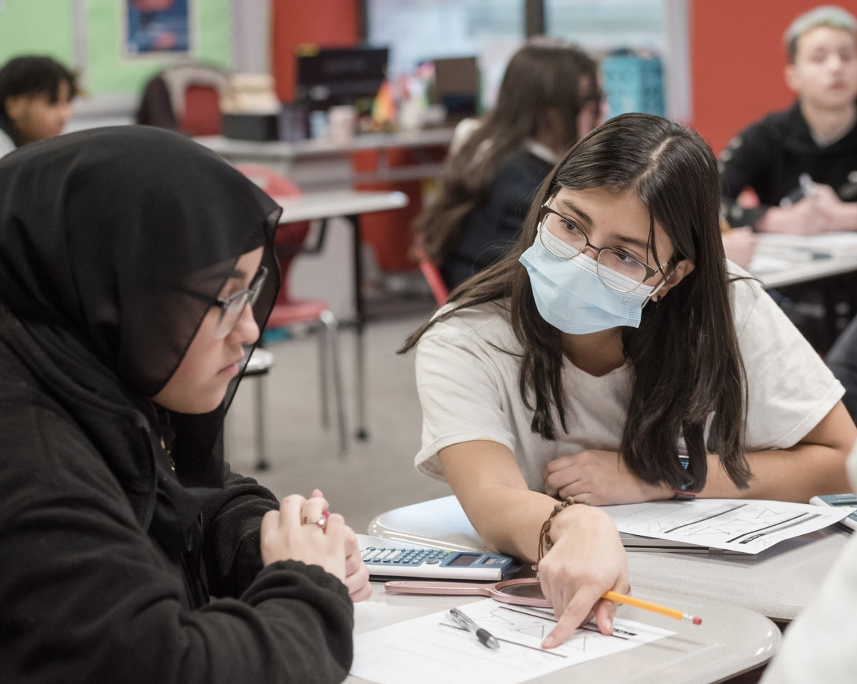
GPA

Slide 49
Q2 GPA
 | 50% > 3.0 | 75% > 2.5 | 90% > 2.0
9th Grade | 52% | 72% | 90%
10th Grade | 45% | 67% | 88%
11th Grade | 52% | 71% | 83%
OVERALL | 50% | 70% | 88%

Slide 50
Y1 GPA (Cumulative)
 | 50% > 3.0 | 75% > 2.5 | 90% > 2.0
9th Grade | 57% | 79% | 91%
10th Grade | 48% | 72% | 91%
11th Grade | 54% | 74% | 89%
OVERALL | 53% | 76% | 91%

Slide 51
LACS Strategic Plan 2023-2027
While we know that schools are complex organizations and that a lot goes into running an effective school, the themes and goals outlined are the most mission-critical priorities over the next 4 years. We believe that by getting these three themes right, we will be one step closer to fulfilling our mission of preparing our students for post-secondary success.
Notes:
448 is our target.

