Slide 1
School Update

Slide 2
MISSION
Through rigorous academics, character development, and strong supports for every learner, Libertas Academy Charter School prepares all sixth through twelfth grade students to succeed within the college of their choice and to be positive, engaged members of their communities.

Slide 3
Core Values

Slide 4
Highlights

Slide 5
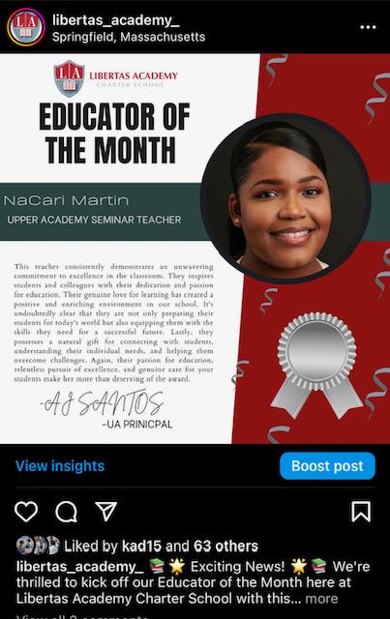
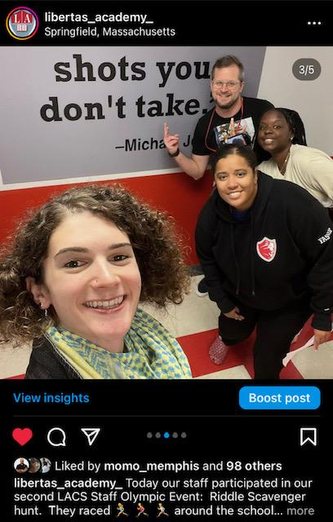
HIGHLIGHTS- Talent
Highlights for Talent
- 5 New Hires in the last month!
-Stevie- UA Spanish
-Logan- UA SST
-Abigail- UA SST
-Silvia- UA SST
Employee of the Month Oct- NaCari
Staff Olympics- Sprinkle Joy

Slide 6
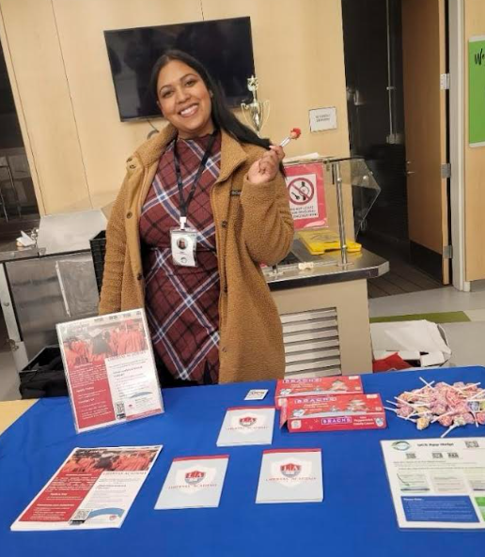
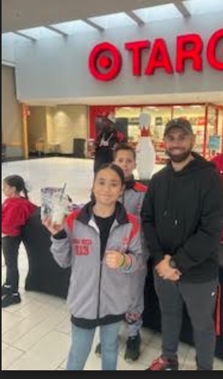
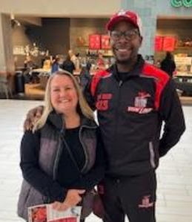
HIGHLIGHTS- Recruitment
Highlights for Recruitment
Canvassed at Brightwood/ Lincoln school
Love seeing new staff support recruitment
We have a wait list already for 8th and 9th grade.

Slide 7
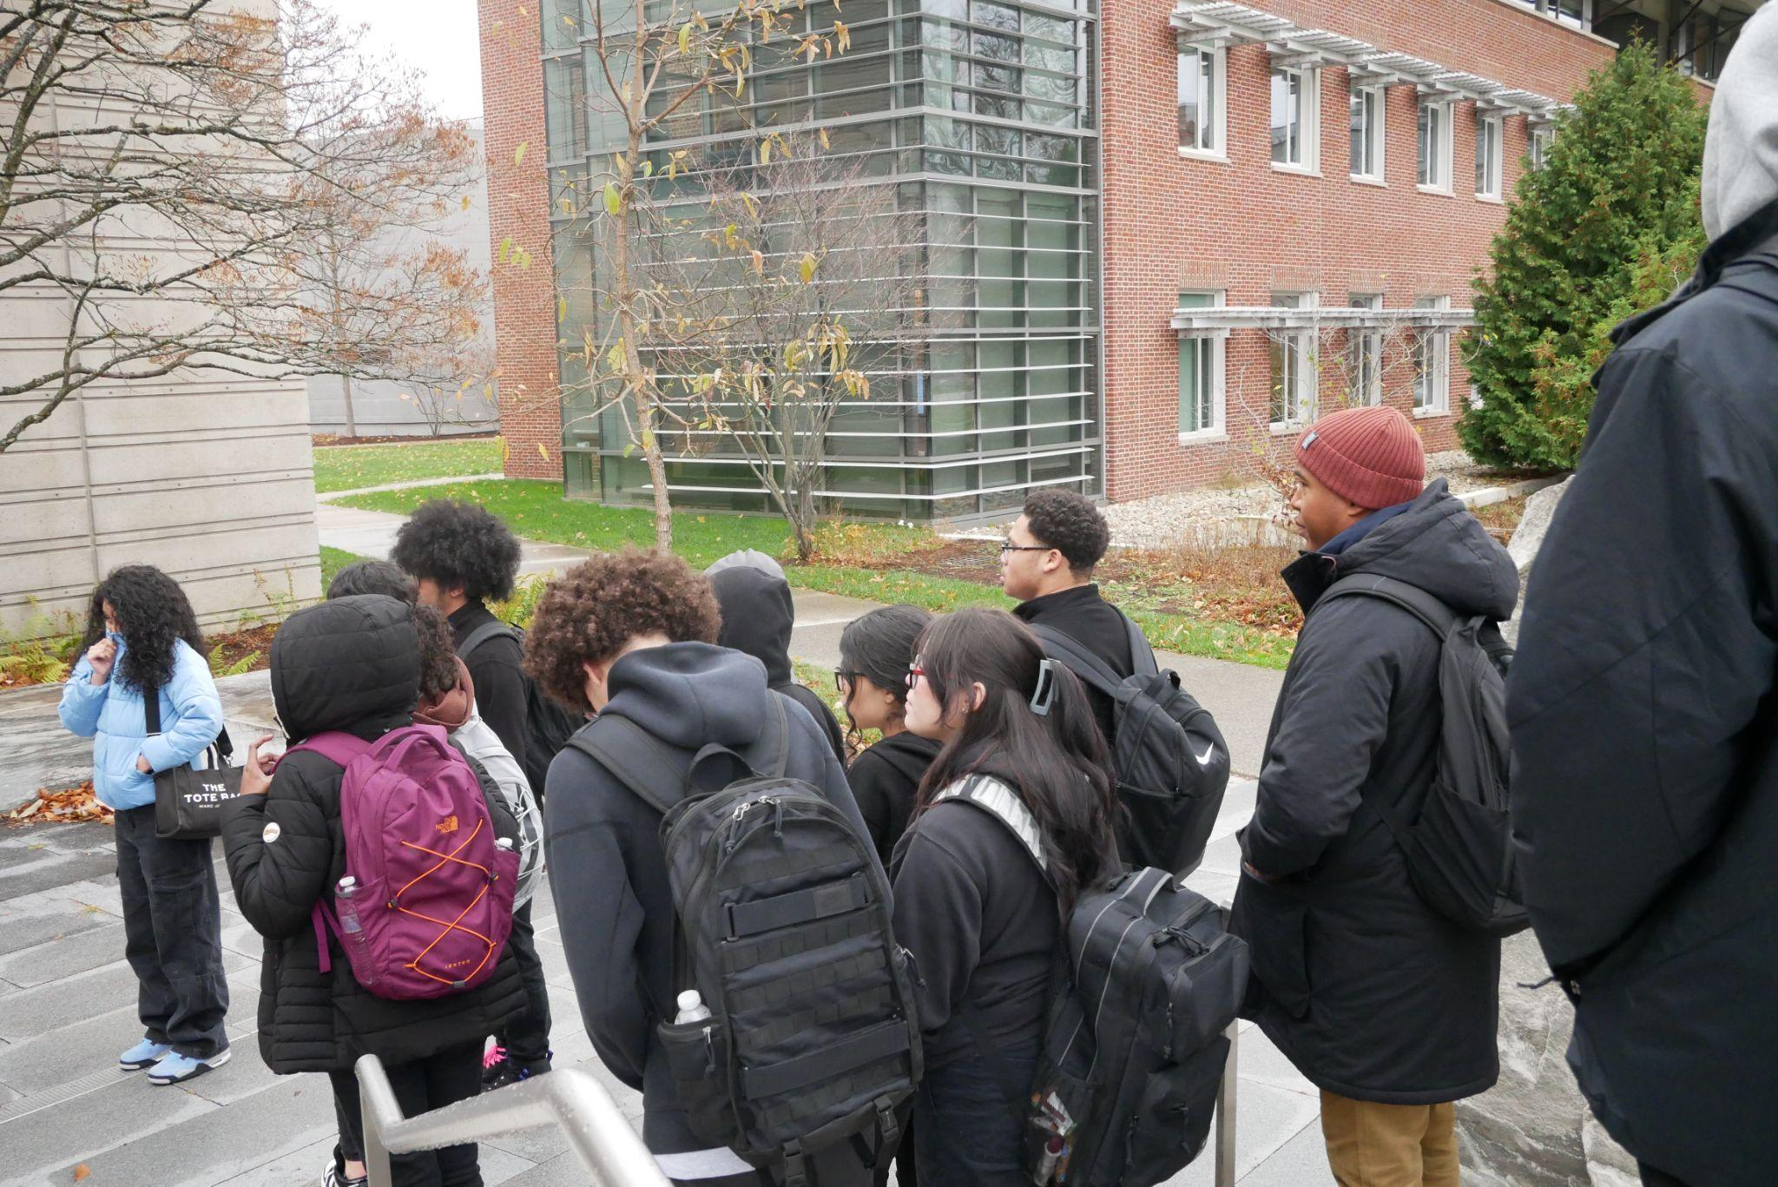
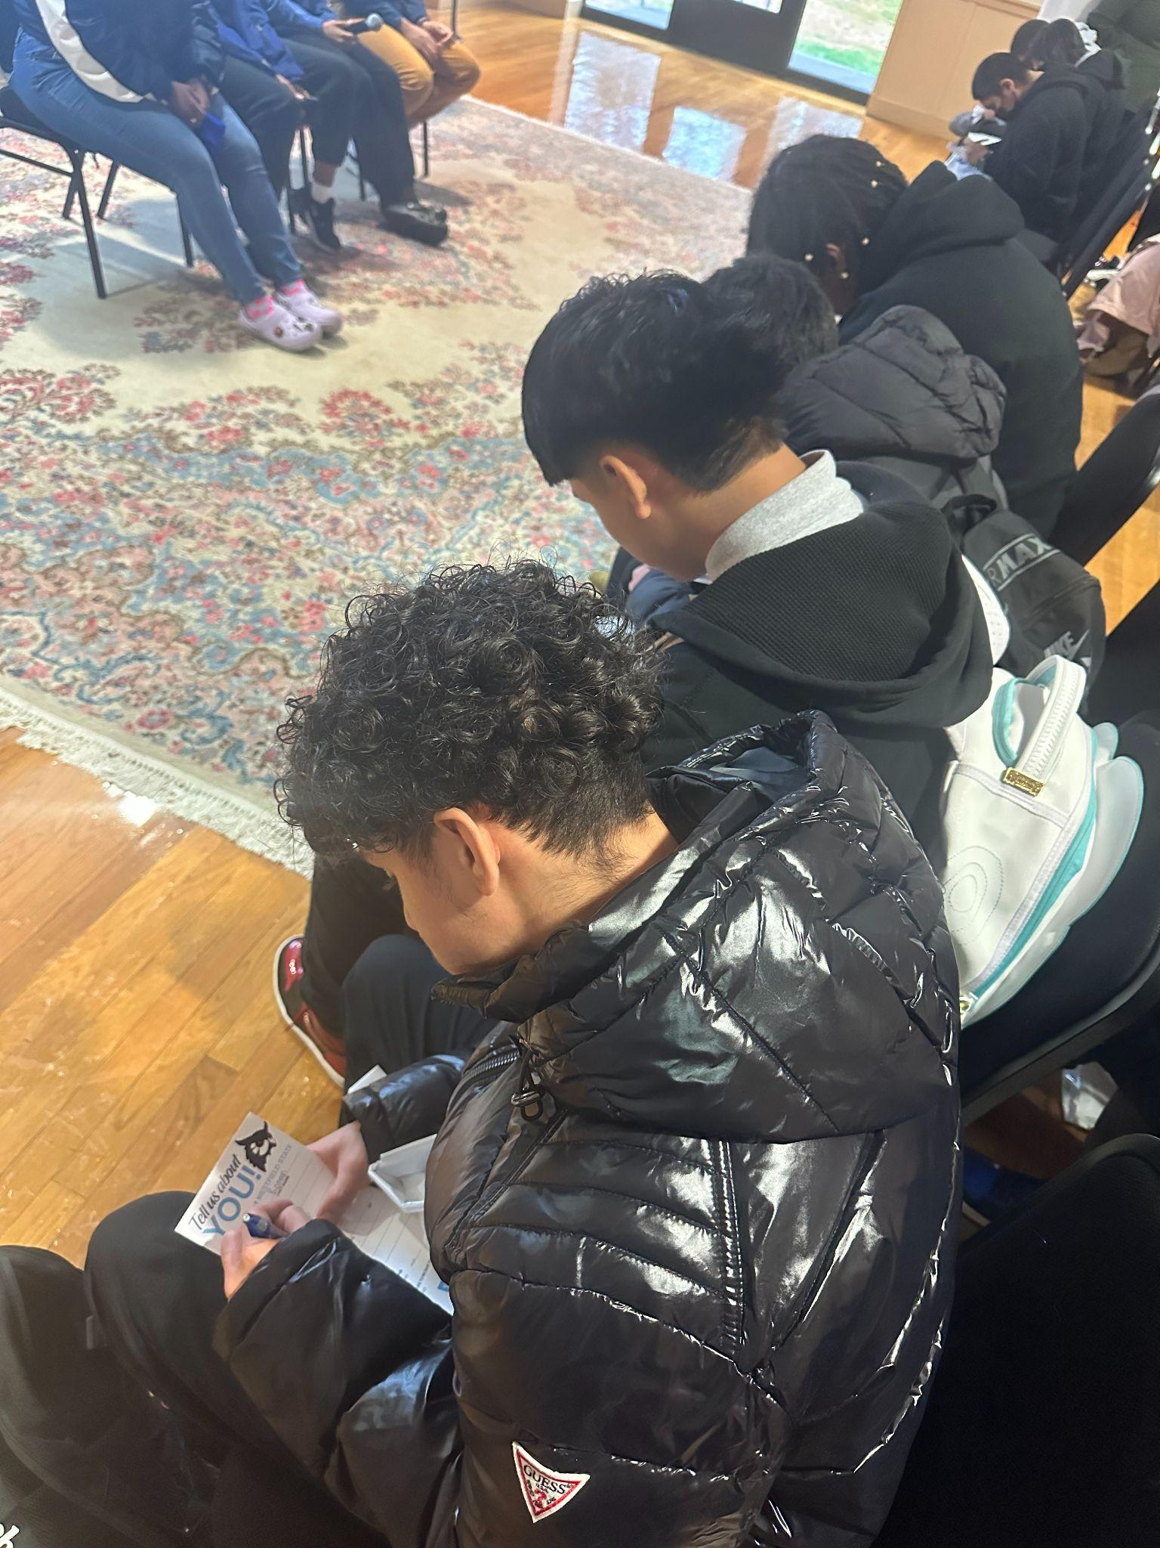
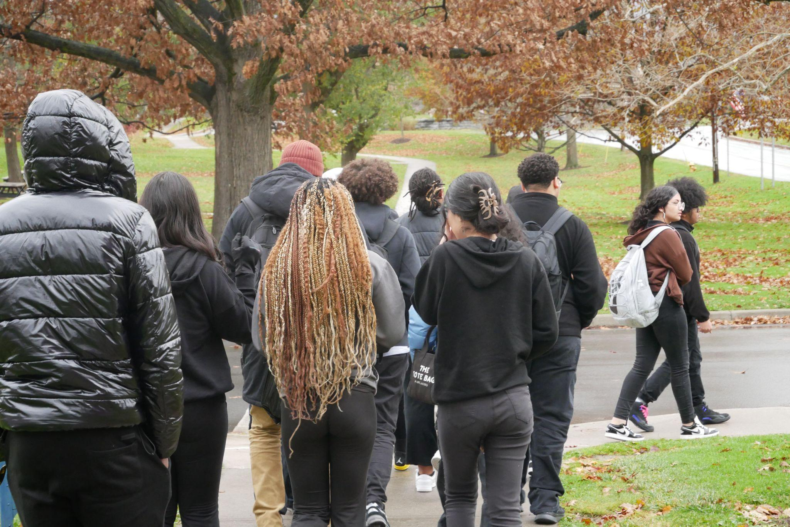
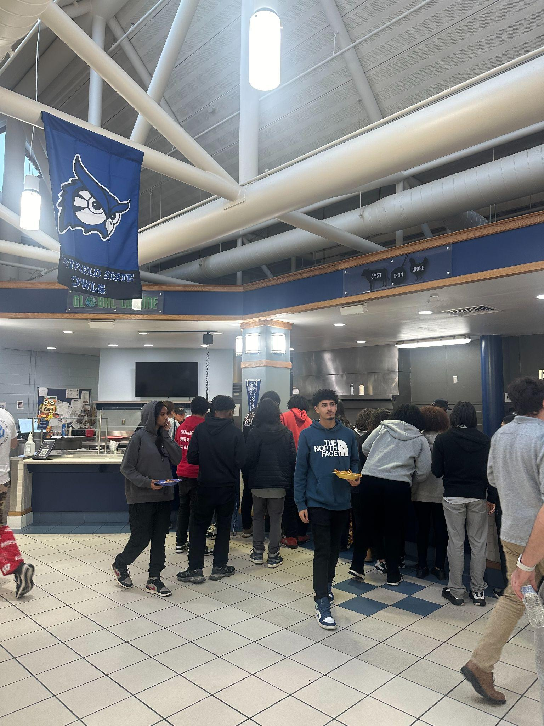
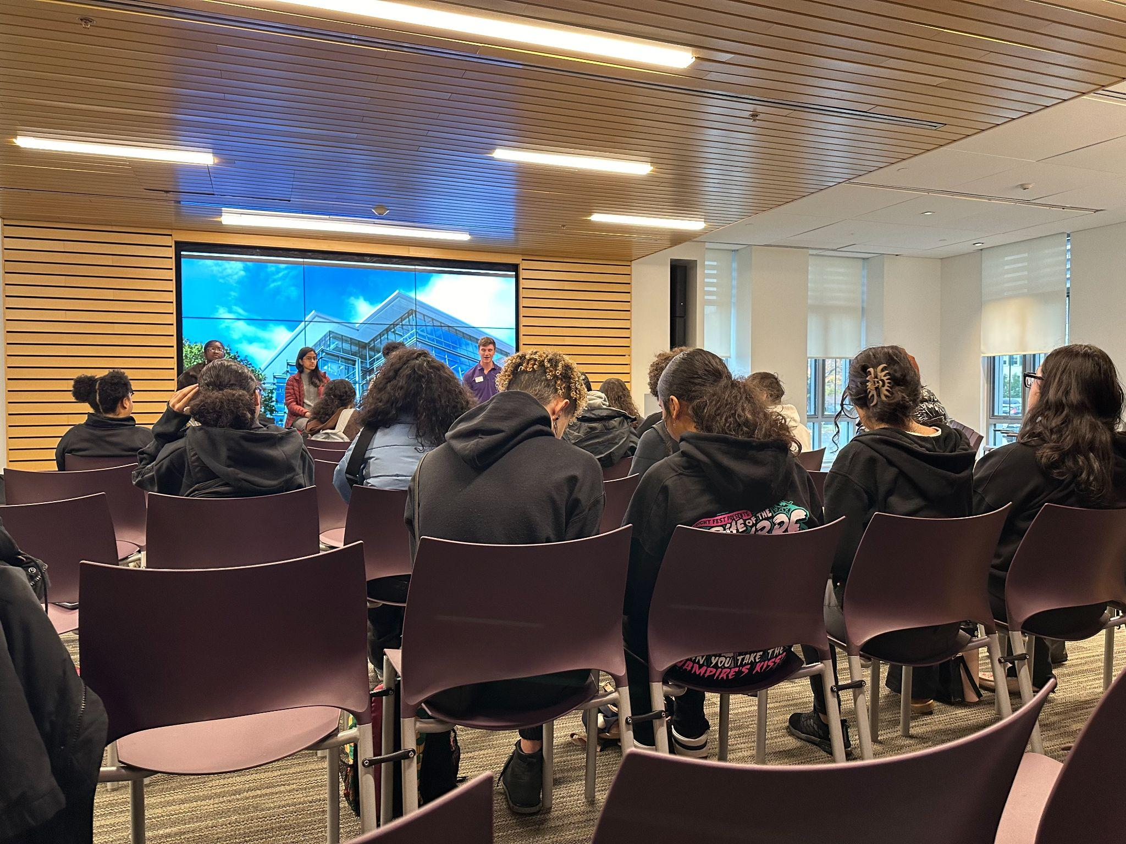
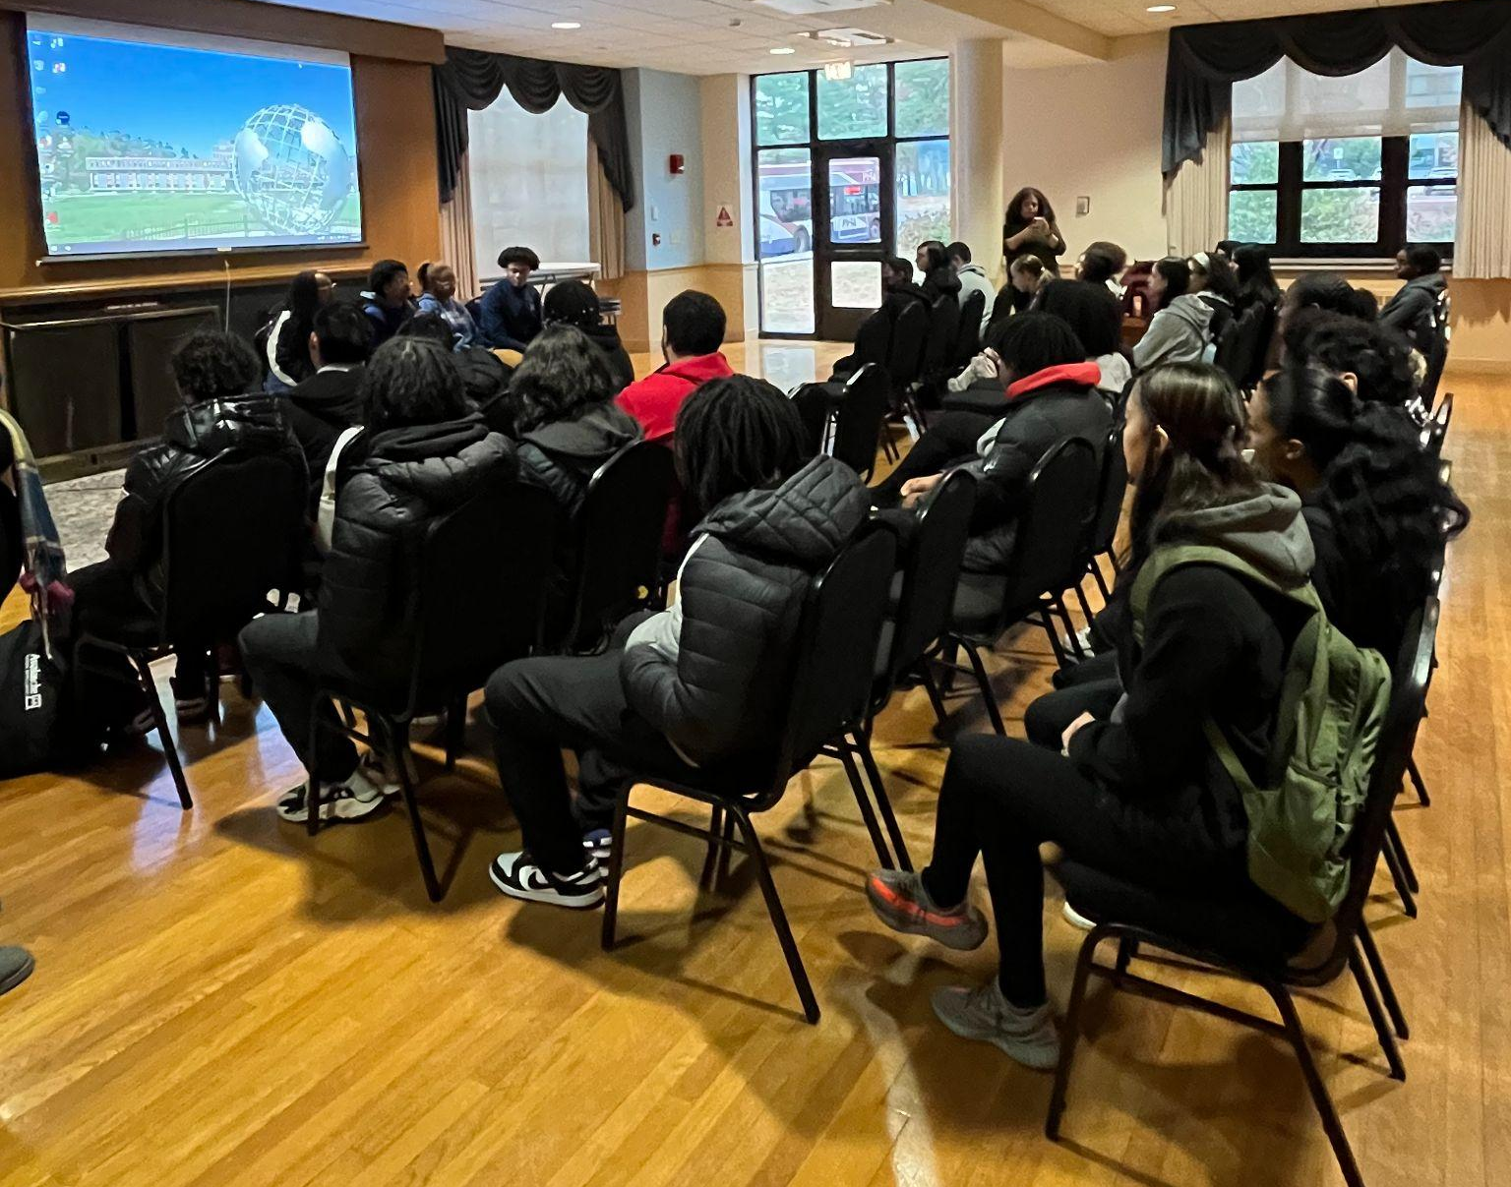
HIGHLIGHTS
College Rep Visits
Bay Path University | Nov 1
Springfield College | Nov 7
Dates for Jan - June will be posted in December
College Field Trips
Williams College (22 students)
10% acceptance rate | $80K per year
Westfield State University (26 students)
90% acceptance rate | $25K per year | Summer Bridge program
Dual Enrollment
Current | Adeychalis (Comp 1 - A) Ismael (Calc - A) Ana (PreCalc - B+)
16 students applied for the spring semester to both HCC & STCC
Class selection deadline is 12/15
Working with students & Santos to determine class selections & feasible scheduling
Courses will likely be: English Comp 1, Pre-calc, Physics & another science

Slide 8
Key School Data

Slide 9
GOALS & DATA - Talent
Current Open Roles
Academy | Group | Staff Name | Position
LA | 8th | OPEN | Math 2
LA | 7th | OPEN | Math 2
UA | 9th | OPEN | Biology

Slide 10
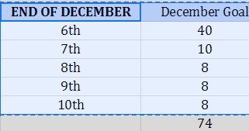
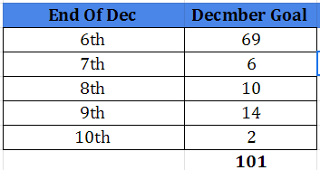
GOALS & DATA- Recruitment
Recruitment Goal for 24-2025 - 627
Progress towards goal and also historical data.
As of 12/13 we are at 101 applications Last year at the end of Dec we were ar 74 applications

Slide 11
Lower Academy Big Goals

Slide 12
Upper Academy Big Goals

Slide 13
Upcoming LACS Events
Event | Date | Time
Club Showcase | 12/20 | 5 PM
Club Showcase | 12/21 | 9 AM

Slide 14
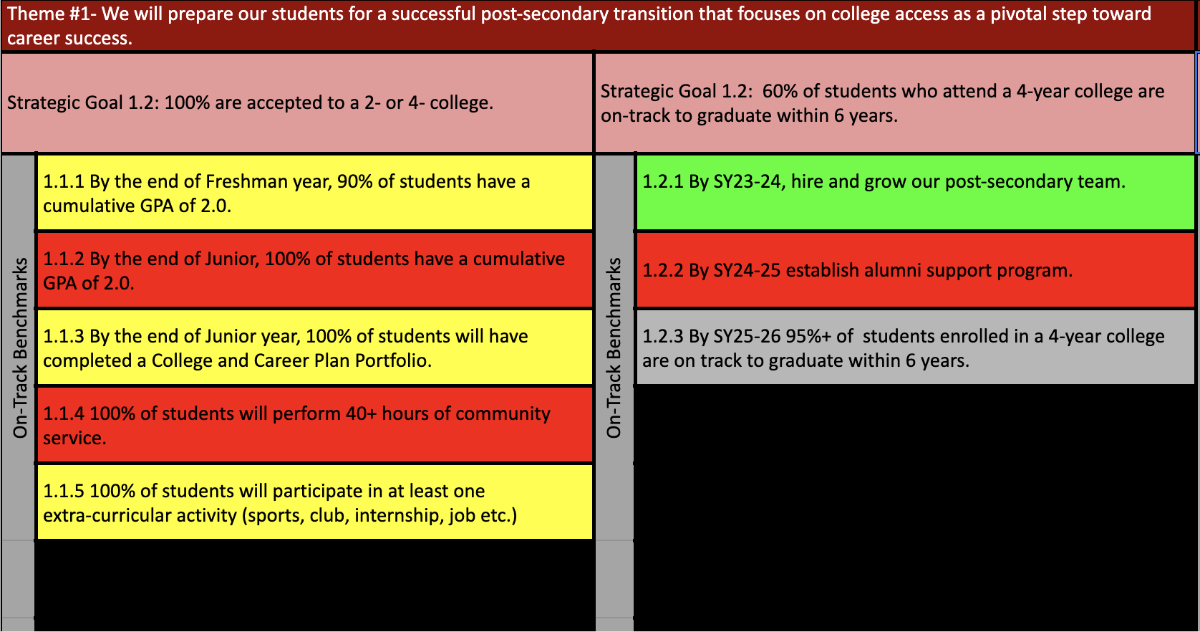
Notes:
AP data: 88%

Slide 17
LACS Strategic Plan 2023-2027
1 | We will prepare our students for a successful post-secondary transition that focuses on college access as a pivotal step toward career success.
2 | We will dramatically increase student achievement performance.
3 | We will recruit, develop, and retain highly effective teachers.
Notes:
448 is our target.

Slide 18
FYIs & Approvals
Approvals:
FYIs:
Investments
MassDevelopment Tech Loan
January Board Meeting & Dinner?

Slide 19
MISSION
Through rigorous academics, character development, and strong supports for every learner, Libertas Academy Charter School prepares all sixth through twelfth grade students to succeed within the college of their choice and to be positive, engaged members of their communities.

Slide 20
Upcoming LACS Events
Look at school calendar: https://docs.google.com/spreadsheets/d/1GdGJGI4IYizFUWEpR7mSQp9Rwj9N2mT3PPbaaUGFe9Y/edit#gid=1594803582
LA tinyurl.com/FY24LACalendar
UA: tinyurl.com/FY24UACalendar
Look at recruitment events! (Student and Staff)

