Slide 1
ED Updates
AAC Management Report

Slide 2
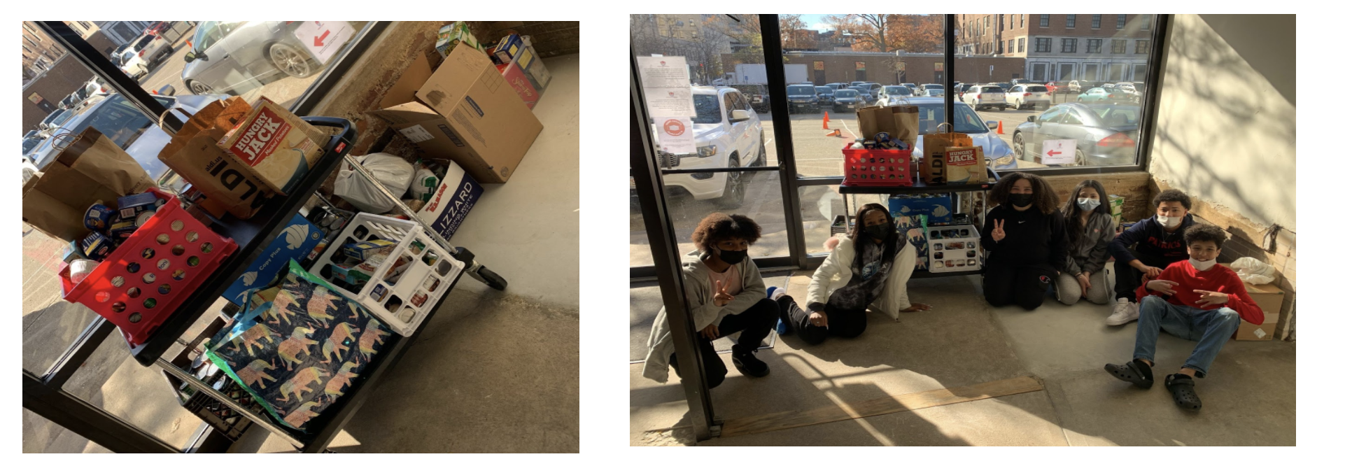

Slide 3
Our Mission
Through rigorous academics, character development, and strong supports for every learner, Libertas Academy Charter School prepares all sixth through twelfth grade students to succeed within the college of their choice and to be positive, engaged members of their communities.

Slide 4
COVID Updates

Slide 5
Our Reopening Philosophy
LACS remains committed to executing a Back-to-School that is grounded in our mission, our core values and that is informed by what the current science is telling us, specific to our local community.
Notes:
LACS will execute a back-to-school plan that is :
Grounded in our mission and aligned with our core values
Informed by science and facts
Specific to our local community

Slide 6
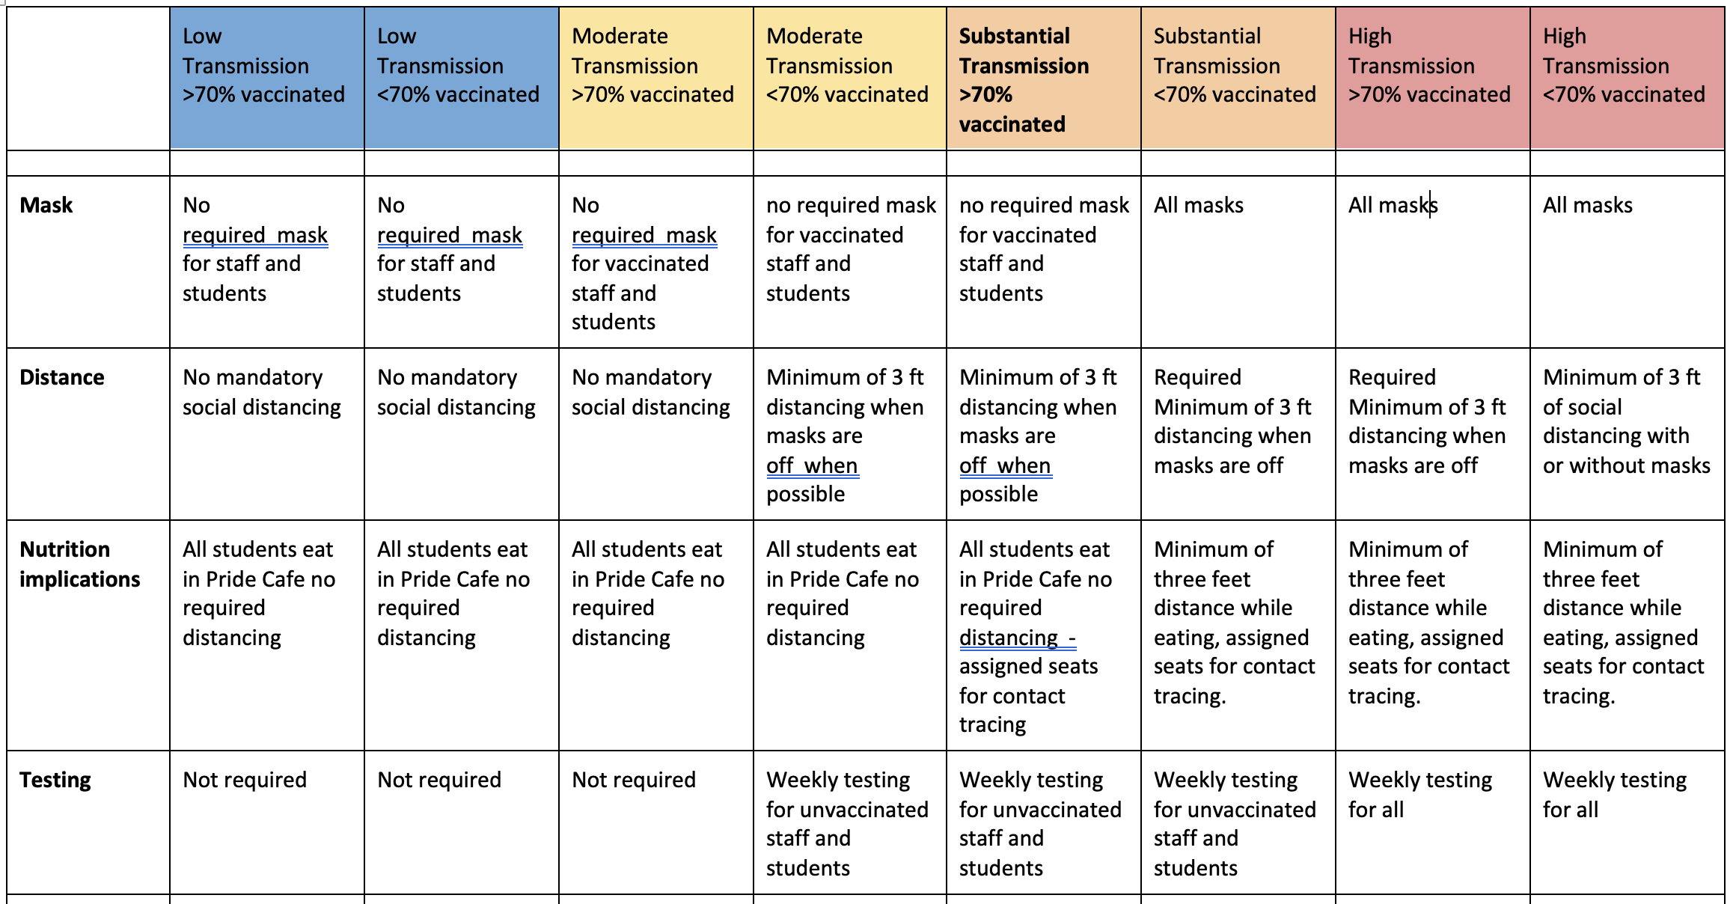
The Plan

Slide 7
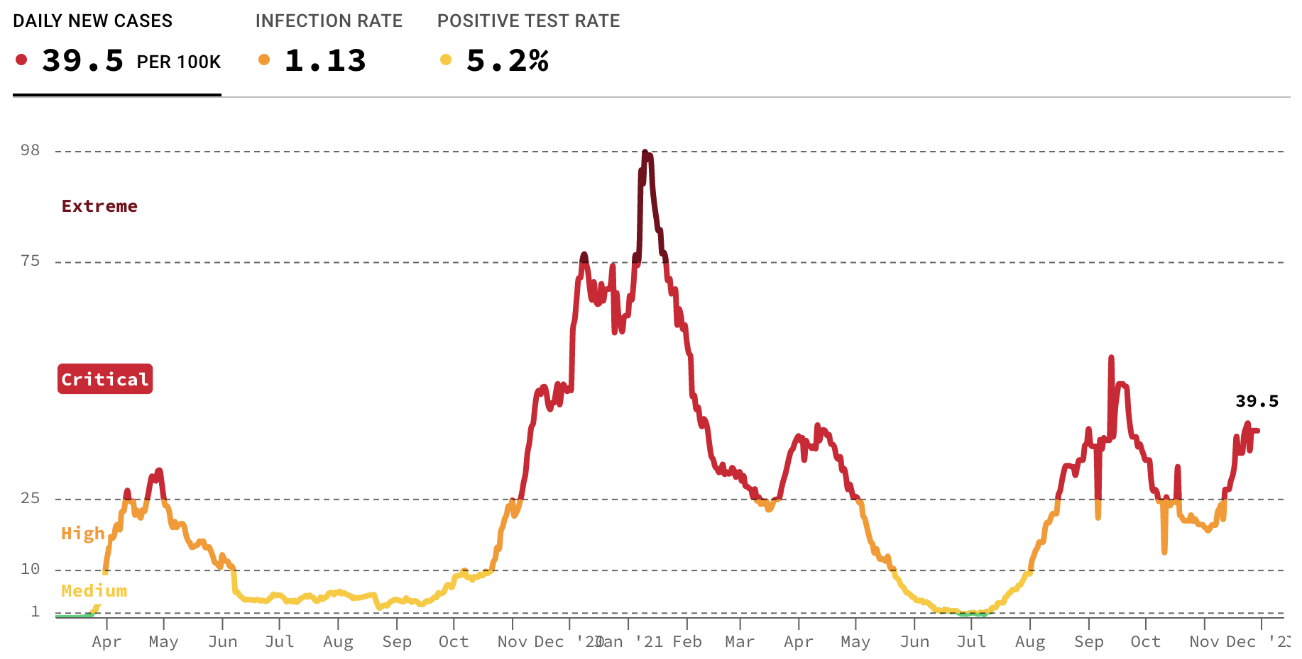
The Plan

Slide 8
Key School Data

Slide 9
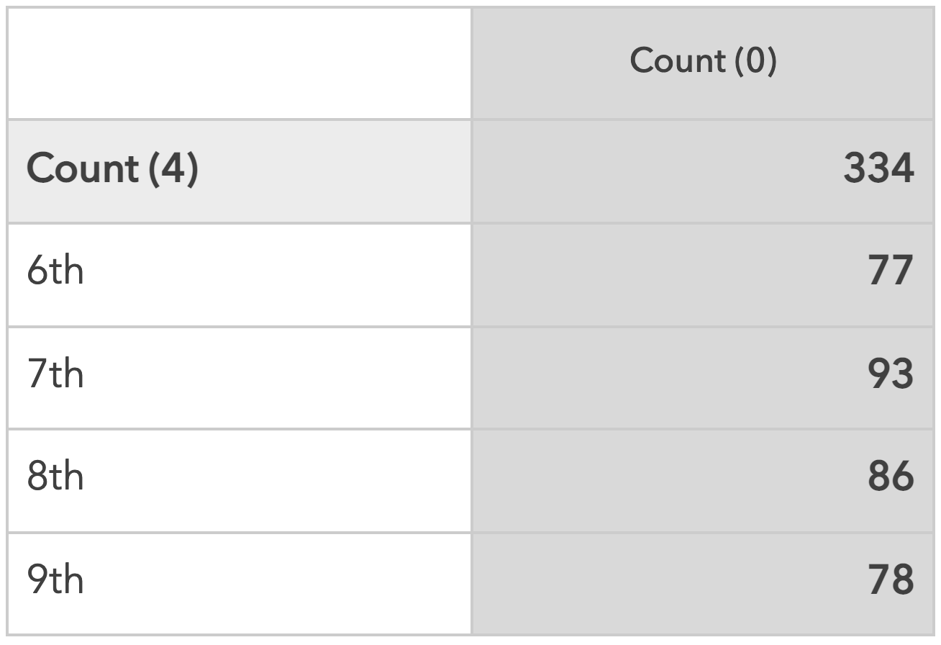
Enrollment

Slide 10
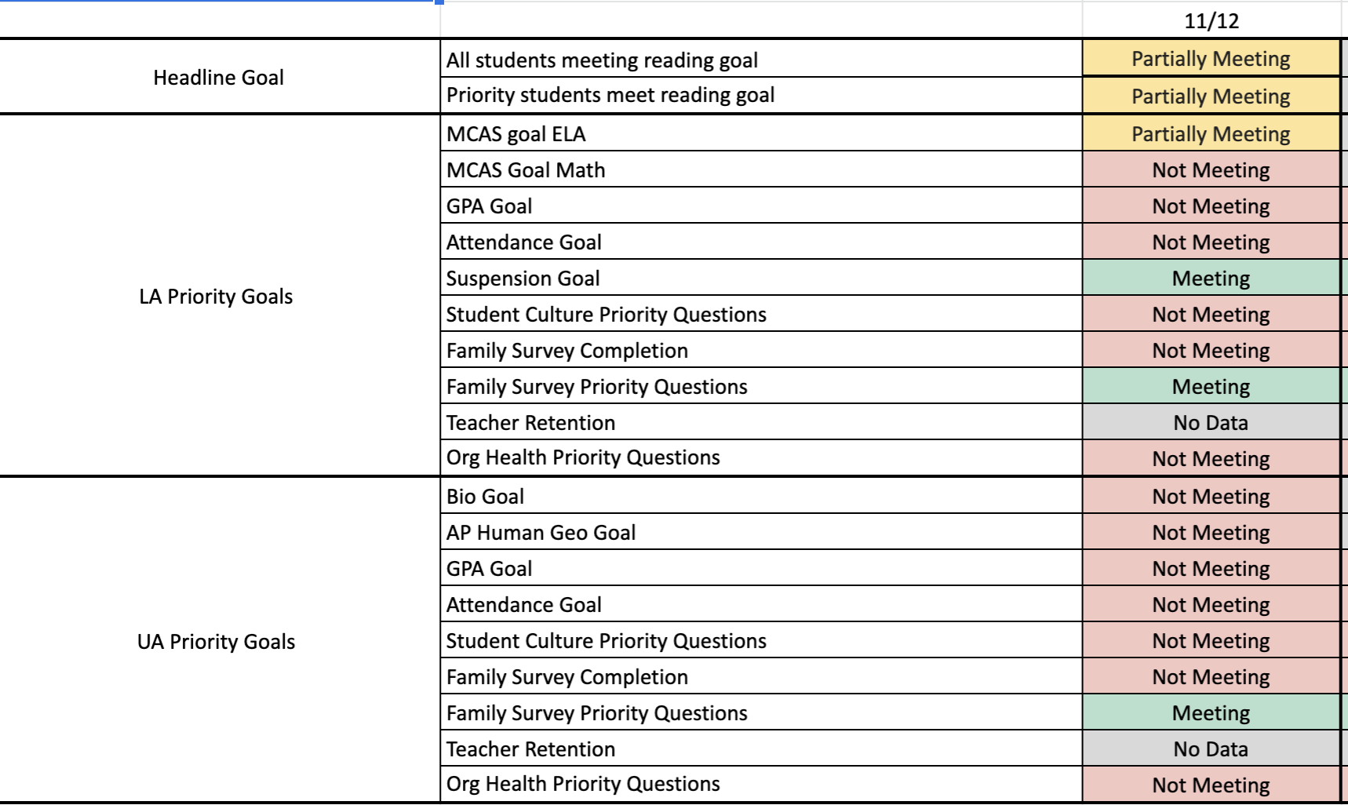
Overview

Slide 11
Lower Academy (6-8)

Slide 12
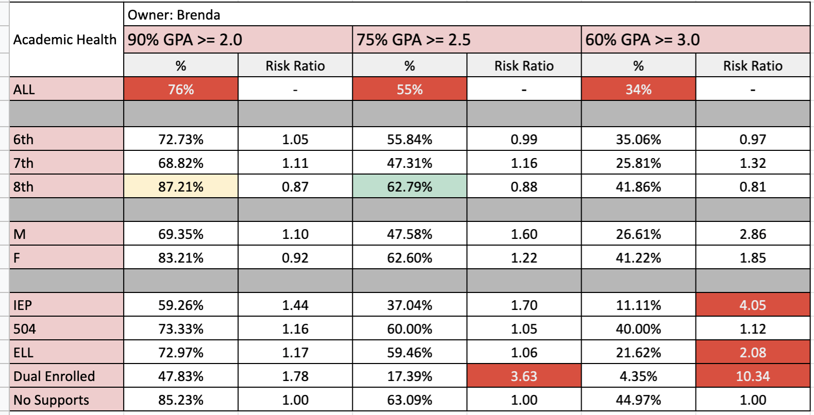
GPA Data

Slide 13
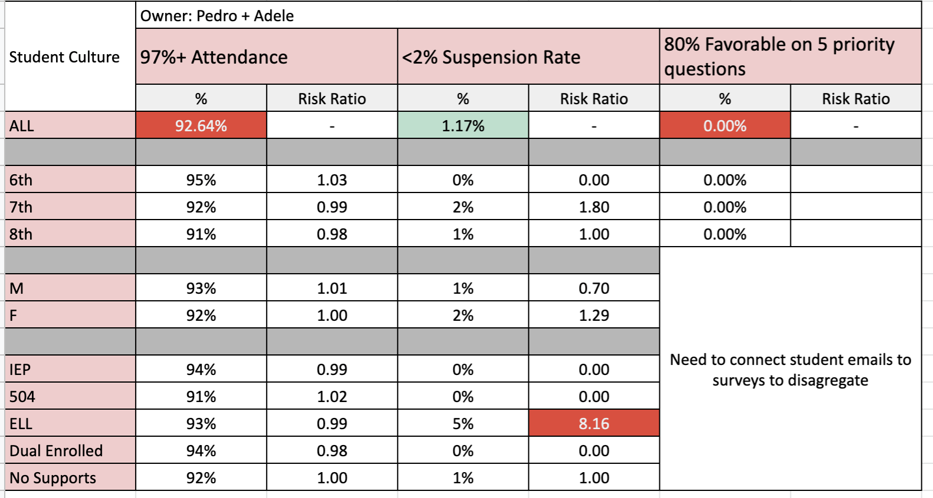
Culture Data

Slide 14
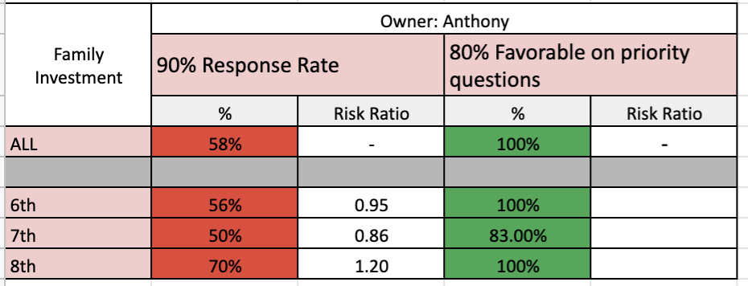
Family Investment Data

Slide 15
Upper Academy (9)

Slide 16
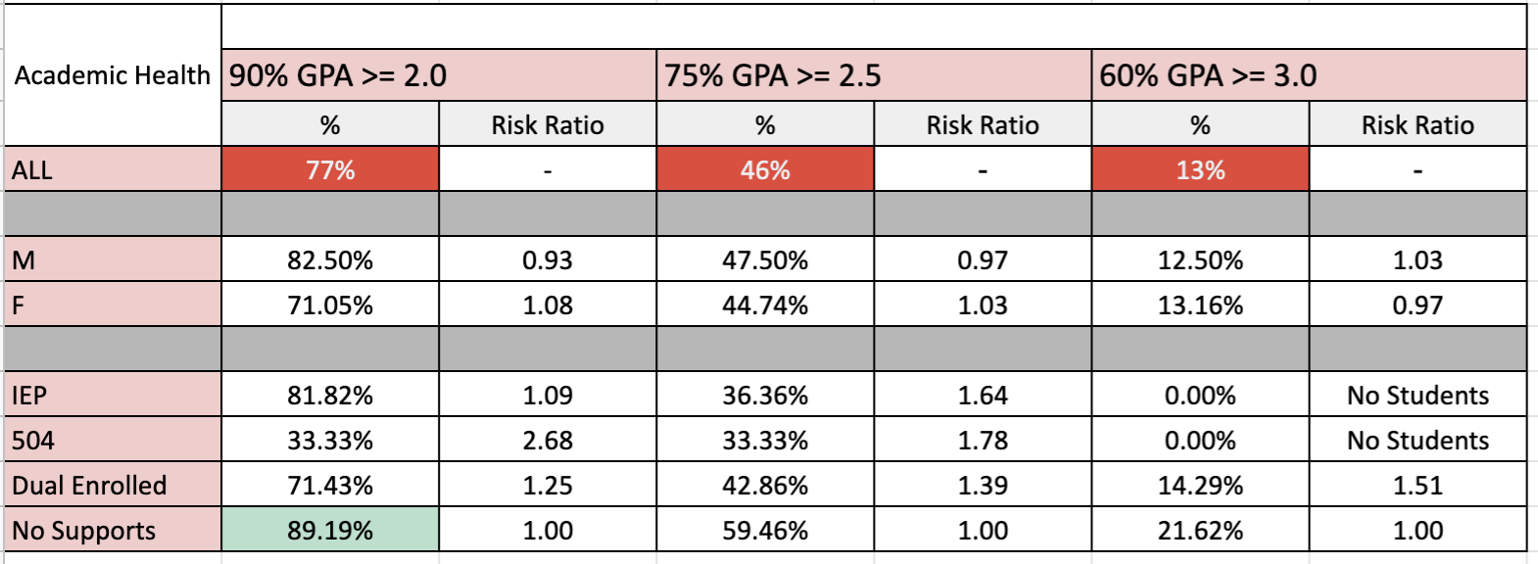
UA GPA Data

Slide 17
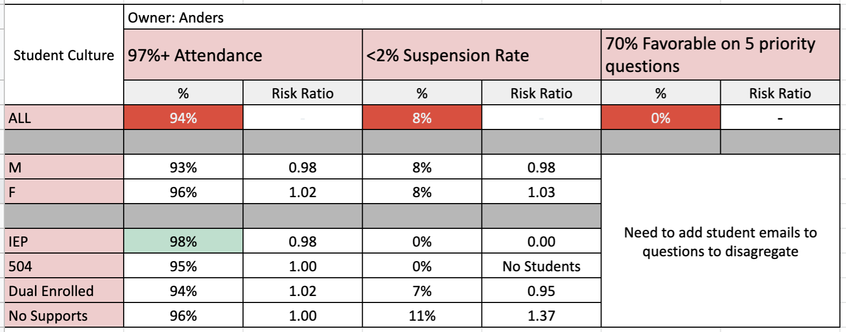
UA Culture Data

Slide 18
Family Investment Data

Slide 19
Q&A

