Slide 1
School Update

Slide 2
MISSION
Through rigorous academics, character development, and strong supports for every learner, Libertas Academy Charter School prepares all sixth through twelfth grade students to succeed within the college of their choice and to be positive, engaged members of their communities.

Slide 3
Core Values

Slide 4
Highlights

Slide 5
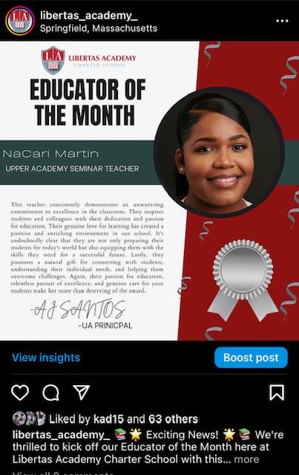
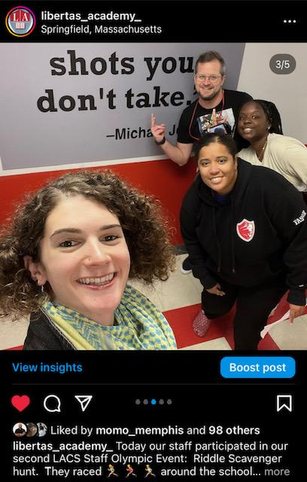
HIGHLIGHTS- Talent
Highlights for Talent
- 5 New Hires in the last month!
-Stevie- UA Spanish
-Logan- UA SST
-Abigail- UA SST
-Silvia- UA SST
Employee of the Month Oct- NaCari
Staff Olympics- Sprinkle Joy

Slide 6
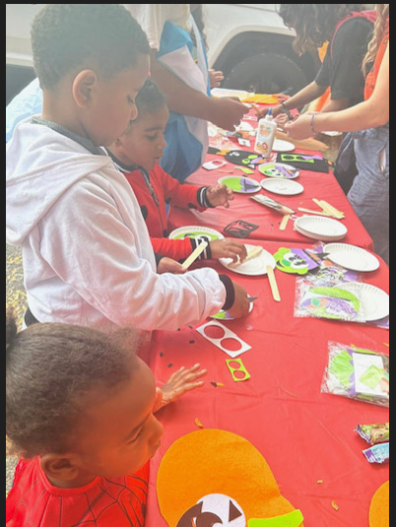
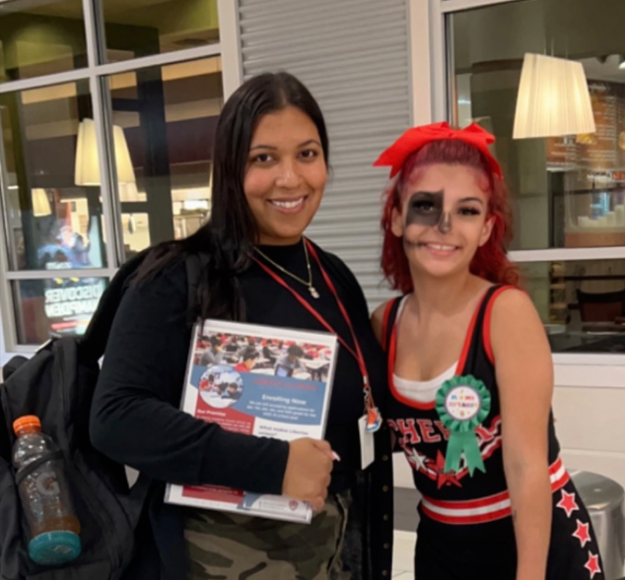
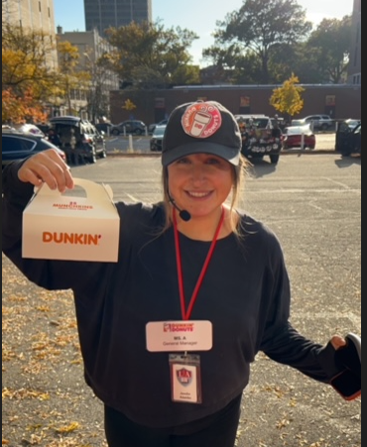
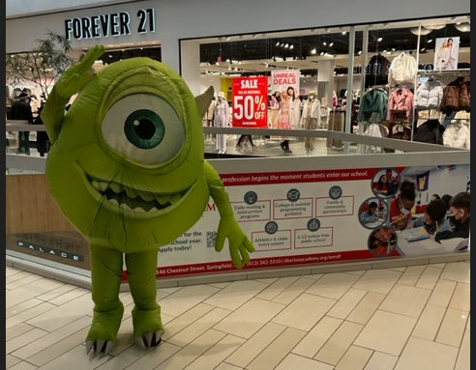
HIGHLIGHTS- Recruitment
Highlights for Recruitment
Trunk or Treat was a great and Mall event were really successful.
2. Based on the applications we have a waitlist for 7th and 8th grade already.
3. Billboards are up this year we got two billboards small so it was ½ the cost.

Slide 7
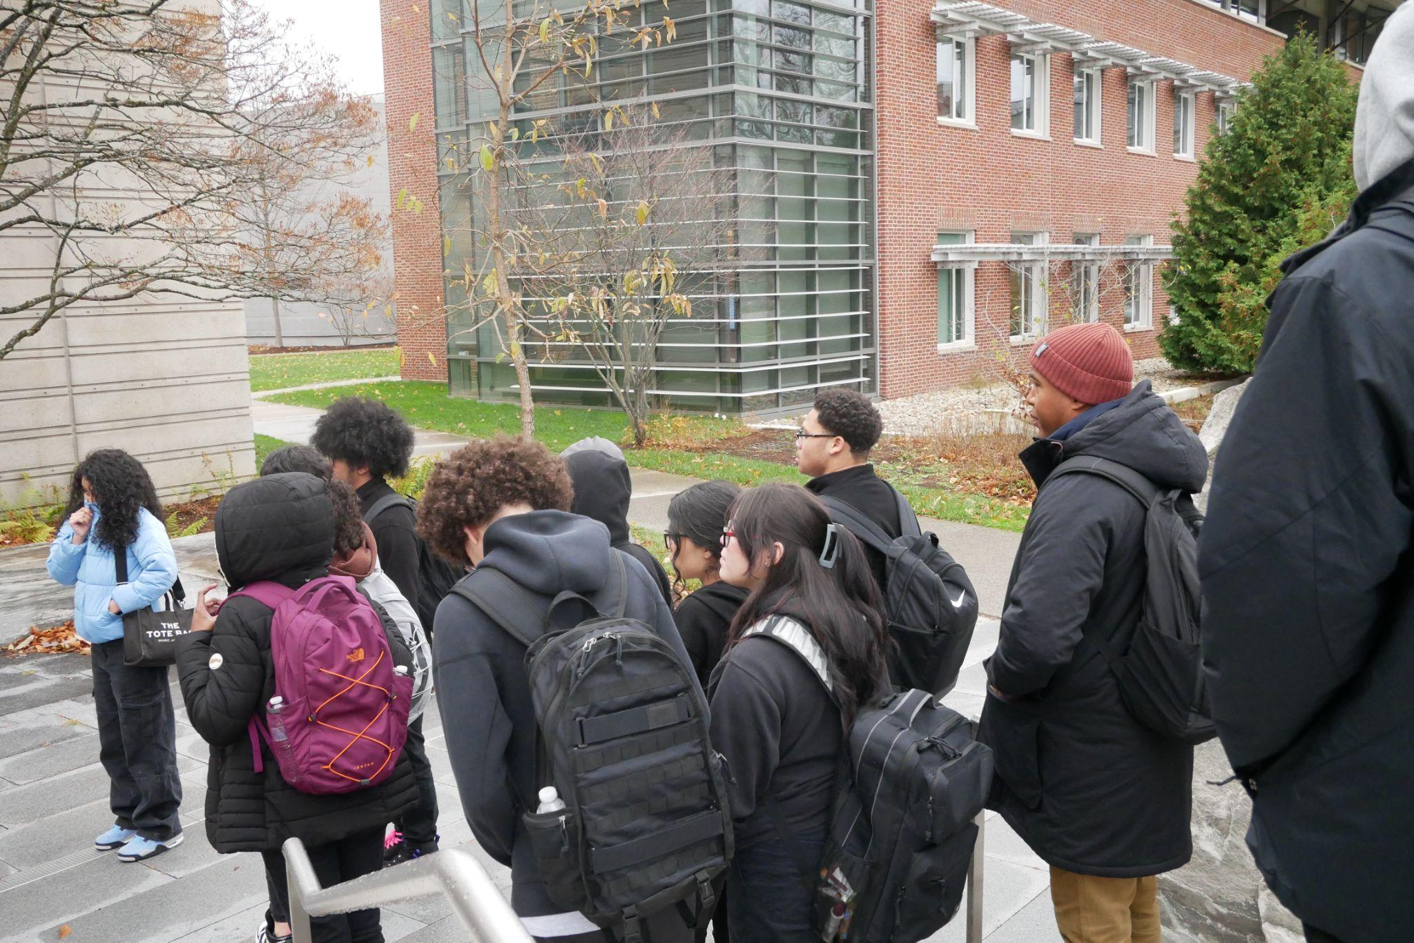
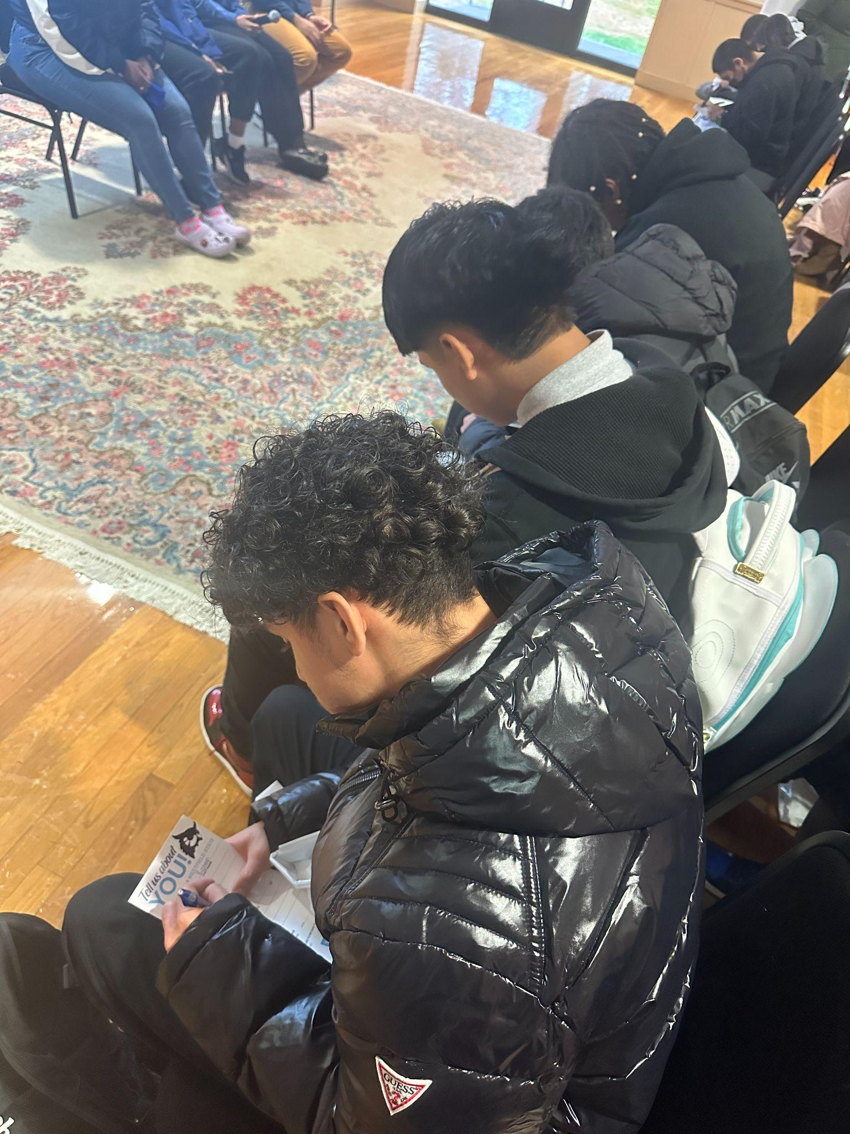
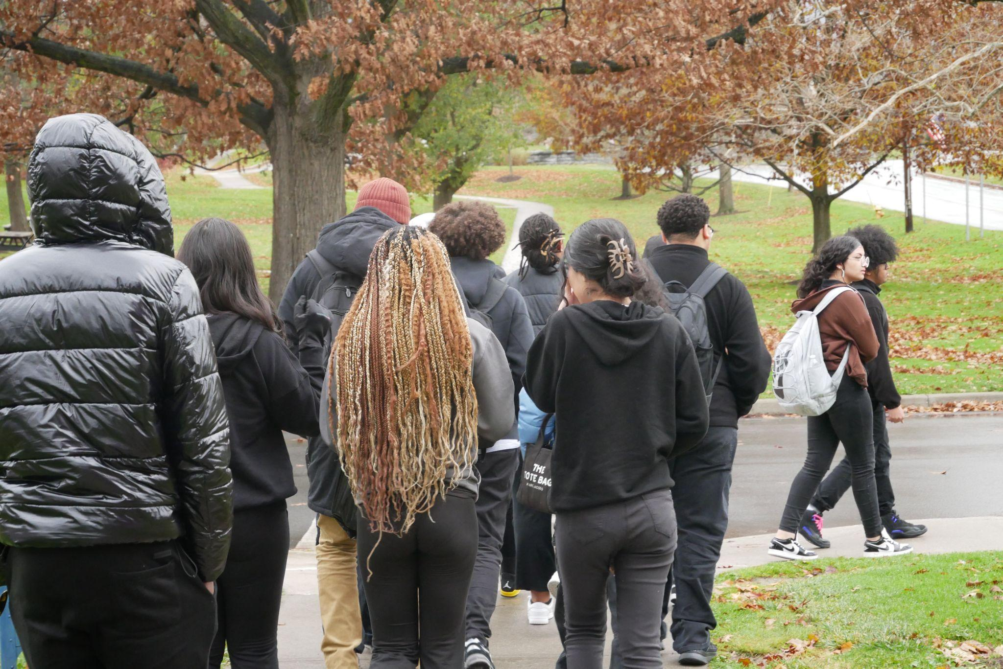
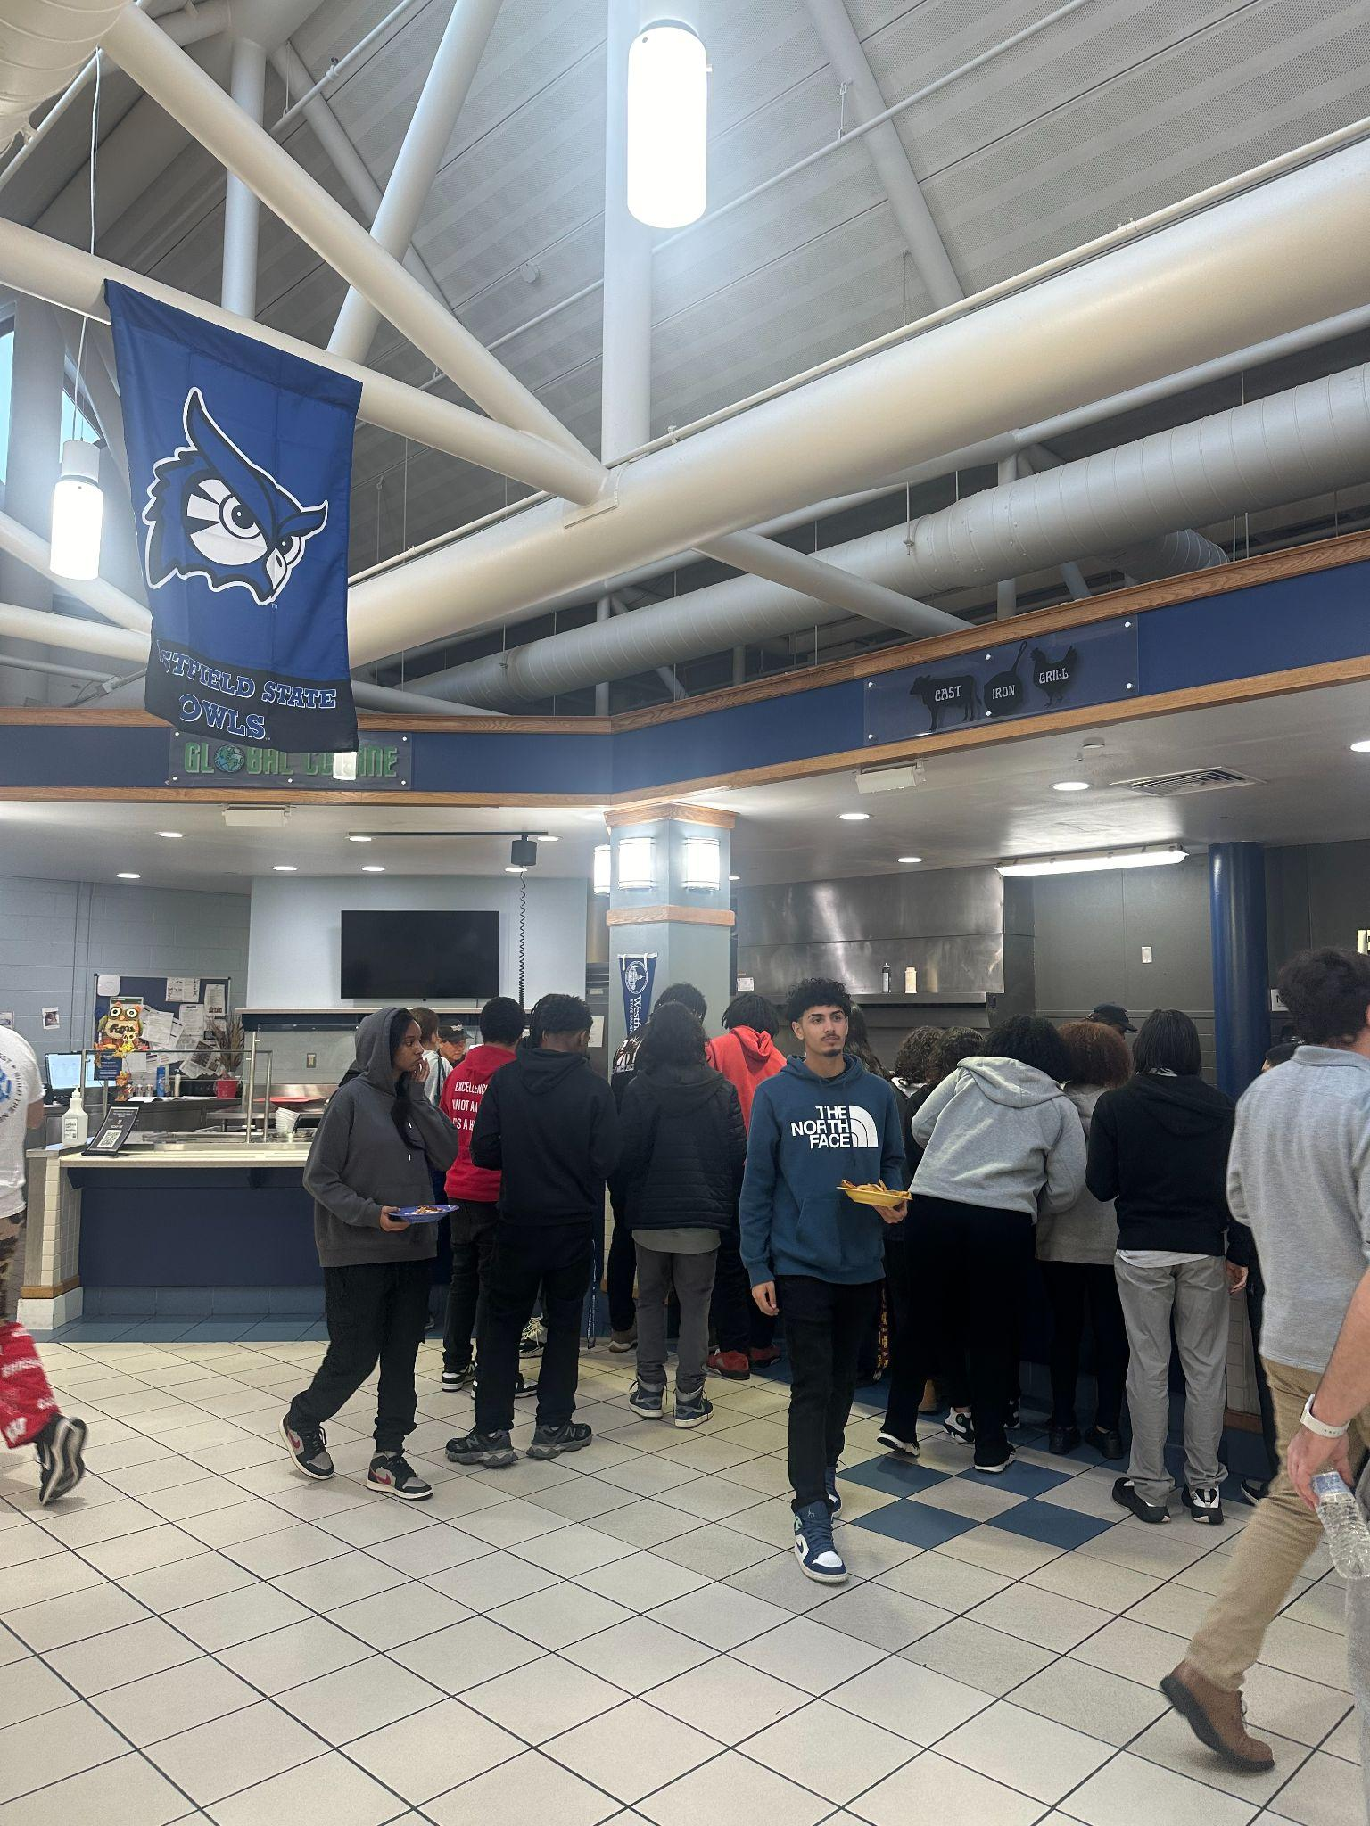
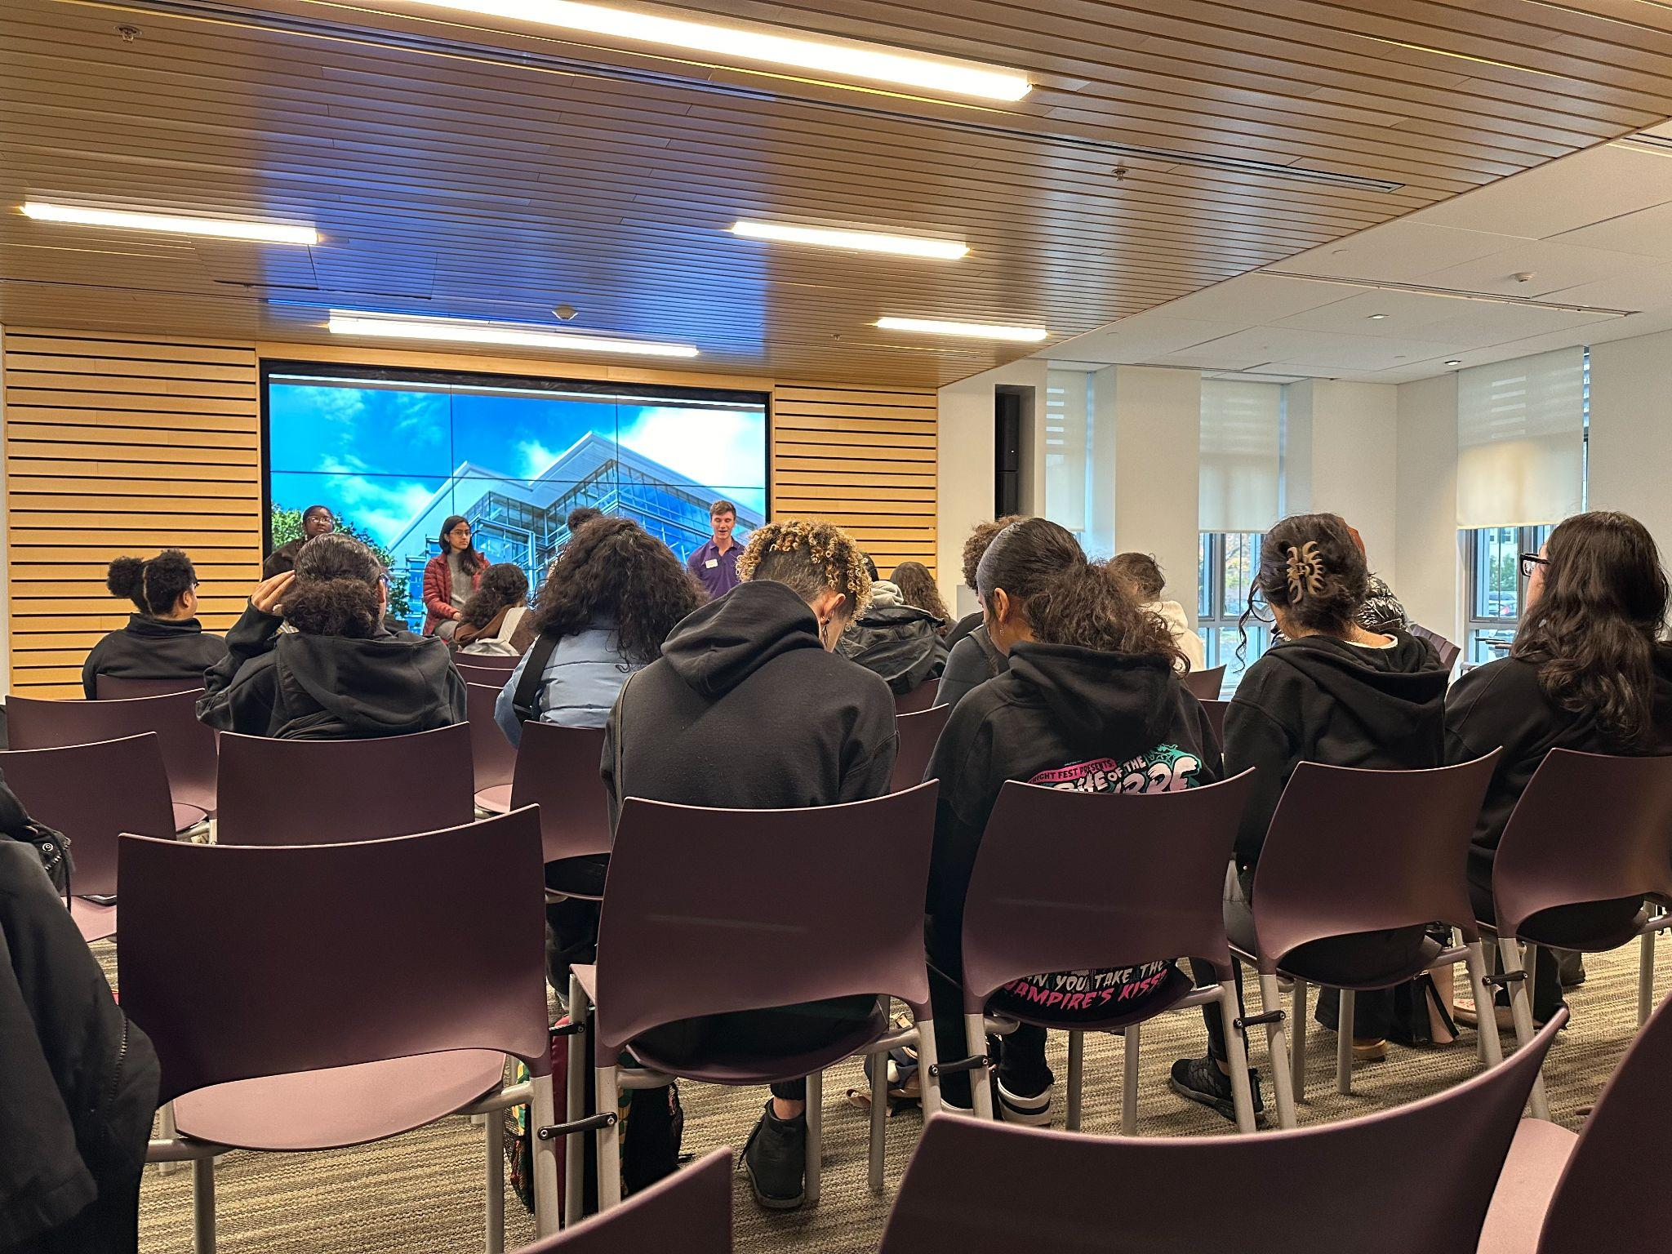
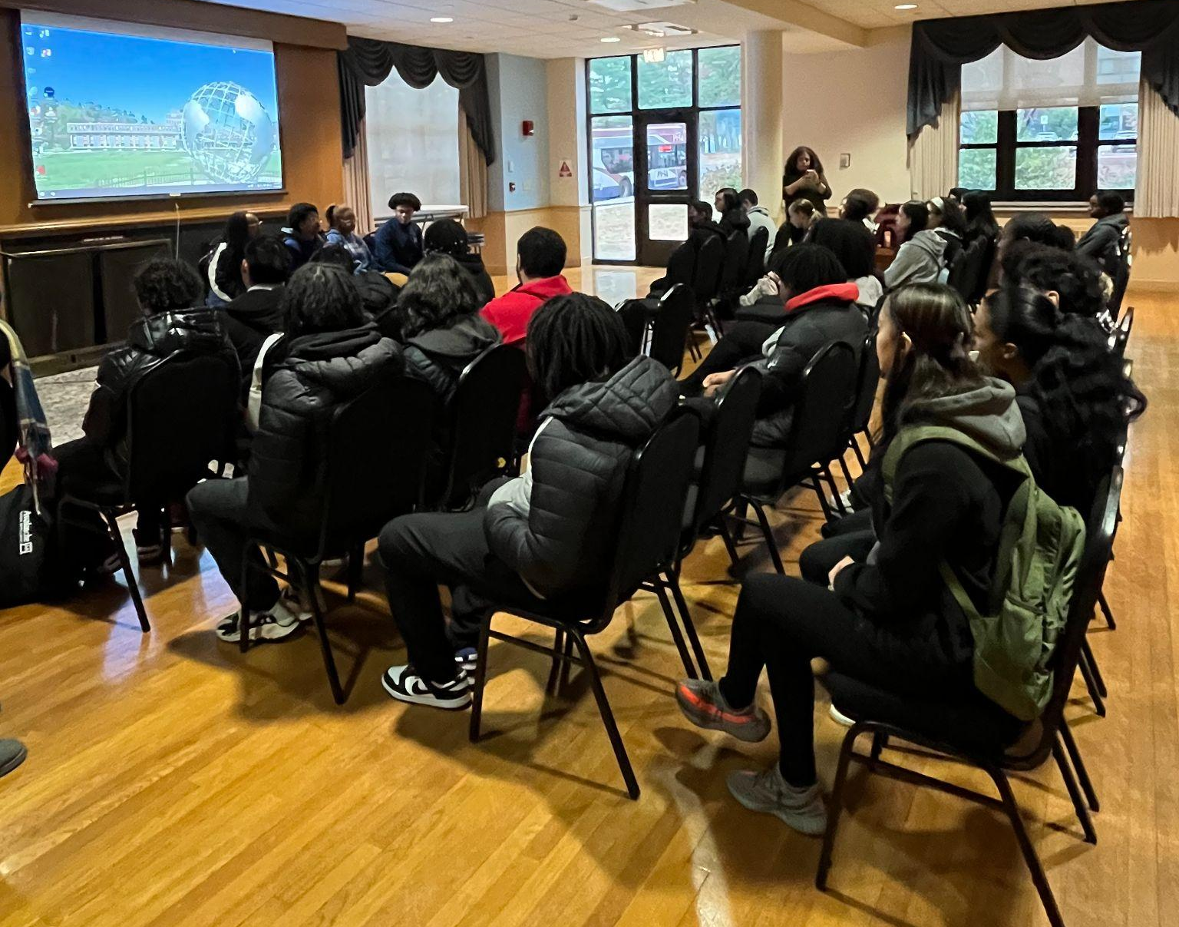
HIGHLIGHTS
College Rep Visits
Bay Path University | Nov 1
Springfield College | Nov 7
Dates for Jan - June will be posted in December
College Field Trips
Williams College (22 students)
10% acceptance rate | $80K per year
Westfield State University (26 students)
90% acceptance rate | $25K per year | Summer Bridge program
Dual Enrollment
Current | Adeychalis (Comp 1 - A) Ismael (Calc - A) Ana (PreCalc - B+)
16 students applied for the spring semester to both HCC & STCC
Class selection deadline is 12/15
Working with students & Santos to determine class selections & feasible scheduling
Courses will likely be: English Comp 1, Pre-calc, Physics & another science

Slide 8
Key School Data

Slide 9
GOALS & DATA - Talent
Current Open Roles
Academy | Group | Staff Name | Position
LA | 8th | OPEN | Math 2
LA | 7th | OPEN | Math 2
UA | 9th | OPEN | Biology

Slide 10
GOALS & DATA- Recruitment
Goal for 24-2025 - 612 students start first day of school.
We have launched new Recruitment year!
Where we are now taking new applications
6th grade - 45
7th grade- 6
8th- grade - 5
9th grade- 11
10th grade - 1
Total of - 68 new applications

Slide 11
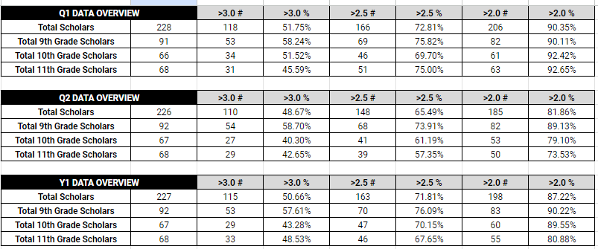
COLLEGE & CAREER READINESS -
GPA GOALS
Most Recent GPA Data (as of 11/15)
Goal | Metric
GPA | 50% @ 3.0+ 75% @ 2.5+ 90% @ 2.0+
SAT | 40% @ 500+ in EWR 35% @ 500+ in Math 75% meet SAT growth goal
Summer Program | 75% of 3.5 11th graders attend pre-college 75 % of 3.8 10th graders attend pre-college 75% of 4.0 9th graders attend a pre-college
PSAT | 35% @ 500+ in EWR 30% @ 500+ in Math
Essay | 90% of Juniors have a 1st draft by June 1
LOR | 100% of Juniors w/ 3.5+ have 1 LOR by June 1
SSR | 50% of Juniors have SSR written by Aug 1
FAFSA | 100% of Juniors have all financial aid docs in by May 1*
College List | 100% of Juniors have a 1st draft college list by June 1
Working with Alexandra to resolve SchoolRunner data pull errors

Slide 12
Lower Academy Big Goals

Slide 13
Upper Academy Big Goals

Slide 14
LACS Strategic Plan 2023-2027
1 | We will prepare our students for a successful post-secondary transition that focuses on college access as a pivotal step toward career success.
2 | We will dramatically increase student achievement performance.
3 | We will recruit, develop, and retain highly effective teachers.
Notes:
448 is our target.

Slide 15
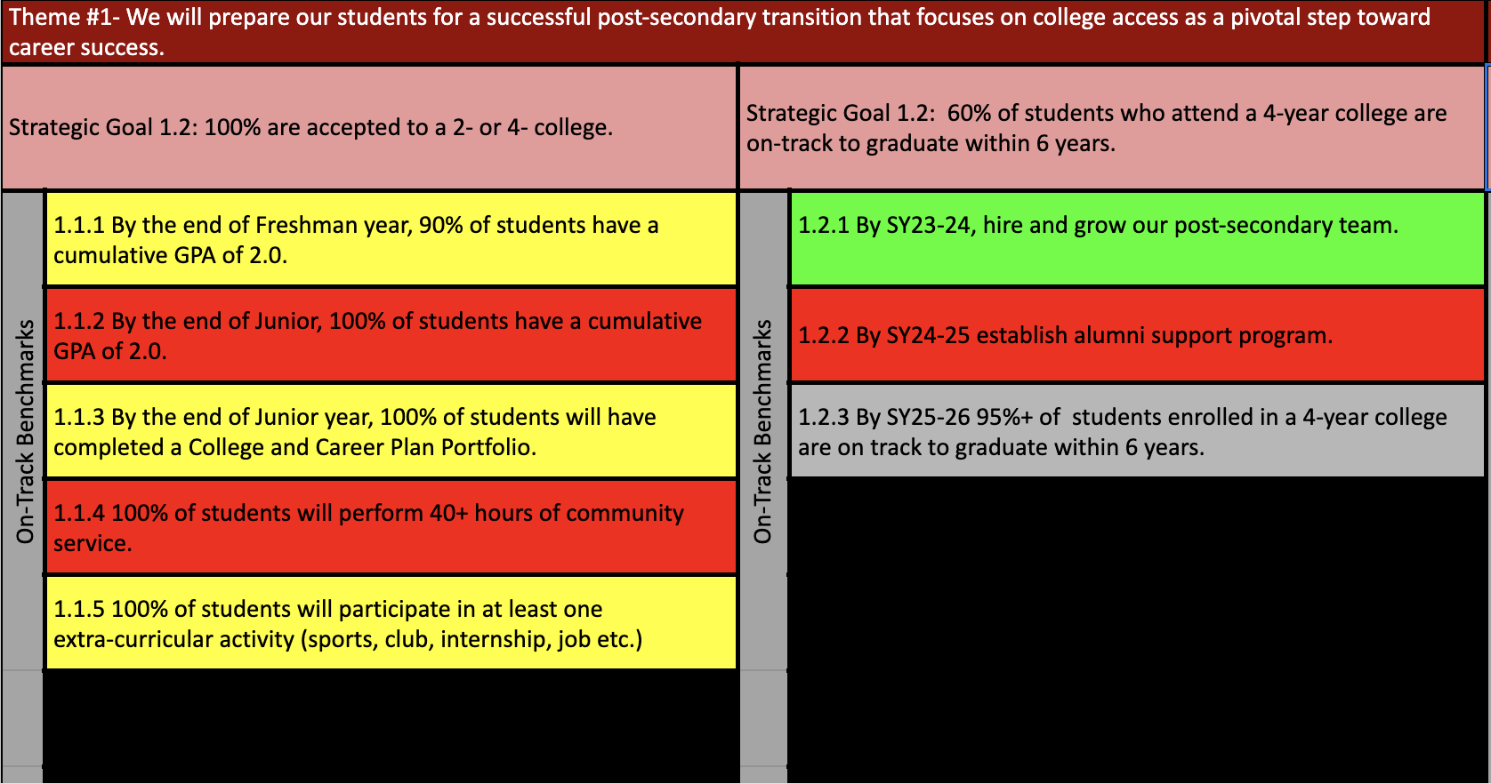
Notes:
AP data: 88%

Slide 18
FYIs & Approvals
Approvals:
FYIs:
Investments
MassDevelopment Tech Loan

Slide 19
Upcoming LACS Events
Event | Date | Time
Staff Holiday Party @MGM | 12/9 | 7 PM
Drumline Showcase After School | 12/20 | 5:00 PM
Club Showcase | 12/21 | 9 AM

Slide 20
MISSION
Through rigorous academics, character development, and strong supports for every learner, Libertas Academy Charter School prepares all sixth through twelfth grade students to succeed within the college of their choice and to be positive, engaged members of their communities.

Slide 21
Upcoming LACS Events
Look at school calendar: https://docs.google.com/spreadsheets/d/1GdGJGI4IYizFUWEpR7mSQp9Rwj9N2mT3PPbaaUGFe9Y/edit#gid=1594803582
LA tinyurl.com/FY24LACalendar
UA: tinyurl.com/FY24UACalendar
Look at recruitment events! (Student and Staff)

