Slide 1
Director’s Meeting
October 24 , 2022

Slide 3
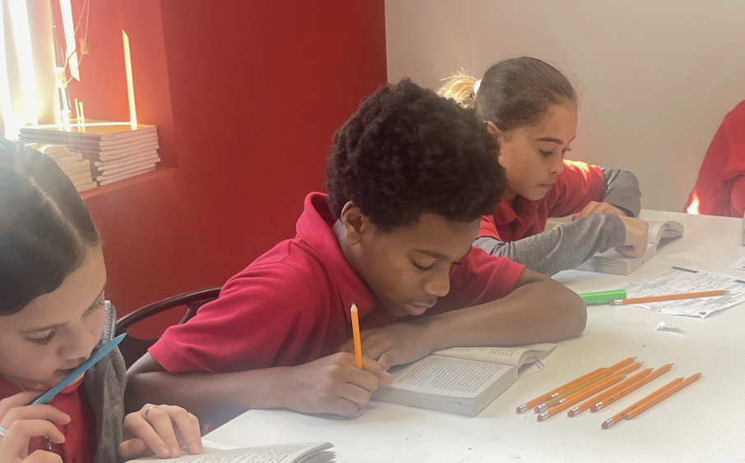
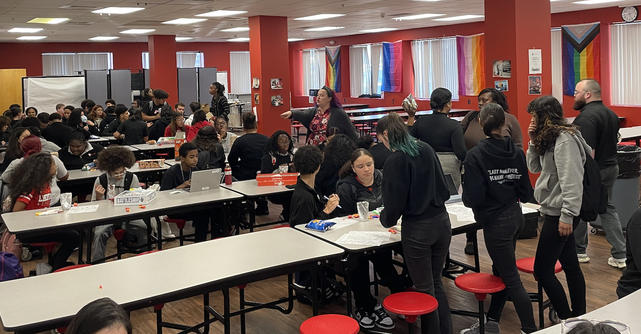

Slide 4
INCLUSIVE COMMUNITY
EXCELLENCE IN ALL EFFORTS
OUR PEOPLE MATTER
PURSUE YOUR BEST SELF
OUR VALUES
SPRINKLE
JOY
LEAVE A LEGACY

Slide 5
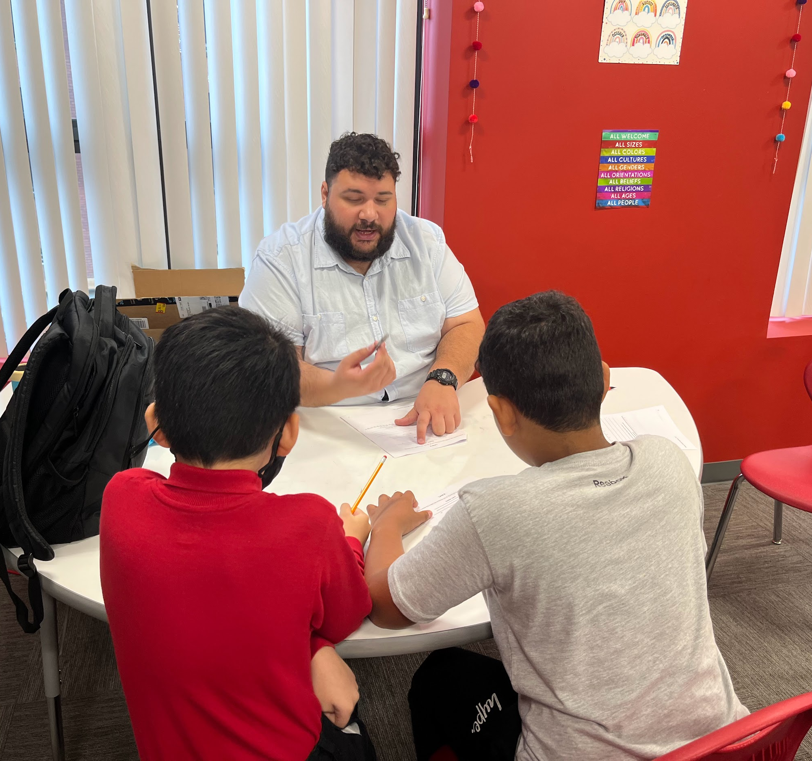
Lower Academy
2023-2024

Slide 6
Q1 IA Data
Notes:
Now we are going to look at our Q1 Academic Data. The questions we are thinking about are the same.
I will stay on these slides a little bit longer.

Slide 7
ELA
IMPORTANT CONTEXT
All 3 tests were different from last year - these are the FY23 released MCAS, and last year we took ANET exams. The tests this year more closely aligned to a day of MCAS with 2 -3 passages, an essay and 15 - 18 questions.
M + E % are stronger than where we were last year in all 3 grades
7th grade is more on track than it was this time last year
NM % are off track in all grades and hiGHer than where we were last year in all 3 grades
OER was better in 7th grade (NF essay) vs the 2 essay scores in 6th + 8th were fiction essays. Last year the essays were narrative essays on ANET
Goal(s) - M+E |  |  | On /Off track | Goal(s) - NM |  |  | On /Off track
30% M + E |  |  | off track | <25% NM |  |  | off track
40% M + E |  |  | on track | <20% NM |  |  | off track
50% M + E |  |  | off track | <20% NM |  |  | on track
M & E
PM
NM

Slide 8
ELA HEADLINES
DEPARTMENT - We have a strong foundation - now we need to capitalize at looking at our outputs, get meticulous about data and how we respond to it to drive urgency + close gaps.
6th Grade: We are in a better spot than anticipated, but we really need to move and close gaps ahead of IA#2, especially with the NM bucket.
7th Grade: We are in a really strong spot, so we want to keep up the momentum + push. We have the opportunity to have the highest achieving LACS class ever in 7th grade
8th Grade: We have a good starting point, but we are far off from 50% still. Converting 14%+ is going to require consistent culture + work outputs from students daily. Need to maintain NM + see if we can decrease it.

Slide 9
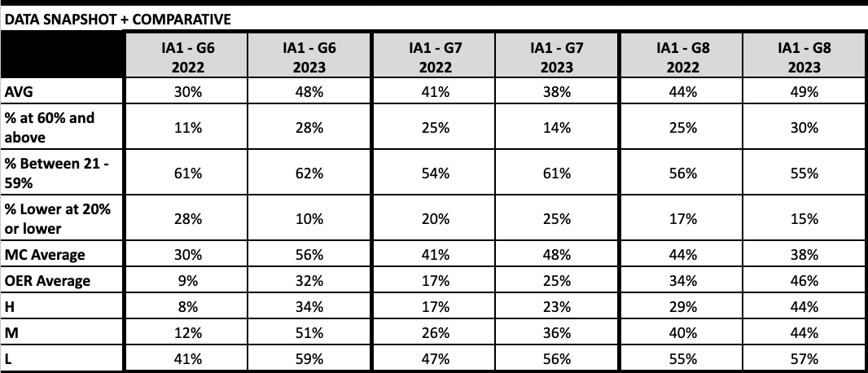
MATH
IMPORTANT CONTEXT
Tests for all 3 grades are different (8th is the most similar) because last year test was ANET and this year test is all released MCAS questions w/ 4 point OER questions. This means rigor is significantly higher.
- M + E is in a stronger spot in both 6th and 8th grade than where we were at IA 1 last year
- However, because our goal is much higher this year in 8th, we are currently off track
- NM % is currently on track for all grades and at a lower % than last year in 6th & 8th grade (5% higher in 7th)
- 7th Grade: Weaker spot than where we were at this point last year (M + E % lower by 11%)
Goal(s) - M+E |  |  | On /Off track | Goal(s) - NM |  |  | On /Off track
35% M + E |  |  | Off Track | <20% NM |  |  | On Track
28% M + E |  |  | Off Track | <25% NM |  |  | On Track
40% M + E |  |  | Off Track | <20% NM |  |  | On Track
MC + OER averages are higher in all grades compared to last year which is a huge win. However given the weight of OER overall averages for the exams appear lower.
M & E
PM
NM

Slide 10
MATH HEADLINES
Department: We are off track from goals and this trajectory will not change unless we make significant shifts to strengthen instruction. The most off vision elements include consistent data tracking, IPP, and interventions.
6th Grade: We are in a stronger spot than last year but LG is currently carrying the data through Math 1. M2 currently underutilized in closing gap, rep. by % of students NM.
7th Grade: 7th Grade is in a vulnerable spot. Data is worse than last year for both goals and with a cohort that we know can produce strong results. We need to rethink staffing and student supports.
8th Grade: Need to do a complete reset/overhaul of student mindsets with focus on what effective student supports look like.

Slide 11
CULTURE
Notes:
Now we are going to look at our Q1 Academic Data. The questions we are thinking about are the same.
I will stay on these slides a little bit longer.

Slide 12
Q1 Advisory Data
GOAL = 80% of advisories at 5+ of 6 on Advisory Rubric
Grade | # meeting GPA Goal | # meeting Attention Goal | # meeting SI Goal | # meeting FI Goal | # meeting 5+ of 6 goal
Grade 6 | 5 | 2 | 7 | n/a | 3
Grade 7 | 5 | 4 | 8 | n/a | 5
Grade 8 | 1 | 2 | 6 | n/a | 1
TOTAL | 11/24 | 8/24 | 21/24 | - | 9/24

Slide 13
Chronic Absenteeism
GOAL = Less than 7.5% (22 students)
 | Aug % | Aug # | Sept % | Sept # | Oct % | Oct # | YTD % | YTD # | < 70% ADA
Grade 6 | 26% | 24/93 | 35% | 33/93 | 7% | 16/93 | 16% | 15/93 | 6/294 6 - 1 7 - 3 8 - 2 _______
Grade 7 | 24% | 25/103 | 40% | 41/103 | 9% | 18/103 | 17% | 18/103
Grade 8 | 22% | 22/98 | 39% | 38/98 | 5% | 20/98 | 23% | 23/98
Total | 24% | 71/294 | 38% | 112/ 294 | 18% | 54/ 294 | 19% | 56/ 294
Notes:
From 22% at end of Q1 to 12% now.

Slide 14
ADA
GOAL = 92% ADA
 | August | September | October | YTD (10.31)
Grade 6 | 95% | 93% | 94% | 94%
Grade 7 | 94% | 92% | 93% | 93%
Grade 8 | 94% | 92% | 92% | 92%
Overall | 94.3% | 92.3% | 93% | 93%
# of students with 100% ADA:
58/294
Notes:
94% = same as end of Q1

Slide 15
SURVEYS
Notes:
Now we are going to look at our Q1 Academic Data. The questions we are thinking about are the same.
I will stay on these slides a little bit longer.

Slide 16
Family Survey Data
Favorability Goal for Priority Questions: 80% or higher

Slide 17
Staff Org Health
Favorability Goal for Priority Questions: 80% or higher

Slide 18
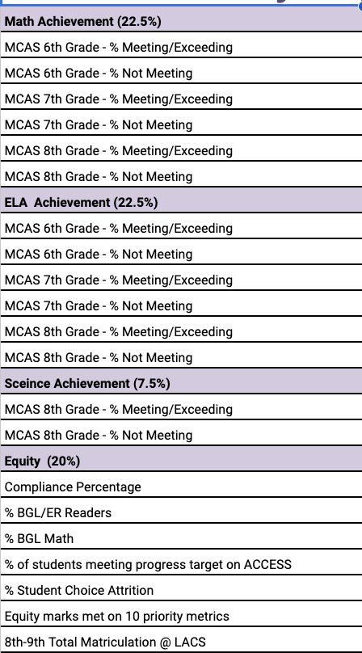
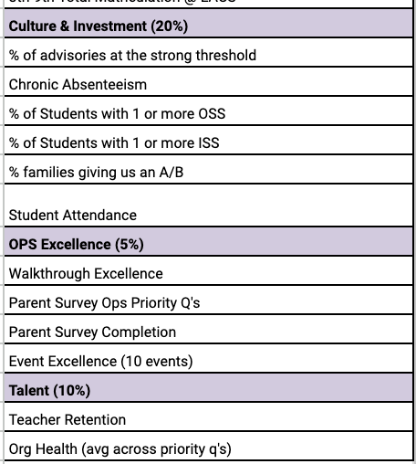
23-24 LA Goals
MISSING:
ADA goal set at the number - 92%
These will be removed and points will be added to NM categories on report card.

Slide 19
HIGHLIGHTS
IMPROVEMENTS IN INTELLECTUAL PREP
We already have had 3-4 academic deep dives this year that revealed strong learnings + shifts re: IPP.
Morning huddles < M, W, F > focus on IPP trends + create strong visibility into quality of teacher internalization
Department Meetings are higher leverage + more purposefully designed given what we are seeing in huddles - leading to increased teaching quality.
ADVISORY
Data for items such as GPA + investment are at a much stronger place than they were last year
While we are still working to crack the code on CA- confirmations have been significantly stronger due to advisor lean in. Resulting in greater movement with less buybacks being offered so far this year.
Leaders are all in on coaching during this time + teachers are making consistent improvements in practices as a result.

Slide 20
CHALLENGES
LEADER TIME MANAGEMENT
Effective this week leaders < - MA + AK > are teaching 2 or more blocks daily.
Concerned about the impact of prep + teaching on leader time especially when thinking about coaching - self included.
I need to effectively support them on time management so that we do not stagnant teacher growth + data movement.
SCHOOL CULTURE < PROACTIVE / REACTIVE >
With more new teachers than we have had over the last 2 years + a new leader owning that team - school culture is more unstable than its been.
This is pulling on my capacity more than it should, resulting in less focused attention on academics.
There are real questions here around whether people are in the right seats - driving the right goals.

Slide 21
GOALS ON TRACK w/ REFLECTION
DATA POINT | STANDING | REFLECTION
Compliance (90%) | 93% - STRONG | NS has been doing a good job in making and sustaining traction in. Better forward thinking + SST PD needs to be done to ensure the goal doesn't slip.
% Student Attrition (5%) | 1.7% - EXEMPL. | We continue to have strong follow up with parents re: withdrawal flags. Need to be mindful of how things like clubs + E.Cs impact parent experience however.
% Student OSS (7.5%) | 2.4% - ON TRACK | We are still thoughtfully using our discretion on these decisions. All but 1 OSS were to high fliers who would tend to have the repeated behaviors.
Parent Survey (90%) | 90% - STRONG | OPS effectively leaning in and partnering with advisors to ensure this was done. Daily tracking + reporting between MA + YC helped significantly.
% A+B Parents (85%) | 86% - STRONG | Advisors have been doing a good job communicating with families. This is still not as consistent as it should be though - we need to be thoughtful of up’ing posis to balance the culture flags/detention calls.
Org Health PQ (75%) | 93% - EXEMPL. | Leaders have done a good job follow up with their people and leveraging 1:1 checkins to unpack how people are feeling + accurately designing supports.
Teacher Retention | ON TRACK | We have had 4 transitions this year. None of the transitions were surprises given the lack of mindset fit. Conversations are happening
ADA (92%) | 93% - STRONG | We have worked to close the gap on systems that were working against us re: attendance. MA + AK need to feel more ownership here though.

Slide 22
GOALS ON TRACK w/ REFLECTION
DATA POINT | STANDING | REFLECTION
MCAS ELA 6 - M | ON TRACK | This year we took an old released MCAS test vs. ANET. While we do not have direct comparative data - the rigor of the test was harder than before. Even with that, we saw all of these categories before BETTER than they did for last year’s IA. 7th grade is performing immensely well - this is a huge testament to what Erika is doing in those spaces + Malanga’s SST supports. We need to bring more of the small group strength to 8th grade to lock us in at goal + have VY do class observations of Erika when possible in order to tighten debrief strength.
MCAS ELA 7 - M + NM
MCAS ELA 8 - NM
MCAS MATH 6 - M + NM |  | NM %s hit goals that were set and were stronger than last year with more rigorous exams that were MCAS aligned. M% on 6th Math was 6% from goal however % stronger than last year with more rigorous test and historical data has shown that lower % trend still yields 30%+ on MCAS from Gardner. Optimistic about how it is trending.
MCAS MATH 8 - NM
MCAS SCI 8 - M |  | Q1 exam had released MCAS questions this round and more rigorous OERs. Pass % hit with necessary priority students. This cohort is also performing better on sci/tech questions which is what will

Slide 23
GOALS OFF TRACK w/ REFLECTION
DATA POINT | STANDING | REFLECTION
Advisor Strength | 33% - POOR | We need to consider thinking about metrics on GPA - this was the category that most people lost points.
% meeting progress metrics (ELL - 48%) | 33% - DEVELOP | More urgent coaching needs to happen of this team especially within consults. Unless we are ACTIVELY making day over day pushes - we will remain stagnant.
ICS (10%) | 5.8% - OFF | We have already used half of potential ICS. We need to continue to be creative with what we are doing so that we are not overryling on ICS.
MCAS ELA 6 - NM | ELA 6 NM + MATH 7 M - POOR ALL OTHERS - DEVELOPING | There is a HUGE number of students currently tracked as NM in 6th. We need to strategically increase the focus on cusp students for both AM + VY.
MCAS ELA 8 - M |  | While this can technically be considered on track comparatively - the weakness of the teacher in that seat prior + the current jigsaw being done leaves me cautious.
MCAS MATH 7 - M + NM |  | Kids MC + OER is stronger than last year however it is still not where it needs to be. While culture is set - we need to more effectively close gaps through data centered practices and push students to perform.
MCAS MATH 8 - M
Chronic Absenteeism (7.5) | 19% - POOR | We are in a better spot than we were this time last year, however we need to continue to strategically hold buybacks to support kids in stabilizing their %s. This time of year is really difficult given that every day has a much larger impact on attendance,

Slide 24
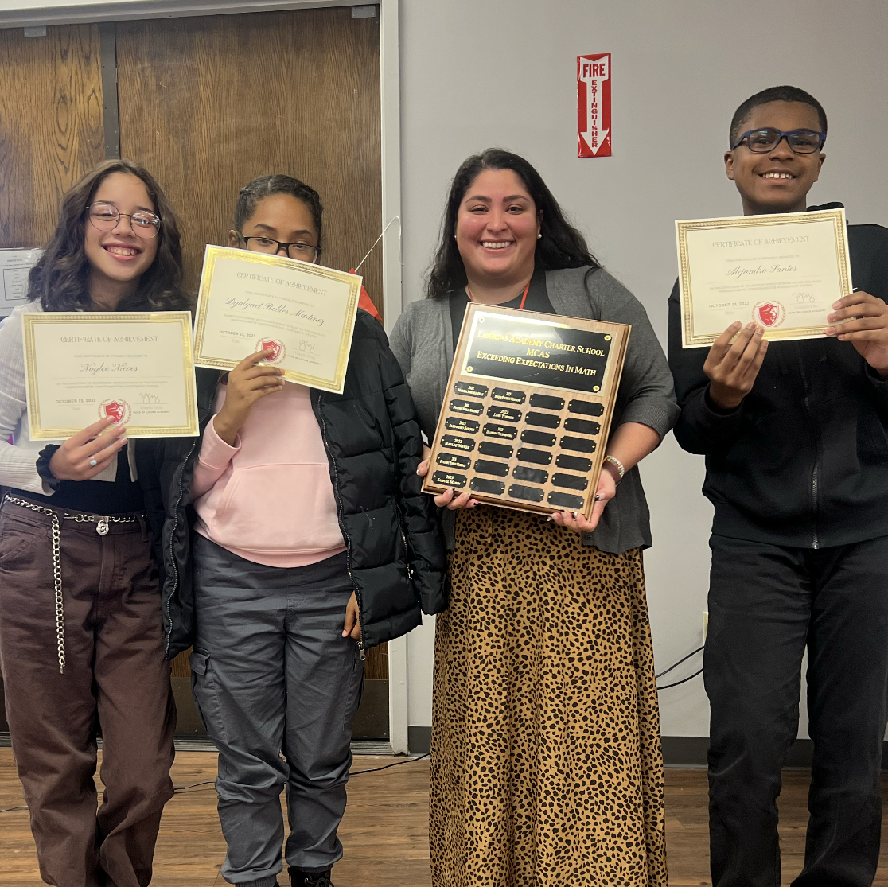
WHAT MUST BE IN Q2
MAXIMIZING COACHING EFFORTS
Leaders need to set their calendars weekly to maximize who and what they are coaching + I need to be religiously giving feedback/spot checking
Data needs to drive strategic decision making
Action Plan tracking needs to be made visible to YC regularly
CULTURE TEAM NEEDS TO BE PUSHED OR CHANGED
We need culture to stabilize and squash non-negotiables now
Culture team needs to more effectively set the bar and shut-ish down
Changes need to be made if culture doesn’t stabilize or sustain by 11/9
GET CO-TEACHING RIGHT
Special ed teachers need to be receiving active coaching on their supports of students in classroom
We need to apply the same data and feedback practices to special supports teachers
We need to urgently + consistently close gaps through co-teaching walk-thru weekly

Slide 25
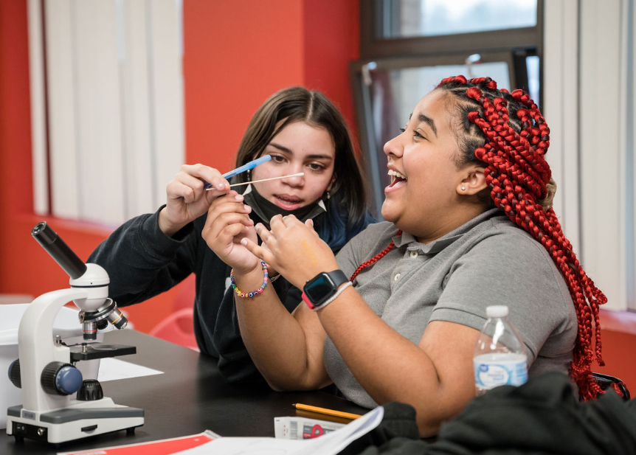
Upper Academy
2023-2024

Slide 26
Q1 Data

Slide 27
Q1 Culture Data
Bright spots worth celebrating?
Gaps we must address in Q2?
Story of our school?
Notes:
Now we are going to look at our Q1 Culture Data. The questions we are thinking about are the same.
I will stay on these slides a little bit longer.

Slide 28
Q1 Advisory Data
GOAL = 80% of advisories at 6/8 on Advisory Rubric
Grade | # meeting GPA Goal | # meeting Attn Goal | # meeting HW Goal | # meeting SI Goal | # meeting 6/8 goal
Grade 9 | 4 | 3 | 1 | 6 | 2
Grade 10 | 3 | 4 | 0 | 6 | 2
Grade 11 | 1 | 1 | 0 | 5 | 1
TOTAL | 8/23 | 8/23 | 1/23 | 17/23 | 5/23

Slide 29
Chronic Absenteeism
GOAL = Less than 7.5% (17 students)
 | Aug % | Aug # | Sept % | Sept # | Oct % | Oct # | YTD % | YTD # | < 70% ADA
Grade 9 | 9% | 9/91 | 38% | 35/91 | 7% | 7/91 | 18% | 17/91 | 4/225 Josten, Jahmir, Joniell, Luis
Grade 10 | 4% | 3/66 | 31% | 21/66 | 9% | 6/66 | 10% | 7/66
Grade 11 | 10% | 7/68 | 30% | 21/68 | 5% | 4/68 | 11% | 8/68
Total | 8% | 19/ 225 | 34% | 77/ 225 | 7.5% | 17/ 225 | 14% | 32/ 225
Notes:
From 22% at end of Q1 to 12% now.

Slide 30
ADA
GOAL = 92% ADA
 | August | September | October | YTD (data is through 10/23)
Grade 9 | 98% | 92% | 96% | 94%
Grade 10 | 99% | 94% | 96% | 95%
Overall | 99% | 93% | 96% | 95%
# of students with 100% ADA:
58/225
Notes:
94% = same as end of Q1

Slide 31
Advisory & Attendance Headlines
ADVISORY: Our student survey results show our students know we care! However, we have a serious HW crisis.
Fix = Upping coaching during advisory specifically targeting goal setting. Advisors should be creating goals that are tailored to each student and what is their most immediate need. Goals should not just be focused on GPA. Attendance and HW are also big parts of your advisory scorecards We are rolling out HW trackers at the start of Q2 instead of using GPA trackers.
ATTENDANCE: Our ADA is consistently above 92%. This is really a team effort and I could not have done any of this without Gibbs, Skia, and Liz.
For every failure, we created a solution to the point where we have little to no failures in regards to ADA. Thank you!
CA: As we got the attendance up and running Chronic Absenteeism took a hit (@30% 3 weeks ago), but thanks to the dedication of the DCD, Bena, and Anderson we are making significant progress (now @14%). For our CA kids, we now really need the help of advisors who have good relationships with families and students to get kiddos in the building

Slide 32
ISS
GOAL = Less than 15% (33/225 students)
Students with ISS:
Ezra A.-9th
Angel S. - 9th
Josh H. - 9th
Victor-10th
Jahmir - 10th
Sanyae - 10th
Jaysiah - 10th
Shally - 10th (W)
Josiah A-11th
Juel - 11th
Kavrynne - 11th
Jonelys - 11th
Khalil P. - 11th
Luis U. - 11th
 | August | Sept | Oct | YTD
Grade 9 | 0 | 0 | 3 | 3
Grade 10 | 1 | 2 | 2 | 5
Grade 11 | 1 | 7 | 1 | 9
Overall | 2 | 9 | 6 | 17
Notes:
Teacher reads

Slide 33
OSS
GOAL = Less than 8% (18/225 students)
 | August | Sept | Oct | YTD
Grade 9 | 0 | 0 | 2 | 2
Grade 10 | 1 | 0 | 2 | 3
Grade 11 | 0 | 0 | 0 | 0
Overall | 1 | 0 | 4 | 5
Students with OSS:
Mason N.-9th
Joniell - 9th
Alex R. - 10th
Jariel - 11th
Notes:
Teacher reads

Slide 34
Q1 Operations Data
Bright spots worth celebrating?
Gaps we must address in Q2?
Story of our school?
Notes:
Now we are going to look at our Q1 Culture Data. The questions we are thinking about are the same.
I will stay on these slides a little bit longer.

Slide 35
Family Survey Data- ALL GRADES UA
Favorability Goal for Priority Questions: 80% or higher
Families Rating LACS B or Higher School: 72.32%
Families Rating LACS C or below: 27.68%

Slide 36
Family Survey Data- ALL GRADES UA
Favorability Goal for Priority Questions: 80% or higher
Favorability Goal Not Met on any Priority Questions

Slide 37
MCAS Achievement (~15%)
9th Grade Bio Meeting/Exceeding
9th Grade Bio Partially Meeting+
10th Grade Algebra Meeting/Exceeding
10th Grade Algebra Partially Meeting+
10th Grade ELA Meeting/Exceeding
10th Grade ELA Partially Meeting+
Equity (20%)
Compliance Percentage
% of scholars with an IEP achieving a GPA over a 2.5
% of students meeting progress target on ACCESS
% of Students with 1 or more OSS
% of Students with 1 or more ISS
% Student Choice Attrition
Equity marks met on 10 priority metrics
8th-9th Total Matriculation @ LACS
Culture & Investment (10%)
% of advisories at the strong threshold
Chronic Absenteeism
Student Attendance
OPS Excellence (5%)
Walkthrough Excellence
Parent Survey Ops Priority Q's
Parent Survey Completion
Event Excellence (10 events)
Talent (7.5%)
Teacher Retention
Org Health (avg across priority q's)
GOALS
GPA & College (15%)
Students with GPA ≥ 2.0
Students with GPA ≥ 2.5
Students with GPA ≥ 3.0
Students with a GPA 4.0+ are enrolled in a Pre-College Program
Students with a GPA 3.0+ are enrolled in a Summer Experience
SAT (8%)
% of students at/above 500 in EWR
% of students at/above 500 in Math
% of students meeting their Spring SAT Growth Goal
AP Achievement (20%)
AP Human Geography at/above 3
AP World History at/above 3
AP Seminar at/above 3
AP Language at/above 3
AP US History at/above 3
AP Pre-Calculus at/above 3
AP Statistics at/above 3
# of all students passing 1+ AP exam

Slide 38
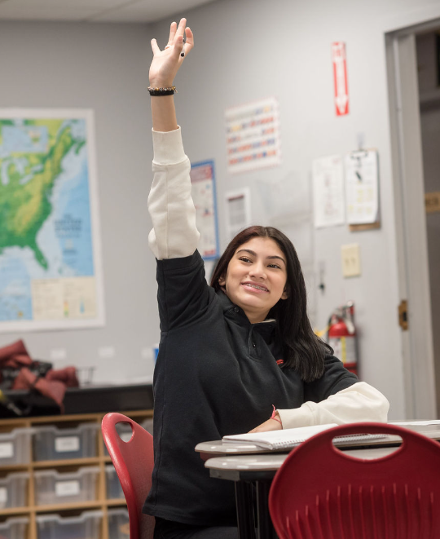
HIGHLIGHTS
TALENT/INFLUENCE OF COLLEGE TEAM IN DRIVING SUCCESS TOWARDS GOALS
GPA in 9th
Chronic Absenteeism reset
CCR planning for 11th grade
College & Career Fair + Rep Visits
SHIFT IN ADVISORY IS PALPABLE
Data doesn’t yet reflect us winning on advisory, but the shift in how the start of the day feels in terms of scholar focus and investment is palpable
Affirms we have the right structure in place, now we need to put pressure on the right spots to get movement

Slide 39
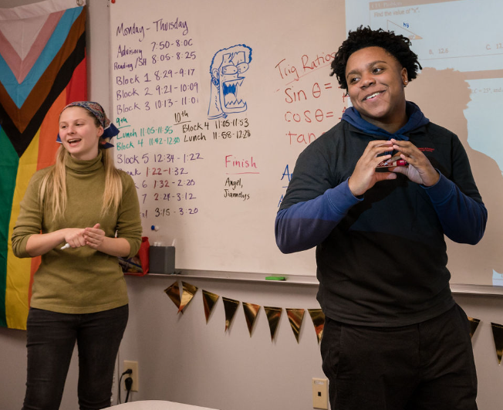
CHALLENGES
STAFF CULTURE
Higher turnover
Several staff members not meeting expectations and polluting the water
The way our principal shows up in terms of setting the standard AND authentically connecting with staff lacked purpose in the first 4 weeks of the school year.
INCONSISTENT UA CULTURE
Some days, classes and culture look strong. Other days, classes and culture look weak. We are not consistently a school where kids are focused and learning.
It is too easy for kids to opt out of learning. Staff are focused on the inputs and not the outputs.
Notes:
Culture is better than last year.
Better behaviorally, but teachers are not pushing academically. LASW audits reflect that. It will improve if we do that more.

Slide 40
GOALS ON TRACK w/ REFLECTION
DATA POINT | STANDING | REFLECTION
AP Lang | 79% passed IA1 | This is encouraging, and speaks to the intellect and skill of the top third of the 11th grade class. Not taking the foot off the gas though since the FRQs on this exam were reflective of AP FRQs.
Geometry | 38% M/E on IA1 | Encouraging given Zahir is new. However, cannot be complacent because of surprise in not meeting MCAS goal last year. Making shifts to get Giovo in that class more.
AP Stats | 100% passed IA1
Compliance | 93% (solid) | This has been a strong point, which is awesome! Having a dedicated team has allowed us to win so far.
ADA | 95% (92% goal) | Mike and Gibbs collaborated to get this right - both are invested and relentlessly followed up until the system was working.
Event Excellence | 1 event, met goal | Gibbs’ talent and skill as the event guru allowed us to hit our PRN attendance goal for the first time in UA history
Parent Survey Comp | 90% | We have a solid strategy that worked in years past, and it worked again, due to hustle of Ops team
Org Health | 85% | This was the end of September, so we need another data point ASAP to get an additional pulse check ahead of December. No surprises.

Slide 41
GOALS OFF TRACK w/ REFLECTION
DATA POINT | STANDING | REFLECTION
AP History (all) | Poor | I have deprioritized this in the spirit of pushing in other areas. There are small things I need to do to get this back on track (proven to work in past years)
MCAS ELA | Poor (18%) | I need to free up Phelipe to truly prioritize this. AND I need to help Phelipe unlock himself so he can recognize when he is being pulled from this and name it for me.
AP Seminar | Develop (29%) | Create low lift / high leverage systems that Phelipe can execute to get this on track while focusing on MCAS.
MCAS Biology | Develop (30%) | Staffing change - Doig is taking over, I need to increase my support for her.
GPA + IEP GPA | Develop | 52%/73%/90%/59% - Focus must be scholars with IEPs. Strong growth in 11th.
SAT | Poor (no data) | No authentic data point, testing happening next week for 1st true data point.
Advisory | Poor (11/20) | Something is wrong with how we reflect and report out - need a stepback with Rochelle to reimagine this.
Chronic Abs | Poor (15%) | We need a dedicated team. Rochelle and Mike have the right structures and drive.
ISS | Off track (7.5%) | I need more visibility into proactive work - we have had moments of success with proactive that has prevented issues, we need more of that. For that to happen, I need visibility.
OSS | Off track (2%)
Attrition | Off track (4%) | Shali, Jerlaine, Zeriahlee, Josue, Alexiany, Yadiel, Eniyah, Celine. Keep tapping in the right adults for convos (alongside myself). Get better at creating alignment among staff (standard + connection) to prevent gaps that lead to attrition.
Parent Survey Priority | Develop (72%) | With data in, report out on changes and create the narrative with families that we listen and change based on their feedback.
ACCESS (ELL) | Poor (20%) | More data points after implementing consult model - get visibility into this so I can adjust as needed.
Notes:
ELL = (25% = 9th/27 = 10th; 8 = 11th)
ISS, CA, Advisory
Teacher attrition

Slide 42
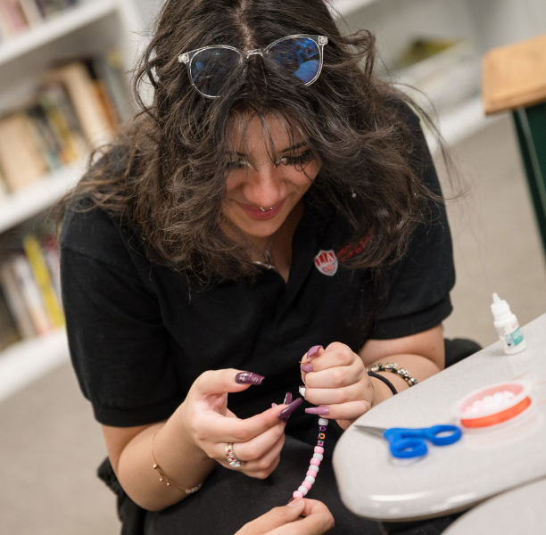
WHAT MUST BE IN Q2
AJ HAS TO BE RELENTLESS IN RESETTING THE SALT SHAKER AND CONNECTING (PRO/REAC) W/ ADULTS TO DRIVE ALIGNMENT + SUCCESS
Spike in both, be intentional in who I am connecting with
ADULTS MUST BE HELD ACCOUNTABLE FOR FOCUSED, AUTHENTIC LEARNING IN THEIR CLASSROOMS
Too easy to opt out of learning
Leaders must hold their teachers accountable for data & 100% minds on
I must hold leaders accountable and staff accountable
WE HAVE TO SEE PROGRESS IN 11TH (GPA, INVESTMENT, SAT)
Staff must row together to do whatever it takes to address 11th grade gaps
GPA Meetings, Advisor Meetings, SAT Team Meetings, meetings with Holladay
Notes:
Talking to adults - this is what we are about. get on board.

Slide 43
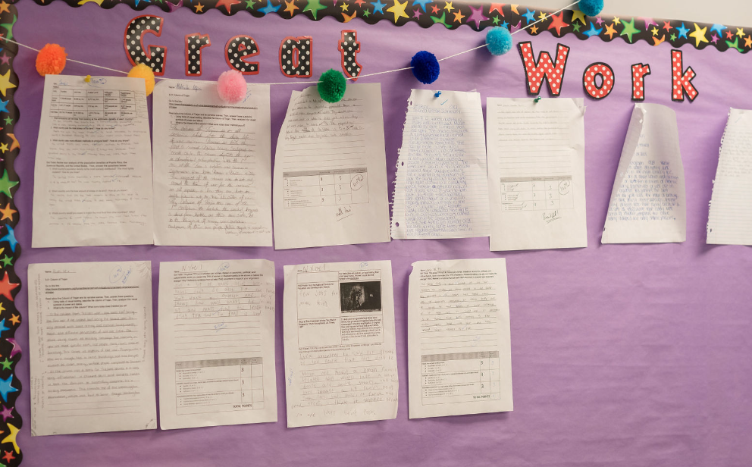
SCHOOL CULTURE + STUDENT SUPPORTS
2023-2024

Slide 44
HIGHLIGHTS
APPROACH TO STAFFING
COMPLIANCE TEAM
Clear R+ R → Meaningful coaching of case managers to ensure strong IEPs/504s are written; Consistent accountability for related service providers
Strong Communication + Teamwork → Proactive planning and collaboration to prevent a significant number of students out of compliance
Created the conditions to shift thinking to authentic compliance
PROACTIVE VS. REACTIVE CULTURE
Increased bandwidth for deans and associate deans which has led to greater ownership
Improved outputs (CA = 22%; OSS = 5 2 grades; 4 - 3 grades; ISS = not tracked; CP is significantly smoother)

Slide 45
CHALLENGES
INVESTMENT IN CULTURE SYSTEMS
System Fidelity Feedback IN THE MOMENT - me, leaders, DCD
Absence of mindset coaching when data reveals folks are opting out
MEANINGFUL CHANGES FOR SPECIAL SERVICES
Made a mistake of deprioritizing ELL services and authentic compliance until October
Balancing urgency and thoughtfulness with changes <too much time brainstorming vs. outlining non-negotiables and executing on them>

Slide 46
WHAT MUST BE IN Q2
PRIORITIZATION
SPECIAL EDUCATION: We will lose on our compliance goal if we are not more intentional about moving up IEP/504 meetings; I need to temporarily lean in and show Katherine how to more thoughtfully respond to request for initial evaluations; initials can’t trump re-evaluations
ELE: How do I make Brenda a super invasive coach leading up to ACCESS?
DCD SKILL BUILDING
SYSTEM FIDELITY → JP + JM = Eye for inconsistent usage; RS = Comfort in giving feedback in the moment; PO = Follow up after feedback
ADVISORY
Put more ownership on MV
Keep the heat up on leader coaching
Improve peer-to-peer feedback during GLT on Fridays to ensure meaningful action plans
Notes:
Talking to adults - this is what we are about. get on board.

Slide 47
LEADERSHIP LEARNINGS
PROACTIVE PLANNING
I’ve been stronger about delegation to somewhat increase my capacity but I still overschedule my time and don’t get to the balcony to answer the question: WHAT DO I WANT THIS TO TRULY LOOK LIKE?
I NEED TO LET PEOPLE THINK + FAIL
I too often provide a safety net and rob folks from the opportunity to learn from their mistakes
I have a tendency to be overly prescriptive in my expectations - cripples folks capacity and confidence

Slide 48
Strategic Plan Overview
Purpose: During the 2022-23 school year, Libertas Academy Charter School will draft and ratify a 4-year strategic plan designed to build upon the existing strengths and improve the overall program. We exist so that students learn and grow so they can maximize their individual potential.
Our strategic seeks to answer the following questions related to the core of our mission:
What should our students achieve?
How well are they achieving at present?
How well do we want them to achieve?
Notes:
Presentation (7 minutes)
Focus question: “To what extent do the themes and goals achieve the stated purpose of our strategic plan?”
Clarifying Questions (5 minutes)
Clarifying questions regard matters of fact.
Substantive issues are saved for later in the protocol so please make sure that clarifying questions are really clarifying.

Slide 49
LACS Strategic Plan 2023-2027
1 | We will prepare our students for a successful post-secondary transition that focuses on college access as a pivotal step toward career success.
2 | We will dramatically increase student achievement performance.
3 | We will recruit, develop, and retain highly effective teachers.
Notes:
448 is our target.

Slide 51
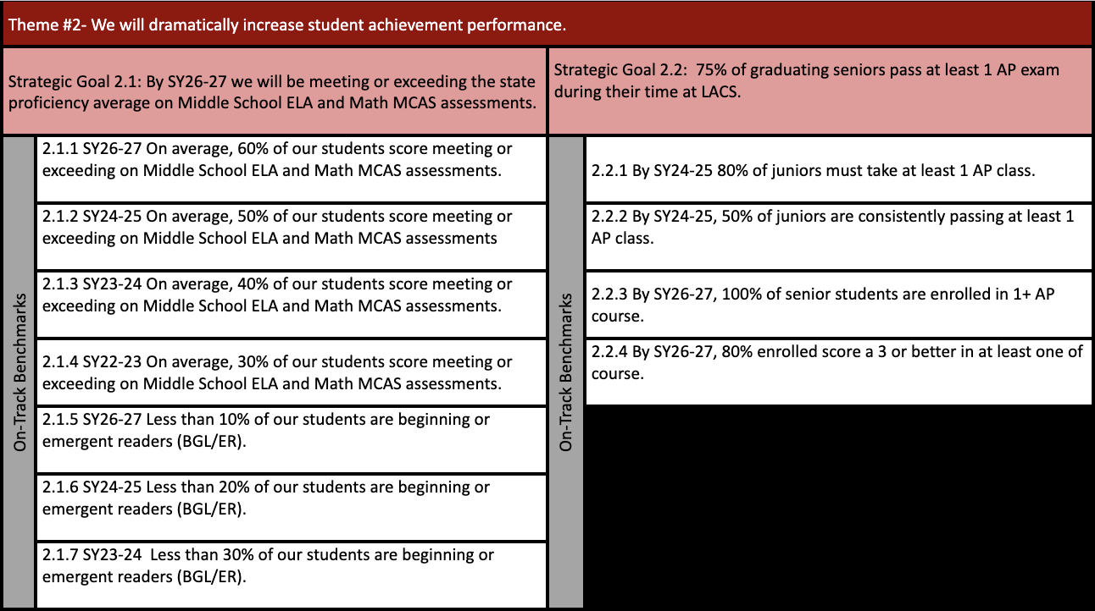

Slide 53
LACS Strategic Plan 2023-2027
While we know that schools are complex organizations and that a lot goes into running an effective school, the themes and goals outlined are the most mission-critical priorities over the next 4 years. We believe that by getting these three themes right, we will be one step closer to fulfilling our mission of preparing our students for post-secondary success.
Notes:
448 is our target.

