Slide 1
School Update

Slide 2
MISSION
Through rigorous academics, character development, and strong supports for every learner, Libertas Academy Charter School prepares all sixth through twelfth grade students to succeed within the college of their choice and to be positive, engaged members of their communities.

Slide 3
Core Values

Slide 4
Highlights

Slide 5
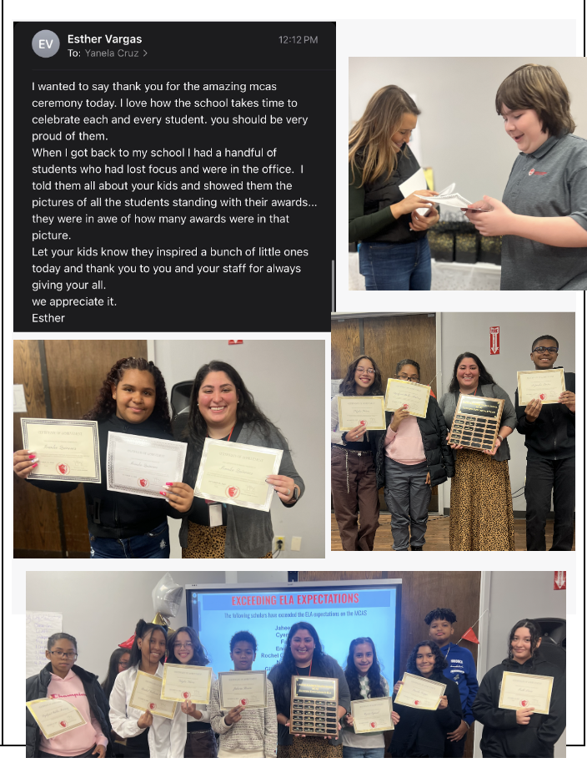
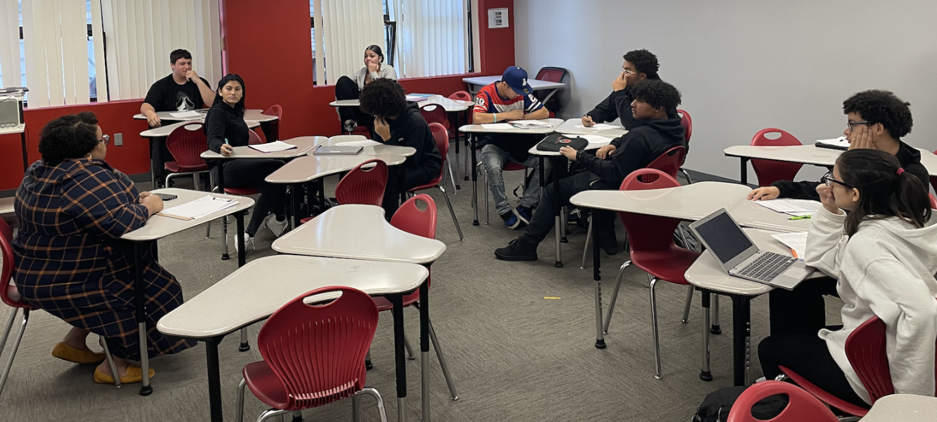
HIGHLIGHTS- Forever Home

Slide 6
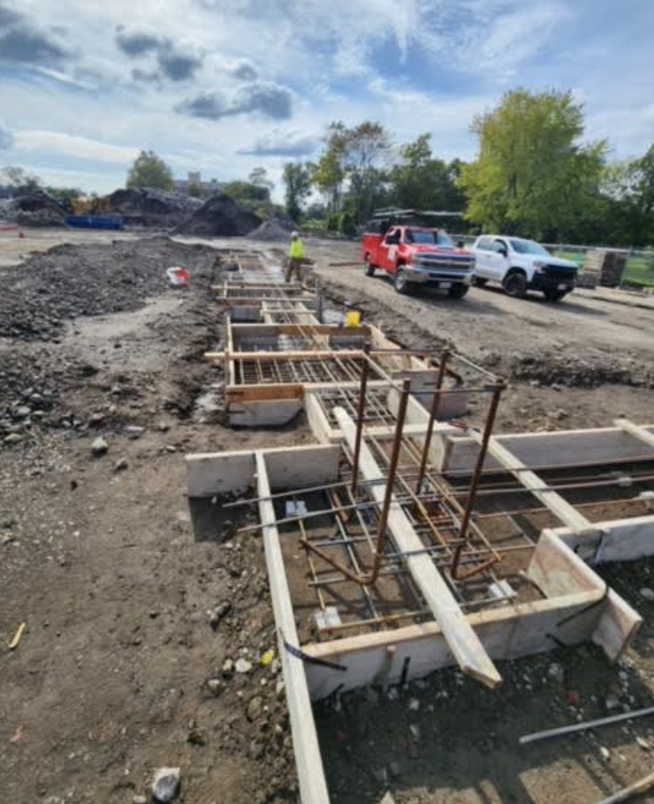
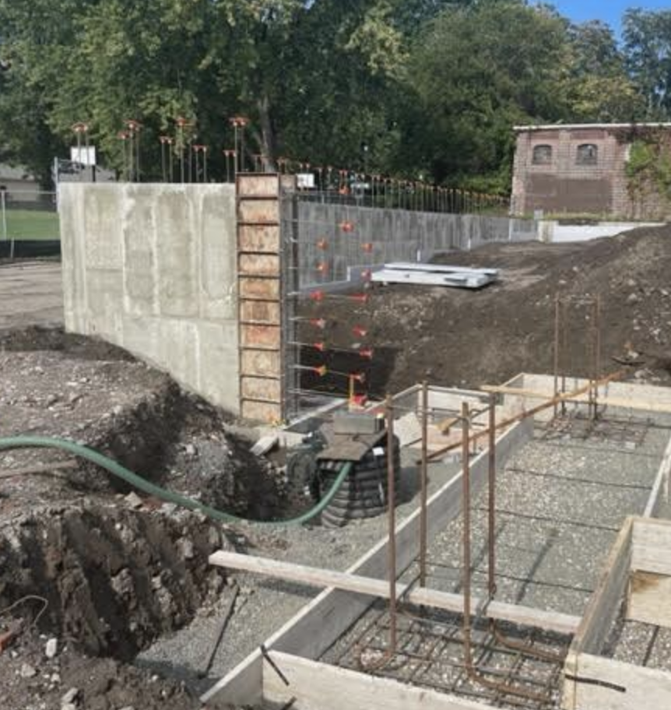
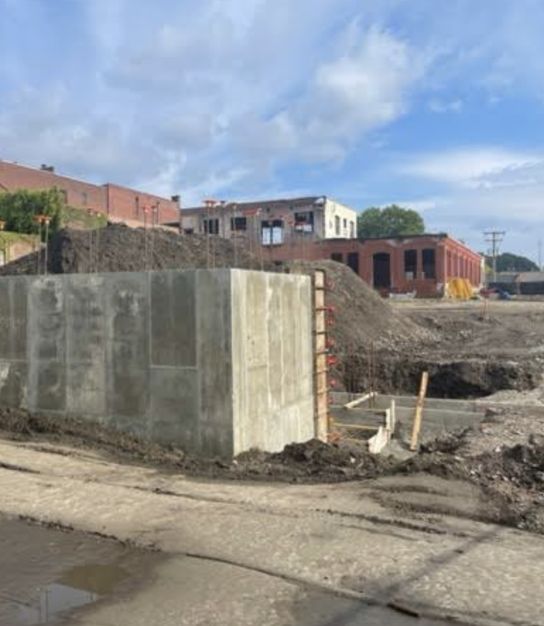
HIGHLIGHTS- Forever Home

Slide 7
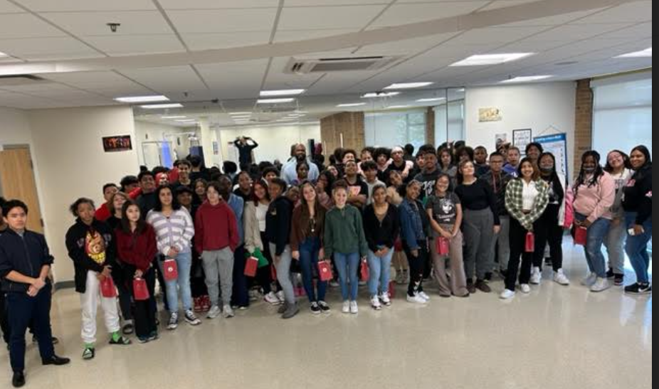
HIGHLIGHTS- Recruitment
Highlights for Recruitment
We are starting the new year strong already have 10 applications for 6th grade.
2. This year we Partnered up with Springfield prep and went to visit their now 8th graders. It was just a positive vist students engaged and asked questions and our presentation was better than Hampden Charter.

Slide 8
HIGHLIGHTS - Talent
New Hires over the last month:
Strategic Community Relationships
-Elms College (meeting held)
-UMASS Amherst (meeting held)
-Smith College (Meeting this afternoon)
Other Organizations
-WayFinders (meeting next week)
-Springfield Pride(pending)
-Boys and Girls Club (meeting next week)
Taionna Pope | Enrichment
Armando Lopez | Teaching Fellow
John Pedraza | BxSpec
Meghan Dushko | ESL Teacher
Emmanuel Ijomah Start date | Teaching Fellow
Echo Council start date | Counselor
Melissa Szumski | Manager of HR and Payroll
Josiris Rodriguez (10/10) | Ops Associate

Slide 9
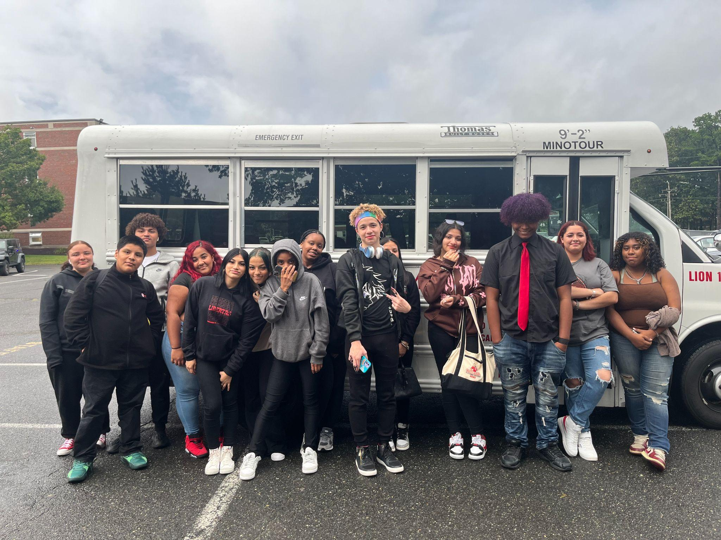
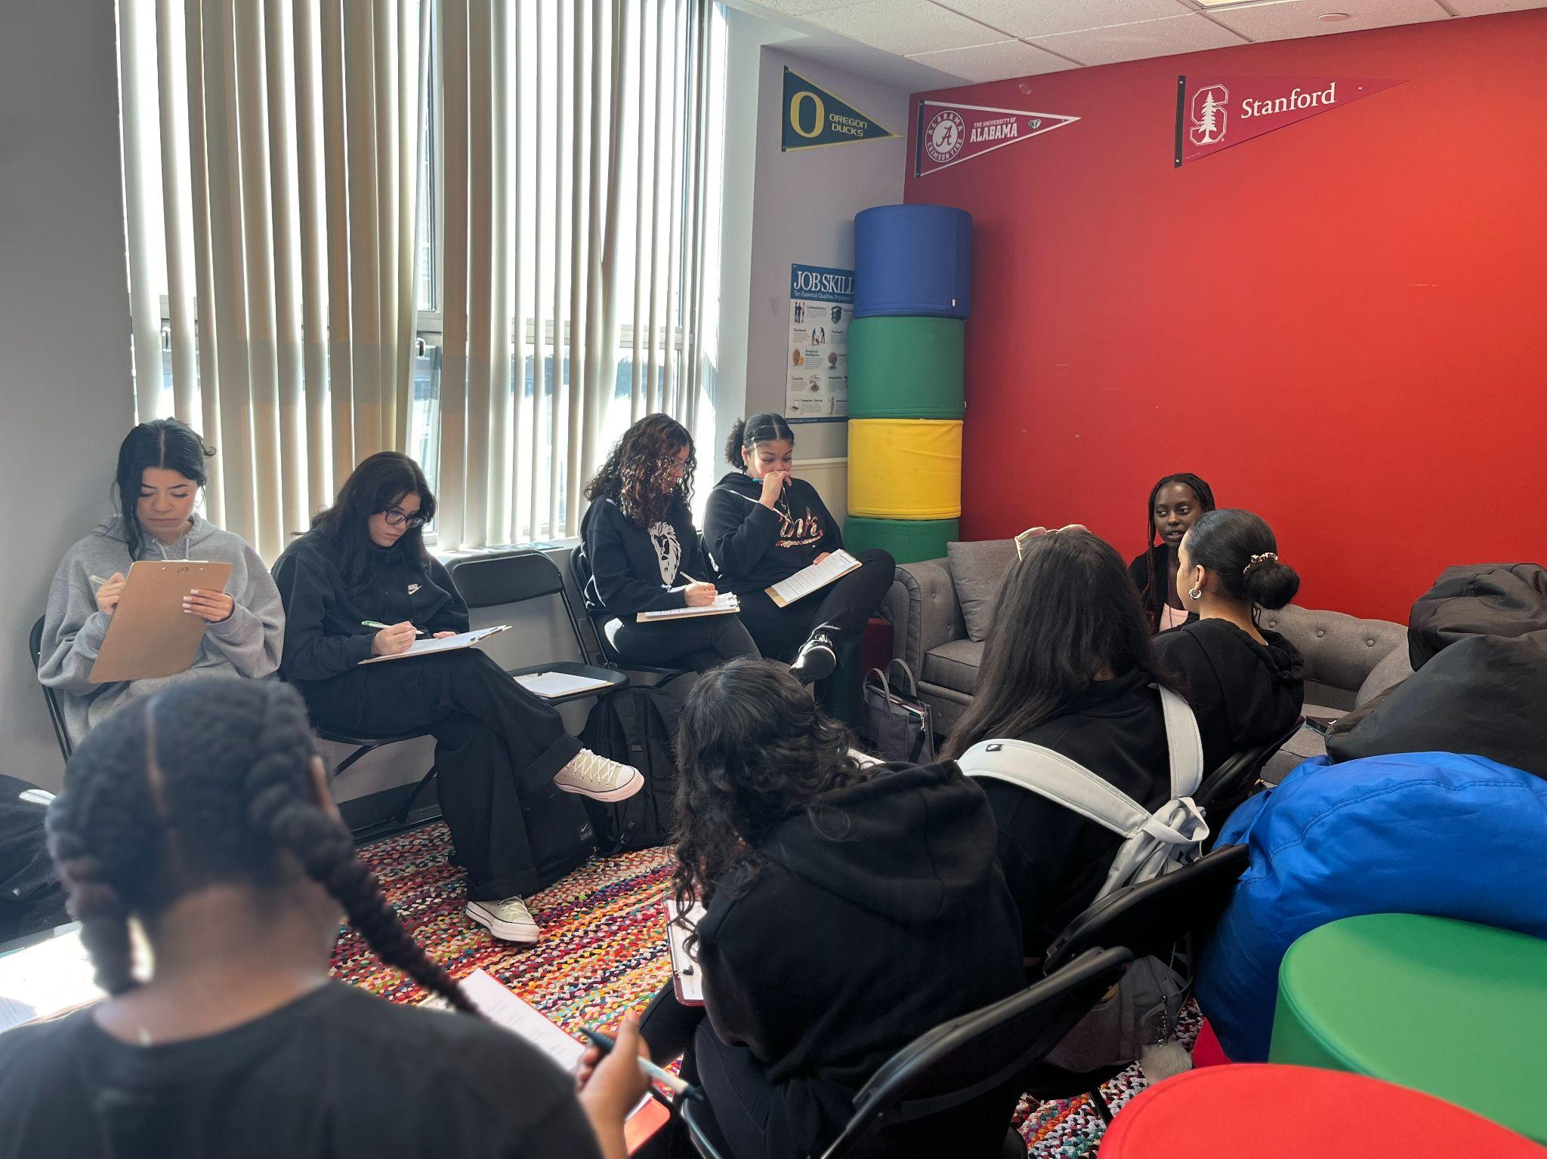
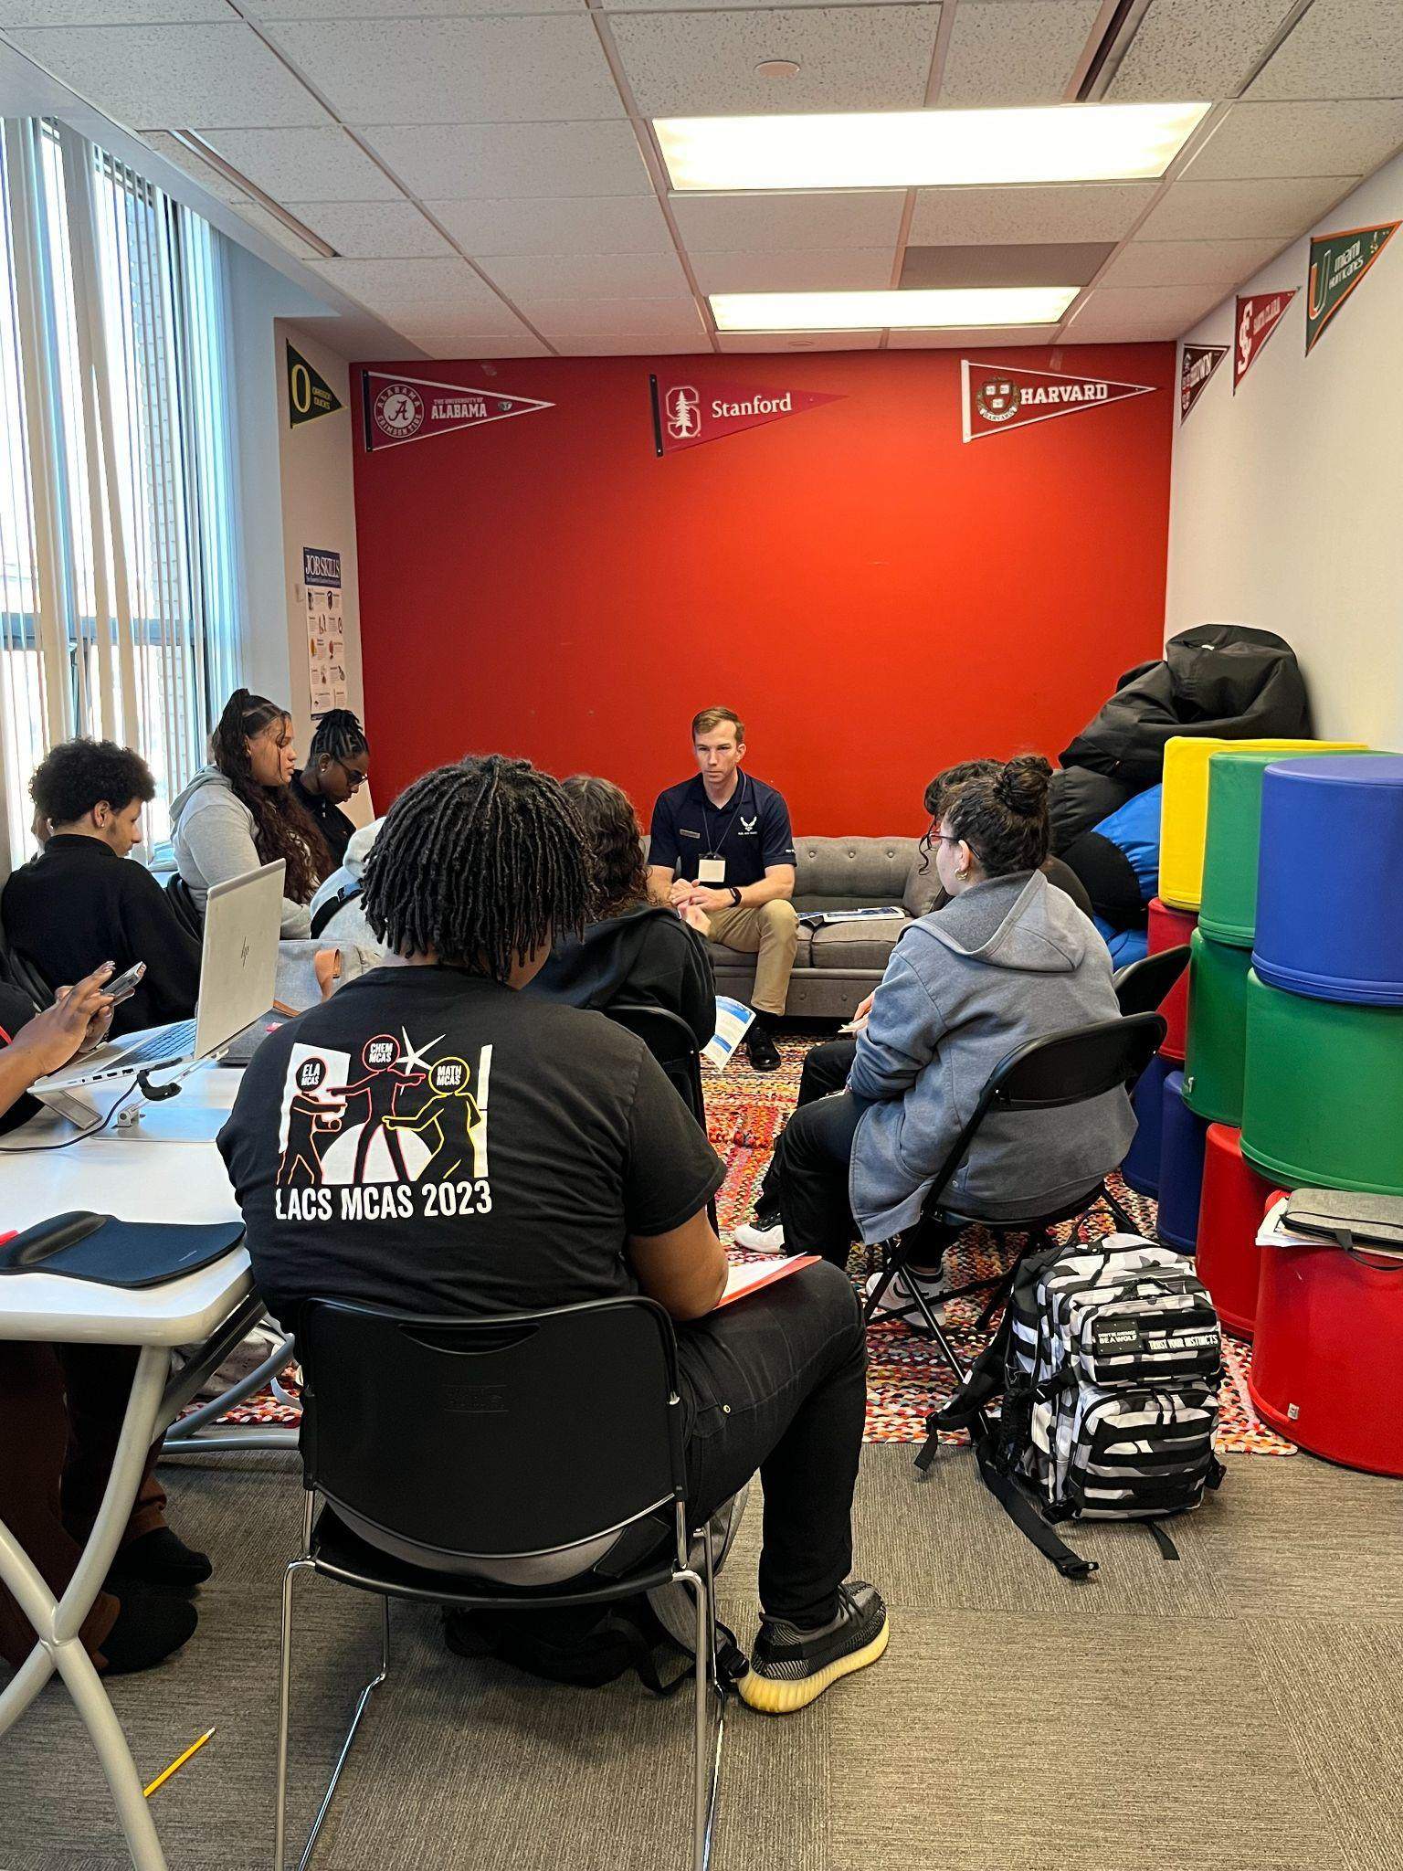
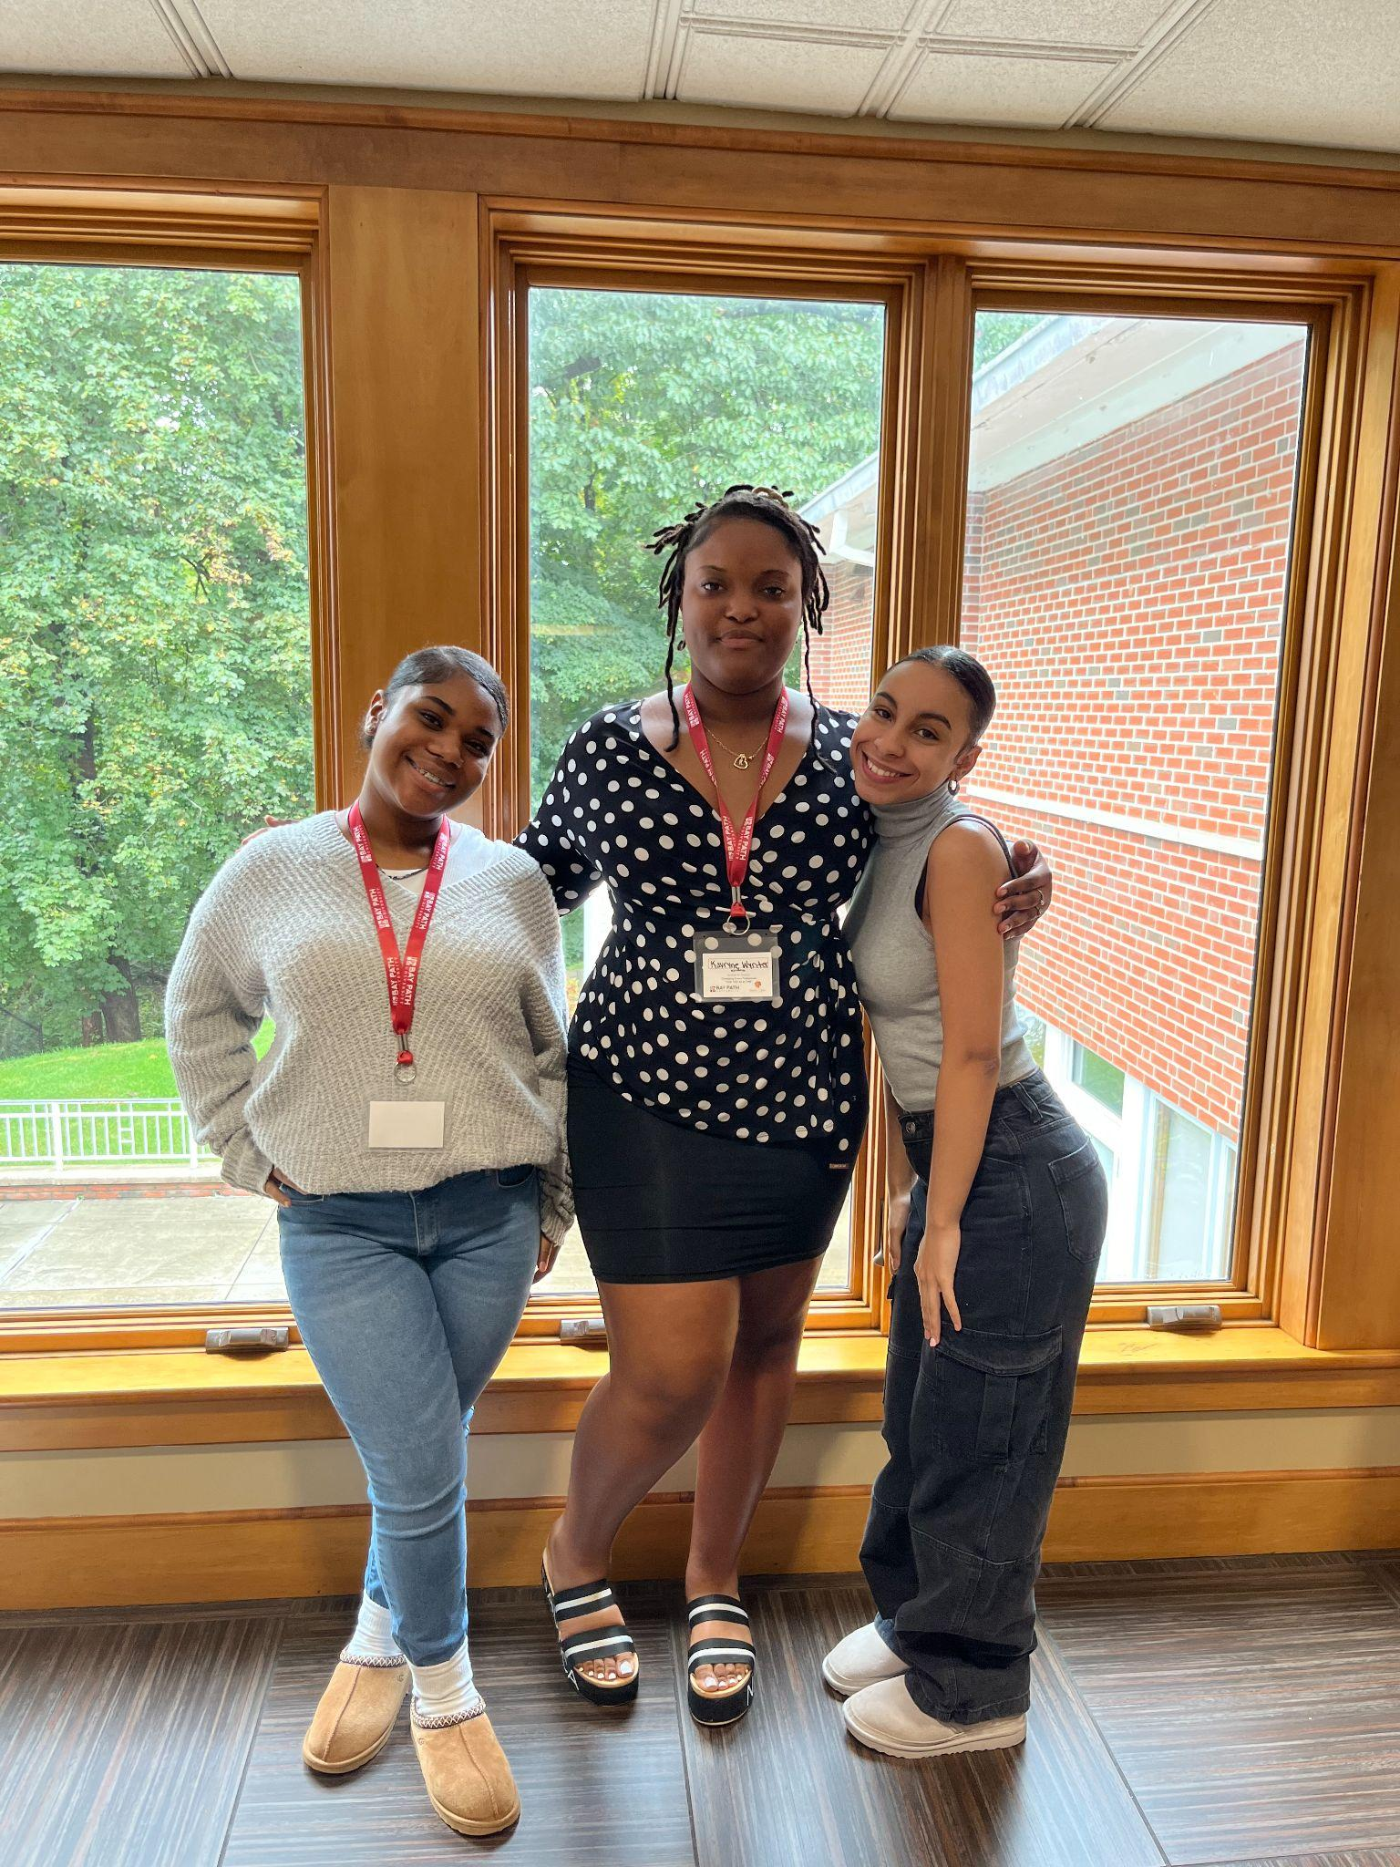
HIGHLIGHTS- College Team
College Fairs
Western New England | September 18 | 6-8pm
LACS | October 24 | 5-7pm | 20 RSVPs so far, final push this week
National Hispanic Fair @ AIC | October 31
College Rep Visits
U.S. Air Force ROTC | Oct 2 | {10}
Hampshire College | October 3 {12}
Western New England | October 16*
STCC | October 23
Worcester State | Oct 26
Bay Path University | Nov 1
College Field Trips
Bay Path | Women’s Leadership Conference | September 30
Westfield State University | November 9
More to come!

Slide 10
Sports we are currently tracking for the 2023-24 SY are:
FALL | WINTER | SPRING
Girls Volleyball | Boys Basketball | Boys Volleyball
Cross Country |  | Track & Field

Slide 11
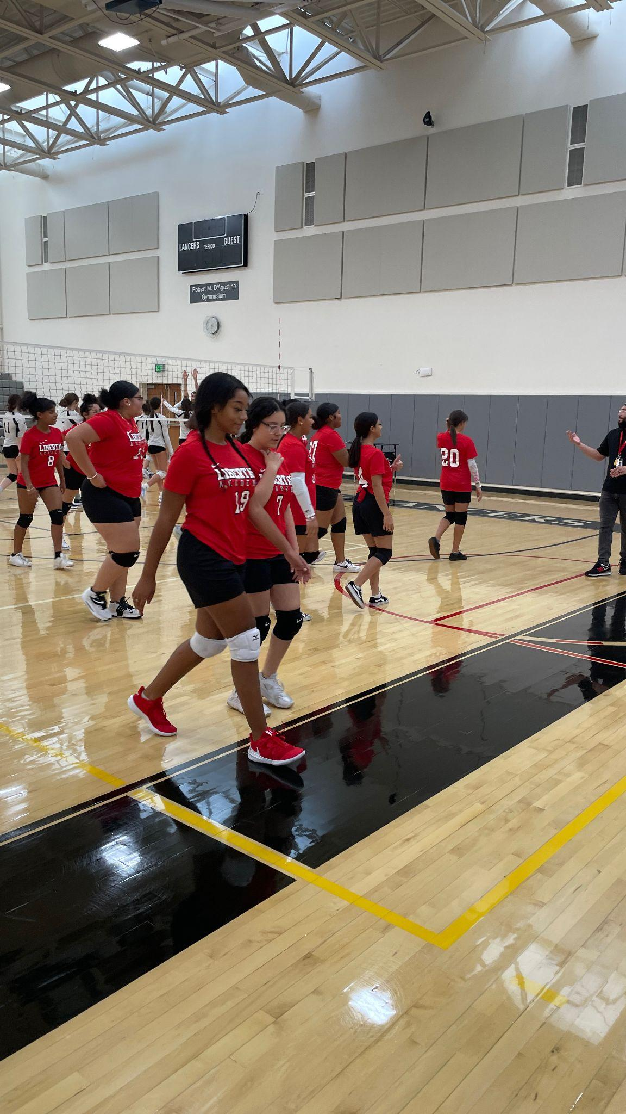
Girls Volleyball
Girls Volleyball currently has 15 participants
The team has an overall GPA of 3.22
They have played 2 games and will play 5 more
They’ve been entered in an end of season jamboree with Hampden Charter (West), PV Christian, SICS, Southwick and Ware

Slide 12
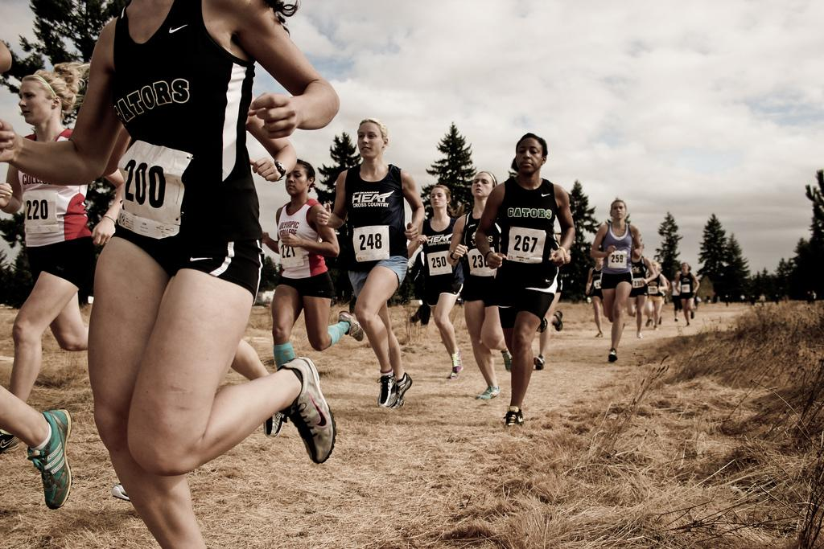
CROSS COUNTRY
X-Country currently has 10 participants (6 Boys and 1 Girl)
The average GPA for the team is a 3.71
Libertas will participate in a X-Country meet in 2 weeks with Agawam and Westfield Tech at Robinson State Park
We are currently looking for 5K opportunities for a community service project

Slide 13
Key School Data

Slide 14
GOALS & DATA - Talent
Current Open Roles Upper Academy:
WOW Resume>Finalist
OPEN | Special Services
OPEN | Seminar 2
OPEN | Spanish
OPEN | Physics
Week of | Resume Submissions | Round 2 | Spark Hire | Finalist | Offer Made | Accepted
9/25-9/29 | 14 | 7 | 5 | 2 | 1 | 1
10/4-10/8 | 13 | 8 | 3 | 3 | 1 | 0
10/11-10/16 | 15 | 7 | 3 | 3 | 0 | 0
Current Open Roles Lower Academy:
Upcoming Finalist Interviews:
Silvia Lopez- UA SST- Tenta 10/18
Stevie Fernandez- Spanish- 10/16
OPEN | ELL
OPEN | ELL
OPEN | SST

Slide 15
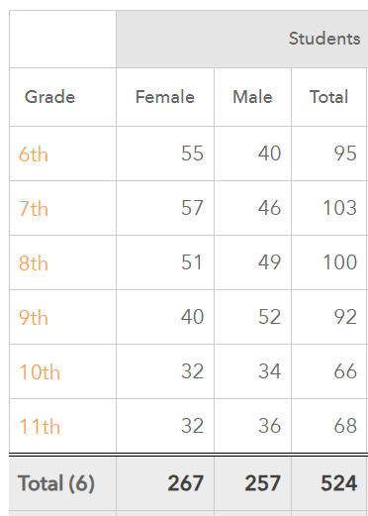
GOALS & DATA- Recruitment
Goal for 23-2024 - 540 students start first day of school.
We are 524 students missing our goal by 16 students
We started with 99- 9th grade students and now at 92
Brought n 3 new 9th grader this month
We started with 80 - 10th and now at 66
Brought in two new 10th this month.
Should be at 529 by the end of Oct.

Slide 16
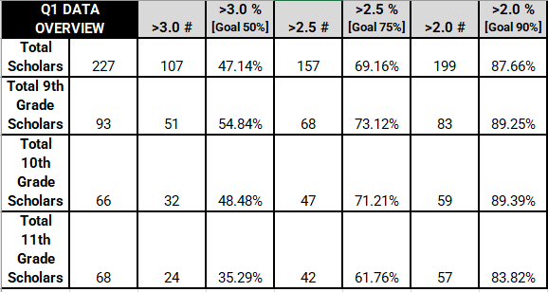
COLLEGE & CAREER READINESS -
GOALS
Most Recent GPA Data (as of 10/16*)
Goal | Metric
GPA | 50% @ 3.0+ 75% @ 2.5+ 90% @ 2.0+
SAT | 40% @ 500+ in EWR 35% @ 500+ in Math 75% meet SAT growth goal
Summer Program | 75% of 3.5 11th graders attend pre-college 75 % of 3.8 10th graders attend pre-college 75% of 4.0 9th graders attend a pre-college
PSAT | 35% @ 500+ in EWR 30% @ 500+ in Math
Essay | 90% of Juniors have a 1st draft by June 1
LOR | 100% of Juniors w/ 3.5+ have 1 LOR by June 1
SSR | 50% of Juniors have SSR written by Aug 1
FAFSA | 100% of Juniors have all financial aid docs in by May 1*
College List | 100% of Juniors have a 1st draft college list by June 1
* Gradebooks are due by EOD today
Advisory | Intervention | Office Hours | CST |
Incentives: Club 3.5 | Lunch Study Groups | Homework Pass | Dressdown Pass

Slide 17
COLLEGE & CAREER READINESS - CHALLENGES
11th grade is struggling with their GPAs.
Because of CCR they would have less study hall time than Grades 9 & 10 who can focus on academic work in both advisory & intervention. In response to their need, CCR shifted to more study hall/intervention time.
This does not help students who are over a 3.0 {#} and on track to being admissible to a wide range of colleges, but it does help the students who need more academic support.
As a solution, I have proposed shifting the CCR classes into strategy bands that are more intentional about the needs of students based on where they are academically and based on what their current post-secondary goals are.
Students were already preliminarily grouped based on GPA. They were also given a survey. The results may cause some shifts, and the groups will continue to adjust based on academic improvement & changes in goals.

Slide 18
Lower Academy Big Goals

Slide 19
Upper Academy Big Goals

Slide 20
Strategic Plan Vision Statement
Within our first charter term, we successfully launched our school and are on track to finalize a permanent home for our learning community. Successfully clearing the operational challenges associated with launching a new school is no easy feat and certainly merits a degree of celebration.
We have had some degree of academic success, and in this new charter term, we recommit to academic excellence. We recommit to a mission grounded in preparing our students to succeed in college and career of their choice. The strategic plan outlined seeks to clarify and chart the path forward.
While we know that schools are complex organizations and that a lot goes into running an effective school, the themes and goals outlined are the most mission-critical priorities over the next four years. We believe that by getting these three themes right, we will be one step closer to fulfilling our mission of preparing our students for college and career success.

Slide 22
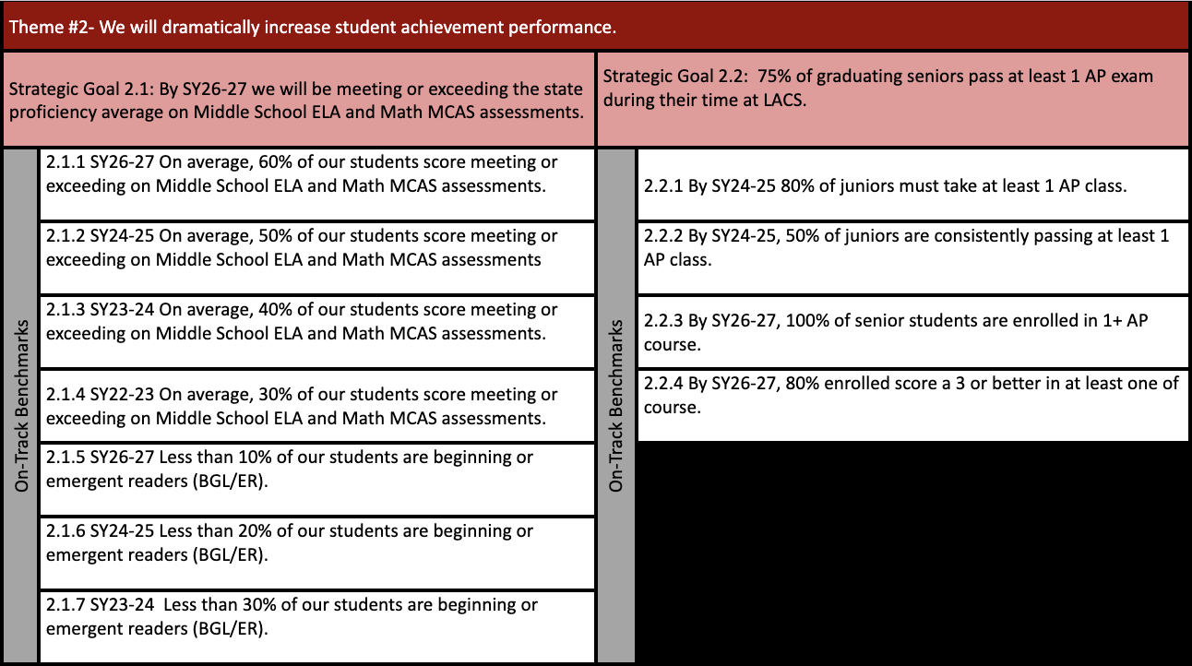

Slide 24
FYIs & Approvals
Approvals:
FYIs:
Annual Audit
Investments
LACS Open House on 11/9 @ 8:30
Hard Hat Tour on 12/6

Slide 25
Upcoming LACS Events
Event | Date | Time
Trunk or Treat Event | 10/20/2023 | 4 to 6 PM
LACS College Fair Owner | 10/24/2023 | 5:00-6:30 PM
Girls Volleyball Games | 10/10, 10/17, 10/24 | 4:30 PM

Slide 26
MISSION
Through rigorous academics, character development, and strong supports for every learner, Libertas Academy Charter School prepares all sixth through twelfth grade students to succeed within the college of their choice and to be positive, engaged members of their communities.

Slide 27
Upcoming LACS Events
Look at school calendar: https://docs.google.com/spreadsheets/d/1GdGJGI4IYizFUWEpR7mSQp9Rwj9N2mT3PPbaaUGFe9Y/edit#gid=1594803582
LA tinyurl.com/FY24LACalendar
UA: tinyurl.com/FY24UACalendar
Look at recruitment events! (Student and Staff)

