Slide 1
School Update

Slide 2
MISSION
Through rigorous academics, character development, and strong supports for every learner, Libertas Academy Charter School prepares all sixth through twelfth grade students to succeed within the college of their choice and to be positive, engaged members of their communities.

Slide 3
Core Values

Slide 4
Highlights

Slide 5
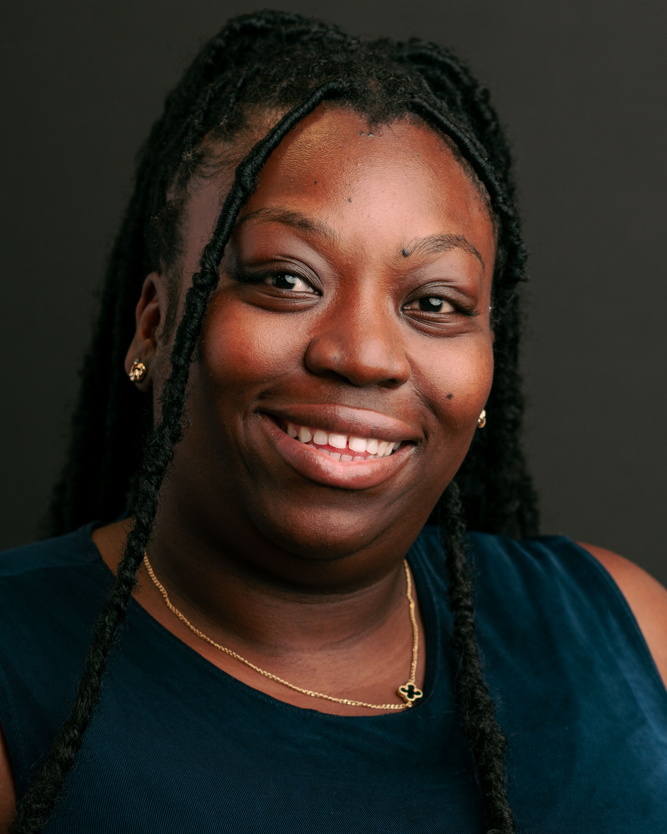
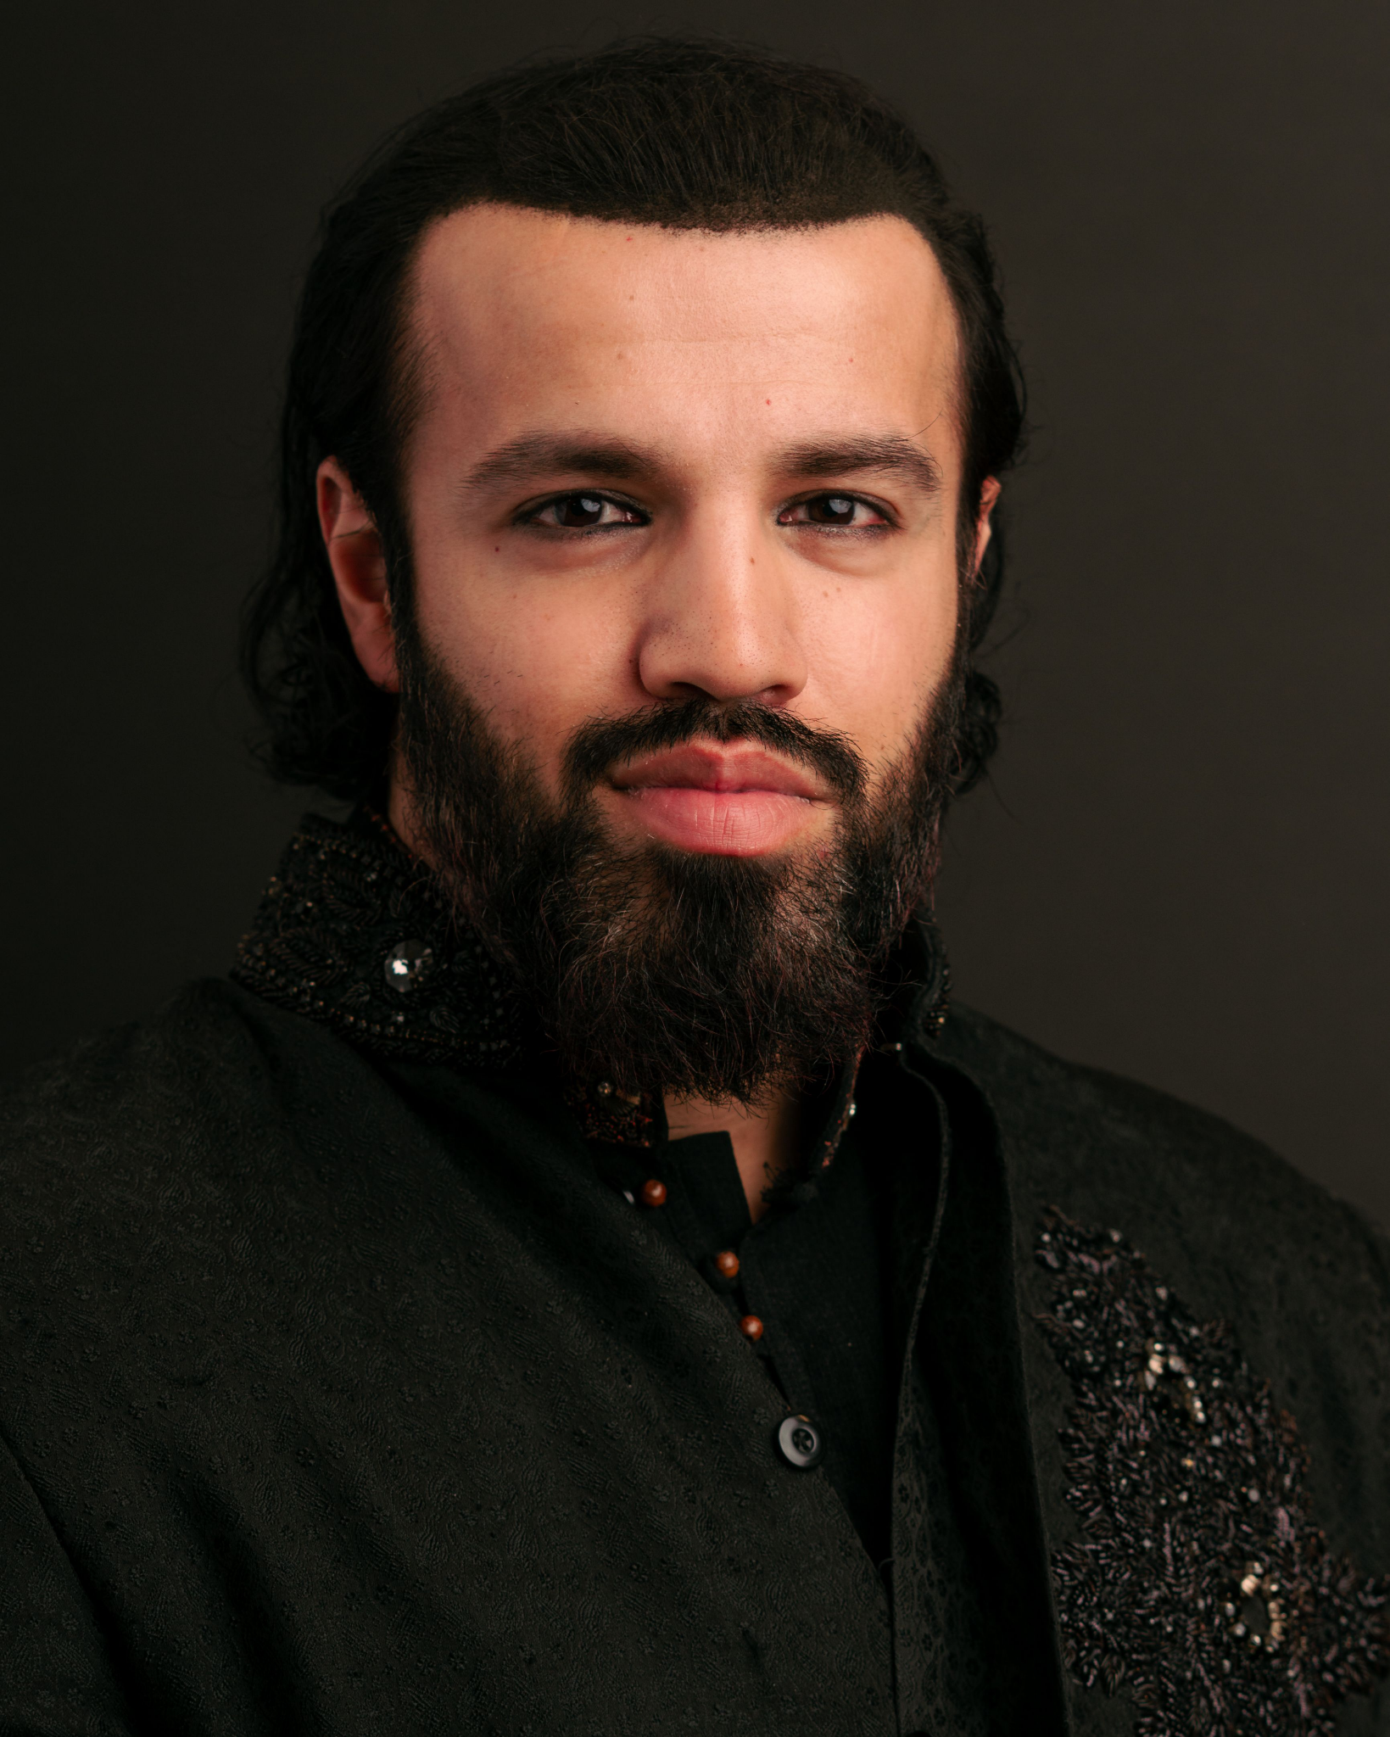
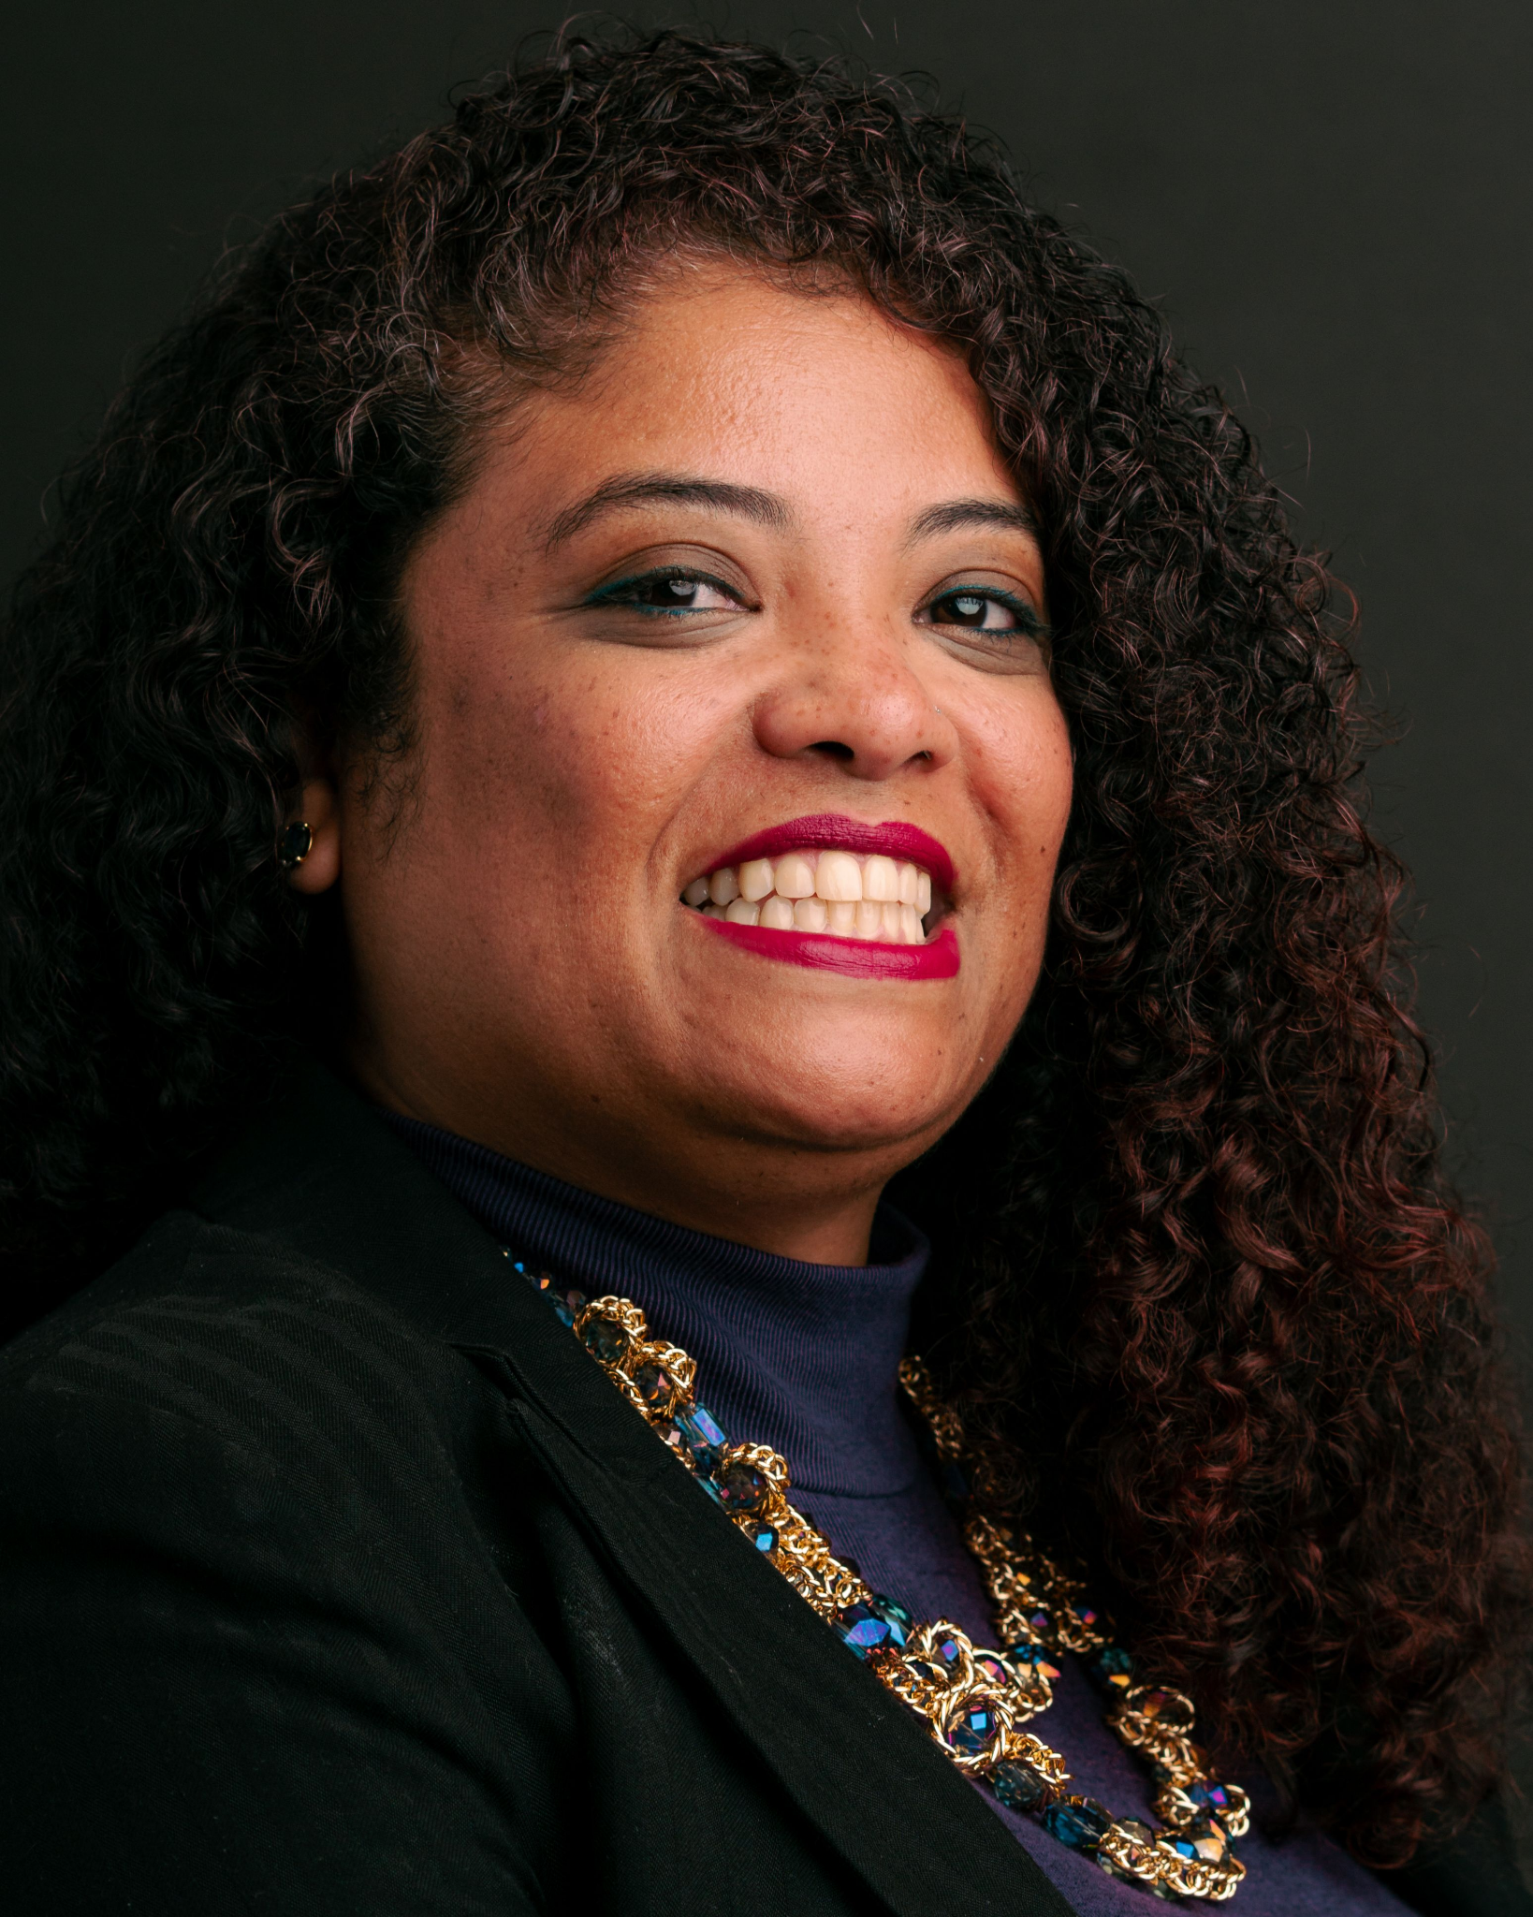
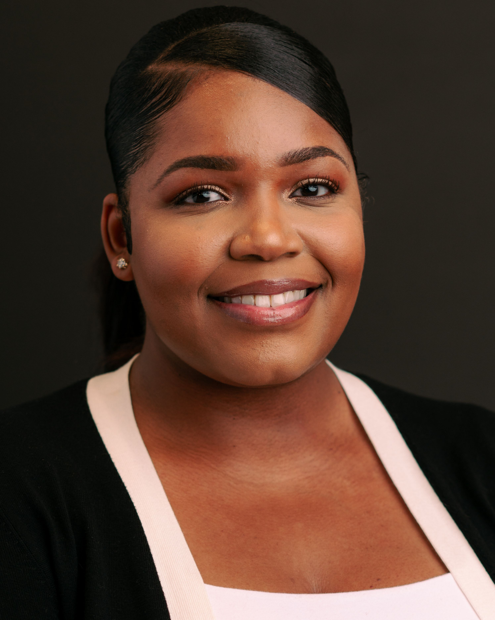
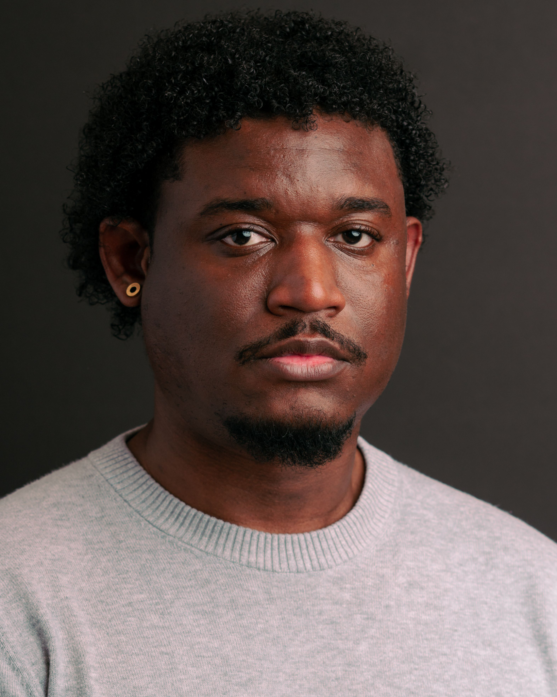
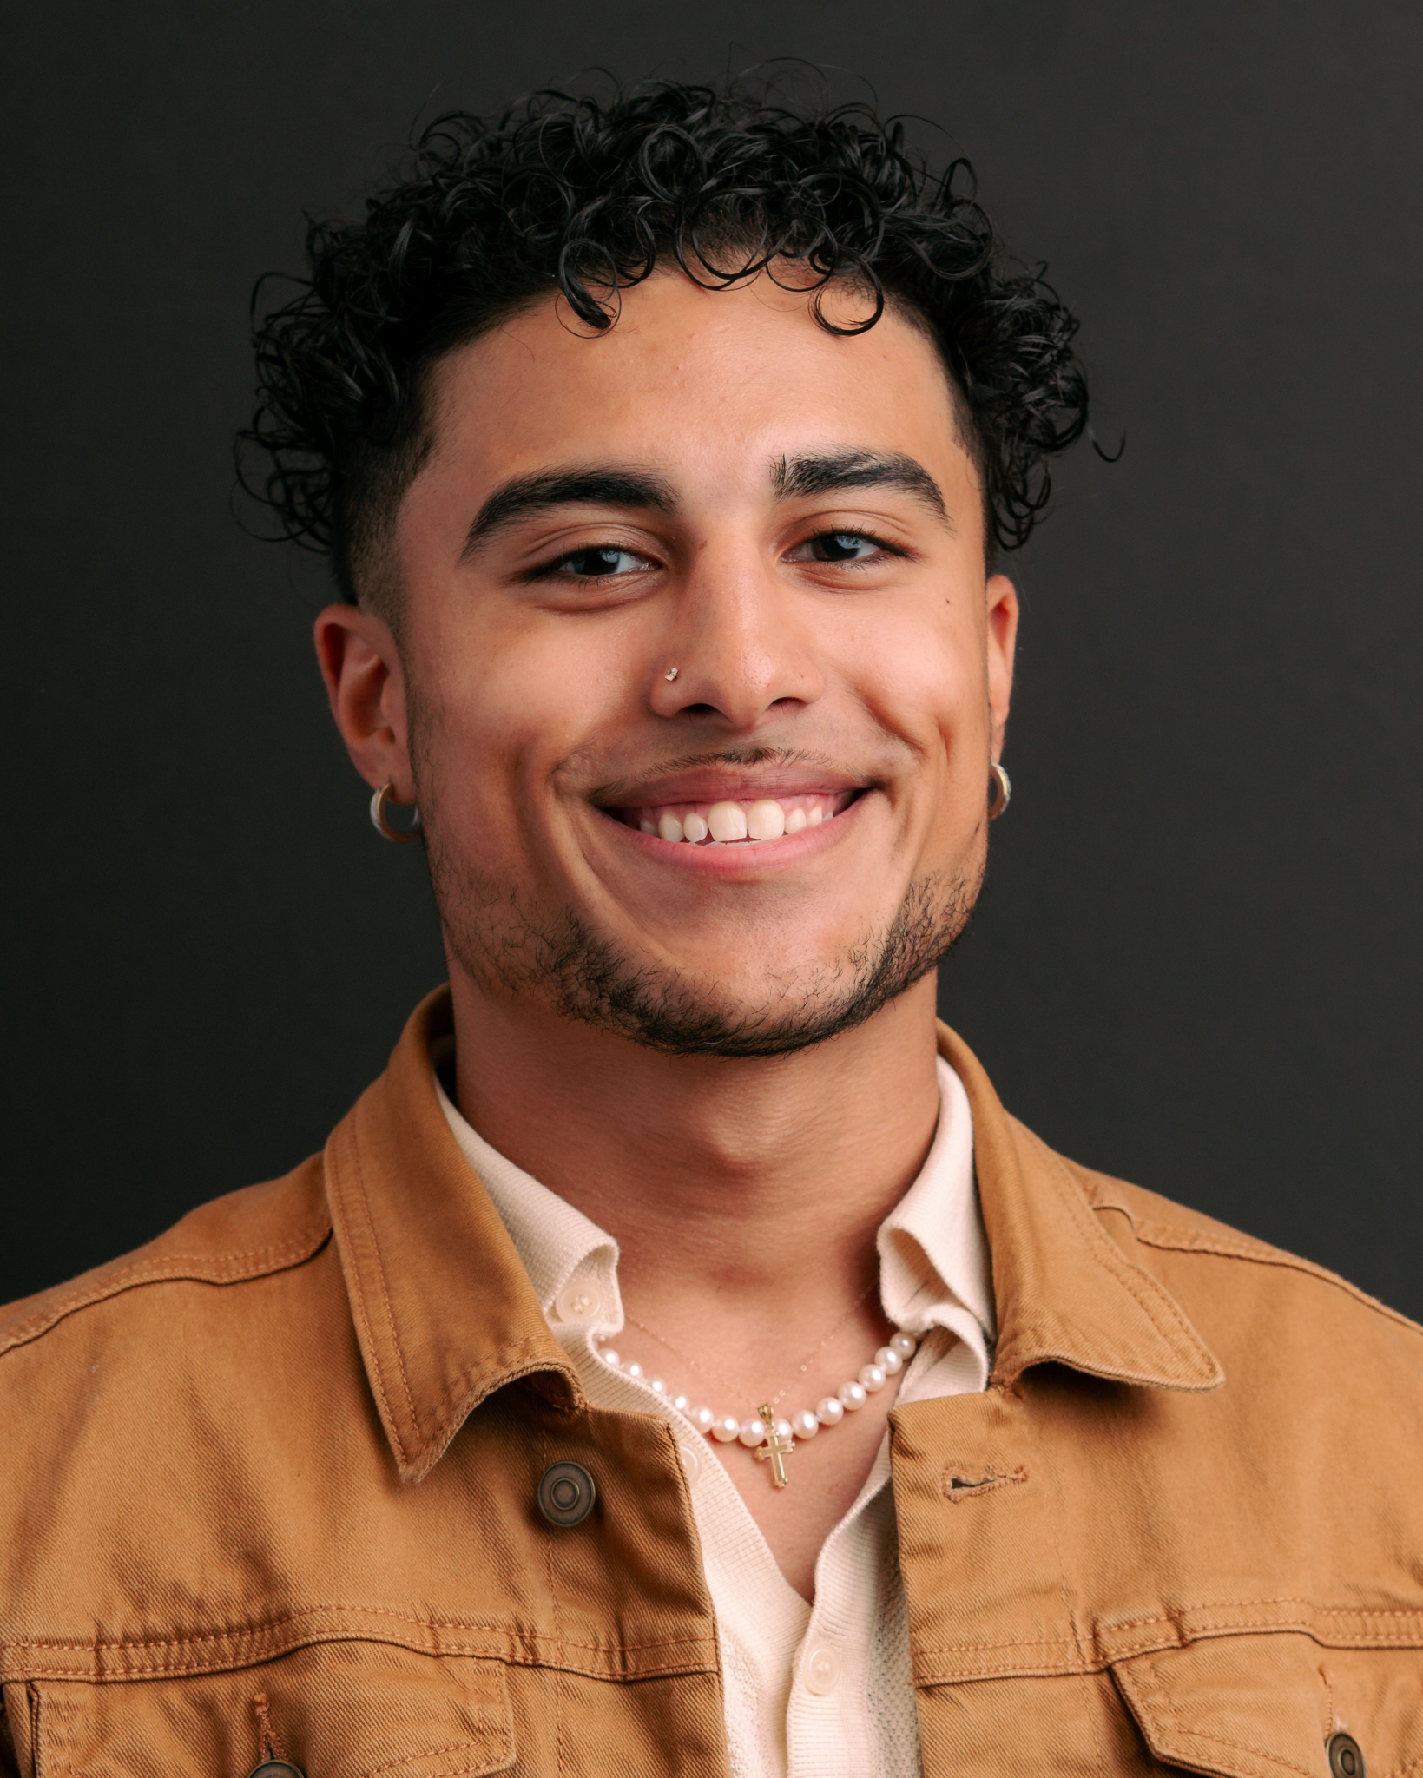
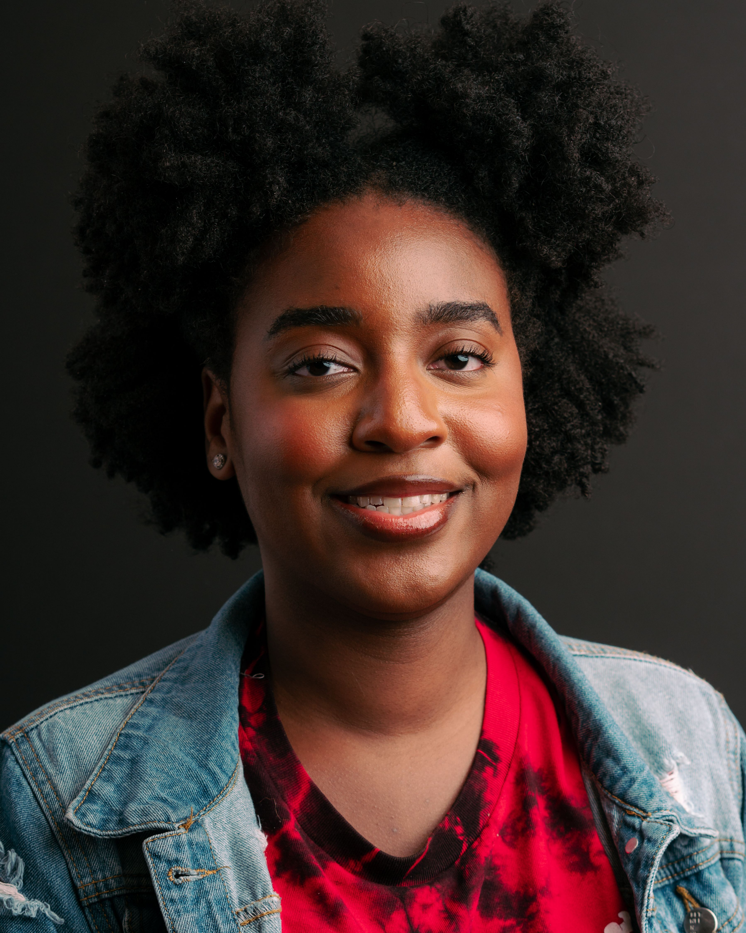
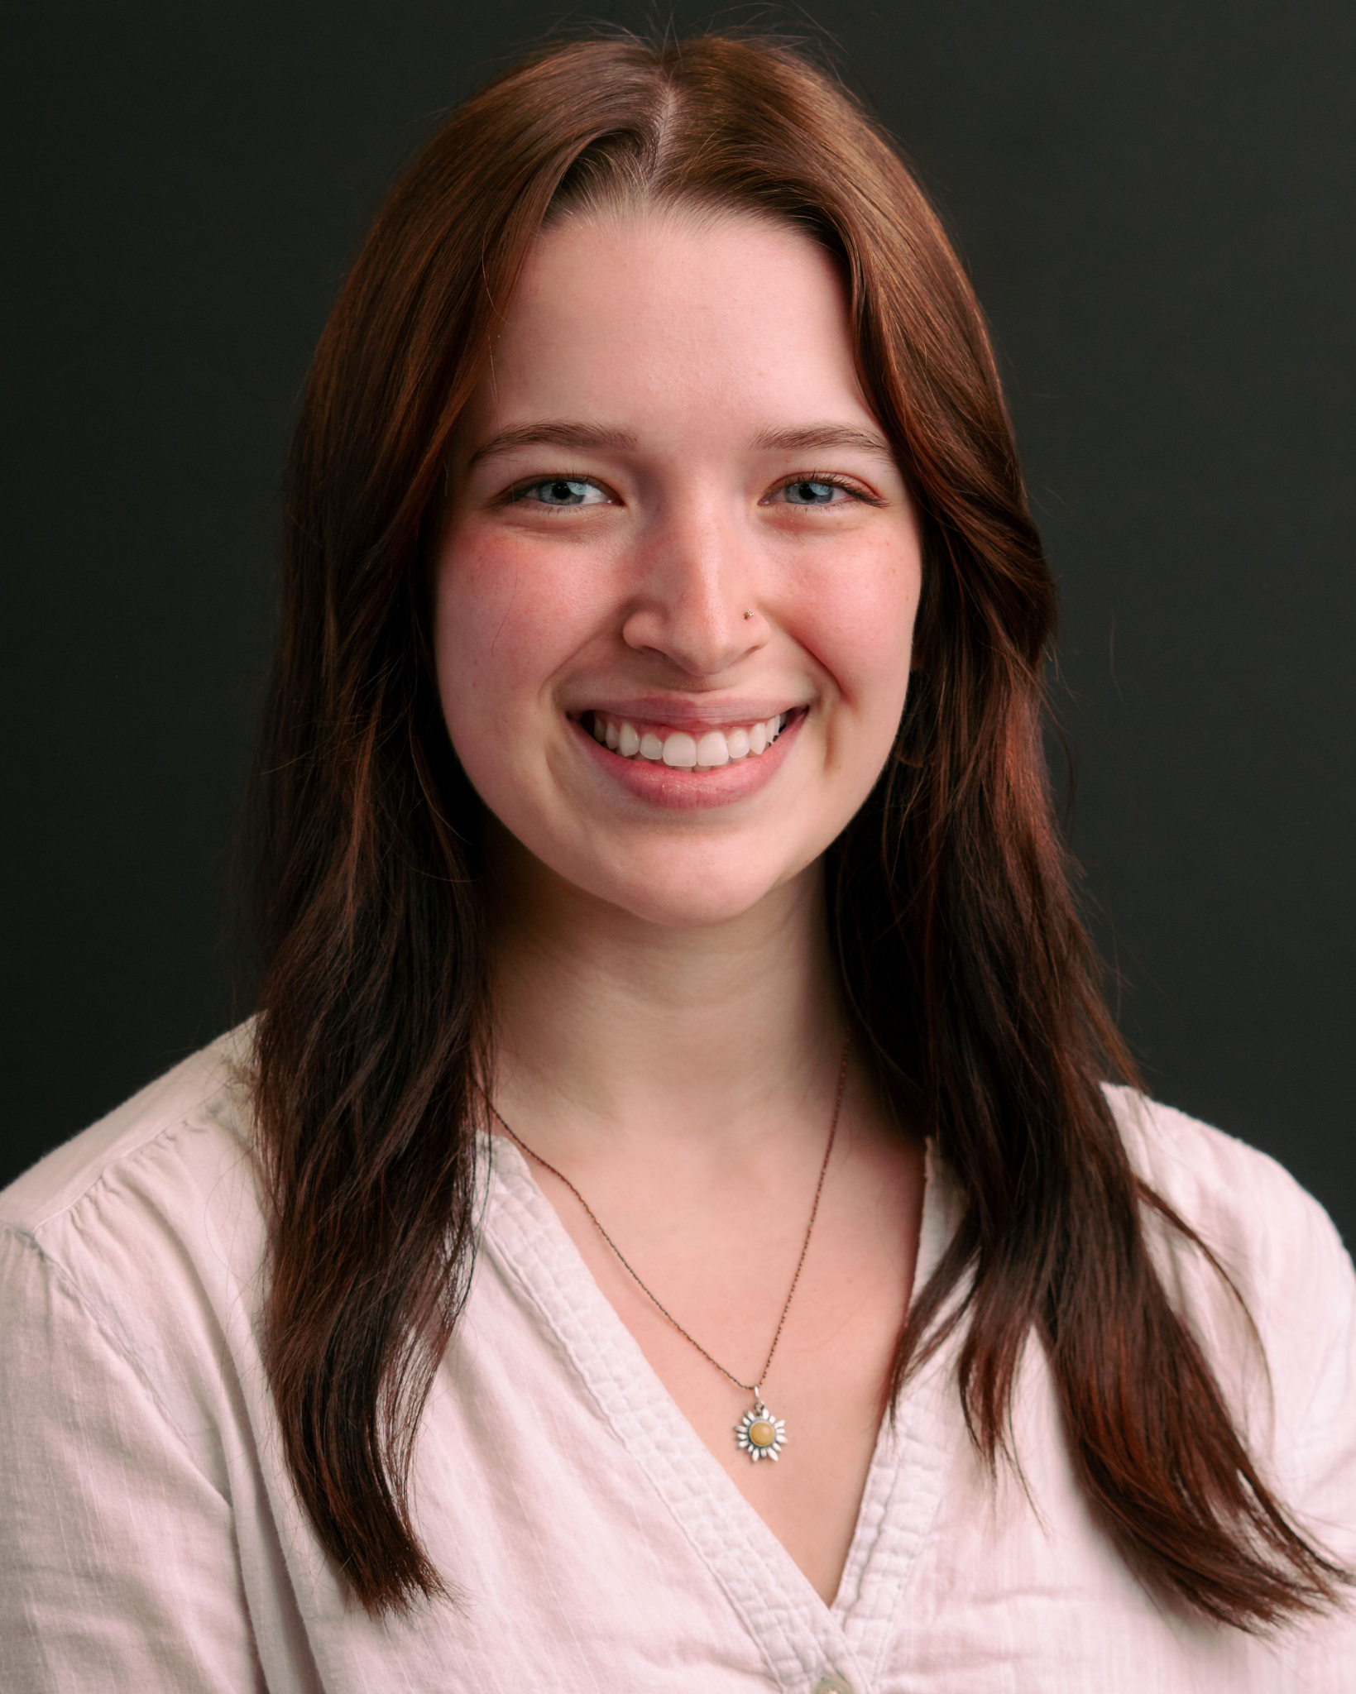
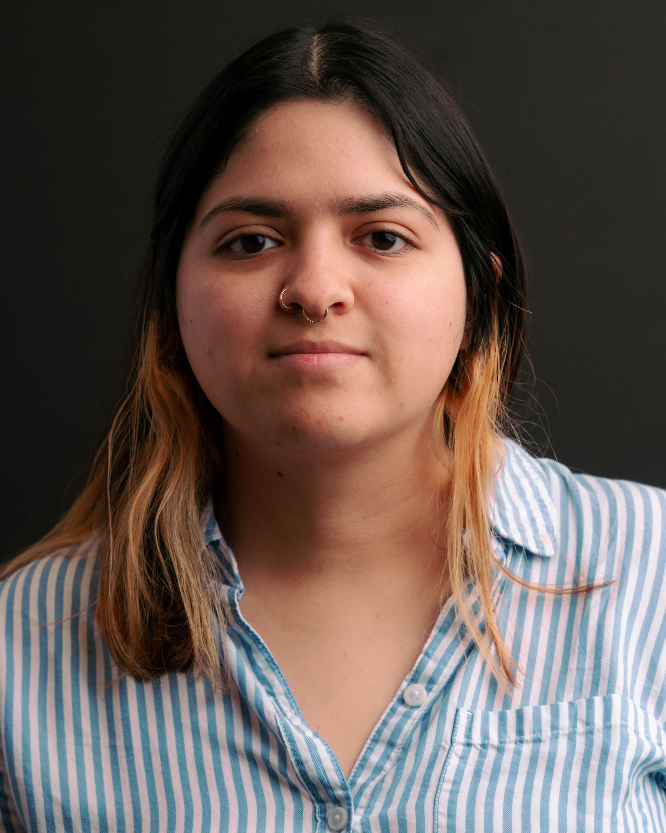
HIGHLIGHTS- Talent
Diversity of Staff
Promoting of Educators helps to foster different perspectives that ultimately help to empower students to embrace differences and helps to cultivate a more inclusive and equitable learning environment. This ultimately helps us to fulfill on our mission to our students
Stats:
55 of our 98 staff members identify as people of color:
56%

Slide 6
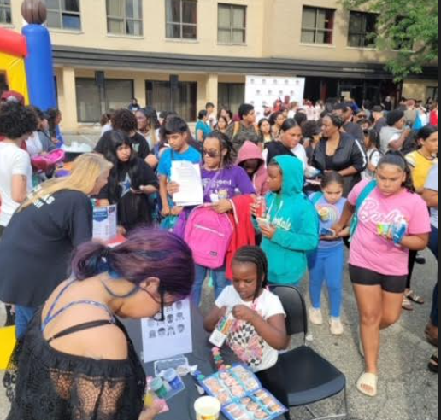
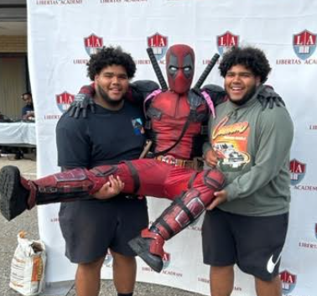
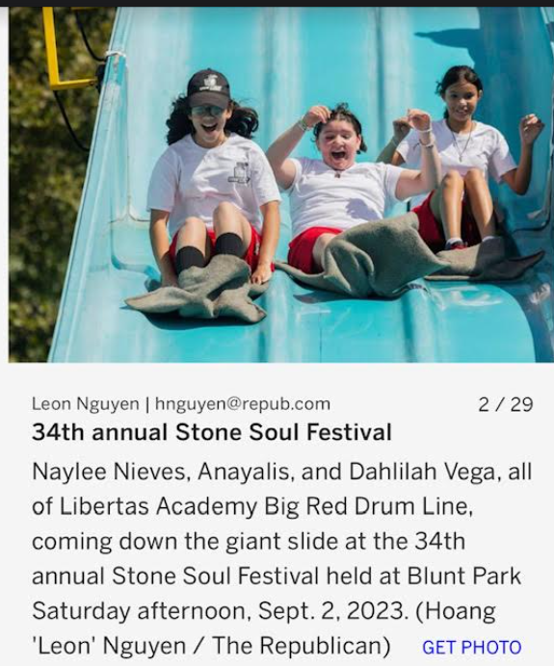
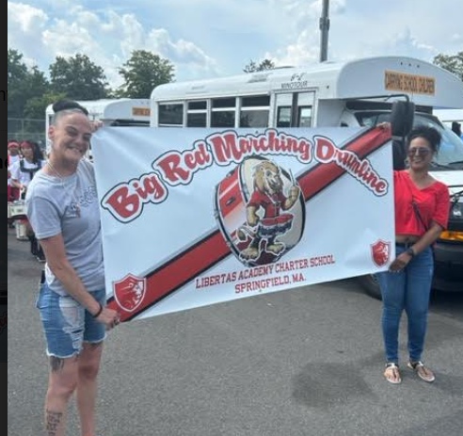
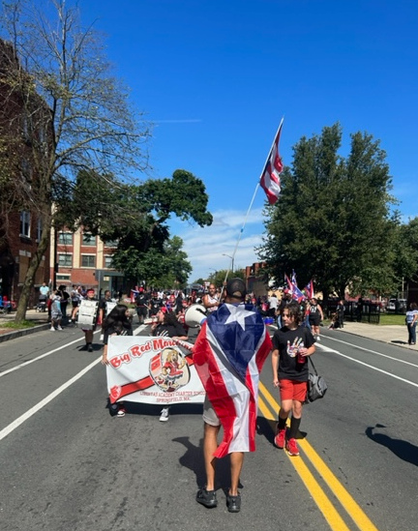
HIGHLIGHTS- Recruitment
Highlights for Recruitment
We are fully enrolled for Middle school and 9th grade.
We have a wait list for 6th, 7th , 8th and for the first time 9th.
We were able to help more than 100 families with backpacks school supplies in our back to school BBQ
Drumline has been recruiting with me at the popular events in springfield and we were on the community news paper.
Puerto Rican parade - We were loved by the community.

Slide 7
Sports we are currently tracking for the 2023-24 SY are:
FALL | WINTER | SPRING
Girls Volleyball | Boys Basketball | Boys Volleyball
Cross Country |  | Track & Field

Slide 8
STATE OF DEPARTMENT - GOALS, DATA, AND HIGHLIGHT
LA Compliance % | UA Compliance % | School Compliance %
Arli: 66% Gonzalez: 100% Bonilla: 100% Nicole: 100% Smith: 100% Santiago: 87% Lee: 100% Cas: 100% Brown: 100% | Cowley- 100% Williams- 100% Romanelli- ~90% Lee- 100% Cas- 100% Brown- 100% | 95%
-J.S (6th) Parental Consent -M.K (8th) Tri/Consent due by DEC - I.D (6th) & J.V (6th) Waiting on parent signature -A.T (8th) Med Doc - 504 | Jose Perez Gonzalez, Christian Birriel, and Terrold Vaughn

Slide 9
College &
Career
J. Rosario

Slide 10
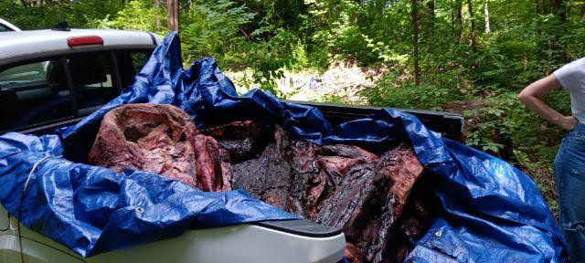
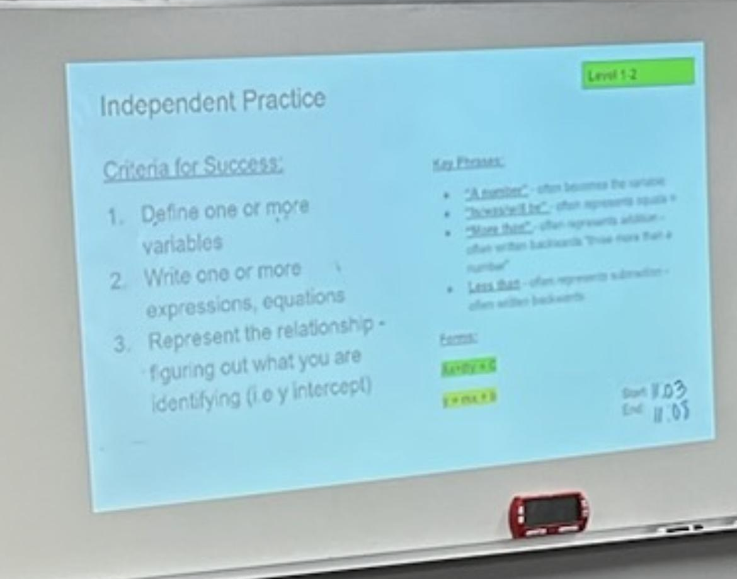
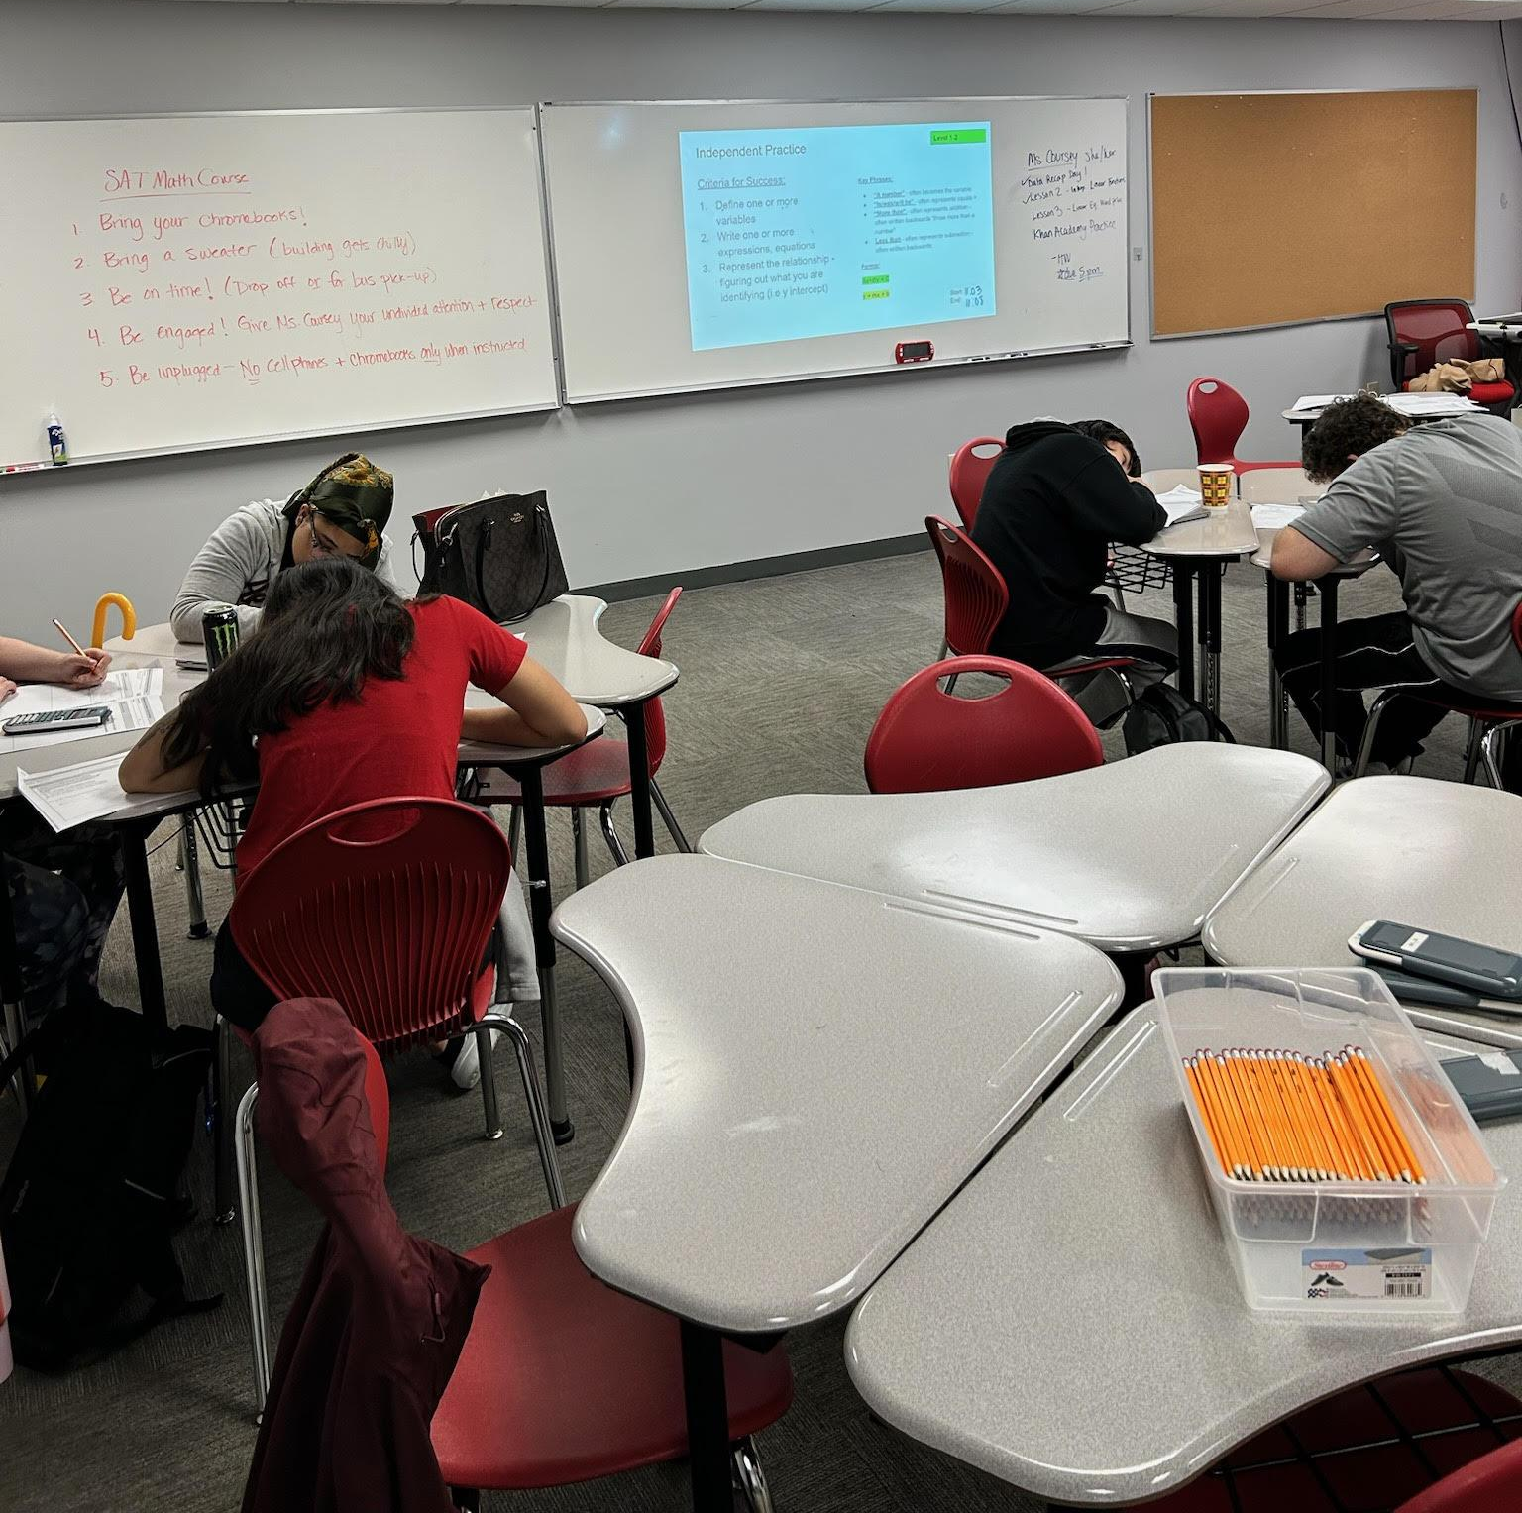
SUMMER HIGHLIGHTS
Summer Pre-College Programs
24 students participated in a pre-college program
Massenberg STEM Institute [UMass]
University Without Walls - various programs [UMass]
EXPLO 360 [Wellesley University]
STCC | Airbrushing & Creating Mobile Apps
HCC | Cooking & Soccer Clinic (LA Student | Joey Dejnak)
SAT Math Summer Academy
One-Week • August 14-18
approx. 12 students
Khan Academy | Katherine Coursey
Incentives | Lunch | Learning

Slide 11
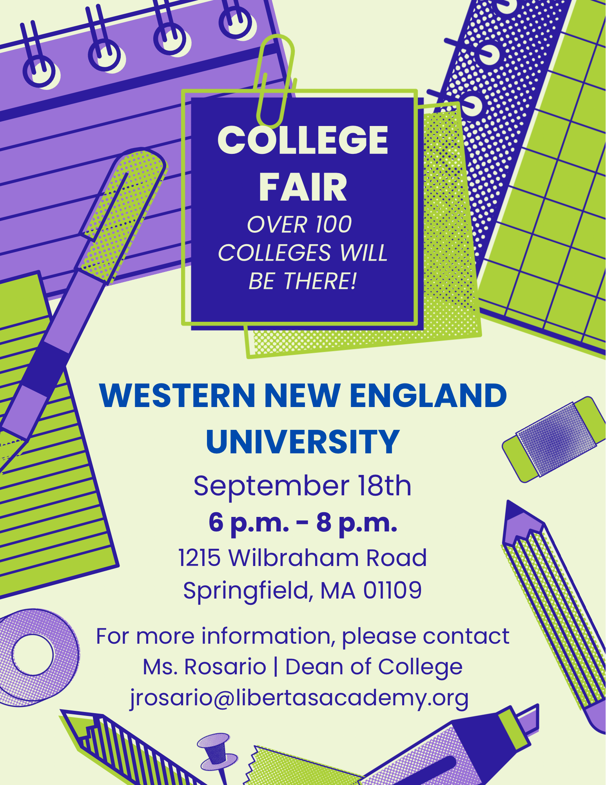
Upcoming Events
College Fairs
Monday, September 18 | 6:00pm - 8:00pm
@ Western New England University
Tuesday, October 24 | 5:00pm - 7:00pm
@ Libertas Academy Charter School
Tuesday, October 31 | 9:00am - 12:00pm
@ American International College (AIC)
Campus Tours
In Progress | 1-2 fall visits | 1-2 spring
‘23-’24 HIGHLIGHTS
2023-2024 Academic Year
First 11th grade class | Class of 2025 | 68 students
College & Career Readiness | Intervention Block | Overgrad
Setting Personal & Academic Goals
Exploration of post-secondary options
The College & Career Search Process
The College Application Process
The Financial Aid Process
Summer program selection & applications
SAT Prep Course (Math & Reading/Writing)

Slide 12
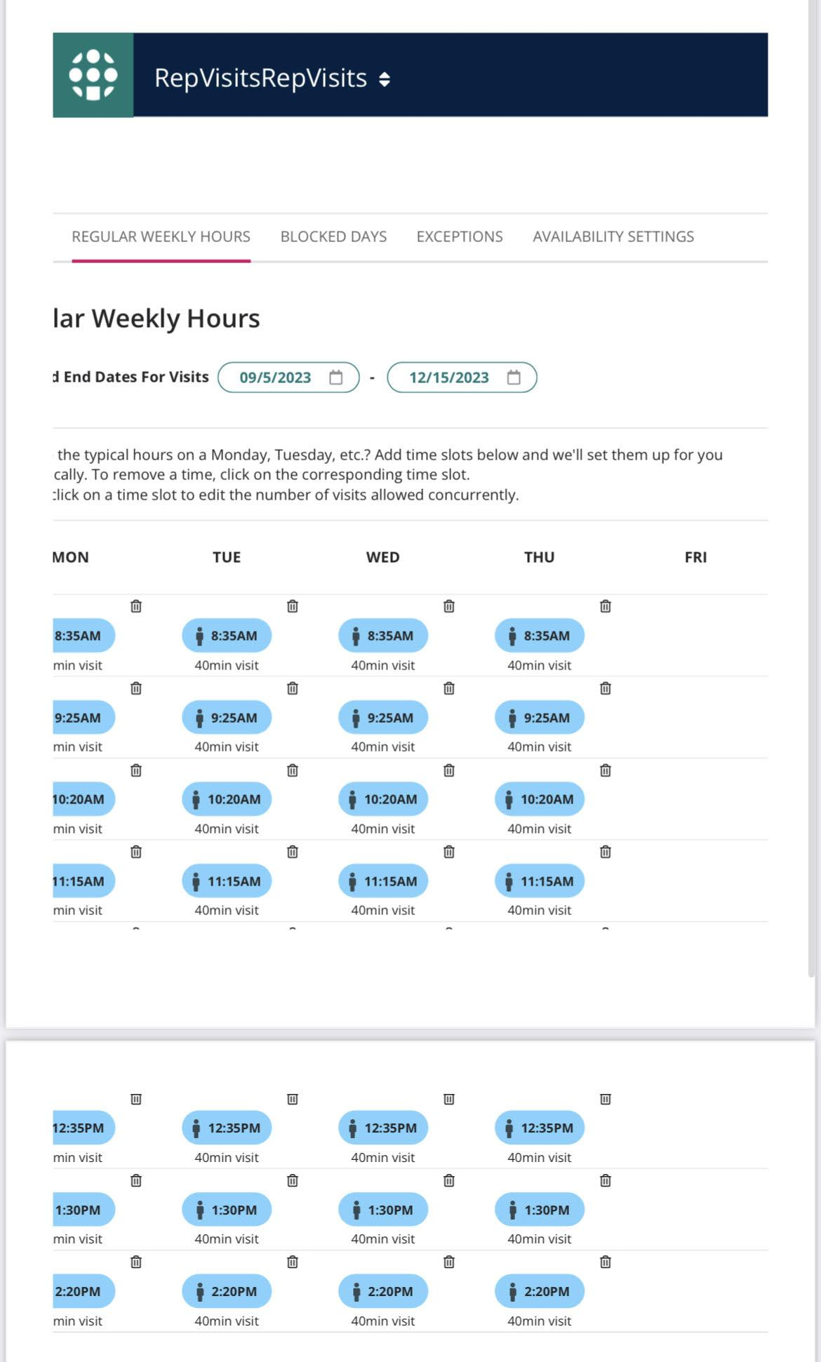
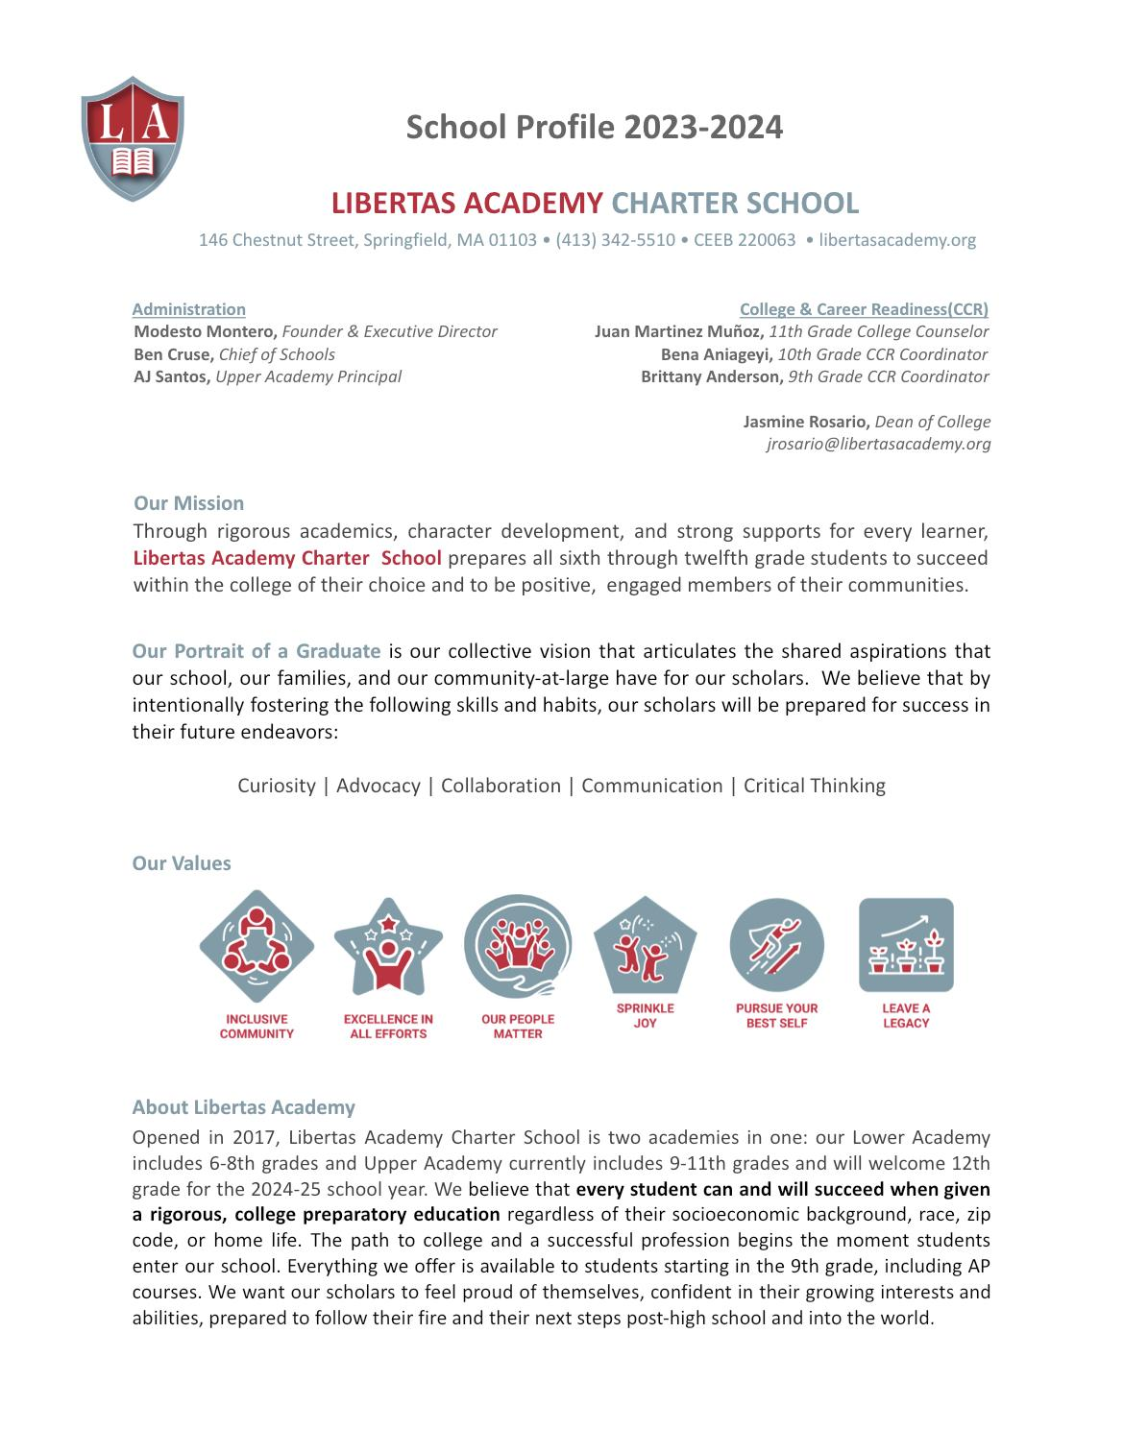
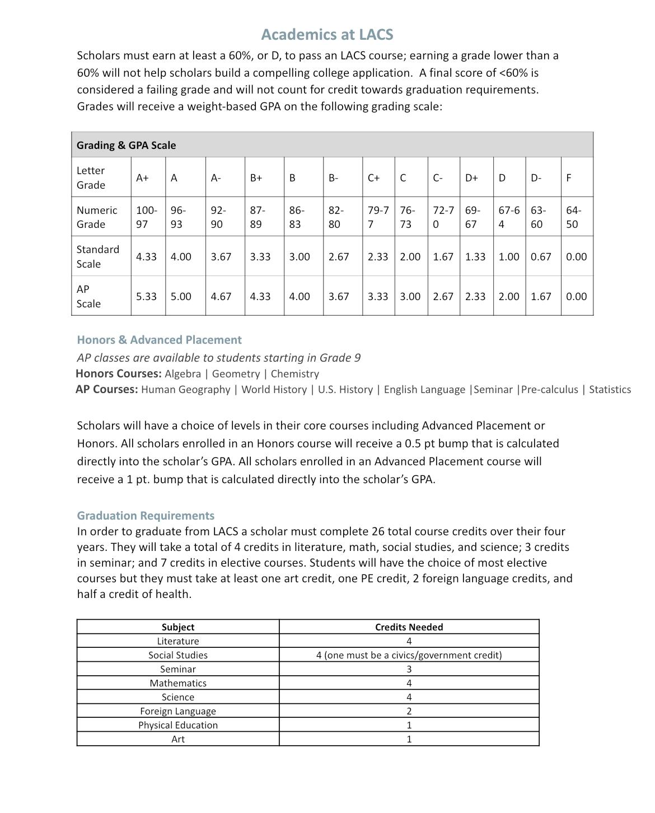
‘23-’24 HIGHLIGHTS
2023-2024 Academic Year
College Rep Visits | Visits from college admission reps throughout the academic year!
College Reps will sign-up via Repvisits.com
Student Ambassadors will greet Reps upon arrival
Visits will be hosted in the College & Career Readiness Suite (307)
Students in 11th grade will be prioritized
Students will learn about visits & sign-up during CCR block
We have an updated School Profile

Slide 13
COLLEGE & CAREER READINESS -
GOALS
Most Recent GPA Data (as of 9/12)
Goal | Metric
GPA | 50% @ 3.0+ 75% @ 2.5+ 90% @ 2.0+
SAT | 40% @ 500+ in EWR 35% @ 500+ in Math 75% meet SAT growth goal
Summer Program | 75% of 3.5 11th graders attend pre-college 75 % of 3.8 10th graders attend pre-college 75% of 4.0 9th graders attend a pre-college
PSAT | 35% @ 500+ in EWR 30% @ 500+ in Math
Essay | 90% of Juniors have a 1st draft by June 1
LOR | 100% of Juniors w/ 3.5+ have 1 LOR by June 1
SSR | 50% of Juniors have SSR written by Aug 1
FAFSA | 100% of Juniors have all financial aid docs in by May 1*
College List | 100% of Juniors have a 1st draft college list by June 1
Advisory | Intervention | Office Hours | CST

Slide 14
WHAT MUST BE IN NEXT MONTH
Summer Program Debrief Data
2024 Summer Program selection process [Progress Report]
At least one scheduled college campus visit | Field Trip
College Rep Visit data [Update]
GPA Data [Progress Report]
Update on LACS College Fair | Oct 24 | 5:00pm - 7:00pm | Pride Cafe

Slide 15
Key School Data

Slide 16
Talent Progress
Open Priority Roles
85% Retention Goal in both Academies
7th Grade History
Manager, HR & Payroll (HIRED!)
Behavioral Specialist (HIRED!)
Teaching Fellows (OFFER OUT)
Part-time School Nurse (Interviewing)
Pending: LA Math 2

Slide 17
23-24 STUDENT RECRUITMENT as of 8.17.23

Slide 18
GOALS & DATA- Student Recruitment
Historical apps 22-23 vs 23-24

Slide 19
MCAS & Accountability Data

Slide 20
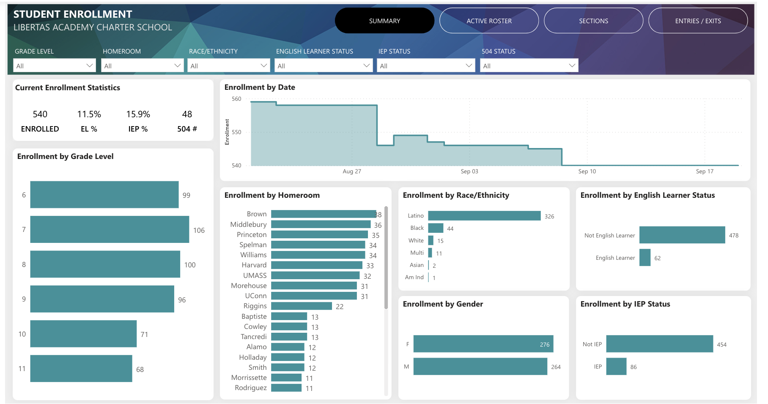
23-24 CURRENT ENROLLMENT

Slide 21
ELA Proficiency Results
 | Goal | Actual | Gain from ‘22
6th | ≥30% | 45% | +8%
7th | ≥40% | 34% | +7%
8th | ≥35% | 38% | +8%
10th | ≥40% | 40% | N/A

Slide 22
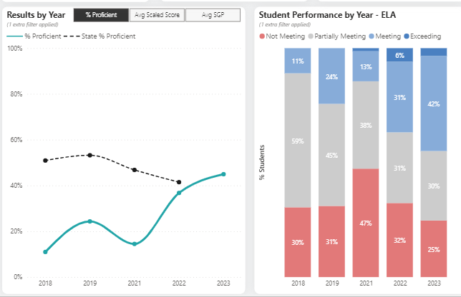
6th - Closer Look

Slide 23
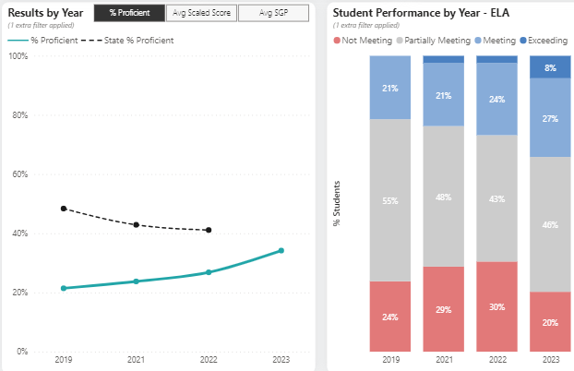
7th - Closer Look

Slide 24
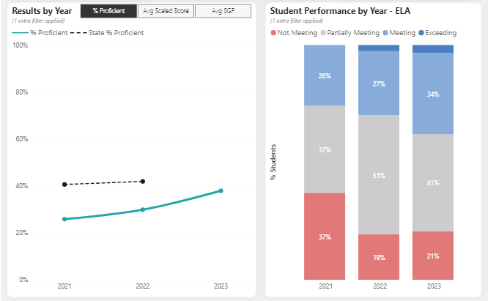
8th - Closer Look

Slide 25
MATH Proficiency Results
 | Goal | Actual | Gain from ‘22
6th | ≥38% | 34% | -3%
7th | ≥40% | 19% | +3%
8th | ≥30% | 40% | +17%
10th | ≥35% | 31% | N/A

Slide 26
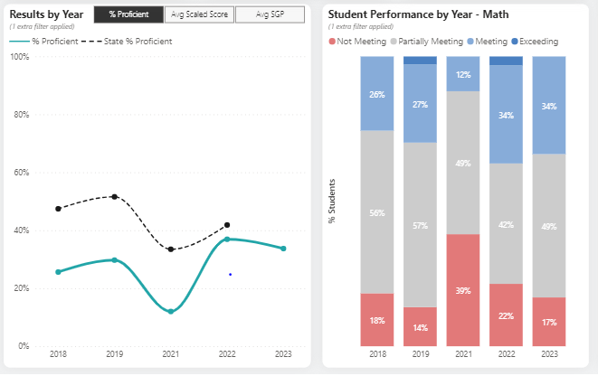
6th - Closer Look

Slide 27
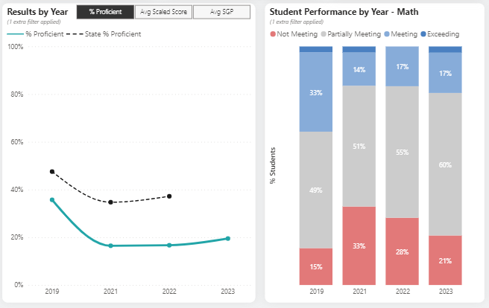
7th - Closer Look

Slide 28
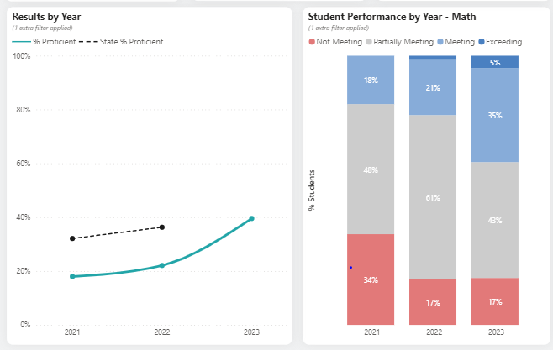
8th - Closer Look

Slide 29
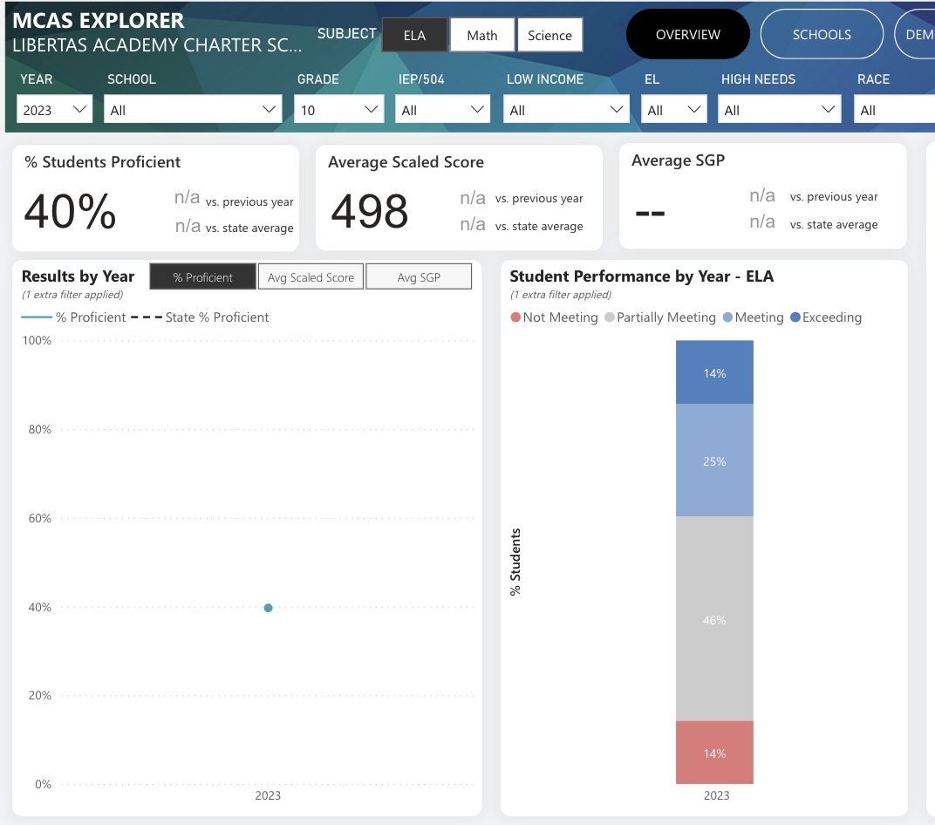
HS ELA - Closer Look

Slide 30
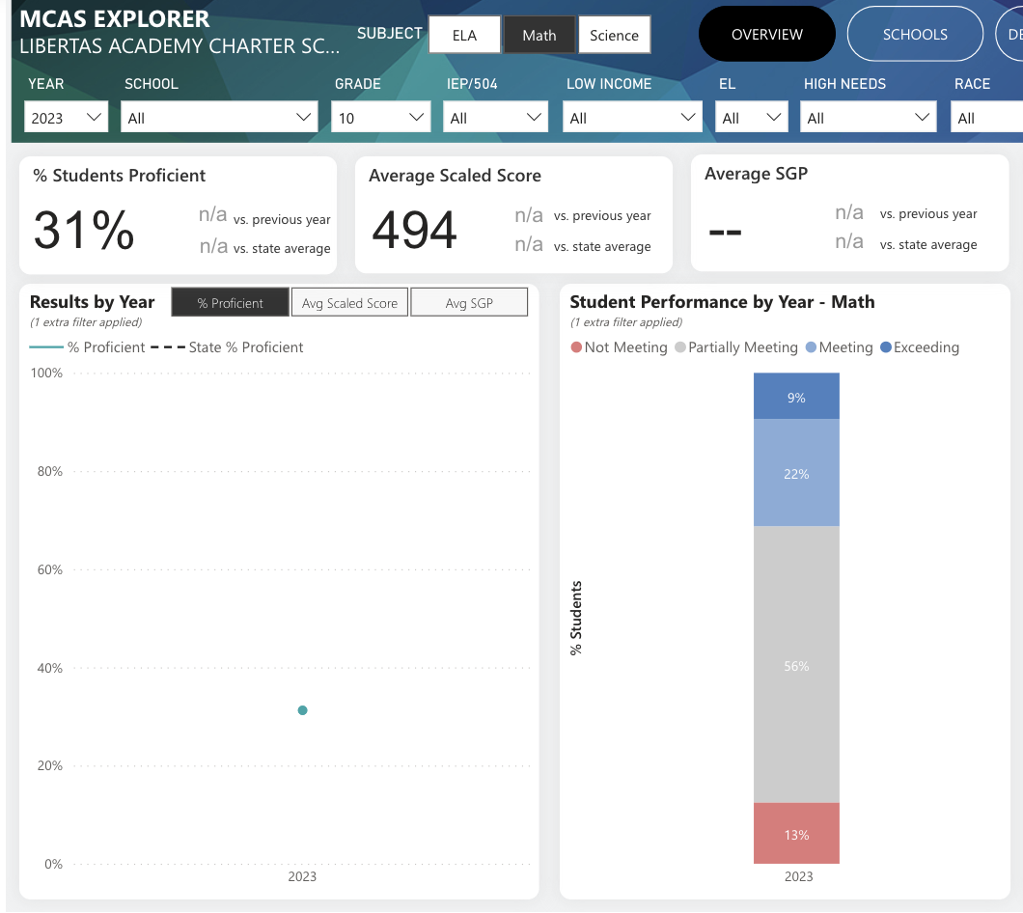
HS MATH - Closer Look

Slide 31
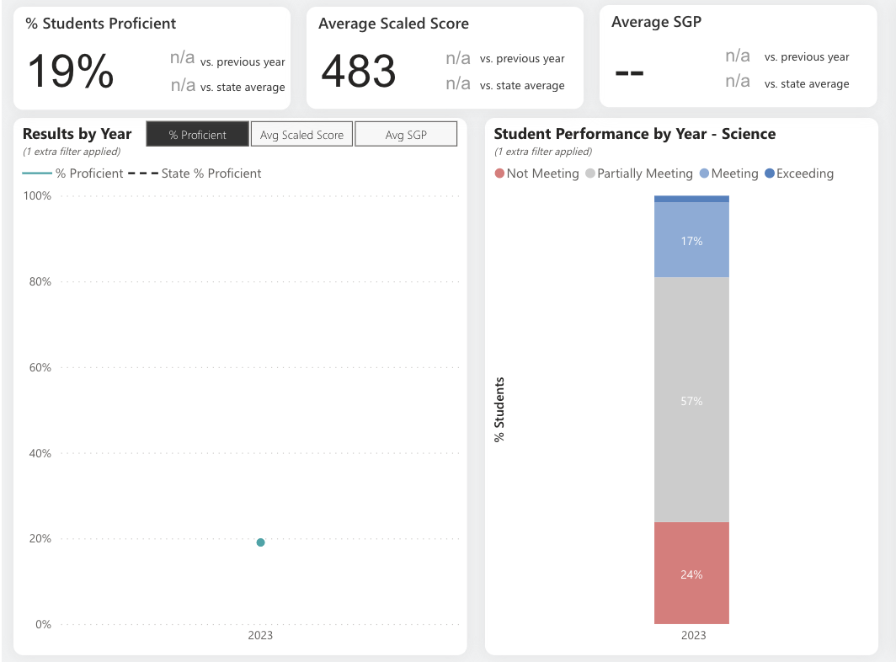
HS BIO - Closer Look

Slide 32
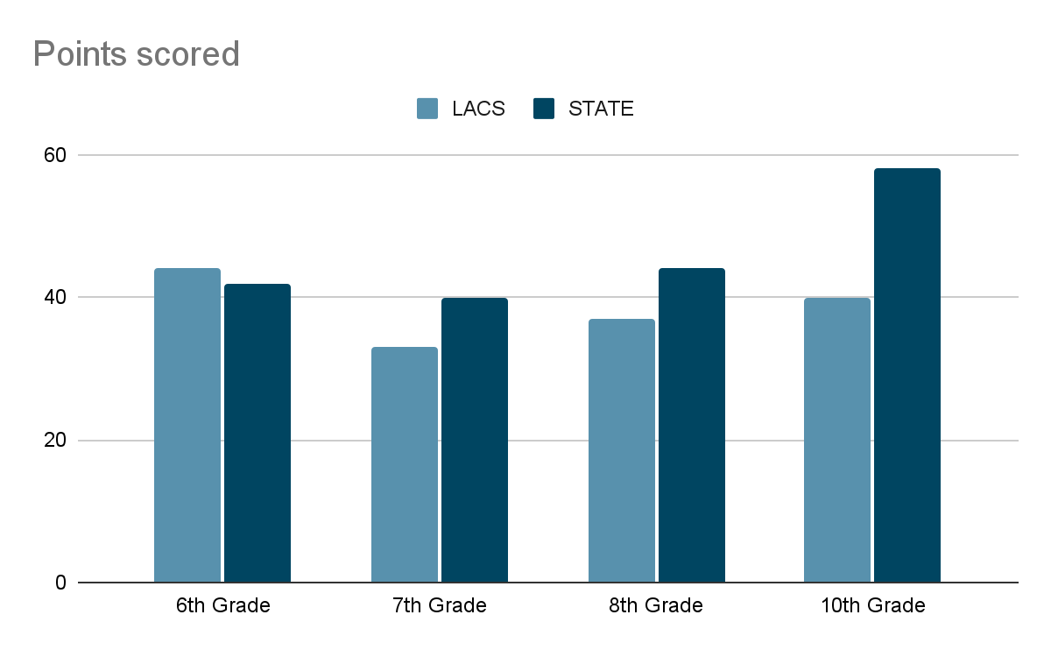
LACS Achievement vs Springfield Public Schools

Slide 33
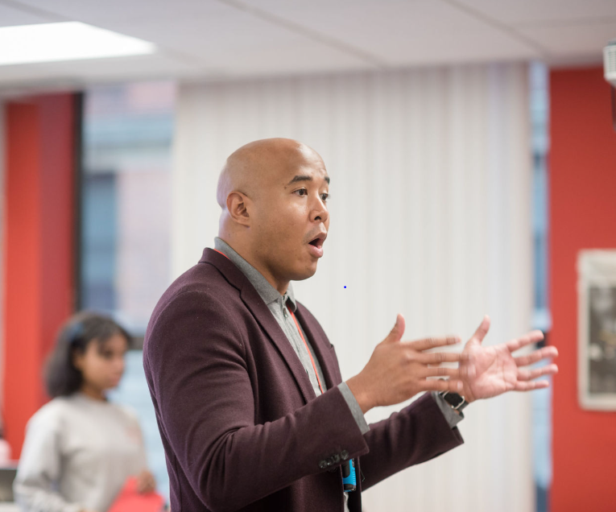
WINS!
6th Grade ELA outperformed the state average!
8th Grade Math performed same as state average!
#5 Highest SGP in MATH n the ENTIRE State (Charter or Public)
#2 Highest SGP in ELA in the ENTIRE State (Charter or Public)
HS ELA was also very strong.

Slide 34
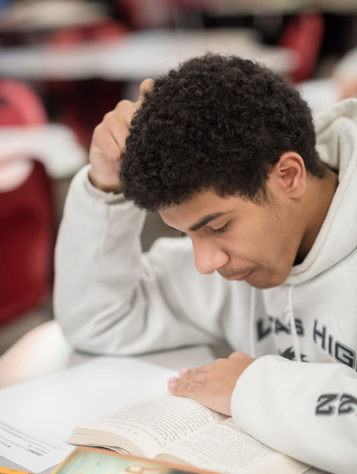
CHALLENGES
7th Grade Math was stagnant.
HS achievement data was not great.
HS SGP was just ‘ok’.
Our students are growing but they are so behind achievement gap is very prevalent.

Slide 35
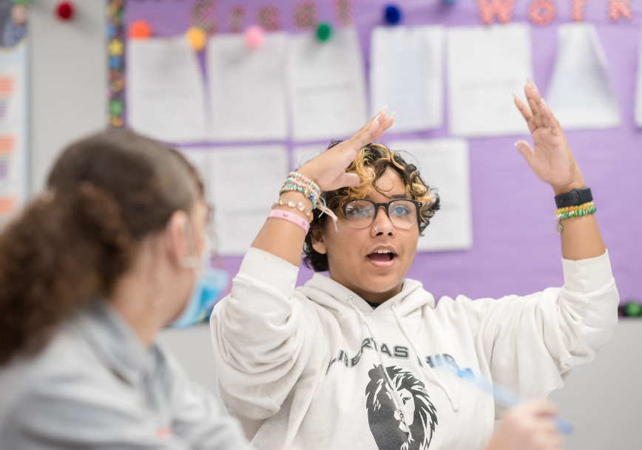
Now What?
Stay the course: same leader and some newer teachers - shifts aren’t where we want to put our energy.
Writing: double down on it. Not only is it important for MCAS - but for college readiness.
Leader to 7th Grade ELA: toughest place to drive results.
AP Language & AP Seminar: come sit in on these courses.

Slide 36
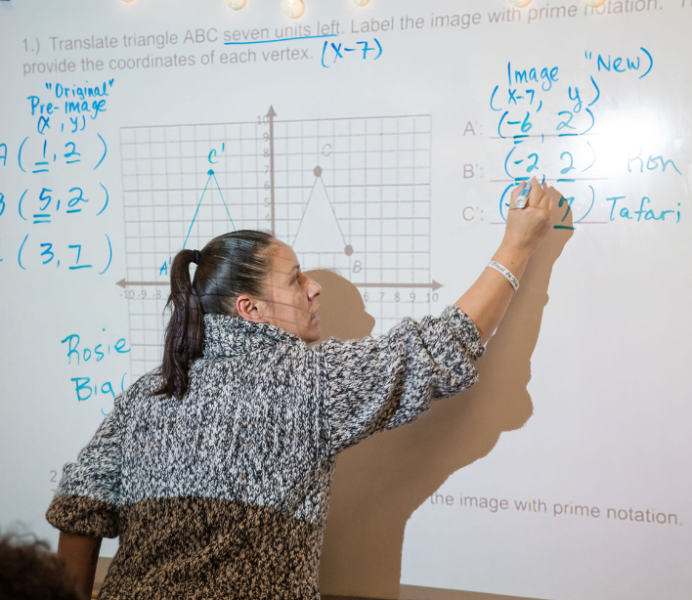
Now What?
Keep the needle moving in 6,8, 9, and 10th: some small concerns in 8th
7th Grade:
Tweaks in the curriculum
Intervention program in school.
After school program driving at our mid and low performers
Initiatives to close gaps from other grades: MATH MASQUERADE!

Slide 37
Strategic Plan Vision Statement
Within our first charter term, we successfully launched our school and are on track to finalize a permanent home for our learning community. Successfully clearing the operational challenges associated with launching a new school is no easy feat and certainly merits a degree of celebration.
We have had some degree of academic success, and in this new charter term, we recommit to academic excellence. We recommit to a mission grounded in preparing our students to succeed in college and career of their choice. The strategic plan outlined seeks to clarify and chart the path forward.
While we know that schools are complex organizations and that a lot goes into running an effective school, the themes and goals outlined are the most mission-critical priorities over the next four years. We believe that by getting these three themes right, we will be one step closer to fulfilling our mission of preparing our students for college and career success.

Slide 39
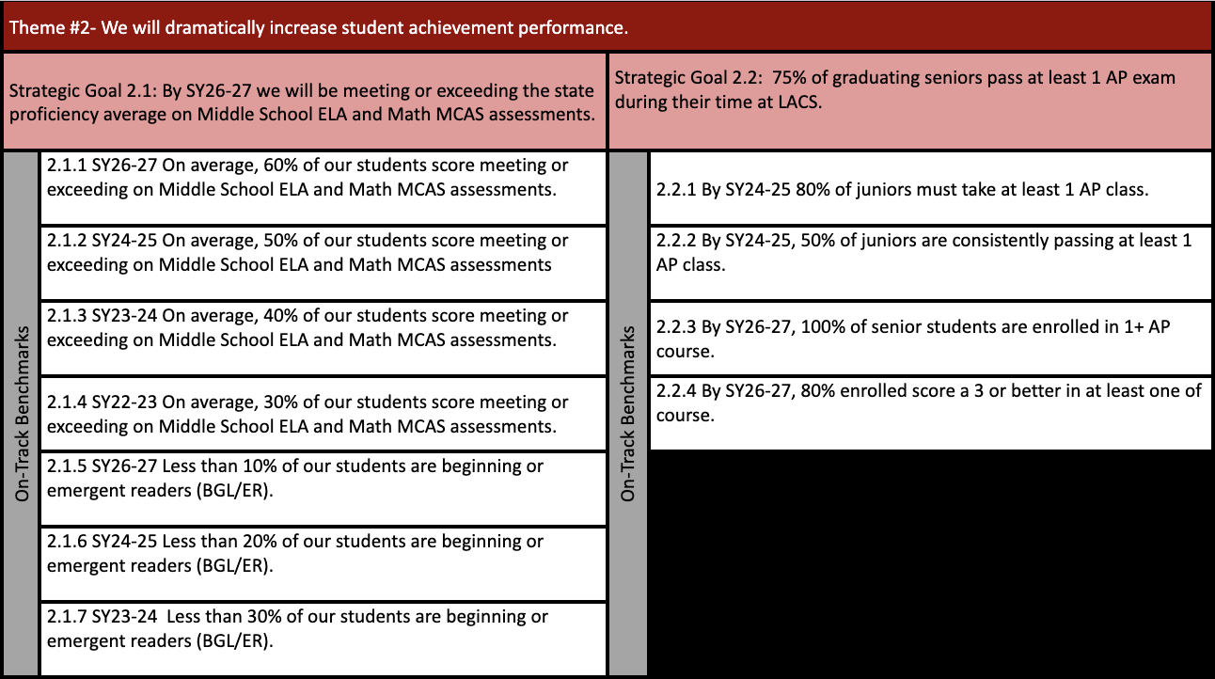

Slide 41
FYIs & Approvals
Approvals:
FYIs:
None
LACS Open House on 11/9 @ 8:30
Hard Hat Tour on 12/6

Slide 42
Upcoming LACS Events
Event | Date | Time
Hispanic Heritage Month | 9/29/2023 | 11 AM to 1 PM
Trunk or Treat Event | 10/20/2023 | 4 to 6 PM
LACS College Fair Owner | 10/24/2023 | 5:00-6:30 PM
Girls Volleyball Games | 10/10, 10/17, 10/24 | 4:30 PM

Slide 43
MISSION
Through rigorous academics, character development, and strong supports for every learner, Libertas Academy Charter School prepares all sixth through twelfth grade students to succeed within the college of their choice and to be positive, engaged members of their communities.

Slide 44
Upcoming LACS Events
Look at school calendar: https://docs.google.com/spreadsheets/d/1GdGJGI4IYizFUWEpR7mSQp9Rwj9N2mT3PPbaaUGFe9Y/edit#gid=1594803582
LA tinyurl.com/FY24LACalendar
UA: tinyurl.com/FY24UACalendar
Look at recruitment events! (Student and Staff)

