Slide 1
School Update

Slide 2
MISSION
Through rigorous academics, character development, and strong supports for every learner, Libertas Academy Charter School prepares all sixth through twelfth grade students to succeed within the college of their choice and to be positive, engaged members of their communities.

Slide 3
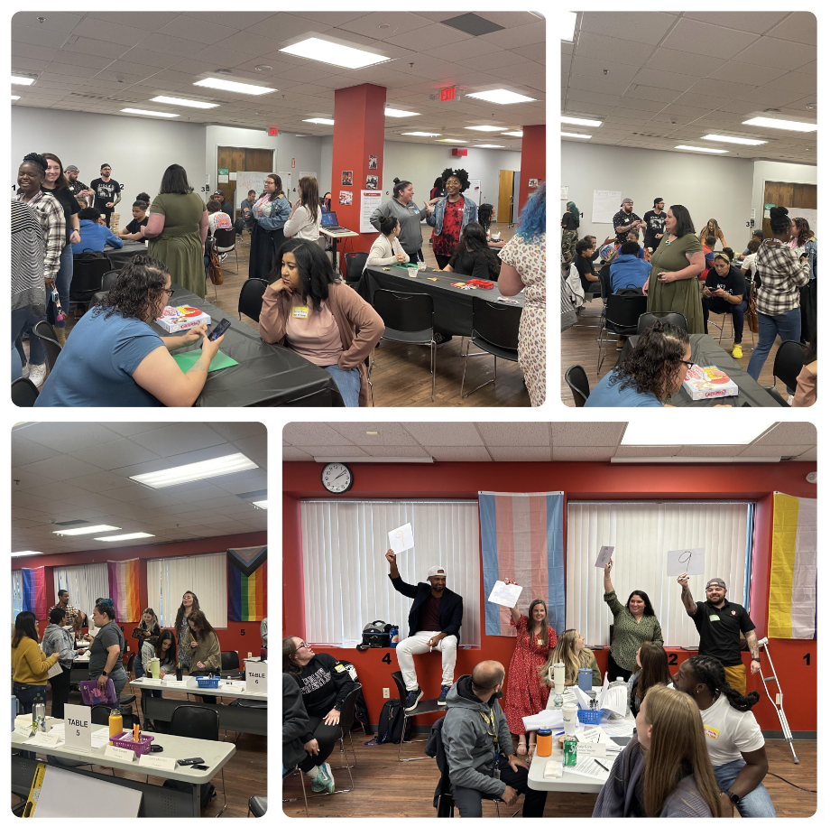

Slide 4
Key School Data

Slide 5
Talent Progress
Open Priority Roles
85% Retention Goal in both Academies
7th Grade History
Manager, HR & Payroll
Behavioral Specialist (UA)
Teaching Fellows (UA)
Part-time School Nurse
Pending: LA Math 2

Slide 6
23-24 STUDENT RECRUITMENT as of 8.17.23

Slide 7
Strategic Plan Vision Statement
Within our first charter term, we successfully launched our school and are on track to finalize a permanent home for our learning community. Successfully clearing the operational challenges associated with launching a new school is no easy feat and certainly merits a degree of celebration.
We have had some degree of academic success, and in this new charter term, we recommit to academic excellence. We recommit to a mission grounded in preparing our students to succeed in college and career of their choice. The strategic plan outlined seeks to clarify and chart the path forward.
While we know that schools are complex organizations and that a lot goes into running an effective school, the themes and goals outlined are the most mission-critical priorities over the next four years. We believe that by getting these three themes right, we will be one step closer to fulfilling our mission of preparing our students for college and career success.

Slide 9
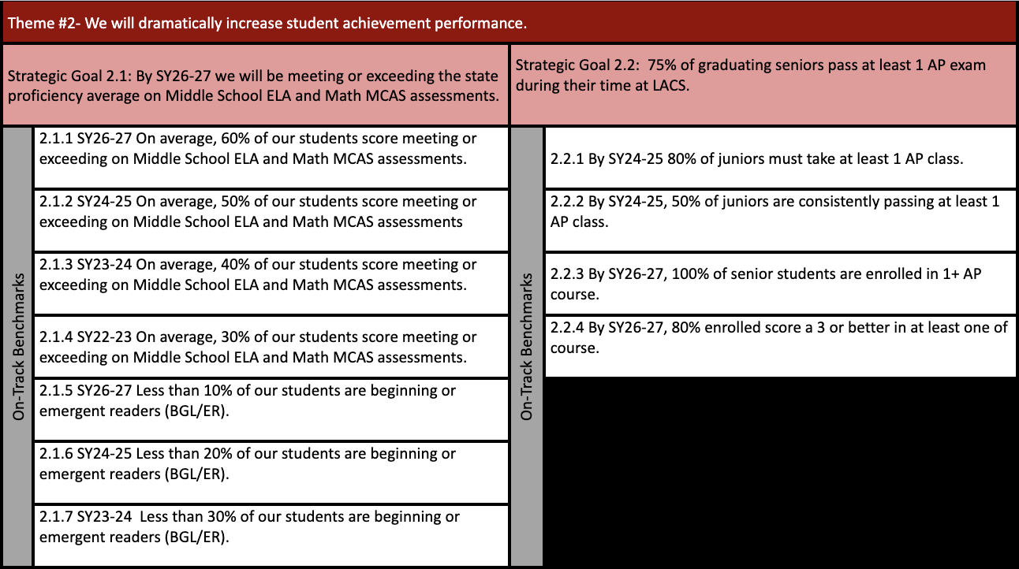

Slide 11
FYIs & Approvals
Approvals:
FYIs:
None
Facilities Update
MCAS Data

Slide 12
Upcoming LACS Events
Look at school calendar: https://docs.google.com/spreadsheets/d/1GdGJGI4IYizFUWEpR7mSQp9Rwj9N2mT3PPbaaUGFe9Y/edit#gid=1594803582

