Slide 1
ED Updates
AAC Management Report

Slide 3
Our Mission
Through rigorous academics, character development, and strong supports for every learner, Libertas Academy Charter School prepares all sixth through twelfth grade students to succeed within the college of their choice and to be positive, engaged members of their communities.

Slide 4
COVID Updates

Slide 5
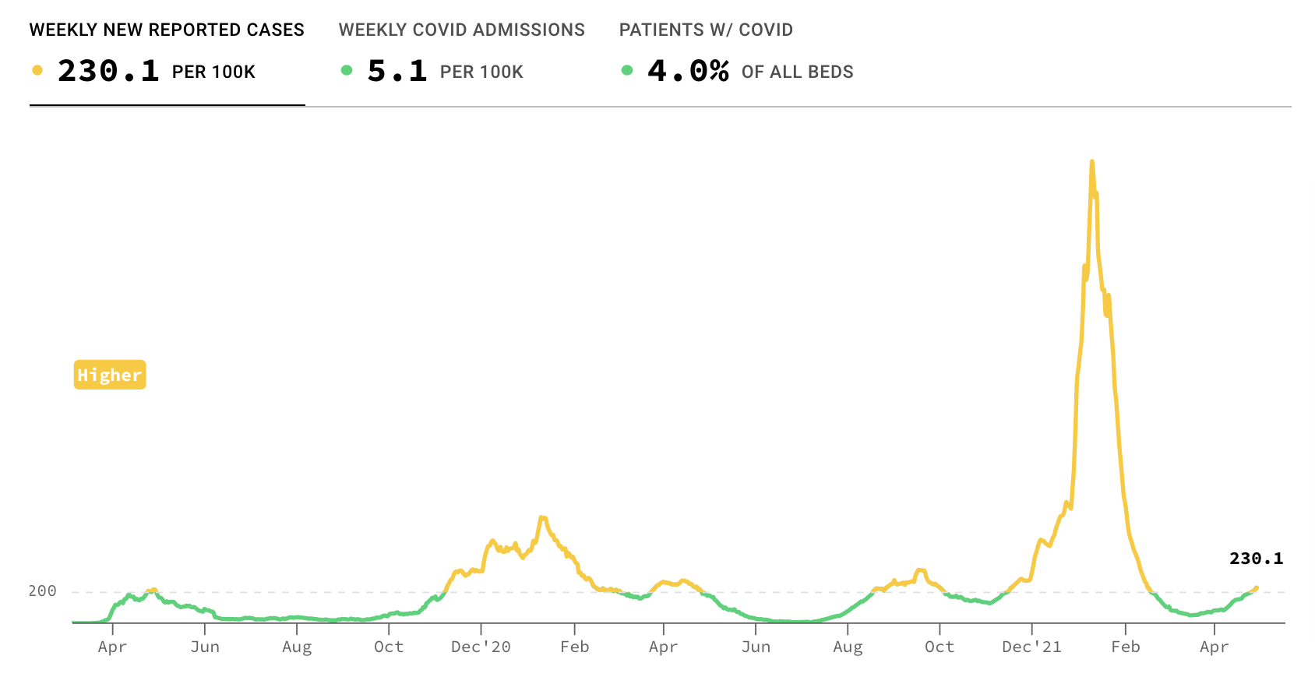
The Plan

Slide 6
The Plan
We’ve lifted the mask mandate in alignment with SPS
Currently masks are optional
We will continue our testing protocols

Slide 7
Key School Data

Slide 8
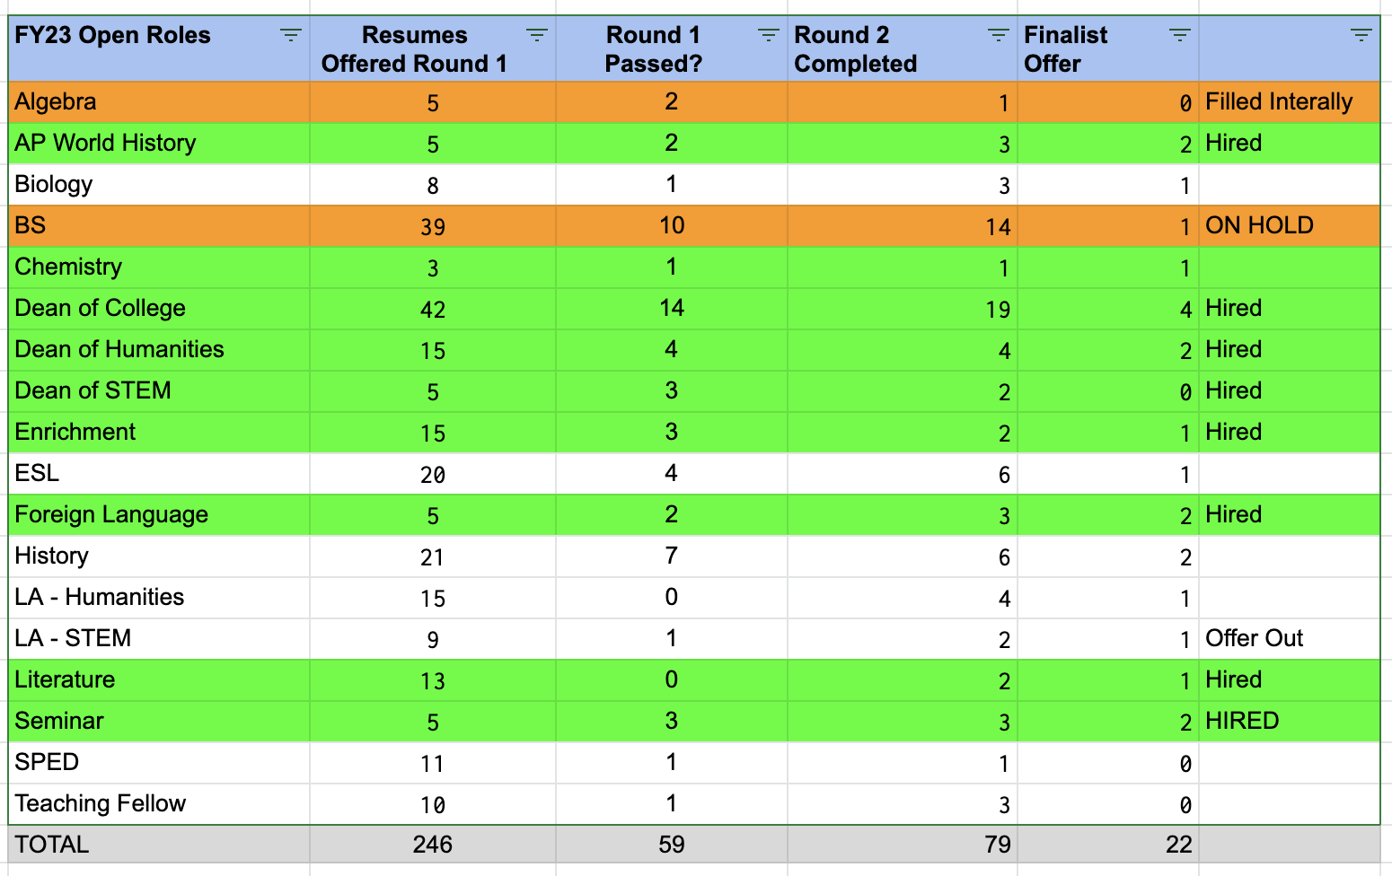
Talent

Slide 9
Open Roles

Slide 10
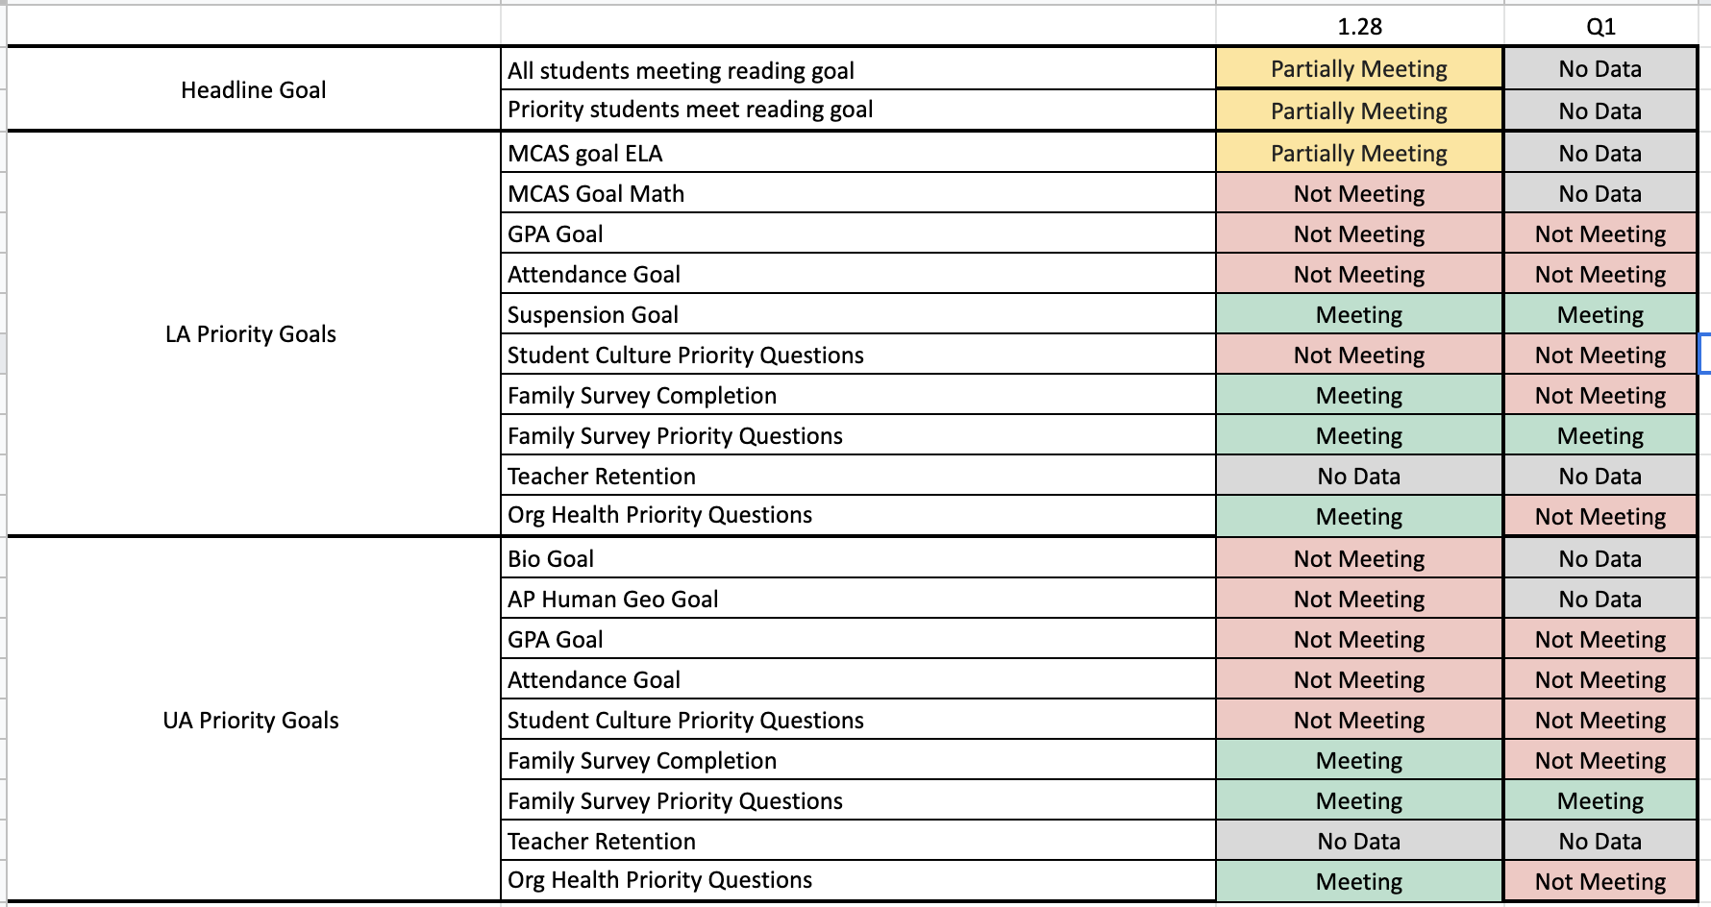
Overview
Notes:
No changes here since last month

Slide 11
Reading Data (as of 2.1)

Slide 12
Reading Data (as of 3.3)

Slide 13
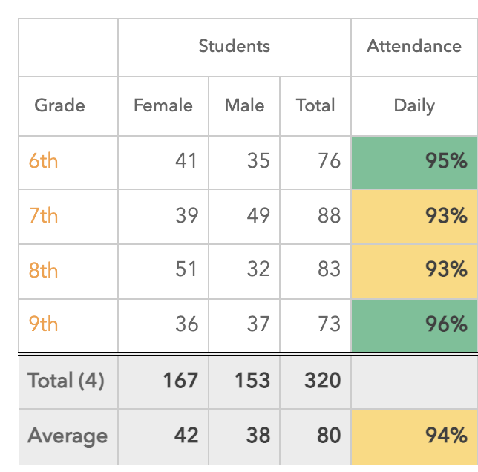
Attendance Data- April

Slide 14
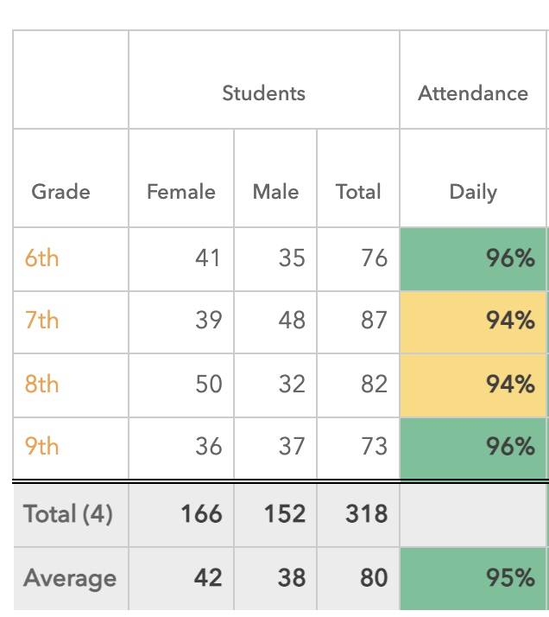
Attendance Data- (May)

Slide 15
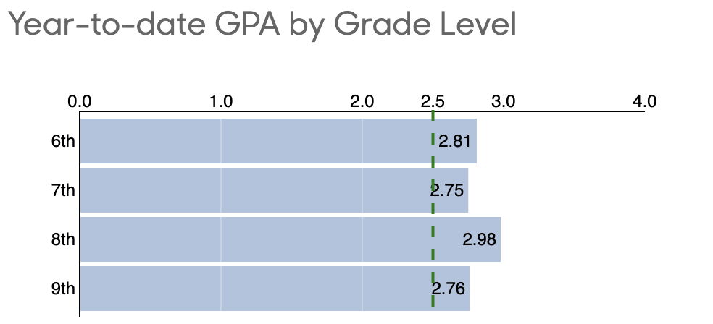
GPA Data (April)

Slide 16
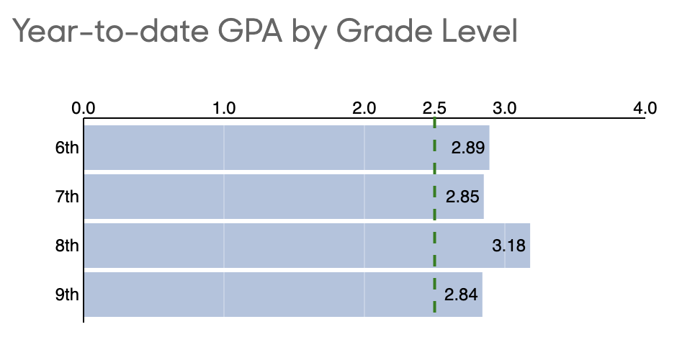
GPA Data (May)
Notes:
Uptick across the board

Slide 17
UA GPA Goals (April)

Slide 18
UA GPA Goals (May)

Slide 19
ELA MCAS

