Slide 1
ED Updates
AAC Management Report

Slide 2
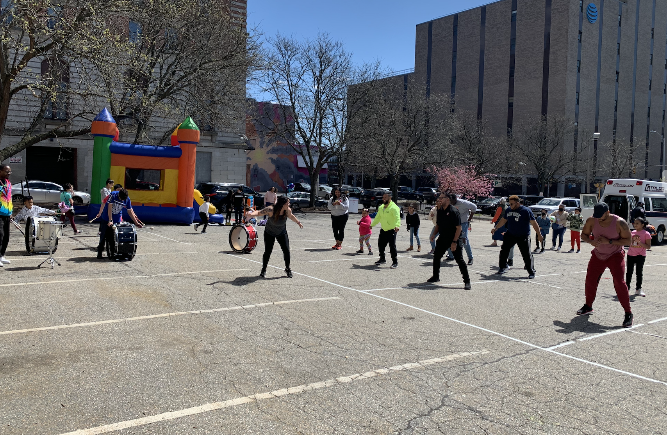
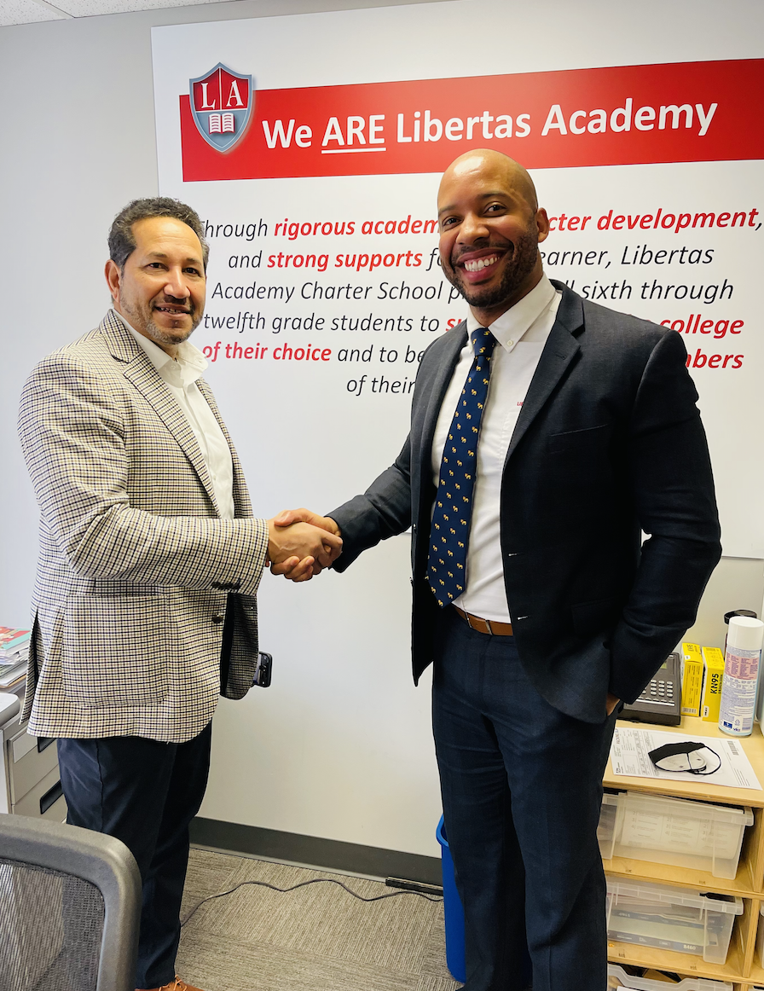
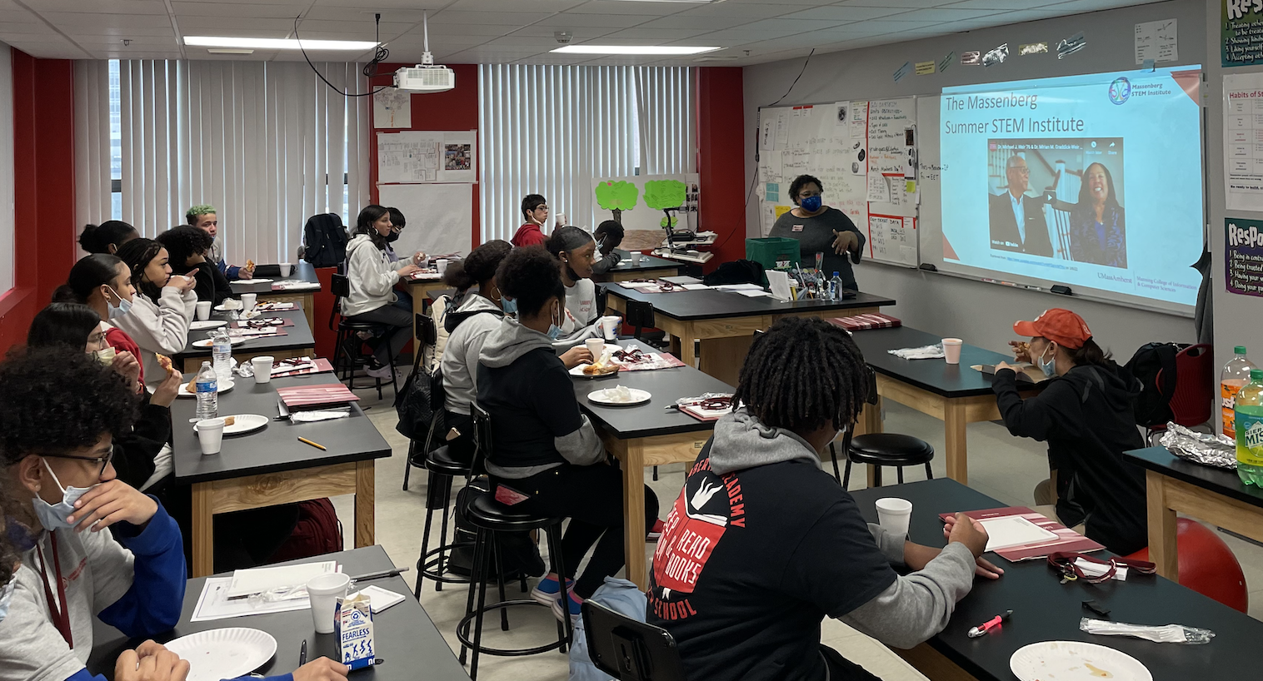

Slide 3
Our Mission
Through rigorous academics, character development, and strong supports for every learner, Libertas Academy Charter School prepares all sixth through twelfth grade students to succeed within the college of their choice and to be positive, engaged members of their communities.

Slide 4
COVID Updates

Slide 5
Our Reopening Philosophy
LACS remains committed to executing a Back-to-School that is grounded in our mission, our core values and that is informed by what the current science is telling us, specific to our local community.
Notes:
LACS will execute a back-to-school plan that is :
Grounded in our mission and aligned with our core values
Informed by science and facts
Specific to our local community

Slide 6
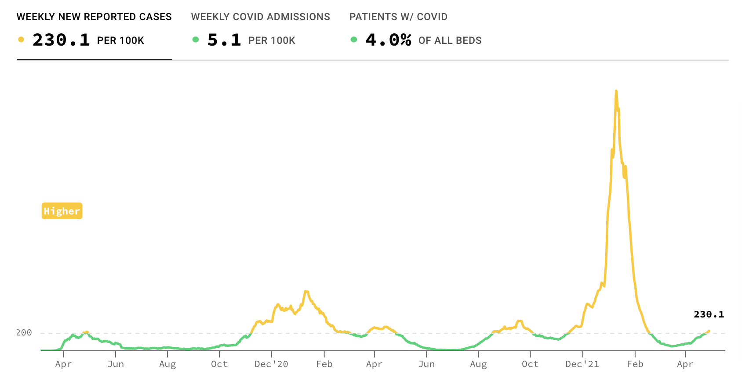
The Plan

Slide 7
The Plan
We’ve lifted the mask mandate in alignment with SPS
Currently masks are optional
We will continue our testing protocols

Slide 8
Key School Data

Slide 9
Talent

Slide 10
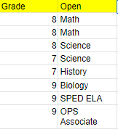
Open Roles

Slide 11
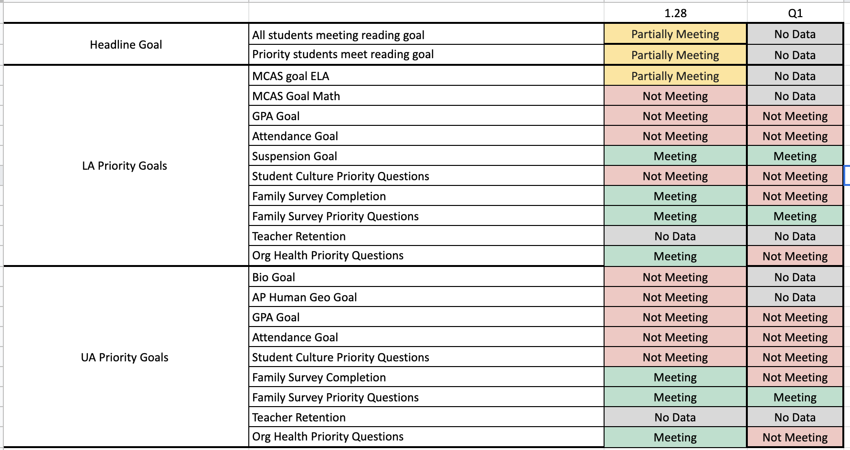
Overview
Notes:
No changes here since last month

Slide 12
Reading Data (as of 2.1)

Slide 13
Reading Data (as of 3.3)

Slide 14
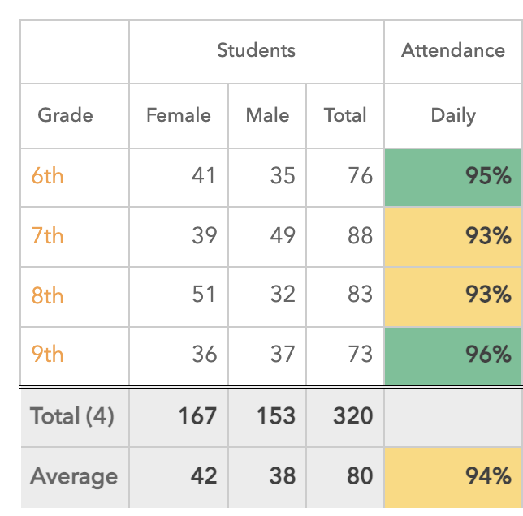
Attendance Data- April

Slide 15
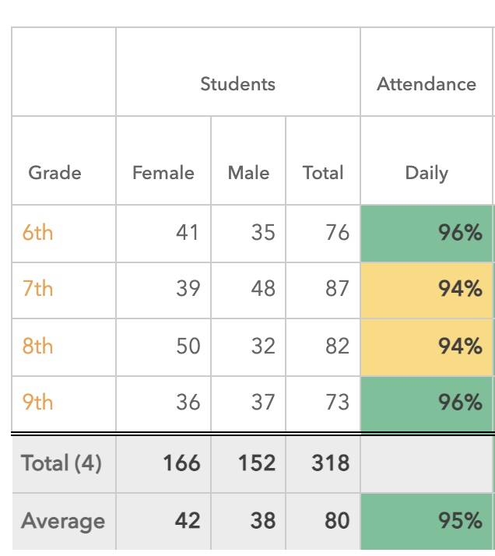
Attendance Data- (May)

Slide 16
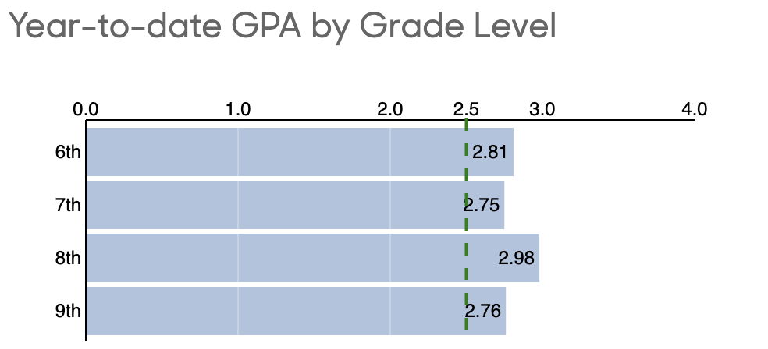
GPA Data (April)

Slide 17
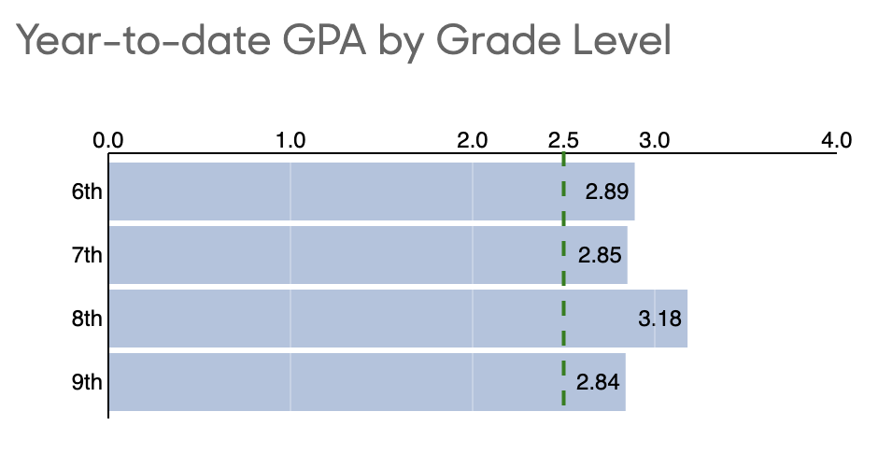
GPA Data (May)
Notes:
Uptick across the board

Slide 18
UA GPA Goals (April)

Slide 19
UA GPA Goals (May)

