Slide 1
ED Updates
April Management Report

Slide 3
Our Mission
Through rigorous academics, character development, and strong supports for every learner, Libertas Academy Charter School prepares all sixth through twelfth grade students to succeed within the college of their choice and to be positive, engaged members of their communities.

Slide 4
Reopening Plan Updates

Slide 5
Our Reopening Philosophy
LACS is committed is to executing a Fall Reopening Plan that is grounded in our mission, our core values and that is informed by what the current science is telling us, specific to our local community, that will help us execute a very safe and successful return to school.

Slide 6
Timeline <Updated 4/26>
April 12: Hybrid begins for students whose families opt them in [appx. 50% of student will opt to be on-site 2 days/week]
May 10 Full in-person for students who opt-in 5 days per week
Students whose family opts them out will remain remote 5 days per week

Slide 7
Full In-Person Schedule
Monday/Tuesday
Arrival- 7:30- 7:50
Dismissal- 3- 3:30 PM
Wednesday
Arrival- 7:30- 7:50
Dismissal- 12 PM
Thursday/Friday
Arrival- 7:30- 7:50
Dismissal- 3- 3:30 PM

Slide 8
High School Planning

Slide 9
Updates- Talent
Staff attrition
Teachers: 22 out 26 (84.61%)
New hires
18 (teachers + support staff)
14 of open roles
Teaching roles: 9
Leader roles: 3
Support Staff: 5

Slide 10
Updates- Talent

Slide 11
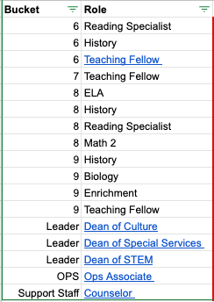
Updates- Talent

Slide 12
Facilities

Slide 13
Updates
Headline: on-track for 7/1
Finalized floor plan layout
Demolition is underway
Landlord is pulling electrical and plumbing permits
MM/KOF working on furniture order

Slide 14
Student Recruitment & Enrollment

Slide 15
FY22 Student Recruitment

Slide 16
Q3 Goals <Update Coming after 4/26 Data Day>

Slide 17
Q&A

