Slide 1
AIMS LUNCH PROGRAM UPDATE
By Ms. Tung
Accountability,Operations Manager/Lunch Program Director
January 16, 2018

Slide 2
Program Success
Daily student participation has been consistently at 450 AIPCS/AIPCS II (fluctuates depending on day of the week).
Feedback from families and student’s are that they are enjoying the meals however would like to see more lunch options. (Determined by vendor contract).
Lunch menu is posted on school website, parent square, AIMS TV monthly.
Successfully passed our first federal/state audit with zero findings.

Slide 3
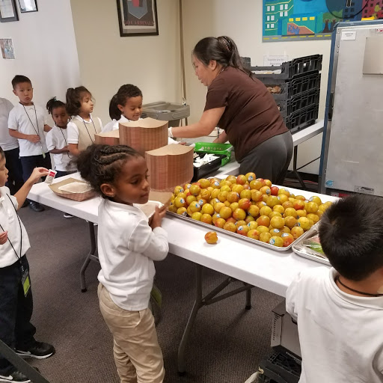
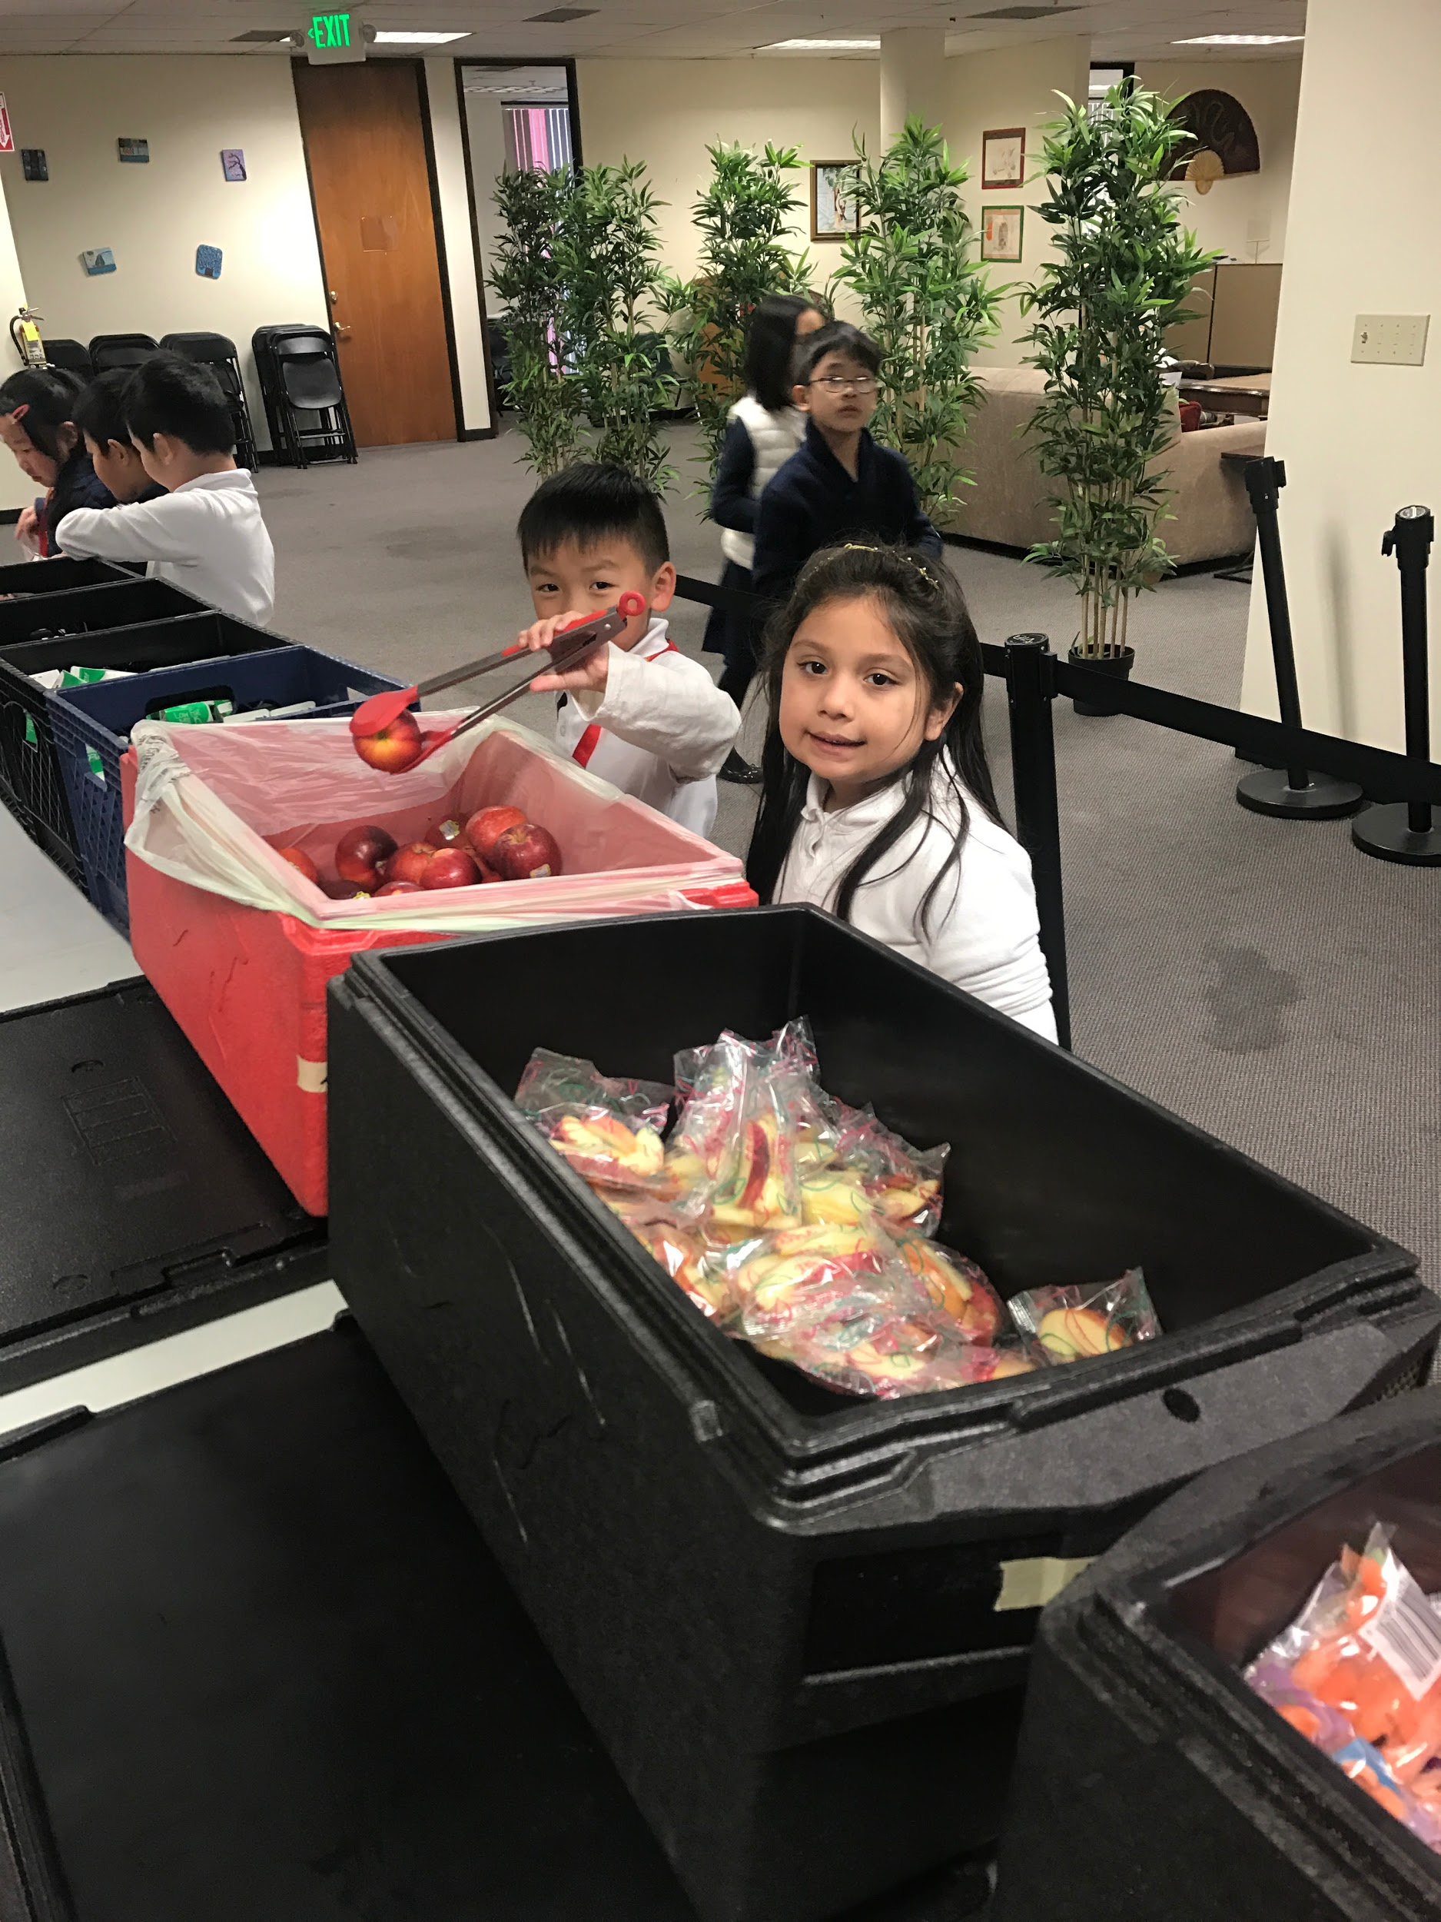
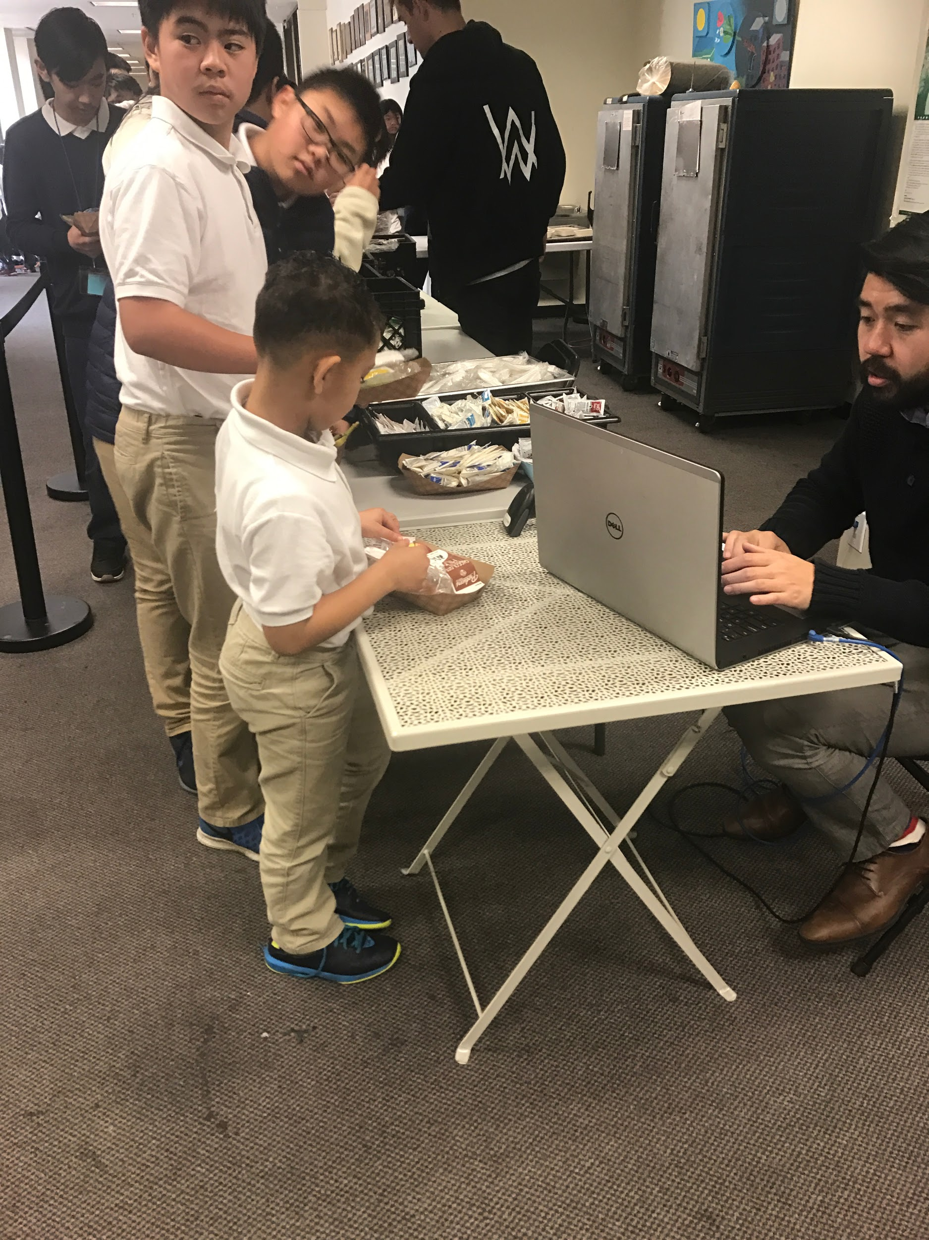
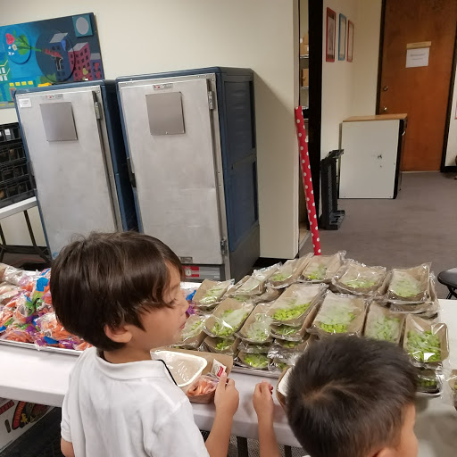
Lunch Service
!!
fgf

Slide 4
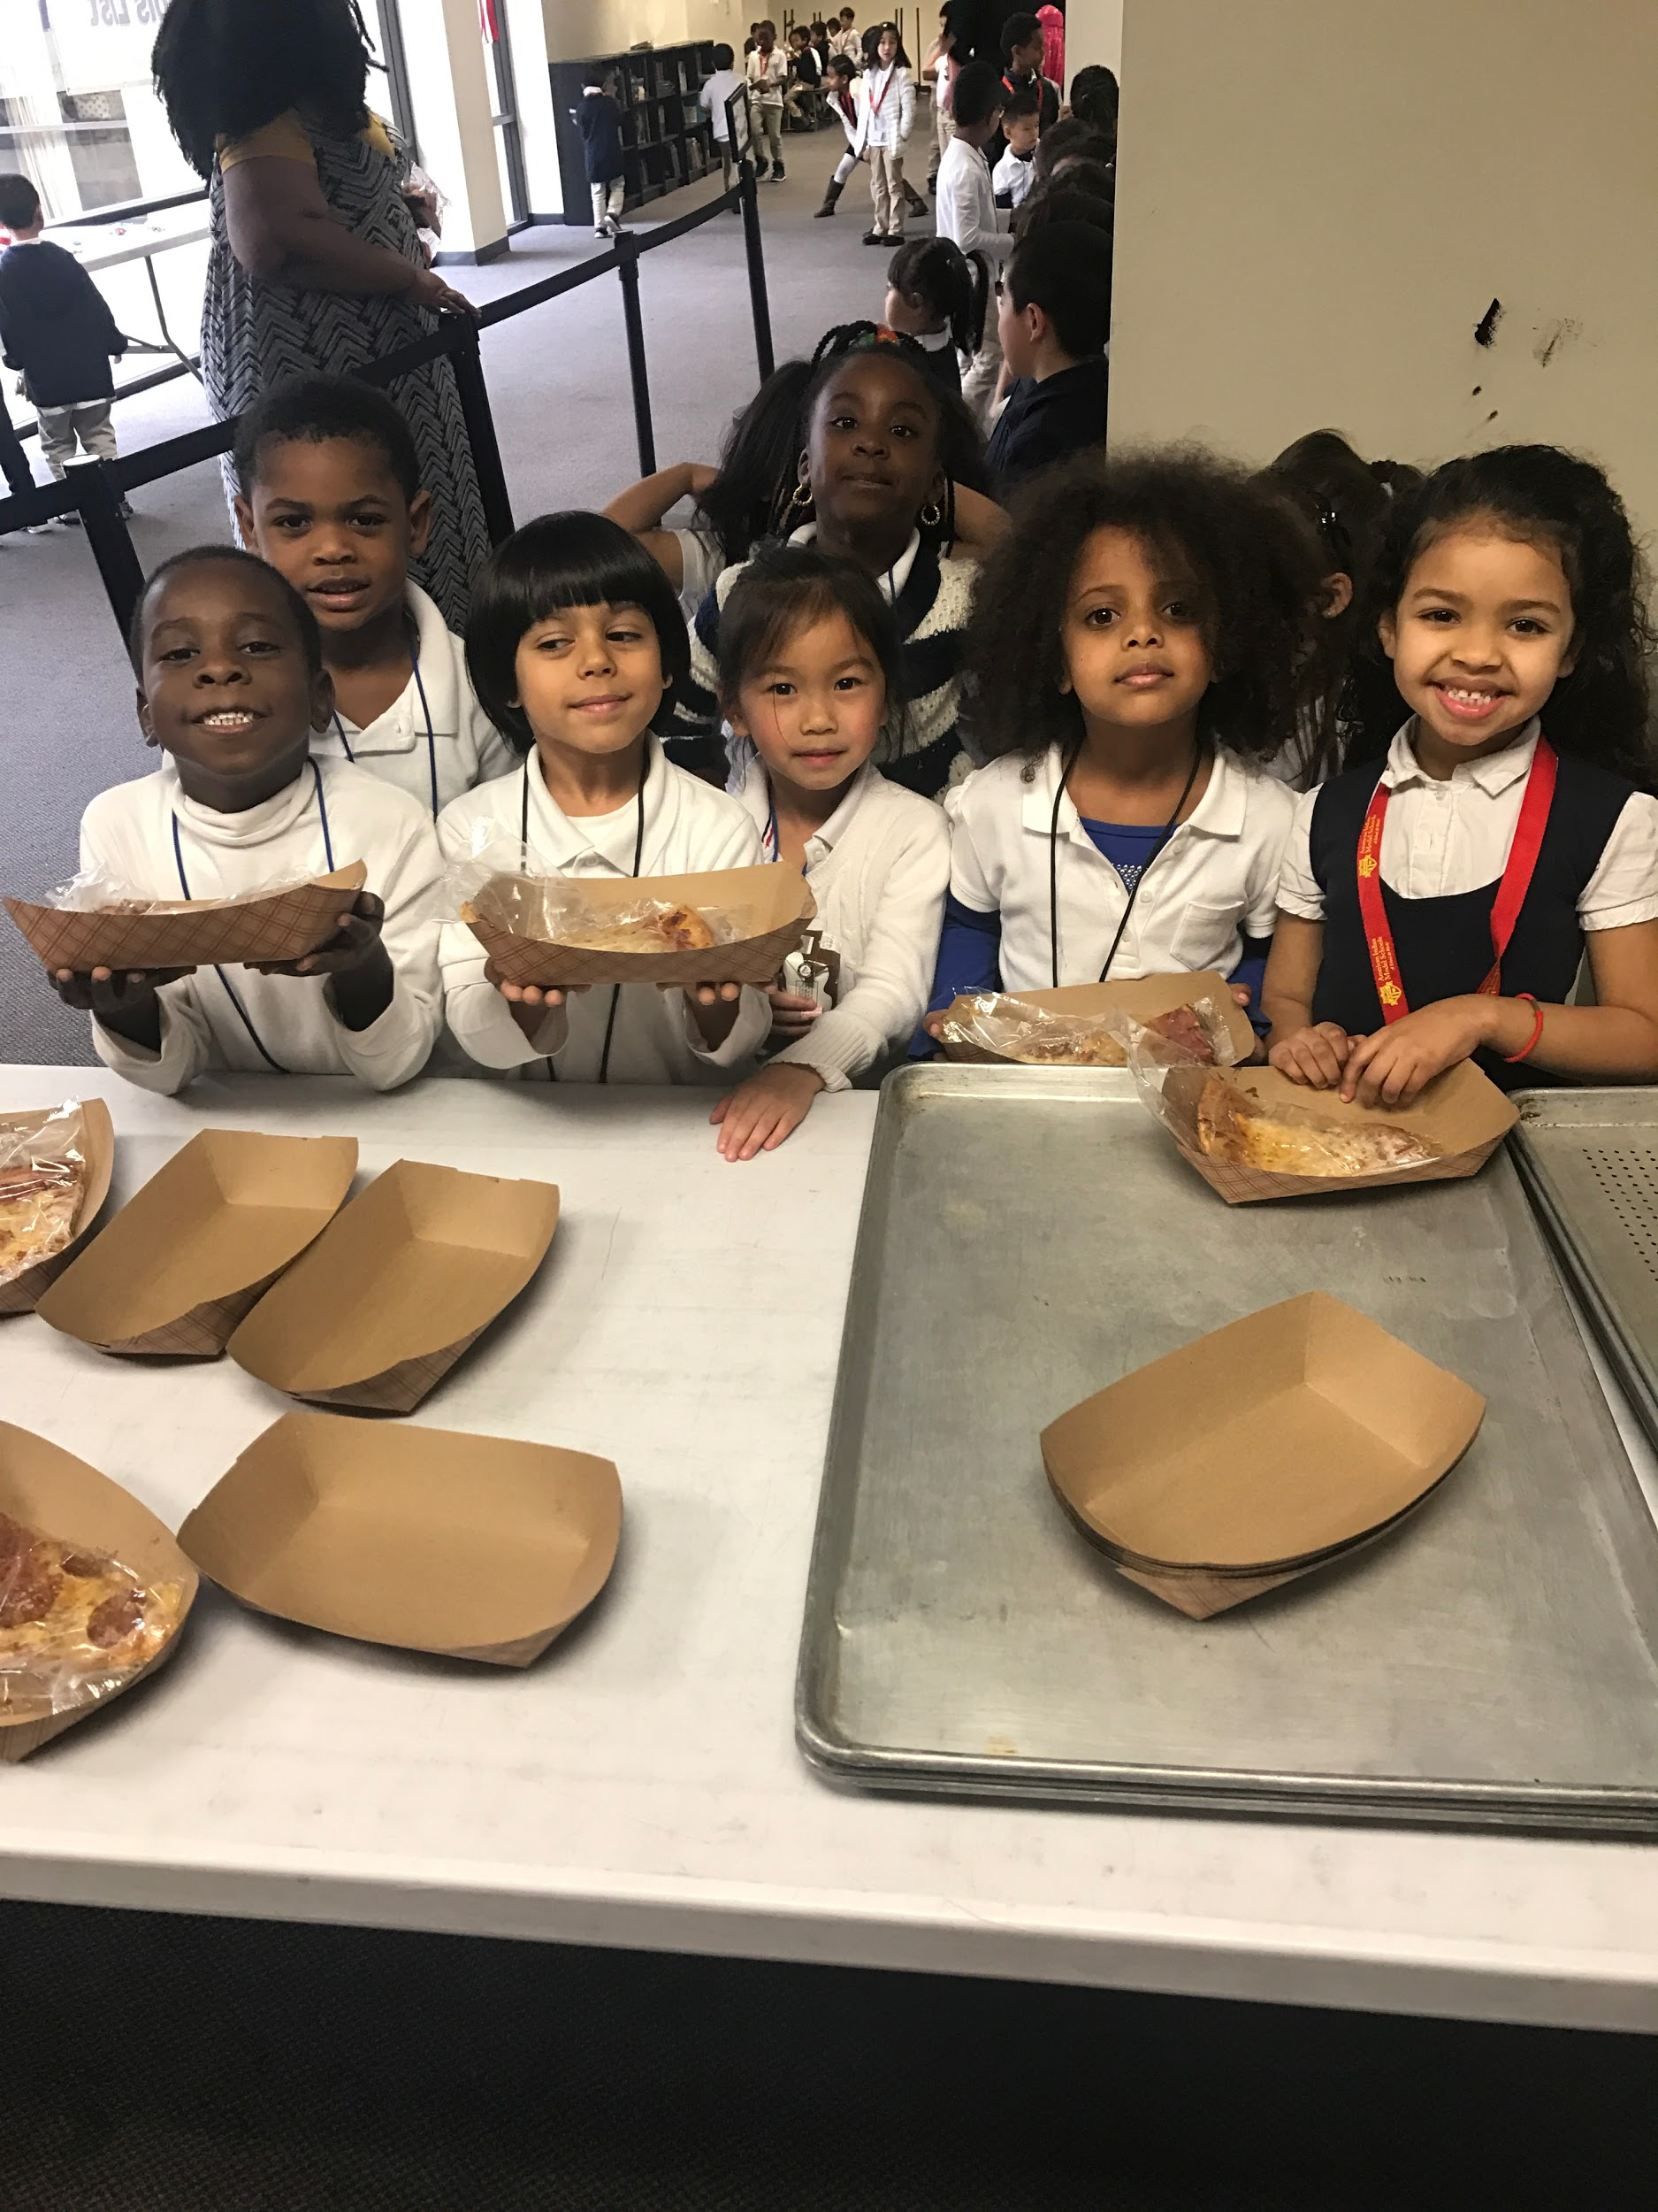
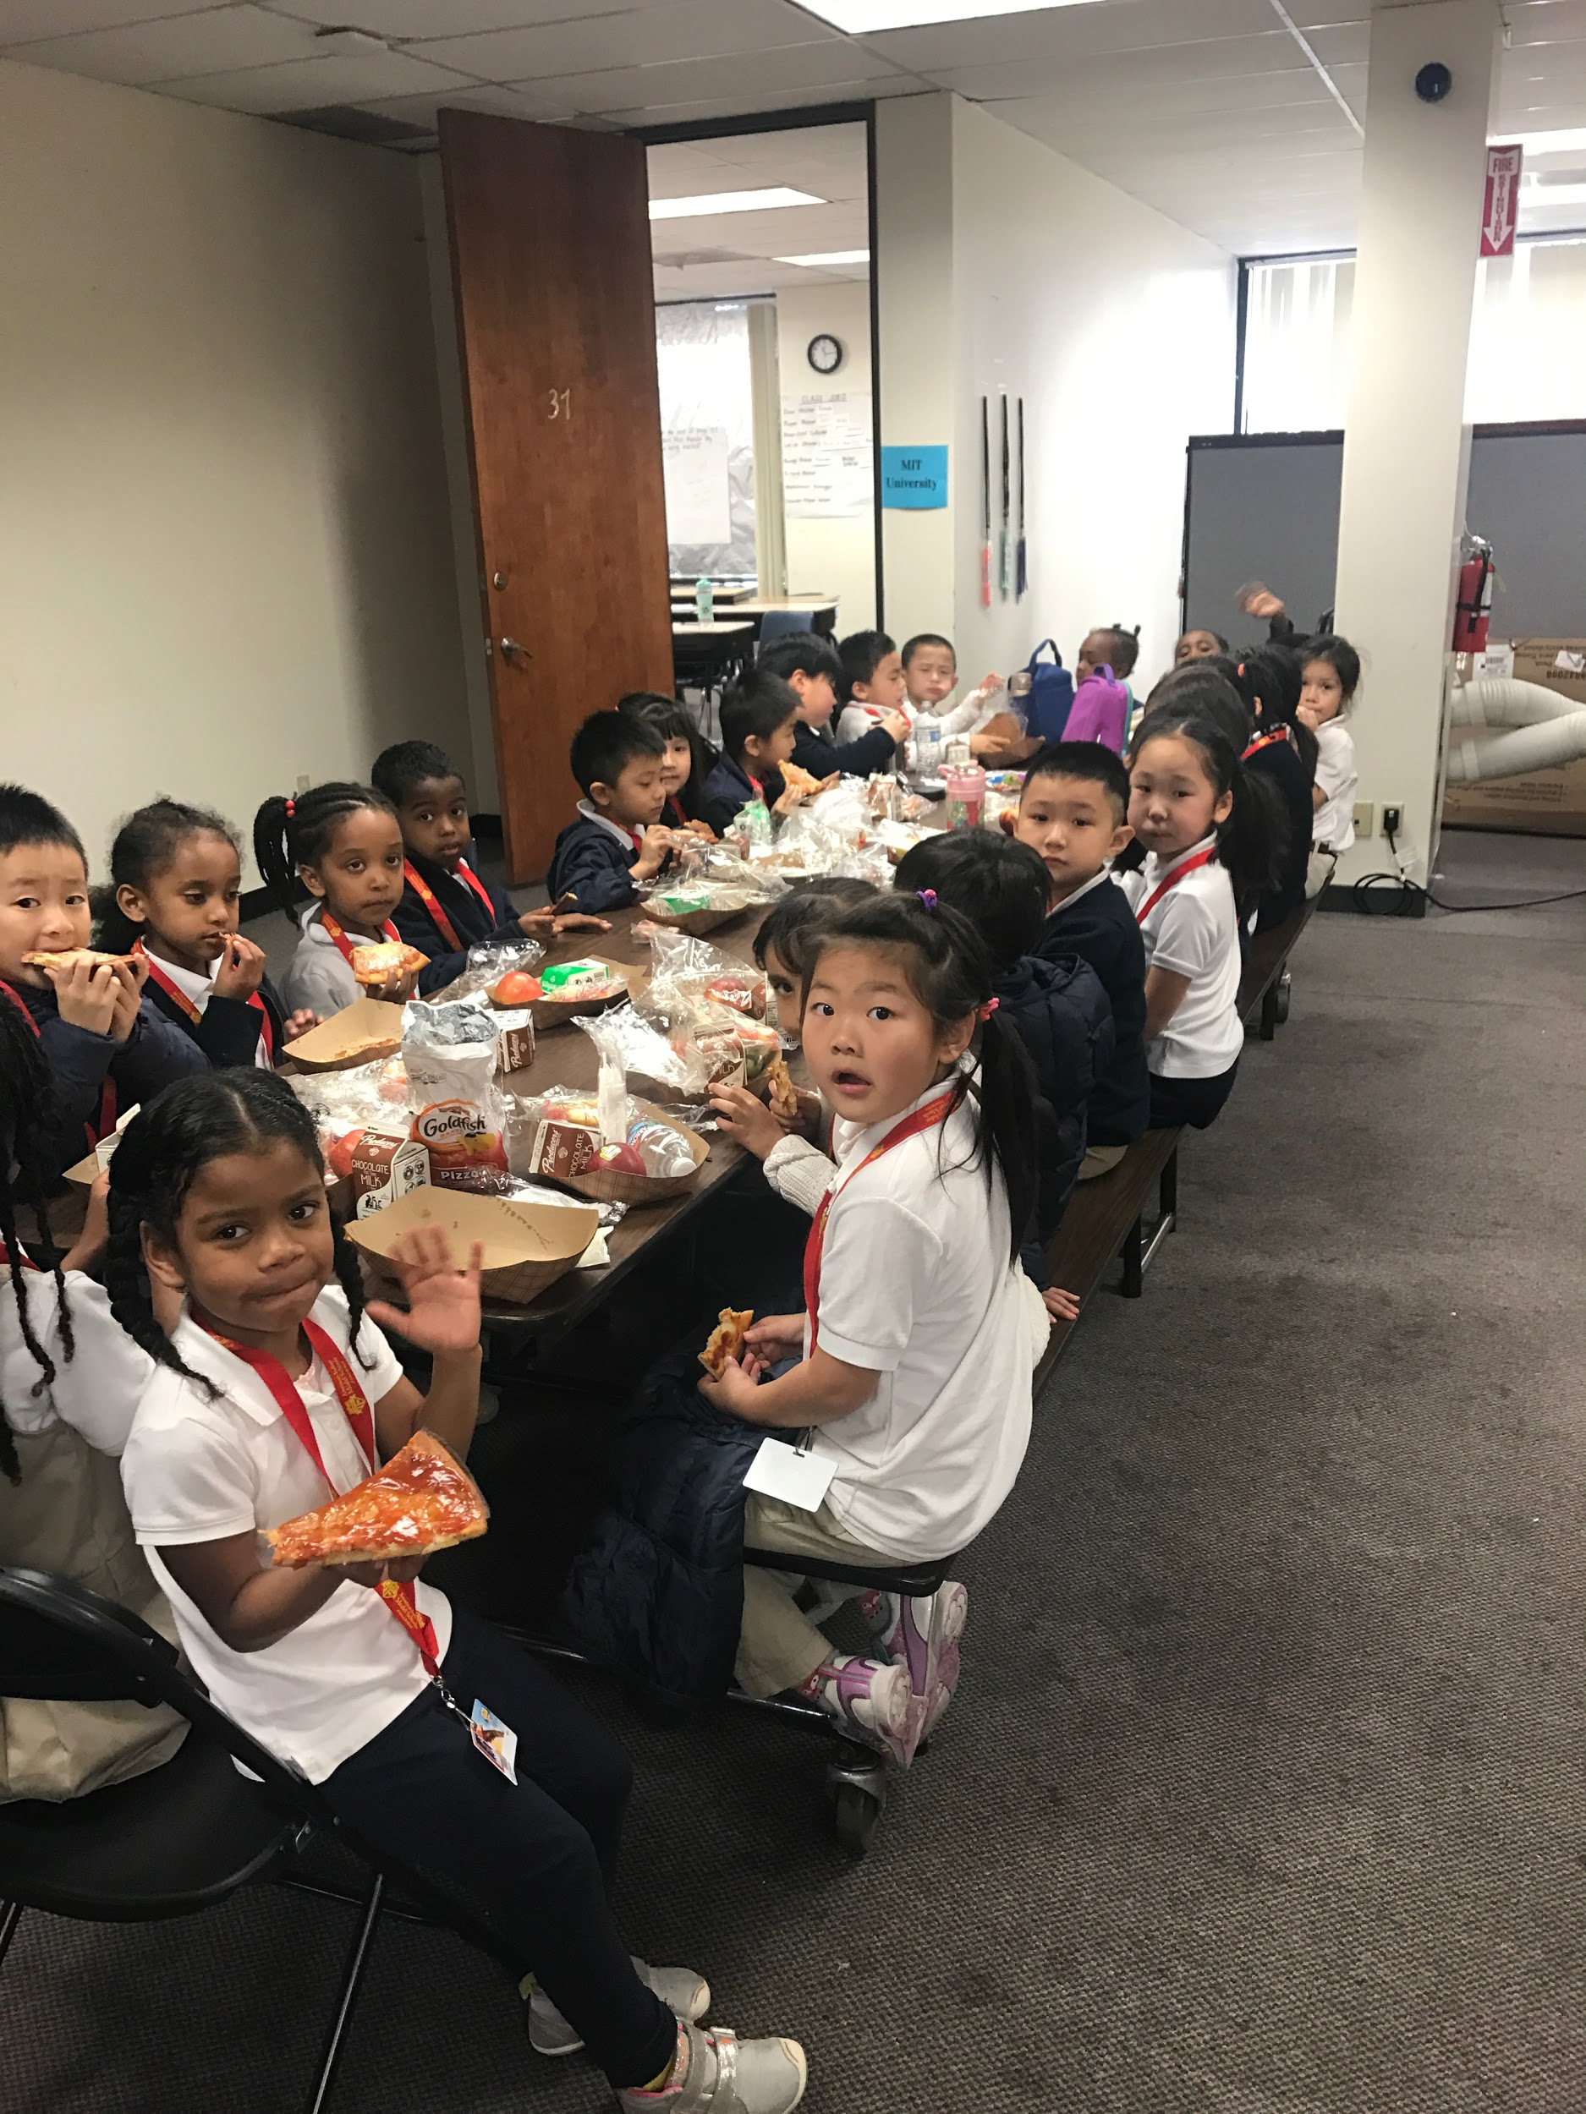
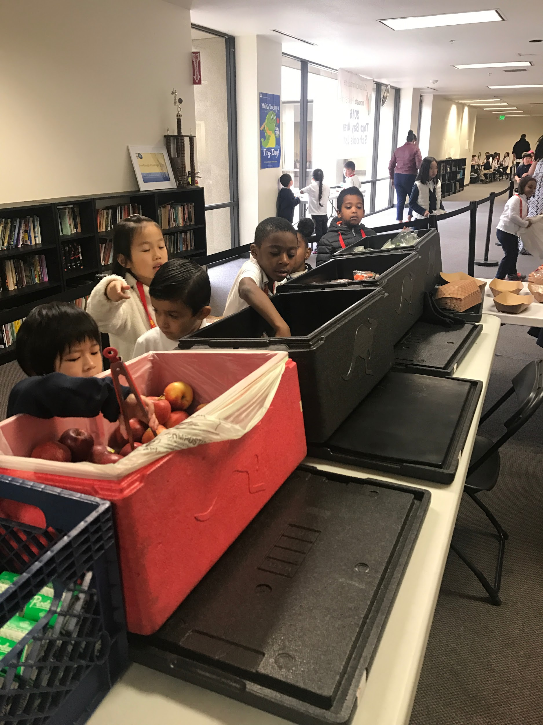
LunchTime Fun

Slide 5
Permitting
Health Department completed inspection on November 8, 2017.
Updated Health Permit through Alameda County Department of Health, valid through January 2019.

Slide 6
Reporting/Policies Protocol
CNIPS (California Nutrition Information and Payment System) EOY report completed and submitted for 2017-2018. (See report in binder)
Monthly claims continue to be submitted, five day turn around for finance department to receive state/fed reimbursements.
Completion of Rights and Complaint policy (will be posted on website).
Completion of updated Unpaid Meal policy. SB 250, Hertzberg. Pupil meals: Child Hunger Prevention and Fair Treatment Act of 2017.
Update on school Wellness Policy (committee will need to be formed of school staff and parents). Will need to meet at least four times a year.

Slide 7
Staff Training
All staff supporting with lunch programming have received Food Handlers certificate and required state mandated training required by CDE.
Civil Rights Training
Food Handlers/Food Safety (ServSafe)
Policy Guidance
NSLP Vended Meals
USDA Eligibility /Meal Pattern (Offer Vs. Served students select 3 components of the 4 offered)
MealTime (Online payment system, provided reports for month FED/State Reimbursements)
Beginning of year training
Free and Reduced Meal application
Production Record/ periodical webinars
Quarterly trainings are provided to lunch program staff to discuss expectations, review nutritional guidelines, proper food distribution and upkeep of reports.

Slide 8
Finances
Estimated Monthly Expenditures Meals AICPS/ AIPCS II- $ 29,000
Estimated Total Federal/State Reimbursement- $25,598.00
Paid Families- estimated $3,000.00 -$5,000 a month
Free-461
Reduced-98
Paid-245
(Depending on student participation totals of reimbursement may change from month to month) .

Slide 9
Collections
Clerical staff contacts families by phone to inform them of their negative balances.
Current Negative Balances by School:
AIPCS - 35 Families $1608.30
AIPCS II- 121 Families $3570.10
Collection from 2016-2017: $3200.00

