Slide 1
Aims E-rate project

Slide 2
What is the E-rate program?
Program that provides discounts to keep students and libraries patrons connected to broadband and voice services.
Administered by the Universal Service Administrative Company (USAC), a non-profit designated by the FCC to make universal service possible.
USAC handles about $10 billion annually to assist schools/libraries, rural health care, Lifeline service, and funding to companies working to expand connectivity infrastructure in unserved or undeserved area.
Schools/Libraries receives significant discounts for both broadband and voice services.

Slide 3
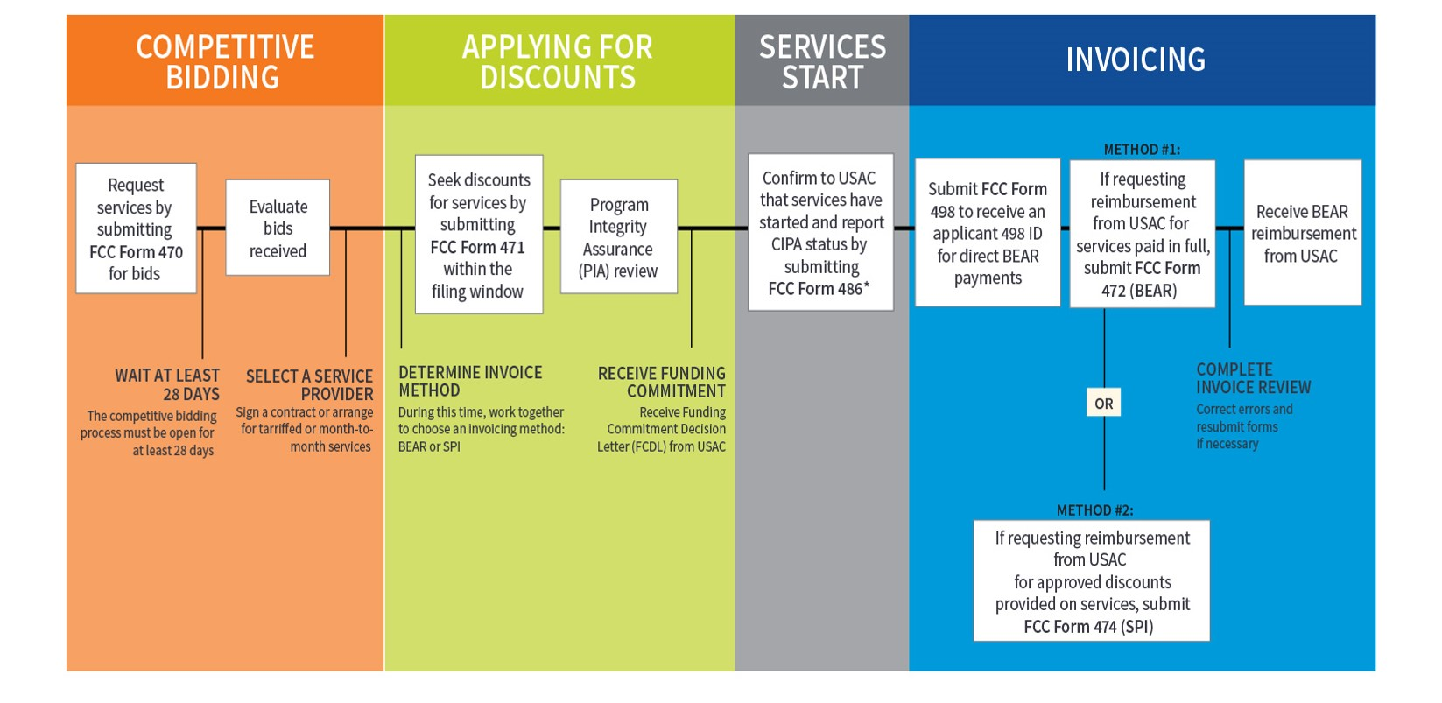
APPLICATION PROCESS FLOWCHART: APPLICANT STEPS
E-RATE Program Steps
*Consortium members report their CIPA status by submitting FCC Form 479 to their consortium leader.
The consortium leader then files FCC Form 486.

Slide 4
E-RATE Program timeline
FCC Form 470 - must be submitted by 02/22/2018
Project requirements – internet, hardware, software, cabling…
FCC Form 471 – must be submitted by 03/22/2018
Evaluation Matrix for chosen vendors
Submit signed contracts to USAC for consideration
AIMS E-Rate application reviewed and wait for funding decision
Service Fulfillment after funding decision.

