Slide 1
AIMS K-12 Board Report
April 17th, 2018
Superintendent Maya Woods-Cadiz
Mrs. Erin Oh (K-2 Division Head)
Mr. Christopher Ahmad (3-5 Division Head)
Mr. Peter Holmquist (Middle School Division Head)
Mr. Tareyton Russ (AIPHS Head of School)
Mr. Maurice Williams (AIPHS Dean of Students)
Ms. Marisol Magana (Operations Director)
Ms. Tiffany Tung (Operations Manager)

Slide 2
Enrollment Numbers
AIPCS
AIPCS II
AIPHS
145
655
359

Slide 3
ADA & ADA %
AIPCS - 142.68 - 98.40%
AIPCS II - 639.68 - 97.63%
AIPHS - 343.68 - 96.20%

Slide 4
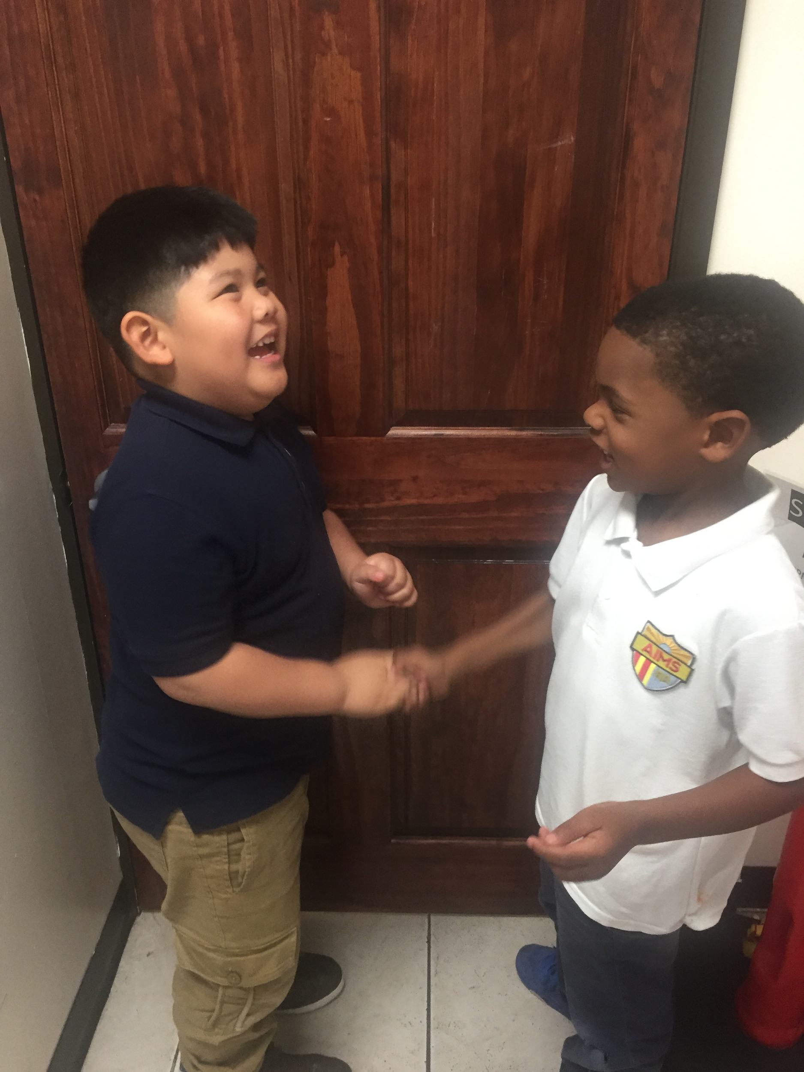
K-2 Updates
94% of students reading at grade level or above (using Lexile scale)
100% at grade level or above using Illuminate math benchmarks
Retention criteria based on skills only taught in early elementary:
Literacy checkpoints
Self-regulation
Age

Slide 5
3-5 Updates
SBAC TESTING WINDOW April 30th-June 5th
3-5 grade will take the test 2nd,3rd,and 4th week of May.
This week, students are taking 2 end-of-the-year comprehensive benchmark tests
They will spend next week reviewing them
Students who complete all Khan Academy Missions will be invited to a special pizza party the first Friday in May. The student must get 100% in math and grammar.

Slide 6
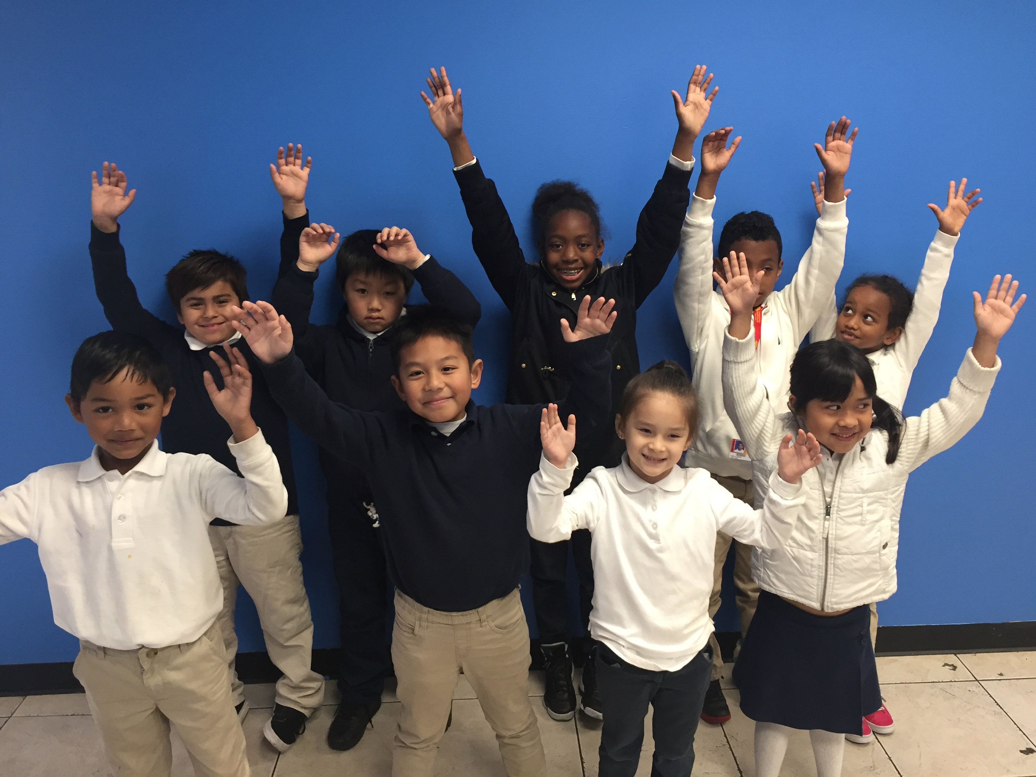
Elementary Students
of the Month
April AIMS Value: Family & Community

Slide 7
More 6-8
18 classes received a classroom presentation on suicide prevention.
Crisis Support Services of Alameda County presented over three days in our middle school.
Students engaged with three presenters during their discussions and time with these crisis support counselors.
This work fulfills some of AB-2246, Pupil suicide prevention policies (Sept. 2016)
6-8 Updates
Academic Focus Fridays have taken the place of Electives during much of the 3rd and 4th quarter. Subject matter reteaching is the usual focus after completing the curriculum, but these Friday sessions focus even further on SBAC preparations and strategies.
Deng Jongkuch spoke to 7th grade classes today, about his experience as a “Lost Boy” of Sudan and a refugee.

Slide 8
K-12th Wellness Committee
School Wellness (committee formed of school staff and parents).
Met February and March to discuss best practices of nutrition and socio-emotional support to promote wellness of the whole-child.
Positive Outcomes: Reduce chronic absenteeism, intentional about educating students and families about proper nutrition, health and wellness of the whole-child.
Next Meeting: April 23, 5:30pm 12th St.

Slide 9
FAC
Meeting postponed due to charter conference & spring break
Next meeting: April 25, 6:30pm Lakeview
Committees: Booster, Parent Education, Community
Popcorn & Kid’s Movie

Slide 10
FAC
Meeting postponed due to charter conference & spring break
Next meeting: April 25, 6:30pm Lakeview
Committees: Booster, Parent Education, Community
Popcorn & Kid’s Movie

Slide 11
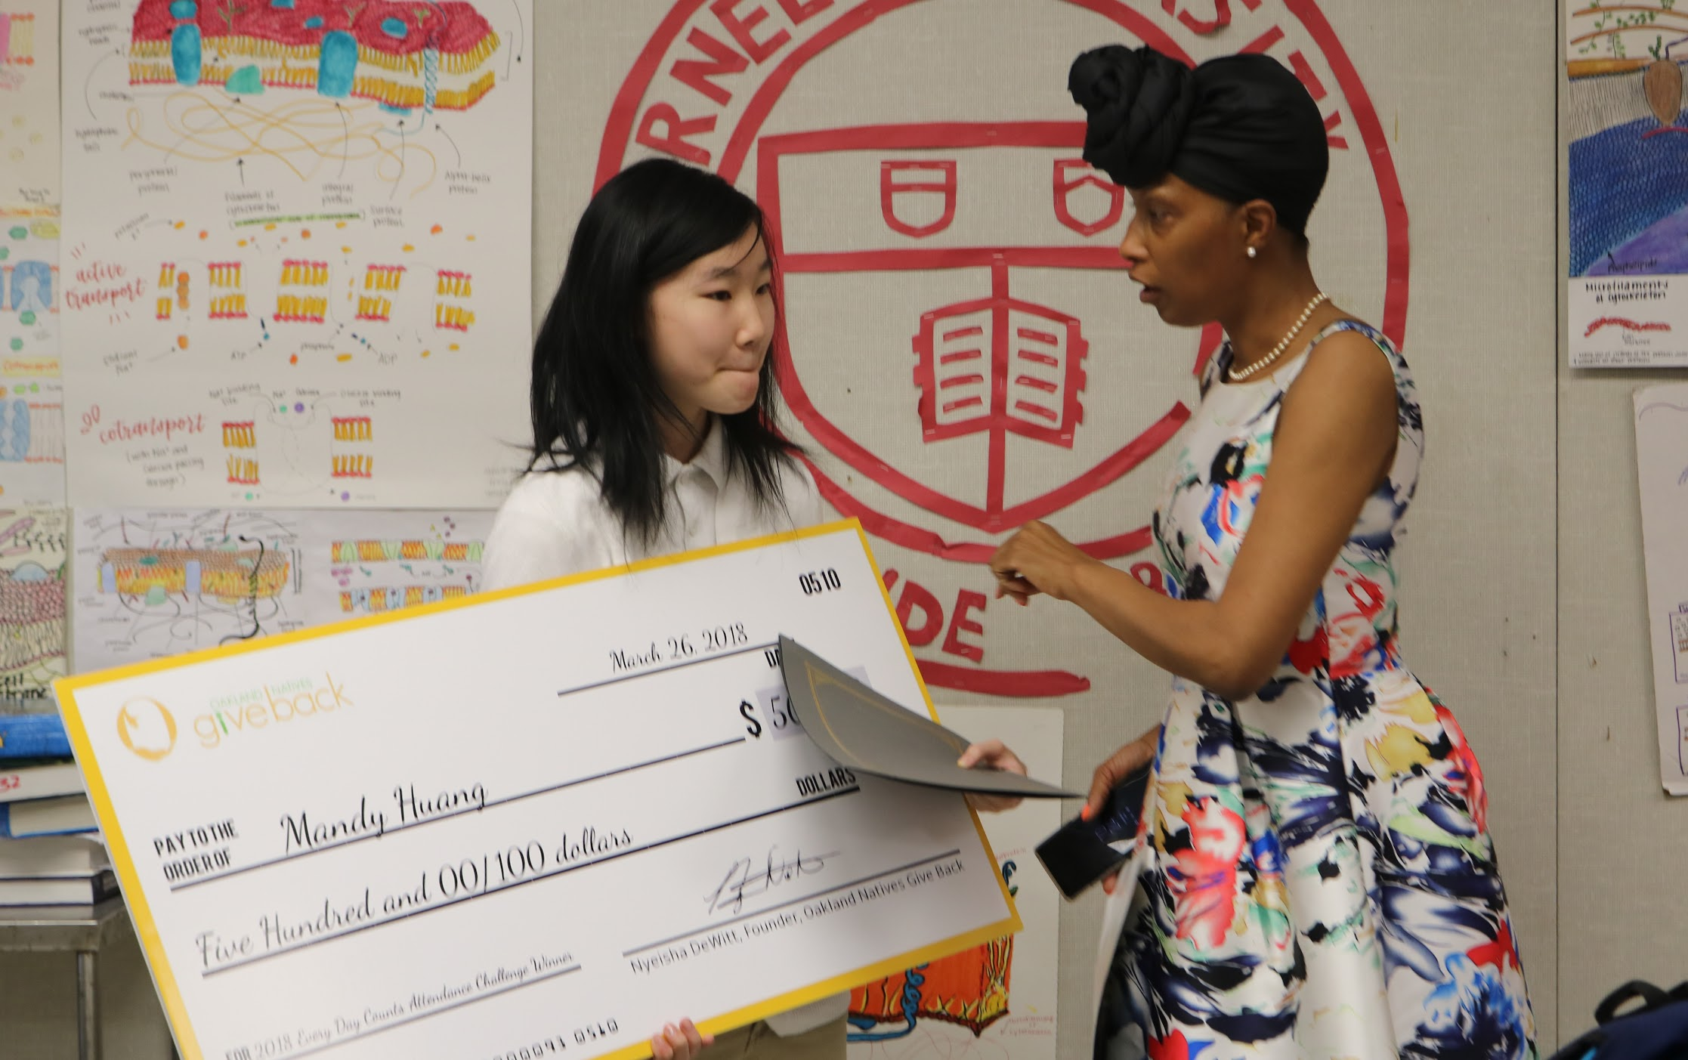
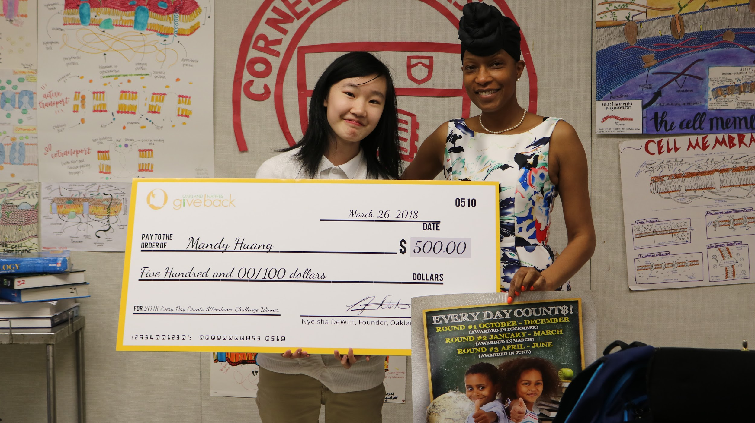
Perfect Attendance
On Wednesday, March 28, AIPHS Sophomore Mandy Huang received a $500 check from Giveback Natives Oakland for its everyday counts attendance challenge.
Applications are available now for AIPHS students to enter the attendance challenge for their Q4

Slide 12
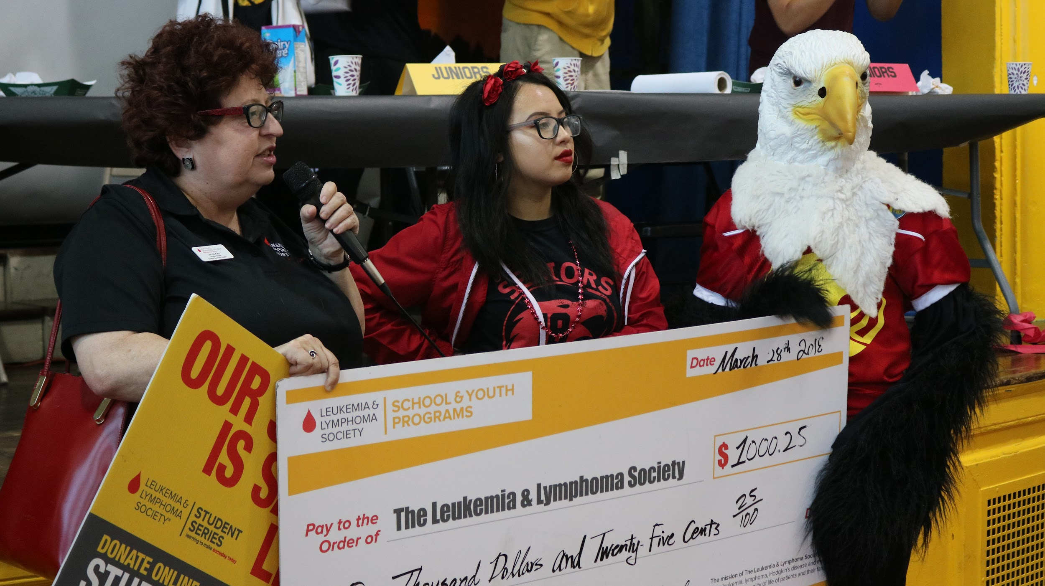
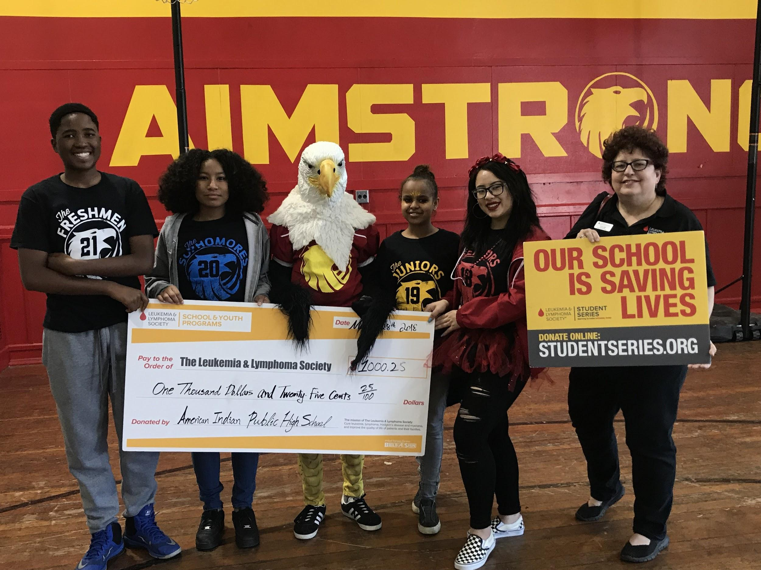
LLS Fundraiser
On Wednesday, March 28, Representatives from the Leukemia and Lymphoma Society attended an AIPHS Pep Rally where the SGA made its $1000 fundraising contribution to LLS.

Slide 13
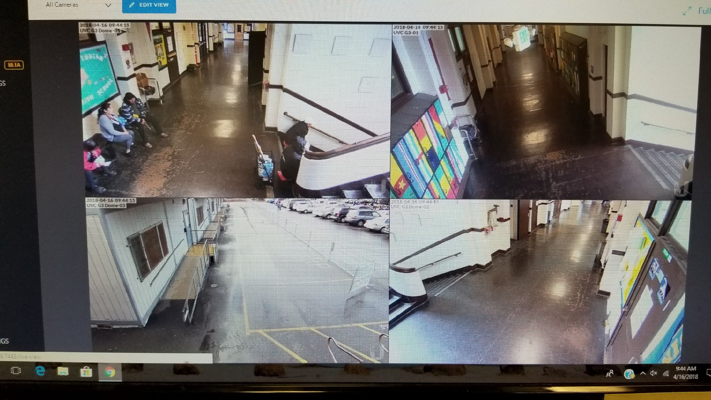
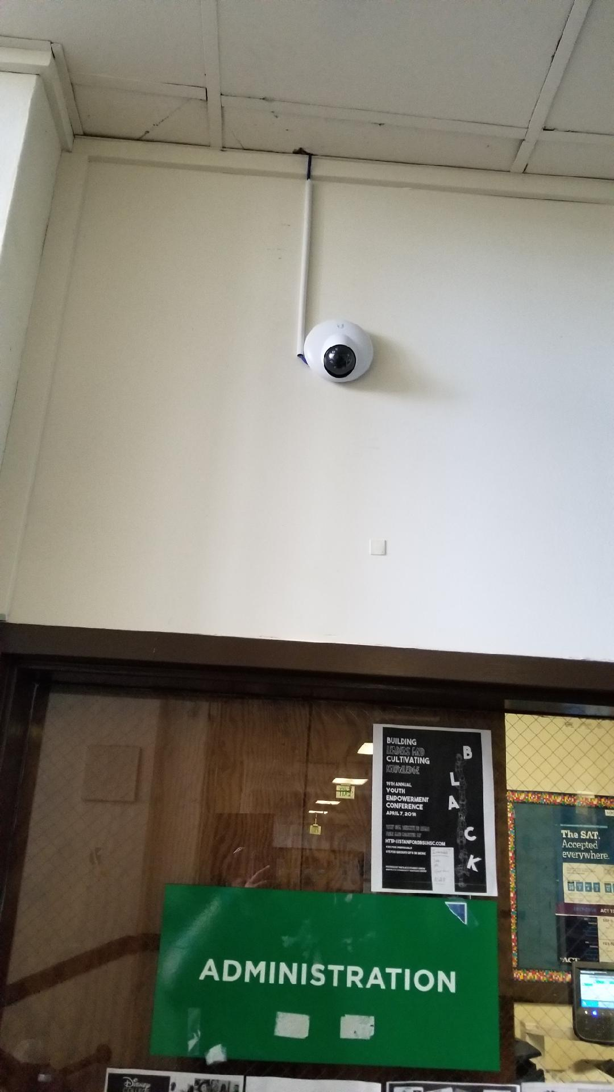
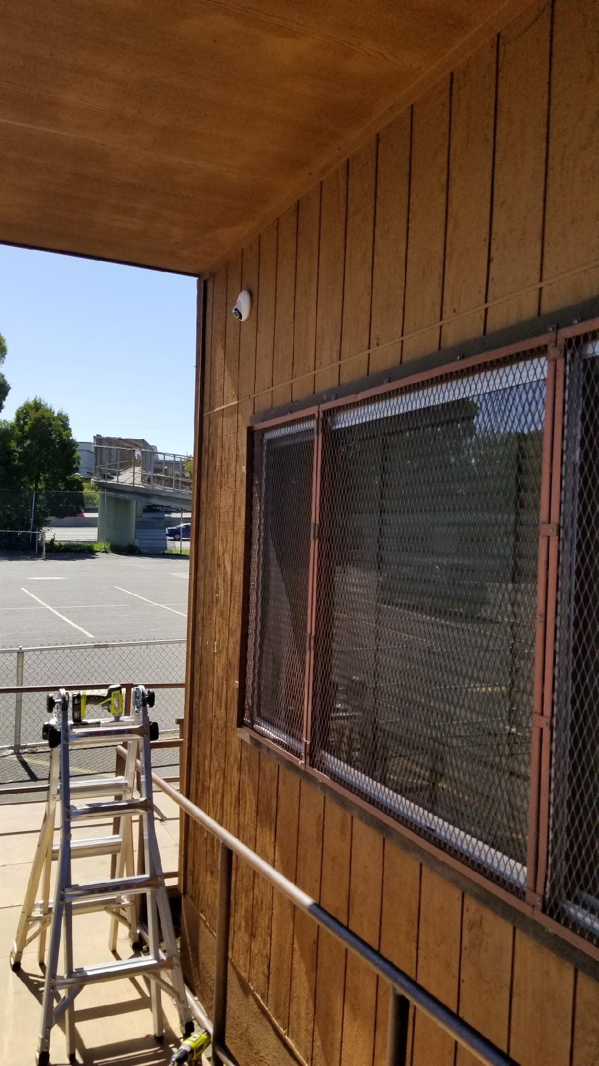
Security Cameras
AIPHS installed 4 Security Cameras on campus over the Spring Break.
Long-term goal is to install as many 8-10 cameras on campus.
This meets goals of 2017-2018 LCAP.

Slide 14
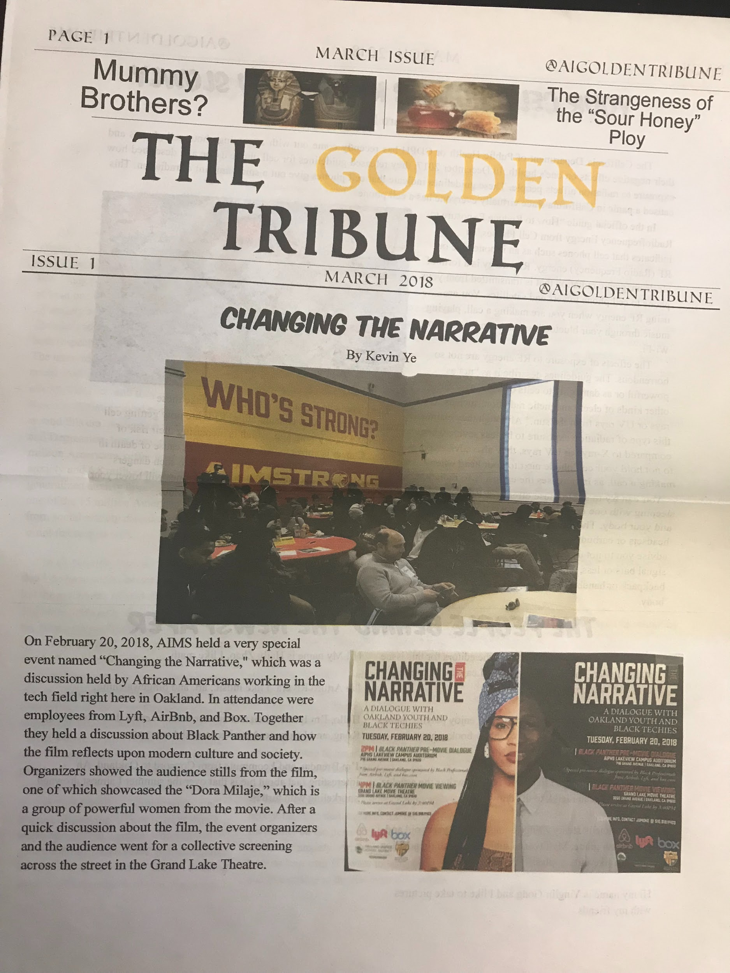
AIPHS Student Newspaper
The first issue of AIPHS’s student Newspaper The Golden Tribune was released in April.
The Golden Tribune is produced in Mr. Daniel Mark’s 6th Period Journalism Class

Slide 15
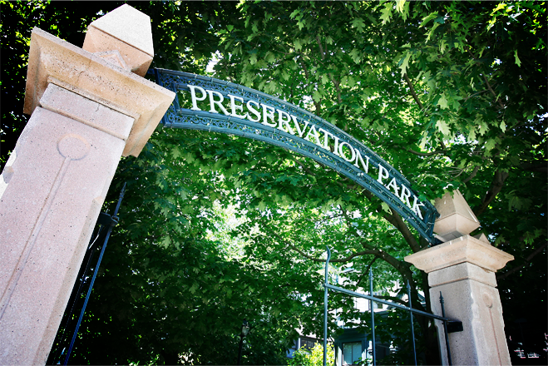
AIPHS Senior Prom
AIPHS will have a joint Junior / Senior Prom titled A Night in Paris, on Friday, June 1, 2018, from 5PM-11PM at Preservation Park, in Oakland.
AIPHS’s prom will be entirely outdoors and tickets are on sale for $40

Slide 16
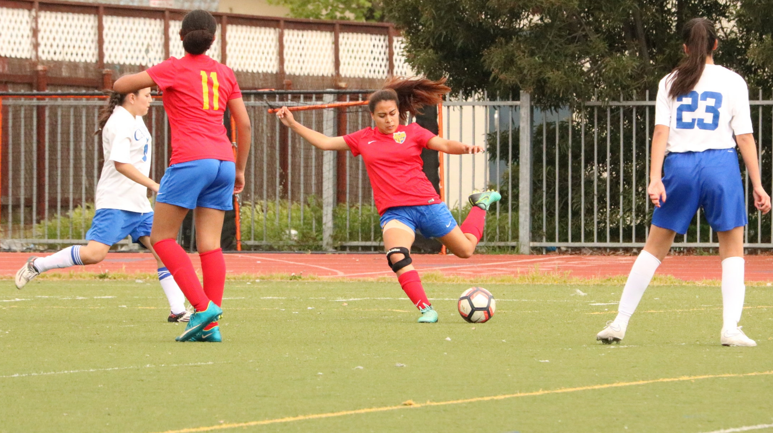
Lady Eagles Soccer Update
The Lady Eagles Soccer Team is currently 3-2 and will secure a playoff spot with today’s win against Oakland Unity.
Senior Paola Barron is currently ranked #4 in the state of California for goals scored in this season and is the league’s leading MVP candidate.

Slide 17
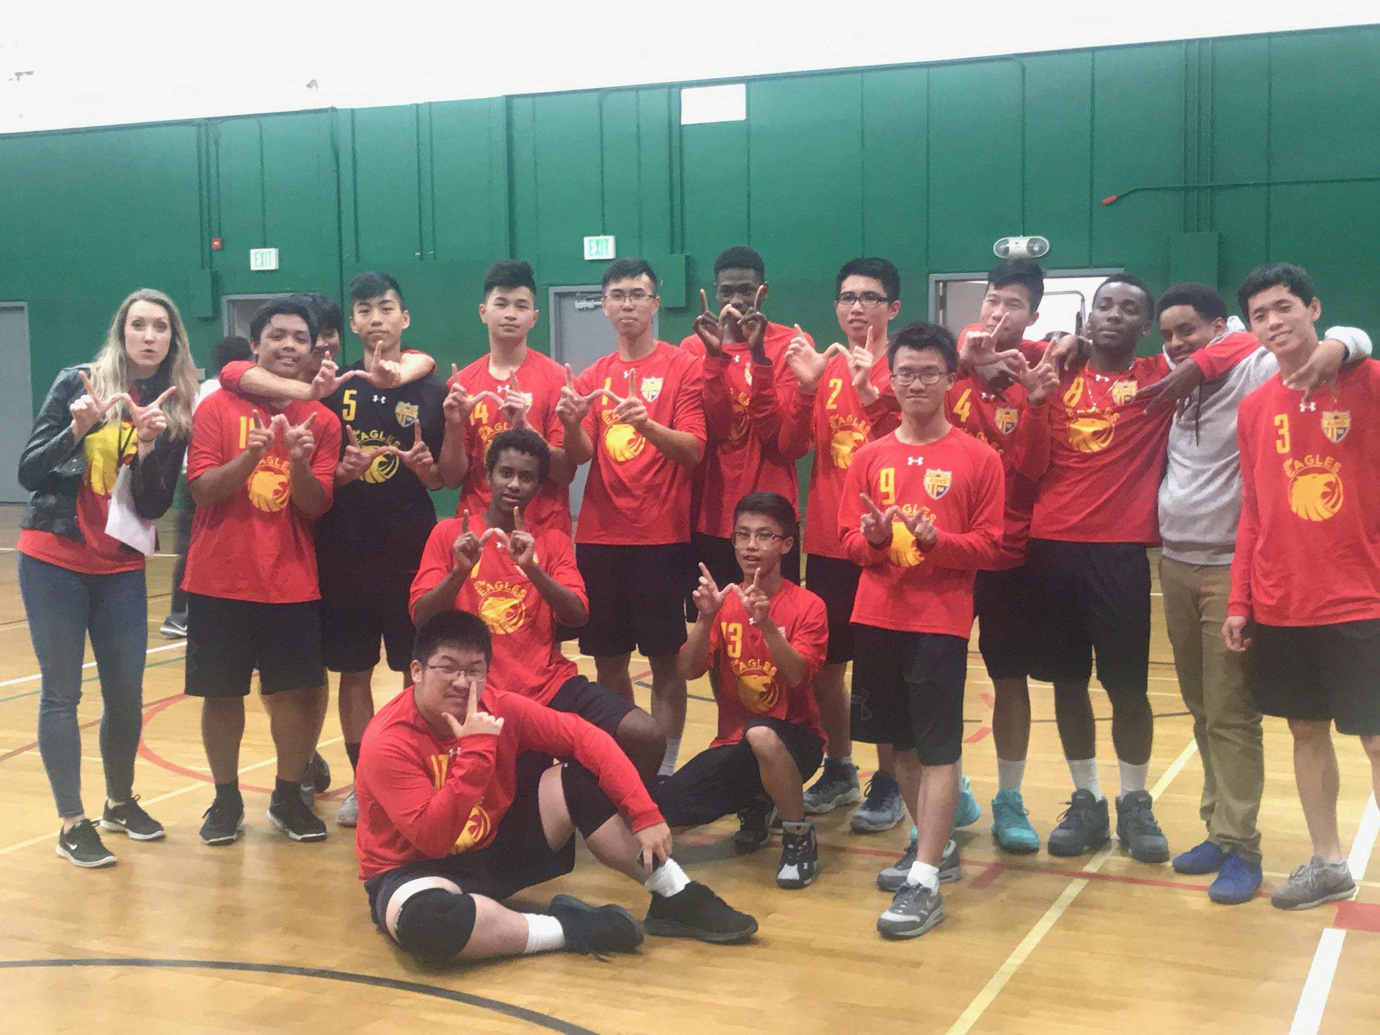
Boys Volleyball Team Update
The Boys Volleyball team earned their first victory of the season against Coliseum College Prep by defeating them 3-0
The Boys Volleyball team will play against Oakland High, Oakland Tech, and Skyline High within the next two weeks

Slide 18
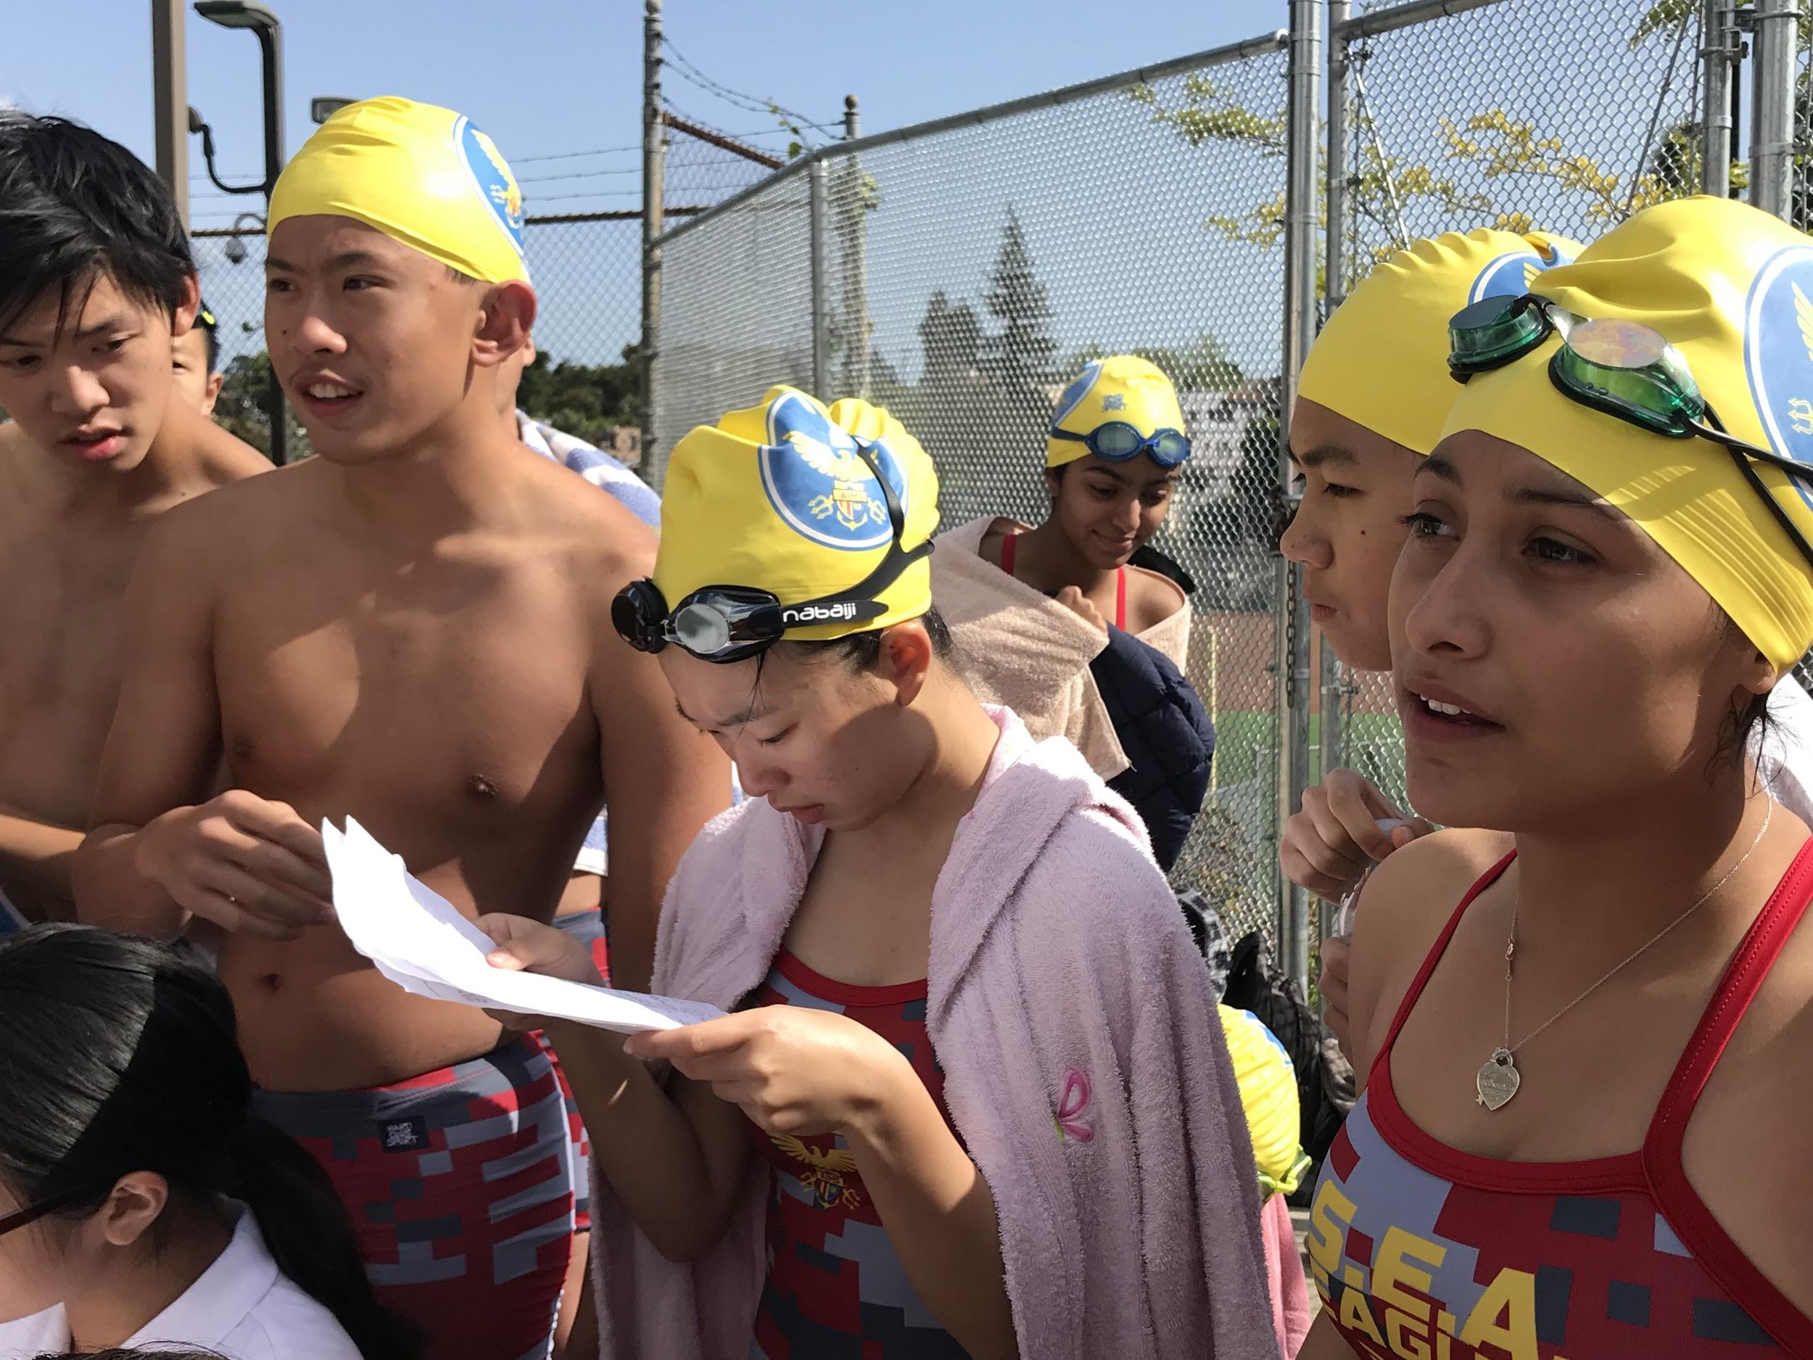
S.E.A. Eagles Update
The AIPHS Swim Team held its first meet of the season on Thursday, April 12
The girls and boys teams competed well considering their limited experience and several AIMS swimmers won their swim heats.
AIPHS’s next swim meet will be held on April 26 at Castlemont High School.

Slide 19
AIPHS Title IX Report
AIPHS’s Annual Title IX Report on the Athletics Program was released and is available online at aimsathletics.com/title-ix

