Slide 1
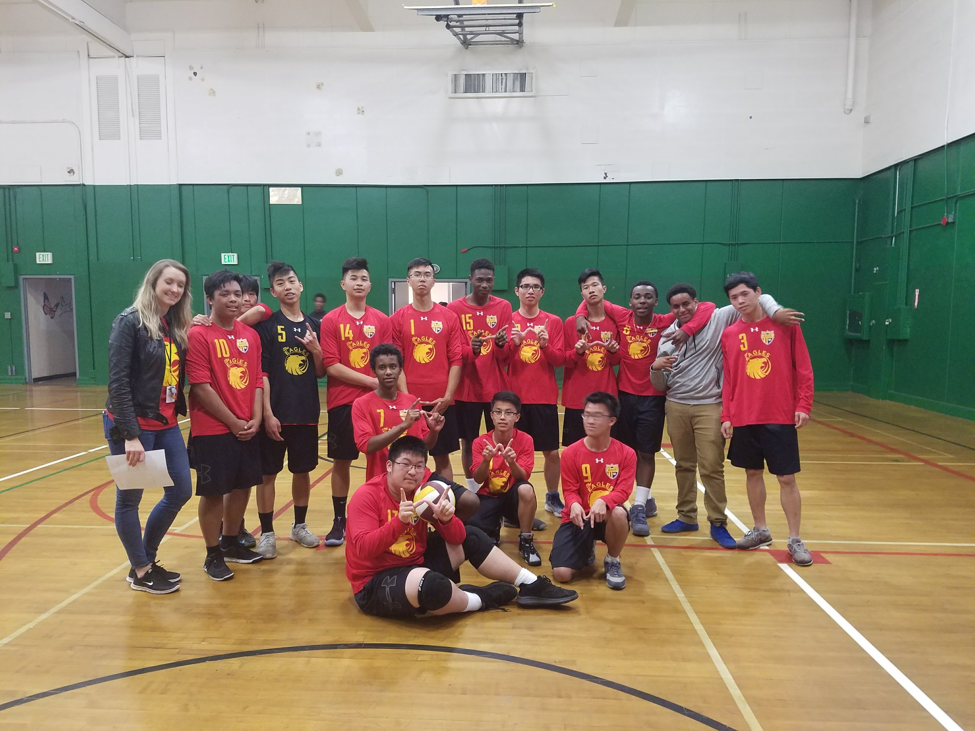
SUPERINTENDENT
BOARD REPORT AIMS K-12 APRIL 2017

Slide 2
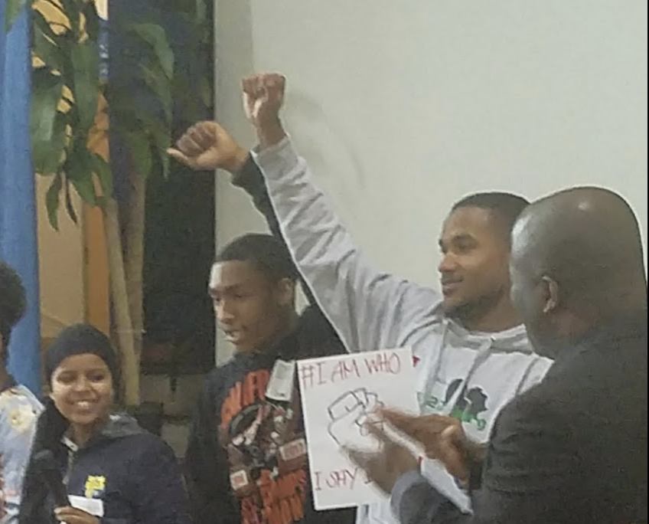
Academic Celebration
For the third year AIMS has been recognized by Innovate Schools for the Academic Performance of our African American students for closing the Acheivement Gap. Innovate tracks and measures the success of traditionally underserved populations in schools.

Slide 3
Celebration of Attendance
Congratulations to AIPHS Sophomore Mandy Huang for achieving perfect attendance and being selected as one of the twenty Oakland Natives Give Back 2018 Every Day Counts Attendance Challenge winners for the third academic quarter! Because of Mandy's perfect attendance, Mandy also earned a check for a whopping $500!

Slide 4
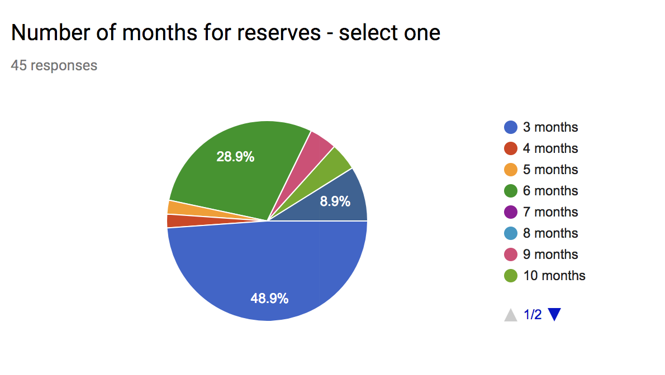
Reserves Inquiry
All AIMS staff was polled for their input about the amount of reserves the organization should hold. Currently 45 out of the over 100 employees have responded. The poll end on the 18th.

Slide 5
AIMS Agreed Upon Prop 39 Offers
01
04
MLK
Lakeview
02
05
Allendale
Westlake
03
WOMS

Slide 6
AIMS 2018-2019 Offers For Hire Timeline
Certificated
Classified
Administration
April 20, 2018
April 20, 2018
May 4, 2018

Slide 7
AIMS Salary and Compensation Report
The following data was shared with all AIMS employees. It is a comparison to hourly compensation from OUSD and GuideStar reports and AIMS hourly compensation (based on salaried amounts for leaders and teachers).
Aides_ $5.38 More
Clerks-.08 More
Admin. Assistants-$3.68 More
S
Teachers-$4.55 More
Administration
Certificated
Classified
AIMS Supt. _ $10.06 Less
AIMS HOS-$4.43 Less
AIMS HOD-$1.59 Less

