Slide 1
AIMS K-12 Board Report
June 19th, 2018
Superintendent Maya Woods-Cadiz
Mrs. Erin Oh (K-2 Division Head)
Mr. Christopher Ahmad (3-5 Division Head)
Mr. Maurice Williams (6-8th Division Head)
Mr. Tareyton Russ (AIPHS Head of School)
Mr. Peter Holmquist (AIPHS Head of Academics)
Ms. Marisol Magana (Operations Director)
Ms. Tiffany Tung (Operations Manager)

Slide 2
Enrollment Numbers
AIPCS
AIPCS II
AIPHS
145
654
359

Slide 3
ADA & ADA %
AIPCS - 139.50 - 96.21%
AIPCS II - 621.60 - 95.34%
AIPHS - 318.73 - 88.78%

Slide 4
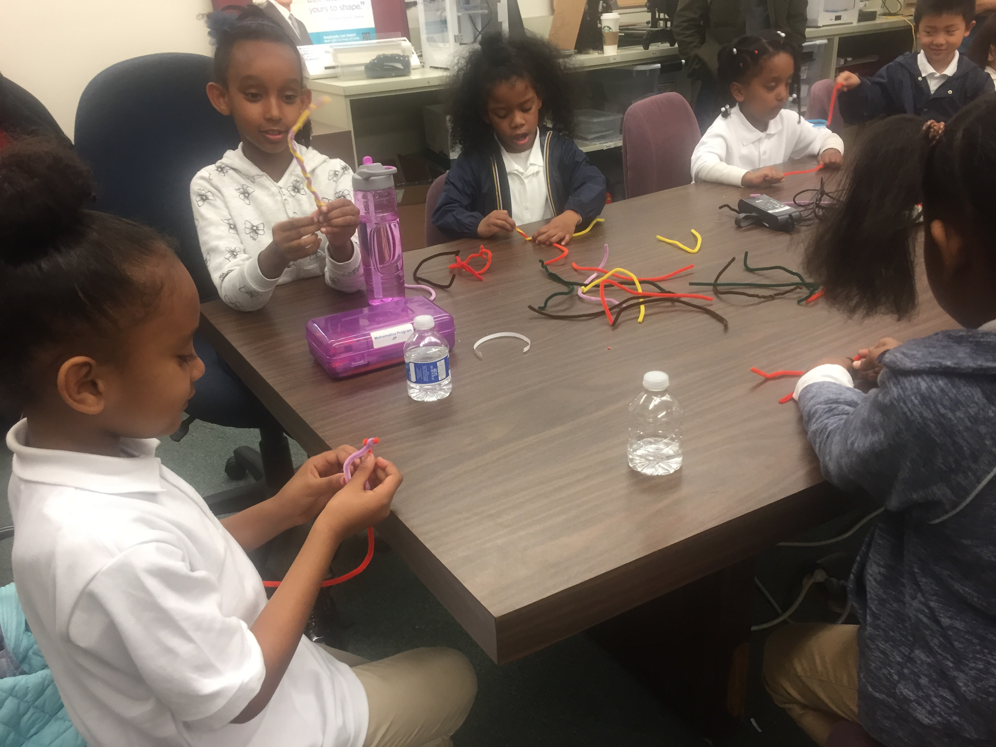
K-2 Updates
*Bedtime Math: Pajama Party
-Over 100 families participated and downloaded the Bedtime Math app
*Each class attended at least 4 field trips by the end of the year
*We met our goal that at least 90% of students who began the school year at risk for retention would be promoted.

Slide 5
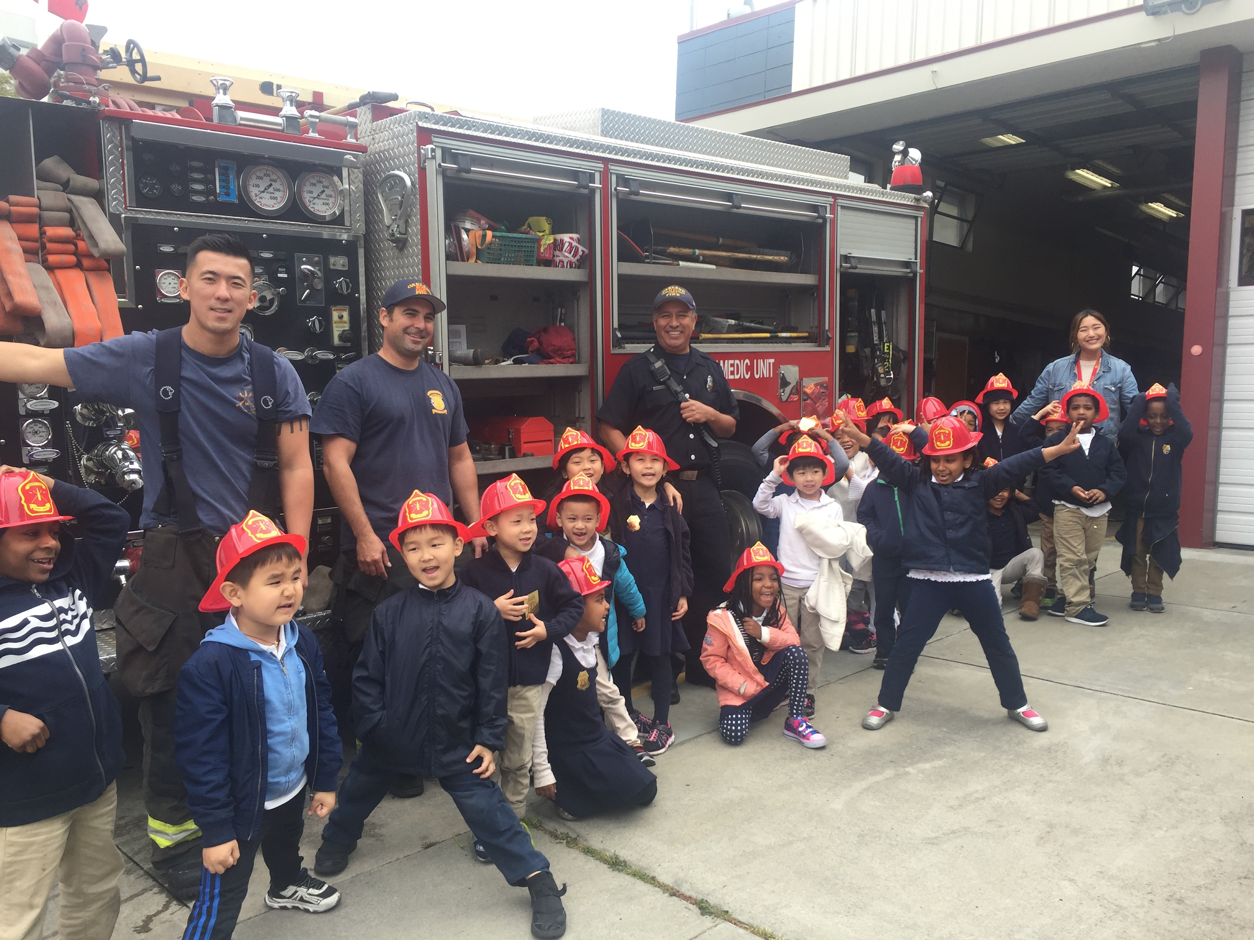
K-2 Updates
Next year:
ESGI programming to track data
Continuation with Center for Collaborative Literacy (high reading and metacognitive outcomes)
GATE-like differentiation
Partnership with Roosevelt: SEL
Implement the recommendations from First 5’s kindergarten readiness assessment
EDUCATING Parents
1:1 iPad usage

Slide 6
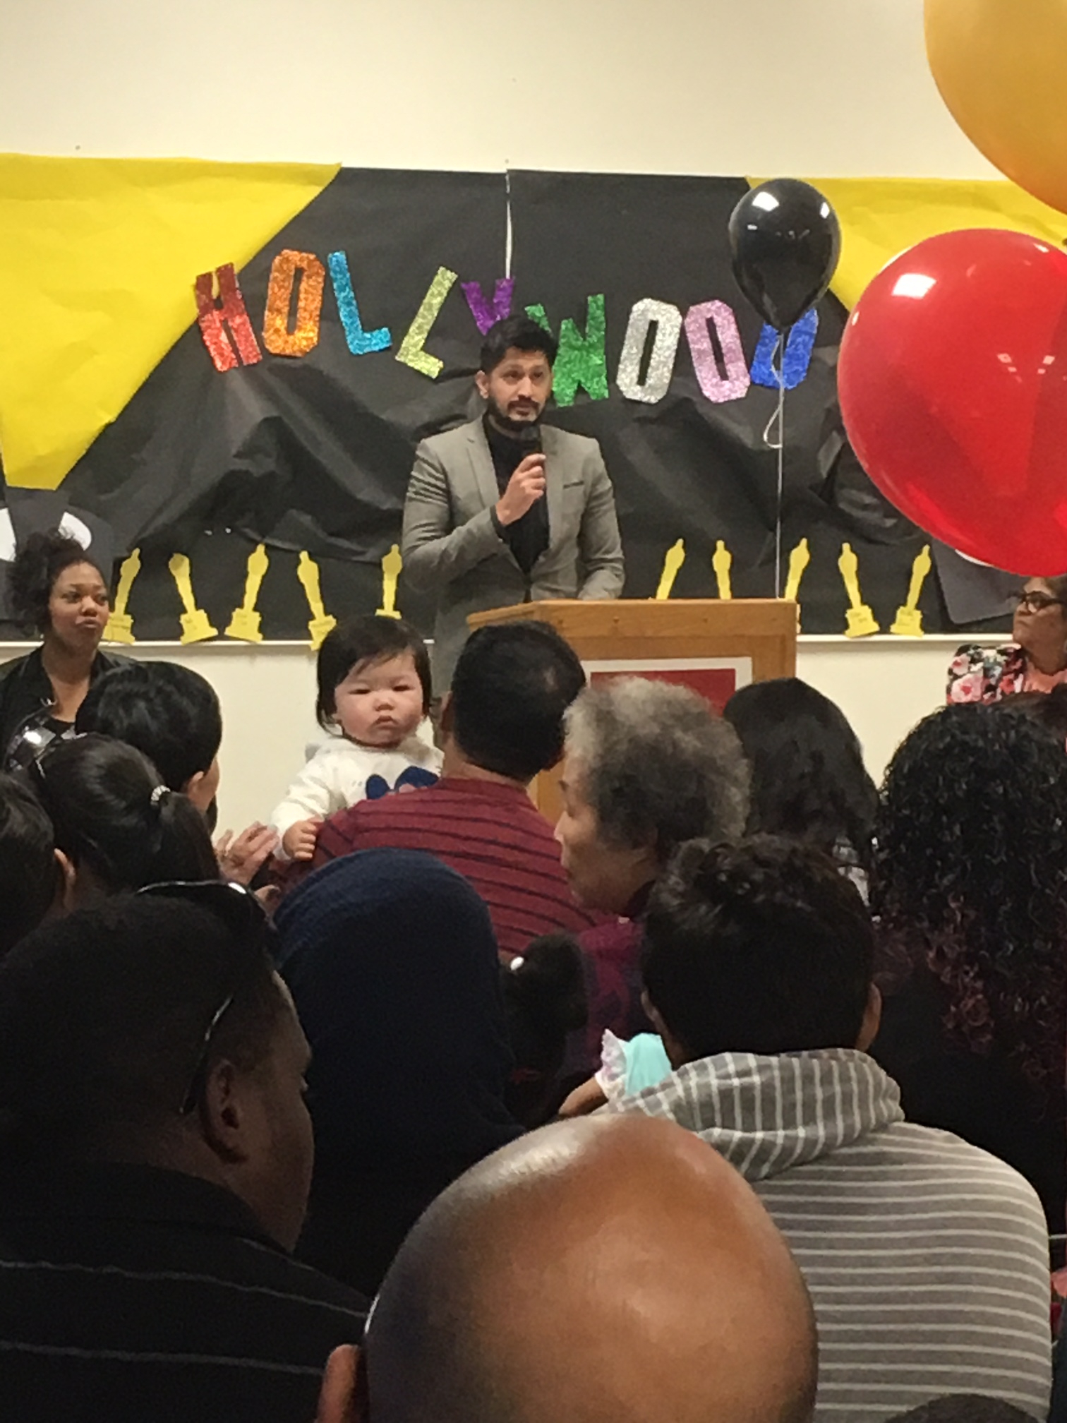
3-5 Updates
5th-grade graduation took place on June 8th, 2018
There was a Hollywood theme
Students walked to get their graduation certificates on a red carpet
Students were able to take pictures with their parents and a Hollywood backdrop

Slide 7
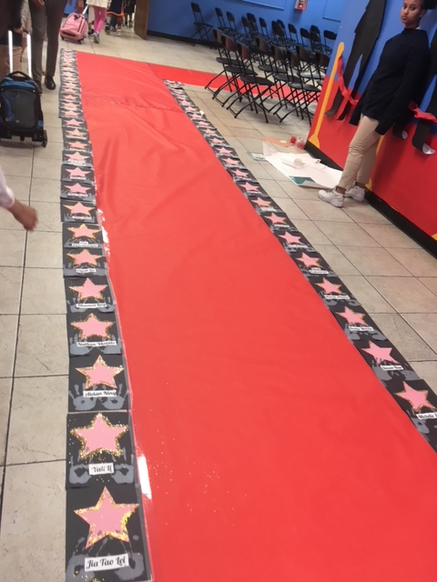
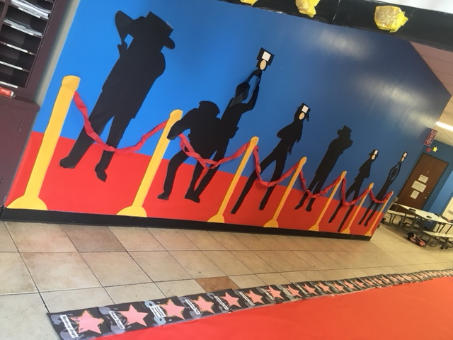
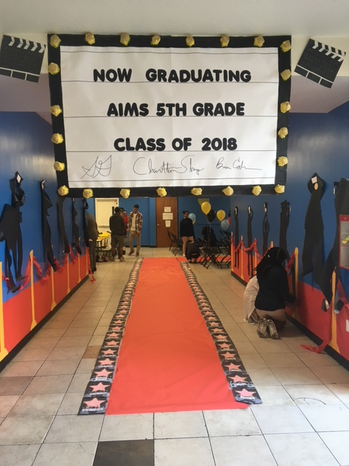
3-5 Updates

Slide 8
3-5 Updates
NEW ELA CURRICULUM!!!!
Grades 2-5 will be using Benchmark Advance
I reached out to the top 150 schools and school districts in California to see what curriculum they were using for various subjects
27 School districts using Benchmark Advance were ranked in the top 100 out of a total of 849
The 3rd highest ranked school district in CA uses Benchmark Advance

Slide 9
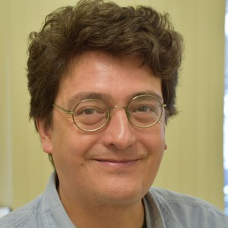
Teacher of the Year
Brian Cabrera won teacher of the year for grades 3-5
He has taught at AIMS for 3 years
Over 89% of his students met or exceeded the standard on the 2016-2017 SBAC test in both ELA and math
Mr. Cabrera was given a plaque for this great
achievement on graduation day

Slide 10
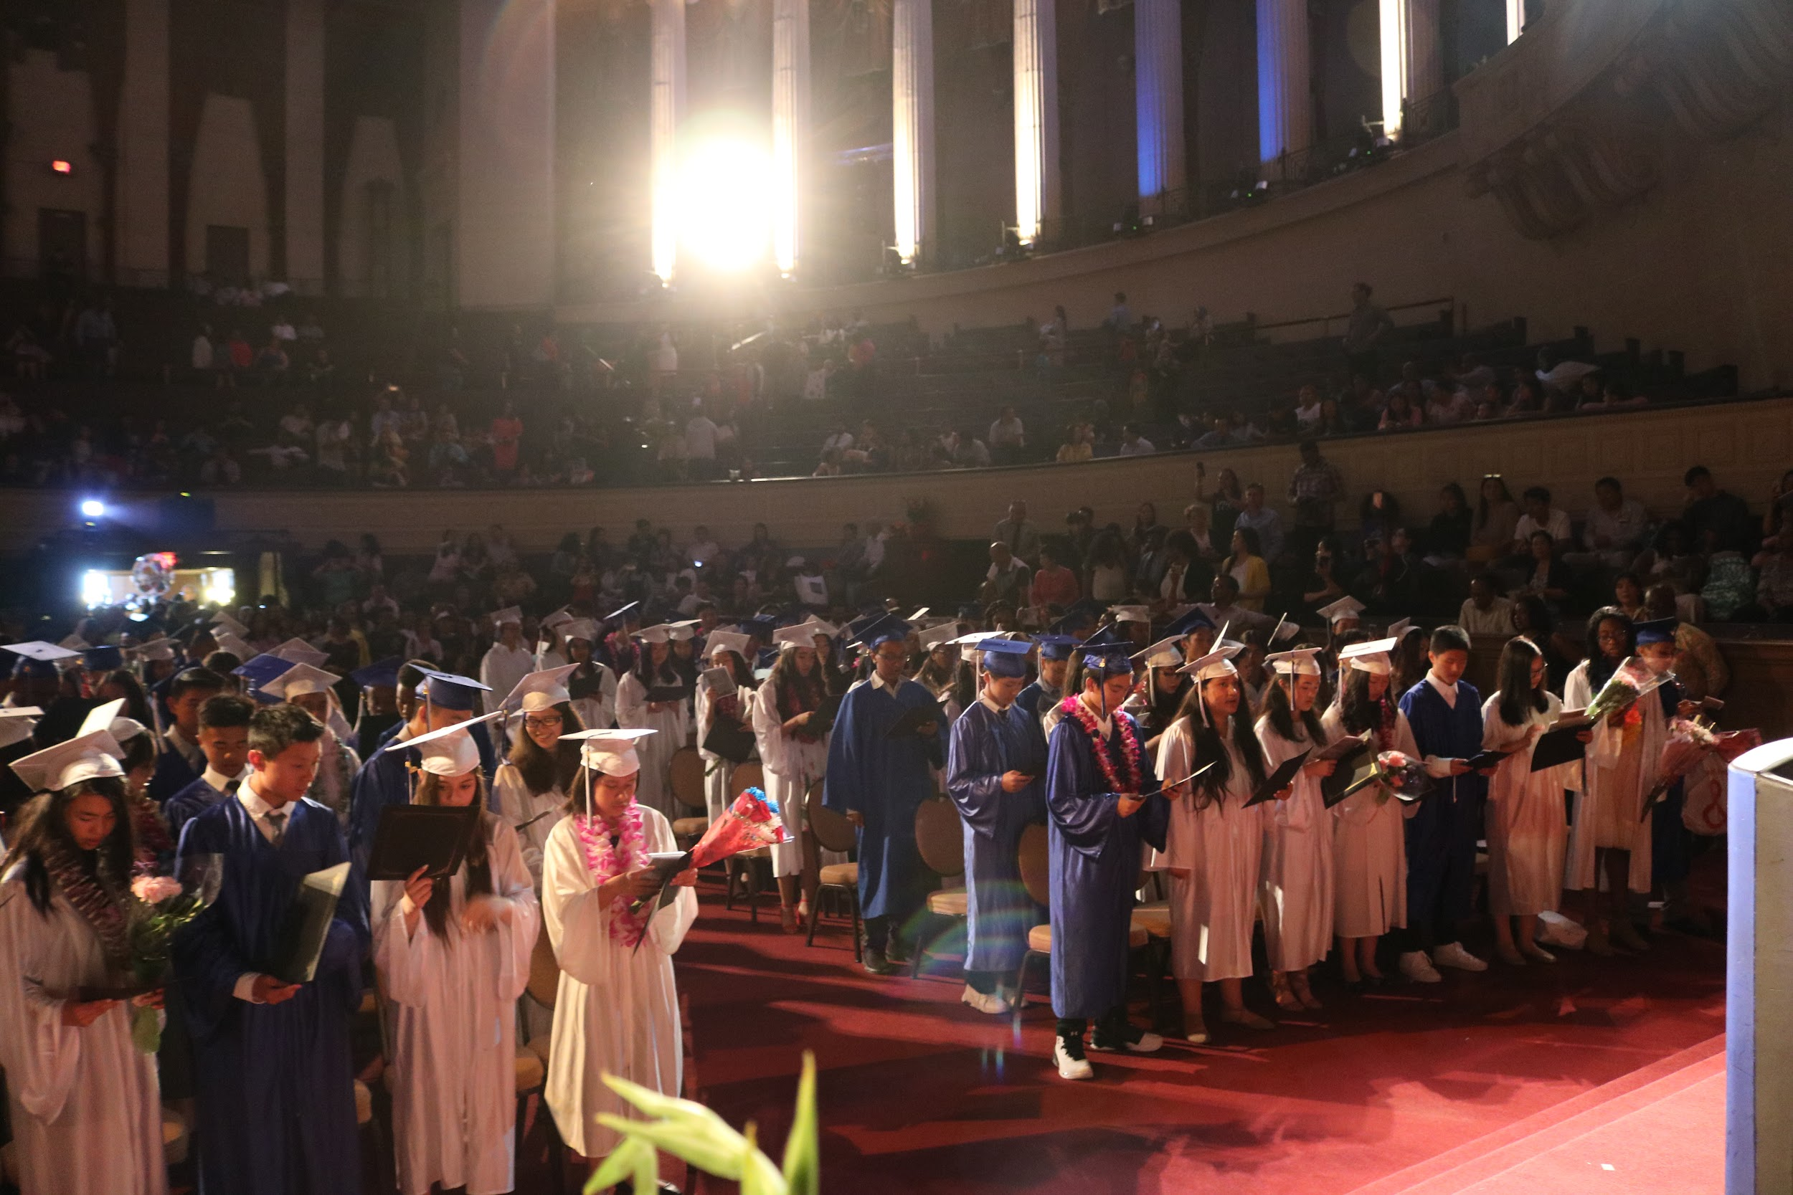
2018 AIMS Middle School Graduation

Slide 11
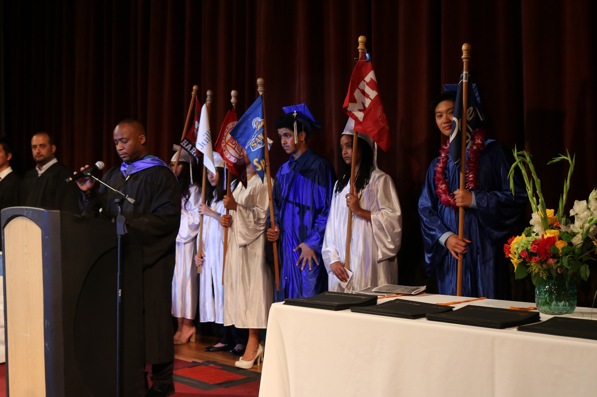
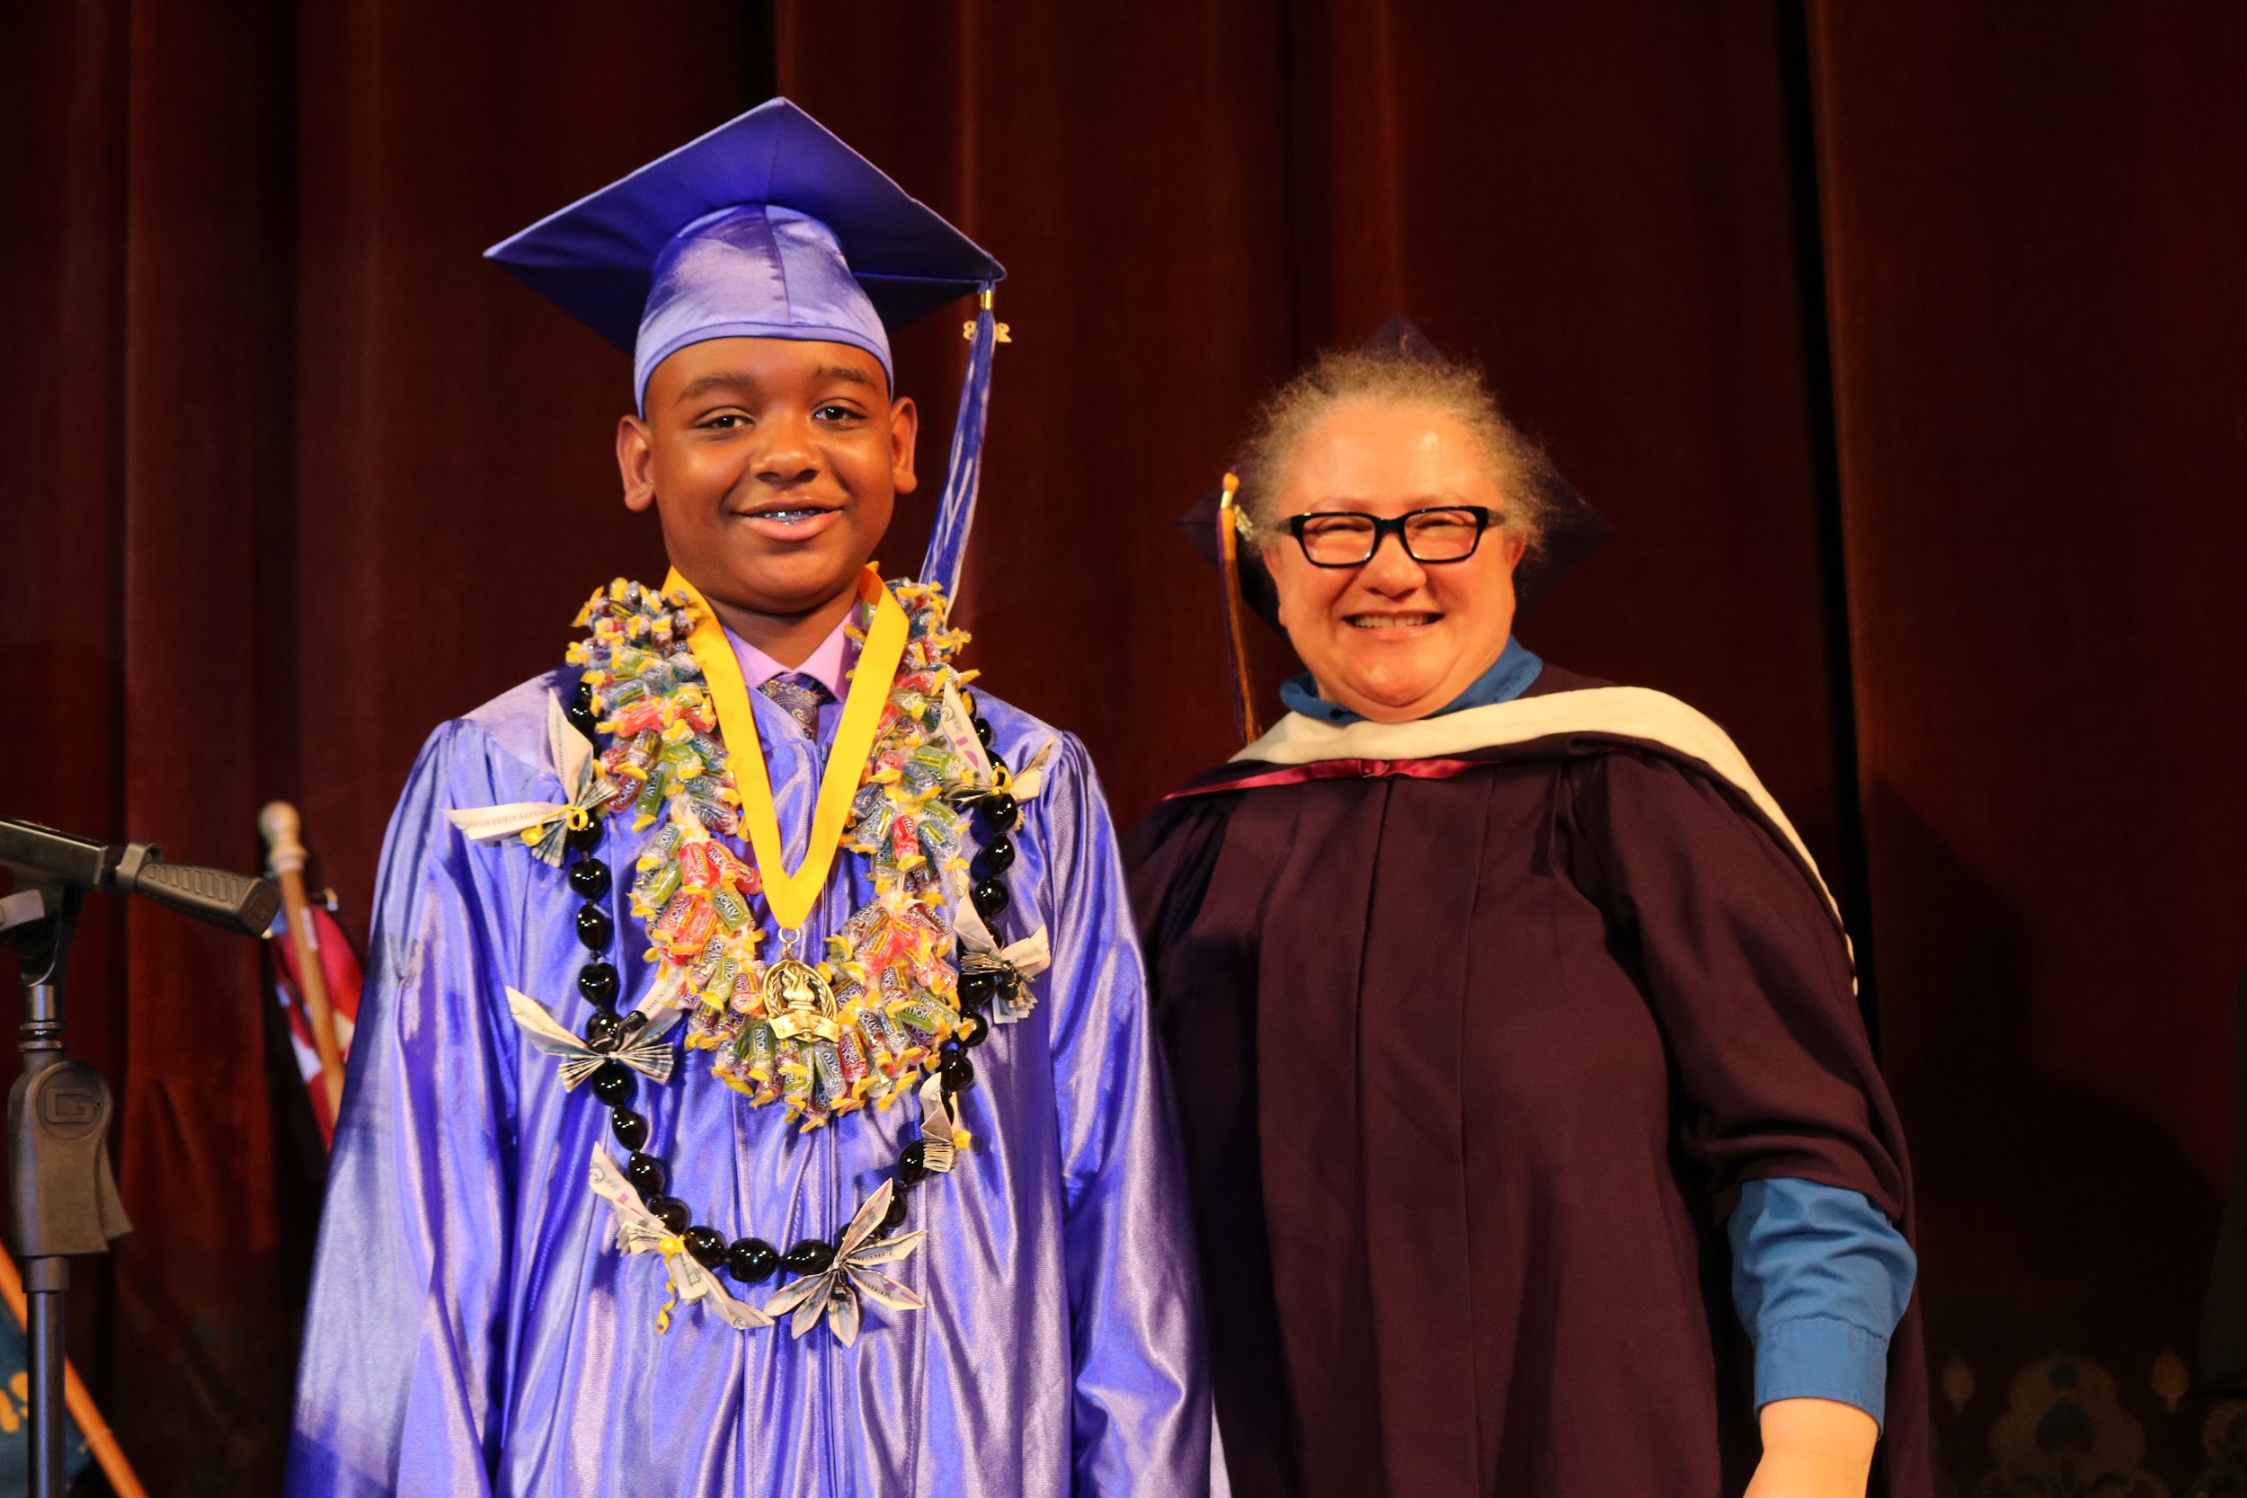
2018 MS Graduation
6 Graduating Classes; One Scholar From Each Class was recognized as Outstanding Scholar for their class.
AIPHS Alumnus, and recent SFSU Graduate Mr. Justin Shelmire, served as the Keynote Speaker.
AIMS veteran teacher Ms. Rebecca Gustafson-O’Hare (Spencer) was selected as the AIMS 6-8 Teacher of the Year

Slide 12
Priorities for 2018-2019
“Back to the Basics” - Emphasis on High Academic Rigor, Structure, Support
Visual Performing Arts integration as part of curriculum (Art and Music Classes)
New Science Curriculum that meets NGSS Standards
New History Curriculum that meets new History-Social Science Framework

Slide 13
Summer Math/ELA Camp
July 9 - July 23, from 10AM - 3PM.
Retained or failing students (Math / ELA), new AIMS Students, and students with less than 85% in Math / ELA are eligible to attend.
Students will be given an assessment prior to Math Camp to determine their placement in one of three tiers (Math 1 - Below Standard); (Math 2 - Near Standard); (Math 3 - Standard Met)
Students in ELA will do an in-depth study of a novel and 5-page paper upon completion of Math/ELA Camp

Slide 14
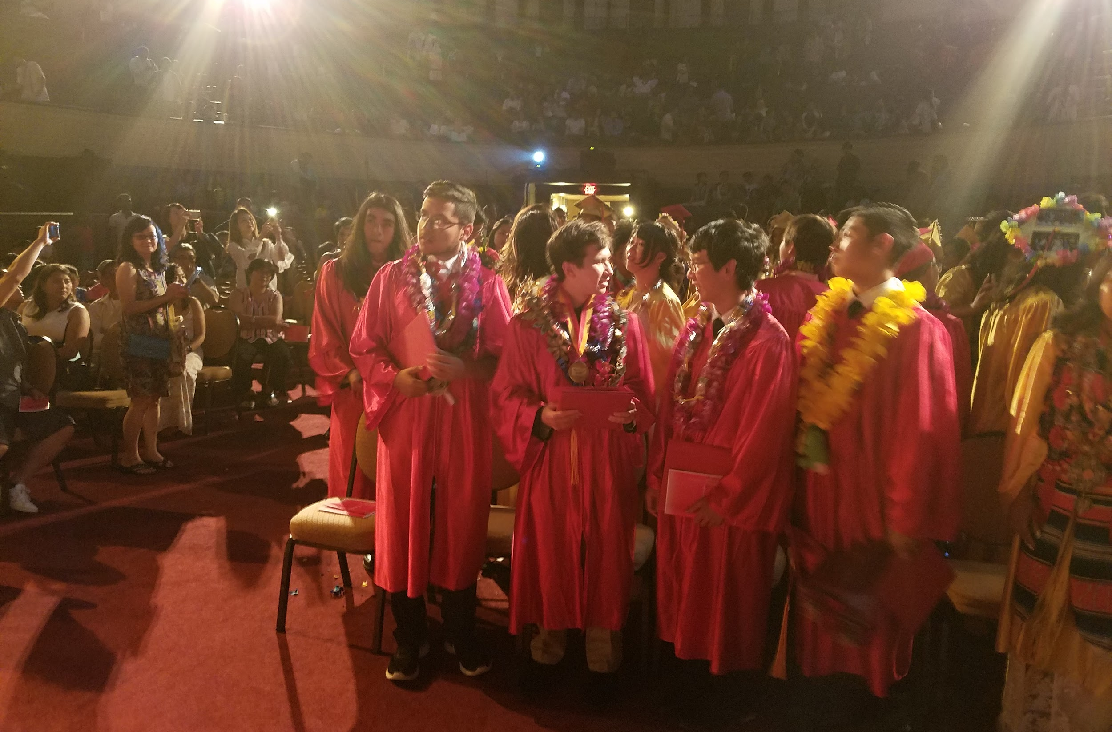
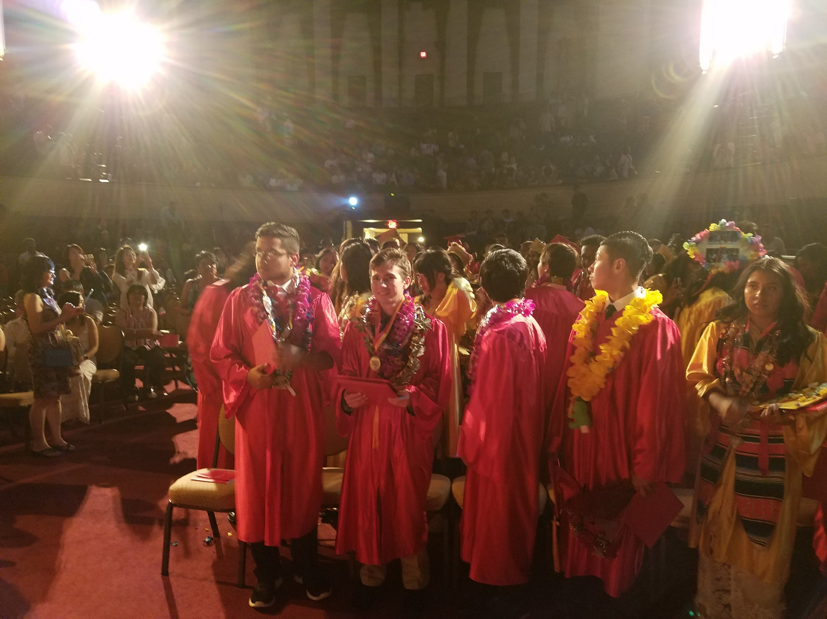
9-12 Updates
This is the largest graduating class yet!
Four classes for credit recovery - offering an opportunity for students to successfully complete two or more classes this summer.
Plus an additional class credit recovery through an online program.
Graduation for 65 young adults from
AIPHS last Tuesday!

Slide 15
K-12th Wellness Committee

