Slide 1
AIMS K-12 School Sites
Julia Li, Director of Schools
Board Report August 2024

Slide 2
K-12 School Site Report Agenda
Student Reports:
Enrollment and Attendance
Academic and Culture Focus
Staff Reports:
Vacancies
Professional Development Focus
Special Events

Slide 3
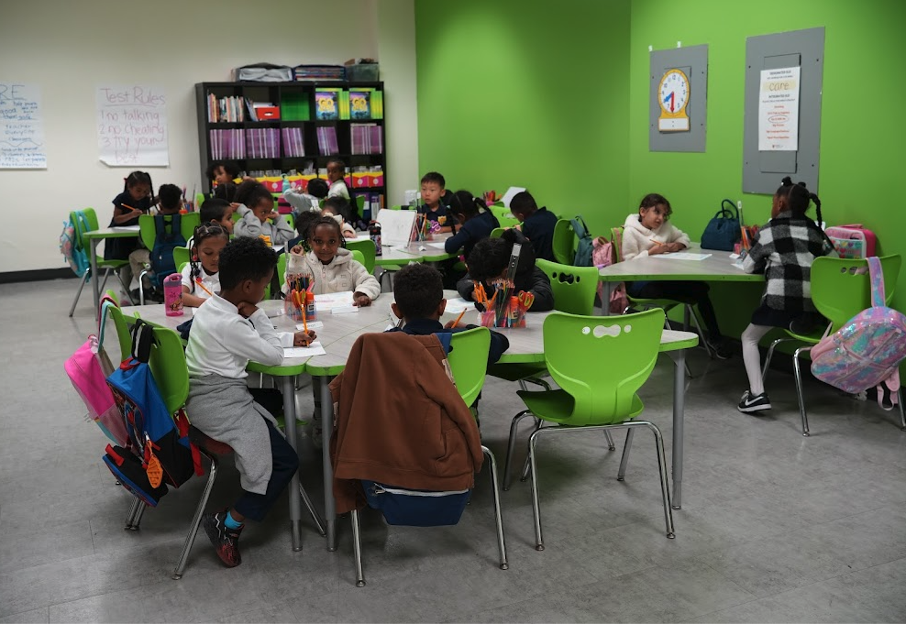
Number of Students Enrolled by Grade Level Comparison 2023 vs 2024
As of August 23, 2024
August 2023: AIMS Elementary School K-8
Kinder | 53
1st | 67
2nd | 75
3rd | 79
4th | 79
5th | 81
6th | 64
7th | 63
8th | 71
August 2024: AIMS Elementary School K-8
Kinder | 51
1st | 66
2nd | 82
3rd | 79
4th | 87
5th | 95
6th | 81
7th | 47
8th | 51
August Total:
2023: 632
2024: 639

Slide 4
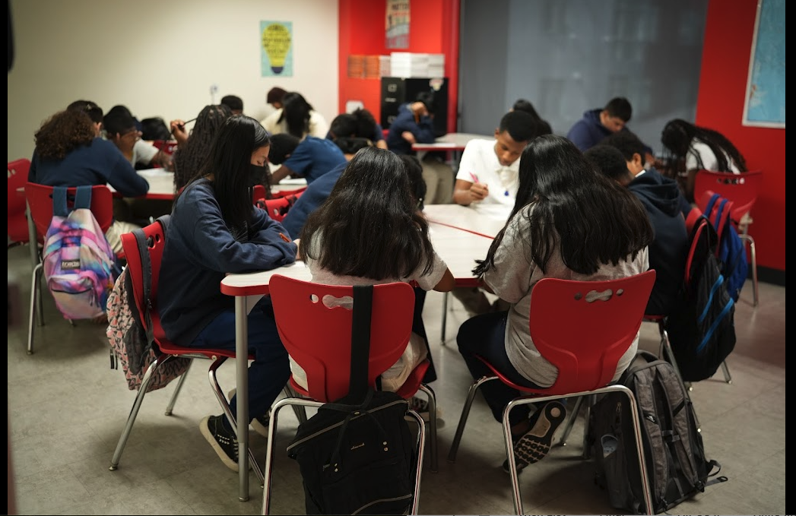
Number of Students Enrolled by Grade Level Comparison 2023 vs 2024
As of August 23, 2024
August 2023: AIMS Middle School 6-8
6th | 57
7th | 56
8th | 79
August Total:
2023: 192
2024: 216
August 2024: AIMS Middle School 6-8
6th | 67
7th | 75
8th | 74

Slide 5
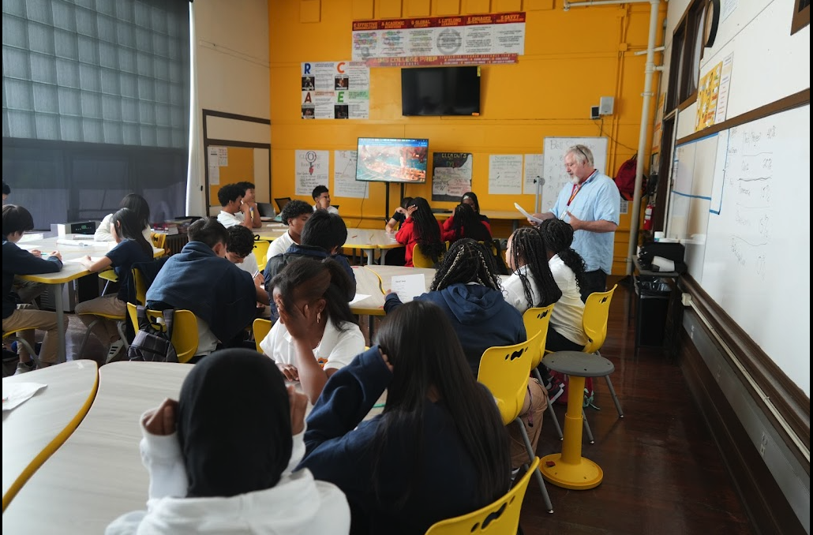
Number of Students Enrolled by Grade Level Comparison 2023 vs 2024
As of August 23, 2024
August 2023: AIMS High School 9-12
9th | 113
10th | 88
11th | 95
12th | 86
August 2024: AIMS High School 9-12
9th | 126
10th | 121
11th | 78
12th | 86
August Total:
2023: 382
2024: 411

Slide 6
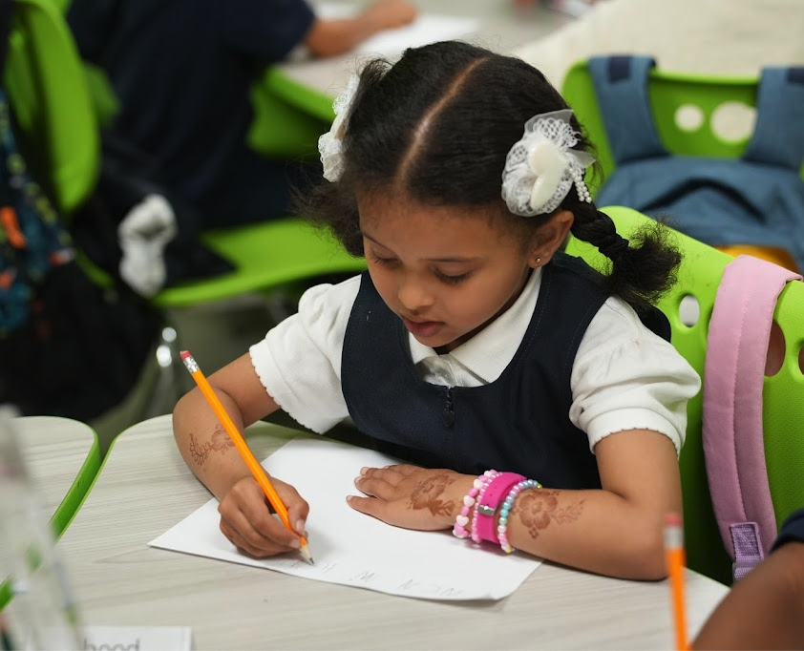
Average Daily Attendance (ADA) from August 14 - August 22
AIMS Elementary School K-8: Enrolled
Kinder | 51
1st | 66
2nd | 82
3rd | 79
4th | 87
5th | 95
6th | 81
7th | 47
8th | 51
AIMS Elementary School K-8: ADA
Kinder | 39
1st | 55
2nd | 70
3rd | 70
4th | 80
5th | 81
6th | 73
7th | 37
8th | 43
Total
Enrolled: 639
ADA: 548

Slide 7
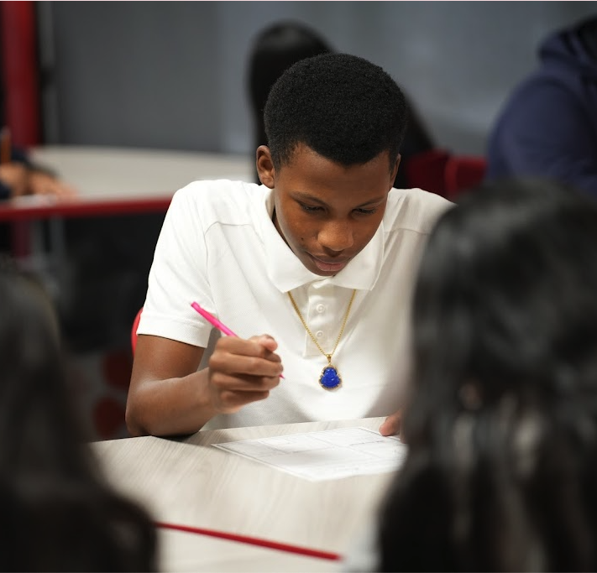
Average Daily Attendance (ADA) from August 14 - August 22
AIMS Middle School 6-8 Enrolled
6th | 67
7th | 75
8th | 74
AIMS Middle School 6-8 ADA
6th | 53
7th | 59
8th | 66
Total
Enrolled: 216
ADA: 178

Slide 8
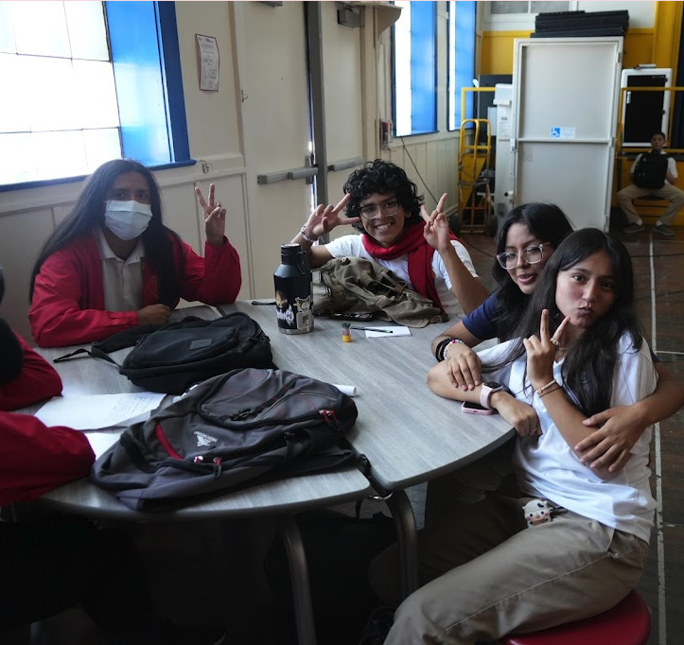
Average Daily Attendance (ADA) from August 14 - August 22
AIMS High School 9-12 Total
Enrolled: 411
ADA: 368

Slide 9
Actions taken to increase attendance:
All parents of absent students are called daily.
Students that are withdrawing from AIMS are sent withdrawal forms.
Invitations to enroll are sent to students on waitlist.
Additional classes will be added to accommodate waitlist.

Slide 10
Academic Focus This Month
● Lesson plans
● Board configuration
● Diagnostic assessment
● Interpreting data
● Data driven instruction

Slide 11
School Culture Focus This Month
A - Academics (Sept)
I - Integrity (Oct)
M - Mentorship (Nov)
S - Strength (Dec)
T - Teamwork (Jan)
R - Responsibility (Feb)
O - Organization (Mar)
N - Nerve (Apr)
G - Grit (May)
● Building positive classroom culture
● Strengthening school community
● Preparing students to be leaders
● Student Government Association

Slide 12
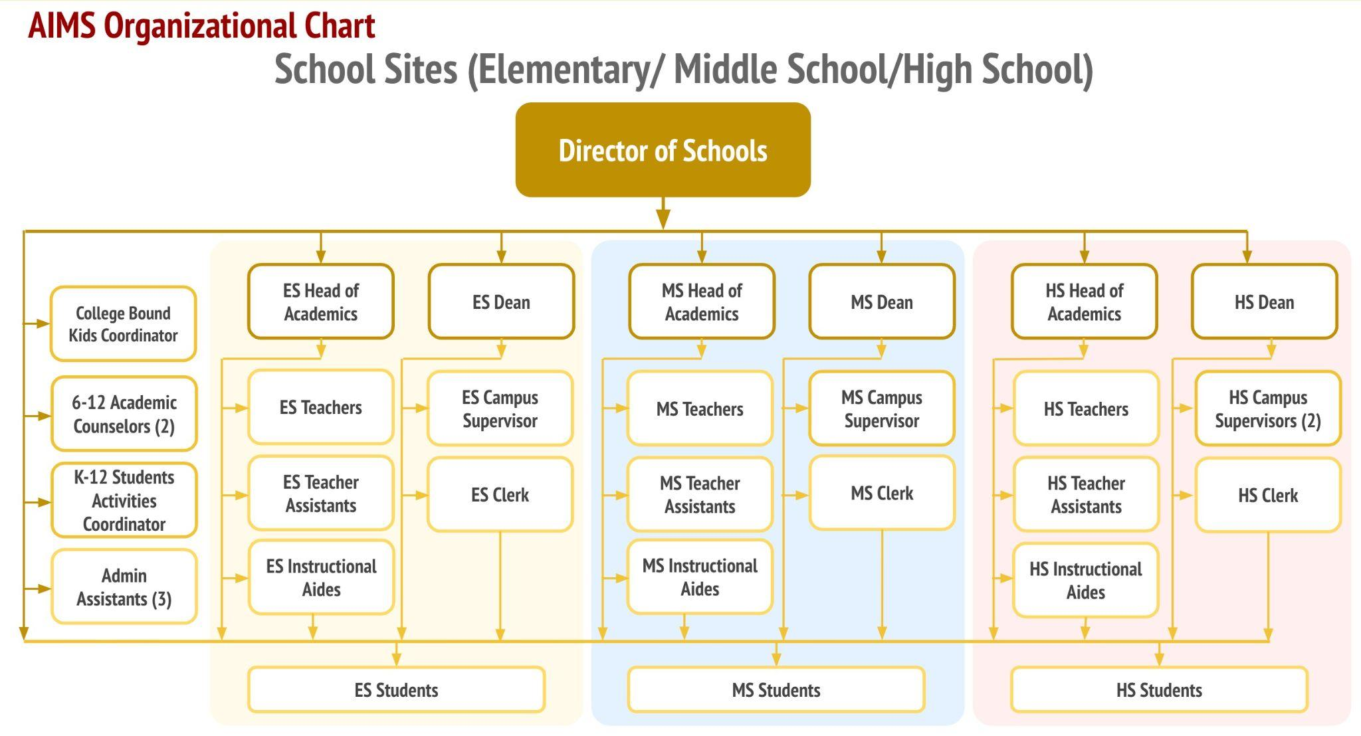

Slide 13
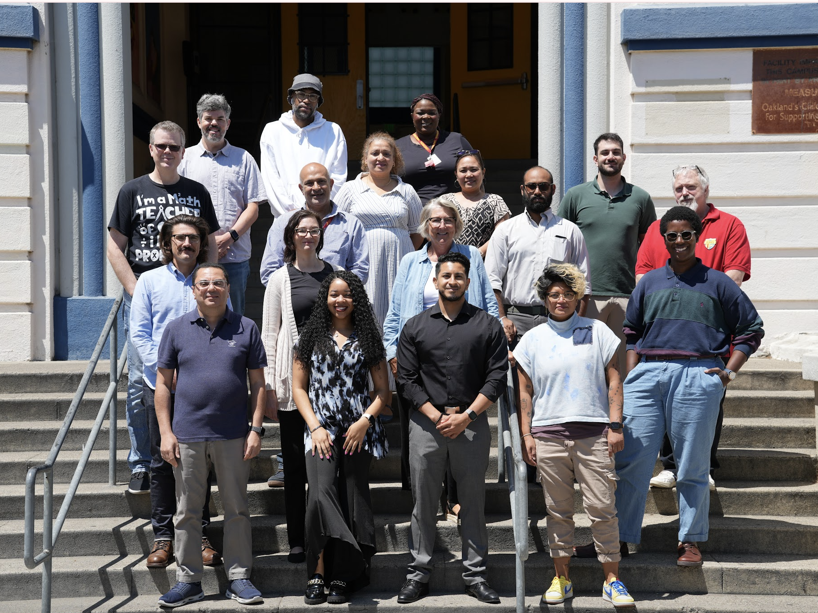
Site Staff Report
 | Returning Staff | New Staff | Vacancies
Elementary School K-5 | 24 | 2 | 6
Middle School 6-8 | 19 | 2 | 6
High School 9-12 | 20 | 6 | 3

Slide 14
Teacher/ Staff Vacancy Report
As of 8/23/24
AIMS Elementary School K-5
Kinder | onboarding
2nd Grade | onboarding
5th Grade | onboarding
Music | Vacant
PE | onboarding
Mandarin | onboarding
AIMS Middle School 6-8th
6th grade ELA/History | onboarding
6th grade ELA/History | onboarding
7th grade ELA/History | onboarding
PE | Vacant
Spanish | Vacant
Clerk | onboarding
AIMS High School 9-12th
Biology | Vacant
PE | Vacant
Clerk | onboarding

Slide 15
Actions taken to fill vacancies:
Recruitment team pre-screening all applications.
Hiring managers conduct ongoing interviews.
Regular follow ups with candidates in the onboarding process.
New partnership with Cultural Exchange Program.
Improved onboarding tracking system.

Slide 16
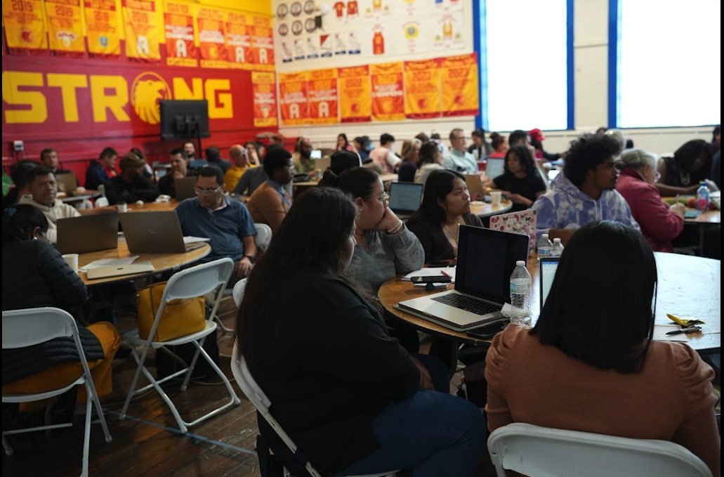
August: Professional Development Focus
Bootcamp from August 1 - August 13
Topics Covered:
Data Driven Instructions
Ability Awareness
Curriculum Review
Lesson Planning/Pacing Guides
Climate and Culture
Intervention Strategies
Student Engagement
Checks for Understanding
Classroom Management
Appropriate Technology Usage

Slide 17
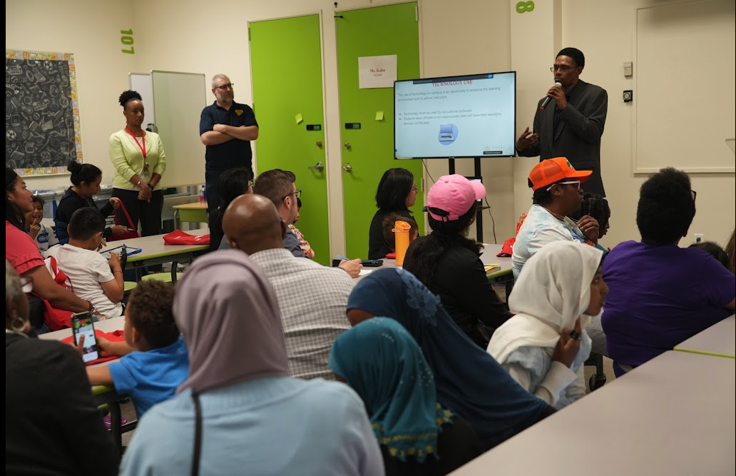
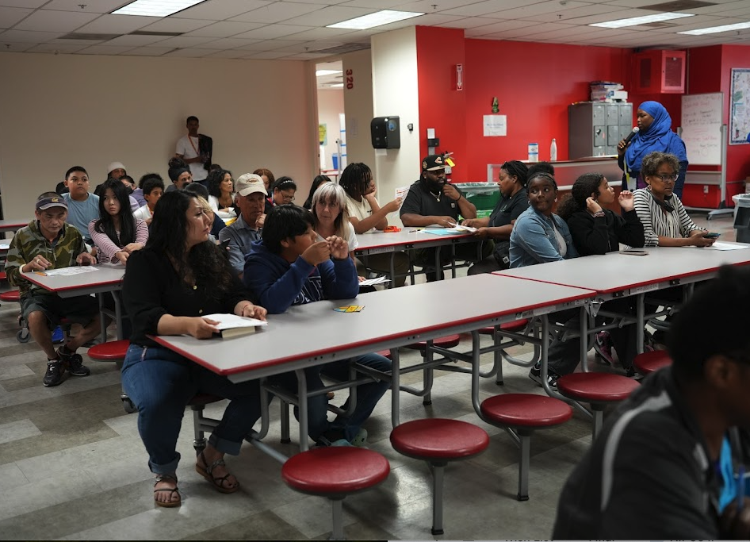
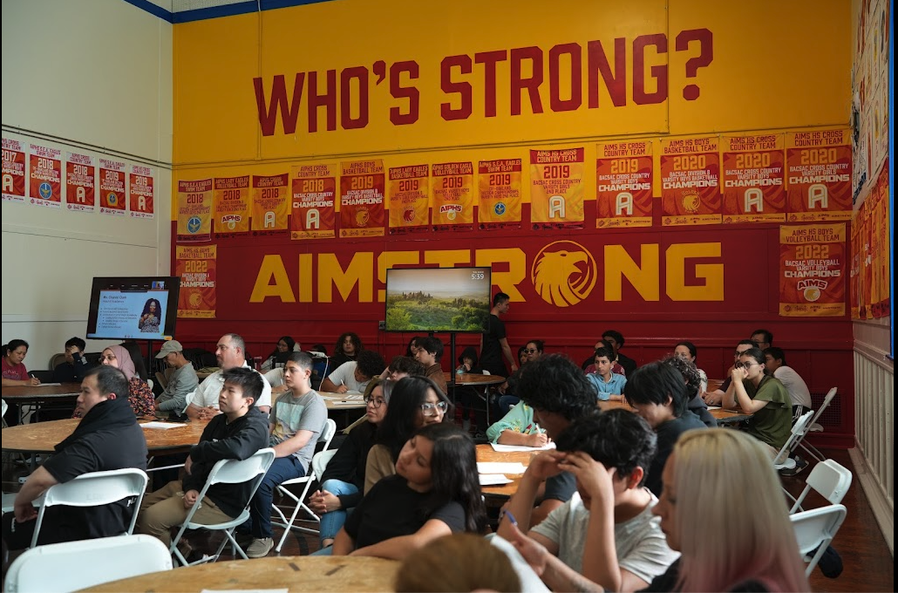
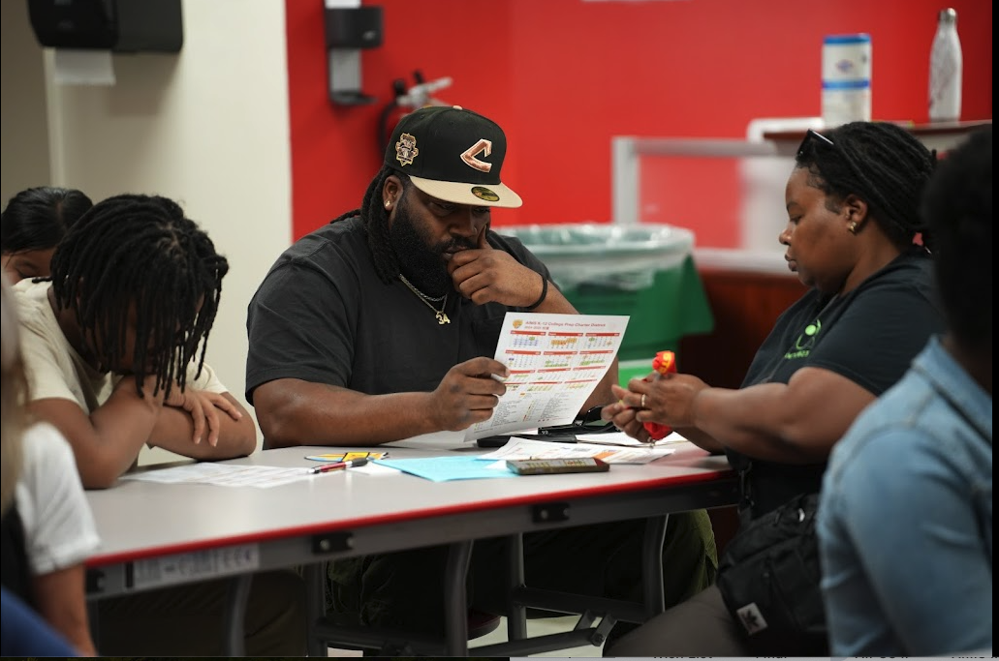
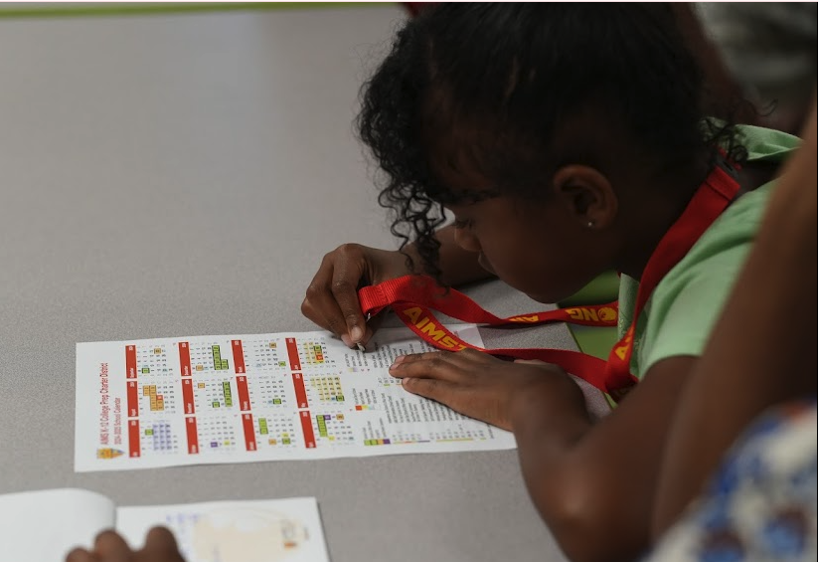
Special Events: Summer Orientation in July and August

Slide 18
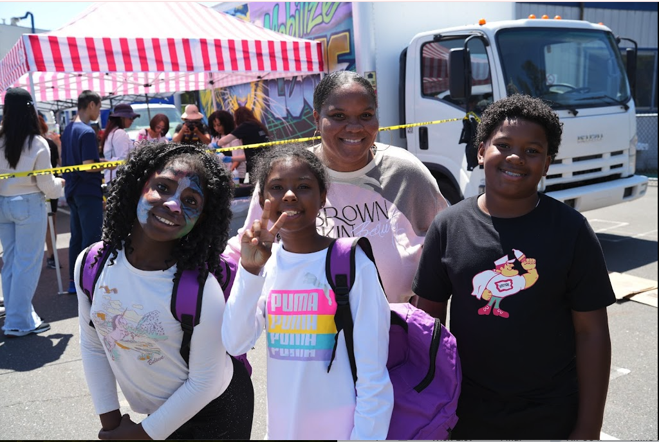
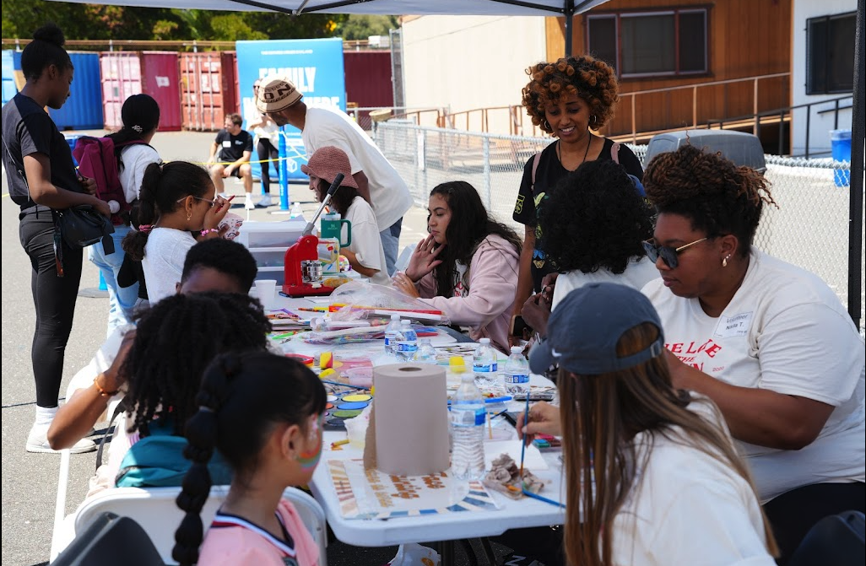
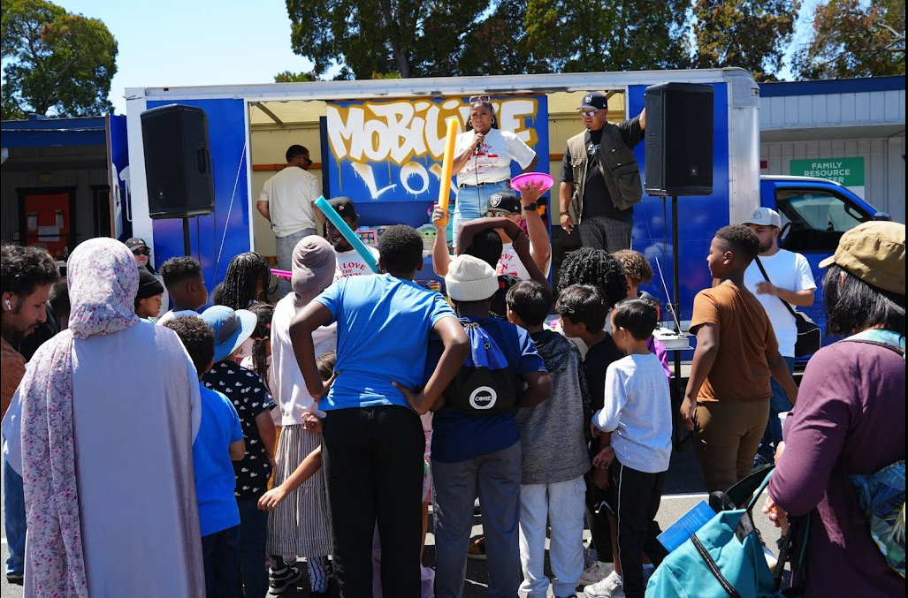
Special Events: Bless The Block: August 10, 2024
We partnered with:
Oakland Ballers
TFH Oakland
Mobilized Love

Slide 19
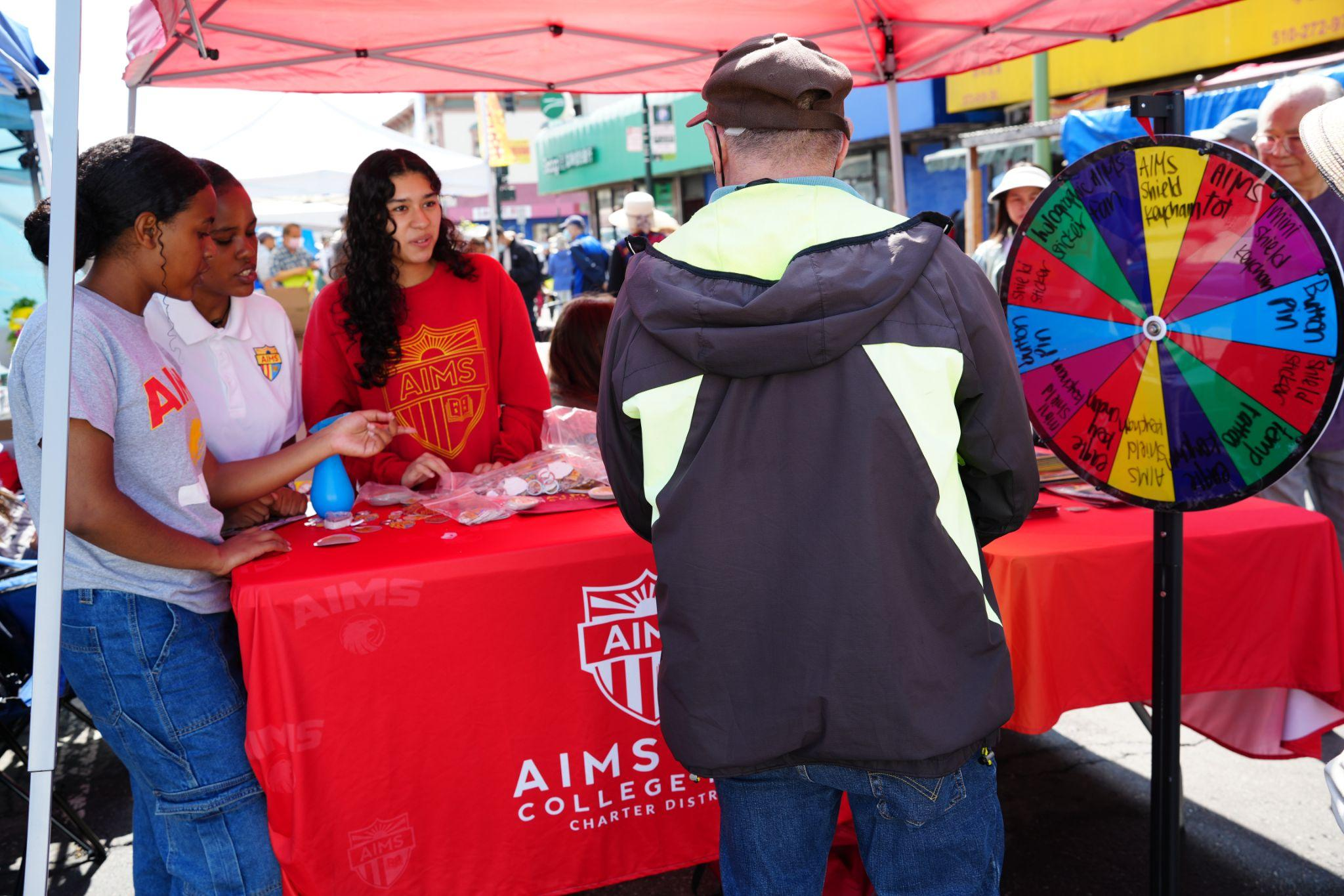
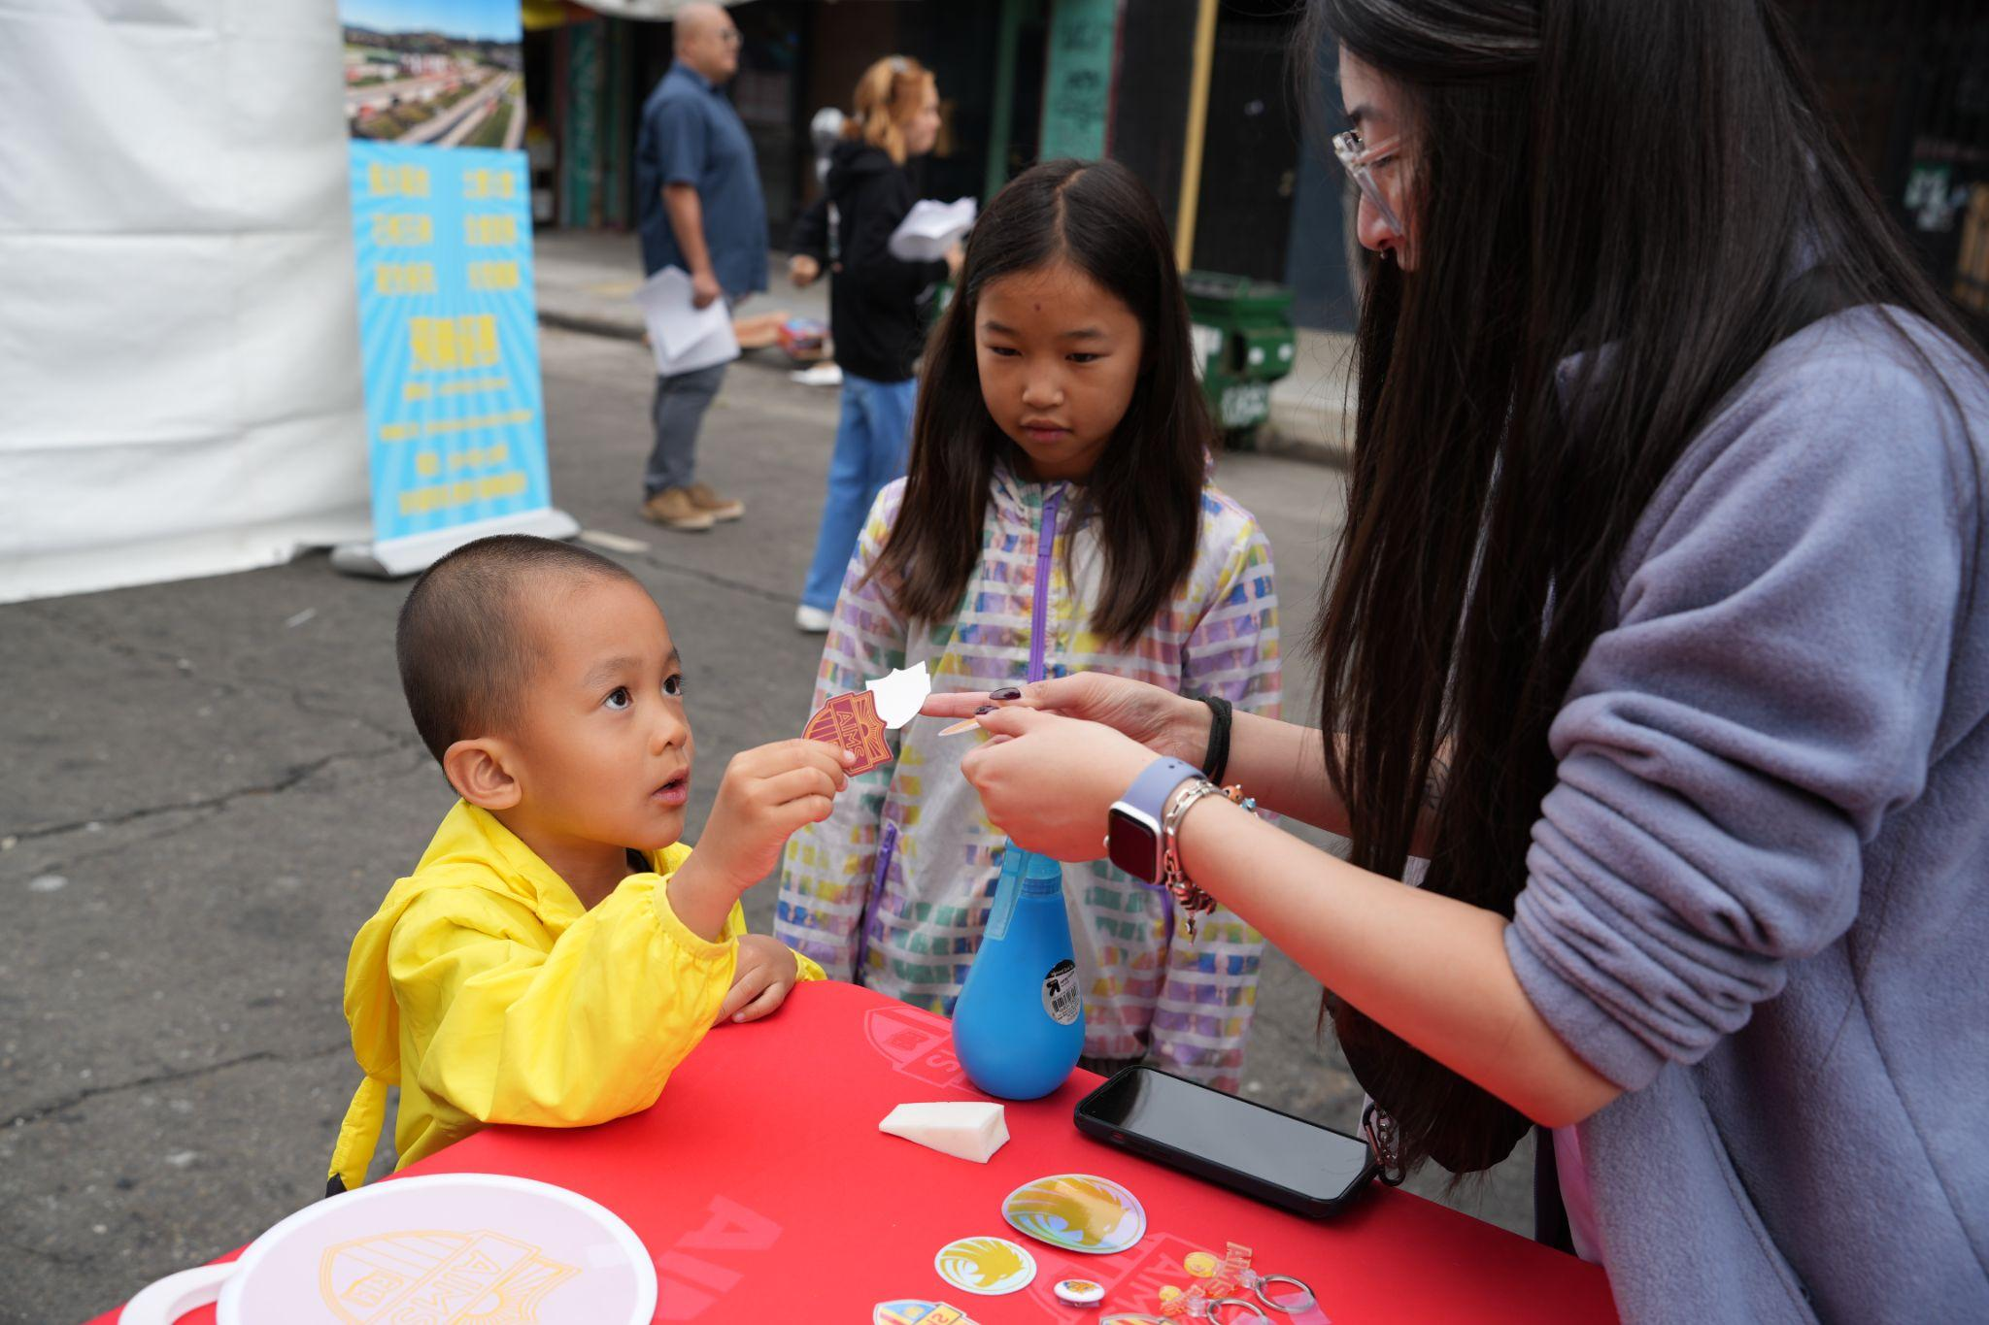
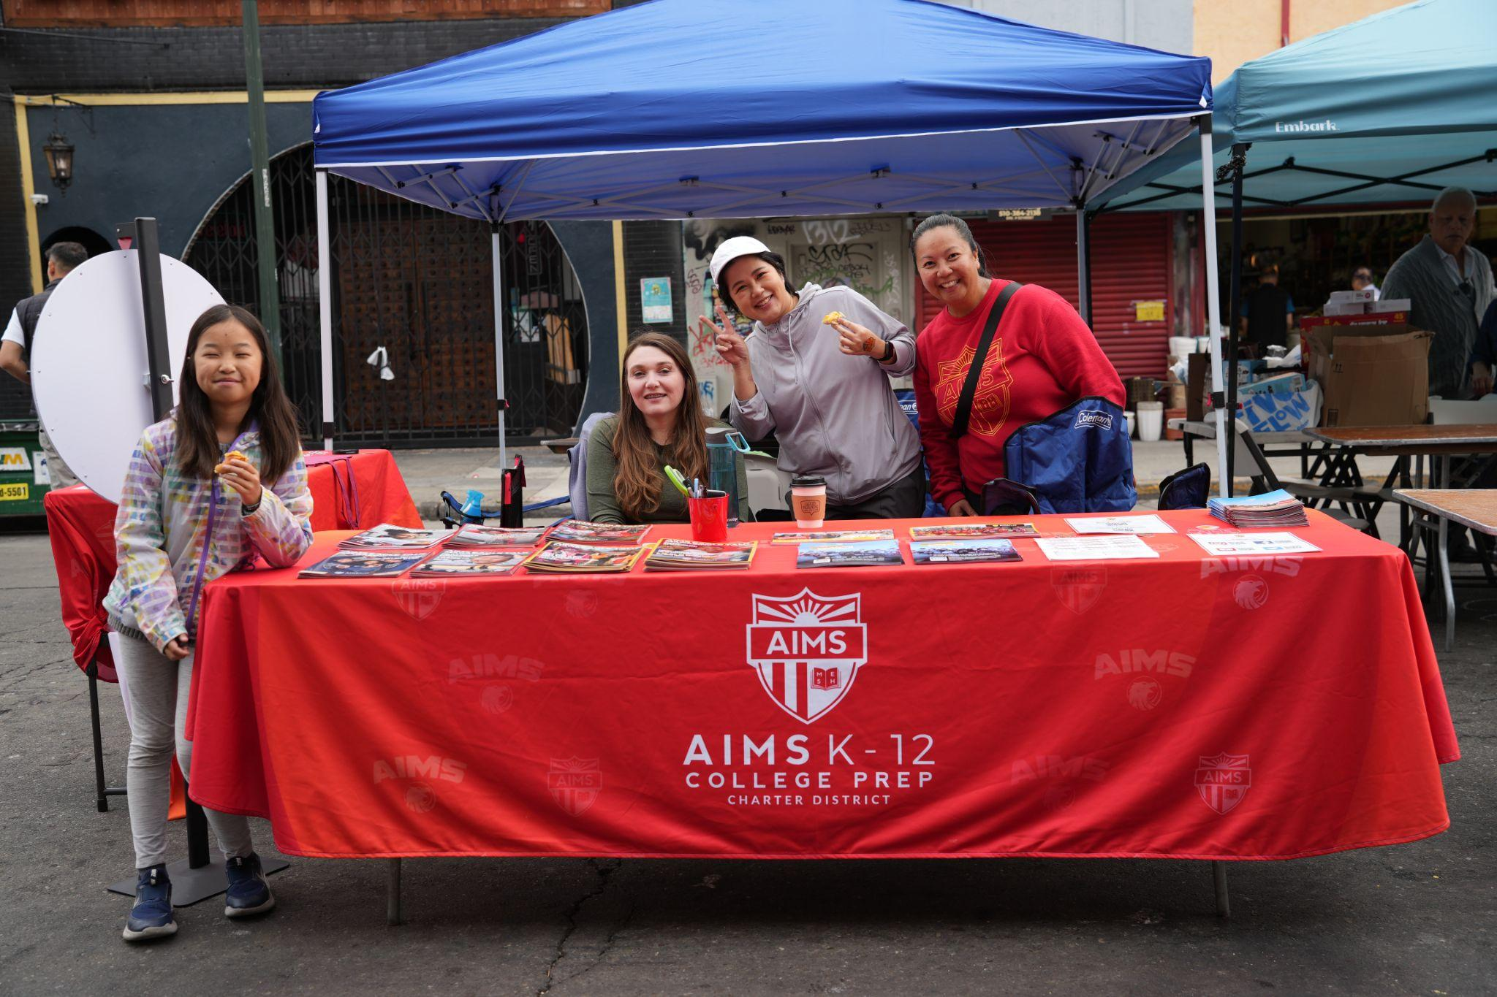
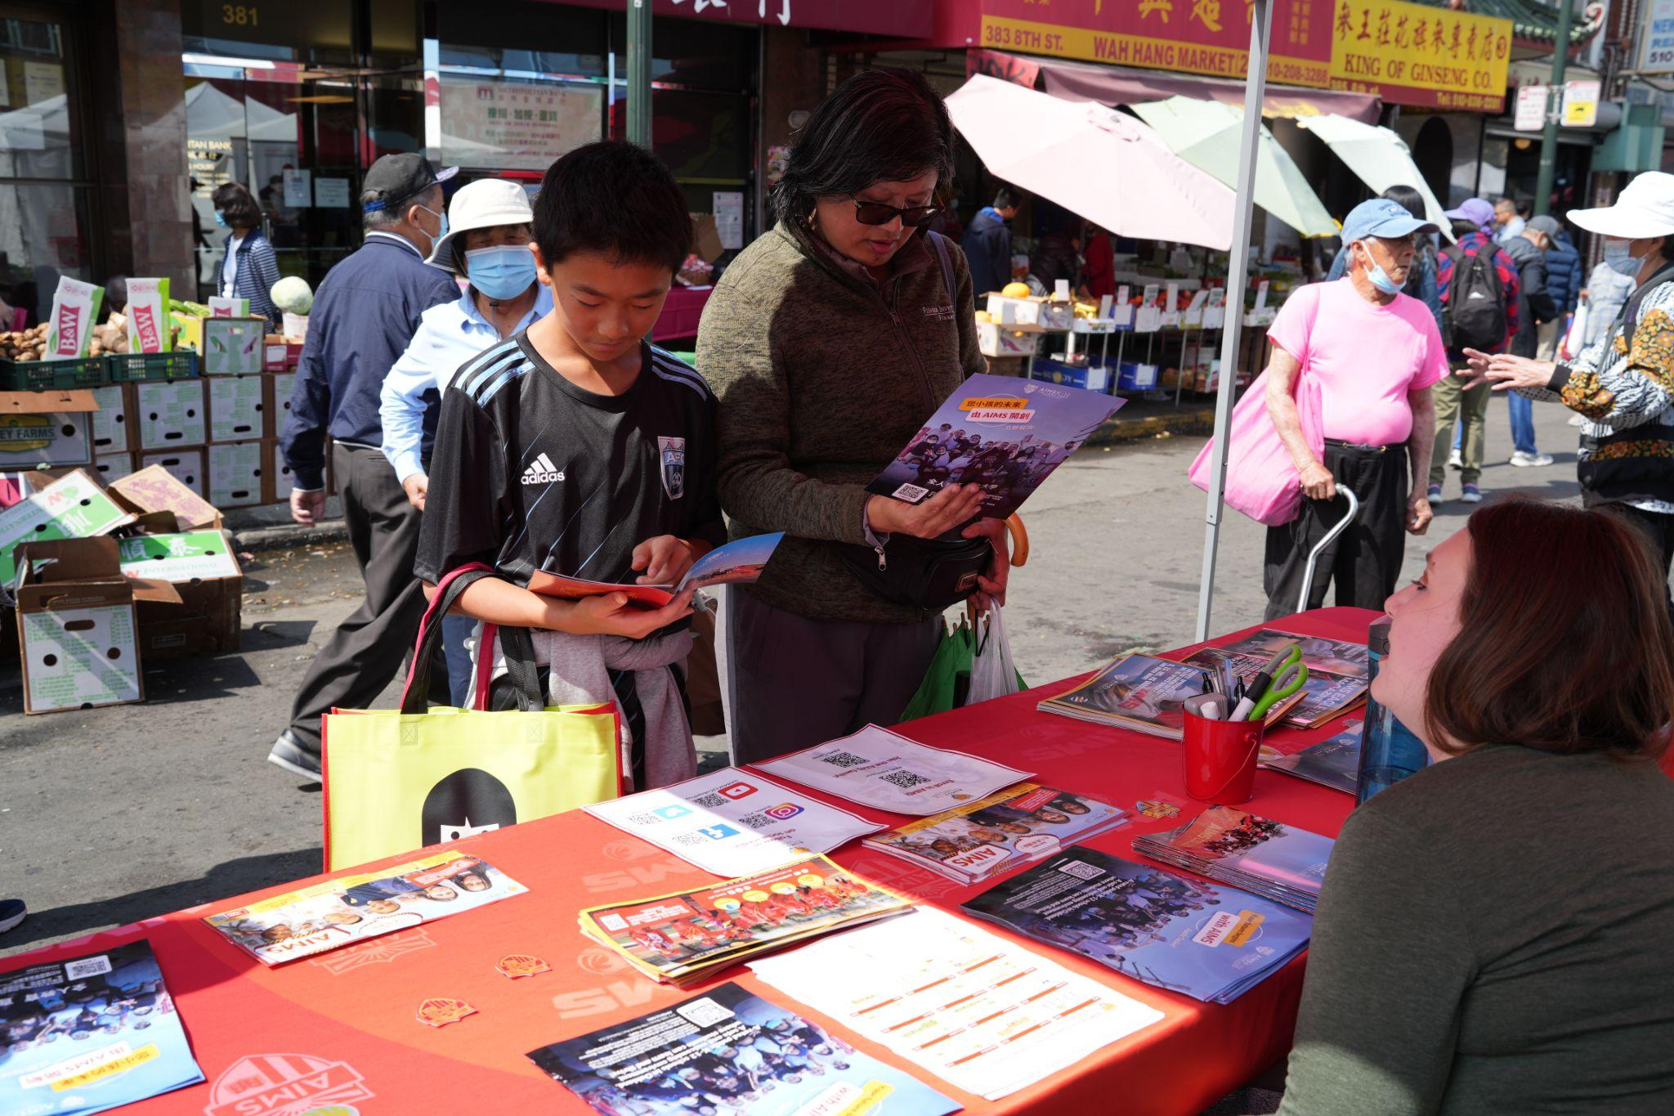
Special Events: Oakland Chinatown 35th StreetFest! August 24-25, 2024

Slide 20
Coming Up:
Back To School Night
Elementary School K-5th:
Tuesday September 17th 5pm
Middle School 6th-8th:
Wednesday, September 18th 5pm
High School 9th-12th:
Thursday, September 18th 5pm

Slide 21
Thank you for your time.
If you have any questions, please email: Julia.Li@aimsk12.org

