Slide 1
AIMS K-12 Marketing, Communications, and
Recruitment Department
August 2024 Board Meeting Presentation
By Suzen Chu - Director of Marketing, Communications and Recruitment

Slide 2
Social Media Fast Facts in Last 28 Days
 | Posts/Stories | Analytics in the Last 28 Days
Facebook | 9/10 | 7.7K reaches
Instagram | 8/7 | 3.2K reaches
YouTube | - | 845 views
AIMS website | - | 10K visits
AIMS Intranet | - | 66 users

Slide 3
August 2024 - Wrap Up
Within the Department
Clean up and update AIMS website & intranet for School Year 2024-2025
Boosting Enrollment
New billboard ad lives on 14th Ave at International blvd
Outdoor banner on HS lakeview campus facing freeway entrance
New round of in-person outreach to fruitvale community service centers
Boosting Recruitment
Indeed campaign
Handshake

Slide 4
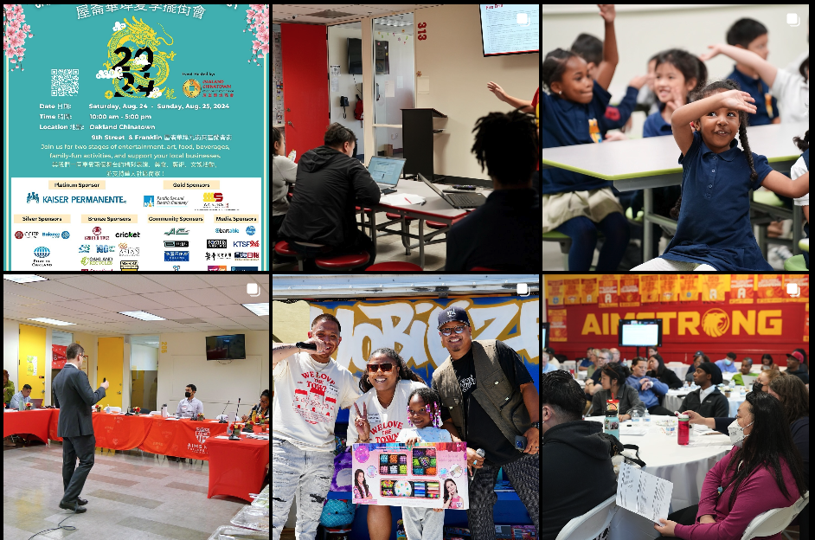

Slide 6
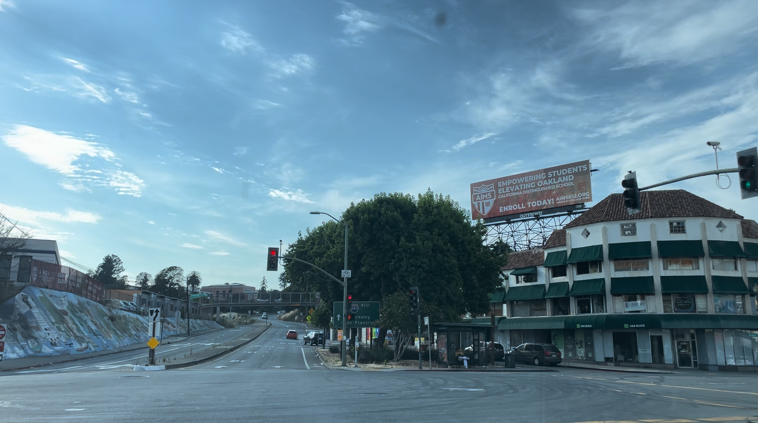

Slide 7
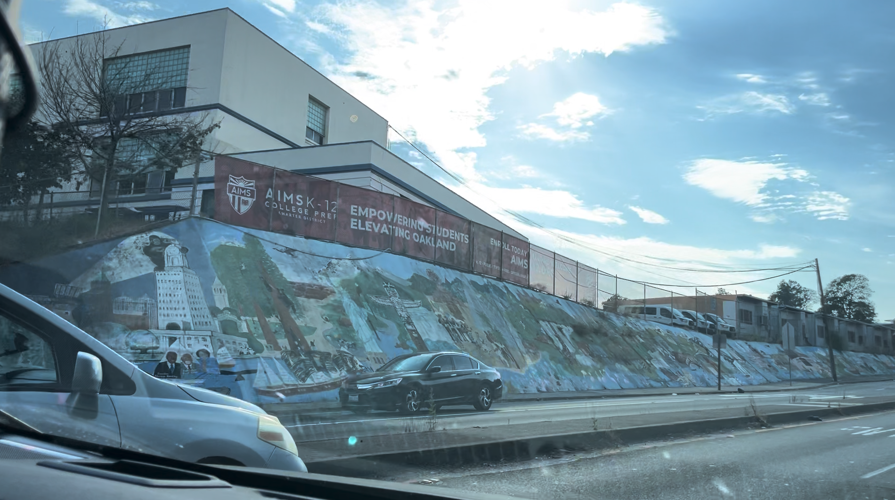

Slide 8
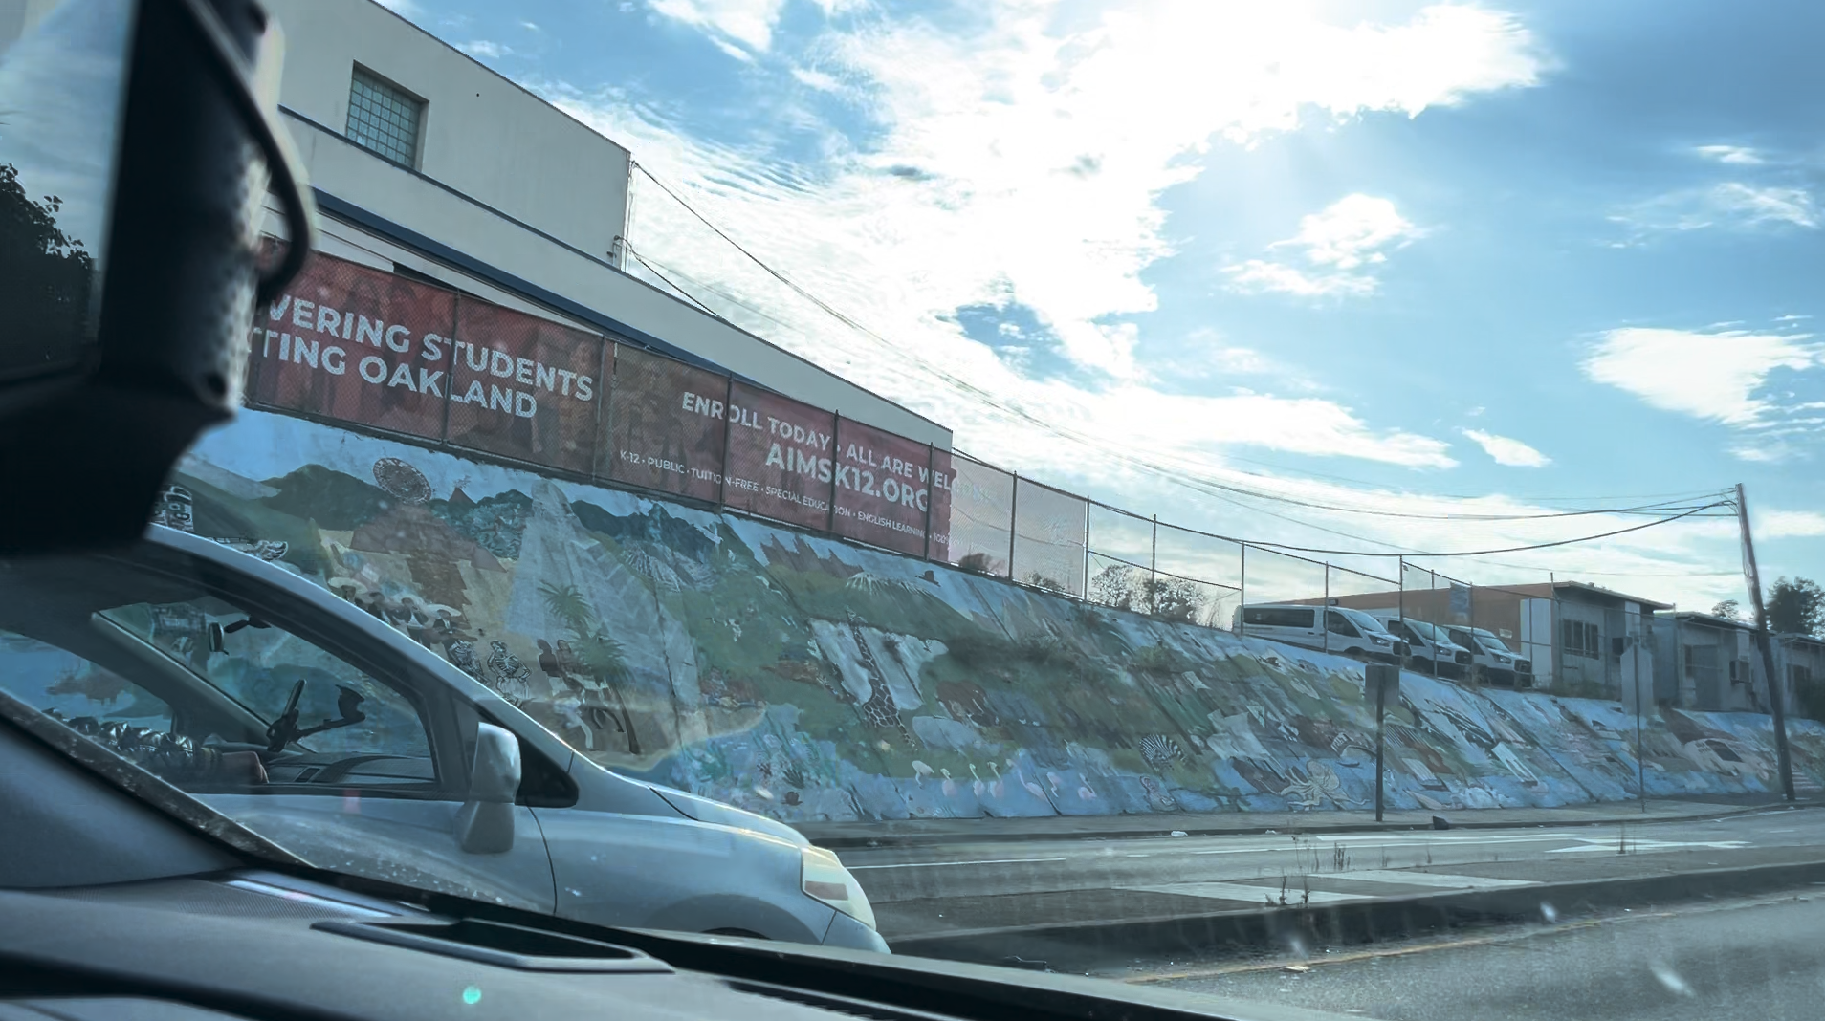

Slide 9
Goals for School Year 2024-2025
Achieve Charter Renewal for AIPCS II
Empower Frontline Staff to Represent AIMS as Key Ambassadors
Enable Site Leaders & Departments to Draft and Send Memos Independently
Secure 100% Enrollment
Ensure 100% Staffing
Increase Media Visibility

Slide 10
Thank you!

