Slide 1
AIMS K-12
Department of Program Compliance
Compliance August Board Report FY 24-25
Presented by: Tiffany Tung, Director of Compliance

Slide 2
Compliance Highlights FY 23-24
Being a recipient of federal and state funding resources, the district is required to implement regulations and controls that serve the purpose of ensuring that the intended results of these funding sources are achieved. Compliance created a structured process to train, monitor and maintain time accounting certification records to adhere with meeting these requirements.
Compliance implemented processes to ensure that AIMS K-12 policy and procedures for compensation and documentation were aligned with school site plans. Compliance collaborated with the Finance Department to audit salary schedules to ensure competitive salaries are in alignment with CA pay standards. A compliance analyst was hired to support with compensation analysis, compensation audits and compensation related matters.
Compliance collaborated with School Support Services to ensure that the FY25 budget tool provided clear guidelines on allowable expenditures for site plans in accordance with best practices outlined by CDE.
Compliance created processes that successfully monitors and tracks extended contract requests and provides accountability & oversight of Extended Contracts, extra pay and extra duty staffing assignments.

Slide 3
Compliance Highlights FY 23-24
Compliance implemented a Department of Justice review process that aligns with regulatory confidentiality requirements and ensures an impartial and equitable review.
Compliance successfully implemented a notification process within PayCom to notify employees of state, federal and local mandated trainings for the school year.
Compliance implemented a Verification of Experience process within PayCom that allows for transparency and verification standards.
Compliance successfully assisted with implementing and maintaining the Request to Hire process within PayCom to create a transparent workflow that provides status and tasks for departmental review.
Successfully reviewed more than half of the organization's job description during JD audit review.
Successfully operated another school year of a NSLP/Universal Meal Program K-12 with zero audit findings.

Slide 4
Compliance Highlights FY 23-24
Created Standard Operating Procedures (SOP) for program compliance is to ensure that AIMS organization consistently adheres to relevant laws, regulations, industry standards, and internal policies and guidelines to serve the following: Standard Operating Procedures Program Compliance
Standardization
Risk Mitigation
Training & Onboarding
Audit Preparedness
Continuous Improvement
Accountability
Compliance successfully created and implemented a Position Requisition Form (PAF), as well as a PAF process within PayCom (HRIS) that allows for identified internal departmental checks and balances to ensure appropriate processing.
Compliance successfully and continuously administered training to staff to ensure that all Spendwise purchase orders are completed with required documentation based on board policies, state, federal and local regulations.

Slide 5
Compliance FY 24-25 Goals
Hire a benefits & risk management coordinator to support with AIMS district risk management and employee benefits programs ensuring compliance with relevant laws and regulations, and safeguarding the school's human and financial resources.
Role will involve coordinating with insurance providers and providing support to employees regarding benefits and risk management.
Continuous Improvement: Establish a framework for ongoing evaluation and improvement of compliance practices and policies.
Monitoring and Reporting: Regularly monitor compliance with established policies and procedures, and prepare reports for stakeholders.
Training and Education: Provide training for staff on compliance issues, including understanding policies, reporting procedures, ethical standards and FPM(Federal Program Monitoring).
Compliance with Labor Laws: Ensure that the school adheres to all employment laws and regulations, including those related to hiring, benefits, and workplace safety.
Compensation and Benefits: Assess alignment with industry compensation packages and benefits programs to attract and retain talent.

Slide 6
Compliance Nutrition Highlights FY 23-24
12th Street
Breakfast - Increased by 58.65%
22/23 SY Served 13,675
23/24 SY Served 21,696
Lunch - Increased by 11.31% increase
22/23 SY Served 72,492
23/24 SY Served 80,690
Snack - Increased by 49.29%
22/23 SY Served 22,821
23/24 SY Served 34,070
Expanded Flavor Experiences with New Spices and Herbs
This year, our K-12 nutritional service program introduced a diverse array of spices, herbs, and sauces to expand students' flavor experiences and encourage a greater appreciation for fruits and vegetables. By incorporating these new ingredients, we aimed to make healthy eating more exciting and enjoyable.
Key achievements include:
Flavorful Additions: Introduced a variety of spices and herbs to enhance the taste of fruits and vegetables.
Creative Recipes: Developed new recipes that feature these ingredients, making healthy foods more appealing to students.
Student Engagement: Encouraged students to try new flavors and discover the benefits of a diverse diet.
These efforts helped broaden students' palates and support their nutrition by making fruits and vegetables a more integral and enjoyable part of their meals.

Slide 7
Compliance Nutrition Goals FY 24-25
1] Our goal for the 2024-2025 school year is to promote healthy eating habits among students, ensuring they make nutritious choices for their growth and development.
To achieve this, we will:
Enforce Smart Snack Standards: Ensure all available snacks meet strict nutritional guidelines, aligning with our wellness policy.
Promote Nutritional Education: Educate students about the benefits of healthy eating.
Monitor Compliance: Regularly review snack options and support staff to maintain standards.
By year-end, we aim for students to better understand healthy eating and consistently choose more nutritious options.
2] Goal for Compliance with SB 1324:
To adhere to the requirements of SB 1324, our primary objectives are to:
Minimize Food Waste: Encourage students to serve only the amount of food they will consume to reduce unnecessary waste.
Educate on Environmental Impact: Provide educational resources and activities to help students understand the importance of reducing food waste and the broader environmental impact.
Promote Composting and Recycling: Implement and promote composting and recycling programs within the school to support sustainable waste management practices.
By integrating these practices, we aim to foster a culture of sustainability and environmental responsibility among our students.
3] Our goal is to have 100% of families complete the income forms, which are crucial for determining our Free or Reduced Lunch (FRL) funding.
To achieve this, we will:
Communicate Clearly: Inform families about the importance of the forms.
Simplify Submission: Make the process easy and accessible.
Track and Follow Up: Monitor submissions and remind those who haven’t completed the forms.
Achieving this goal will help us accurately determine FRL percentages

Slide 8
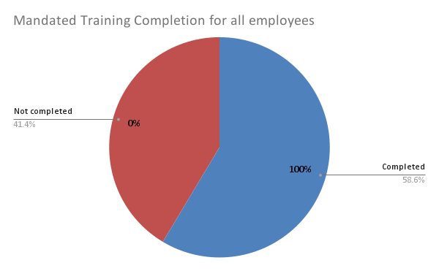
Mandated Trainings
Goal for FY 24-25 was to have all mandated trainings completed by August 14, 2024. Below is a snapshot of what was completed. In comparison to FY23-24 we have completed about 20% more trainings then last year by deadline.
SB553 Workplace Violence
Sexual Harassment
Mandated Reporter
Title IX

