Slide 1
Data and Academic Performance Board Report August 2023
(Christopher Ahmad, Adria Bani, Jose Kabeer, and Maryetta Golden)

Slide 2
Introduction
The department of Data and Academic Performance helps the schools out by sharing student performance. We help source new curriculum, gather student assessment metrics, and improve overall student performance.
The purpose of this presentation is to inform the board and the public on how we do this.

Slide 3
Key Functions and Responsibilities
Select appropriate and well-researched curriculum options for K-12
Create district-wide benchmarks
Create district wide-lesson plans and pacing guide templates for teachers to use
Host professional development based on student performance
CAASPP State Testing help
Manage digital data housing platform, Unified Insights
Create graphs for student performance for data walls
Helps principals run and organize all things academics
Ensures that students get a 100% acceptance rate for 4-year colleges/universities
Oversees the ELD department
Makes sure Title III funds are being managed and properly spent
Communicates with the families and community on events

Slide 4
Current Activities and Achievements
Created a new 9-week Pacing Guide Model for all teachers to use
Placing all of last year’s academic data into Powerschools and making it available to teachers in Unified Insights
Finalized and created the year-long professional development plan
Partnered with the founders of Fountas and Pinnell, Heinemann, to host professional development for the year

Slide 5
Data Comparisons - 2019 (before the Pandemic vs. 2021-2022 vs. 2022-2023 for the CAASPP State Test

Slide 6
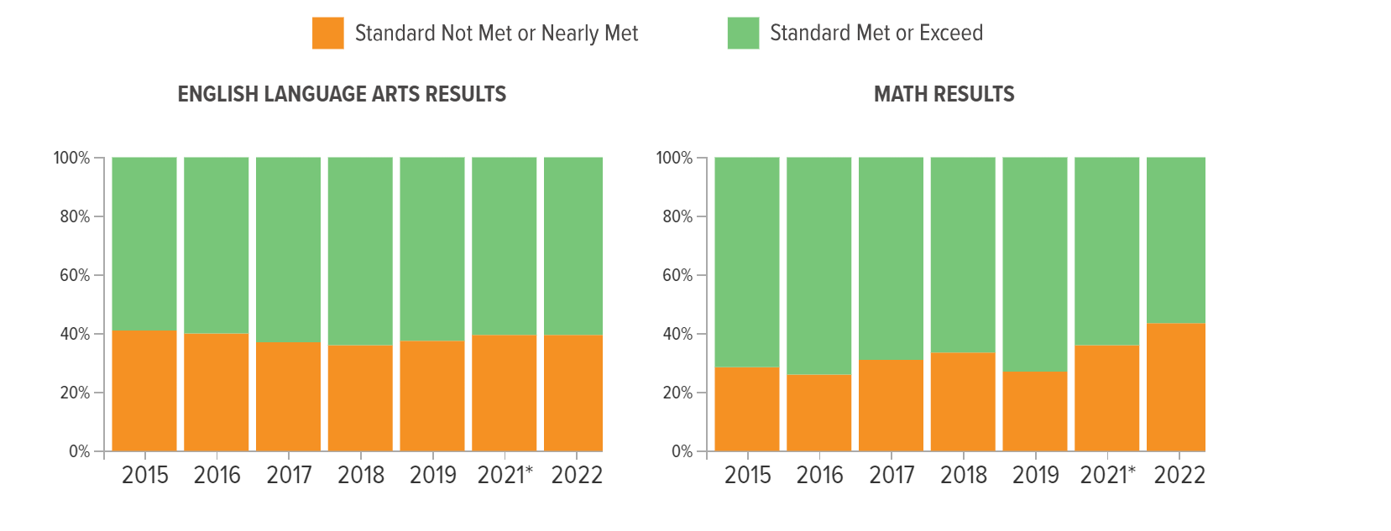
2021/2022 - State Tests - AIPCS II
In the overall American Indian Public Charter II test results for 2022, 60.56% of students met or exceeded the state standard in English, while 39.44% did not, a change of -2.03% from 2019. In math, 56.61% of students met or exceeded the state standard, with 43.39% not meeting it: a change of -16.52% from 2019. Comparisons were made between 2022 and 2019 to show the impact of performance because of Covid-19 learning loss.

Slide 7
2021/2022 - State Tests - AIMS Middle School
In the overall AIMS Middle School test results for 2022, 55.16% of students met or exceeded the state standard in English, while 44.84% did not, a change of 7.72% from 2019. In math, 45.74% of students met or exceeded the state standard, with 54.26% not meeting it: a change of -20.27% from 2019. Comparisons were made between 2022 and 2019 to show the impact of performance because of Covid-19 learning loss.

Slide 8
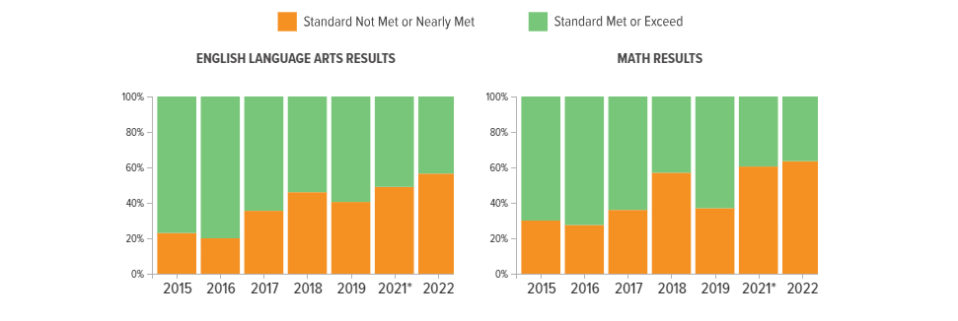
2021/2022 - State Tests - AIMS High School
In the overall AIMS High School test results for 2022, 43.33% of students met or exceeded the state standard in English, while 56.67% did not, a change of -15.99% from 2019. In math, 36.67% of students met or exceeded the state standard, with 63.33% not meeting it: a change of -26.29% from 2019. Comparisons were made between 2022 and 2019 to show the impact of performance because of Covid-19 learning loss.

Slide 9
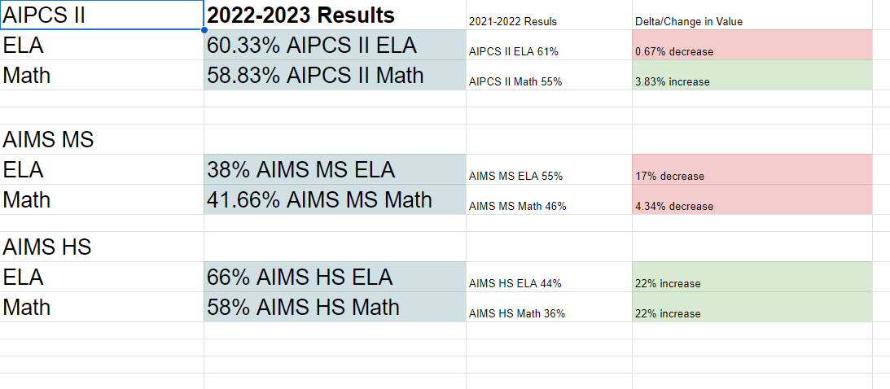
2022-2023 Results

Slide 10
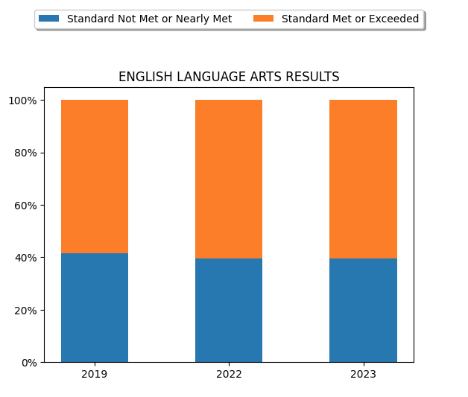
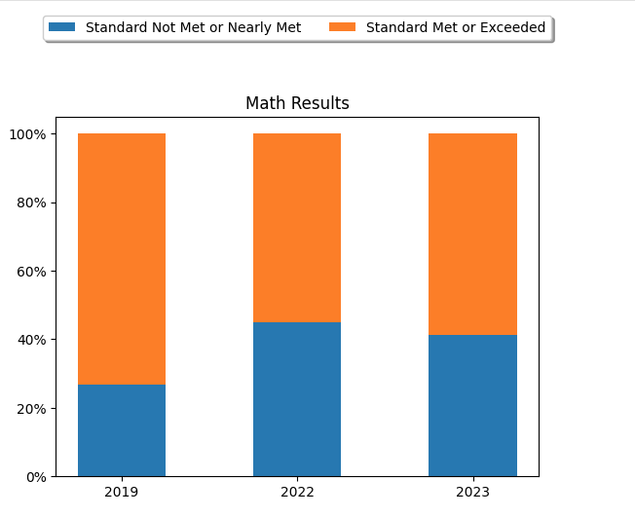
2019-2023 Results Comparison - AIPCS II

Slide 11
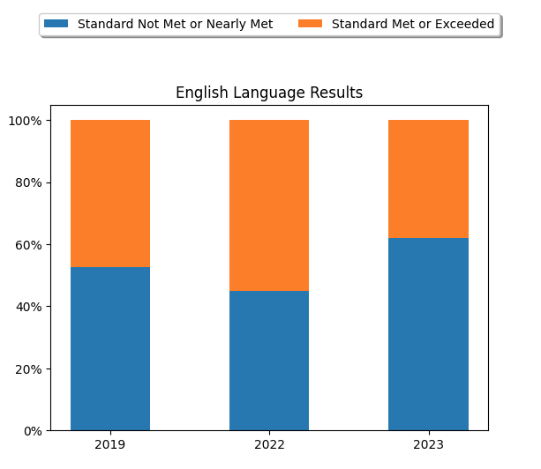
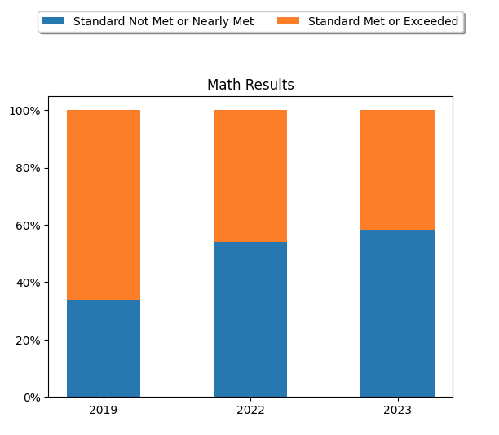
2019-2023 Results Comparison- AIMS Middle School

Slide 12
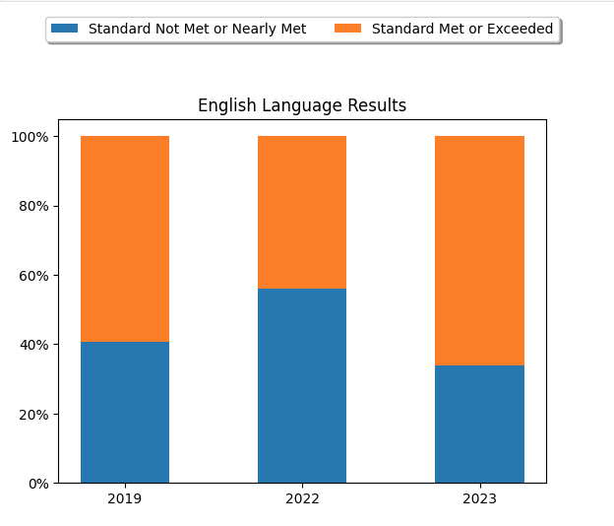
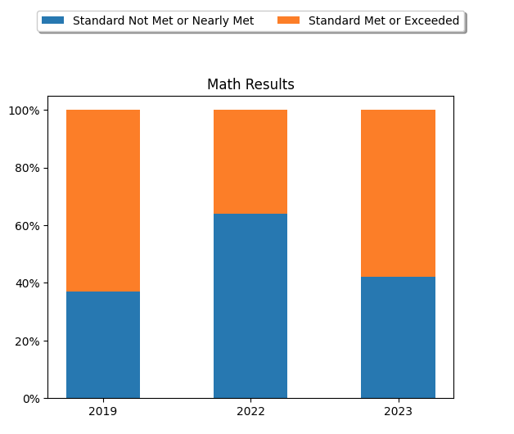
2019-2023 Results Comparison - AIMS High School

Slide 13
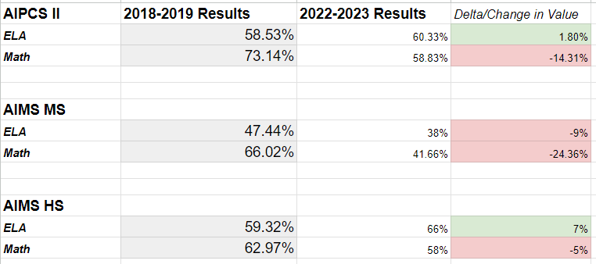
2019-2023 Results Comparison

Slide 14
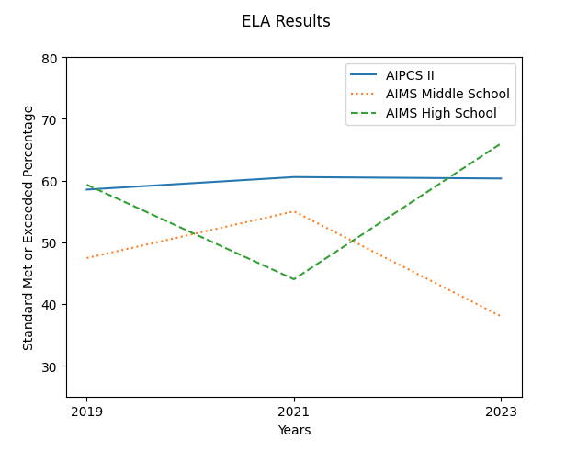
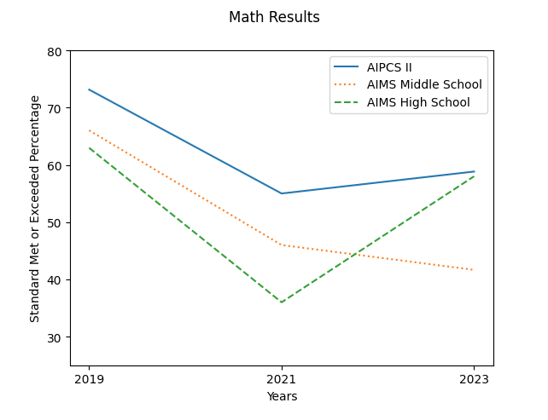
2019-2023 Results Comparison

Slide 15
AIMS College/University Acceptances 2023

Slide 16
College Planning (CBK)
Goal: To have 100% of graduating seniors getting accepted into a 4 year university.
Actions:
-Reviewing college essays
-Finding scholarship opportunities
-Providing campus tours
-Helping with the college planning class
-Introducing K-8 to the idea of college
-Arranging speakers from various universities and colleges to come out and speak
UPCOMING:
Brown and Duke will be coming to AIMS High in September to speak to the students

Slide 17
Technology
-AIMS will be using Unified Insights to track data for students throughout their time here at AIMS. This data includes performance data, benchmark data, state test scores, attendance, and behavioral data.
-AIMS will be creating their own in-house benchmark tests based off of teacher’s pacing guides using a program called Illuminate
-All teachers have access to Scholastic Inventory to track math quantile and reading Lexile levels throughout the year

Slide 18
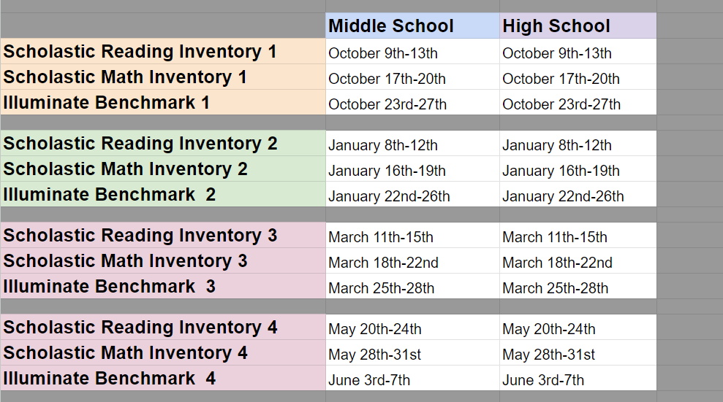
Assessments

Slide 19
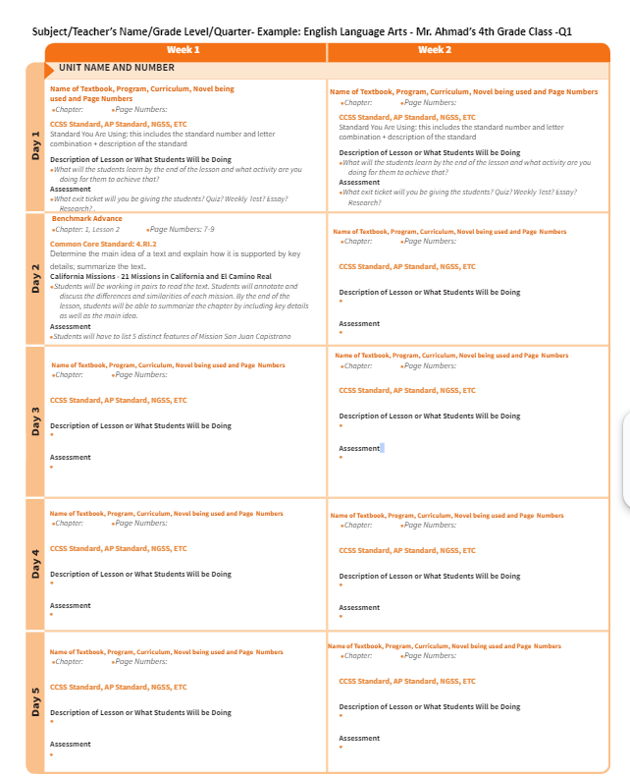
Pacing Guides

Slide 20
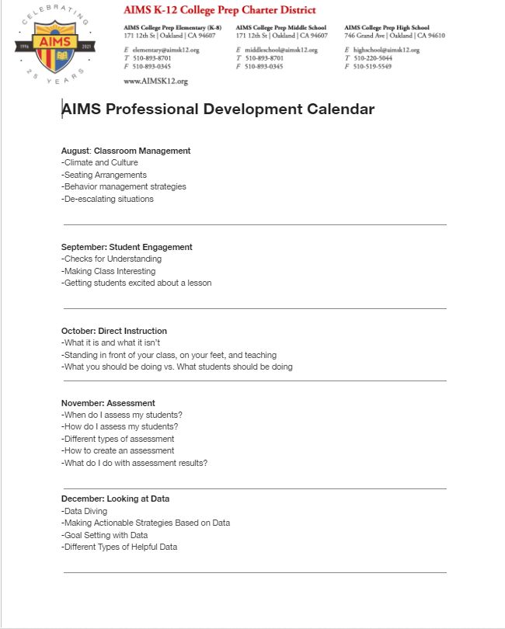
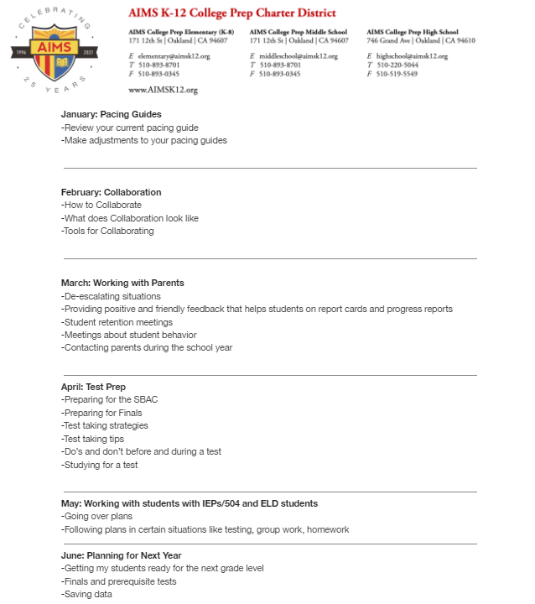
Professional Development Plan

Slide 21
CBK UPDATES
Brown and Duke will be visiting in September
There will be one full college campus tour in September

Slide 22
ELD UPDATES
During the month of August, I have been working with Enrollment to get completed home language surveys for all new enrollees. We are currently in the data entry process of updating ELAS information for new enrollees from CALPADS, as well as generating SSIDs for students new to the US and updating their test eligibility in the test operations system that we use for ELPAC, with the help of our data vendor. The K-8 ELD teacher and I have received the new ELD curriculum from Center for the Collaborative Classroom and have begun assessments to place level 1 and 2 EL students into intervention groups, which should begin next week. I have also been setting up the ELD materials at the high school and working to recruit a high school ELD teacher to fill the vacancy there. My current first choice for an after school ESL instructor is also interested in the HS ELD teacher position, so a meeting with recruitment about that is forthcoming. The ELD informational bulletin board outlining resources for teachers, guest teachers and students that I worked on during the summer is now mounted on the wall in the teacher lounge at 12th street. All teachers who were on-boarded by early August completed the BeGLAD ELD training and I have been reinforcing the training with posters and check-ins during the first week. Next month I will be trying to schedule a make-up BeGLAD training for teachers who are on-boarded at that time. I am also working on a general ELD informational newsletter and survey about ESL classes which I plan to send out to families late this month or very early next month. The completed MOU for Title III 23-24 spending is pending board approval and must be submitted to that subgrant program by late September once approved.

Slide 23
Community LIAISON UPDATES
I have had several meetings and communications with parents explaining and processing their Volunteer applications. The Volunteer Guidance Document and Application have been posted on Parents Square, Facebook, Instagram, and AIMS website. The steps for them to complete the process have been provided.
Also working with All Tied Up on an upcoming project with CISCI Systems that will provide computer training for our parents. All Tied Up will present a Zoom Meeting for parents with the details shortly.
Ms. Golden

