Slide 1
AIMS K-12 College Prep
12th Street Kitchen Proposal

Slide 2
KIT Funding Awarded
(1st round)
2021 KIT Funds - $64,000.00
Leftover Funds: $23,296.79
Received Funds: May 2022
Deadline for Expenditures: June 30, 2024
(2nd round)
2022 KIT Funds - $130,548.00
Estimate: June 2023
Deadline for Expenditures: June 30, 2025
Notes:
MS - $2586.24
($3143.01)
AIPCS II - $6865.83
($4768.71)
High School - $5933
Total= $15,385.07
($23,296.79)

Slide 3
Expenditures Deadlines
2021 Kit Funds Deadline:
June 30, 2024
2022 KIT Funds Deadline:
June 30, 2025
Notes:
Funding must be dispersed by the following dates

Slide 4
Allowable Expenditures
Cooking Equipment Supporting infrastructure system needs Service equipment Refrigeration and storage Transportation of ingredients, meals and equipment between sites Food Service Staff Training and professional development | Food Service Staff Training and professional development Providing additional compensation for additional work relating to serving universal school meals Costs for planning and implementing freshly prepared onsite preparation of reimbursable school meals, serving fresh and nutritious reimbursable school meals using California-grown food, or expanding reimbursable meal options for pupils with restricted diets

Slide 5
Why build out the kitchen?
Expansion to allow a grab-and-go option for students
Reduction of a crowded line space
Expansion of the lunch area will also help to reduce potential safety hazards
Expanding kitchen space for storage
Creating inviting entrances
Extending for a better layout
Improving access to healthy food
Reduce shortness of lunch periods
Increase participation and consumption
Why is ventilation needed?
In order for our new oven to properly function, it requires adequate clearance for ventilation
Notes:
Students will have more time to consume their lunches instead of having 10 minutes
Kitchen serves for a long term operation
Reduction in overcrowded lines
Expansion of the lunch area will also help to reduce potential safety hazards that come about with such a crowded space
Expansion of door allows more students to come in and out

Slide 6
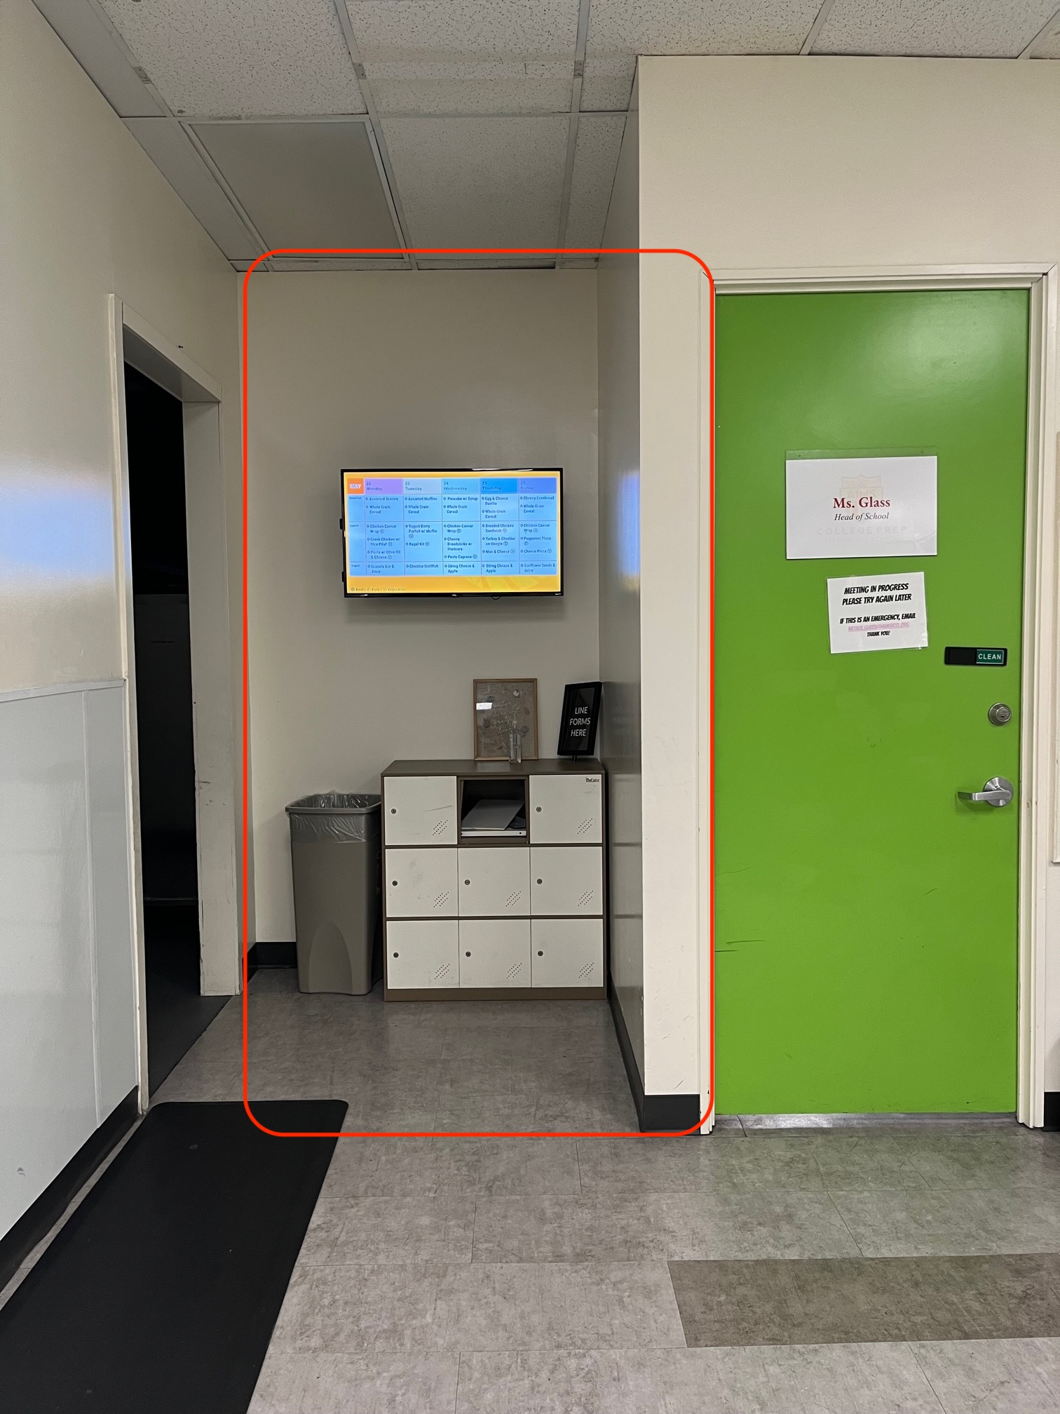
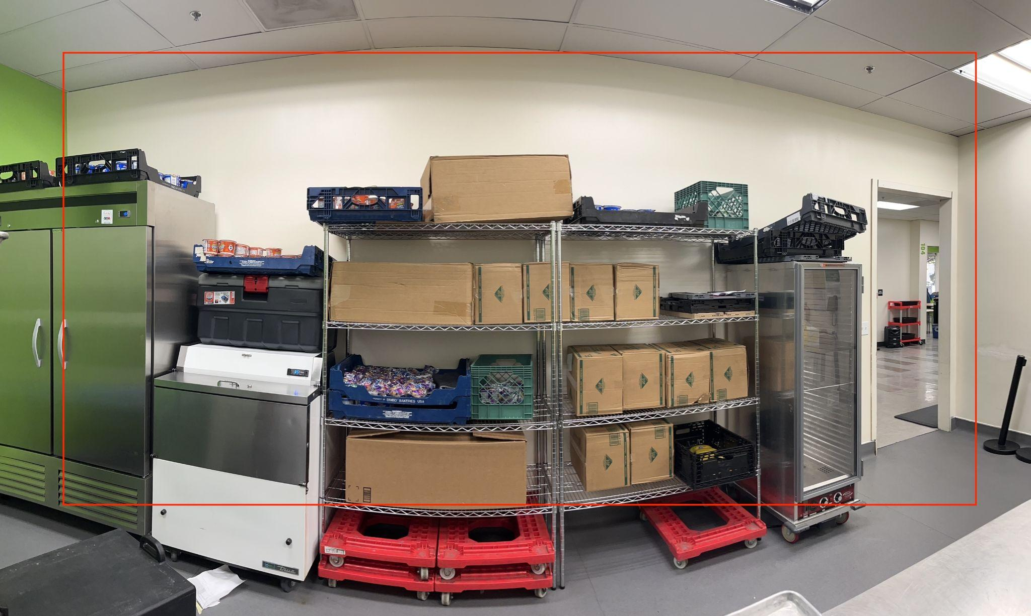
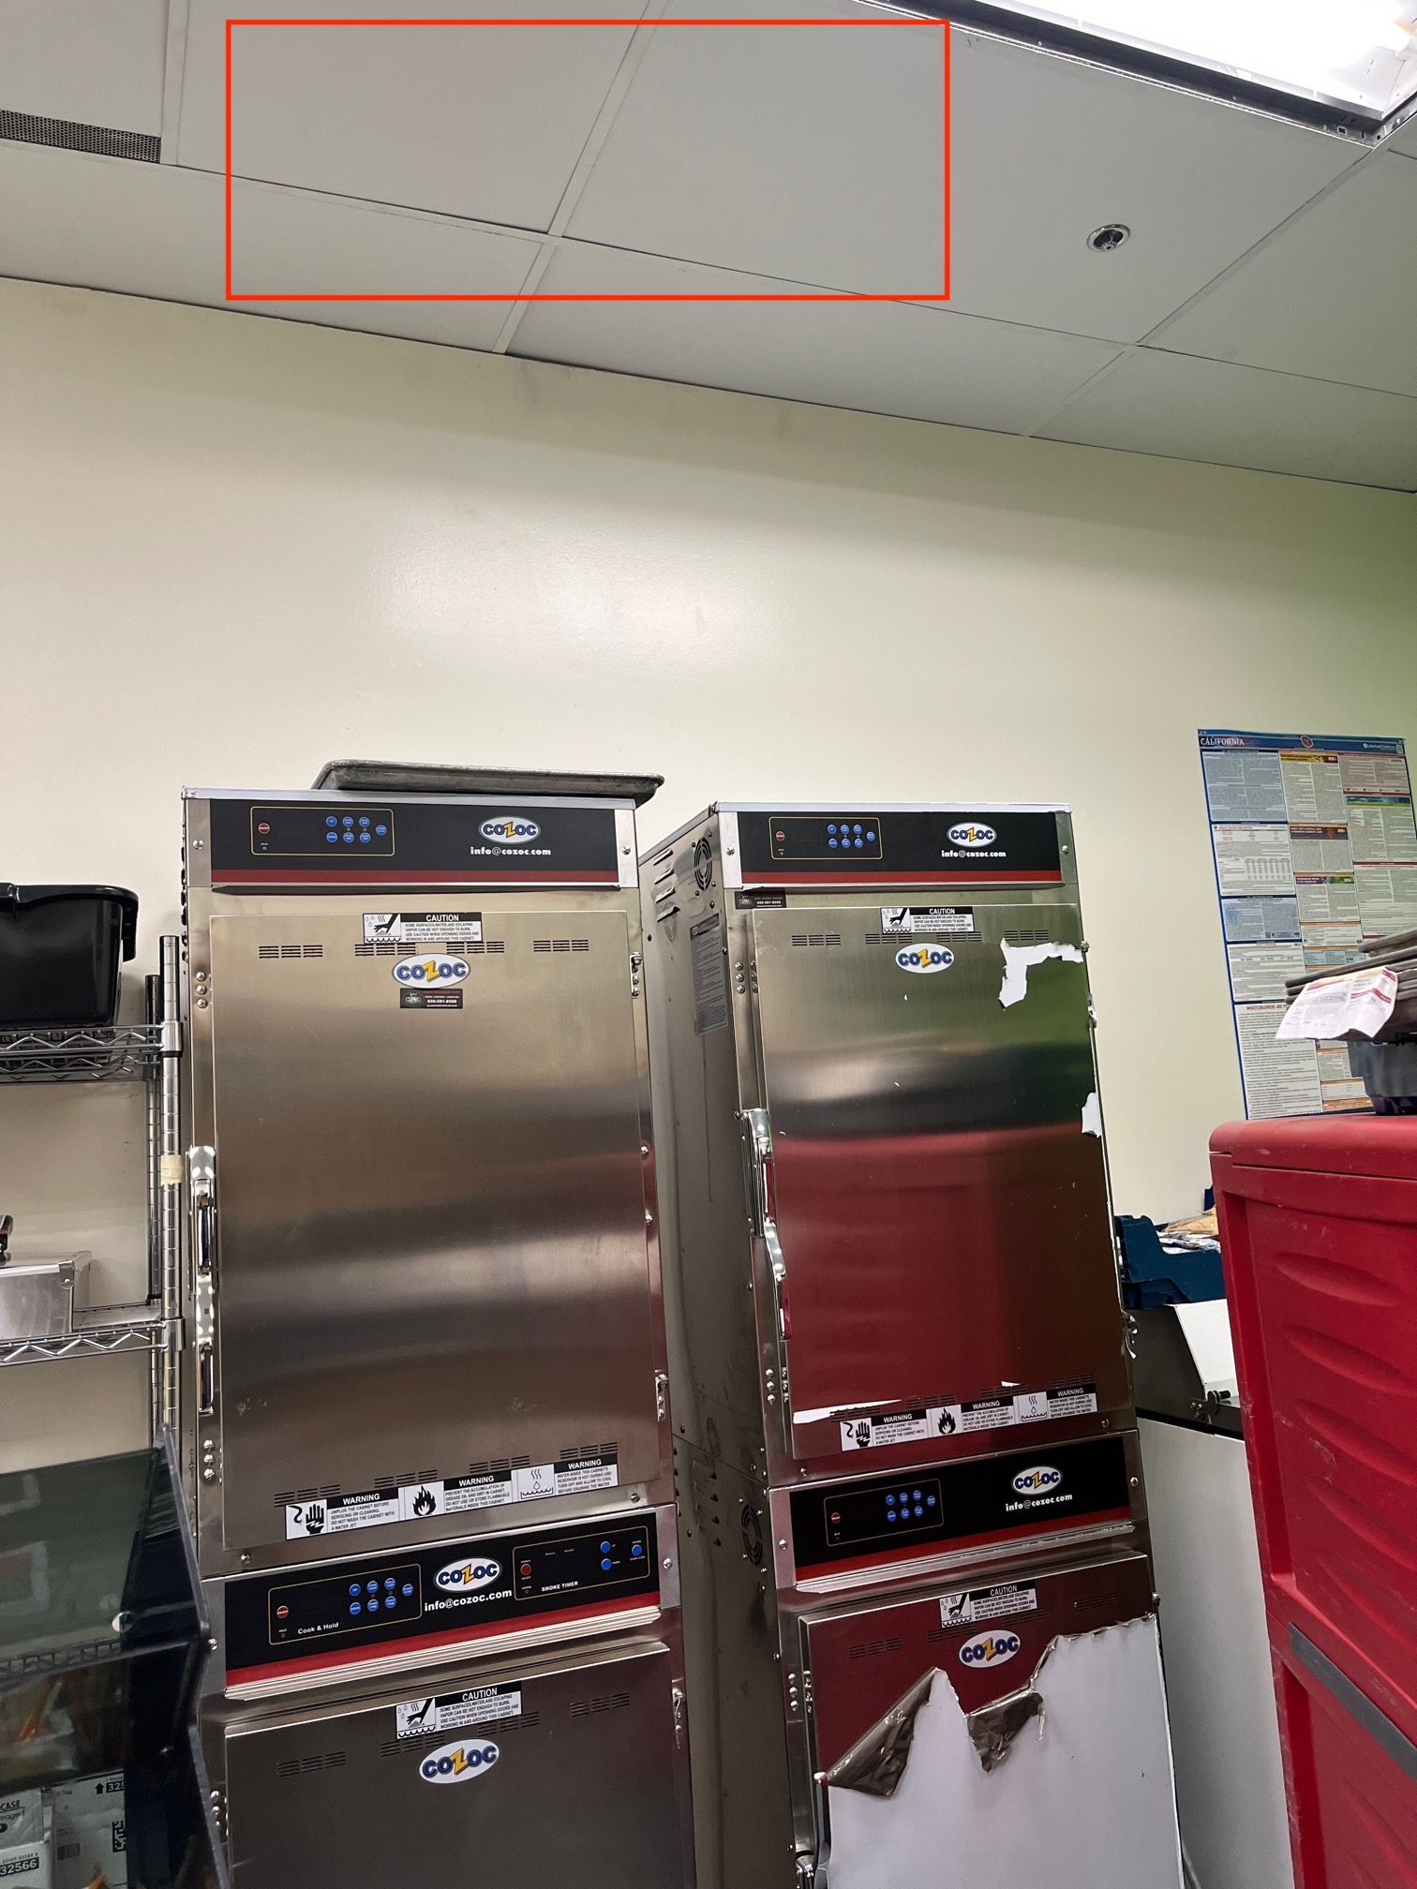
Improvements for 2022-2023 School Year
Notes:
Construction of tearing down the wall, expanding into the office & building new wall
Adding ventilation above the ovens
New Door
Electrical work
Cost of permit

Slide 7
Plans for 12th Street
Goal: Increase participation and consumption of students
Construction of tearing down the wall, expanding into the office & building new wall
Adding ventilation above the ovens
Installing a wider kitchen door
Electrical work
Cost of permit

Slide 8
Cost/Quotes
Expansion of Wall:
Construction of a New Wall:
Ventilation:
Electrical Work:
Permit:

Slide 9
Q&A
Thank you!

